Slide 1
RPMS Immunization Package Training – PATIENT MENU
Version 8.5*1
Amy Groom, MPH
IHS Immunization Program Manager
Amy.Groom@ihs.gov

Slide 2
Some basic tips
To go back to a previous screen, enter “^” (shift 6)
To save changes and exit, hit the F1 key and “E” in quick succession
To quit and go back to the previous screen WITHOUT saving changes, hit the F1 key and “Q” in quick succession

Slide 3
Agenda
PATIENT Menu
SGL Patient Record
Adding and Editing Data
vaccines you give today
historical vaccines
patient information
Forcing doses to be valid/invalid
ImmServe Profile
Lists and Letters
Generating Patient Lists

Slide 4
RPMS Immunization Package
MENU SYSTEM
PAT Patient Menu …
REP Report Menu …
MGR Manager Menu …

Slide 5
RPMS – Patient Menu
PAT Patient Menu
SGL Single Patient Immunization Record
LET Print Individual Patient Letter
LLS Due Lists and Letters
The immunization record with forecasting you need when you walk into a patient’s room.
- also in the Health Summary
- also is what you see in EHR

Slide 6
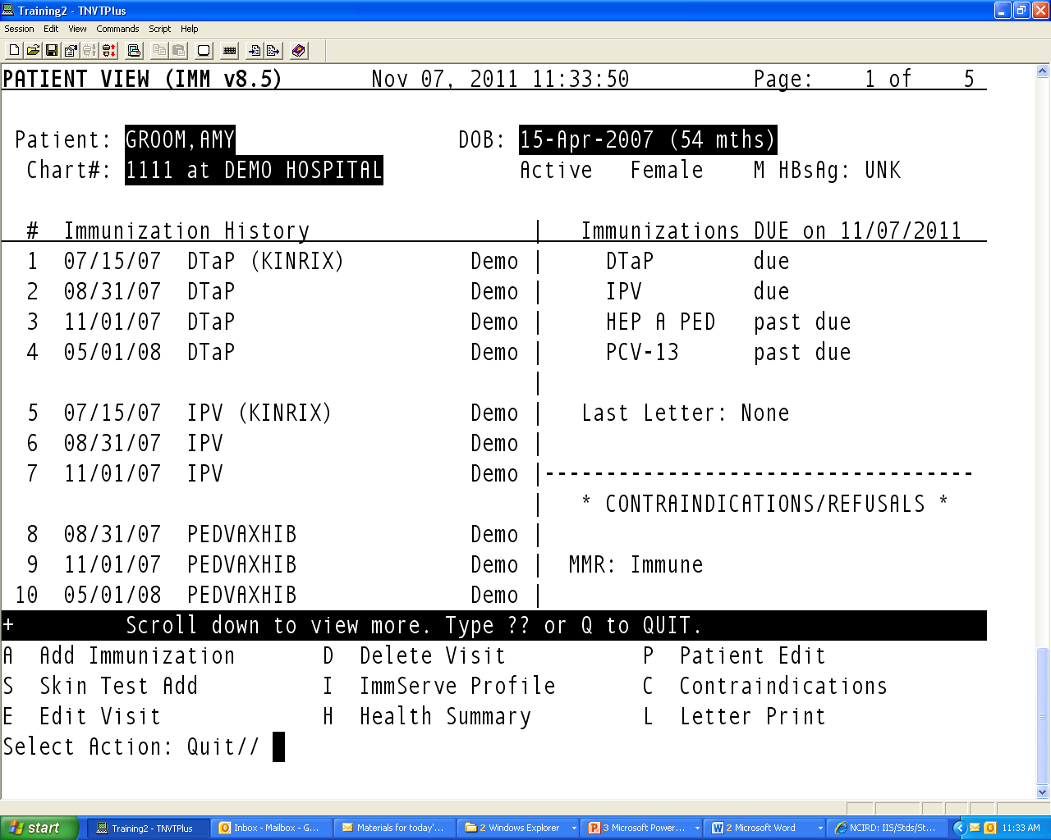
Image of Printscreen shot of Patient View

Slide 7
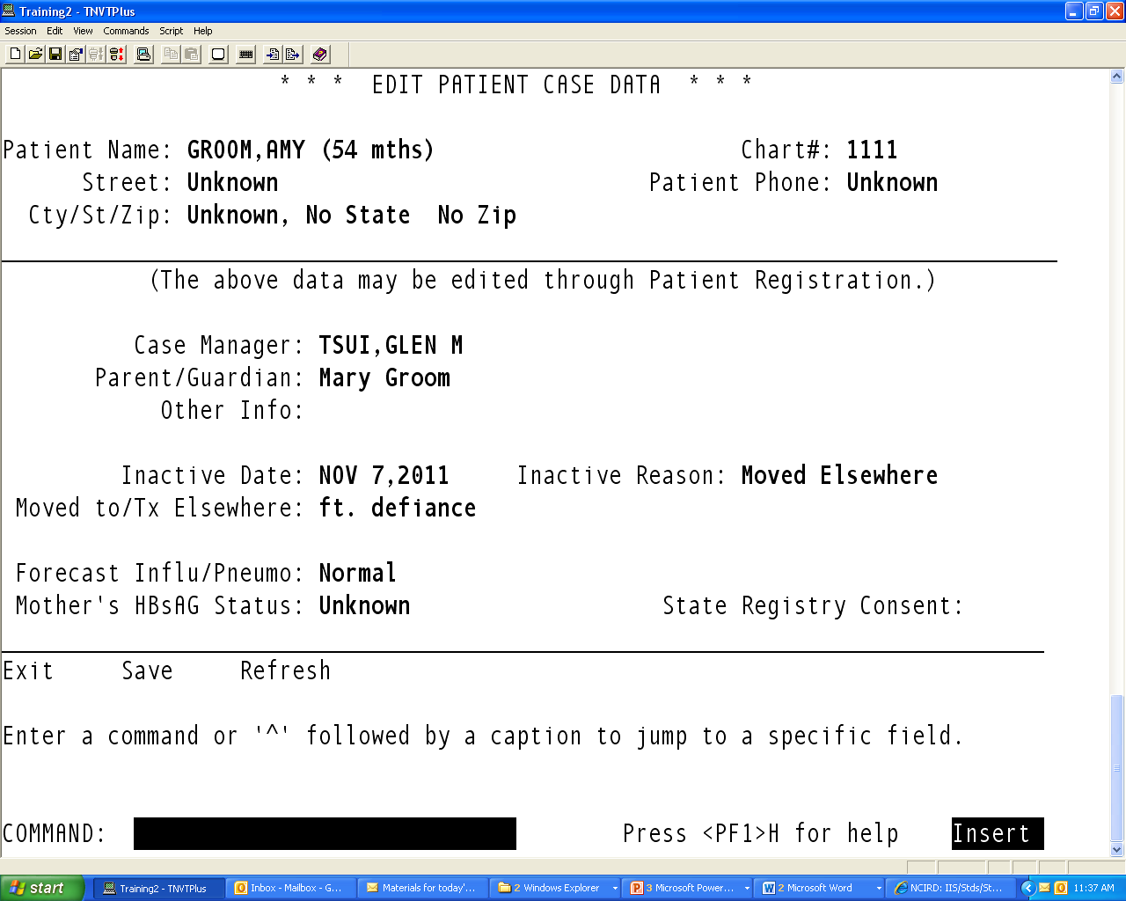
Image of printscreen shot of Edit Patient Case Data

Slide 8
Active/Inactive in the Immunization Package – What does it mean?
Active/Inactive in the Immunization Package is independent of ‘Active” status in RPMS
Can be inactive in the immunization package, but still have an active chart
Active/Inactive ONLY impacts who is included in your childhood reports
3-27 month, Two year old
All children <36 months who reside in one of your GPRA communities are automatically activated into the immunization package
Can Inactivate children who meet the Moved or Going Elsewhere (MOGE) criteria
Active/Inactive status DOES NOT determine inclusion in Adolescent , Adult, or Influenza reports
Active/Inactive DOES NOT impact forecasting – software forecasts for all patients, regardless of status

Slide 9
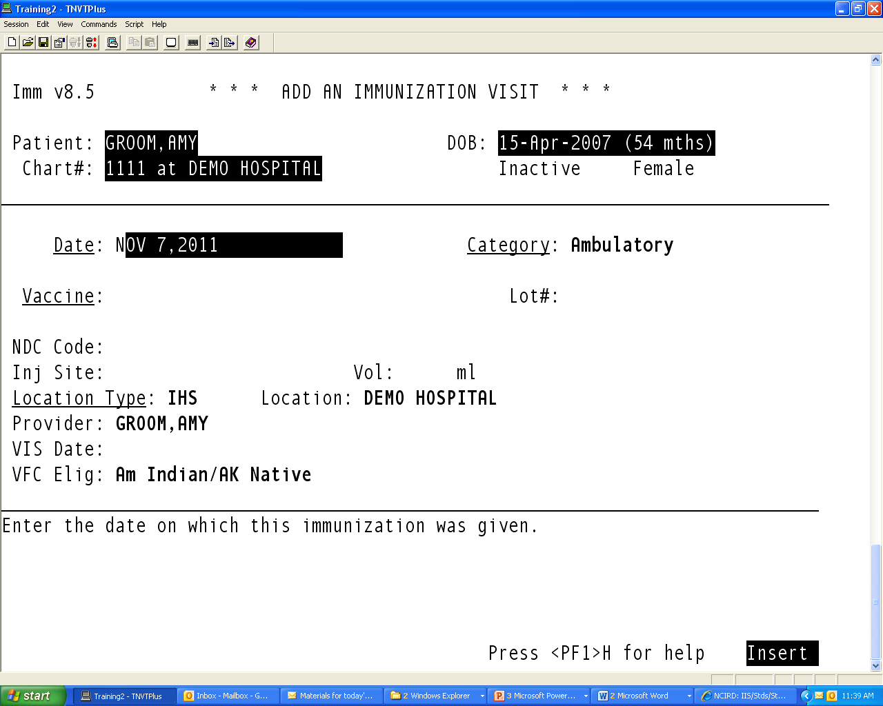
Adding an Immunization

Slide 10
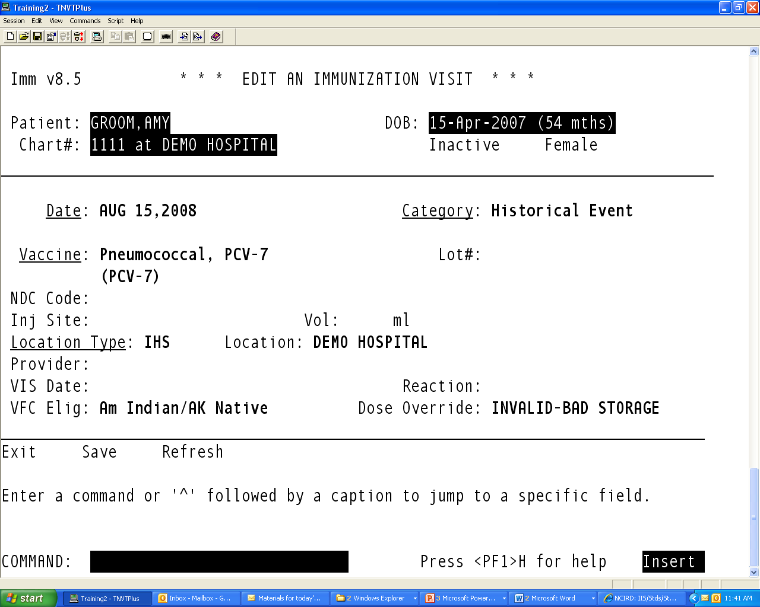
Make a Dose Invalid
Select “E” to Edit the Immunization Visit
Select the visit with the vaccine that you want to make invalid

Slide 11
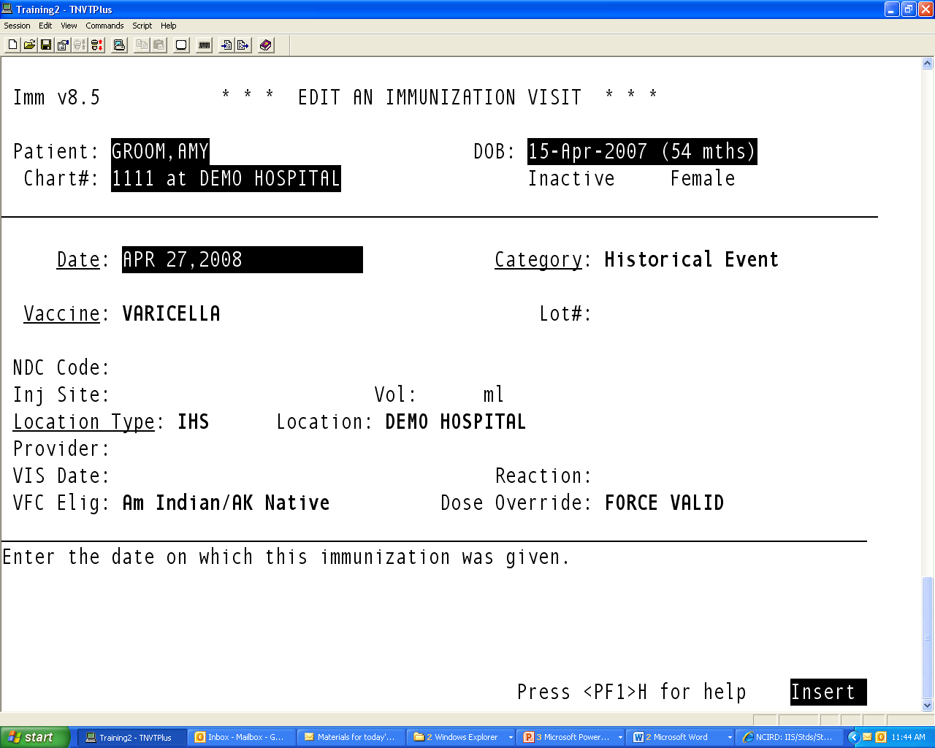
Force a dose to be Valid
Select “E” to Edit the Immunization Visit
Select the visit with the vaccine that you want to force to be valid

Slide 12
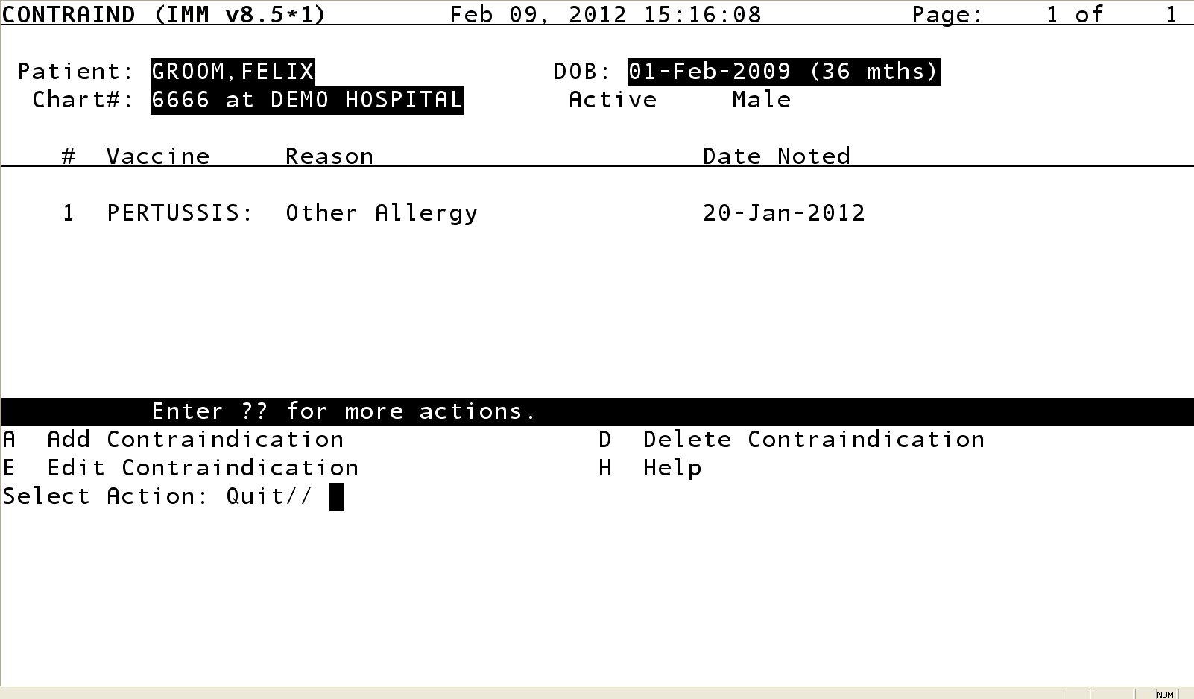
Add a Contraindication

Slide 13
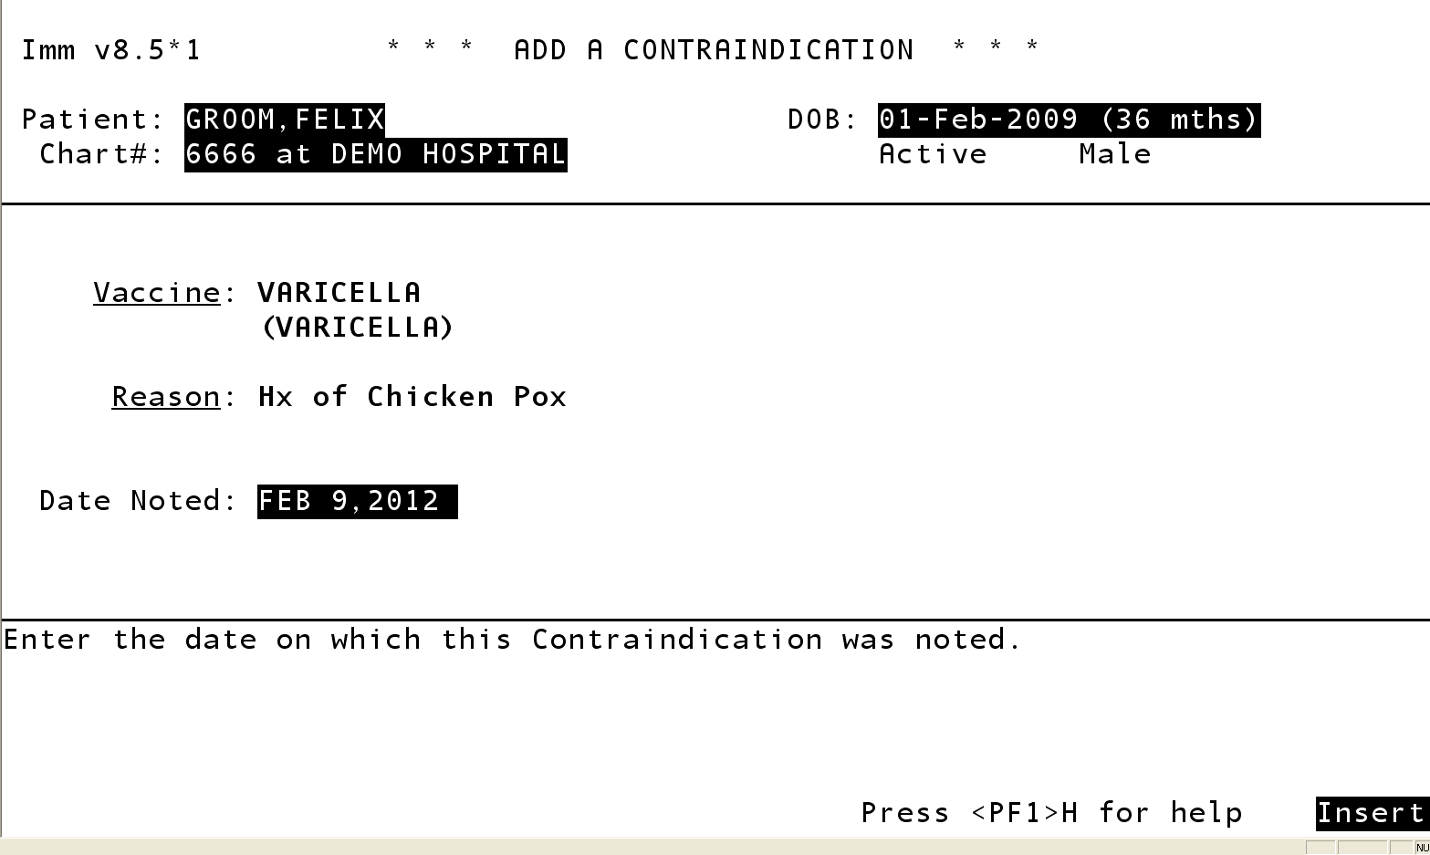
Contraindication, Cont.

Slide 14
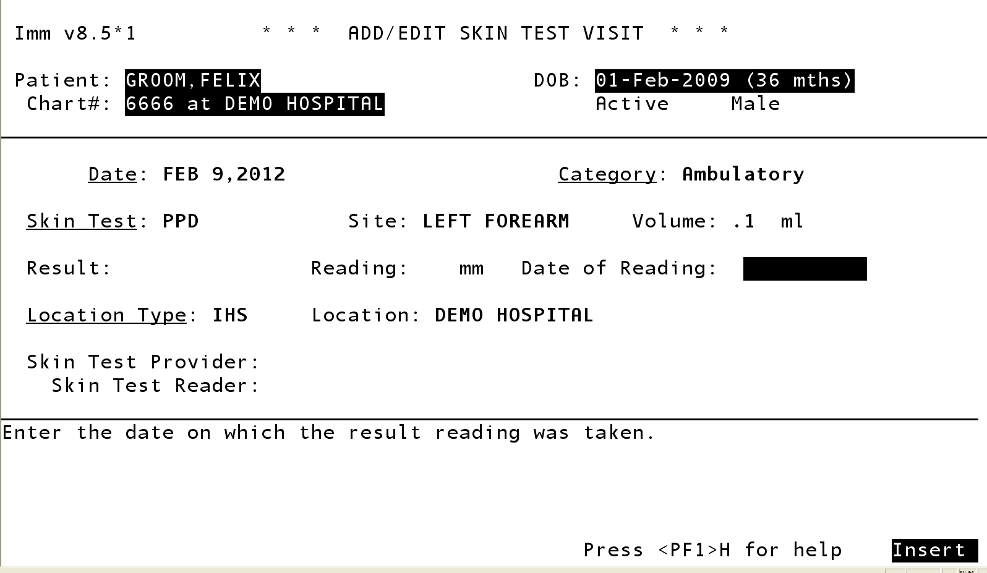
Add a Skin Test

Slide 15
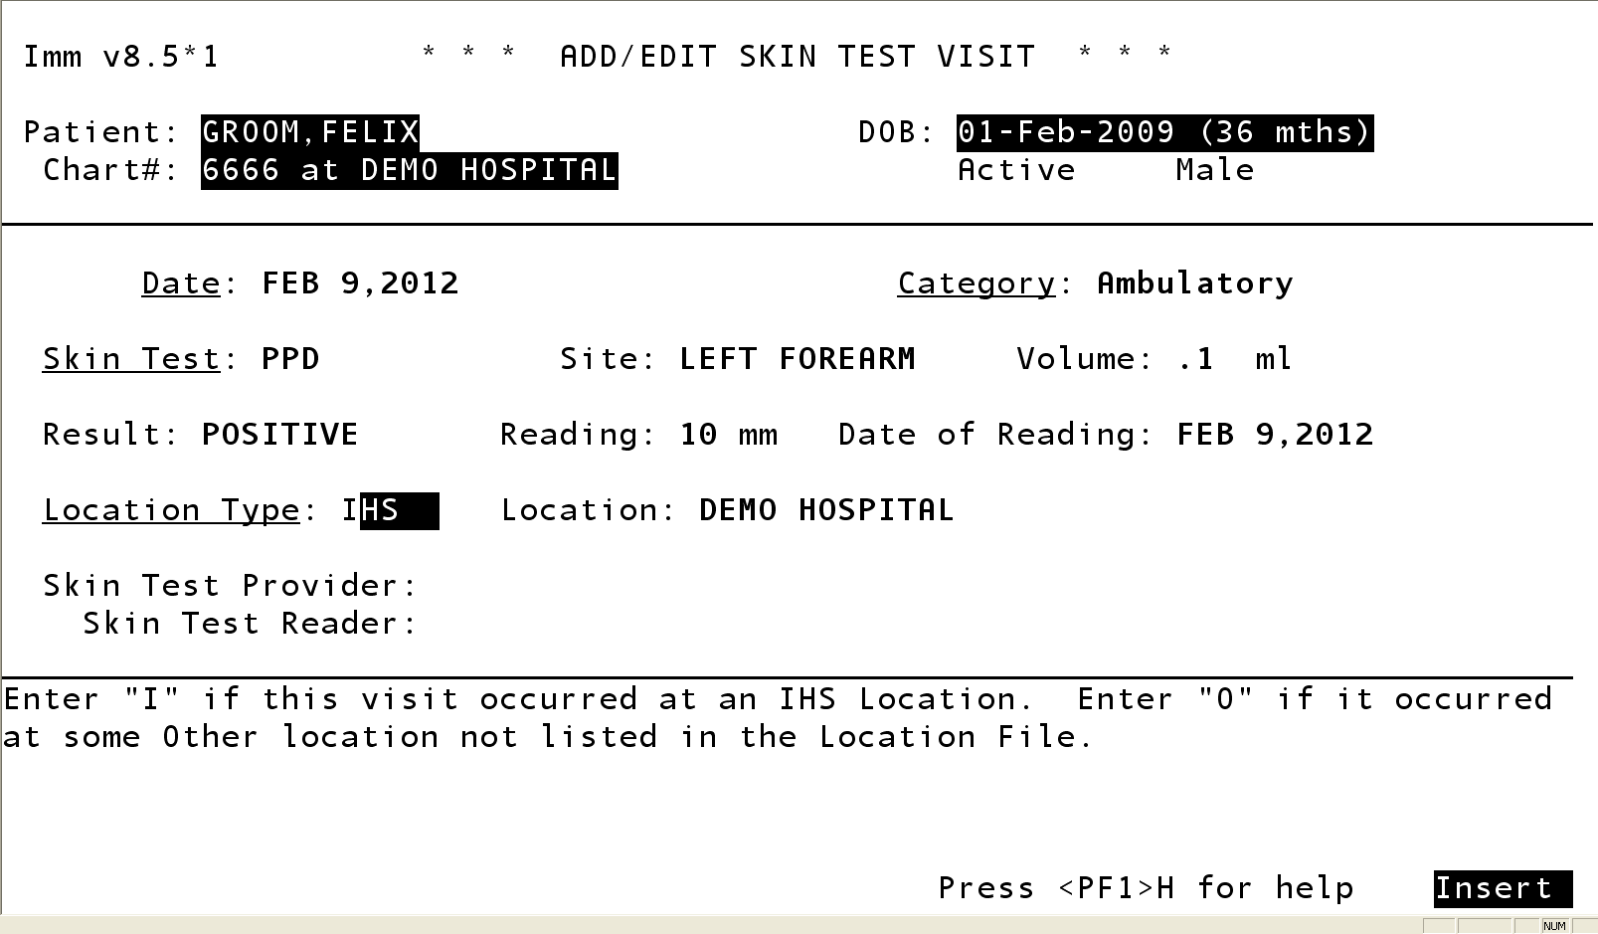
Edit Visit to add a skin test reading

Slide 16
Hands on Exercises SGL Patient Menu – Use Demo Patients!
Change patient status to Inactive in Immunization Registry
Add a MMR vaccine for today’s date
Add FluMist for yesterday’s date
Check the ImmServe profile to see why the MMR is invalid
Force the MMR vaccine to be Valid
Make the FluMist vaccine invalid because of poor storage
Add a contraindication for Varicella vaccine, Hx of Chickenpox

Slide 17
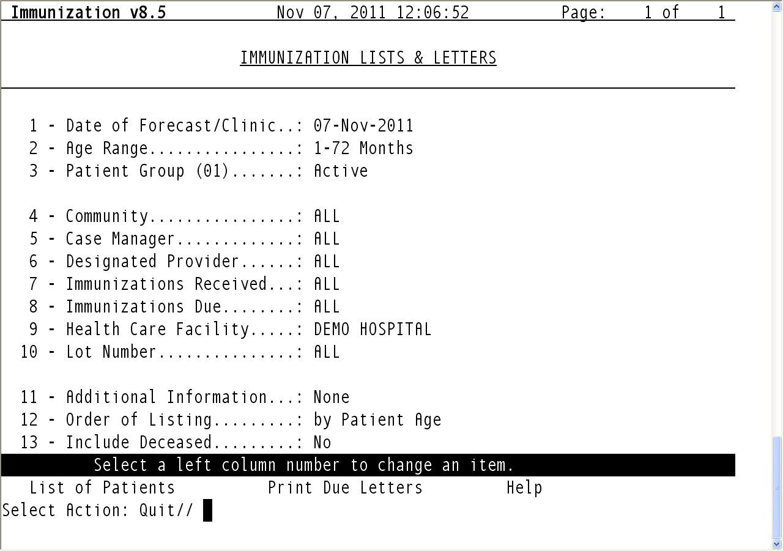
Patient Menu - LLS

Slide 18
Hands on Exercises – Lists and Letters
Generate the following lists and include the total number:
Children 0 – 35 months who are Inactive ___________
Children 0 – 35 months inactivated between Jan 1, 2010-March 31st 2010 ______
Children 0 – 35 months automatically activated between Jan 1st 2011 – Dec. 31st 2011_____
Active and Inactive Adolescents 11-18 yrs _____________
All Patients 11-12 yrs who are Due for a Tdap ________
Patients due for a 2nd or 3rd dose of HPV _____
All children <5 who received a Varicella vaccine between Dec. 1st, 2010 – Dec. 31st 2010, ________
List of all AI/AN (e.g. beneficiary) patients < 5 years of age who refused a vaccine _________
List of all patients all ages who received seasonal flu vaccine Oct 31st, 2011.
List of children < 6 yrs who are due for a PCV, with parent/guardian name

Slide 19
Immunization Resources
RPMS Immunization Package User Manual
RPMS Application Documents
http://www.ihs.gov/RPMS/index.cfm?module=home&option=documents
IHS vaccine preventable disease page
http://www.ihs.gov/epi
CDC vaccine resources
http://www.cdc.gov/vaccines
Immunization Action Coalition
http://www.immunize.org

