Slide 1
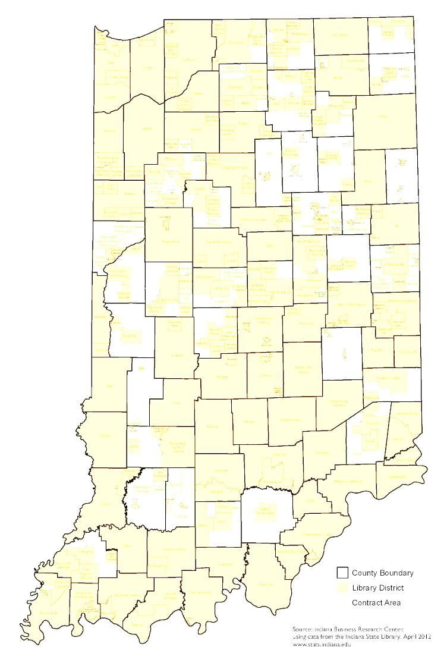
Summit on Serving the Unserved
Hosted by
Ellen Stuckey,
Kelly EhingeR & Jake Speer
Indiana State Library
July 11, 2012

Slide 2
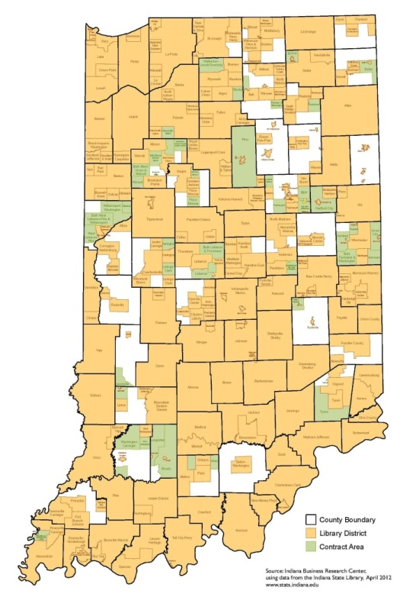
Today’s Agenda
Overview of Indiana’s unserved
Studies addressing unserved
Prior Legislation
Discussion
Related Issues
What Happens Next
Homework

Slide 3

An Overview
38 counties
128 libraries within those counties
Over 160 libraries contiguous to an unserved area

Slide 4
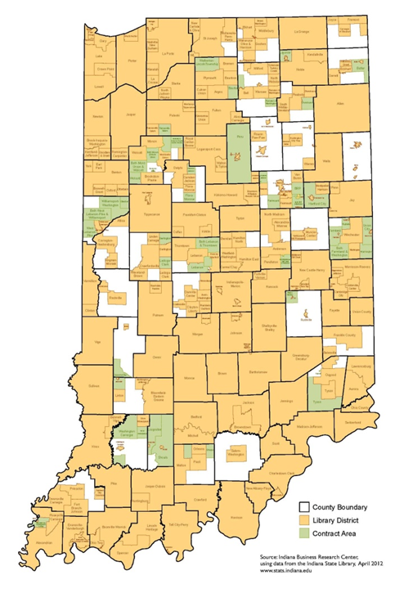
An Overview
Top Ten Counties
Clay (69%)
Martin (66%)
Miami (64%)
Warren (59%)
Rush (58%)
Parke (58%)
Adams (57%)
Carroll (55%)
Daviess (55%)
DeKalb (54%)
Unserved Percentages in each County
> 50%
21-50%
10-20%
< 10%

Slide 5
An Overview
Counties with Unserved by ILF District
District 1: 5 counties 5 / 11 45.5%
District 2: 7 counties 7 / 14 50.0%
District 3: 6 counties 6 / 9 66.7%
District 4: 3 counties 3 / 8 37.5%
District 5: 3 counties 3 / 10 30.0%
District 6: 3 counties 3 / 17 17.6%
District 7: 4 counties 4 / 11 36.4%
District 8: 7 counties 7 / 12 58.3%
Statewide: 38 / 92 41.3%

Slide 6

History
1816 Constitution
County libraries
Early 1900s
Establishment of libraries
Funding
Township Act
Contractuals
Library Law of 1947
Studies on funding & structure
Discussions on Unserved

Slide 7

Studies addressing unserved
1965-66 Legislative Study
1967 Legislative Study
1993 Legislative Study
1994 Legislative Study
2007 Unserved Taskforce
2007 Kernan-Shepard Report
2008 Library Coalition
Notes:
1965-66 Legislative Study
Enlarged school districts and their impact on public library service
How best to serve the 905,815 citizens without direct access to a public library
1967 Legislative Study
1993 Legislative Study
“Statewide service is a public expectation.” (p.6)
Study addressed: reciprocal borrowing, unserved areas, library district restructuring particularly with respect to serving school students, organization of library districts and boards
1994 Legislative Study
“The Committee finds unacceptable the current percentage of Indiana residents living in areas unserved by public libraries.” (p.11)
Recommendation: county library planning commissions (see: preliminary draft 3298)
2007 Unserved Taskforce – recommendations:
publicly supported library service should be universally available;
Indiana libraries should provide fair and equitable service – which led to standards discussions
2007 Kernan-Shepard – recommendations included: 92 county libraries
2008 Library Coalition – recommendations included: structures of libraries in each county to be analyzed
SB348 (Gard)

Slide 8

Studies & Legislation
1965-66 Legislative Study
1967 Legislative Study
1979
Consolidation of Fort Wayne Public & Allen County Contractual
1993 Legislative Study
1994 Legislative Study
Committees in each county to study and recommend library structure

Slide 9
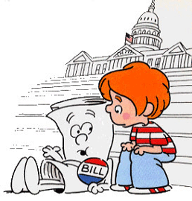
Legislation
Passed
Failed
1999 Sen. Gard SEA 166-1999
Hancock Co. CEDIT
2000 Rep. Ripley
Gave Adams County townships the ability to partially or fully fund individual non-resident cards
1999 Sen. Kruse
Township-focused option to join library districts

Slide 10
Studies
2007 Unserved Taskforce
Publicly supported library service should be universally available
Indiana libraries should provide fair & equitable service
Kernan-Shepard
92 county libraries
Library Coalition
Structure & funding of libraries
Coalition representative of all sizes of public libraries

Slide 11
Legislation
2009 Sen. Gard
Catalysts: Local Government Reform, Taskforce on Unserved, Library Coalition
Addressed library structure & funding
Planning Committees in each county
If Committee fails to develop plan, ISL develops plan for county
2012 Sen. Kruse
Initiated by DeKalb County Libraries
Addressed only counties with unserved
Planning Committees formed
A developed plan will be put to voters in a referendum
If referendum fails, Committee disbanded for four years.

Slide 12
Discussion

Slide 13
Discussion #1
Legislation
What features would you like to see in legislation to bring full service throughout Indiana?

Slide 14
Related issues
E-government Services
Tax Caps
Contracts with Townships
Serving Schools
PLAC
Reciprocal Borrowing
Other?

Slide 15
Discussion
#2: What would you like to see to help you market this issue to your communities?
#3: What additional ways can you suggest to accomplish our goal of universal service?

Slide 16
What Happens Next?
Summit Follow-Up
August 9, 2012
Survey Results
Draft Legislation
Hearing from our Representatives
Talking Points

Slide 17
Homework
Online Survey
Please complete the online survey at:
https://www.surveymonkey.com/s/T7GBH72
Information needed:
A list of studies* (local, regional) suggesting a need to extend library service in your communities
A list of your county’s attempts to extend service to unserved areas
*Please email copies of the studies to Ehinger@apls.lib.in.us

