Slide 1
Employer Advisory Group Focus on ERM
Thursday, July 14, 2011

Slide 3
What is Employer Reporting and Maintenance?
A joint TRF-PERF project
Online system designed to make pension plan administration more:
intuitive
routine
paperless

Slide 4
Why ERM?
One-stop shop for employers
Comply with state law requiring employers to submit data and contributions electronically on a payroll basis
Gets ASA contributions to members’ accounts faster – more chance to earn money!

Slide 5
Submitting on a payroll basis will …
Save time
Increase accuracy of information
Comply with state law regarding electronic reporting
IC 5-10.3-7-12.5

Slide 6
Estimated ERM Timeline
Milestone | Estimated Timeframe
Development and Testing | Now - 9/30/2011
Employer Pilots | 10/1/2011 - 11/30/2011
Transition to Production/Training Ready | 12/1/2011 - 12/31/2011
Employer Training | 1/1/2012 - 2/28/2012
Soft Opening/Transition to Go-Live | 3/1/2012 – 3/31/2012
Estimated Go-Live | 4/1/2012

Slide 7
ERM at a Glance
Employer Management (Self-service)
Member Management
Wage & Contribution Management
Reporting

Slide 8
Employer Management
Role-based security management
Contact information management
Employer information management
Bank account management (ACH)

Slide 9
Member Management
New member enrollments
Existing member updates for status changes (LOA, terms, etc.)
Upload file feature

Slide 10
Wage & Contribution (W&C) Management
Payroll-based reporting
Regular W&C reporting
Adjustment W&C reporting
Upload file feature for regular and adjustment W&C’s
Online error/exception handling
Online payment

Slide 11
Reporting
Online reporting to provide you relevant information throughout the W&C or enrollment submission process
Summary level reporting
Detailed level reporting

Slide 12
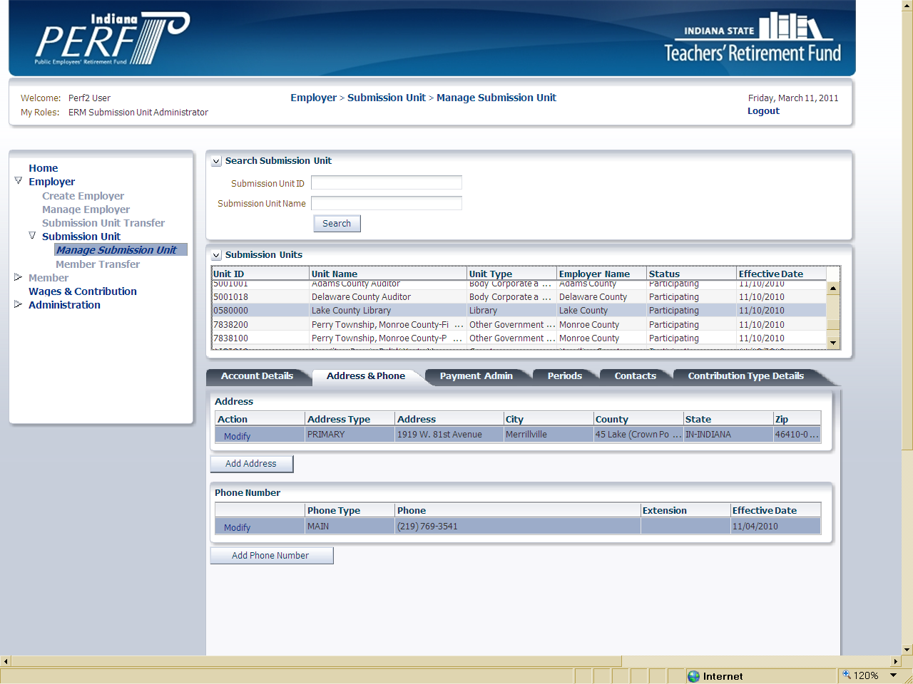

Slide 13
Thinking ahead …
How will my processes be affected?
Submitting on a payroll basis
Online payments (ACH)
New file layout for W&C upload
Member enrollments & status changes
Are there specific reporting needs that would help me do my job better?

Slide 14
Supporting the transition …
Computer-Based Training
Quick Reference Guides
Online user manuals
User discussion groups
On-site seminars
Full technical support

Slide 15
Partnering with employers
Employer focus groups
Many employers have participated
Providing ideas to make the system more intuitive
Working with payroll vendors and IT staffs
Pilot Groups

Slide 16
Open Discussion
-Questions
-Concerns
-Requests
-Reporting Needs

Slide 17
Feel Free To Contact Us!
Jeff Hutson, Chief Communication Officer: jhutson@inprs.in.gov
Jodi O’Neill, Communication Manager: joneill@inprs.in.gov
Megan Papenfuss, IT Business Analyst: mpapenfuss@inprs.in.gov
Derek Walling, Project Manager: dwalling@inprs.in.gov
Cara Zadrozny, Senior Communications Specialist: czadrozny@inprs.in.gov

