Slide 1
Medical Surge Preparedness and Response
Clare Helminiak, MD, MPH Rear Admiral, USPHS Deputy Director for Medical Surge Office of Preparedness and Emergency Operations Office of the Assistant Secretary for Preparedness and Response Department of Health and Human Services

Slide 2
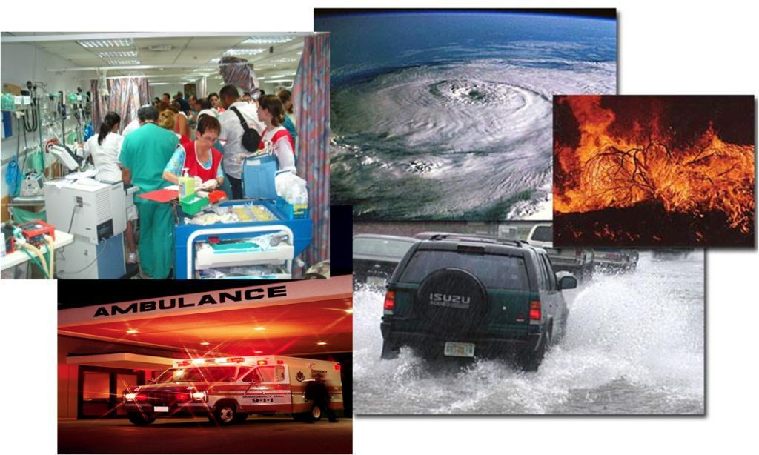
Preparedness and Response
The successful delivery of daily emergency care is key to our nation’s healthcare system emergency preparedness efforts
Notes:
If you can’t do it everyday, you will not be able to do it on game day.

Slide 3
Healthcare System Preparedness
Public-private responsibility
Supported, in part, by the Hospital Preparedness Program and Public Health Emergency Preparedness grant programs
Improve the quality, safety, and efficiency of daily patient care
Enhance the use of health care data to improve quality, efficiency, transparency, and outcomes
Improve access and reduce health disparities
ESF #8 and the National Disaster Medical System provides federal support when jurisdictions are overwhelmed

Slide 4

All-Hazards Preparedness

Slide 5

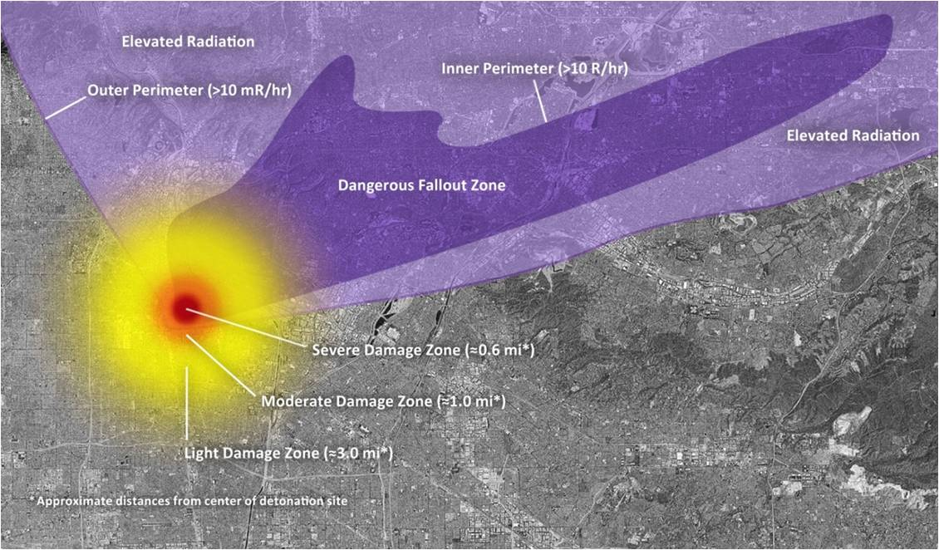

All-Hazards Preparedness
Notes:
(Note: The next series of slides discuss the damage characteristics of an IND event).

Slide 6
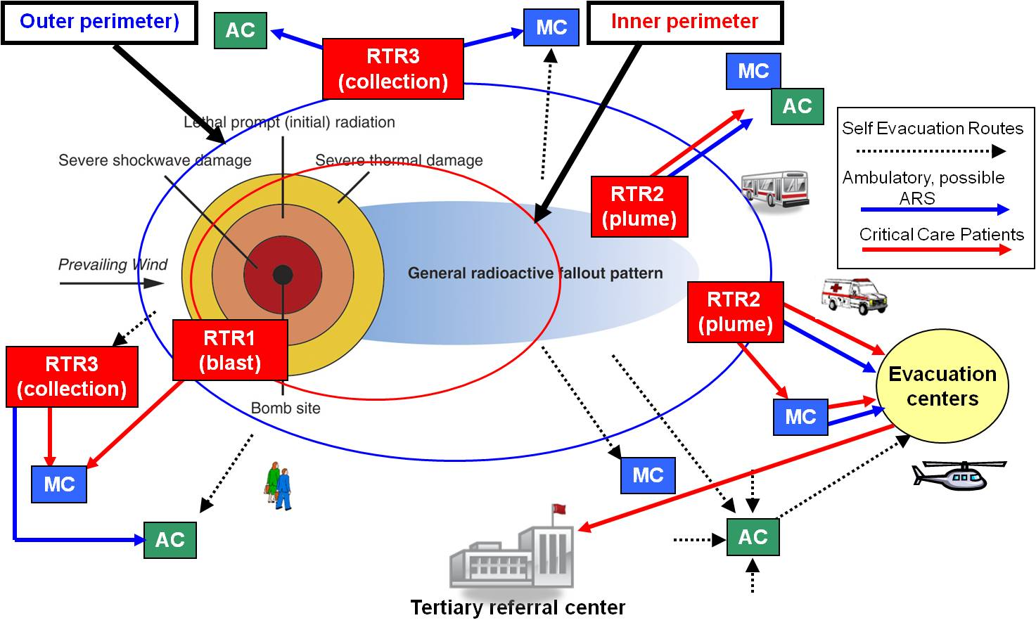
All-Hazards Preparedness

Slide 7
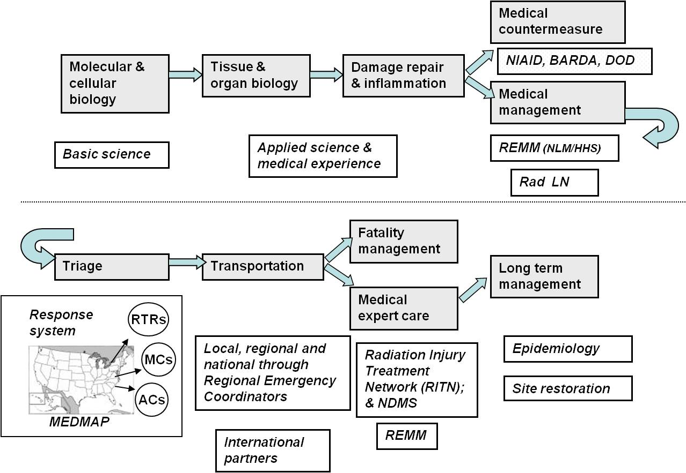
Expertise Required for Comprehensive Medical Response to a Radiation Event

Slide 8
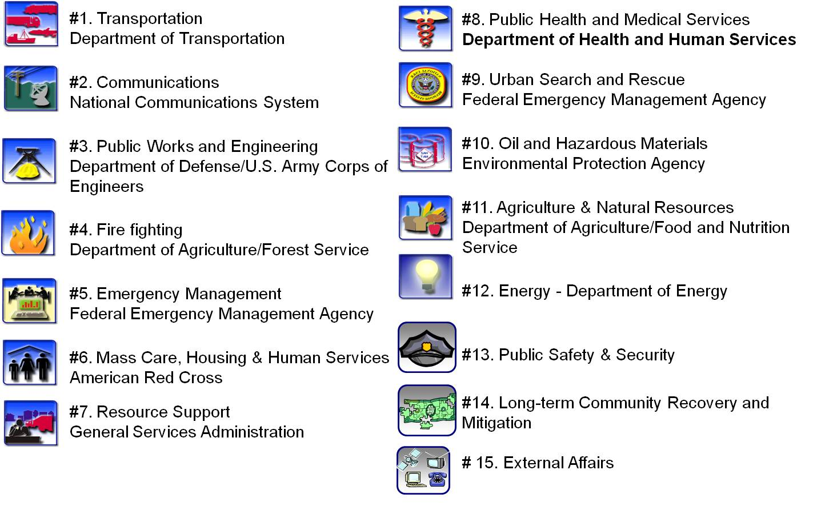
Emergency Support Functions (ESF’s)
Notes:
Public Safety and Security = Law Enforcement
External affairs = Emergency Public Information and External Communications
The plan itself is broken down into 12 emergency support functions or ESFs as noted above.
The principle agency responsible is indicated beneath each area.
Note the DVA is not an ESF!
As you can see, the ESFs cover response requirements for virtually any area affected by a disaster.
The agency in charge of a given area has at it’s disposal the combined assets of numerous agencies in providing support.
Note that DOD is actually “in charge” of only one area: Public Works. However DOD is the only agency which provides support capabilities to all 12 emergency support functions.
Our focus will be on ESF #8, Health and Medical Services.
#1. Transportation: Department of Transportation
#2. Communications: National Communications System
#3. Public Works and Engineering: Department of Defense/U.S. Army Corps of Engineers
#4. Fire fighting: Department of Agriculture/Forest Service
#5. Emergency Management: Federal Emergency Management Agency
#6. Mass Care, Housing & Human Services: American Red Cross
#7. Resource Support: General Services Administration
#8. Public Health and Medical Services: Department of Health and Human Services #9. Urban Search and Rescue: Federal Emergency Management Agency
#10. Oil and Hazardous Materials: Environmental Protection Agency
#11. Agriculture & Natural Resources: Department of Agriculture/Food and Nutrition Service
#12. Energy: Department of Energy
#13. Public Safety & Security
#14. Long-term Community Recovery and Mitigation
# 15. External Affairs

Slide 9
NRF and ESF #8: Responsibilities
Public Health Food & water safety Health surveillance Vector control Drug and blood safety Worker safety | Acute Care Victims Responders Casualty evacuation
Primary Care Special needs populations Community outreach Nursing home residents Mental health | In-patient Care Victims Displaced hospital patients

Slide 10
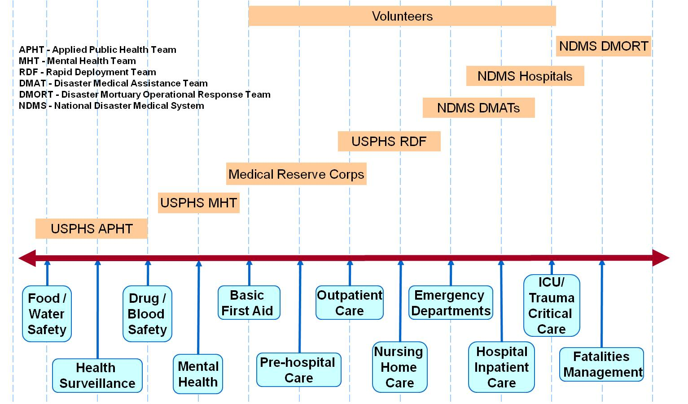
The Spectrum of Care & Phased Deployment

Slide 11
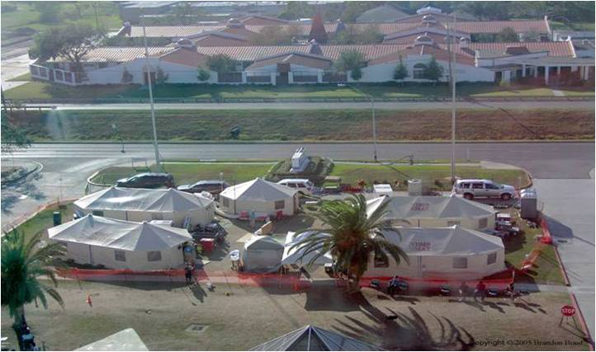
DMAT Field Deployment

Slide 12
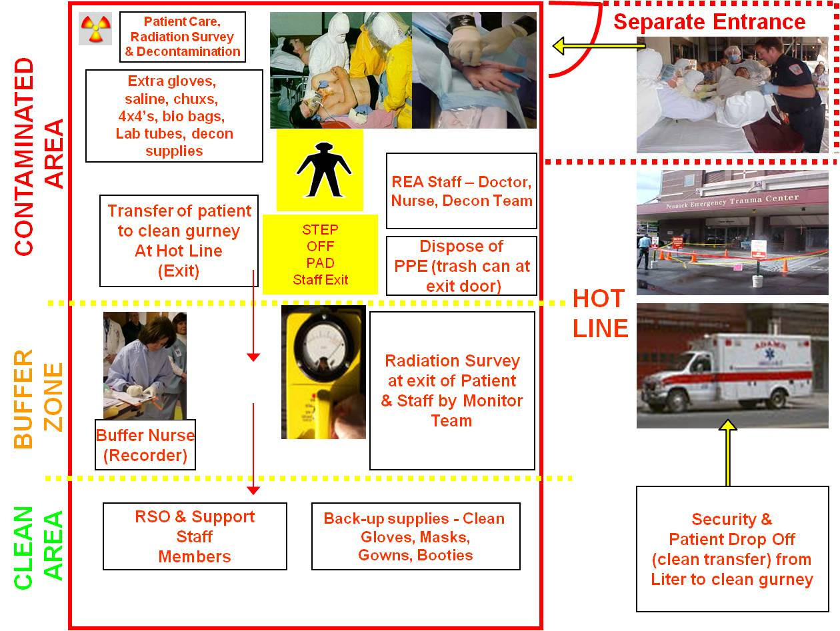
Radiation Emergency Area (REA)

Slide 13
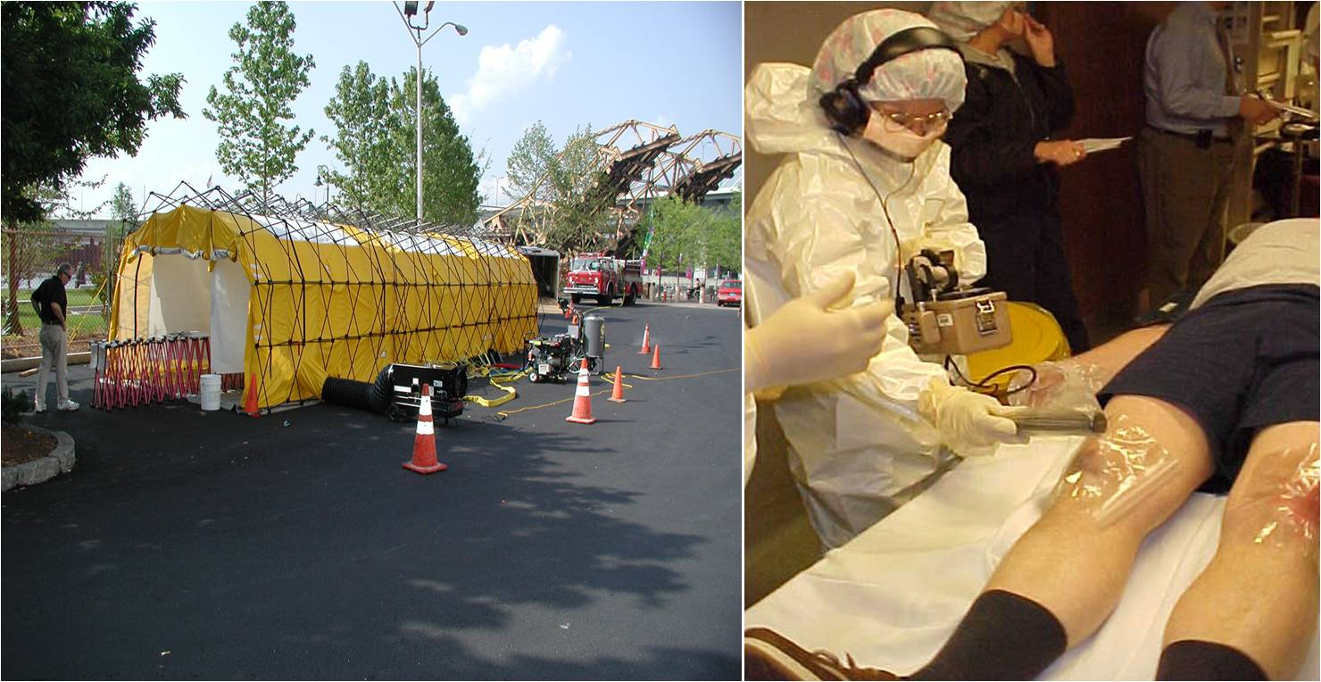
Decontamination

Slide 14
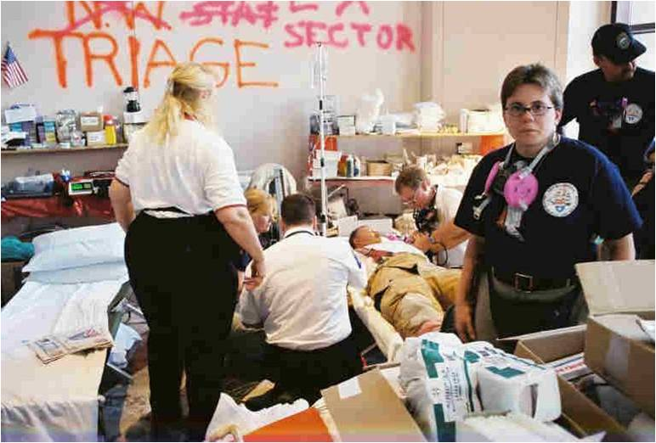
Triage

Slide 15
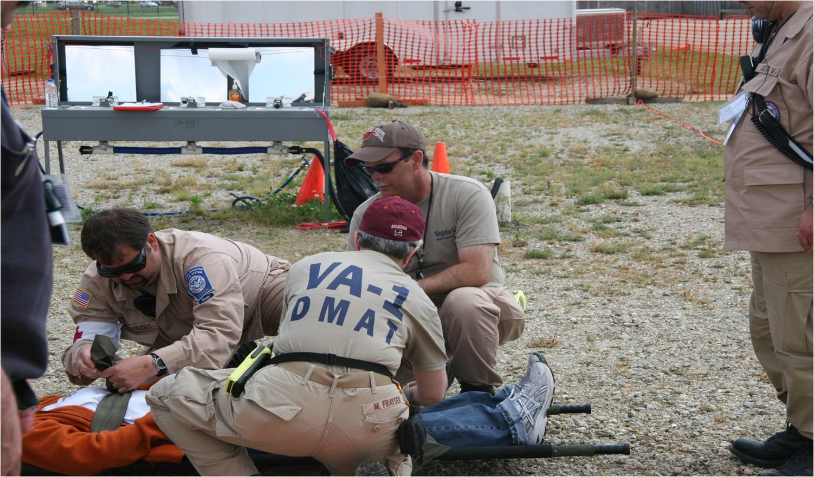
Triage

Slide 16
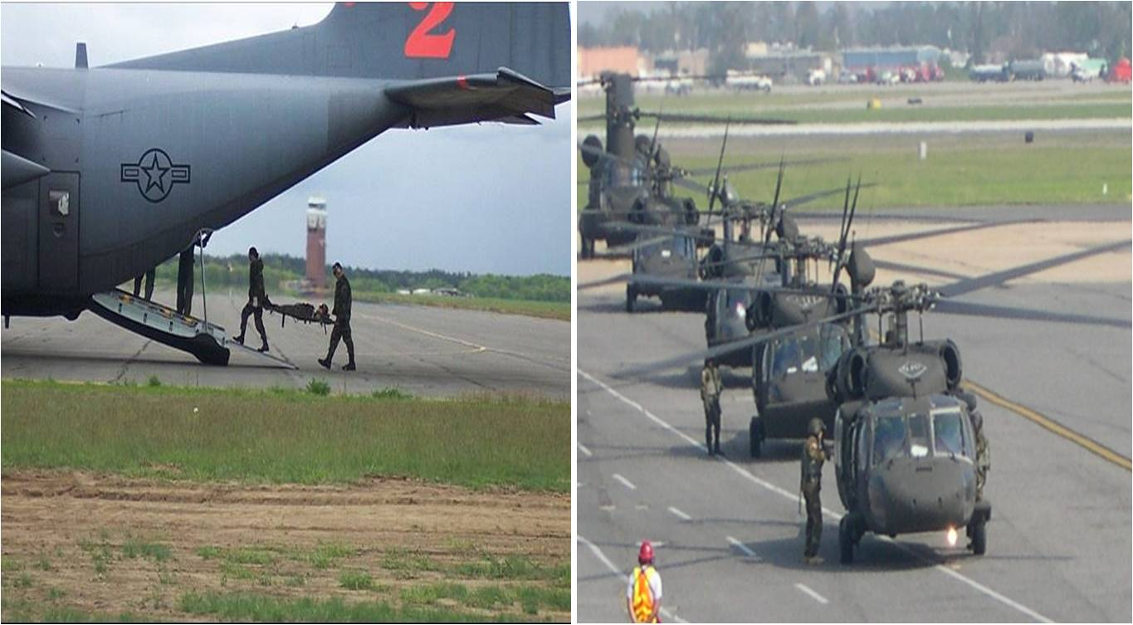
Patient Movement

Slide 17
Special considerations
Lab capacity
Radiobioassay
Biodosimetry
Hematology Surge
Radiation Injury Treatment Network (RITN)
National Marrow Donor Program and the National Cancer Institute Cancer Centers

Slide 18
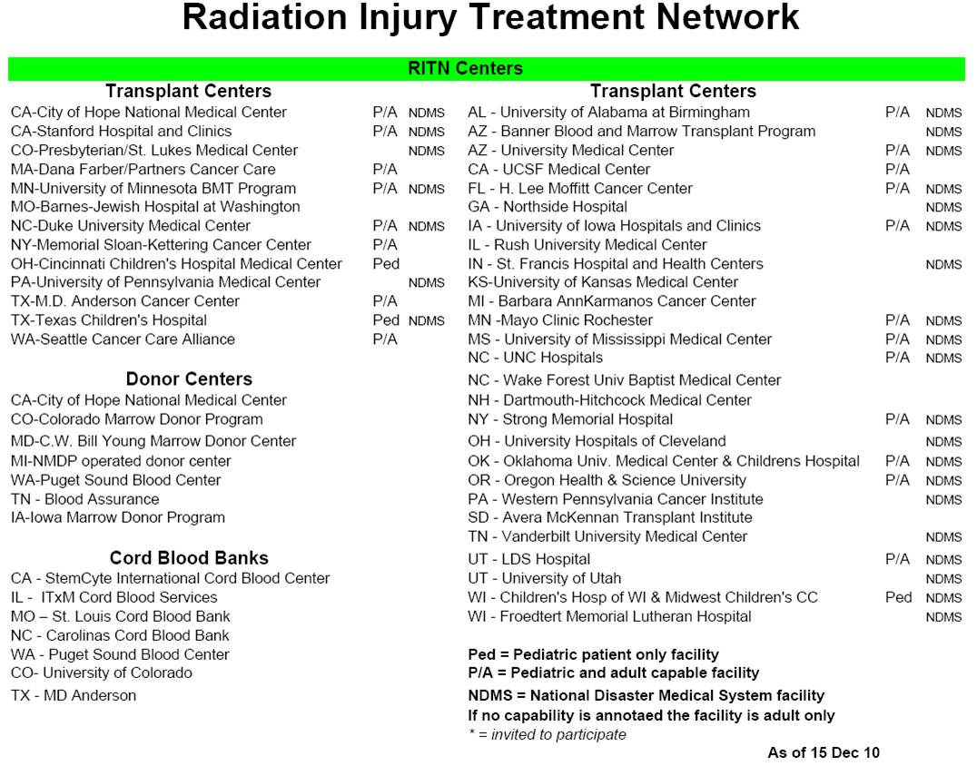
Radiation Injury Treatment Network

Slide 19
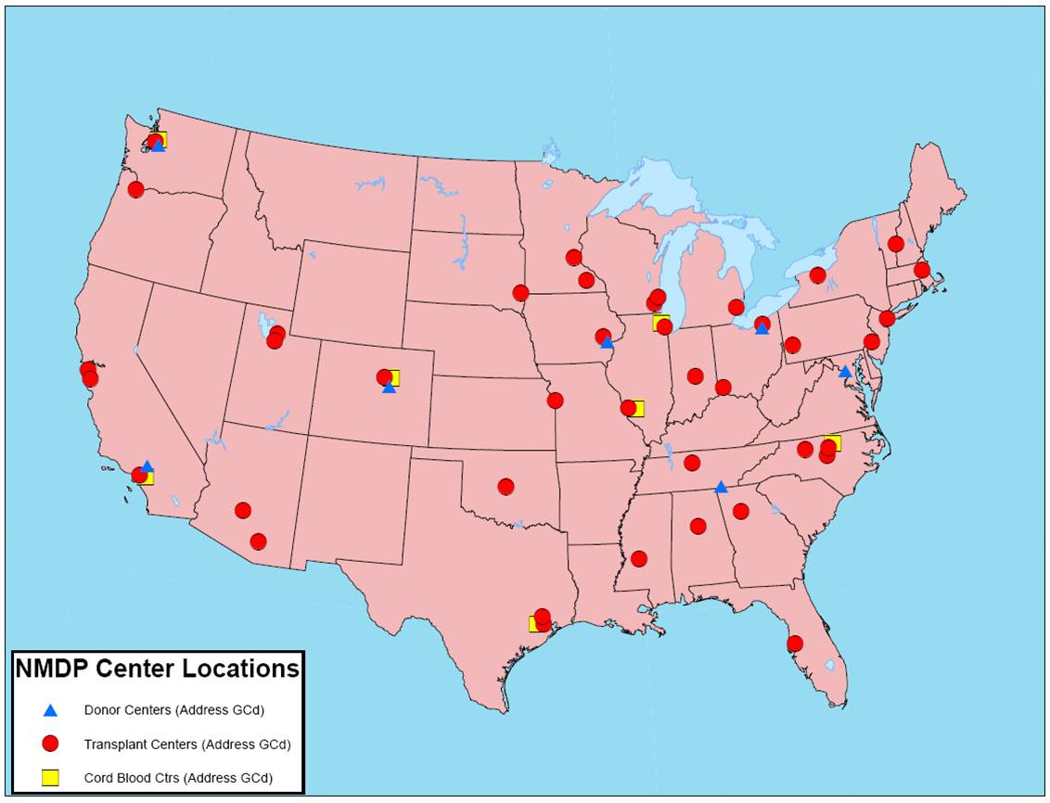
RITN Distribution Across USA

Slide 20

Playbooks and References
Playbooks for:
Radiation Dispersal Device
Improvised Nuclear Device
CDC Website
Radiation Event Medical Management (REMM)
Website for clinicians
www.remm.nlm.gov
NIOSH
Population monitoring in radiation emergencies: a guide for state and local public health planners

Slide 21
Hospital Preparedness Program (HPP)
PAHPA Goals
Integration
Coordination
Medical
At-Risk Individuals
Continuity of Operations
PAHPA Mandated Accountability Provisions
Maintenance of Funding (State level)
Evidence-Based Benchmarks and Objective Standards
Submission of State Pandemic Influenza Plan (CDC Driven)
Maximum Carryover Amount (15%)
Matching Requirements (10%)
Withholding
20
Notes:
5/18/2011
20

Slide 22
Hospital Preparedness Program (HPP)
FY09/10 HPP Overarching/Sub-Capability Requirements
Overarching
National Incident Management System (NIMS)
Education and Preparedness Training
Exercises, Evaluation and Corrective Actions
Needs of At-Risk Populations
Level 1 Sub-Capabilities
Interoperable Communication Systems
Tracking of Bed Availability (HAvBED)
ESAR-VHP
Fatality Management
Medical Evacuation/Shelter in Place
Partnership/Coalition Development
* Level 2 Sub-Capabilities may also be funded.
21
Notes:
5/18/2011
21

Slide 23
HPP and Nuclear – Radiation Preparedness
Connecticut
Nuclear/radiation planning for hospitals
Hospital EOP Nuclear – Radiation annexes required since 2005
Training
Has only civilian Biodosimetry Laboratory in US
Has KI for hospitals near nuclear power facility
Evac Plans are in place

Slide 24
HPP and Nuclear – Radiation Preparedness
Massachusetts
Supports all-hazards approach to emergency preparedness
Many hospitals fund purchase of pharmaceuticals for radiological scenarios (e.g., KI and Prussian Blue)
SNS program for KI distribution around Pilgrim Station
Radiation Control Program
Massachusetts Environmental Radiation Laboratory
Evac Plans are in place

Slide 25
HPP and Nuclear and MCM Exercises
Phoenix, AZ
Palo Verde Nuclear Generating Station - Full-Scale Exercise based on an Ingestion Exposure Pathway, defined as a radius of fifty miles surrounding the facility
Chicago, IL
Incident Command in a Mass Casualty Incident Online Tabletop Exercise
HAvBed (Illinois Bypass System) Online Tabletop Exercise
Healthcare Interoperable Communications Full-Scale Exercise
Hospital Evacuation Tabletop Exercise
Fatality Management Tabletop Exercise

Slide 26
HPP and Nuclear and MCM Exercises
Colorado
Annual NDMS/FCC MCM exercise – transporting 200+ patients to 15 healthcare facilities
New York
8 regional mass fatality response tabletop exercises
Participation: 99% of hospitals outside NYC
Oregon
Tabletop exercise about county/local/hospital roles and responsibilities during an earthquake mass fatality event
Utah
Chemical Stockpile Emergency Preparedness Program (CSEPP )
Major health system full-scale exercises

Slide 27
Grant Alignment
26
Stakeholders have requested alignment to reduce duplicative/conflicting activities and redundant reporting
CDC, ASPR, FEMA, DOT, and HRSA are working to identify collaborative and innovative strategies to:
Streamline processes and improve emergency response consistent with the HHS National Health Security Strategy/FEMA Whole of Community approach
Offer a more clear return on investment with improved, joint metrics and “sharing of the success story”
Enhance state/local customer service and reduce burden
Notes:
5/18/2011
26

Slide 28
Grant Alignment
27
ASPR and CDC alignment activities already underway:
Standardization of grant processes to identify, unify, and rapidly restructure a common path forward for:
Capabilities
Applications, forms, templates
Technical assistance, site visits, peer review
Data management, reporting, and alignment of business processes
Co-development of metrics and pilot testing joint measures
Consistent budgetary requirements
Engagement of stakeholders
Notes:
5/18/2011
27

Slide 29
Grant Alignment
28
Expanding grant alignment to the Interagency
Provide a framework for alignment for priority-setting, review, and reporting of Interagency preparedness grants
Facilitate a common pathway to focus dollars, measure outcomes, reduce duplication, and enhance return on investment and reporting
Facilitate the advancement of health care coalitions (including the emergency management world) to improve strategic planning, site visits, exercises, communications, metrics, and accountability
Enhance data sharing for situational awareness for response
Notes:
5/18/2011
28

