Slide 1
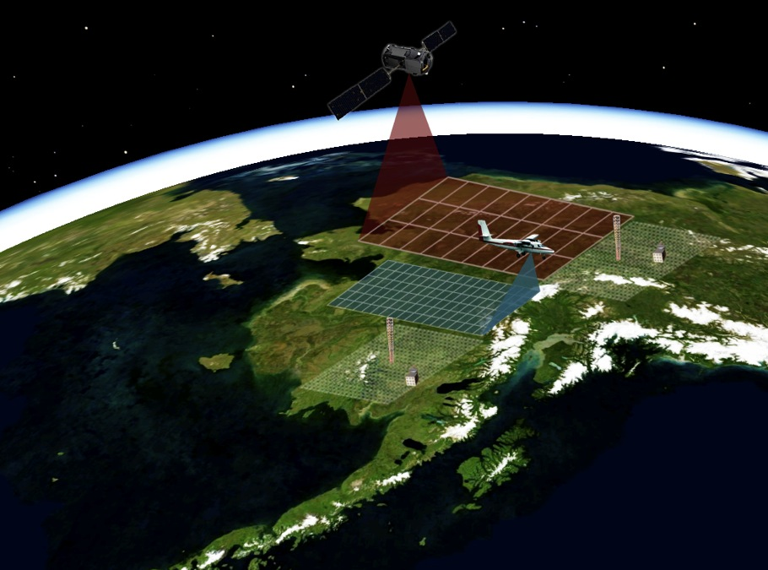
Carbon in Arctic Reservoirs Vulnerability Experiment (CARVE)
Spring 2011 Update
Engineering Flights & Project Status
Charles Miller, PI
Steve Dinardo, PM
CARVE Science Team NASA CCE Joint Workshop
Alexandria, VA
3-5 October 2011
Charles Miller, Annmarie Eldering, Kevin Bowman Meemong Lee, Zheng Qu, James Wood
Notes:
CARVE air-borne observations connect satellite and ground-based measurements with vastly different spatial and temporal characteristics

Slide 2
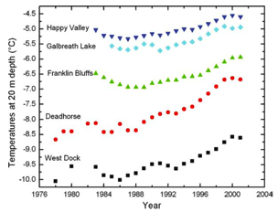
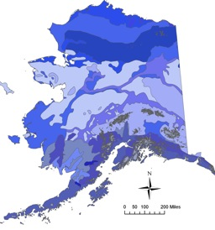
Massive Reservoirs of Arctic Carbon are Vulnerable to Climate Change
Rapidly increasing temperatures threaten to mobilize permafrost C into dynamic cycling, creating a potentially massive perturbation to the climate system
An estimated 1400–1850 PgC are stored in permafrost and frozen soils [McGuire et al., 2010]
~200 PgC at depths 0 – 30 cm
~500 PgC at depths 0 – 100 cm
~1000 PgC at depths 0 – 300 cm
[Tarnocai et al., 2009]
How much C is vulnerable to release?
How fast might it be released?
What fraction would be released as CO₂? As CH₄?
Are there signatures that an irreversible climate system “tipping point” is approaching?
Osterkamp, 2003
Soil temperature trends
Brown et al., 2001 [NSIDC]
Alaska permafrost domains
Notes:
If we are looking for climate change perturbations to the Earth system, it makes sense to look at the domains that have the largest sensitivity to change

Slide 3
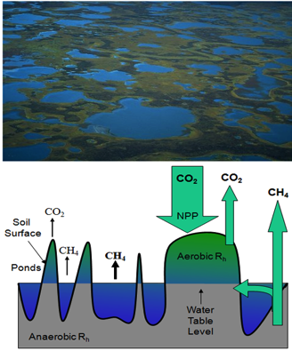
CARVE Addresses Key Unanswered Science Questions
What are the sensitivities of the Alaskan Arctic carbon cycle and ecosystems to climate change?
How does interannual variability in surface controls (e.g., soil moisture) affect landscape-scale atmospheric concentrations and surface-atmosphere fluxes of CO₂ and CH₄ in the Alaskan Arctic?
What are the impacts of fire and thawing permafrost on the Alaskan Arctic carbon cycle and ecosystems?
A mosaic of wet and dry areas is common for regions in the Arctic. Microtopography dictates the partitioning of soil respiration into aerobic processes (CO₂ release) and anaerobic processes (CH₄ release). The partitioning of carbon fluxes from Arctic ecosystems is not known accurately.
Notes:
Read them yourselves – they are straight from the proposal
Thermokarst ponds emphasize the inseparable coupling between the carbon (green) and hydrologic (blue) cycles in the Alaskan Arctic
Cartoon: vertical cross section of microtopographic variability in thermokarst regions and how the presence or absence of water drives carbon cycle dynamics

Slide 4
The CARVE Science Investigation
CARVE operates out of Fairbanks, AK
Each colored loop represents a single day’s flight path. Each flight path would be covered multiple times per intensive.
CARVE flight plans sample multiple permafrost domains, ecosystems, burn-recovery chronosequences, and well-instrumented ground cal/val sites
Flight plans sample regions where conditions and variability may be used as a proxy for climate change
CARVE measurements will provide strong model constraints on key processes
Permafrost domains: continuous (dark blue), discontinuous (light blue), sporadic (gray), and subsea (hatched). NSIDC, 2001

Slide 5
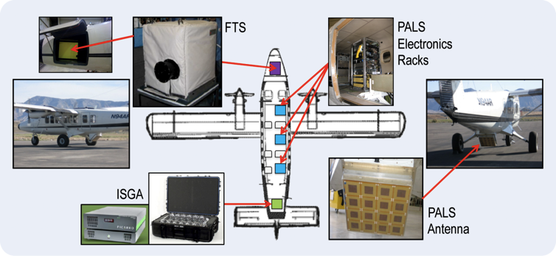
The CARVE Flight System: Twin Otter + Science Instruments
The CARVE Science instruments include
PALS (Passive-Active L-band System)—surface control variables
FTS—Column CO₂, CH₄, and CO
ISGA (In situ Gas Analyzer)—atmospheric trace gas concentrations

Slide 6
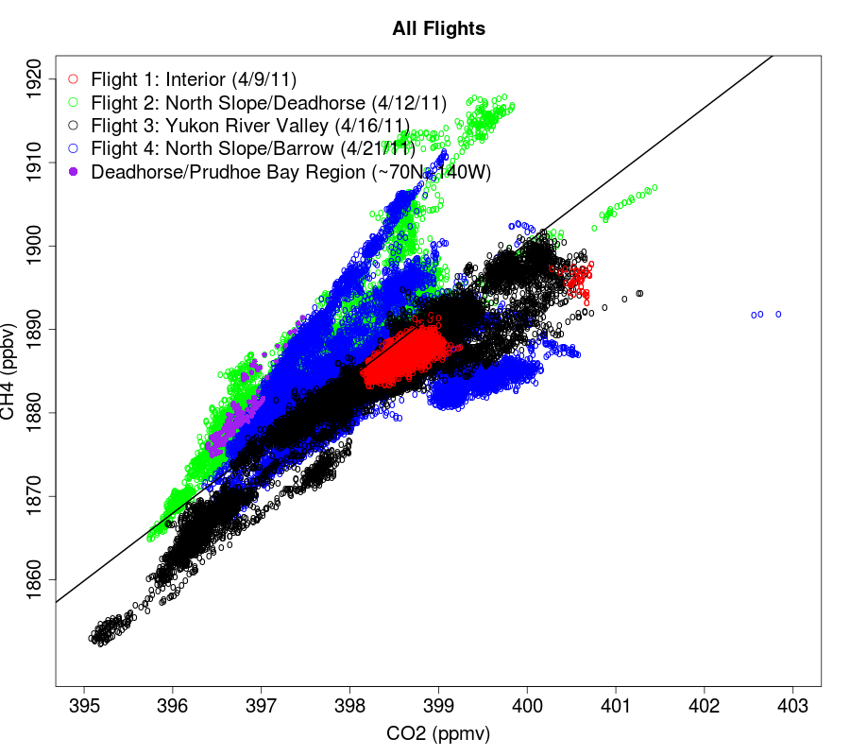
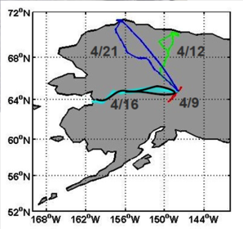
Summary of CARVE AK 2011 Test Flights
Notes:
CO2-CH4 Correlations are an important tool for understanding the origins of the signals/variations we observe

Slide 7
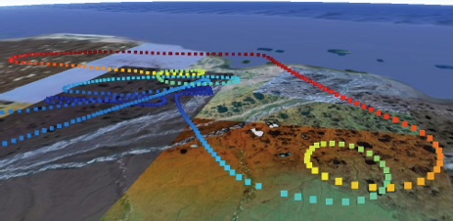
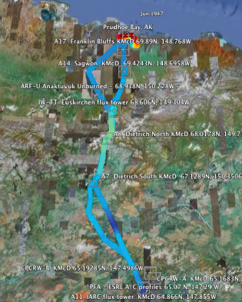
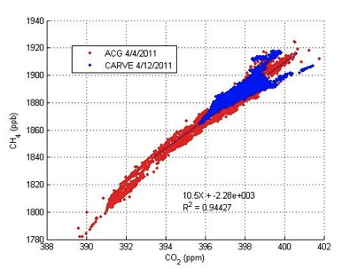
AK Test Flight #2 - 12 April 2011 North Slope/Deadhorse AK Flight Path
Spiral over Deadhorse
Flight Track
4/12/11
Notes:
CARVE 4/12/11 Engineering Test Flight – North Slope flight path #1 to Deadhorse
Flyovers for multiple ground sites from Fairbanks to Deadhorse and back
Spiral over Deadhorse (Prudhoe Bay Refineries) to sample potentially polluted air
Continuous in situ CO2 and CH4 show strong correlation and agree well with measurements made by NOAA on their 4/4/11 flight – highest concentrations of CO2 and CH4 observed over Deadhorse at ~6500 ft

Slide 8
Science Operations are Scheduled 2012–2014
CARVE Master Schedule
The CARVE Science Investigation entails
Engineering test flights in summer–fall 2011
Intensive field deployments in Alaska during the spring, summer, and fall of each year from 2012 to 2014
Each campaign will provide up to 80 hours of flight data

Slide 9

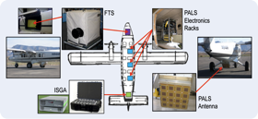
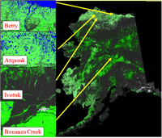
Carbon in Arctic Reservoirs Vulnerability Experiment (CARVE): An EV-1 Investigation
CARVE bridges critical gaps in our knowledge and understanding of Alaskan Arctic ecosystems, linkages between the terrestrial carbon and hydrologic cycles, and the feedbacks from fires and thawing permafrost.
Instrument Payload
L-band radar/radiometer
Nadir viewing Fourier transform spectrometer
Continuous in CO₂, CH₄ and CO
Programmable flask packages (whole air sampling)
Measurements
Surface parameters controlling carbon emissions: soil moisture, freeze/thaw state, inundation state, surface temperature
Total atmospheric columns of CO₂, CH₄ and CO
Atmospheric concentrations of CO₂, CH₄ and CO
Ground-based measurements of ¹⁴CO₂ and ¹⁴CH₄
Earth Science Relevance
High priority objectives across NASA’s Carbon Cycle & Ecosystems, Atmospheric Composition, and Climate Variability & Change focus areas
Air Quality and Ecosystems elements of Applied Sciences Program
Flight Tracks
Principal Investigator : Charles Miller
Project Manager: Steve Dinardo
Implementation Center: JPL
Flights
Platform: De Havilland DHC-6 Twin-Otter
Engineering test flights start in April 2011
Science Operations: Regular spring, summer and fall deployments annually 2012 – 2014 when arctic carbon fluxes are large and change rapidly

