Slide 1


Open Voting Consortium
EML for Open Voting
NIST Voting Data Formats Workshop Gaithersburg October, 2009
Parker Abercrombie
parker@TheOkoriGroup.com

Slide 2
Who we are
Not-for-profit organization dedicated to the development of open voting systems
Interested in creating universal voting machines
Interested in both national and international standards

Slide 3
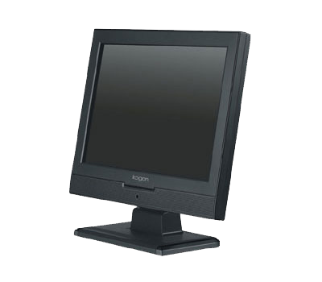

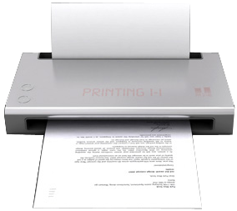
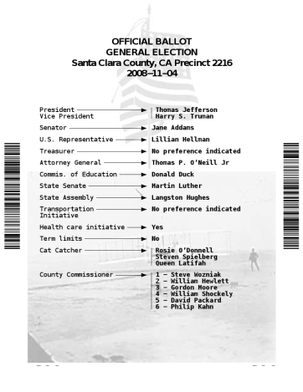
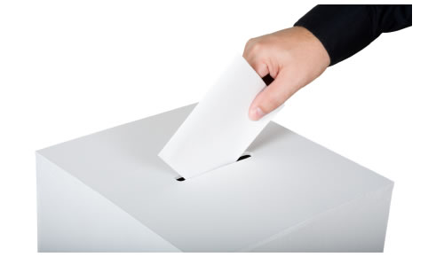
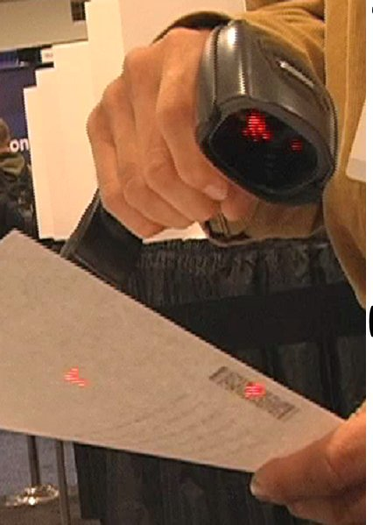
An OVC Voting Machine
Standard PC
Touch screen
Boots from a CD
No hard drive
Attached printer
Ballot
Human readable text
Machine readable barcode
Ballot goes into ballot box
Barcodes are scanned for tabulation

Slide 4
Goals
Election official should not be asked to discern voter intent
Goal: a machine printed, unambiguous paper ballot
Poll site
Absentee voter
Early voting
A voting machine for disabled access
All ballots look the same and tabulate the same

Slide 5
Before Election Day
Ballots are defined using Election Management System
Voting software is packed on CD
Each CD has a serial number and digital signature

Slide 6
On Election Day
CDs arrive at polling sites
Voting machines are set up and tested
Digital signatures are checked

Slide 7
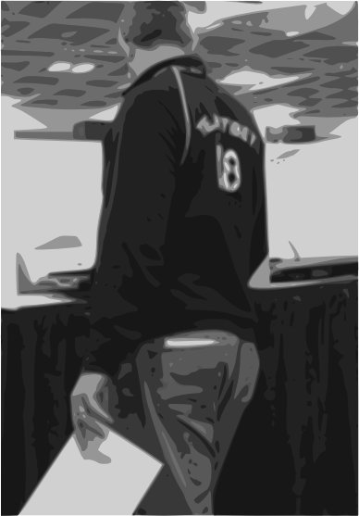
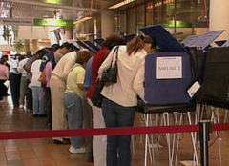
Voting
Voter makes selections on touch screen
When finished, a ballot is printed
This ballot is placed in a locked ballot box
Each printed ballot has bar code

Slide 8
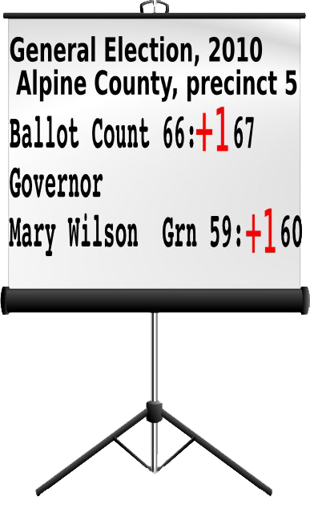
After Polls Close
Ballots are scanned publicly
Totals displayed on a screen
When finished, a tally sheet is printed

Slide 9
Central Tabulation
Precinct tally sheets are scanned for central tabulation
All tally sheets are publicly available

Slide 10


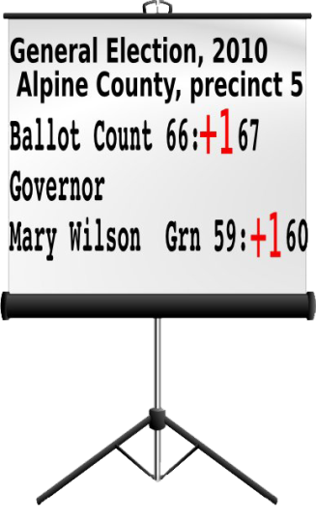
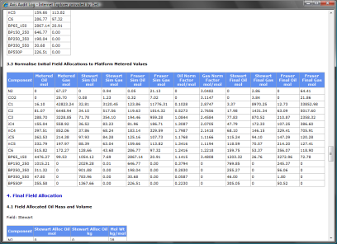
Data Flows
Voting Machine
Election
Management
System
Candidates
Issues
Contests
Ballot definition
Ballot definition
Digital signatures
Ballot
Election totals
Tabulation
Audit logs
Voter selections
Digital signatures
Tabulated votes

Slide 11
Data Requirements
Open standards
Prefer XML based standards
Flexible
Write in candidates, Instant Run Off voting, etc
Accessible
Support audio interfaces
Multilingual
Our solution: Oasis EML

Slide 12
Applying EML v6
Pre Election - Voters
EML-310
EML-330
EML-340
EML-350a
EML-350b
EML-350c
EML-360a
EML-360b
Pre Election - Candidates
EML-210
EML-220
Pre Election
EML-120
EML-130
EML-110
EML-230
EML is big
Election – Voting
EML-420
EML-430
EML-445
EML-450
EML-460
EML-470
EML-480
EML-410
Options Nomination
EML-610
EML-620
EML-630
EML-440
Post Election – Results
EML-510
EML-520

Slide 13
Applying EML v6
Election
EML-110
Candidates
EML-230
Ballot
Cast Vote
Count
Results
EML-410
EML-440
EML-510
EML-520

Slide 14
Applying EML v6
EML 110
EML 230
EML 410
EML 440
EML 520
EML 510
EML 480

Slide 15
Applying EML v6
EML 110 – Election Event
<EML Id="110“SchemaVersion="6.0">
<ElectionEvent>
<Description>California General Election 2009</Description>
<Languages>
<Language>en-US</Language>
<Language>es</Language>
<DefaultLanguage>en</DefaultLanguage>
</Languages>
<Election>
<Description>%type=MessagesStructure%</Description>
<Date>%type=ComplexDateRangeStructure%</Date>
<Contest DisplayOrder="%1%">
<ReportingUnit>
<Description>%type=MessagesStructure%</Description>
<MaxWriteIn>%1%</MaxWriteIn>
<Messages>%type=MessagesStructure%</Messages>
</Contest>
<Messages>%type=MessagesStructure%</Messages>
</Election>
</ElectionEvent>
</EML>
EML 110
EML 230
EML 410
EML 440
EML 520
EML 510
EML 480

Slide 16
Applying EML v6
EML 230 – Candidate List
<EML Id="230" SchemaVersion="6.0">
<TransactionId>WL-2009-10-31</TransactionId>
<CandidateList>
<Election>
<ElectionIdentifier Id=“Wonderland 2009" />
<Contest>
<ContestIdentifier Id="Supreme Ruler" />
<Candidate>Mad Hatter</Candidate>
<Candidate>March Hare</Candidate>
<Candidate>Tweedledee</Candidate>
<Candidate>Tweedledum</Candidate>
</Contest>
</Election>
</CandidateList>
</EML>
EML 110
EML 230
EML 410
EML 440
EML 510
EML 520
EML 530
EML 460
EML 480

Slide 17
Applying EML v6
EML 410 – Ballot
<EML Id="410">
<TransactionId>410</TransactionId>
<Ballots>
<EventIdentifier Id="Evt1"></EventIdentifier>
<Ballot>
<Election>
<ElectionIdentifier Id="Elc1"></ElectionIdentifier>
<Contest>
<ContestIdentifier Id="Con1">
<ContestName>Governor</ContestName>
</ContestIdentifier>
<MaxVotes>1</MaxVotes>
<MinVotes>0</MinVotes>
<BallotChoices>
<ReferendumOptionIdentifier Id="1629">Dude 1</Ref…>
<ReferendumOptionIdentifier Id="1631">Dude 2</Ref…>
</BallotChoices>
</Contest>
</Election>
<BallotIdentifier Id="thisballotid1"></BallotIdentifier>
</Ballot>
</Ballots>
</EML>
EML 110
EML 230
EML 410
EML 440
EML 510
EML 520
EML 530
EML 460
EML 480

Slide 18
Applying EML v6
EML 440 – Cast Vote
<EML Id="440" SchemaVersion="6.0">
<TransactionId>Token</TransactionId>
<CastVote Spoilt="Token">
<Vtoken><Component>string</Component></VToken>
<EventIdentifier>string</EventIdentifier>
<Election>
<ElectionIdentifier>
<ElectionName>Token<ElectionName/>
</ElectionIdentifier>
<Contest>
<ContestIdentifier/>
<Selection Value="1">
<CandidateIdentifier>string</CandidateIdentifier>
<PersonalIdentifier>Token</PersonalIdentifier>
<WriteinCandidateName>Token</WriteinCandidateName>
<ReferendumOptionIdentifier>Token</ReferendumOptionIdentifier>
</Selection>
</Contest>
</Election>
</CastVote>
</EML>
EML 110
EML 230
EML 410
EML 440
EML 520
EML 510
EML 480

Slide 19
Applying EML v6
EML 510 - Count
<EML Id="510" SchemaVersion="6.0">
<EventIdentifier Id="State Of Connecticut - USA"></EventIdentifier>
<Election>
<ElectionIdentifier Id="State Election"></ElectionIdentifier>
<Contest>
<ContestIdentifier Id="1"></ContestIdentifier>
<TotalVotes>
<Selection Id="1">
<CandidateIdentifier Id="1A"></CandidateIdentifier>
<WriteinCandidateName></WriteinCandidateName>
<ValidVotes>5</ValidVotes>
</Selection>
<Selection Id="2">
<CandidateIdentifier Id="1B"></CandidateIdentifier>
<WriteinCandidateName></WriteinCandidateName>
<ValidVotes>2</ValidVotes>
</Selection>
</TotalVotes>
</Contest>
</Election>
</EML>
EML 110
EML 230
EML 410
EML 440
EML 520
EML 510
EML 480

Slide 20
Applying EML v6
EML 520 - Result
<EML Id="520" SchemaVersion="6.0">
<TransactionId>2007-04-18</TransactionId>
<Result>
<Election>
<EventIdentifier Id="State of Connecticut Election -2007, “/>
<Contest>
<ContestIdentifier Id="Governor“></ContestIdentifier>
<Selection>
<CandidateIdentifier ID="1A" DisplayOrder="1">
<CandidateName>M. Jodi Rel</CandidateName>
</CandidateIdentifier>
<Affiliation>
<AffiliationIdentifier ID="DEM">
<RegisteredName>Republican</RegisteredName>
</AffiliationIdentifier>
</Affiliation>
<Votes>5</Votes>
</Selection>
</Contest>
</Election>
</Result>
</EML>
EML 110
EML 230
EML 410
EML 440
EML 520
EML 510
EML 480

Slide 21
Ballot Pre-Rendering
EML 410
Ballot Definition
CSS
XSLT
Ballot Compiler
Pre-rendered Ballot File

Slide 22
Summary
Case study of applying EML to an open source voting machine
We need data formats that are:
Open
Flexible
National and international
Support multilingual ballots
Support audio interfaces

Slide 23
Q & A

Slide 24
Why Use a Computer?
Support multiple languages
Print only the ballots that you need
Reduce user error
Simplify navigation of complex ballots

