Slide 1
Developing Standards for Linking Electronic Health Records and Vital Records Systems: Opportunities and Challenges
Hetty Khan
Health Informatics Specialist
Centers for Disease Control and Prevention
National Center for Health Statistics
Aug 18, 2010

Slide 2
Opportunity: Vital Records (VR) in Standards Development Activities
Standards Development Organizations (SDOs) and other standards related groups are engaged in activities to develop and implement standards for electronic health record systems (EHR-S)
Health Level Seven International (HL7) – clinical information systems
Accredited Standards Committee (ASC) X12 – administrative data collection
Integrating the Healthcare Enterprise (IHE) – interoperability among EHRs
Notes:
The first opportunity that I have noted here is the engagement of vital records in the standards development activities.
There are standards development organizations that are engaged in activities to develop and implement standards for electronic health record systems.
HL7 (Health Level Seven International) is mainly focused on the clinical information systems: laboratory, radiology, pharmacy, etc.
X12 is mainly focused on administrative data – Admissions, discharges, financial, insurance
IHE (Integrating the Healthcare Enterprise) focuses on the sharing of information - interoperability among systems – across multiple healthcare enterprises)
These standards impact what and how data are collected in systems and how it is shared

Slide 3
Opportunity: VR in Standards Development Activities
Vital Records
Have established standards for VR data collection:
Model Law
2003 U.S. Standard Certificate of Live Birth
2003 U.S. Standard Certificate of Death
2003 U.S. Standard Report of Fetal Death
Collects much of the same data that are inherent in EHR-S
mother’s and infant’s medical records serve as the source for more than ½ of all data items collected on the Birth Certificate and Fetal Death Report
Notes:
We know vital records have well developed standards for the collection of VR data. These are evident in the Model Law and on the national certificates. VR knows what data is needed and how it is needed.
This is why we are able to establish a fact that much of the same data needed by Vital records are inherent in EHR-S.
More than ½ of the data items collected on the 2003 U.S. standard certificate of live birth and fetal death are found in the mother’s and infant’s medical records

Slide 4
Opportunity: VR in Standards Development Activities
VR can serve as the bookends of a longitudinal EHR, beginning with birth and ending with death
The Electronic Health Record (EHR) :
is a longitudinal electronic record of patient health information
is generated by one or more encounters in any care delivery setting
includes patient demographics, progress notes, problems, medications, vital signs, past medical history, immunizations, laboratory data and radiology reports
automates and streamlines the clinician's workflow
has the ability to generate a complete record of a clinical patient encounter
supports other care-related activities directly or indirectly
Source: Healthcare Information and Management Systems Society (HIMSS) http://www.himss.org/ASP/topics_ehr.asp
Notes:
I really like this definition of the EHR that is taken from HIMSS.
The EHR is Longitudinal – begins with birth and ends with death; vital records need birth information and death information; also other medical information that influences the birth and death of the individual
Many encounters are all in one place – complete record
Much information: demographics, progress notes, problems, medications, vital signs, past medical history, immunizations, lab data, radiology reports.
Automates and streamlines workflow
Supports other care-related activities: much of the reports that are needed by VR

Slide 5
Opportunity: VR in Standards Development Activities
VR can influence standards development for EHR systems for relevant data items
assure that the data collected is consistent with national requirements
Eliminate the need to retrofit VR requirements later
Notes:
Vital records need to get involved now to influence the development of these standards.
Why? – so that we could assure the relevant data for vital records that are collected in the EHR are consistent with the national requirements
We would not want to wait until these data standards are developed based on the requirements of those who are at the table, then having to work to retrofit the requirements later on to meet the needs of VR.

Slide 6
Opportunity: Mesh Clinical and VR Requirements
Eliminate the silos that currently exist between clinical and VR requirements
Identify where commonalities exist in clinical and VR data requirements
Communicate the needs of the clinical and VR domains and come together where appropriate
Develop a standard format that may be utilized by clinical systems that includes VR requirements
Notes:
At the same time, this is an opportunity to work with the clinical community to identify where there are commonalities between requirements and see where we can come together to develop a standard format that may be utilized to by clinical systems that includes VR requirements.
This way we could eliminate the silos that currently exists between clinical and VR requirements

Slide 7
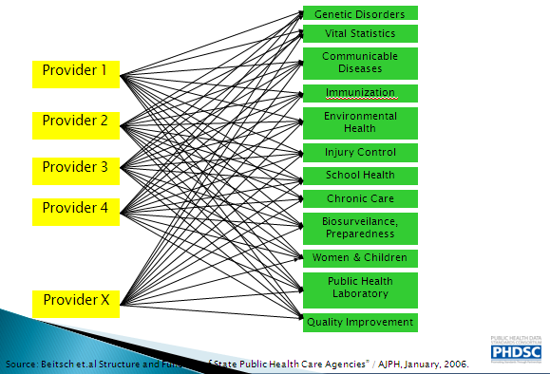
Example: Clinical Communication with Multiple PH Domains using Multiple Standards

Slide 8
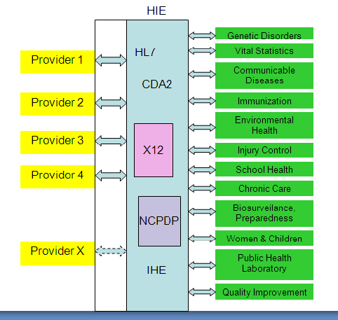
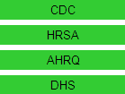
Example: Clinical Communication with Multiple PH Domains using single standard
Notes:
Here is a visual of using standards to communicate the information:
Much simpler: one standard communication can be sent to several entities

Slide 9
Example: Clinical Communication with PH Domains using single standard
Early Hearing Detection and Intervention (EHDI) Program:
supports the coordination of primary care providers and audiologists in referrals and evaluations of infants
EHDI developed Content profile at IHE
NCHS and Public Health Data Standards Consortium (PHDSC) will develop HL7 Public Health Functional Profile for EHR Systems with EHDI focus
PHDSC and EDHI will develop certification and testing criteria for EHR Systems that are capable of exchanging data for EHDI
Notes:
Just to provide a quick but concrete example of present work to develop standards within one domain of public health and to consider that vital records can follow a similar approach:
This is in the are of Early Hearing Detection and intervention (EHDI) program:
EHDI developed a content profile at IHE (describes the content and format of the data)
Starting on September 8th, NCHS and the Public Health Data Standards Consortium, through a CDC co-operative agreement will be developing a public health functional profile. (describe the capabilities that the EHR system ought to have to collect and exchange public health data)
We will pay particular attention to be sure that all of the capabilities needed by EDHI are listed in the functional profile. However, we want to engage all the other domains of public health that are willing to participate.
Following this the PHDSC will work with EDHI to develop some criteria for testing EHR systems that are capable of exchanging data for EDHI. These criteria can be used to certify thae EHR systems that claim the capability of exchanging EHDi data.
We can do the same for vital records and have been working on standards for doing this

Slide 10
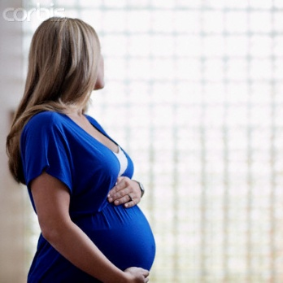


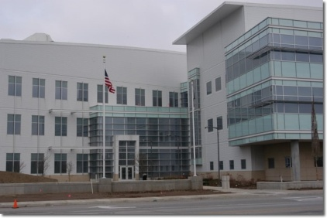
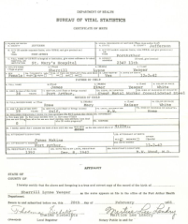
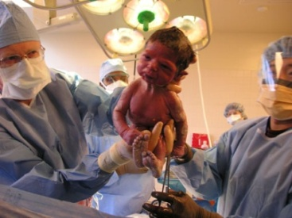
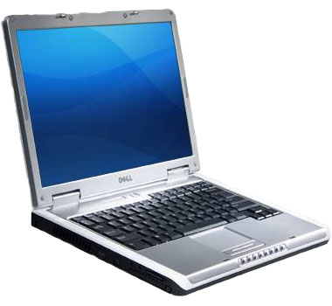



Opportunity: Utilize a Standard Format for VR to Communicate with EHRs
Mother's Worksheet
Mother
Registrar
Birth Registration System (EBRS)
Birth Information Specialist
(Select items)
Birth Certificate
State Department of Health
Birth Event
Electronic Health Record
CDC/NCHS
Nurse
Obstetrician

Slide 11
Opportunity: Utilize a Standard Format for VR to Communicate with EHRs
Two HL7 projects supported by funding from CDC/NCHS:
HL7 Vital Records (VR) Domain Analysis Model
Identify the birth and death registration activities and data items utilizing an HL7 recognized format.
Guide future design and implementation efforts for standardizing the electronic data exchanges between EHR and VR systems, NCHS and other public and private information systems
HL7 EHR-S Vital Records Functional Profile (VRFP)
Specifies the functional requirements needed to facilitate EHR systems capturing VR data at the point of care or point of contact and to enable interoperable electronic exchanges among EHR systems, VR systems and potentially other public information systems for birth, death and fetal death
Notes:
So, what are we doing to support the development of VR standards?
NCHS , NAPHSIS , several state vital records representatives, several VR vendors, EHR vendors and health care providers have been working on two projects supported by funding from CDC/NCHS:
DAM: specifies birth and death registration activities - used to guide the standardization of electronic data exchange between systems
VRFP: specifies the capabilities needed by EHR systems to capture the selected VR data at the point of care and transmit the needed information to VR.

Slide 12

Opportunity: Improve Data Quality and Timeliness
Debates abound about the:
Use of EHRs as a source for VR information
Improvements in quality and timeliness of VR data
Reductions in the redundancy of data captured

Slide 13
Opportunity: Improve Data Quality
Interoperable data exchange between EHRs and VR systems may improve data quality
For example:
Race and Ethnicity data
Method of Delivery
Electronic Health Record
Birth Registration System (EBRS)
Notes:
We still believe, however, that is worthwhile to lay the foundation for VR standards. EHRs are not yet fully developed; standards are just being worked on. This is the time to be sure that VR needs are met within EHR systems to assure the quality and timeliness of the data are met.
IF we can have interoperable data exchange between EHRs and VR systems, we will increase the likelihood of improving the quality of the data, both in EHR systems and VR systems.
Data collected in the VR systems may even be allowed to populate the EHR. It can work both ways.
For example: Race and ethnicity data: collected in the VR system ; may be able to be transmitted to the EHR
Method of delivery: VR requires some detail and asks specific question of the delivery method that, if collected in the EHR, may enhance the quality of the EHR data

Slide 14
Opportunity: Improve Data Quality and Timeliness
Consider the eventual benefits of a longitudinal EHR for certifying the underlying cause of death
Other public health data systems are getting on board with developing national standards for data transmission
Immunization Registries
Cancer Registries
Newborn Screening
Vitals??
Let’s begin the process to determine lessons learned and how to improve the process and quality
Notes:
Consider the longitudinal EHR: it would list the patient’s problems and diagnosis over such a vast time period and that information will be complete. Consider the benefits of that information leading to more accurate data for physicians to determine the underlying cause of death
Other public health systems are getting on board:
Let’s begin the process

Slide 15
Opportunity: Benefit from “meaningful use” of EHRs
Recent activities to support meaningful use of EHRs using national standards may lead to increased use of EHR-S
Final Rule: Issued on July 13, 2010
Initial Set of Standards, Implementation Specifications, and Certification Criteria for Electronic Health Record Technology
http://www.ofr.gov/OFRUpload/OFRData/2010-17210_PI.pdf
Identifies a set of core objectives that constitute an essential starting point for meaningful use of EHRs
http://www.nejm.org/doi/pdf/10.1056/NEJMp1006114
Notes:
What is the future of the EHR?
Recent activities to support meaningful use of EHRs using national standards suggest that EHR development and use will increase.
The Final Rule on meaningful use was issue on July 13th
It outlines the initial set of standards for EHR technology; it also identifies a core set of objectives that constitute an essential starting point for the meaningful use of EHRs

Slide 16
Opportunity: PH Benefits from “meaningful use” of EHRs
VR data items that are consistent with the meaningful use criteria:
Record patient demographics (sex, race, ethnicity, date of birth, preferred language, and in the case of hospitals, date and preliminary cause of death in the event of mortality)
Record vital signs and chart changes (height, weight, blood pressure, body-mass index, growth charts for children)
Record smoking status for patients 13 years of age or older
Notes:
A closer look at the final rule identifies the collection of some of the data items in which vital records will be interested:
Sex, race, ethnicity, date of birth, date and preliminary cause of death in the event of mortality
Height , weight
Smoking status

Slide 17
Opportunity: PH Benefits from “meaningful use” of EHRs
MEANINGFUL USE CRITERIA
Smoking status
current every day smoker
current some day smoker
former smoker
never smoker
smoker, current status unknown
unknown if ever smoked
U.S CERTIFICATE OF LIVE BIRTH
Cigarette smoking before and during Pregnancy
Average number of cigarettes or pack of cigarettes smoked per day:
Three months before pregnancy
First three months of pregnancy
Second three months of pregnancy
Third trimester of pregnancy

Slide 18
Opportunity: Pilot Projects
VR should develop draft standards that may be implemented and pilot tested
Specify the VR data sets that may be obtained from an EHR and sent to a vital records system
For example, CDC/NCHS is working with IHE to develop technical requirements that will support interoperability testing between EHR and VR vendors
IHE 2011 North American Connectathon
www.ihe.net
Lay the foundation for pilot testing with states to implement these specifications to evaluate interoperability and quality
Notes:
.
Opportunity for pilot projects:
Develop draft standards
Specify the data to be exchanged
NCHS is working with IHE to develop technical requirements that will support interoperability testing between EHR and VR systems
We just held a webinar which was attended by several EHR and VR vendors. We hope to get some interest in the vendor community to develop pilot systems using these specifications
We hope to test these specifications at the 2011 North American Connectathon held by IHE
Lay the foundation for pilot testing with states to implement these specifications to evaluate interoperability and quality

Slide 19
Challenges: Developing a comfort level of using EHR data for VR
Issue of legal responsibility for VR data has resulted in:
Discomfort in considering the possibility of using EHR data for VR
Lack of receptivity to EHR functionality that may provide support for capturing and deriving VR data consistent with VR requirements
Slows progress towards development, pilot projects, implementation and adoption of EHRs for VR purposes
Notes:
I have tried to paint a picture of opportunities and possibilities.
However, many challenges also exist
There is the issue of legal responsibility for VR data. There are legal requirements.
State registrars are responsible for the accuracy of the data
So there is a discomfort in considering the possibility of using EHR data for VR

Slide 20
Challenge: Vendor interest in Developing EHRs for VR
PH is not at the top of the list for EHR developers
PH must engage vendors to develop systems that meet our requirements
Funding support needed to support states to implement new VR systems

Slide 21
Challenges: Adoption of national standard and state specific VR requirements
Lack of consistency in adoption of national VR standards for birth, death and fetal death will add to the complexity of implementing a national electronic standard for VR
Electronic standards must have the ability to exchange the variety of requirements needed by specific states

Slide 22
Moving forward with eVitals
Continue work with the SDOs
Begin to pilot developing standards
Improve standards based on lessons learned from pilot projects
Evolving process…………

Slide 23
CONTACT
Hetty Khan
Health Informatics Specialist
CDC/National Center for Health Statistics
3311 Toledo Road
Hyattsville, MD 20782
Ph: 301-458-4311
Email: hdk1@cdc.gov

