Slide 1
National Research Council
Canada
Conseil national de recherches
Canada
Activities in Frequency and Time at the
National Research Council of Canada
John Bernard
Research Officers and Research Council Officers:
John Bernard, Group Leader
Stan Cundy
Rob Douglas
Pierre Dubé
Marina Gertsvolf
Alan Madej
Louis Marmet
Technical Officers:
Bill Hoger
Wojciech Pakulski
Student:
Maria Tibbo
Notes:
The Frequency and Time Group at NRC currently has 10 members.
The majority are research scientists or Research Officers.
We also have two excellent Technical Officers who keep most of our systems running.
We have one MSc student who is working with Alan Madej on the single-ion standard.

Slide 2
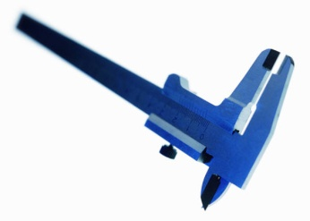
Major Activities
Time Standards Laboratory
Keep official time for Canada and disseminate it to the public
Provide traceability to the SI second
Provide calibrations of customer chronometers, frequency sources, clocks, and masers
Research and develop advanced sources of frequency and time
Optical Frequency Standards Laboratory
Provide traceability to the SI metre
Provide calibrations of laser frequency/vacuum wavelength for customer lasers in the visible, near infrared, and optical telecommunication regions
Research and develop advanced optical frequency standards and optical clocks
Notes:
The Frequency and Time Group has two main activities:
Time Standards
Optical Frequency Standards
The Time Standards Laboratory keeps official time for Canada and disseminates it by a variety of means to the public.
It also provides traceability to the SI second and provides fee-for-service calibrations for devices ranging from
stopwatches and tachometers to masers and caesium time standards.
The Time standards laboratory is also active in several areas of research which will be described later.
The Optical Frequency Standards Laboratory has activities in support of the measurement of length.
It provides traceability to the SI metre through the SI second and provides calibrations of customer lasers
in the visible, near-infrared, and optical telecommunications regions of the spectrum.
It also is very active in research which will be described later.

Slide 3
Time Standards
Notes:
I will first describe for you some of the activities at NRC in Time Standards

Slide 4
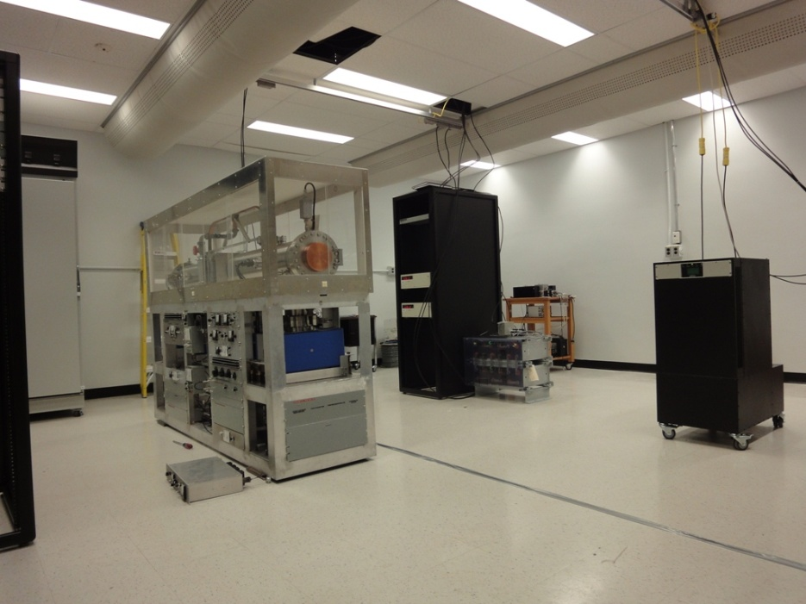
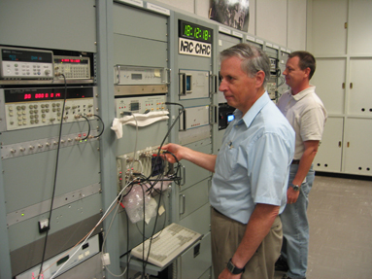
Facilities
Main Site:
Located on the main NRC campus in Ottawa
Houses the majority of our clocks, as well as our masers, clock intercomparison equipment,
and time dissemination equipment
Clock Room #1: CsVIa (left),
two 5071A clocks (back centre),
Symmetricom MHM-2010 maser (right)
Control room: Ray Pelletier and Bill Hoger and the
clock comparison and dissemination
equipment
Notes:
Our time activities take place at 2 sites.
Our main site is located on the main NRC campus in Ottawa.
This site houses the majority of our clocks and masers, our clock intercomparison equipment
and most of the equipment we use to disseminate time to the public.
The photo on the left shows one of our two new clock rooms.
These rooms typically achieve a temperature stability of ±0.1 C and a relative humidity
stability of ±2%
The photo at the right shows our main control room.

Slide 5
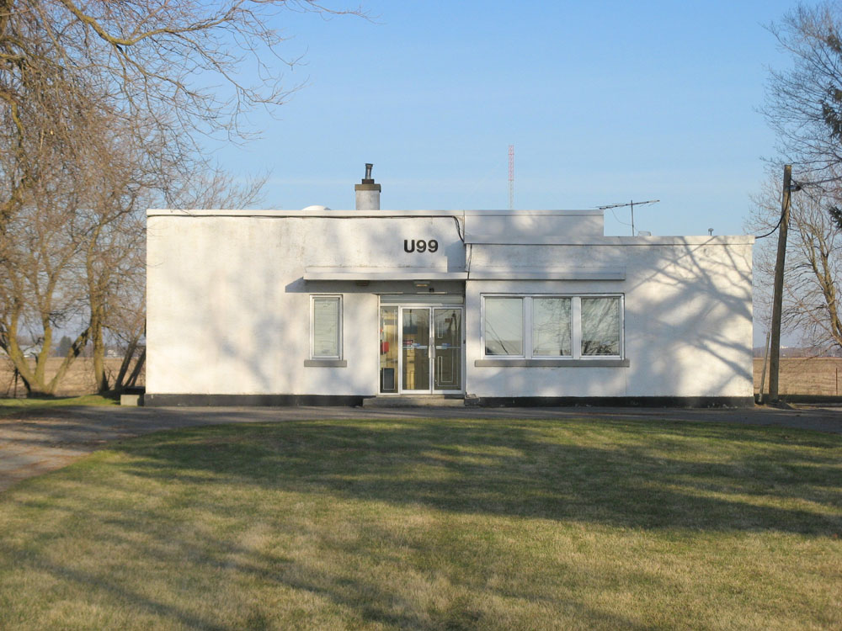
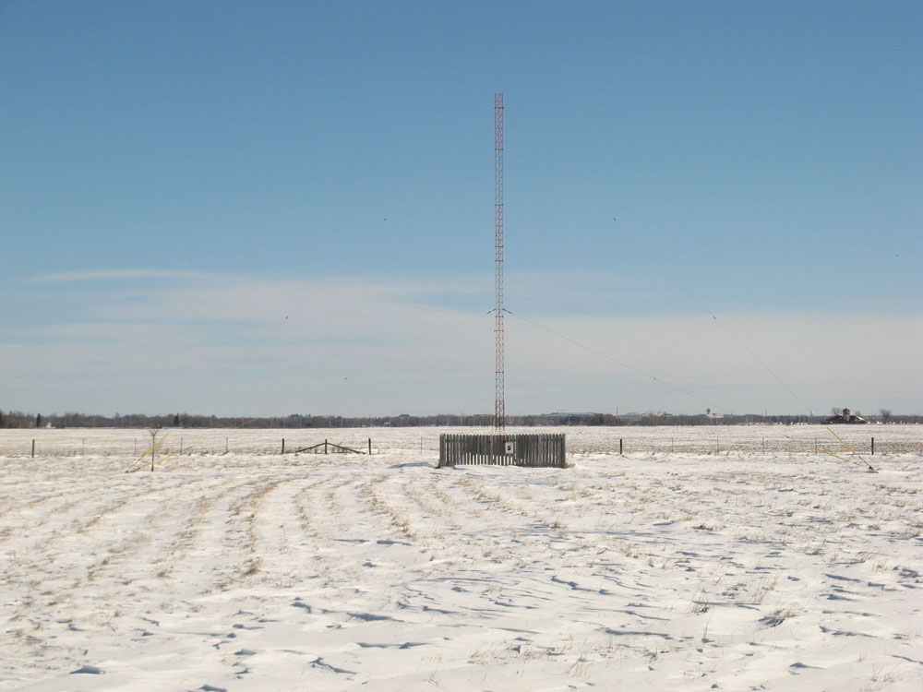
Facilities
CHU site:
Located approximately 20 km from our main site
Acts as a backup site
Keeps an independent timescale
Broadcasts the time of day and computer code to listeners around the world on three
shortwave frequencies (3330, 7850, and 14 670 kHz )
Serves as an independent source of Network Time Protocol (NTP)
Notes:
Our second site is located at our shortwave station CHU.
This station broadcasts the time of day and computer code 24 hours/day on
three shortwave frequencies.
This site acts as a backup to the main site and keeps an independent timescale.
It also serves as an independent source of Network Time Protocol time.

Slide 6
Clocks and Masers
Main Site:
6 HP/Symmetricom 5071A (high performance) caesium clocks
(Currently operating 4)
One of these clocks serves as UTC(NRC)
2 NRC-built caesium beam clocks (CsVIa and CsVIc) (1970’s)
Both CsVI clocks are currently undergoing repair
4 Active Hydrogen masers
2 NRC-built: H4 and H3 (under repair) (1991)
1 Kvarz CH1-75A (2004)
1 Symmetricom MHM-2010 (2012)
CHU Site:
1 HP/Symmetricom 5071A (normal performance) caesium clock
2 rubidium clocks
Notes:
At our main site, we have 6 5071A high-performance caesium clocks. Currently, we are operating 4.
We also operate two NRC-built caesium beam clocks, Caesium-6 A and C.
These clocks were completed in the 1970’s and served as primary frequency standards.
They are both being refurbished.
We also have two NRC-built hydrogen masers which became operational in about 1991 as well as two
commercial masers from Kvarz and Symmetricom, purchased in 2004 and 2012, respectively.
At CHU we operate one normal-performance 5071A clock and two rubidium clocks.

Slide 7
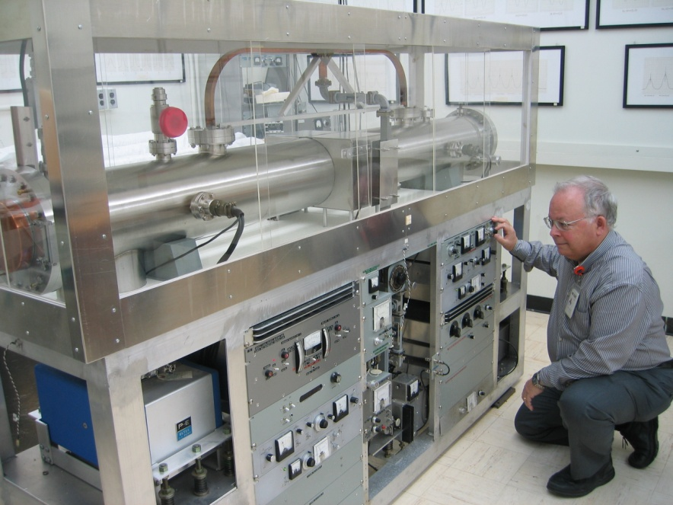
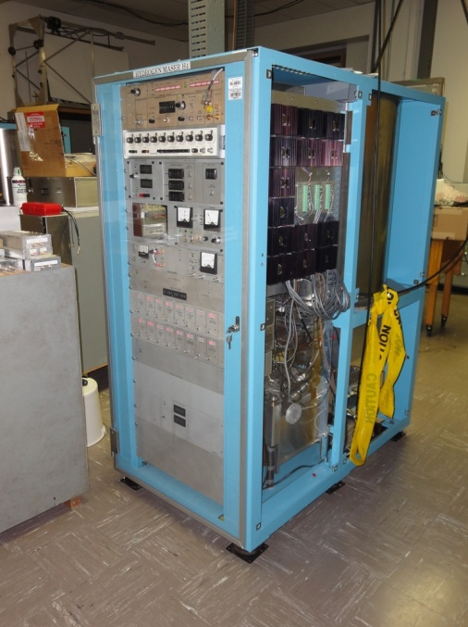
Clocks and Masers
Rob Douglas with one of the CsVI caesium
beam clocks (1970’s)
Hydrogen maser H4 (1991)
Notes:
The photo on the left shows one of the Caesium-6 clocks.
The photo on the right shows maser H4. This maser currently serves
as the reference for our GPS receivers and our phase measurement
system.

Slide 8
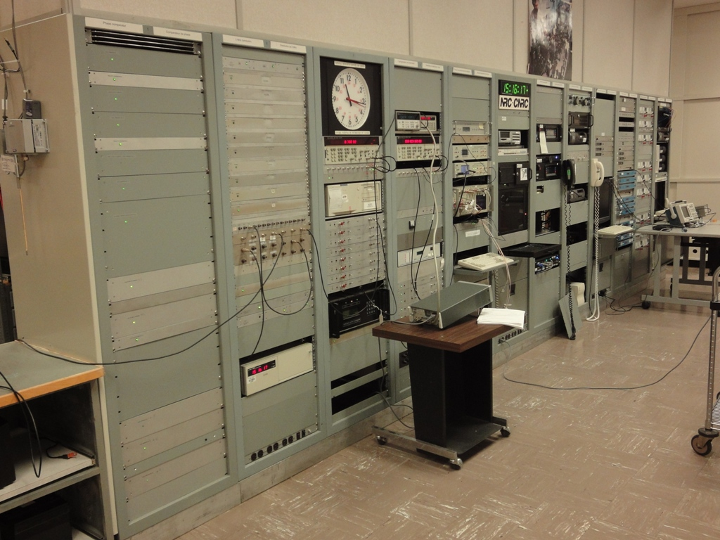
Clock Intercomparison Systems
Main Site:
NRC-built 5-MHz and TimeTech 80 MHz
phase comparison systems
Clocks and masers are compared against
maser H4
Readings are recorded every second
NRC-built 1-PPS intercomparison systems
Clocks and masers are compared
against UTC(NRC) using HP 5370B Time Interval Counter
2 independent systems for redundancy
Readings are recorded every hour
GPS systems (w/o SIM)
Ashtech, Topcon, Novatel (total 3 antennas, 4 Rx)
PPP and P3 inter comparisons
H4 as a reference
CHU Site:
NRC-built 1-PPS intercomparison system
Rubidium clocks and GPStime are
compared against the 5071A clock
GPS systems
Novatel (total 2 Rx)
5071 as a reference
Clock comparison and dissemination equipment:
The first two racks contain the distribution and phase
comparison equipment. The next two racks contain
the two 1-PPS systems.
Notes:
This photo shows our clock intercomparison and time dissemination equipment in
our main control room.
Clocks are inter-compared through an NRC-built 5-MHz phase comparison system and
a TimeTech 80-MHz system.
Readings are taken every second.
We also compare the 1-PPS outputs from the clocks in two time interval systems.
Readings are taken every hour.
We operate several GPS receivers to intercompare our clocks to those around the world.
At CHU the clocks are inter-compared through an NRC-built 1-PPS system.
CHU has 2 GPS receivers for redundancy.

Slide 9
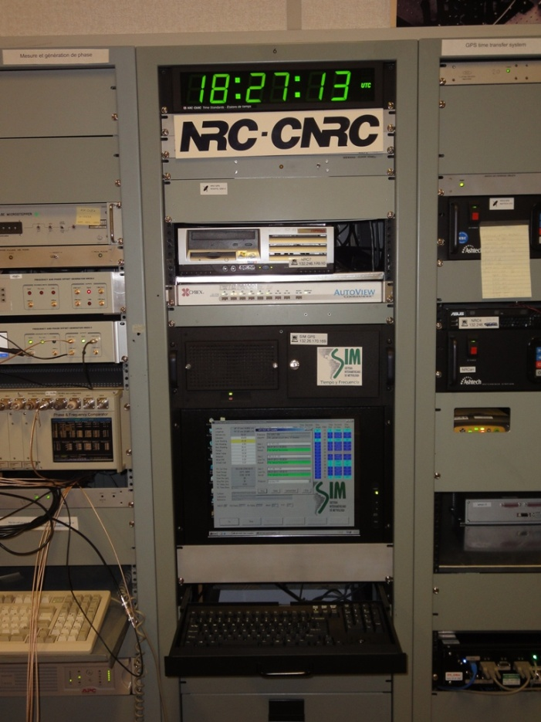
GPS Receivers
GPS receivers are used for comparing our clocks
to those around the world and for providing traceability
to the SI second.
We operate several GPS receivers at both sites for
redundancy.
Main Site (4 receivers):
Ashtech Z12 – Used for UTC
Topcon Net-G3A
Novatel OEM-5 and OEM-4
Maser H4 is the common reference
CHU Site (2 receivers):
Novatel OEM-5 and OEM-4
HP/Symmetricom 5071A is the reference
SIM Time Network Receiver:
Located at our main site
Reference is UTC(NRC) (plus cable and receiver delays)
NRC hosts one of the SIM time servers along with CENAM and NIST
The SIM time network receiver.
Notes:
GPS receivers are used for comparing our clocks to those around the world and for providing
traceability to the SI second.
We operate several GPS receivers at both sites for redundancy.
Our main receiver is an Ashtech Z12 timing receiver. It is used for our reports to the BIPM. The other receivers are used for backup.
At CHU, we operate two Novatel receivers.
The SIM Time Network receiver is located in our main control room. Its reference is
UTC(NRC).

Slide 10
Time Dissemination Services
Services in 2010
Network Time Protocol (NTP):
CHU 1.1 billion
Main Site 11.1 billion
Talking clock (telephone):
English 383 179
French 61 035
Bilingual 1 156
CBC/Radio Canada time signal:
430,000 listeners per day (2007)
Web clock:
Java English 173 236
Java French 41 406
Static English 156 542
Static French 262 467
Computer time (telephone):
Newhall code 32
Leitch code 41 387
CHU:
Unknown users until something goes wrong
Calibrated 5 or 10-MHz reference signal
Traceability for the metre (optical frequency)
Traceability for the volt
Watt balance
Notes:
This slide lists our time dissemination services and the number of requests
for time in 2010.
Probably our most popular service is Network Time Protocol or NTP.
We also operate a telephone talking clock service where people can call
by telephone for the time of day.
Canada’s national broadcaster, CBC/Radio Canada, carries our time signal at noon
and 1 PM Eastern on their French and English networks. This service is probably
our greatest source of publicity.
We also operate a web clock and a computer time code service.
We distribute calibrated 5 and 10 MHz signals throughout our building for standards work.

Slide 11
Optical Frequency Standards
Notes:
I will now move on to our activities in Optical Frequency Standards

Slide 12
Facilities
Laser Standards:
3 I₂/HeNe standards at 633 nm
CMC uncertainty ±10 kHz or 2x10⁻¹¹
2 C₂H₂ stabilized laser systems at 1510 to 1550 nm
CMC uncertainty ± 10 kHz or 4x10⁻¹¹
Single strontium ion standard at 674 nm
Uncertainty 3 Hz or 7x10⁻¹⁵
Optical frequency comb
Ti:sapphire based comb for calibrations from 530-1200 nm and 1530-1560 nm
CMC uncertainty of 3x10⁻¹⁴
Notes:
In Optical Frequency Standards, we provide calibration services in support of length measurement.
An ensemble of 3 iodine-stabilized HeNe lasers are used for calibrations at the popular wavelength
of 633 nm.
We also provide calibrations of acetylene-stabilized lasers in the optical telecommunication region
through two homebuilt laser systems.
NRC is one of the few labs in the world to offer comb-based calibrations for lasers in much of the
visible and near-infrared regions as well as for optical telecommunication wavelengths.

Slide 13
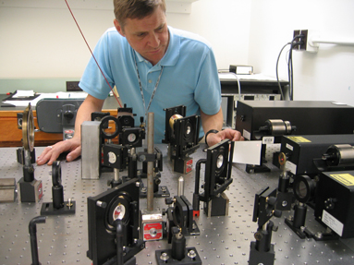
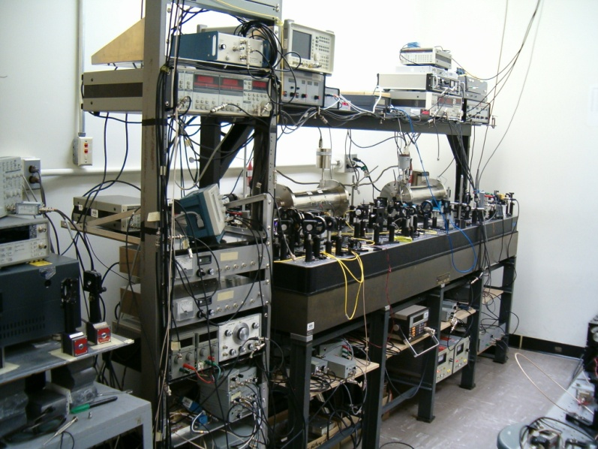
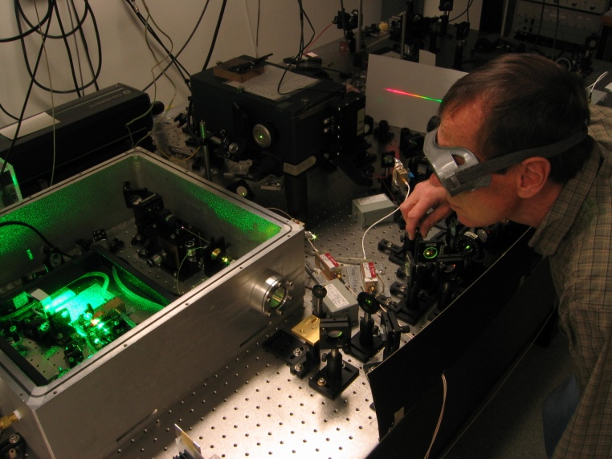
Laser Standards and the Optical Frequency Comb
Alan Madej with the I₂/HeNe lasers
Acetylene-stabilized laser systems
John Bernard with the Ti:sapphire optical frequency comb
Notes:
These photos show the ensemble of HeNe lasers, the acetylene-stabilized laser systems,
and the Ti:sapphire optical frequency comb.

Slide 14
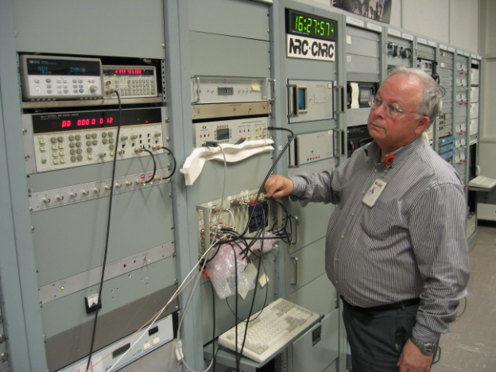

Calibration Services
Time Standards
Counters, Timers and Synthesizers
A33-07-02-01
Crystals, Rb, Cs, and H-masers
A33-07-02-02 to 06
A33-07-03-01 to 03
Authenticated NTP
A33-07-06-01 to 03
Optical Frequency Standards
Optical Telecom Lasers (1511-1552 nm)
A33-07-05-00
HeNe and I₂/HeNe Lasers (633 nm)
A33-07-05-01 and 02
Comb-based calibrations (530-1200 nm
and 1530-1560 nm)
A33-07-05-03
Calibrations of clocks and masers
Calibrations of HeNe lasers at
633 nm
Calibrations of visible and IR lasers
via the comb technique
Notes:
This slide lists our calibration services in both Time Standards and
Optical Frequency Standards.
Most of our services are covered by Calibration and Measurement
Capabilities as listed in Appendix C of the Key Comparison Database.

Slide 15
Key Comparisons
Time Standards
CCTF-K001.UTC (Calculation of the reference time scale
UTC (Coordinated Universal Time) ) - ongoing
SIM Regional intercomparison (stopwatch) - September 2010
Optical Frequency Standards
Node laboratory for SIM for CCL-K11 (Comparison of
optical frequency and wavelength standards)
Hosted Argentina (INTI), Brazil (INMETRO),
and Mexico (CENAM) in September 2009
Hosted USA (NIST) in August 2012
Notes:
NRC participates in a number of key comparisons.
We participate in the ongoing K001.UTC key comparison for the
calculation of UTC.
We also participated in the SIM regional intercomparison for
stopwatch calibrations.
In Optical Frequency Standards, NRC serves as the node laboratory
for the SIM region for the comparison of optical frequency and
wavelength standards. This key comparison uses our optical
frequency comb.

Slide 16
Research Projects
Time Standards
Development of a Cs-fountain primary frequency standard
Refurbishment of the NRC-built CsVI clocks and masers
Development of a 100-MHz phase comparison system
Optical Frequency Standards
Development of an optical frequency standard or optical clock based on a single trapped and laser-cooled strontium-88 ion
Development of a fibre-based optical frequency comb to serve as an optical clockwork
Notes:
We try to devote as much time as possible to several research projects which
I have listed here.
The largest effort probably has gone into the development of a caesium fountain clock
and the development of an optical frequency standard based on a single trapped
and laser cooled ion.

Slide 17
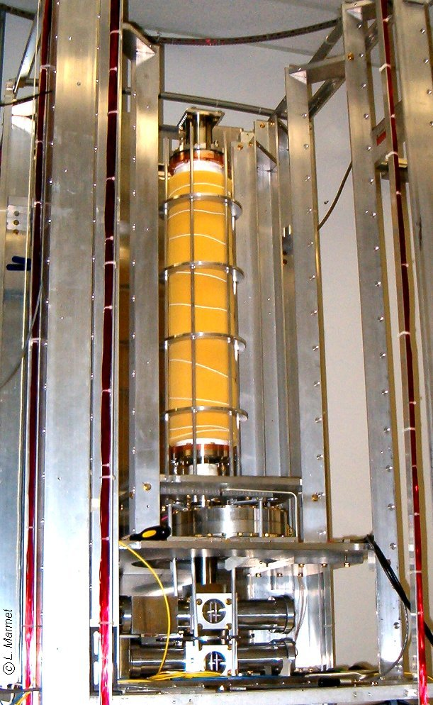
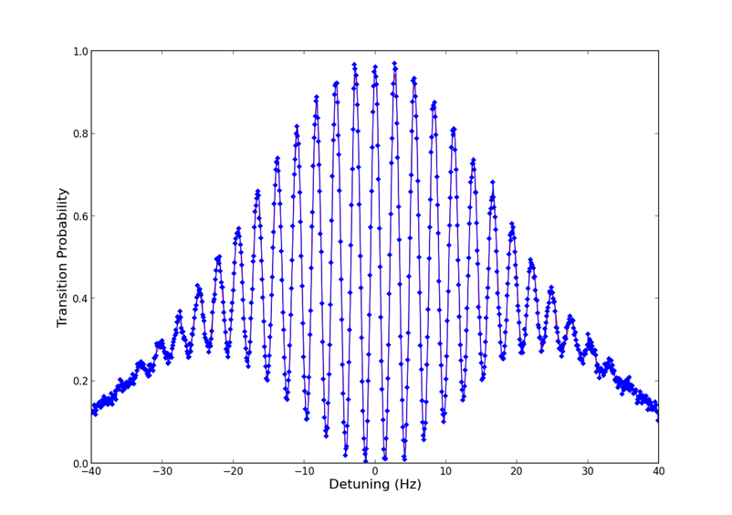
Caesium Fountain Clock
Purpose
To serve as a primary frequency standard
To contribute to the steering of TAI
Features
Transverse C-field
Rectangular Ramsey cavity
Plan to report an evaluation within a year
Caesium fountain during assembly. The drift tube is at the top along with the rods for the transverse C-field. Detection optics are at the bottom.
Ramsey spectrum. One measurement per point.
Notes:
The caesium fountain clock will serve as a primary frequency standard
and will contribute to the steering of TAI.
It has several unique features including a transverse C-field and a
rectangular Ramsey cavity.
The photo on the right shows the fountain under construction.
The drift tube is at the top along with the rods for the transverse
C-field. The detection optics are at the bottom. The MOT is off the
bottom of the photo.
On the left is a recent Ramsey spectrum.

Slide 18
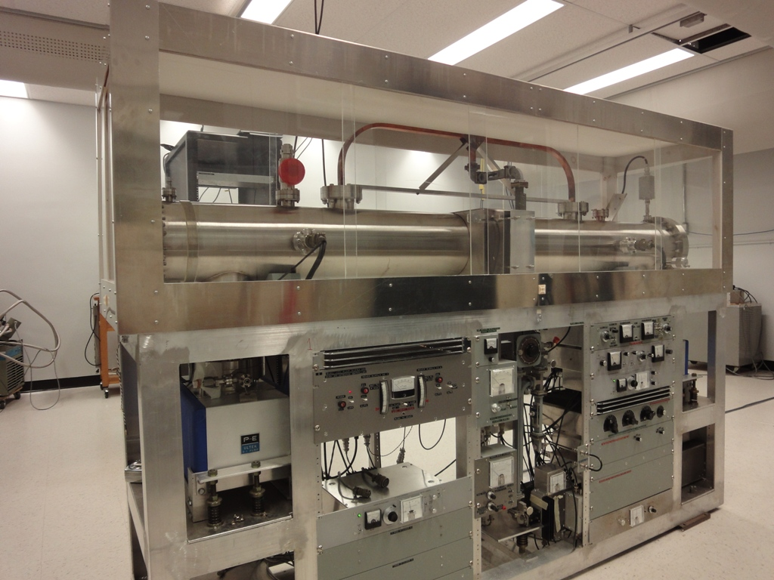
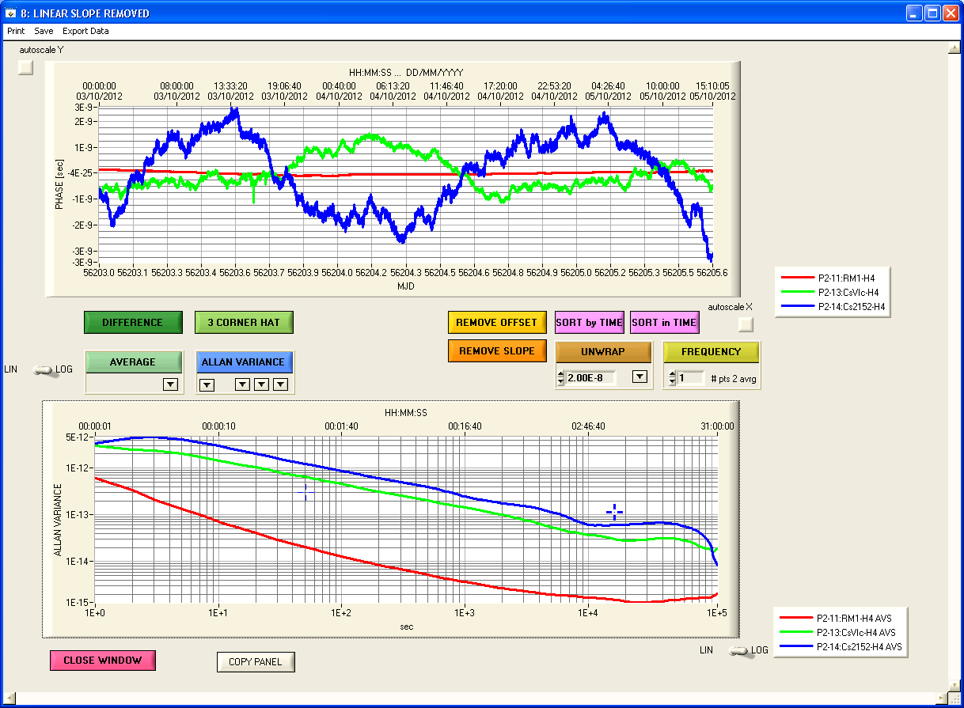
Refurbishment of the NRC-built CsVI clocks
CsVIa and CsVIc were built in the 1970’s and served as primary frequency standards
Improvements:
Digital servo for locking to the central Ramsey fringe
New detector bias control unit
Improvements to the 9.192 GHz synthesizer
Improvements to the S/N of the hot-wire electrometer
5071A
Maser
CsVIc
Notes:
Currently, we are refurbishing the two caesium beam clocks
that were built in the 1970’s with the aim of turning off several
of the 5071A commercial clocks.
Work is progressing well. CsVIc now shows a short-term
stability superior to that of a commercial clock.

Slide 19
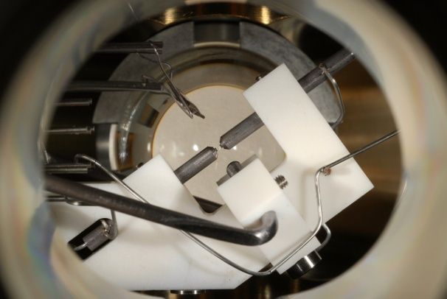
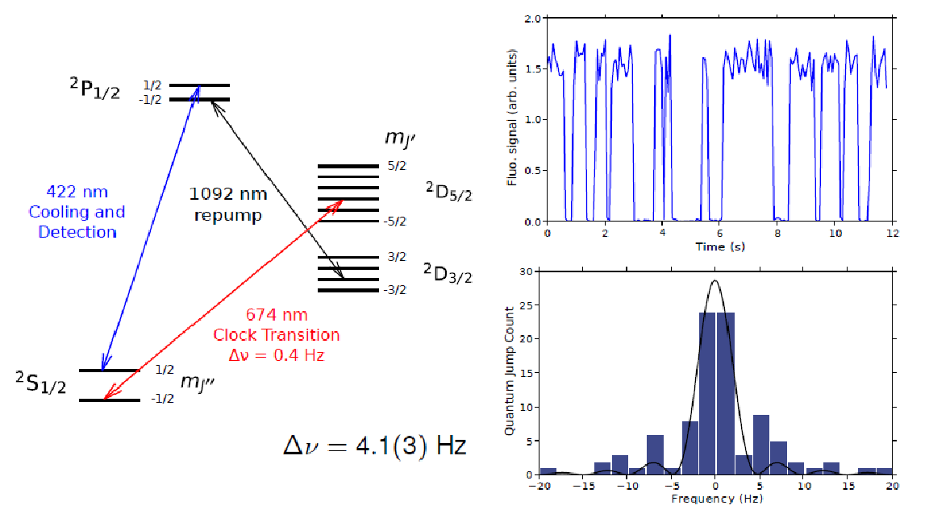
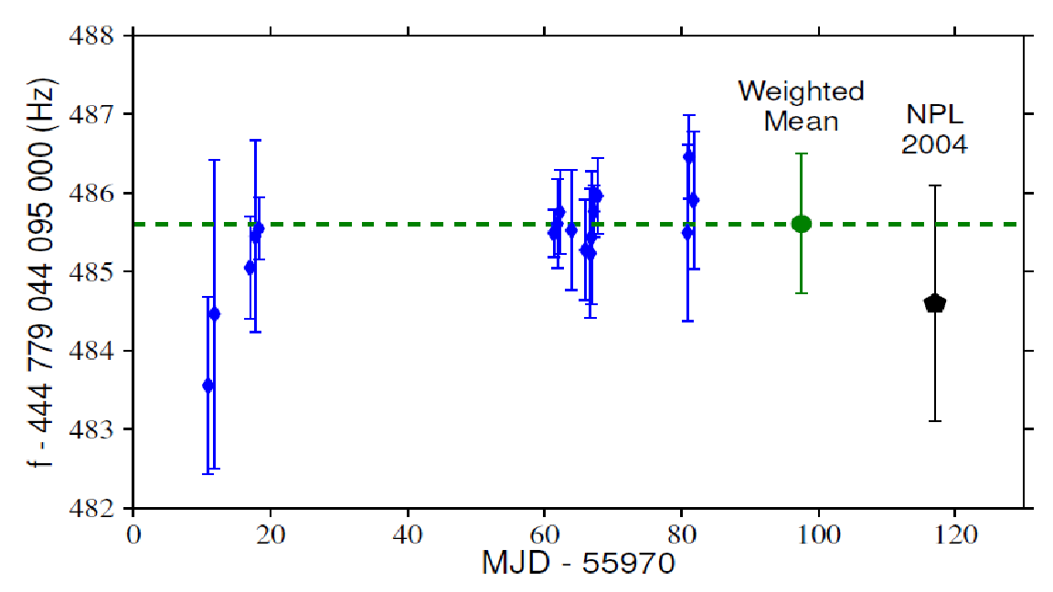
Single ⁸⁸Sr⁺ ion optical frequency standard at 474 THz (674 nm)
Single ion is held in an end-cap trap and probed by three lasers
The “Clock” transition is probed by an ultra-stable laser with a linewidth of under 4 Hz.
The clock transition frequency has been measured with a fibre-based comb
Evaluated uncertainty less than 1x10⁻¹⁶
f_{S-D} = 444 779 044 095 485.5 ± 0.9 Hz
(recognized as a secondary realization of the
SI second)
Notes:
For a number of years, we have had a project to develop an optical frequency
standard at 674nm or 445 THz, based on a single, trapped and laser-cooled
strontium-88 ion.
The ion is held in an electro-dynamic trap under ultra-high vacuum conditions.
It is interrogated by three lasers including an ultra-stable laser with a linewidth
of less than 4 Hz.
This laser is locked to the so-called “clock” transition at 674 nm and its frequency
is measured simultaneously with a fibre-based optical frequency comb.
The results of a recent series of measurements over a period of several months
is shown in blue on this graph. The current uncertainty is 2 parts in 10¹⁵.
We are working towards improving the long-term performance of this standard
and turning it into an optical clock.

Slide 20
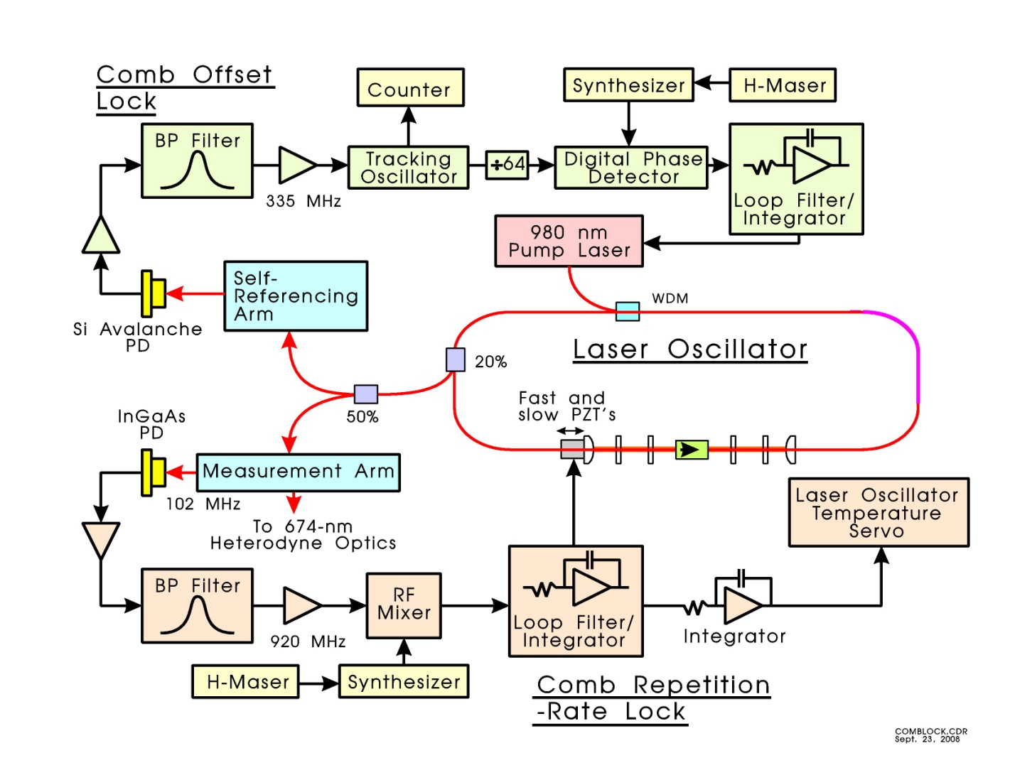
Fibre-based Optical Frequency Comb
Up to now the fibre-comb has been used to measure the ⁸⁸Sr⁺ ion “clock” transition frequency with respect to the SI second.
We are developing a fibre-comb with a pulse repetition frequency of 100 MHz which will be locked to the ⁸⁸Sr⁺ clock transition at 445 THz.
Purpose:
Ultra-stable source of 100 MHz for the evaluation of clocks and masers
Single-ion clock will contribute to the stability of TAI
Notes:
My final slide shows the fibre-based optical frequency comb that we used
to measure the clock frequency of the single-ion standard.
We are currently developing a new oscillator for this comb which will be locked
to the clock transition and provide an ultra-stable output at 100-MHz.
This 100-MHz signal should have a stability superior to a signal from
a maser and can be used to evaluate the performance of masers and
clocks.
A longer term objective is to use this comb along with the single-ion
standard to produce an optical clock which will be reported to the
BIPM as a secondary realization of the SI second and that can be used
to monitor the stability of TAI.

