Slide 1
Overview of All SEER-Medicare Publications Through 2012
Mark D. Danese, MHS, PhD
July 24, 2012

Slide 2
Overview
Information was extracted from the National Cancer Institute (NCI) online reference database for “SEER Medicare” publications
http://healthservices.cancer.gov/seermedicare/overview/pubsearch.html
Data accessed May 15, 2012- articles published in 2012 may be underrepresented due to reporting lag.
714 citations retrieved
NCI classified all publications according to the following:
14 topic areas (e.g., economics of cancer, outcomes, etc.)
19 tumor types (e.g., breast, prostate, etc.)
Summary measures were calculated by year, tumor site, topic area, and author
Exploratory analyses were conducted to assess publication frequency relative to cancer incidence, prevalence, and deaths

Slide 3
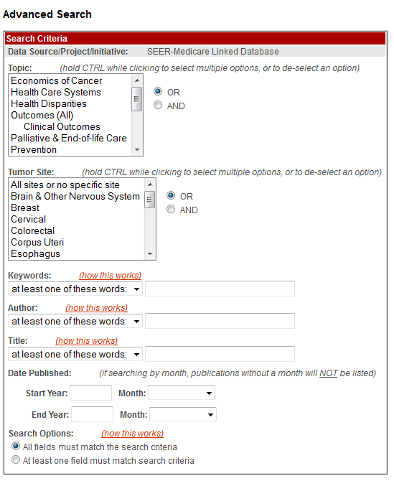
SEER-Medicare Publications Search
Topic:
Economics of Cancer
Health Care Systems
Health Disparities
Outcomes (All)
Clinical Outcomes
Palliative & End-of-Life Care
Prevention
Quality of Care
Research Methodology
Risk Factors
Screening
Surveillance
Survivorship
Treatment
Tumor Site:
All sites or no specific site
Brain & CNS
Breast
Cervical
Colorectal
Corpus Uteri
Esophagus
Gastric
Head and Neck
Leukemia
Liver
Lung
Lymphoma
Ovary
Pancreas
Prostate
Renal
Urinary Bladder
Other

Slide 4
By Tumor Site, Year, and Topic area
Summary of Publications

Slide 5
Publications by Tumor Site (All Years)

Slide 6
Publications by Tumor Site (2006-2012)

Slide 7
Publications by Year (1993-2012)
*2012 publications through May 15 are under-counted due to reporting lags

Slide 8
Publications by Top 4 Tumor Sites and Year

Slide 9
Publications by Topic Area (All Years)

Slide 10
Publications by Topic Area (2006-2012)

Slide 11
Publications Relative to Population Size
Exploratory Analyses

Slide 12
Methodology
Publication counts were plotted against tumor type
Counts of incident and prevalent patients, as well as deaths from cancer, were taken from SEER estimates (see Appendix for references)
Ratios of publications to these patient counts were estimated
Publications divided by incidence (per 10,000 patients)
Publications divided by prevalence (per 100,000 patients)
Publications divided by deaths (per 1,000 deaths)*
Higher numbers reflect more publications per patient
The median publication ratio across all tumors was used as an index for establishing high versus low ratios
(*Note that the deaths were divided by 10,000 for creating the figure.)

Slide 13
Publications Relative to Incidence, Prevalence, and Deaths

Slide 14
Publications per Patient According to Incidence, Prevalence, and Death
 | Breast | Colorectal | Prostate | Lung | Urinary Bladder | Pancreas | Ovary | Head & Neck | Lymphoma | Liver | Esophagus | Renal | Gastric | Leukemia | Corpus Uteri | Cervical | Brain & CNS
Total Publications | 194 | 167 | 151 | 81 | 32 | 30 | 28 | 24 | 22 | 18 | 17 | 16 | 12 | 11 | 8 | 7 | 6
% incident patients ≥ 65 years (2004-2009) | 41% | 61% | 59% | 68% | 72% | 67% | 46% | 44% | 50% | 45% | 60% | 49% | 63% | 53% | 41% | 19% | 35%
Pub/Incidence ratio (per 10,000) | 8.6 | 11.6 | 6.2 | 3.6 | 4.4 | 6.8 | 12.6 | 4.6 | 2.8 | 6.3 | 9.7 | 2.5 | 5.6 | 2.3 | 1.7 | 5.8 | 2.6
Pub/Prevalence ratio (per 100,000) | 7.1 | 14.6 | 6.0 | 20.9 | 5.8 | 78.3 | 15.3 | 6.8 | 3.3 | 50.6 | 53.4 | 5.0 | 17.1 | 4.0 | 1.4 | 2.8 | 4.4
Pub/Death ratio (per 1,000) | 4.9 | 3.2 | 5.4 | 0.5 | 2.2 | 0.8 | 1.8 | 2.1 | 1.1 | 0.9 | 1.1 | 1.2 | 1.1 | 0.5 | 1.0 | 1.7 | 0.4
Notes: Higher numbers indicate more publications per patient. See next slide for comparisons to the median ratios.

Slide 15
Publication Ratios Standardized to the Median Ratio
 | Breast | Colorectal | Prostate | Lung | Urinary Bladder | Pancreas | Ovary | Head & Neck | Lymphoma | Liver | Esophagus | Renal | Gastric | Leukemia | Corpus Uteri | Cervical | Brain & CNS
Total Publications | 194 | 167 | 151 | 81 | 32 | 30 | 28 | 24 | 22 | 18 | 17 | 16 | 12 | 11 | 8 | 7 | 6
% incident patients ≥65 years (2004-2009) | 41% | 61% | 59% | 68% | 72% | 67% | 46% | 44% | 50% | 45% | 60% | 49% | 63% | 53% | 41% | 19% | 35%
Pub/Incidence ratio (per 10,000) | 1.5 | 2.1 | 1.1 | 0.6 | 0.8 | 1.2 | 2.2 | 0.8 | 0.5 | 1.1 | 1.7 | 0.4 | 1.0 | 0.4 | 0.3 | 1.0 | 0.5
Pub/Prevalence ratio (per 100,000) | 1.0 | 2.2 | 0.9 | 3.1 | 0.9 | 11.5 | 2.3 | 1.0 | 0.5 | 7.5 | 7.9 | 0.7 | 2.5 | 0.6 | 0.2 | 0.4 | 0.7
Pub/Death ratio (per 1,000) | 4.3 | 2.8 | 4.7 | 0.4 | 1.9 | 0.7 | 1.6 | 1.8 | 1.0 | 0.8 | 1.0 | 1.0 | 1.0 | 0.4 | 0.9 | 0.9 | 0.4
Notes: Ratios reflect the tumor-specific publication ratio relative to median publication ratio (see previous slide for non-standardized ratios). Values above 1.0 indicate ratios higher than the median, and values below 1.0 indicate ratios below the median (shaded orange).

Slide 16
Conclusions
There has been steady growth in the number of publications over time using the SEER-Medicare data
Breast, colorectal, prostate, and lung are the tumor sites with the highest number of publications
This corresponds well with estimates of incidence and prevalence in the United States population
The number of publications appears to align better with incidence and prevalence than with death, particularly for more common cancers
Leukemia, lymphoma, lung, and renal might be under-represented in terms of the absolute number of publications

Slide 17
Additional results and Information
Appendix

Slide 18
Journal
Summary of Publications

Slide 19
Publications by Journal (All Years)

Slide 20
Publications by Journal (2006-2012)

Slide 21
Authors (Any position)
Summary of Publications

Slide 22
Publications by Journal (2006-2012)

Slide 23
Publications by Author (2006-2012)

Slide 24
Data Sources
Incidence (2012), Deaths (2012) and Prevalence (2009)
http://seer.cancer.gov/statfacts/index.html
Howlader N, Noone AM, Krapcho M, Neyman N, Aminou R, Altekruse SF, Kosary CL, Ruhl J, Tatalovich Z, Cho H, Mariotto A, Eisner MP, Lewis DR, Chen HS, Feuer EJ, Cronin KA (eds).SEER Cancer Statistics Review, 1975-2009 (Vintage 2009 Populations), National Cancer Institute. Bethesda, MD, http://seer.cancer.gov/csr/1975_2009_pops09/, based on November 2011 SEER data submission, posted to the SEER web site, 2012.
Proportion of patients age ≥65 at diagnosis
Surveillance, Epidemiology, and End Results (SEER) Program (www.seer.cancer.gov) SEER*Stat Database: Incidence - SEER 18 Regs Research Data + Hurricane Katrina Impacted Louisiana Cases, Nov 2011 Sub, Vintage 2009 Pops (2000-2009) <Katrina/Rita Population Adjustment> - Linked To County Attributes - Total U.S., 1969-2010 Counties, National Cancer Institute, DCCPS, Surveillance Research Program, Surveillance Systems Branch, released April 2012, based on the November 2011 submission.
Year of diagnosis = 2004-2009
All Site and Morphology classifications were aligned among all data sources with the exception of Head & Neck
Head & Neck was defined using two readily available categories: Larynx + Oral Cavity and Pharynx

Slide 25
Acknowledgements
Thanks to Jennifer Duryea for the SEER*Stat analyses and to Marc Halperin for extracting the data from the NCI website

Slide 26
Contact Information
Mark D. Danese
340 N. Westlake Blvd, Suite 200, Westlake Village, CA 91362
805-498-0034
mark@outins.com
www.outins.com

