Slide 1
Bill Healy & Tania Ullah Energy and Environment Division National Institute of Standards and Technology Science Afternoon at NIST December 14, 2011
Net-Zero Energy
Buildings & Solar Energy

Slide 2
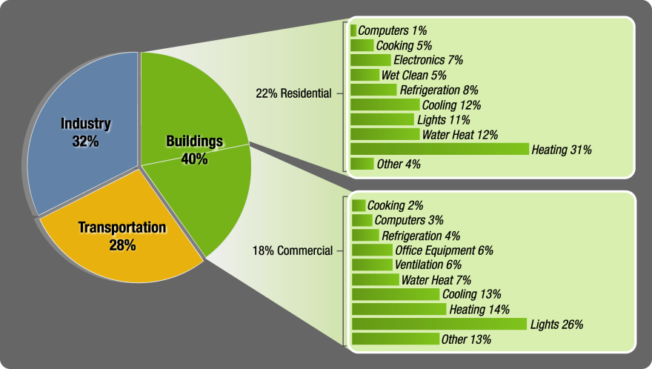

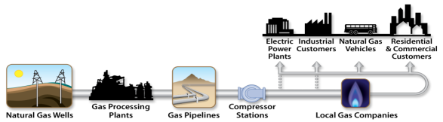
Why Buildings’ Energy Use Is Important
The combined residential and commercial buildings sector is the largest energy consumer in the U.S.
40% of U.S. Primary Energy Consumption
72% of U.S. Electricity
55% of U.S. Natural Gas
U.S. spends $515B/year in energy costs for operation and use of constructed facilities
Notes:
2
Note: 21% of the 55% of NG is used to produce electricity used by buildings.. (double counting)
When it comes to the U.S. energy economy, buildings matter. Together, residential and commercial buildings account for 40% of all energy use in the United States and consume more energy than either the industrial or transportation sectors, surpassing the industrial sector as the number one consuming sector in 1995.
Buildings account for 72 percent of U.S. electricity consumption, and 36 percent of natural gas consumption.
Without action, U.S. energy consumption is projected to grow about 25 percent over the next two decades, and buildings are expected to play a large part in that growth.

Slide 3

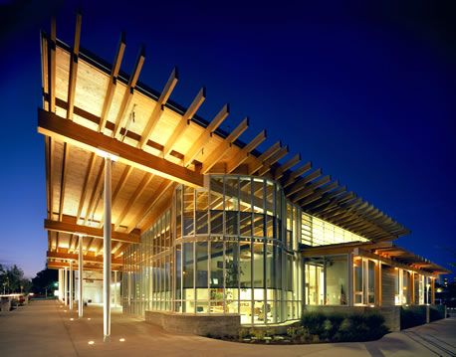

Fastest-Growing Energy Sector
Energy consumption by commercial buildings sector rose 71% between 1980 and 2010
Notes:
3
Mention the quantity of energy used – e.g., 40 quads.. And the magnitude of this number. A quad is a unit of energy equal to 10¹⁵ (a short-scale quadrillion) BTU . One quad = 25,200,000 Tonnes of oil or 293,071,000,000 Kilowatt-hours
Commercial energy consumption rose from just 14% of total US energy consumption in 1980 to 18% by 2005; a 70% increase. Continuation of this trend, and the overall growth of buildings energy consumption, in the face of present and projected energy supply difficulties and price pressures increases the imperative for concerted public and private action.

Slide 4
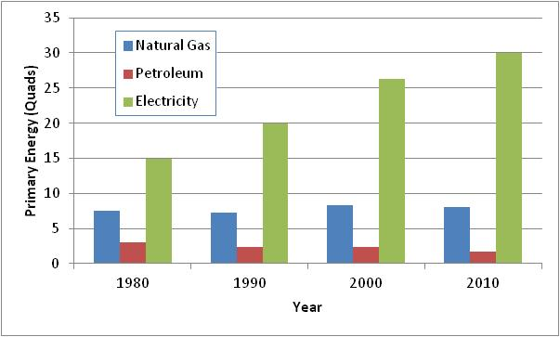
Electricity: A Dominant and Growing Source of Building Energy
Electricity increased from 56% of overall primary energy use in buildings in 1980 to 74% in 2010
Source: 2011 Buildings Energy Databook, Table 1.1.1
Buildings’ electricity demand is driving need for electricity infrastructure
Source: EIA Annual Energy Review, Table 8.9, October 2011
Notes:
4
4
Increasing electrification has been a central trend in the buildings sector, increasing from 56 percent of site energy use in 1980 to 74 percent in 2010. Direct natural gas use was essentially flat and declining as a percentage of site energy use over the same period.
Equally important to the fact that electricity is growing as a source of primary energy use is that it is already the dominant source. This is reflected in the graphs, and is referenced in the title.
Buildings petroleum energy use, primarily home heating oil in regional markets, declined from 11 percent of sector energy use in 1980 to 4 percent in 2010. In fact the number of oil heated homes and sector oil consumption has declined in absolute terms.
__________________________________________________________________________________________________________________
Electricity is the most versatile fuel form and also the most expensive per equivalent Btu. Electricity usage accounted for 65% of the energy costs in 2005. However, electricity prices declined in real terms during this period and as a result, expenditures for electricity did not rise as quickly as overall usage. Still, the electricity expenditures rose with increased demand from $144B in 1980 to $238B in 2005 as measured in constant 2005 dollars.
Natural gas is the second most used fuel in the buildings sector. Natural gas use was essentially flat from 1980 to 2010 and as such decreased as a percentage of total use from 28% in 1980 to just 20% by 201-. Still, expenditures rose significantly due to an over 60% increase in the price of natural gas driven largely by increased utility demand for electricity production.
Petroleum, mostly a home heating fuel, declined in both absolute and relative terms from 1980 to 2010. While petroleum represented 11% of total building energy use in 1980, the share dropped to just 4% by 2010 falling from just over 3 Quads to about 1.7 Quads by 2005. Total expenditures also fell significantly for petroleum, due to decreased usage, even though prices increased by 10% over this period.

Slide 5
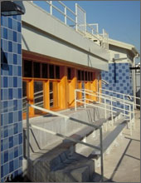

Net-Zero Energy Buildings
“A net-zero energy building produces as much energy as it uses over the course of a year” DOE
Net-Zero Site Energy
Net-Zero Source Energy
Net-Zero Energy Costs
Net-Zero Energy Emissions
Notes:
What can we do about it on the buildings side?
A unifying goal has been net-zero energy buildings, definition given by DOE. There are a number of ways to define it in more detail, site-basis, source-basis, etc. The details of the accounting are not important at this time, as the approach that is needed to achieve these is essentially the same.

Slide 6
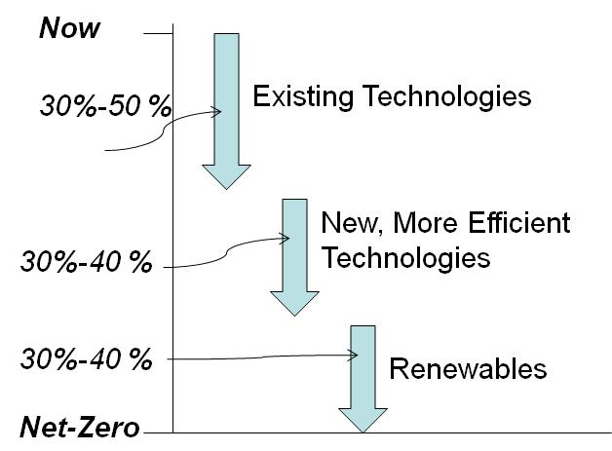
Getting to Net-Zero
Decrease the loads (need for space conditioning)
Install efficient equipment
Utilize renewables
Notes:
Getting to net-zero buildings is essentially a 3-step process.
It is generally thought that we can get from where we are now to about a 30-50% reduction in energy use through the implementation of existing technologies, e.g., better windows, better HVAC systems, better lighting, etc. It is believed that new, more efficient technologies can get us another 30-40% in energy reductions. To get to net-zero, about 30-40% will need to come from renewables.

Slide 7
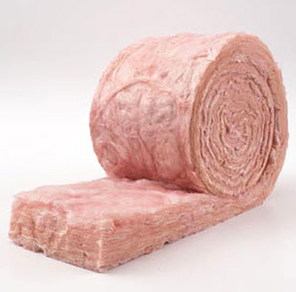
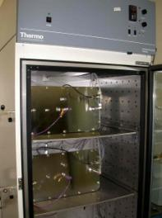
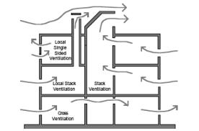
Load Reduction
Install more/better insulation in walls
Ensure walls are air tight
Minimize pollutant generation in homes to reduce need for ventilation
Ventilate efficiently

Slide 8
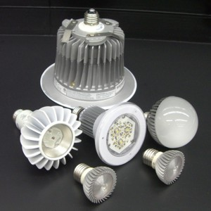
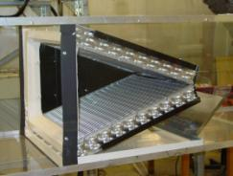
Efficient Equipment
For example,
Heat pumps and air conditioners
Lights
Example: Top slab receives up to 30% more air flow than the bottom slab

Slide 9
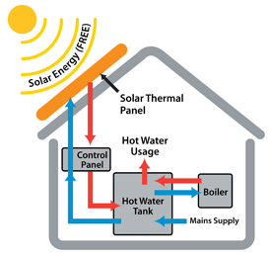
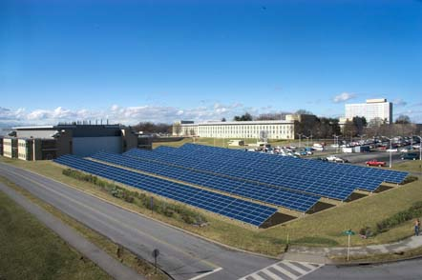
Renewables
Solar is the primary source at the building site
Solar Thermal
Photovoltaics

Slide 10
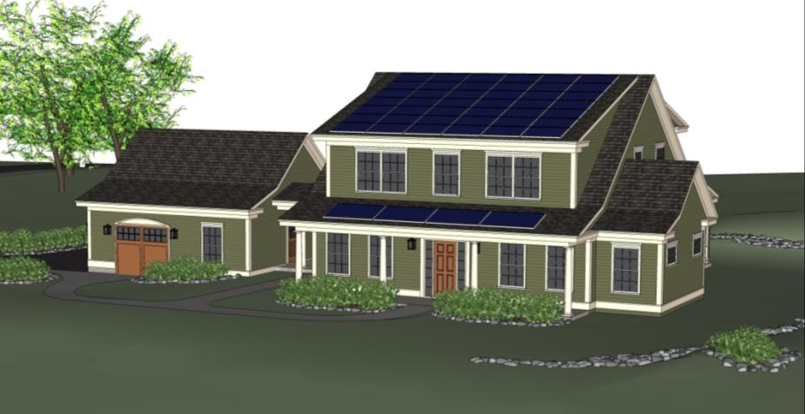
Net-Zero Energy, Residential Test Facility
Notes:
Let’s dive into the title of this talk, a discussion of a new facility that is being constructed on the NIST campus, the Net-Zero Energy, Residential Test Facility.
This image depicts what the facility will look like. It is supposed to look like a typical home that one might find in this area. For those that may have gone down to the Solar Decathlon a few weeks ago, you saw that some of the designs were a bit out of the ordinary from an architectural viewpoint. Residential homebuyers tend to be conservative in their aesthetic choices, so we felt that it was important to keep the home looking like a normal home. There is a main living area and a detached garage. The detached garage, while not uncommon in this area, is more of a practical consideration. We will install our monitoring equipment in there so as not to add an unusual heat load to the main living space.
Photovoltaics will fill the south facing upper roof, while a solar thermal system will be installed above the front porch.

Slide 11
Objectives
Demonstrate Net-Zero Energy for a home similar in nature to surrounding homes
Provide a test bed for in-situ measurements of various components and system
Provide “real world” field data to validate/improve models
Improve laboratory test procedures of systems/components to give results that are representative of field performance
Notes:
Demonstration stage will be the first year.
After that, it will turn into a test facility.

Slide 12
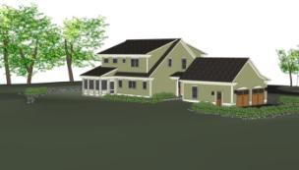

Project Overview
Climate: Mixed-Humid (4A)
Type: Single-Family
Stories: 2
Bedrooms: 4
Baths: 3
Floor Area: 2,709 sq. ft.
Basement Area: 1,518 sq. ft.
Smart Grid Ready
Electric Vehicle Ready
Family of Four Occupancy to be simulated
Showers
Appliances
Sensible and Latent Loads of People

Slide 13
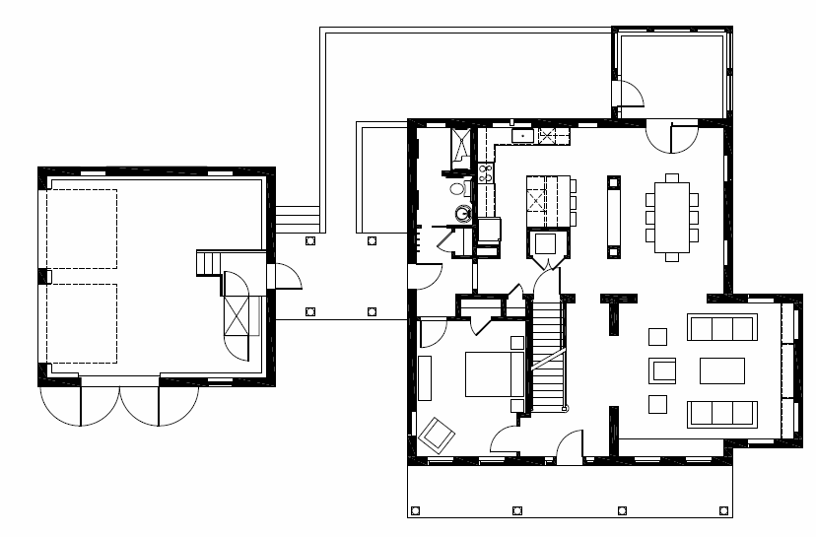
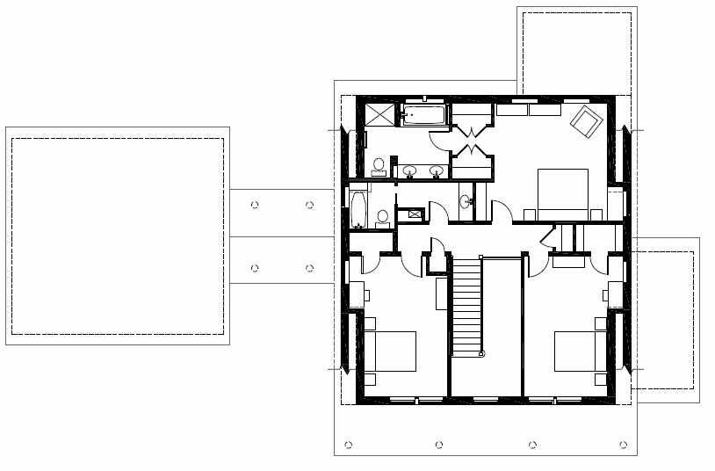
Floor Plan – First Floor
Floor Plan – Second Floor

Slide 14
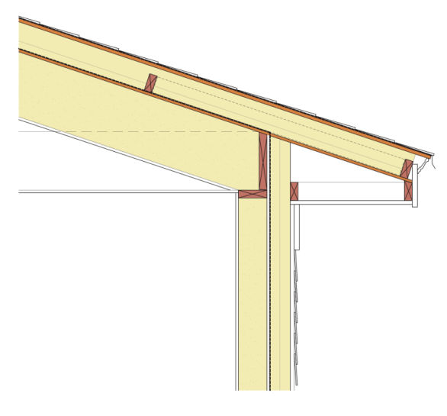
Enclosure Design
R-72 Roof Insulation
3 layers of polyisocyanurate insulation (1.5”, 2”, 1.5”)
Plywood sheathing ½ inch inner and 5/8 inch outer
11 7/8 netted blown cellulose
R-45 Walls
2x6 framing at 24” o.c. with advanced framing
Cellulose cavity insulation
Two layers of 2” foil-faced polyisocyanurate sheathing)
Windows
Double Pane with Suspended Film
Inert Gas Filled
Fully Insulated Frame
U = 0.19 or R-value of 5.3
Roof Assembly
Notes:
Code-compliant roof in this area is R-38
Code-compliant wall in this area is R-13
Code-compliant windows are R-2.9
Designed to minimize thermal shorts and to be extremely airtight.

Slide 15
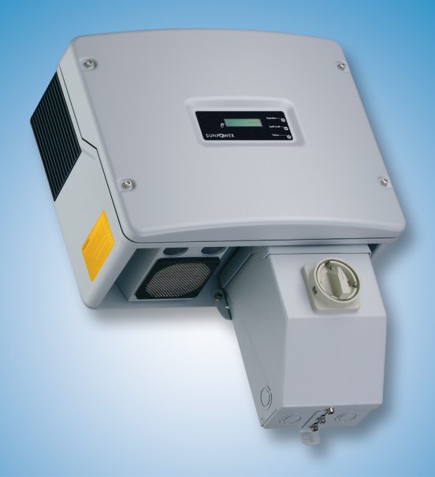

Solar Photovoltaic Array
Roof Mounted
South half of main roof
Max roof area for PV = 32’ x 19.5’ (624 ft²)
PV modules in same plane as roof
4:12 pitch (18.4 degrees)
Minimized shading: no chimney, vents, nearby trees, etc.
High efficiency PV modules
Potential for fitting 9.6 kW on roof
Likely 6 series strings (1.6 kW each)
Balance of System
Will use 2 DC-to-AC inverters
PV rack will position PV module a few inches above the shingled roof
No battery storage
Inverter Features: 93+% efficiency over most of loading range; Robust: 10-year warranty
Possible Module Option: 18.5% efficient module using mono-Si Back-contact cells
Notes:
PV aligned with roof, not optimized for this climate (latitude of 39 degrees)

Slide 16
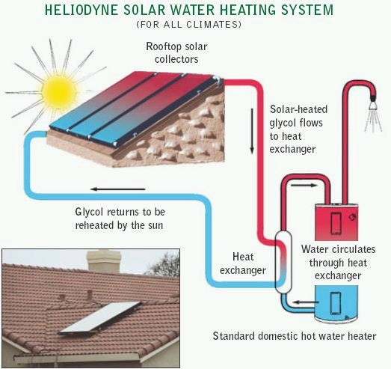

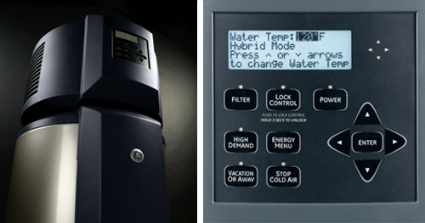
Water Heating System
Solar thermal preheat
80-gal tank, electric auxiliary heating
Active, indirect forced-circulation system for cool climates
Four solar thermal flat-plate collectors (dimensions 6’ x 4’) installed on porch roof
Capability to vary number of collectors included in circulation loop
OG-300 certified and ENEGY STAR® qualified
Control unit with Wi-Fi hub and stored energy data
Source: Solar Force Corporation
Heat pump water heater downstream
50-gal tank, electric auxiliary heating
Multiple operating modes: heat pump, hybrid and standard electric
ENEGY STAR® qualified
Energy Factor (EF) of 2.35 and consumes 62% less energy than standard electric WH
GE GeoSpring™ hybrid water heater
w/ digital control panel
Notes:
Remember that this is destined to be a test facility; we are not claiming that this configuration is best, but it will afford us opportunities in the future. Additionally, our first year will be all electric, so use of gas backup was not an option.

Slide 17
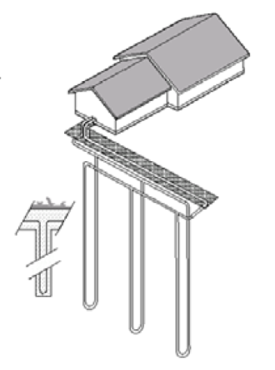

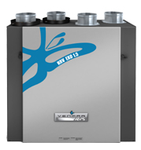
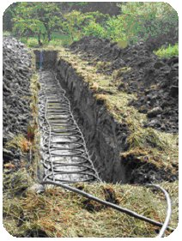
Heating, Cooling and Ventilation Systems
Facility is Configured to Accommodate Various Technologies
Advanced Air-to-Air Heat Pump Systems Suitable for Low Energy Homes
Geothermal Heat Pump Systems with Three Distinct Earth Coupled Fields
Combined Solar/Geothermal Heat Pump Systems
Multisplit heat pump with minimal duct system
Fully ducted Heat Recovery System
Multiple Zoning Capabilities
Floor
Perimeter
Individual Register
Three types of ground heat exchangers
HRV Air Exchanger
Notes:
Three different types of heating sytems. Three geothermal loops. Different distribution systems.
Different zoning capabilities.

Slide 18
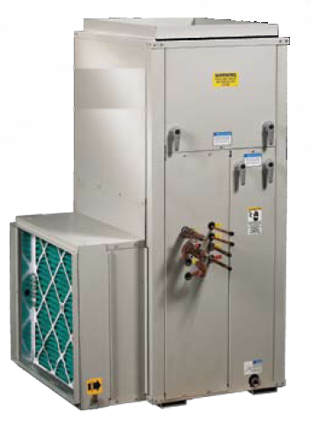
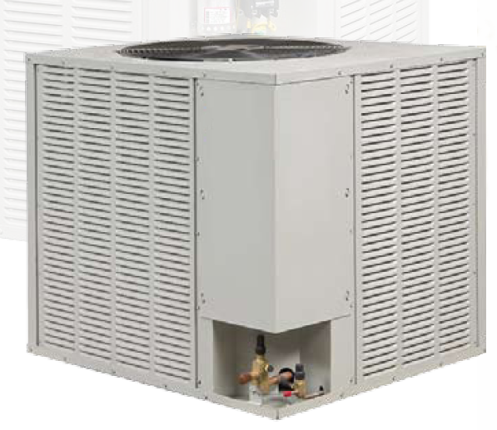
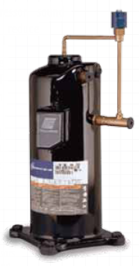
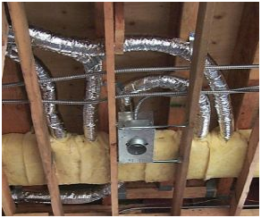
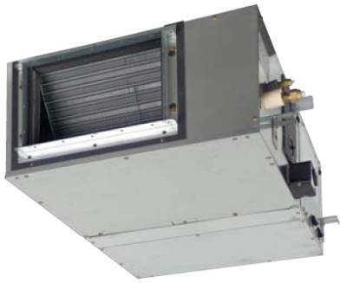
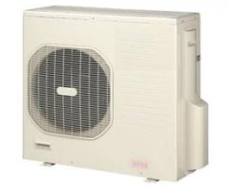
Advance air-source heat pump
Small duct, high velocity system
Multi-split heat pump
Variable-speed, dedicated dehumidifying heat pump system
Typical small duct, high velocity ducting
Two indoor unit multi-split
heat pump

Slide 19

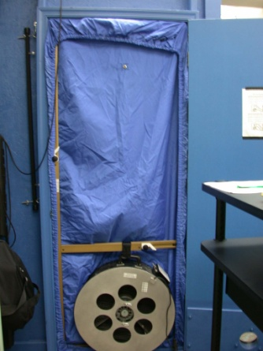
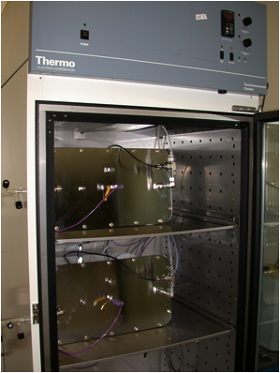
Ventilation and Indoor Air Quality
Ventilation specifications
Heat recovery ventilator compliant with ASHRAE Standard 62.2
Capable of increasing ventilation rate to study IAQ & energy impacts
High-efficiency, low sone whole house exhaust fan
Alt. 62.2 compliance path
62.2 compliant kitchen/toilet exhausts – humidity control
Envelope airtightness, 1 h⁻¹ at 50 Pa per ASTM E779
ASHRAE 62.2
Specifications on material emissions
Focused on formaldehyde and other VOCs
Specs by material type, e.g. adhesives & sealants, paints & coatings, floor coverings
Air tightness testing w/ blower door
Chamber testing of material emissions
Notes:
With these tight homes, we can no longer count on leaks through walls and windows to provide the outdoor air needed to maintain indoor air quality. We will impose a mechanical ventilation system, in which fans exhaust air continuously through heat exchangers that swap heat between the indoor air and outdoor air. “Build tight, ventilate right” Better than pulling air through dirty insulation or places that are not appropriate.

Slide 20
Electrical Design
Includes two distinct power systems :
"House power" = outlets, appliances, and lighting normally found in home
"Research power" = dedicated to research instrumentation, internal load simulation, and safety lighting
All circuits either "off", manual "on", or programmed "automatic"
House power
Passes through smart meter for house
Watt-metering of each circuit
Room lights programmable to simulate human occupancy
Provision for plug-in electric/hybrid vehicle
Research Power
Bypasses house metering, but circuits watt-metered individually
Available in each room and at garage workstations

Slide 21
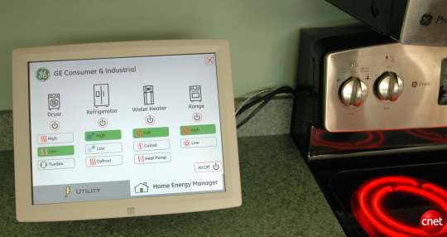
Appliance Research
Energy Reduction
Max Tech, Usage best practices
Peak load shifting
Clothes Dryer-Reducing # of energized heating elements
Refrigerator- delaying defrost cycle, ice-making events, changing set points
Dishwashers, delayed start
GE Home Energy Meter
Notes:
Appliance selections In order of impact on peak power requirements.
Refrigerator:
Requirement: Top mount refrigerator, as small as possible but must be adequate for a 3BR house, uses least amount of energy.
Suggested model: Whirlpool G9RXXFMWS, 19ft3, rated energy consumption of 343 kWh/yr
Link: http://www.whirlpool.com/catalog/product.jsp?src=REFRIGERATORS&cat=96&prod=1815
Dimensions Depth: 31 1/2 Inches Height: 66 1/2 Inches Width: 29 1/2 Inches
Dishwasher*:
Requirement: Most energy efficient unit accommodating 12 place settings and having soil sensing technology
Suggested model: Whirlpool GU2800XTVY, rated energy consumption of 299 kWh/yr, 4.18 gallons/cycle, EF=0.72
Link: http://www.whirlpool.com/catalog/product.jsp?parentCategoryId=74&categoryId=108&subCategoryId=109&productId=1328#tabs
Dimensions Depth: 24 7/8 Inches Height: 34 1/2 Inches Width: 23 7/8 Inches
Cooking appliances are not rated, therefore requirement is to match models of other appliances and conform to kitchen design layout.
Cook top:
Whirlpool GJC3055RS, 30” Ceramic glass cooktop
Link: http://www.whirlpool.com/catalog/product.jsp?src=COOKTOPS&cat=80&prod=1306
Dimensions Depth: 21 Inches Height: 2 7/8 Inches Width: 30 Inches
Range hood:
Whirlpool GZ9730XSS, 30” canopy hood, 370 CFM ventilation system
Link: http://www.whirlpool.com/catalog/product.jsp?src=HOODS+AND+VENTS&cat=86&prod=1344
Dimensions Depth: 19 11/16 Inches Height: 46 1/8 Inches Width: 30 Inches
Microwave**:
Whirlpool GH7208XRS, 2.0 ft3 built in combination microwave/convection oven.
Link: http://www.whirlpool.com/catalog/product.jsp?src=MICROWAVES&cat=90&prod=1298
Dimensions Depth: 18 1/8 Inches Height: 15 1/4 Inches Width: 29 7/8 Inches
Oven**:
Whirlpool GBS309PVS, 30” built in oven/convection oven
Link: http://www.whirlpool.com/catalog/product.jsp?src=BUILT-IN+OVENS&cat=83&prod=1285
Dimensions Depth: 26 Inches Height: 29 Inches Width: 29 3/4 Inches
*A few dishwashers were identified that are rated substantially better, however they are from different manufacturers. One example is the Bosch SHE68E05UC, which is rated at 180 kWh/yr and claims 1.57 gallons/cycle. This may be a better option for the dishwasher if emphasis is strictly on energy consumption, not matching the model series.
**The rationale for selecting the chosen pair of microwave and oven, both with convection, is to give the occupants the ability to bake in the smallest oven for each task which would ultimately use less energy.
Washer and Dryer
The washer and dryer combination will be kept separate from the kitchen appliances, therefore may be of different product families from the other appliances, but should match each other. It should be noted that dryers are not rated products, therefore comparative analysis was based on washer performance.
Requirement: CEE Tier III qualification, full size, minimal electronics (standby power concern), stackable
Option #1:
Whirlpool WFW9750 W* washer, rated 136 kWh/yr, MEF=2.63
Whirlpool WED9750W* matching dryer
Option #2:
Bosch WFVC8440UC washer, rated 130 kWh/yr, MEF=2.55
Bosch WTVC8330 dryer

Slide 22
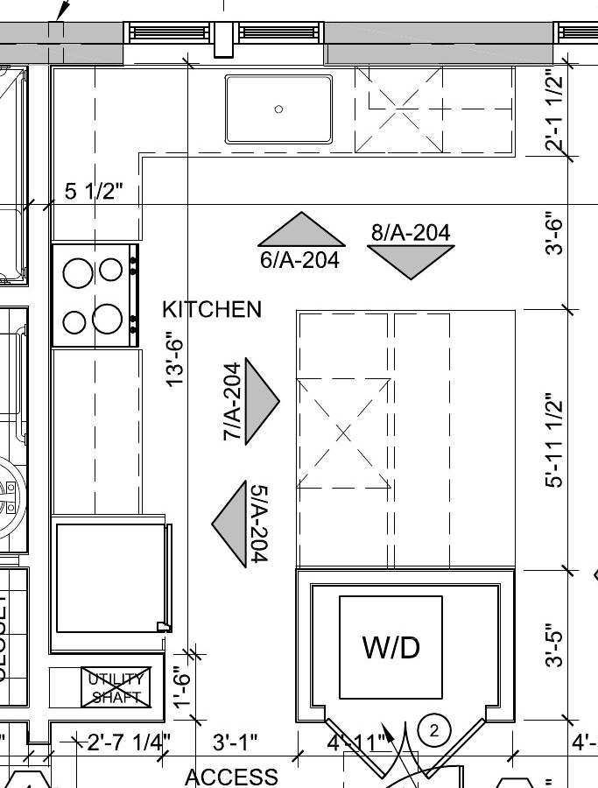
Residential Appliances
Heat Pump
Water Heater
Range/Oven
Clothes Washer/Dryer
Microwave Oven
Range Hood
Refrigerator
Dishwasher
Selection Criteria
Energy efficiency
Energy Star, CEE Tier rating
Low standby power consumption
Smart-Grid compatibility
W
Notes:
Appliance selections In order of impact on peak power requirements.
Refrigerator:
Requirement: Top mount refrigerator, as small as possible but must be adequate for a 3BR house, uses least amount of energy.
Suggested model: Whirlpool G9RXXFMWS, 19ft3, rated energy consumption of 343 kWh/yr
Link: http://www.whirlpool.com/catalog/product.jsp?src=REFRIGERATORS&cat=96&prod=1815
Dimensions Depth: 31 1/2 Inches Height: 66 1/2 Inches Width: 29 1/2 Inches
Dishwasher*:
Requirement: Most energy efficient unit accommodating 12 place settings and having soil sensing technology
Suggested model: Whirlpool GU2800XTVY, rated energy consumption of 299 kWh/yr, 4.18 gallons/cycle, EF=0.72
Link: http://www.whirlpool.com/catalog/product.jsp?parentCategoryId=74&categoryId=108&subCategoryId=109&productId=1328#tabs
Dimensions Depth: 24 7/8 Inches Height: 34 1/2 Inches Width: 23 7/8 Inches
Cooking appliances are not rated, therefore requirement is to match models of other appliances and conform to kitchen design layout.
Cook top:
Whirlpool GJC3055RS, 30” Ceramic glass cooktop
Link: http://www.whirlpool.com/catalog/product.jsp?src=COOKTOPS&cat=80&prod=1306
Dimensions Depth: 21 Inches Height: 2 7/8 Inches Width: 30 Inches
Range hood:
Whirlpool GZ9730XSS, 30” canopy hood, 370 CFM ventilation system
Link: http://www.whirlpool.com/catalog/product.jsp?src=HOODS+AND+VENTS&cat=86&prod=1344
Dimensions Depth: 19 11/16 Inches Height: 46 1/8 Inches Width: 30 Inches
Microwave**:
Whirlpool GH7208XRS, 2.0 ft3 built in combination microwave/convection oven.
Link: http://www.whirlpool.com/catalog/product.jsp?src=MICROWAVES&cat=90&prod=1298
Dimensions Depth: 18 1/8 Inches Height: 15 1/4 Inches Width: 29 7/8 Inches
Oven**:
Whirlpool GBS309PVS, 30” built in oven/convection oven
Link: http://www.whirlpool.com/catalog/product.jsp?src=BUILT-IN+OVENS&cat=83&prod=1285
Dimensions Depth: 26 Inches Height: 29 Inches Width: 29 3/4 Inches
*A few dishwashers were identified that are rated substantially better, however they are from different manufacturers. One example is the Bosch SHE68E05UC, which is rated at 180 kWh/yr and claims 1.57 gallons/cycle. This may be a better option for the dishwasher if emphasis is strictly on energy consumption, not matching the model series.
**The rationale for selecting the chosen pair of microwave and oven, both with convection, is to give the occupants the ability to bake in the smallest oven for each task which would ultimately use less energy.
Washer and Dryer
The washer and dryer combination will be kept separate from the kitchen appliances, therefore may be of different product families from the other appliances, but should match each other. It should be noted that dryers are not rated products, therefore comparative analysis was based on washer performance.
Requirement: CEE Tier III qualification, full size, minimal electronics (standby power concern), stackable
Option #1:
Whirlpool WFW9750 W* washer, rated 136 kWh/yr, MEF=2.63
Whirlpool WED9750W* matching dryer
Option #2:
Bosch WFVC8440UC washer, rated 130 kWh/yr, MEF=2.55
Bosch WTVC8330 dryer

Slide 23
Simulation Results – Electricity Consumption
Total – 12,106 kWh
HVAC and DHW – 34%
Lighting – 19%
Appliances/Plug Loads– 47%
Notes:
First year will be all electric. In this house, it is projected that appliances and plug loads will make up nearly half of the electrical demands. The typical home, 30% goes to heating, but this house should be so well-insulated and airtight that heating will be less.

Slide 24
Simulation Results – On-site Production
Solar PV Electricity Production
14,234 kWh
118% of Total Electricity Consumption
Notes:
Nearly even in production and use in February and November. Pulling from the grid in Jan and Dec. Putting more into the grid from March to October.

Slide 25
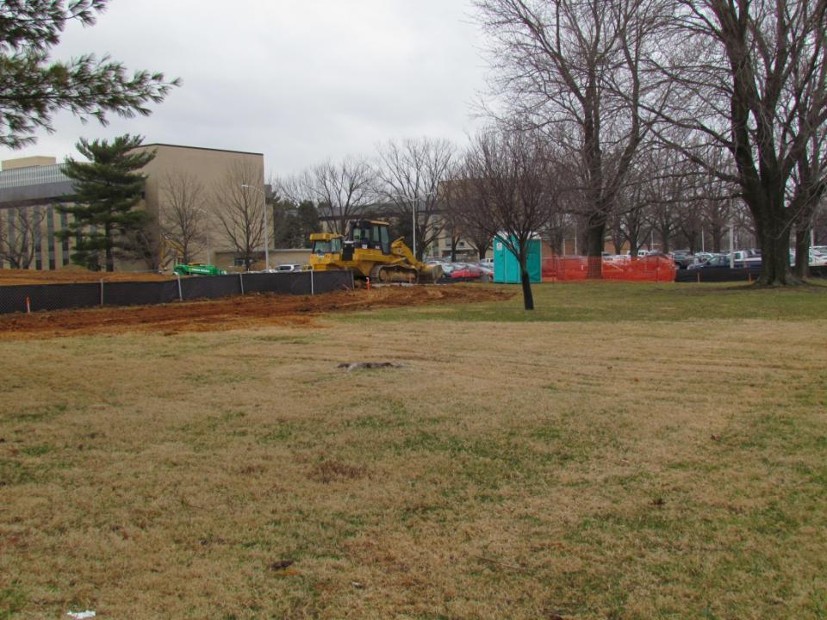
NZERTF Location – Adjacent to Building 226 on NIST Campus

Slide 26
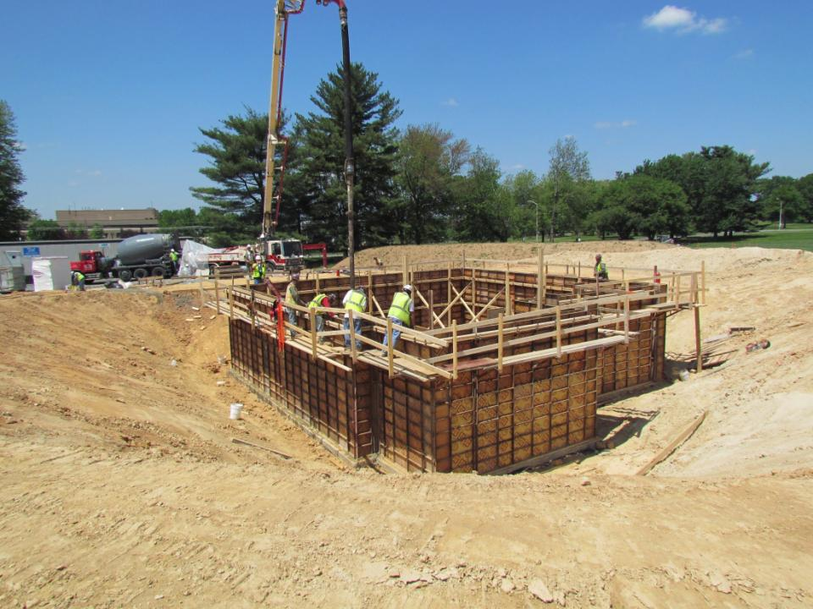
Pouring Concrete within Basement Wall Forms
Basement Walls Complete, Waterproofing Complete, Floor Trusses in Place

Slide 27
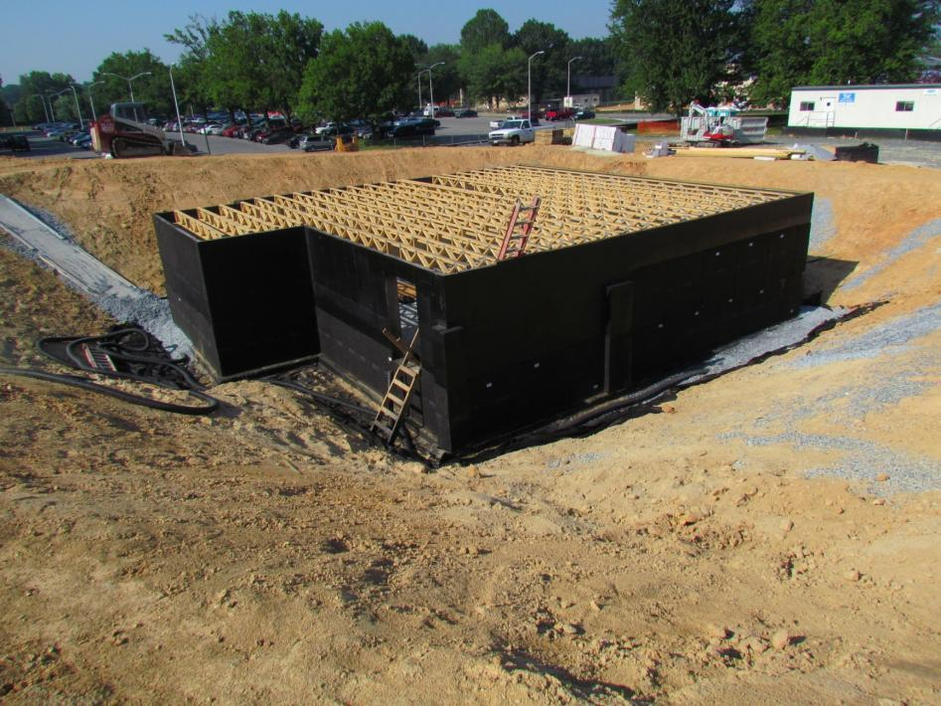
Basement Walls Complete, Waterproofing Complete, Floor Trusses in Place

Slide 28
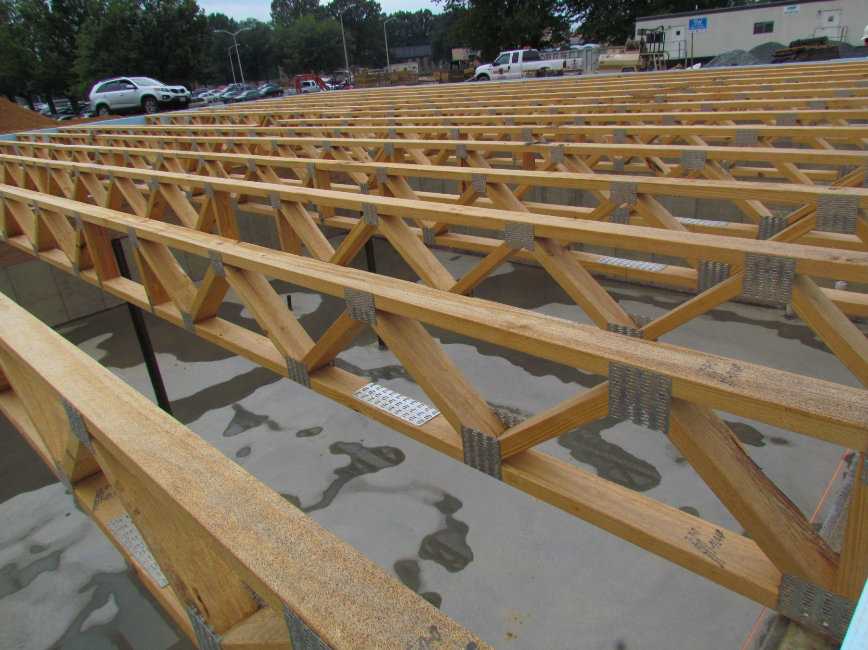
Open Truss Framing

Slide 29
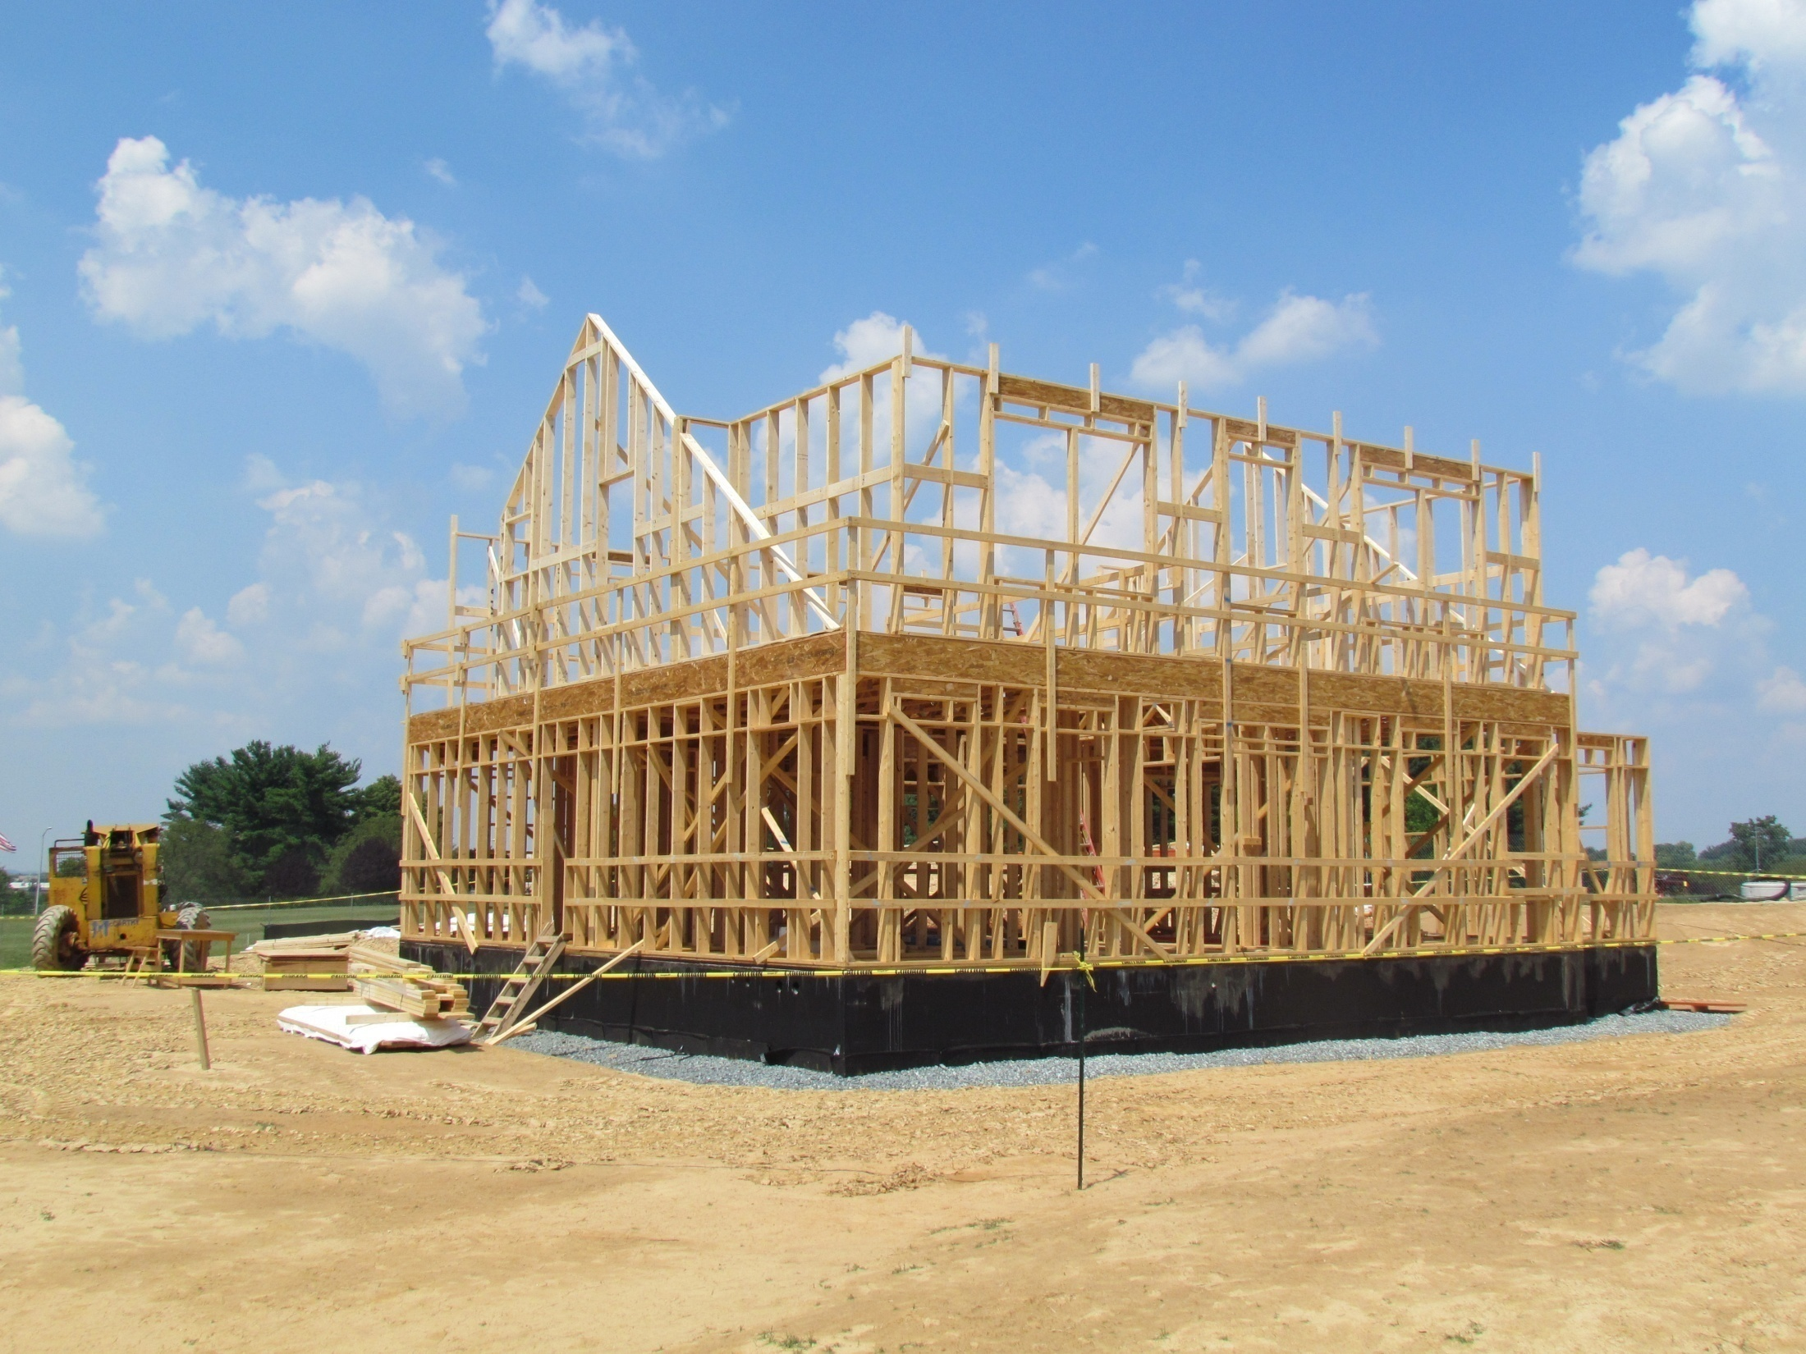
Advanced Framing with 2x6 construction, 24” on center

Slide 30
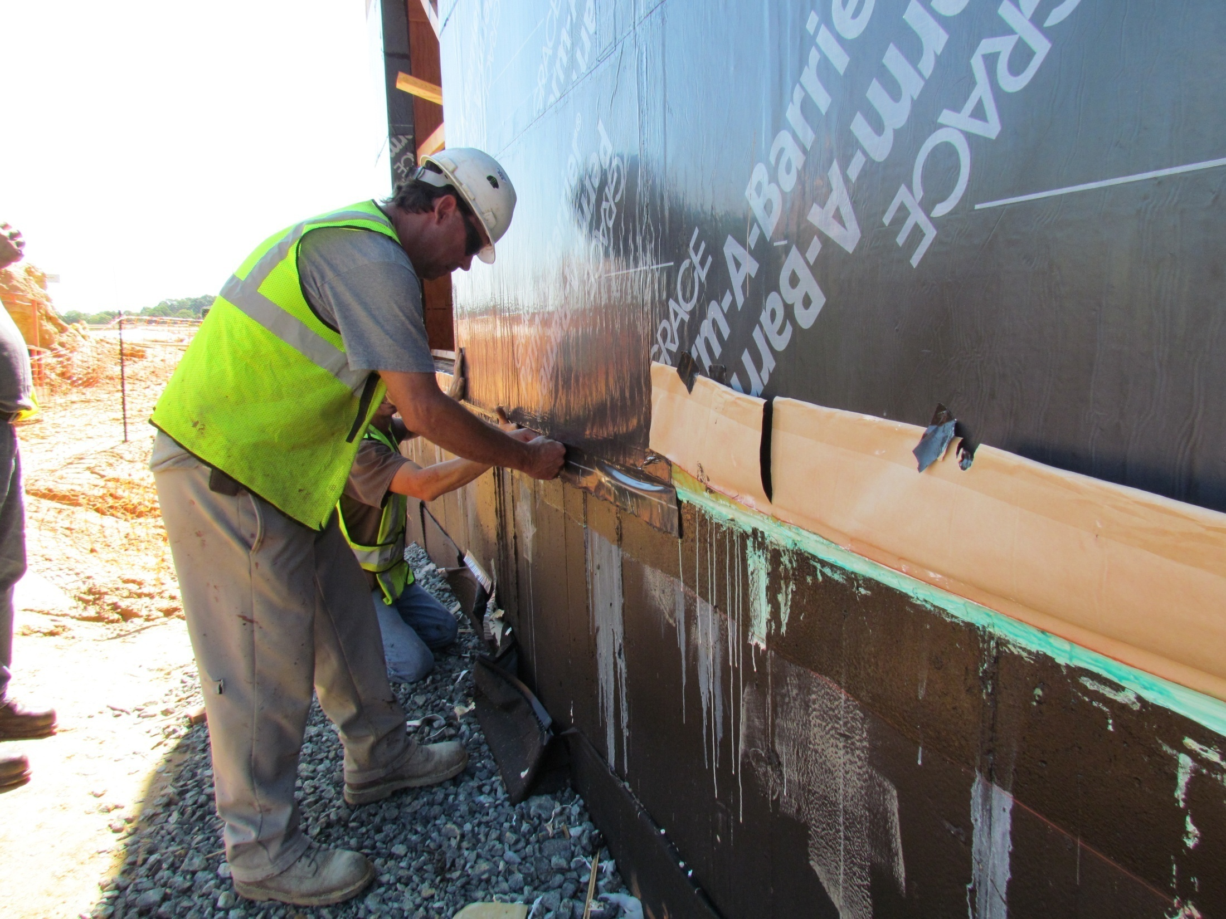
Attention to detail in installing weather barrier

Slide 31
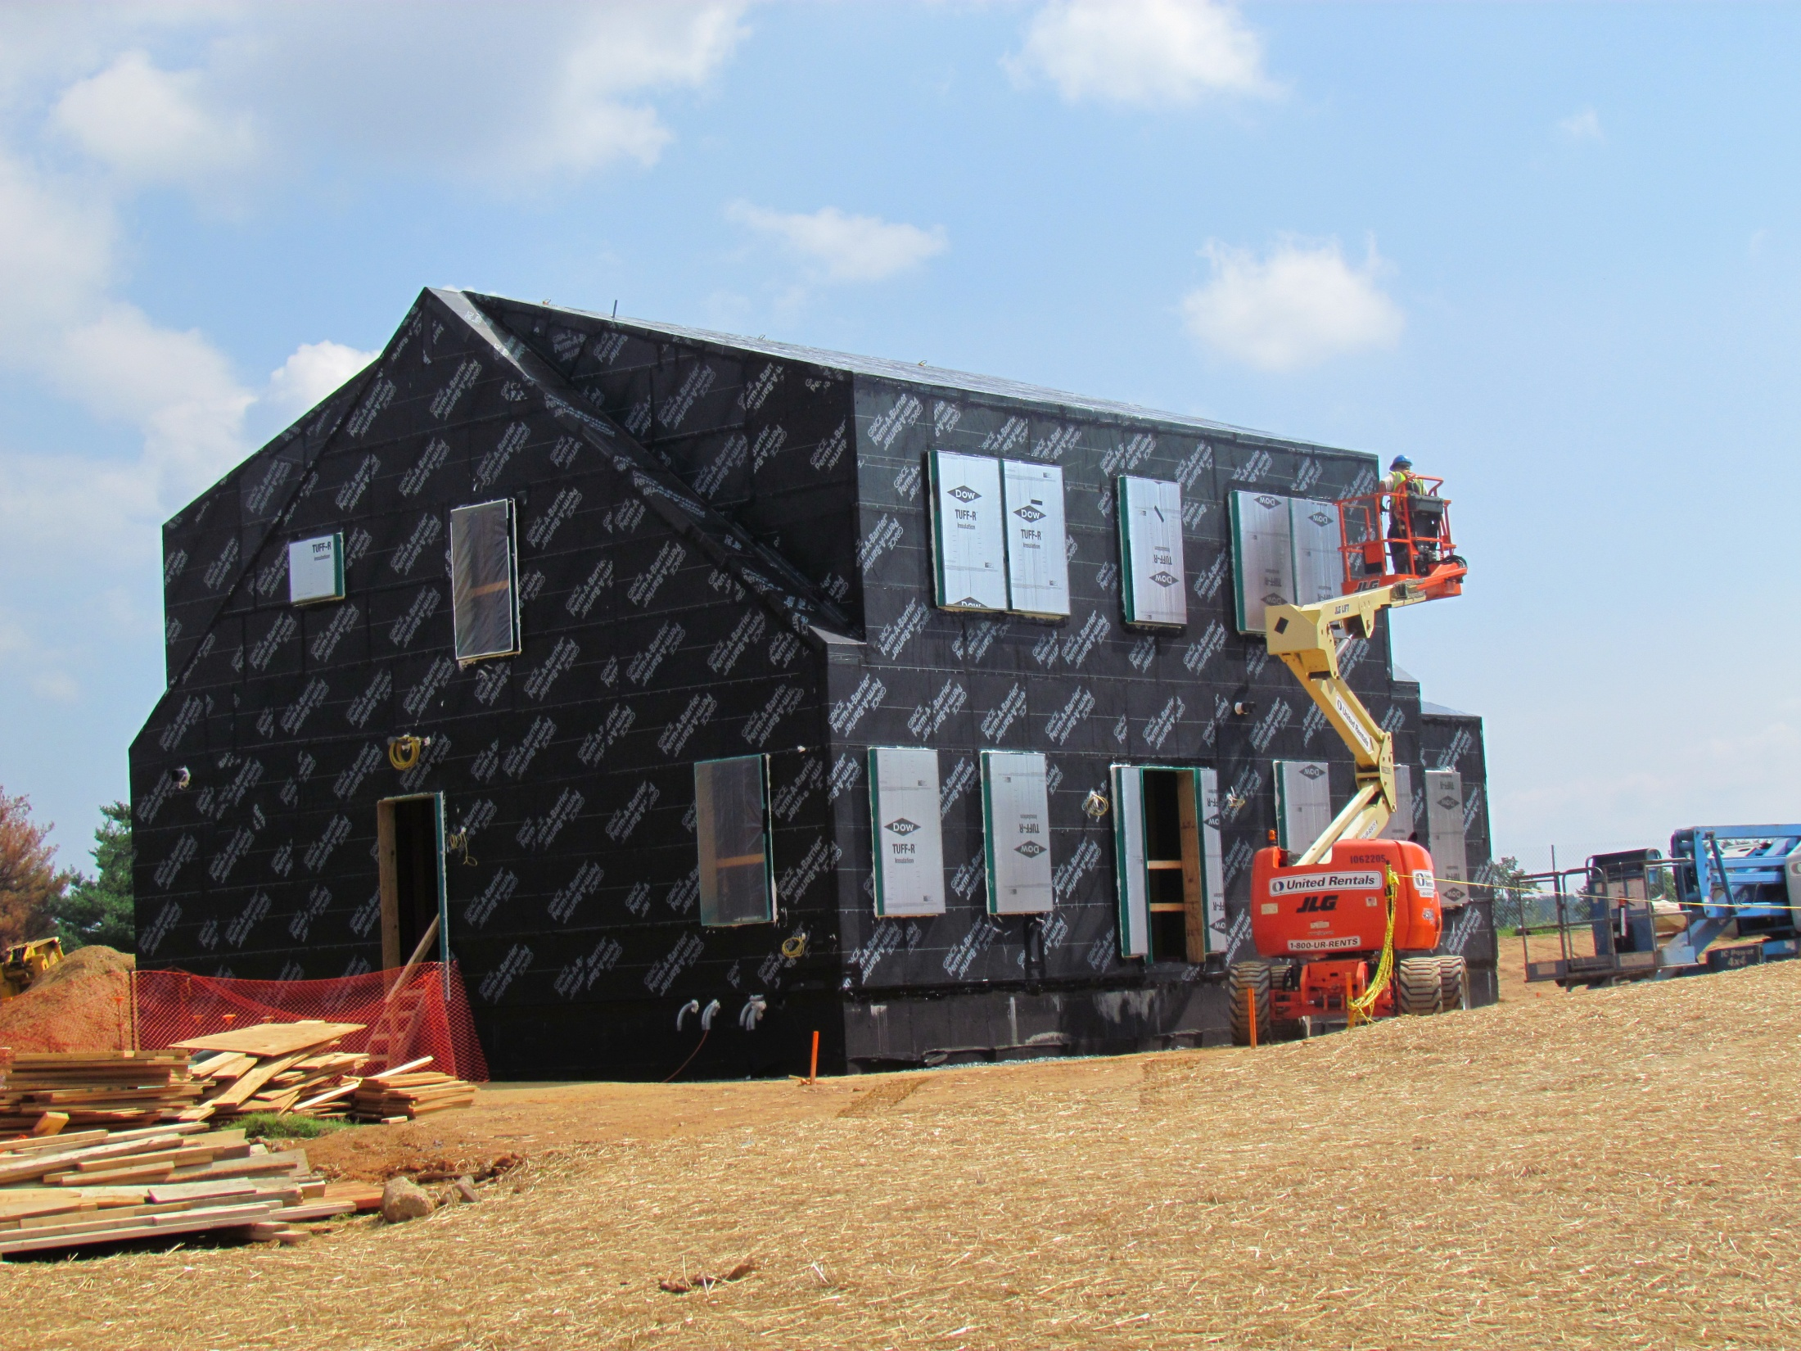

Slide 32
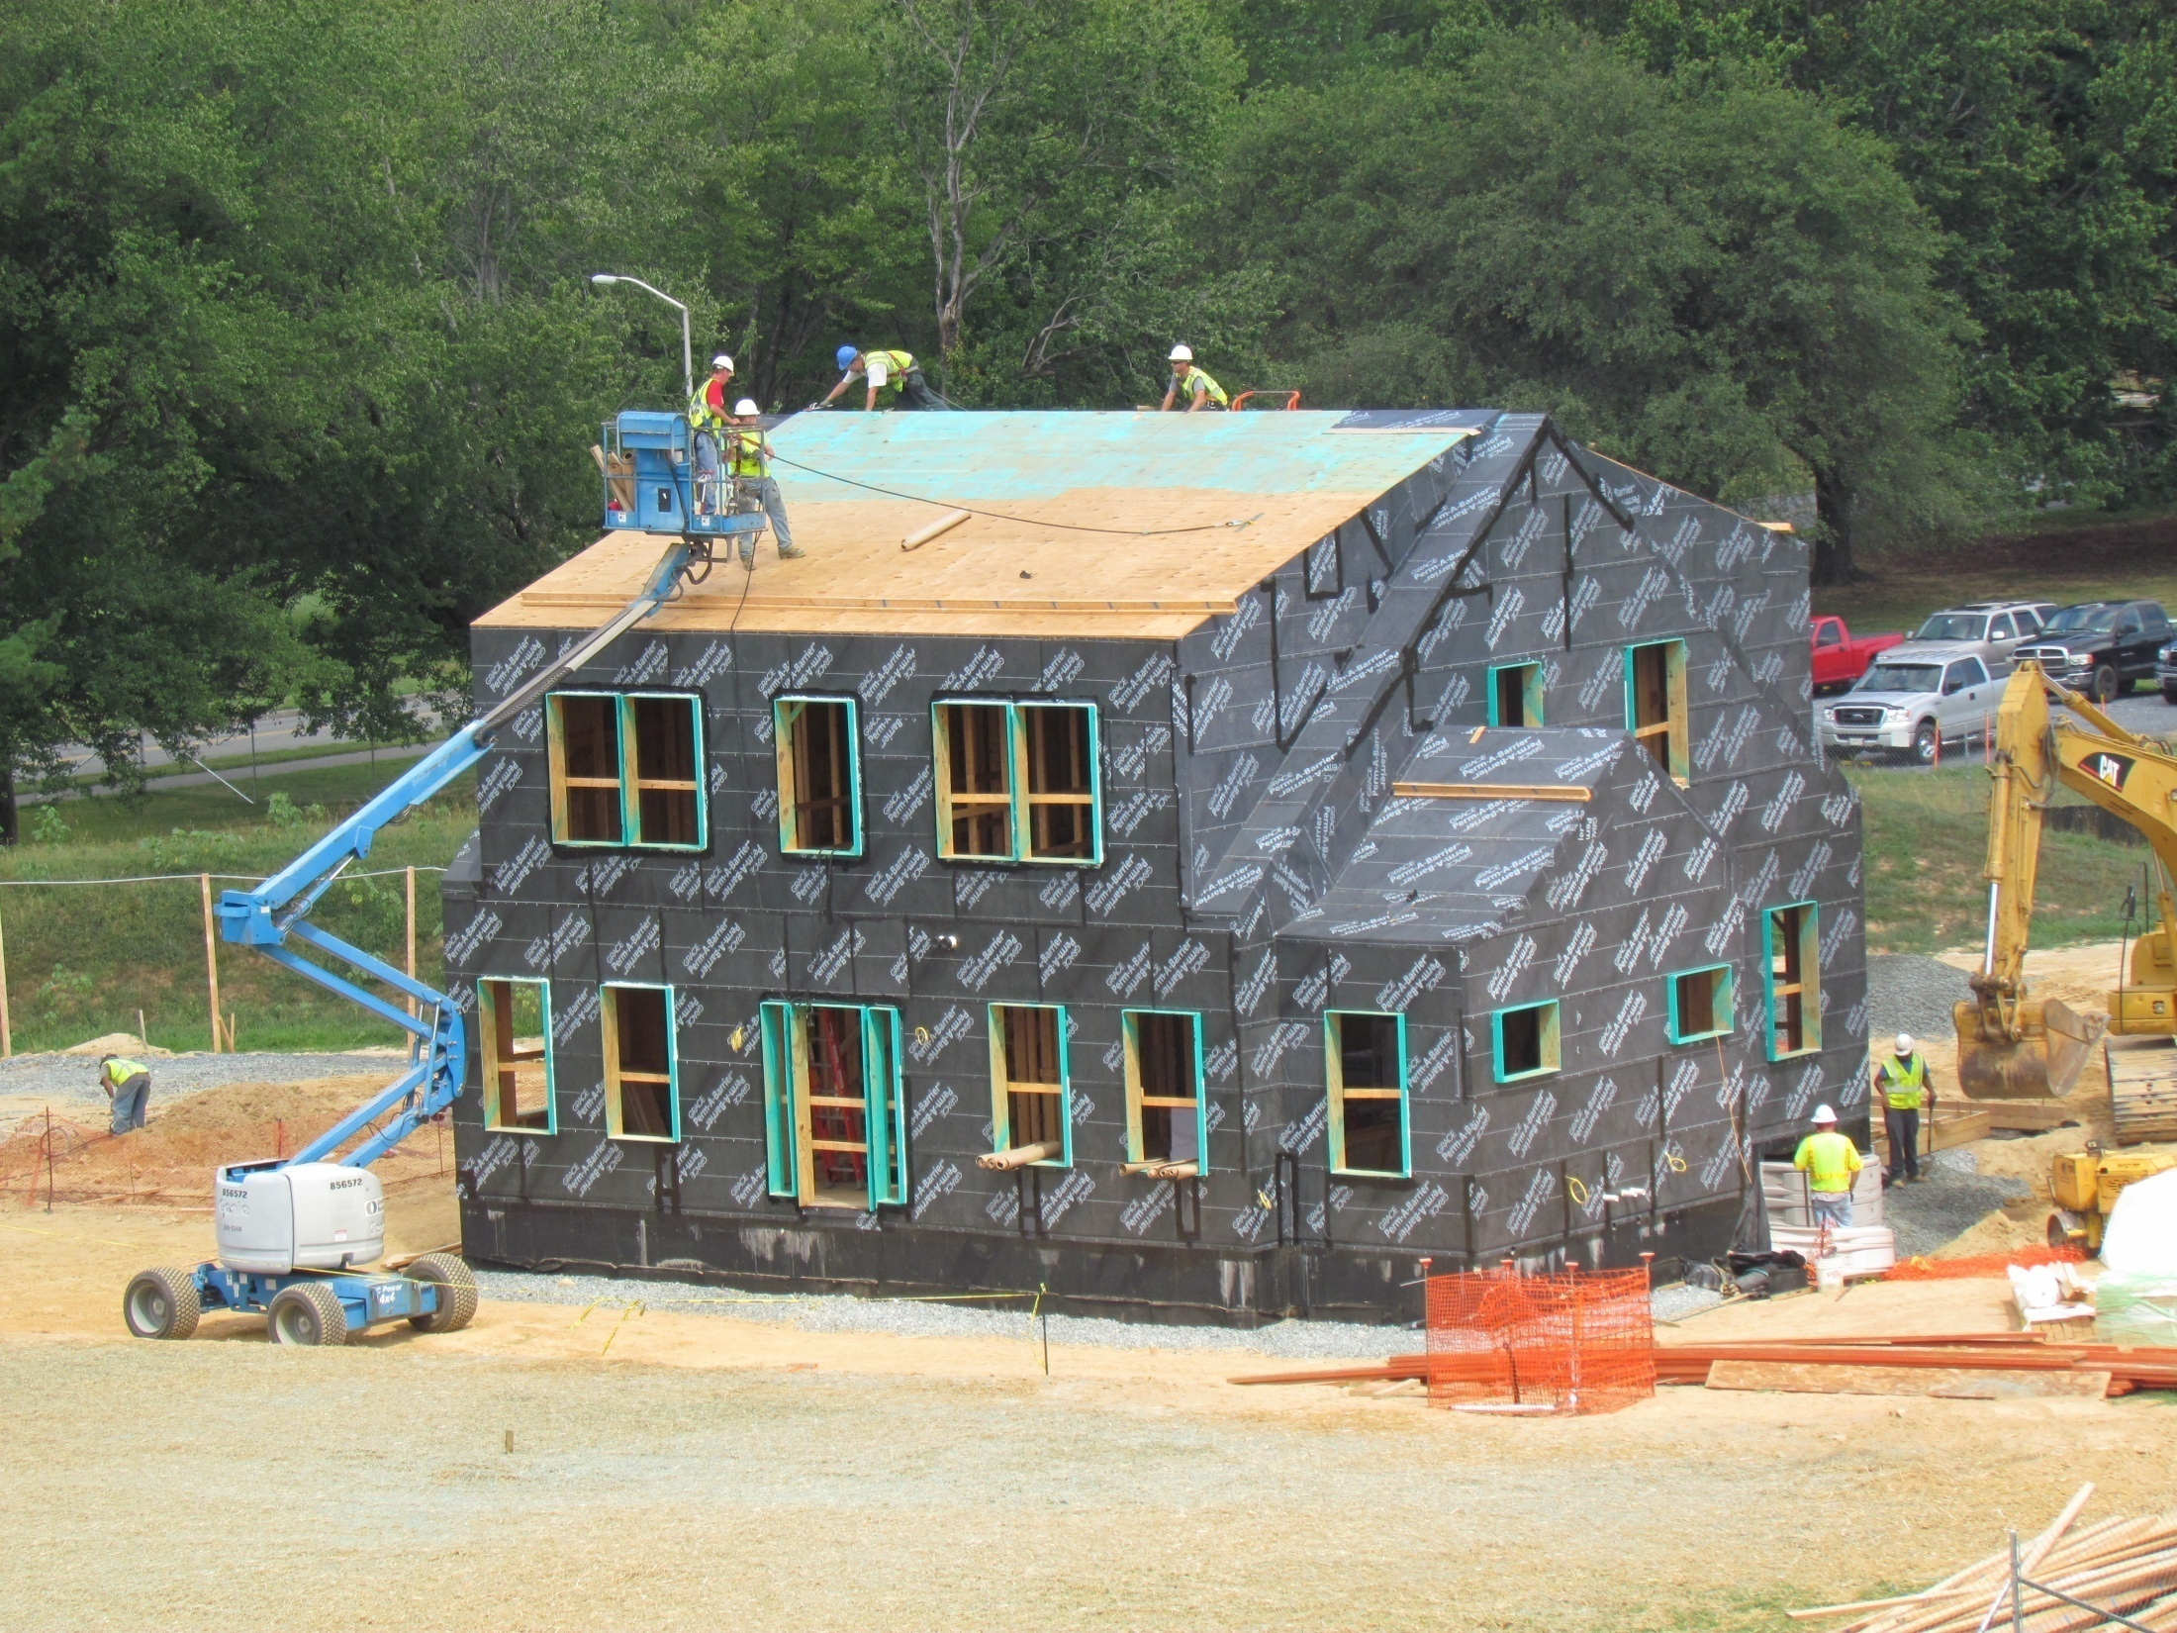
Tight, continuous seal of envelope

Slide 33
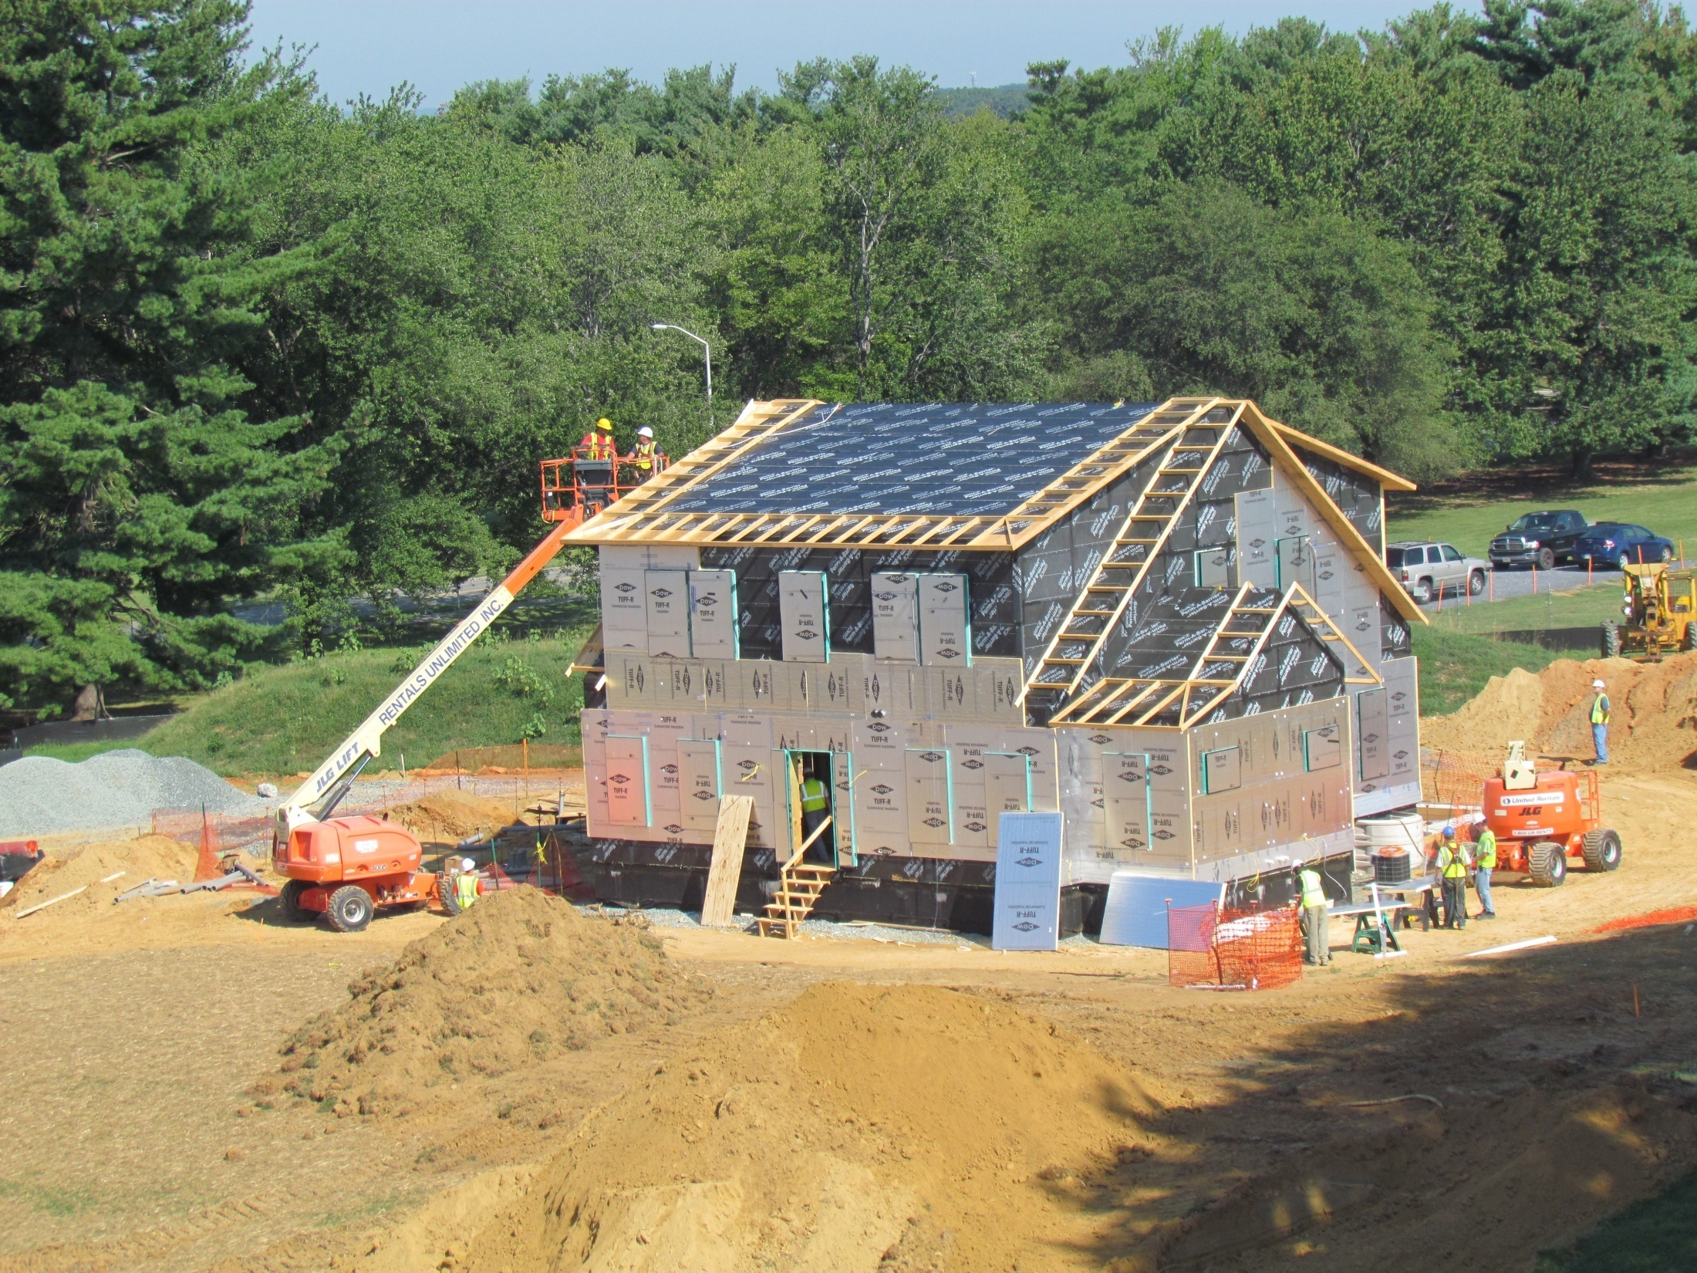
Installation of foam insulation on top of sheathing

Slide 34
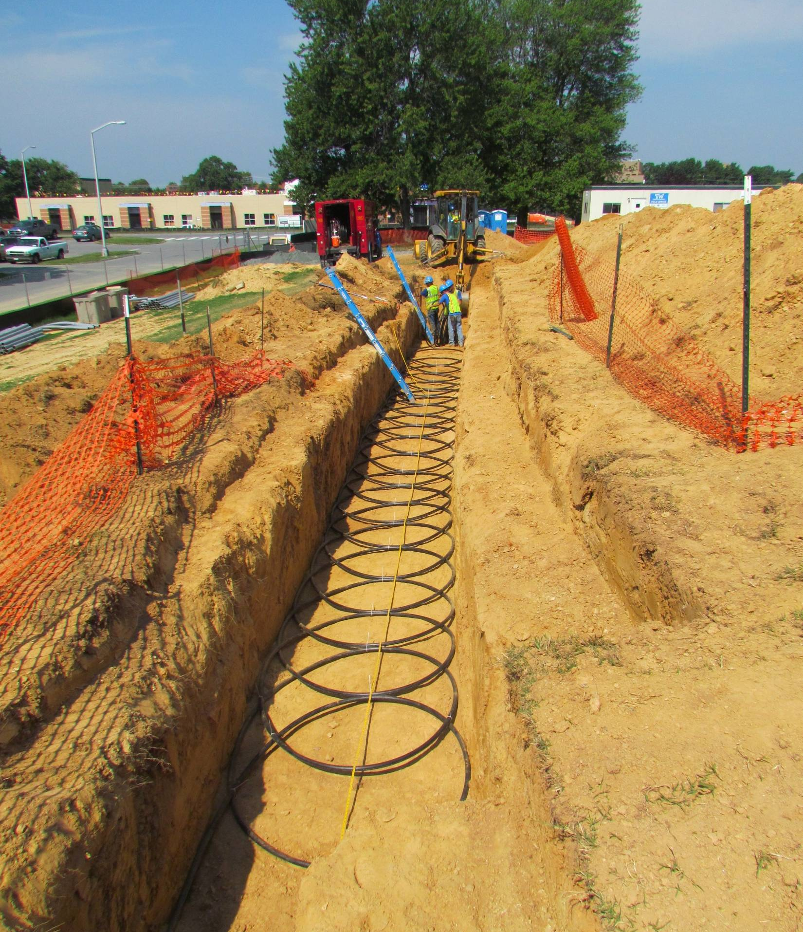
“Slinky” geothermal loop

Slide 35
Questions?

