Slide 1
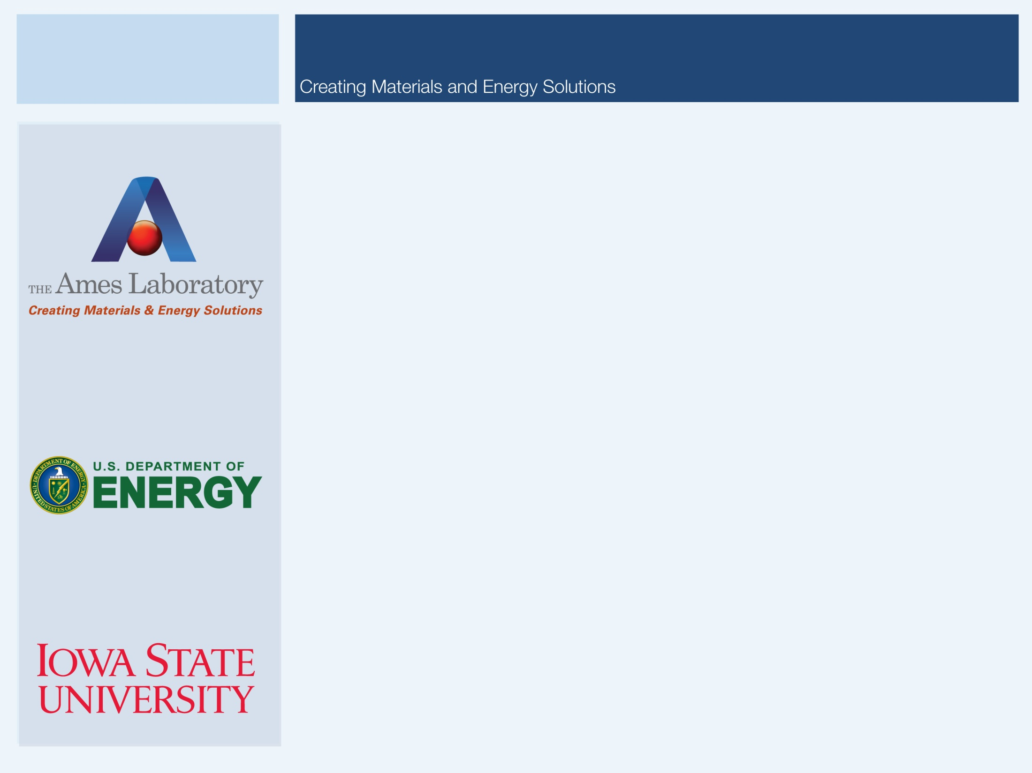

Current and Future Directions in Processing Rare Earth Alloys for Clean Energy Applications
Iver E. Anderson
Division of Materials Sciences and Engineering
Ames Laboratory (USDOE), Iowa State University
MIT Energy Institute
Boston, MA
December 3, 2010

Slide 2
Motivation: Rare Earth Supply
Many industrial and consumer uses for rare earths are growing and will continue to be major demands for rare earth metals in the future.
High performance permanent magnets
Ni-MH secondary storage batteries

Slide 3

Permanent Magnet Development for Automotive Traction Motors Includes: Beyond Rare Earth Magnets (BREM)
Iver E. Anderson
Organization: Ames Laboratory (USDOE)
Email: andersoni@ameslab.gov
Phone: 515-294-9791
Leadership Team: Iver E. Anderson, R. William McCallum, Matthew J. Kramer: Ames Lab (USDOE)
BREM Team: B. Harmon, K.M. Ho, C.Z. Wang, V. Antropov, and R. Napolitano: Ames Lab
(USDOE) R. Skomski, D. Sellmyer and J. Shield: Univ. Nebraska-Lincoln
M. Stocks: ORNL
I. Takeuchi: Univ. Maryland
S. Sun: Brown Univ.
S. Constantinides: Arnold Magnetic Technologies, Inc.
Project Duration: FY2001 to FY2015
DOE Vehicle Technologies Program
Advanced Power Electronics and Electric Machines Research
FY11 Kickoff Meeting
Oak Ridge National Laboratory
Oak Ridge, Tennessee
November 18, 2010

Slide 4


The Problem
To meet 2015 goals for enhanced specific power and reduced cost for high volume manufacturing of advanced electric drive motors, it is essential to improve the alloy design and processing of permanent magnets (PM), particularly by innovative solidification and powder processing.
The fully developed PM material must:
contain little or no rare earth (RE) elements due to an impending world wide RE shortage
achieve superiority for elevated temperature (150-200˚C) operation to minimize motor cooling needs.
remain competitive at room temperature with current high magnetic energy density (MGOe) materials to conserve valuable materials.

Slide 5
Description of Research Phases
Stage 1 (accomplished FY2008): New isotropic Mixed Rare Earth (MRE) permanent magnet alloy design (Nd-Y-Dy) was developed as nano-crystalline flake particulate and fine spherical powder.
Developed a robust, scalable particulate coating process
Stage 2 (started FY2009): New anisotropic RE permanent magnets will be developed from high-temperature (HT) magnet alloy design to boost (up to 4X) energy density and operating temperature (up to 200˚C).
To create ultra-high energy polymer bonded magnets, will develop aligned, nano-crystalline particulate.
To displace current sintered, aligned magnets, will develop fully sintered micro-crystalline HT magnets (single crystal/single domain particles).
Stage 3 (new start FY2010): New high strength non-RE anisotropic permanent magnets will be developed that meet the requirements for advanced interior PM electric traction motors.

Slide 6
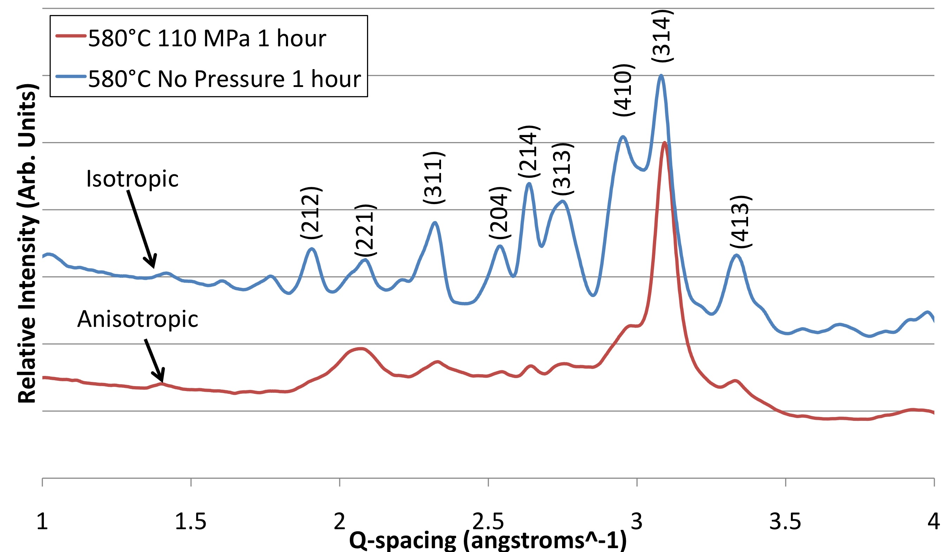
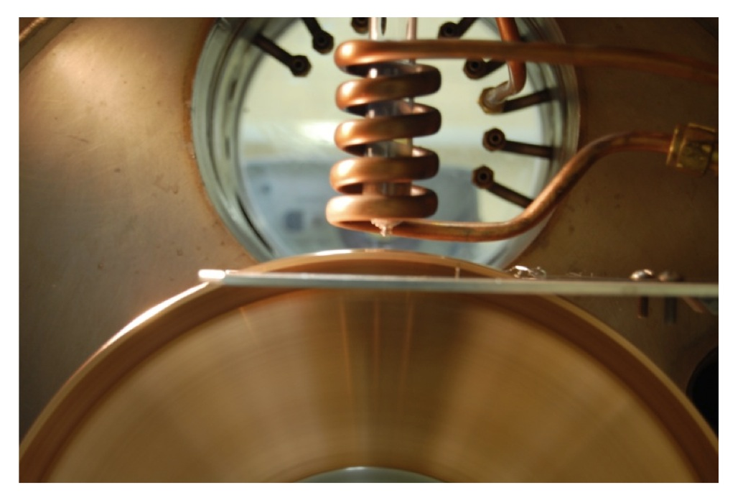
Uniaxial Pressure to Promote Anisotropic 2-14-1 Growth from Amorphous Ribbon for HT Bonded Magnet Particulate
Grains grow in the direction of highest elastic constant when uniaxial pressure is applied
In Nd₂Fe₁₄B, a-axis shows higher elastic constant than c-axis
Has been used in the die upset process to create bulk anisotropic material
Study effects of applying uniaxial pressure while crystallizing from amorphous state

Slide 7
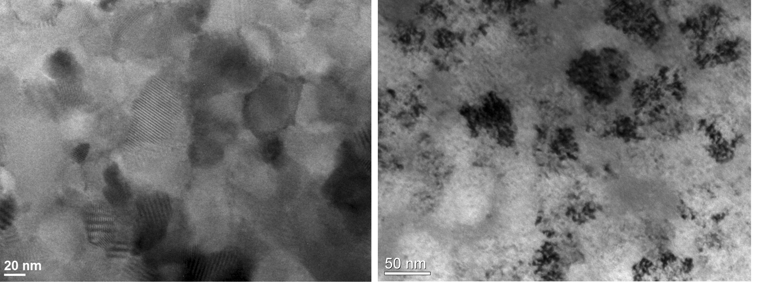
Implications of findings for HT bonded magnets
The application of uniaxial pressure during crystallization of amorphous ribbon can induce significant texturing
Coercivity is lost when pressure is applied
Likely caused by high defect density (unique observation)
Further investigation needed on recovery of defects (should boost coercivity and energy product)---need scalable processing

Slide 8
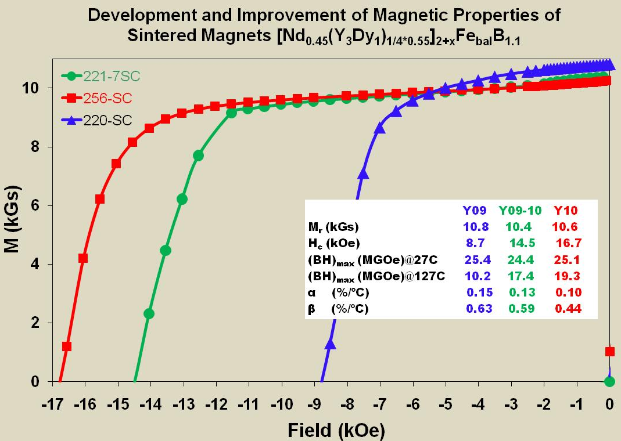
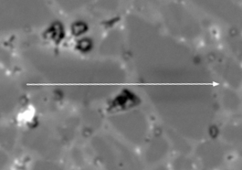
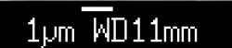
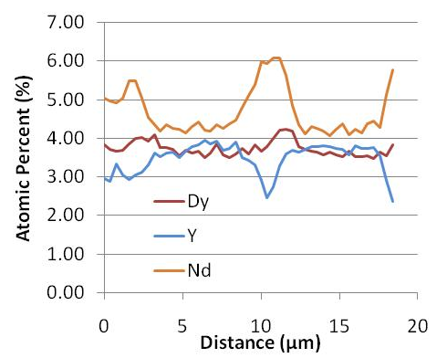
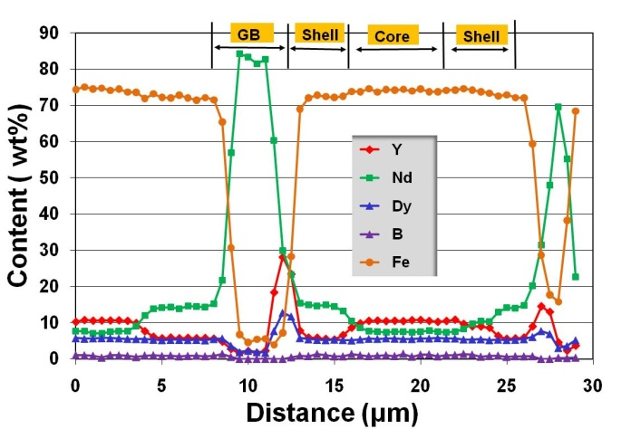
FY2010 Progress: Anisotropic Sintered Rare Earth Permanent Magnets
Temperature stability of magnets have been greatly improved since 2009.
(BH)_{max} of newly developed magnet was increased from 10.2 to 19.3 MGOe at 127C. However, the (BH)_{max} is still lower than that of commercial high temperature magnets at room temperature
Conventional sintering (CS) vs. Pressurized sintering (PS)
CS PS
Pressure (MPa) 0 100-150
Sintering T (˚C) >1000 <850
Microstructure Cored Uniform
Composition and processing need to be further optimized.
New pressurized vacuum sintering technique is very promising to develop aligned MRE-Fe-B magnets.
Dual purpose alignment & pressing die to be tried to maximize magnetic strength.

Slide 9
Hydrogen Storage in Ni/MH Secondary Batteries
Advantages of Ni/MH Batteries over Ni/Cd:
Eliminate charge “memory” limit
Minimize spontaneous discharge losses
Non-toxic anode substitution
Increased energy storage density (30 to 55 Wh/g)
Choices for MH anode:
AB₂ = TiNi₂ (Laves phase alloys)
AB₅ = LaNi₅ (hexagonal phase alloys)--Highest energy storage density
Increase cycle life
Improve alloy design (typically MmNi_{3.55}Co_{0.75}Mn_{0.4}Al_{0.3} ) to reduce cost and improve corrosion resistance
Eliminate Co addition without losing corrosion resistance
Reduce RE cost without losing energy storage capacity
Reduce processing cost (typically cast/anneal/crush)
Minimize high temperature annealing (hours to days) in vacuum
Eliminate hazardous (explosivity) grinding process

Slide 10
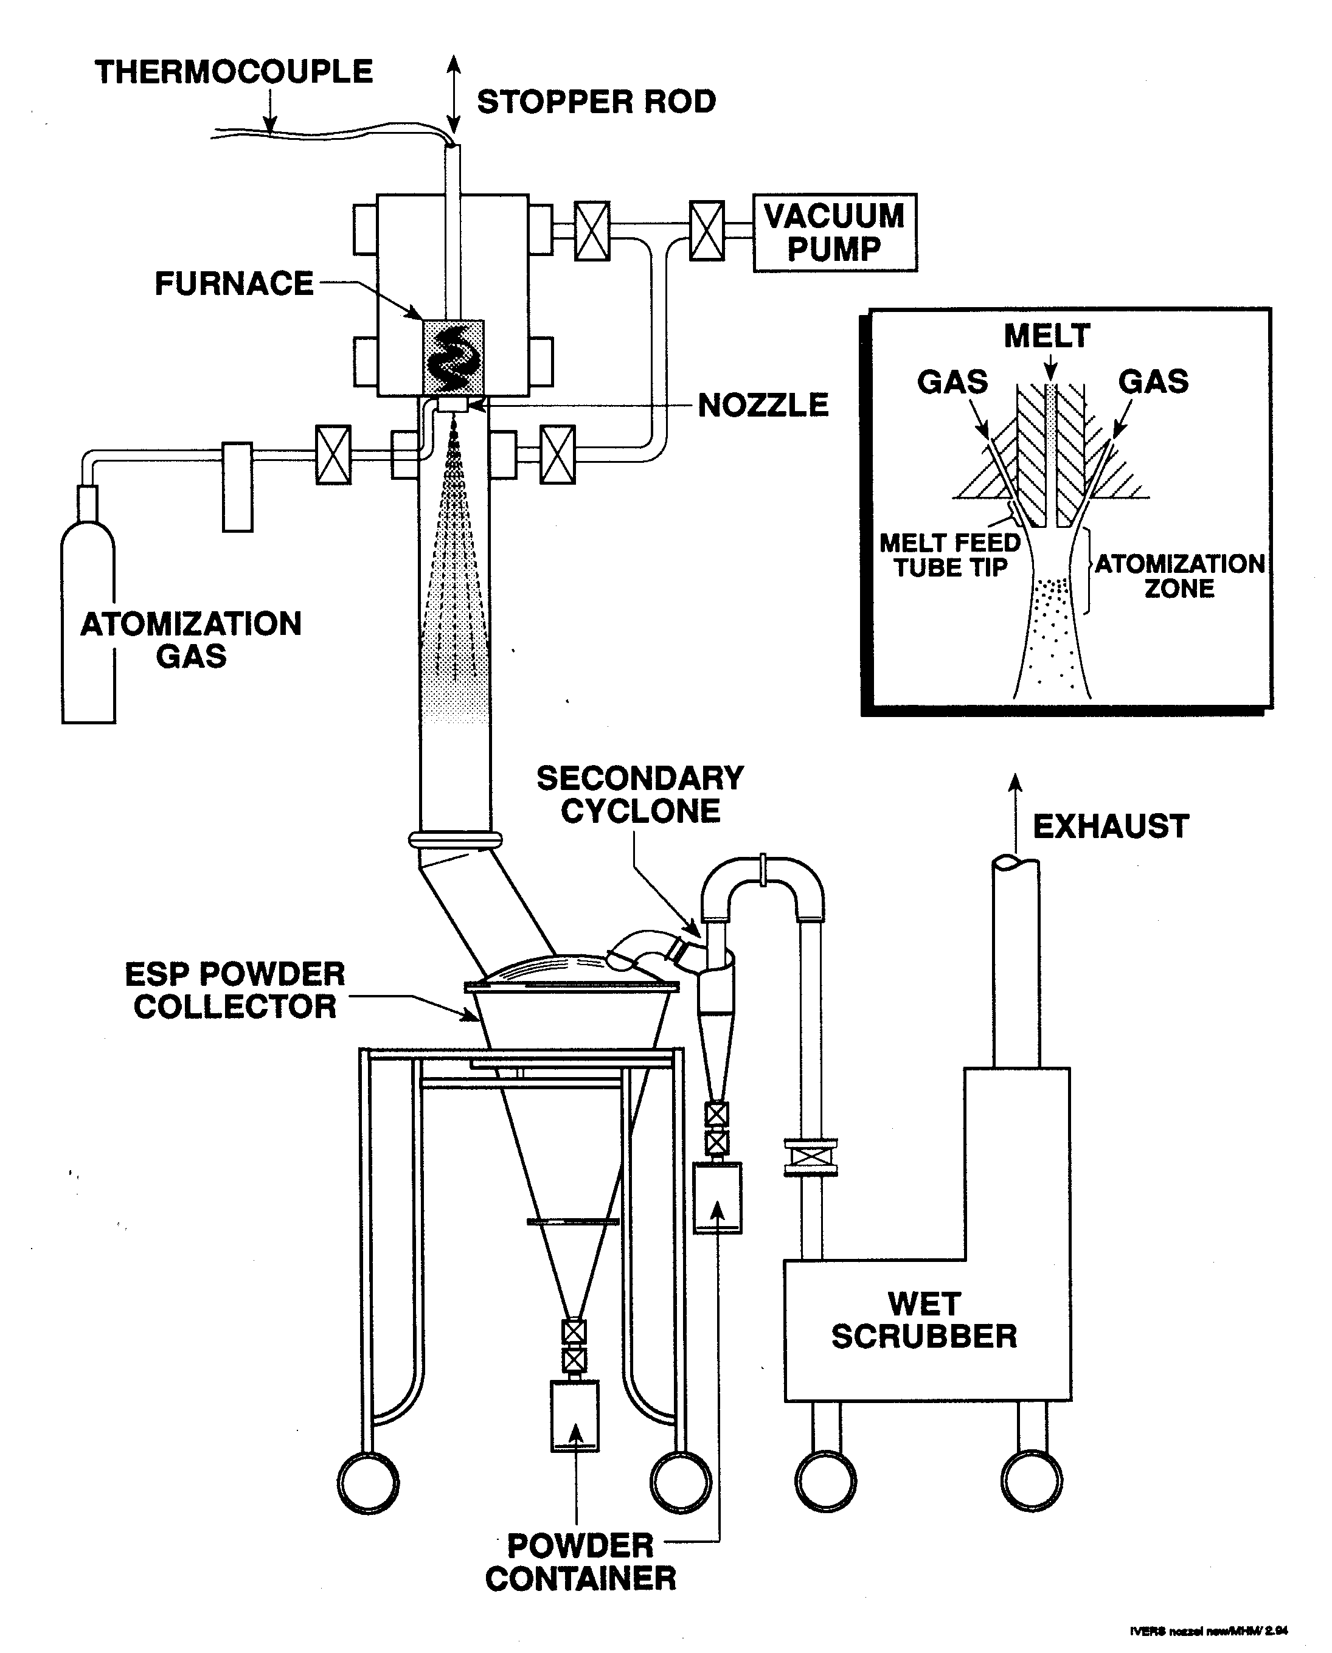
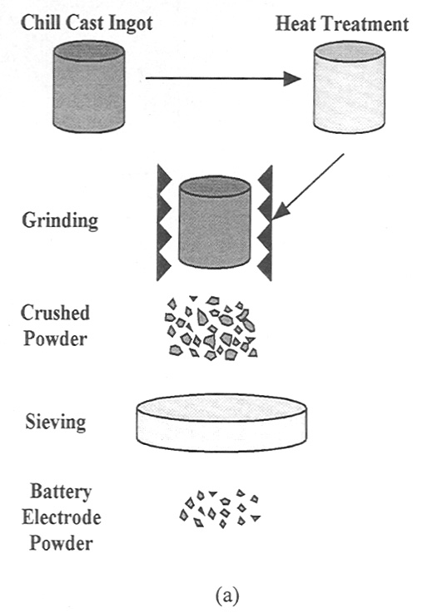
Direct MH Particulate Processing by Gas Atomization

Slide 11
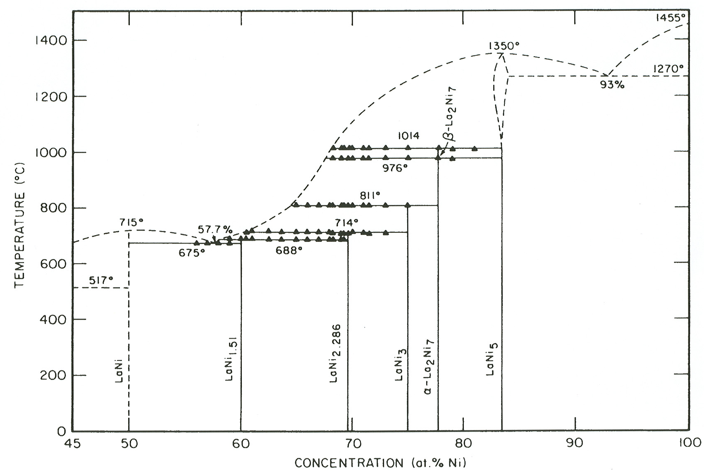
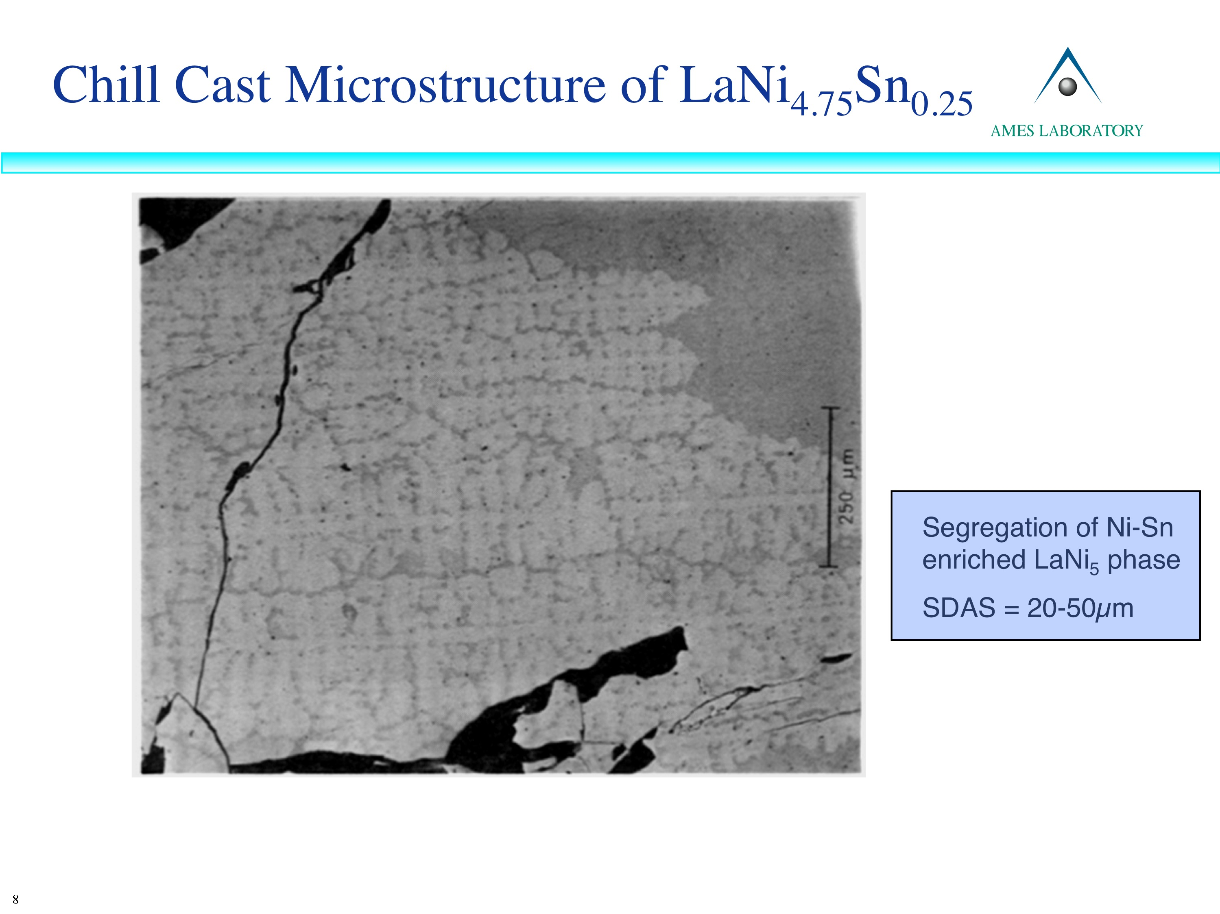
Rapid Solidification Processing Needed for La-Ni
Zhang, D., J. Tang, and K.A. Gschneidner, J. Less-Common Metals, vol. 169, 1991, pp. 45-53.

Slide 12
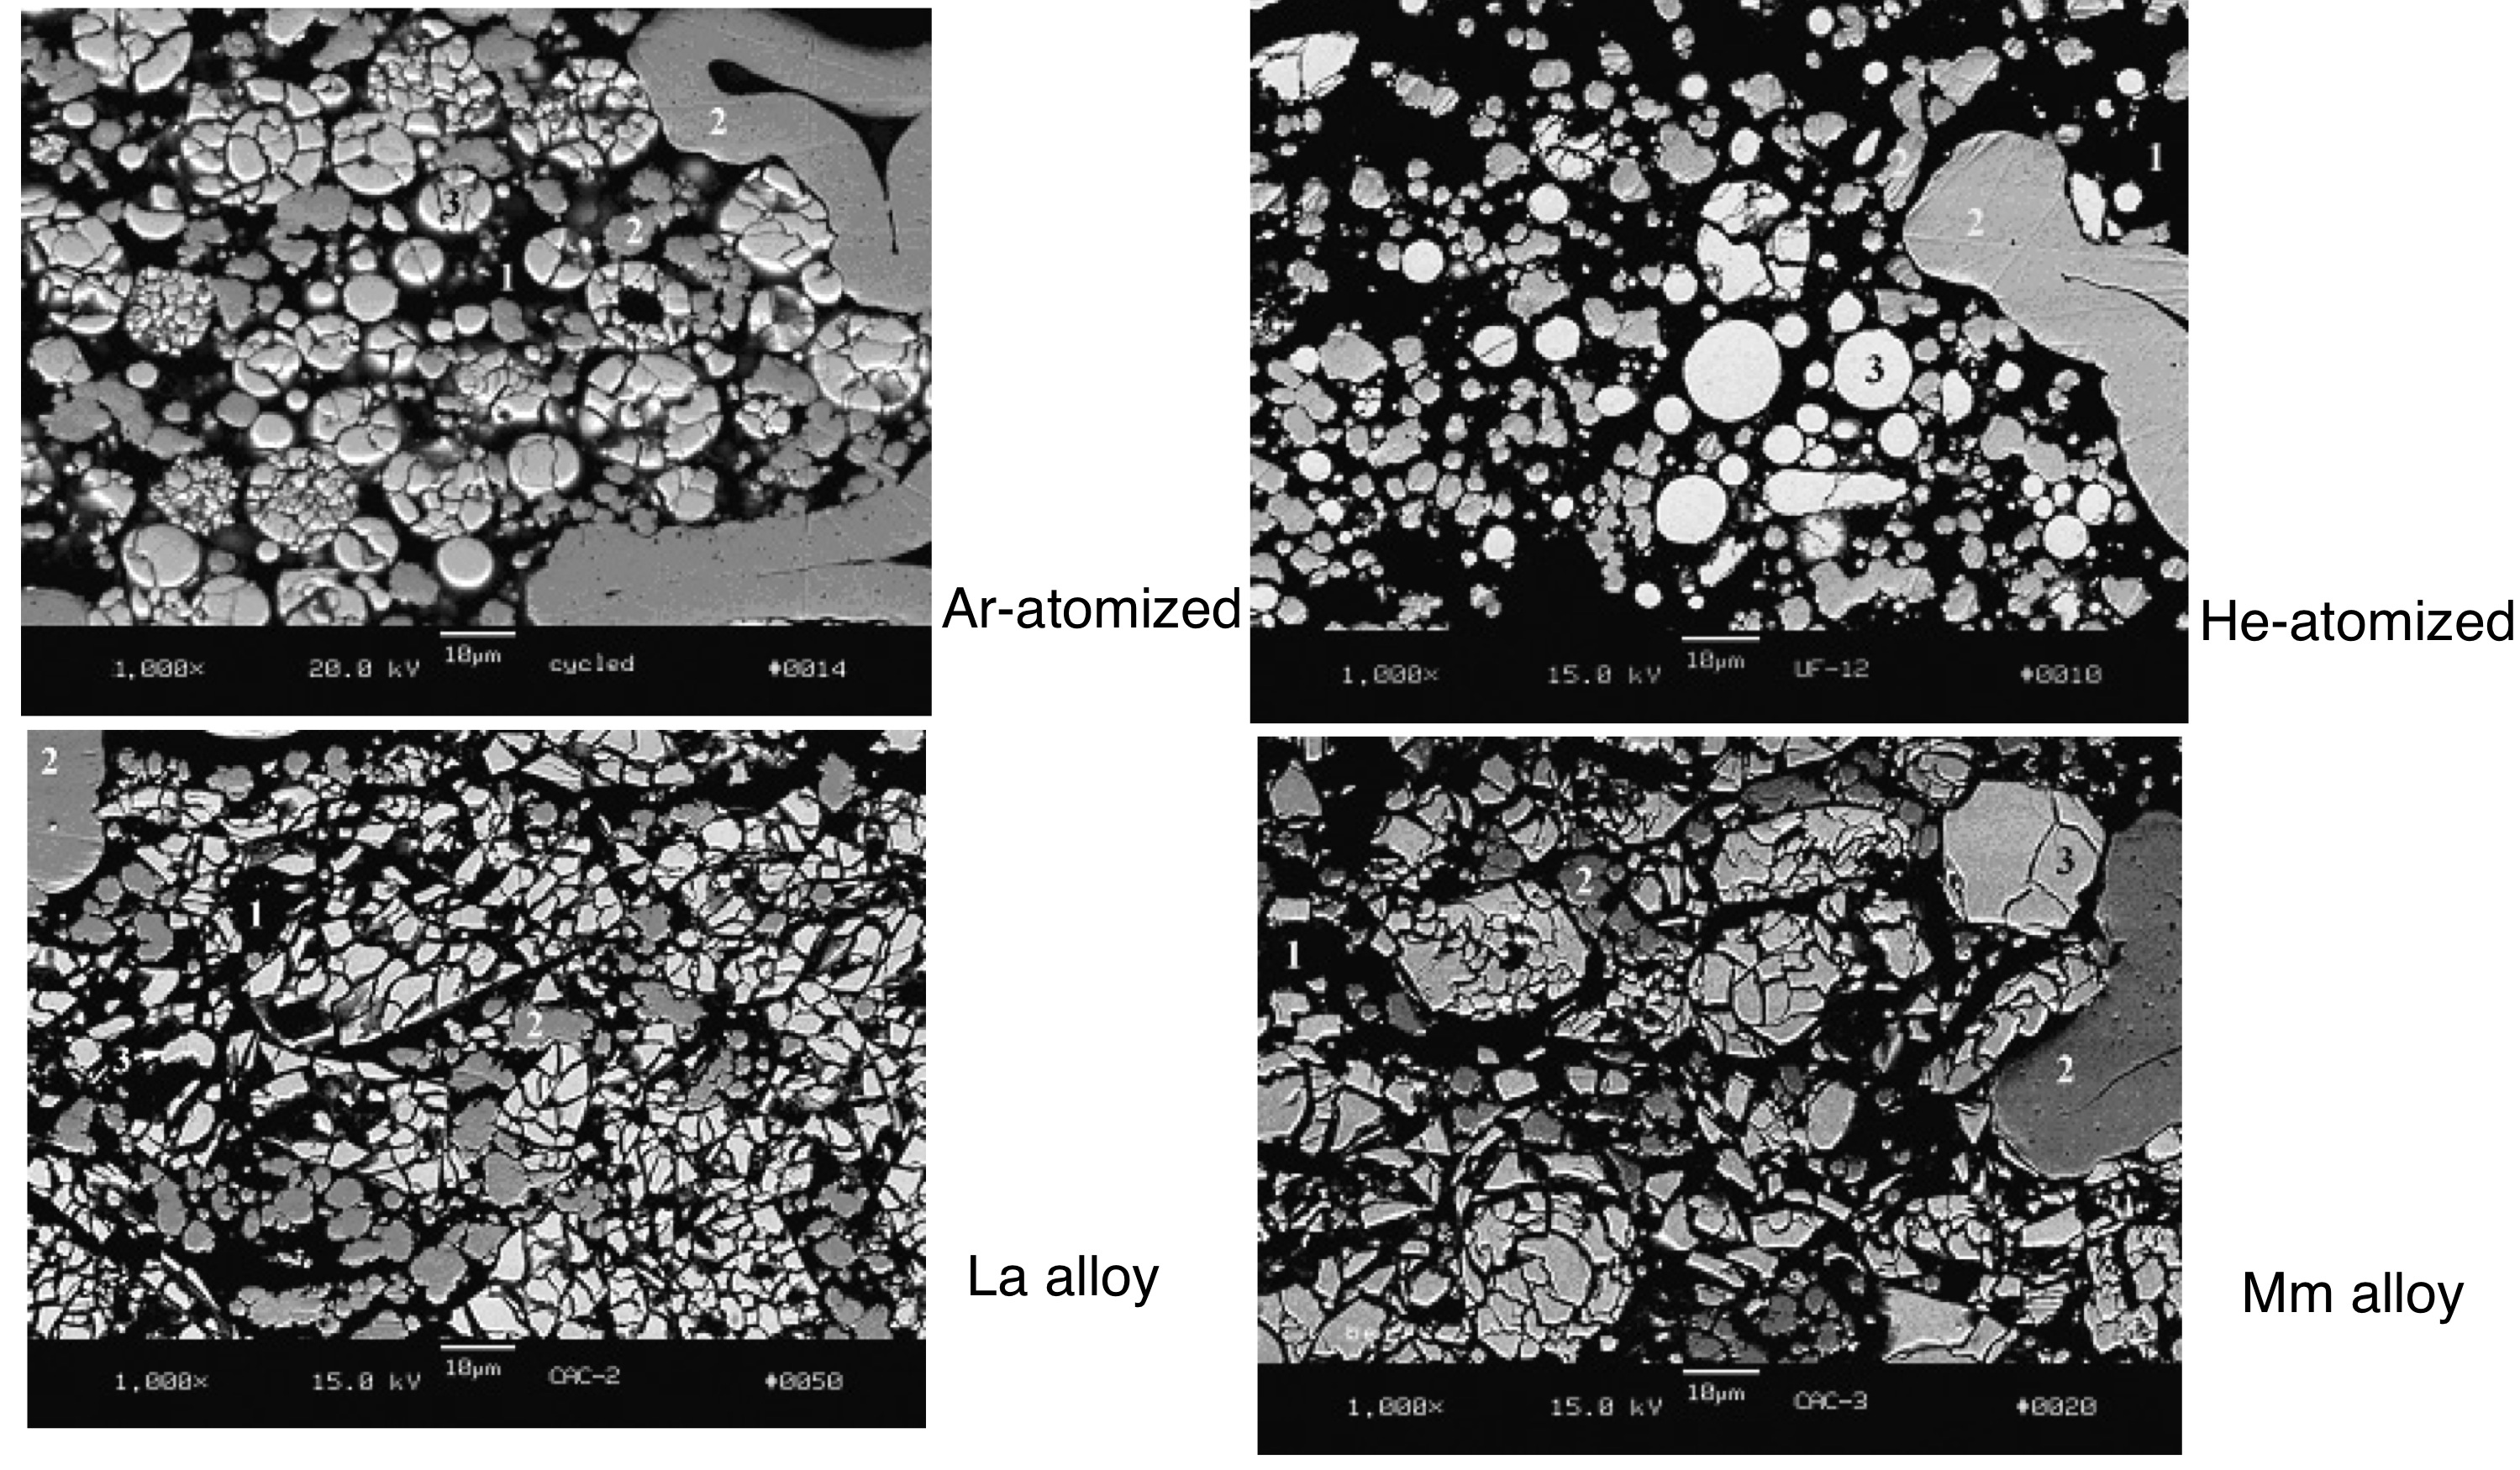
Comparison of Powder Types after 20 Cycles

Slide 13
Summary of MH Processing Studies
Rapid solidification by gas atomization can simplify the manufacturing of metal hydride powders, although a brief high temperature anneal is still required.
Spherical atomized powders had improved electrochemical cycling stability for LaNi_{4.75}Sn_{0.25} metal hydride alloy compared to conventional fragmented particulate.
Cycling stability improved for helium over argon atomized powders, perhaps a remnant of a finer solidification microstructure.
Gas-based fluorination process showed that continuous, thin LaF₃ coating could be formed on LaNi_{4.75}Sn_{0.25} gas atomized powders but spallation of the fluoride layer occurred during cycling..
In spite of coating spallation, the finest powders did show some improvement in electrochemical capacity, possibly related to sub-surface nickel enrichment.

Slide 16
Project Overview
Objective
Develop non-RE permanent magnets with sufficient coercivity and energy product for advanced IPM traction motors.
Further develop anisotropic sintered rare earth (RE) magnets to achieve highest energy product (4-6X isotropic bonded) with high temperature stability from single crystal/single domain micron-sized particles
Addresses Targets
The goal of this research is to maintain high temperature tolerance while improving the energy density of permanent magnets to permit advanced traction motors to reach 2015 goals of enhanced specific power (>1.2kW/kg), reduced size (>5kW/l), and reduced cost (<$12/kW).
Uniqueness and Impacts
Looming RE cost pressure and a very recent threat to RE supply motivated a large augmentation of the permanent magnet project to include a major research effort to elevate transition metal-based permanent magnet designs (modify or discover new) to the realm of the high magnetic strength (especially coercivity) necessary for high torque drive motors..
16

