Slide 1
The Unique World of
Workers’ Compensation
The Hanford Experience
2010

Slide 2
RCW & WAC
All workers’ compensation claims filed in Washington State are handled utilizing the same guidelines
RCW Title 51 - Revised Code of Washington
WAC - Washington Administrative Codes

Slide 3
NO FAULT
Washington’s industrial insurance program is a “No Fault” system

Slide 4
Course of Employment
For an injury claim, the worker does not have to be doing his/her actual job in order to be covered
The worker is usually covered:
while acting at the employer’s direction
furthering the employer’s business

Slide 5
Compensability
For both an injury and occupational disease claims, the medical condition diagnosed must be related to the incident and/or job duties on a “more probable then not basis”
It is not sufficient that a physician indicate “possibly” or “may” be the cause

Slide 6
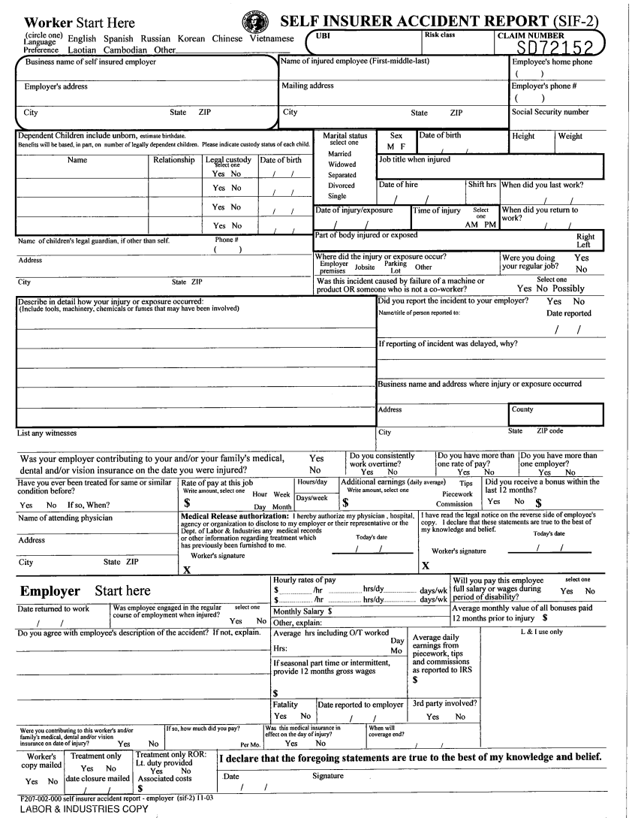
SIF2 – Self Insured Accident Report

Slide 7
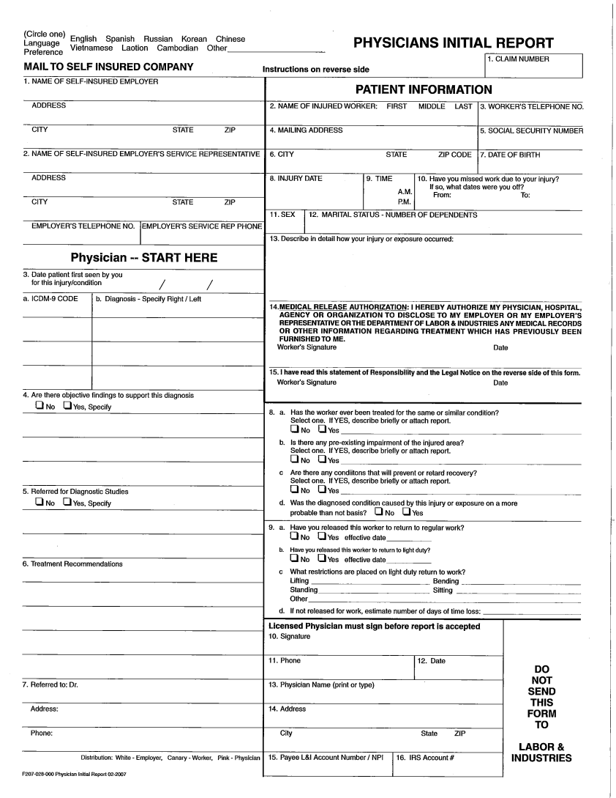
PIR – Physician’s Initial Report

Slide 8
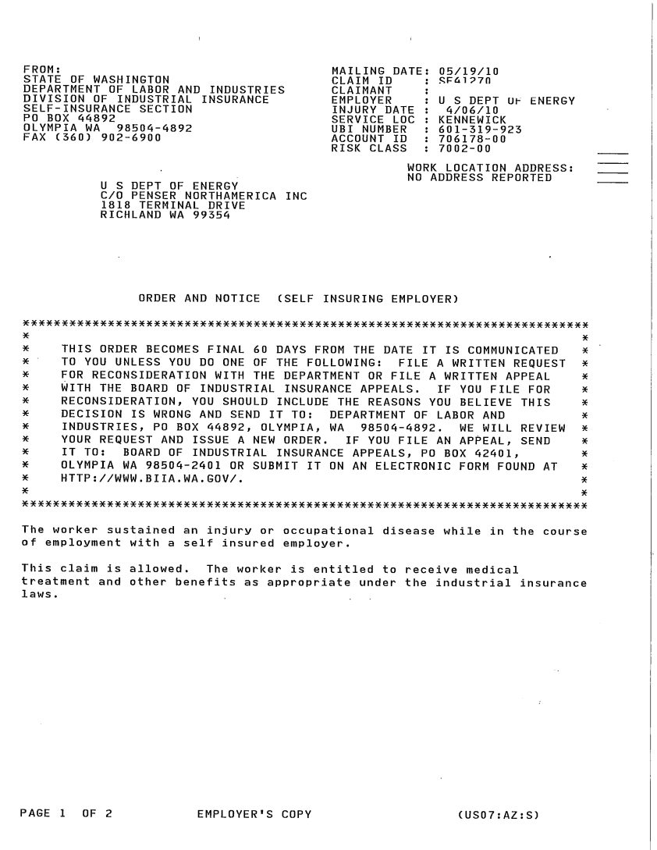
Department of Labor & Industries Order & Notice

Slide 9
SELF – INSURED CLAIM
Report the injury to your employer
Request a Self Insurer Accident Report (SIF2) from your Worker’s Compensation Representative (WCR)
See a doctor of your choice
The doctor will complete the Physician’s Initial Report (PIR) form
The doctor mails the completed PIR to the Third Party Administrator (TPA)

Slide 10
Worker Responsibility
Tell the doctor that the injury or disease is work related
Respond timely to requests for information:
- prior medical
- attending physician contact information
- correct personal contact information
- work history
Communicate with your claims examiner

Slide 11
Benefits Covered
Medical treatment/bills
Wage compensation
Vocational services
Permanent partial disability

Slide 12
Medical Treatment
The cost of all hospital, surgical and other medical services necessary for the treatment of the work place injury or disease is covered.

Slide 13
Wage Compensation
Temporary Total Disability (TTD)
TTD is payable when an injury or disease temporarily and totally disables an employee’s ability to return to work
Loss of Earning Power Benefits (LEP)
LEP is payable when an employee has returned to light duty and the light duty results in a wage reduction greater then 5%
Permanent Total Disability (PTD)
PTD is payable when an injury or disease permanently and totally disables an employee’s ability to return to the work force

Slide 14
Permanent Partial Disability
When a work place injury or disease results in a permanent physical impairment, a rating evaluation is conducted by either the treating physician or an independent medical examiner. Once the percentage of impairment is determined the Washington State Department of Labor & Industries will issue a closing order that stipulates the impairment award associated with the percentage of loss.

Slide 15
Independent Medical Examinations
An injured worker must appear for an independent medical evaluation (IME) scheduled by the self insured employer or the third party administrator.

Slide 16
Purpose of IME
To determine if current treatment is appropriate or to determine if further treatment is necessary
To determine if a condition is at maximum medical improvement
To determine permanent partial disability
To resolve disputes in the claim
To address reopening of a claim

Slide 17
Office of the Ombudsman
For Self Insured Injured Workers

Slide 18
What they do:
They can:
- advise workers of the rights and responsibilities
- investigate complaints
- work to ensure workers receive the appropriate benefits under the law
They cannot:
- issue Department orders
- authorize treatment
- pay benefits
- represent workers at the Board of Industrial Insurance Appeals

Slide 19
Why would a worker contact their office?
If a worker has a general questions about workers compensation
If a worker has a claim and feels they need assistance with understanding the claims process or to resolve a specific claim issue

Slide 20
Ombudsman Contact Information
Mailing address:
Office of the Self Insured Ombudsman
Department of Labor & Industries
PO Box 44001
Olympia WA 98504-4001
Phone: 1-888-317-0493 Fax: 360-902-4202
Website: Ombudsman.Selfinsured.wa.gov

Slide 21
Other resources for information:
Self insurance section of the Washington State Department of Labor & Industries
Phone: 360-92-6901
http://www.lni.wa.gov/Main/WorkerTopics.asp
To locate a provider: findadoc@lni.wa.gov

Slide 22
Questions?????

Slide 23

Work Suitability Evaluation (WSE)

Slide 24
Today we will talk about
Coordination and Communication with Penser and the Contractors
Work Suitability Evaluation (WSE)
Work Capacity Evaluation (WCE)
Fitness for Duty Evaluation (FFD)

Slide 25
Coordination and Communication
Monthly Case Management Meetings at Penser
Coordination of Return to Work Evaluations
Coordination of Referrals to National Jewish Health
Notes:
Meet with Julie, Craig, Lawrence, Penser, AMH, and Contractors
Mutual goal to RTW in a timely manner
Beryllium referrals

Slide 26
What is a Work Suitability Evaluation (WSE)?
Case management occupational medical evaluation to assess the worker’s ability to perform the essential and/ or supplemental functions of their job.

Slide 27
When is a WSE Needed?
This service may be initiated by the employing company through AMH case management, particularly in cases where:
recovery has been delayed
functional abilities have decreased during treatment
injury or illness is recurrent
there is permanent impairment, disability or restrictions

Slide 28
What is needed before a WSE can be scheduled?
employee job task analysis (prepared by the company)
a letter from the contractor’s human resources or industrial relations organizations outlining the reason for the request
medical information from the worker’s private medical provider

Slide 29
When an Employee is Working
AMH Case Manager:
Receive WSE request from contractor
Contact employee at work to request release of information for their private provider
Fax completed release to private provider
Receive records
Schedule WSE
Route medical records to AMH provider

Slide 30
When an Employee is Working
AMH provider performs WSE
AMH Case Manager:
Prepare WSE results letter
Gives copy to patient
Fax and hard copy of letter to contractor

Slide 31
Employee is not working
AMH Case Manager:
Receive WSE request from contractor
Contact employee at home:
For release of records from private provider
Determine whether employee has a RTW release
Fax record release to private provider
Receive medical records
Route to medical provider
Schedule WSE

Slide 32
Employee is not working
AMH Provider Complete WSE
AMH Case Manager:
Prepare WSE results letter
Gives copy of letter to employee
Instructs employee to go home
Their company will contact them or
AMH performs a RTW/Contractor instruction

Slide 33
Employee is not working
Fax and hard copy letter to contractor
Contractor contacts employee
Employee goes to AMH for Return To Work

Slide 34
WSE with a Work Capacity Evaluation (WCE)
AMH Case Manager:
Fax Concurrence letter to private provider
Schedule WCE
Schedule WSE consult
Follow WSE procedure

Slide 35
What is a Work Capacity Evaluation?
This Industrial Rehabilitation service provides an evaluation of individuals for jobs that require specific physical capabilities to perform their essential elements as defined in the appropriate worker job task analysis (EJTA)

Slide 36
Testing components of the work capacity evaluation (WCE)
Analysis of client reliability of pain and disability report
Evaluation of marginal effort
Intake and vital signs
sitting/standing/walking
lift and carry capacity
range of motion

Slide 37
Components cont.
muscular strength and endurance (i.e. climbing, pushing, pulling)
functional aerobic capacity
musculoskeletal evaluation
fine & gross dexterity & hand pinch/grip
job simulation and job-task-specific assessment

Slide 38
What is a Fitness for Duty (FFD)Evaluation?
This evaluation is a comprehensive, behavioral health assessment as requested by eligible Hanford employers and/or their human resources organizations for performance concerns or for work suitability or reliability.

Slide 39
FFD may include one or all of the following:
Psychological assessments
Psychological testing
Substance abuse assessments
Return-to-work assessments
Psychological monitoring plans
Substance abuse monitoring plans

Slide 40
WSE with Fitness For Duty (FFD)
Request for FFD received from contractor
Behavioral Health Services (BHS) will schedule
Follow WSE protocol
WSE letter is signed by BHS clinician and AMH provider

Slide 41
Questions???

Slide 42

UNDERSTANDING WASHINGTON WORKERS’ COMPENSATION
Lawrence E. Mann

Slide 43
overview
Coverage.
Injury vs. Occupational Disease.
Time Loss.
LEP.
Claim Closure.
Pensions & Fatalities.
PPD.
Reopening.
Appeals Process.

Slide 44
Coverage
1.

Slide 45
COVERAGE
The Industrial Insurance Act only provides coverage for employees.
Under the Act, an employer-employee relationship exists only where:
(1) The employer has the right to control the worker’s physical conduct in the performance of his/her duties; and
(2) There is consent by the employee to this relationship.

Slide 46

COVERAGE
Course of Employment
RCW 51.08.013
The worker must be acting at his or her employer’s direction or furthering the employer’s business interests.

Slide 47
COVERAGE
Course of Employment
Key distinctions between Washington State law and other jurisdictions include:
No consideration is given to degrees of “fault” by the worker or employer in determining entitlement to benefits.
While it is necessary that the injury occur in the course of one’s work, it is not necessary that the injury “arise out of” the particular duties a worker is paid to perform.

Slide 48
COVERAGE
Parking Lots
(RCW 51.08.013)
Injuries that occur in parking lots are generally not allowable.
However, courts have held that the statute allows coverage for parking lot injuries if the job duties require the worker’s presence in the parking lot.

Slide 49
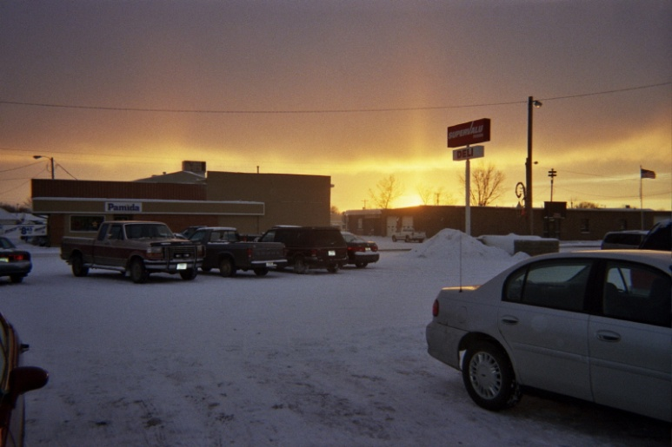
COVERAGE
Parking Lots
(RCW 51.08.013)
For example, a grocery store employee who is injured while carrying groceries to a customer’s car would be covered.

Slide 50
COVERAGE
Coming & Going
(RCW 51.08.013)
A worker injured going to and coming from the workplace in a private vehicle is generally deemed outside the course of employment.
However, the worker is covered within a company-controlled area (except a parking lot), while reporting to or leaving work.

Slide 51
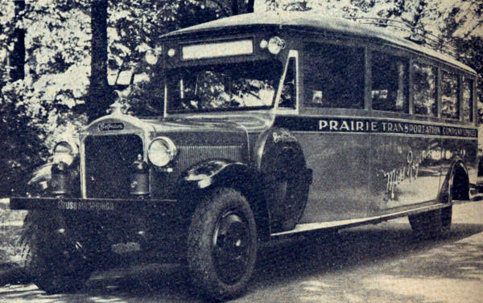
COVERAGE
Coming & Going
(RCW 51.08.013)
A worker may be covered when the employer provides transportation or compensation for travel. This arrangement can be a contractual obligation, an employee benefit, or a requirement of the job.

Slide 52
Injury vs. Occupational Disease
2.

Slide 53
Injury vs. occupational disease
When a claims manager reviews a claim, he or she begins by determining if the claim is filed for an injury or an occupational disease.
This characterization of the claim will dictate further adjudication, including the application of timely filing requirements and requirements for allowance.

Slide 54

Injury vs. occupational disease
INJURY
(RCW 51.08.100)
A sudden and tangible happening, of a traumatic nature, producing an immediate or prompt result, and occurring from without, and such physical conditions as result therefrom.

Slide 55

Injury vs. occupational disease
INJURY EXAMPLES
Joe, a maintenance worker, had to wash windows as part of his work duties. Joe decided to climb up to the top of the ladder to reach the window, and fell. Despite Joe’s contributory negligence, this is a compensable industrial injury.

Slide 56
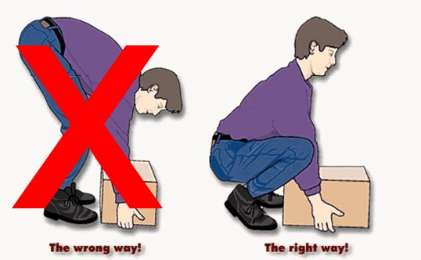
Injury vs. occupational disease
INJURY EXAMPLES
Sally, who works in the office, strains her low back at work while lifting a box. As the injury occurred in the course of Sally’s employment, this is a compensable industrial injury.

Slide 57
Injury vs. occupational disease
INJURY EXAMPLES
HOWEVER…
Employee Perry is struck in the face by his supervisor, Beverage, with a ceramic pitcher. Asked how hard he had struck Perry, the supervisor responds: “I struck him with all my might. I don’t know just how hard I did strike him.” This has been held to not constitute an industrial injury under the “deliberate intention” exception to the Industrial Insurance Act. Perry v. Beverage, 121 Wash. 652 (1922).

Slide 58
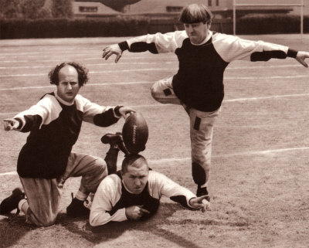
Injury vs. occupational disease
“Horseplay”
Injuries sustained on the job as a result of “horseplay” are typically compensable, so long as the worker did not deviate from the “course of employment.”

Slide 59
Injury vs. occupational disease
INJURY EXAMPLES
Bill was injured while scuffling with a co-worker during his lunch break on the employer’s premises. His co-workers had been teasing him the entire morning. This is likely a compensable injury because the injuries were received in the lunchroom. In re: Vince Polmanteer, BIIA Dec., 88 0362 (1989).

Slide 60
Injury vs. occupational disease
HOWEVER…
Frank was injured while lifting his employer’s business associate during a “beer break” near the end of normal working hours. This was deemed to be not compensable because Frank’s participation in the beer break was a deviation from and abandonment of the course of employment. In re: Thomas G. Roe, BIIA Dec., 43 694 (1974).

Slide 61

Injury vs. occupational disease
Occupational Disease
(RCW 51.08.140)
A disease or infection that arises naturally and proximately out of employment.

Slide 62
Injury vs. occupational disease
Timeliness
Claims for occupational disease must be filed within two years following the date the worker had written notice from a doctor than an occupational disease exists and a claim for disability benefits may be filed. The Department has no authority to waive the statutory filing time limit.

Slide 63
Injury vs. occupational disease
Criteria for Allowance of O.D. Claims
After timely filing, three additional requirements must be met before an occupational disease can be allowed:
(1) Legal Requirement – The disease must arise naturally and proximately out of employment; and
(2) Causal Relationship – The doctor must state, on a more probable than not basis, the disease is related to work activities; and
(3) Medical Findings – The doctor must substantiate the diagnosis with objective medical findings.

Slide 64
Injury vs. occupational disease
Common to All Employment or
Non-Employment Life
Diseases that can be contracted from conditions present in all employment or non-employment setting are considered common to all employment or non-employment life.
For example, an office worker who develops low back degenerative disc disease from 30 years of sitting, standing, and walking at work would not have a compensable occupational disease.

Slide 65
Time loss
3.

Slide 66
TIME LOSS
The Act attempts to reimburse an injured worker for the wages he or she was earning at the time of the injury.
The term “wages” may also include the reasonable value of board, fuel, housing, or other consideration of like nature received from the employer as part of the contract of hire. Rose v. DLI, 57 Wash.App. 751 (1990).
Employer-paid health insurance benefits are a form of compensation that must be included in wages used to calculate an injured worker’s time loss rate. Cockle v. DLI, 142 Wash.2d 801 (2001).

Slide 67
TIME LOSS
Time Loss Rates
Single
Married
No Dependents 60%
Each Under 18 2%
Maximum of 5 70%
No Dependents 65%
Each Under 18 2%
Maximum of 5 75%

Slide 68
TIME LOSS
Payment of Ongoing Time Loss
To be eligible for ongoing time loss, the injured worker must be receiving regular curative treatment.
The attending provider must certify the worker’s ongoing inability to work is the result of the accepted medical condition(s).
The AP must submit medical reports at approximately 60-day intervals to support ongoing time loss.

Slide 69
TIME LOSS
Provisional Time Loss
When a determination regarding claim allowance can’t be made immediately (i.e. because the employer is still investigating validity), Penser is able to make “provisional” payments of time loss when it is otherwise appropriate.
Any provisional payments must be paid back if the claim is ultimately denied.
Provisional payments are not considered a binding determination on the self-insurer or worker and must be made until a determinative order is issued.

Slide 70
Loss of earning power
4.

Slide 71
LOSS of earning power (LEP)
Earning Power is defined as the worker’s ability to earn income as a result of labor.
RCW 51.32.090 requires the self-insurer to compensate a worker for LEP when the worker’s earning capacity has decreased as a result of the industrial injury or occupational disease.

Slide 72
LOSS of earning power (LEP)
In order to be eligible for LEP, the worker:
Must have LEP exceeding 5% of wages at the time of injury.
Must have medical certification indicating the worker’s LEP is due to the industrial injury or O.D.
Must be working at any employment for income, salary, wages, or commission.

Slide 73
LOSS of earning power (LEP)
Situations where a Worker May be
Entitled to LEP
The worker returns to work at a lower wage.
The worker has more than one job at the time of injury and is restricted from performing one of the jobs even if it is not the job of injury.
The worker returns to work but is unable to work at the premium or higher rates he/she normally works.
The worker returns but must work less hours.

Slide 74
Pensions & fatalities
5.

Slide 75
Pensions & fatalities
Pensions are a monthly payment made if a worker is permanently and totally disabled from a workplace injury or occupational disease.
A Statutory Pension is defined as the loss of both legs or arms, one leg and one arm, total loss of eyesight, or total paralysis. These severe injuries qualify for placement on pension regardless of employability.
An Administrative Pension is defined as any condition that permanently incapacitates the worker from performing any work at any gainful occupation.

Slide 76
Pensions & fatalities
Surviving Spouse/Domestic Partner
The surviving spouse or domestic partner must submit an application for benefits within one year of the worker’s death.
If the death is due to the covered injury or occupational disease, pension benefits continue to the spouse or domestic partner’s death and/or eligible dependent children.

Slide 77
Pensions & fatalities
Fatalities
Fatal claims constitute an umbrella of claims where a worker either dies while on the job, or dies later from a condition contended as related.
When a beneficiary’s claim is approved, a one-time immediate payment is made if there is a spouse, domestic partner, child, or dependent. The amount of the immediate payment is 100% of the average monthly wage in the State.

Slide 78
Claim closure
6.

Slide 79
Claim closure
Medical Fixity
Vocational Fixity
A claim is ready to be closed when…
When the worker’s condition has stabilized to the point where no further “curative” treatment is required, the condition is “fixed.”
The worker must be reasonably capable of continuous gainful employment

Slide 80
Claim closure
Closing Order Timeline of Events
Closing Order is requested by Penser along with evidence showing medical and vocational fixity.
DLI issues an order identifying the dates time loss was paid and PPD if appropriate.
Any party who disagrees may protest or appeal within 60 days.

Slide 81
Permanent partial disability
7.

Slide 82
ppd
PPD is determined by a qualified examining physician after the claimant has reached maximum medical improvement.
PPD must be established by objective clinical and medical findings establishing a loss of function.
The rating must be based on medical opinion in accordance with the WAC’s and AMA Guidelines.
Permanent impairment does not mean “pain and suffering”

Slide 83
PpD
Schedule of Benefits
The schedule of benefits establishes a monetary award for permanent bodily impairment resulting from an industrial injury or occupational disease. The benefit amount on each schedule is updated every year to account for cost of living and other adjustments.
FOR EXAMPLE…

Slide 84

PpD
A worker is injured on July 2, 1994, when
a machine explodes damaging the left side
of his body. Once his conditions are
medically fixed and stable, and the worker has returned to work, the IME finds the following:
Category II low back impairment $6,107.63
25% of left leg above the knee joint
with functional stump $16,490.60
Loss of hearing in the left ear $9,772.20

Slide 85
PpD
If that same worker was instead
injured on July 2, 2009, he would be
entitled to the following:
Category II low back impairment $9,069.31
25% of left leg above the knee joint
with functional stump $24,487.13
Loss of hearing in the left ear $14,510.83

Slide 86
REOPENING
8.

Slide 87

REOPENING
Timeliness
When an injured worker applies to reopen a claim, the Department has authority to reopen injuries or occupational disease claims within 7 years from the date the first closing order became final.

Slide 88
PpD
“Aggravation” is objective worsening of the worker’s condition since the claim was last closed.
The worker must show the following:
Causal Relationship
Medical Opinion
Objective Evidence
Between the accepted condition at the time of closure and the current condition.
That the condition has worsened.
To substantiate the
medical opinion.

Slide 89
Appeals process
9.

Slide 90

Appeals process
AppealsOverview
Any aggrieved party has the right to file an appeal of a Department order within 60 days of its issuance.

Slide 91
Appeals process
Court of
Appeals
Washington
Supreme
Court
Board of
Industrial
Insurance Appeals
Superior
Court

Slide 92
Appeals process
Board of Industrial Insurance Appeals
A granted appeal begins assigned to a mediation judge, who will facilitate communication between all parties to the appeal, with the goal being resolution.
If no resolution is possible, the appeal will be assigned to a hearings judge .

Slide 93

Appeals process
Board of Industrial Insurance Appeals
Hearings before the Board follow the
rules of evidence used in Superior Court.
Hearings are a formal process, with
evidence provided by sworn witness
testimony before an industrial appeals
judge (IAJ).

Slide 94
Appeals process
Board of Industrial Insurance Appeals
After hearings are conclude, the IAJ will
issue a Proposed Decision & Order,
containing:
1. Discussion and analysis of issues
raised and evidence presented.
2. Findings of fact.
3. Conclusions of law on each
contested issue.

Slide 95
Appeals process
Board of Industrial Insurance Appeals
Any party who disagrees with the PD&O
may file a Petition for Review within 20
days of communication.
The Board must then issue a Decision
and Order which may be appealed to
Superior Court within 30 days.

Slide 96
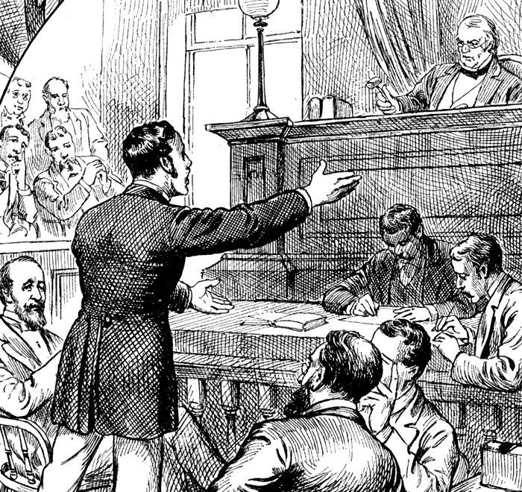
Appeals process
Superior Court
The party aggrieved by the Board’s final decision
may then appeal to Superior Court.

Slide 97
Appeals process
Superior Court
In Superior Court, one maintains the right to a trial by jury.
The parties are limited to the Board’s record.
Appeals from a final decision by Superior Court go to the Court of Appeals, and finally the Washington Supreme Court.

Slide 98

Questions???

Slide 99
RETURN TO WORK AND VOCATIONAL REHABILIATION IN Washington STATE
Craig Bock, MA, CRC – Bock Consulting
June 30, 2010

Slide 100
Revised Code of WA (RCW) WA Administrative Code (WAC)
RCW 51.32.090 – Time Loss
RCW 51.32.095 – RTW
RCW 51.32.099 – Vocational Rehab
WAC 296-19A-010 – Definitions
WAC 296-19A-070 – Ability to Work
WAC 296-19A-170 – Job Analyses
Bock Consulting

Slide 101

What is a Vocational Rehabilitation Counselor?
Counselor.
Employment Consultant.
RCW & WAC Resource.
Expert.
Information hub.
Job analyst.
Helper.
Professional.
Bock Consulting

Slide 102
What is a CRC, CDMS & ABVE?
CRC = Certified Rehabilitation Counselor.
CDMS = Certified Disability Management Specialist.
ABVE = American Board of Vocational Experts.
Bock Consulting

Slide 103
Do You Need A Vocational Rehabilitation Counselor?
RCW 51.32.090 Temporary total disability — Partial restoration of earning power — Return to available work — When employer continues wages — Limitations.
Utilizing the Work Status Activity Report and Job Descriptions prior to VRC involvement.
Bock Consulting

Slide 105

Why We Exist – RCW 51.32.095
Return to work at the employer of record.
Functional light duty. New skills acquisition.
Job Analyses.
New job.
Bock Consulting

Slide 106
Why We Exist – RCW 51.32.095
Employability. (WAC 296-19A-070)
Work history.
Transferability Work Skills worksheet.
Residual physical capacities.
Job Analyses.
WAC 296-19A-010 – (6) What is a Job Analysis?
WAC 296-19A-170 – Required information in JA.
Bock Consulting

Slide 107
RCW 51.32.099 – Vocational Rehabilitation Plans
A Vocational Rehabilitation Counselor must conclude that the worker is eligible for vocational rehab services (retraining).
Employer has 15 days from date on retraining approval letter to make a valid job offer.
If no job offer, plan development.
Bock Consulting

Slide 108

The Vocational Rehabilitation Pilot Project
Effective January 1, 2008.
Significant amendments to vocational rehabilitation services, applicability of rehabilitation services, benefits, criteria, allowable costs, and performance criteria.
Bock Consulting

Slide 109

RCW 51.32.099 – Vocational Rehabilitation Plans
90 days to develop plan.
2 years/$14,000+.
Mileage.
Plan submission. State has 15 days to respond.
Worker selects: Option 1 / Option 2.
Bock Consulting

Slide 110
QUESTIONS?
Craig Bock, M.A., CRC
Bock Consulting
www.bockconsulting.com
Bock Consulting

