Slide 1
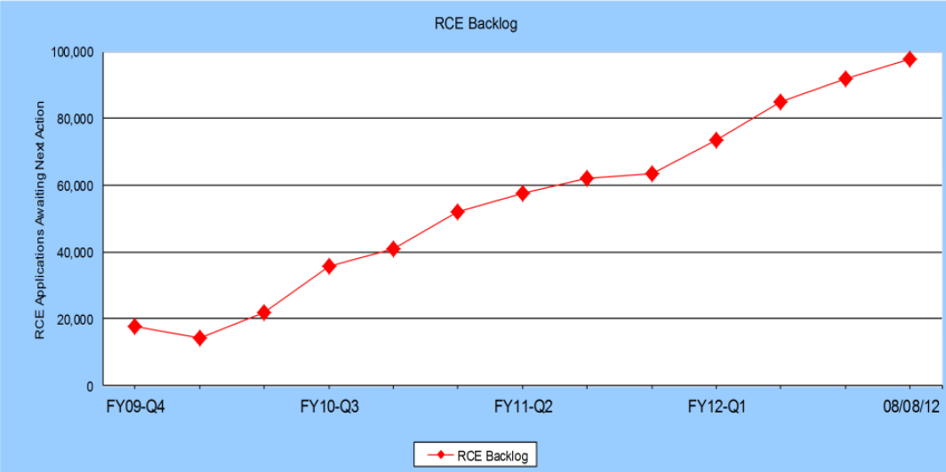
RCE Backlog
Sample: New case inventories at the end of each fiscal quarter from the fourth quarter of 2009 through August 8, 2012.
Output: The total number of RCE filings awaiting an Office action.
Finding: The inventory of RCE applications awaiting action has increased more than 4.5-fold since 2009.

Slide 2
RCE Disposals Over Time
Sample: All application disposals for the indicated fiscal year.
Output: The fraction of total application disposals that were for entry of an RCE.
Finding: RCE disposals as a fraction of total application disposals has not increased over the period that has seen the increase in RCE inventory.

Slide 3
RCE Filings per Application
Sample: Applications with final disposals from June 2008 through May 2009 or June 2011 through May 2012.
Output: The fraction of applications in the entire sample containing the indicated number of RCE filings.
Finding: A substantial majority of disposals within the sampled time period did not include an RCE. The distribution has not significantly changed since fiscal year 2009.

Slide 4
RCE Frequency and Number of Claims
Sample: Allowance disposals from June 2011 through May 2012.
Output: Applications containing the indicated number of claims and at least one RCE as a fraction of the total number of applications containing the indicated number of claims.
Finding: Applications having more than 20 allowed claims are substantially more likely to include at least one RCE than applications having fewer than 20 claims.

Slide 5
RCE by Technology
Sample: Application final disposals from June 2011 through May 2012
Output: The fraction of applications classified in the indicated technology disciplines containing the indicated number of RCE filings.
Finding: The fraction of applications containing RCE filings is generally the same across technology disciplines.

Slide 6
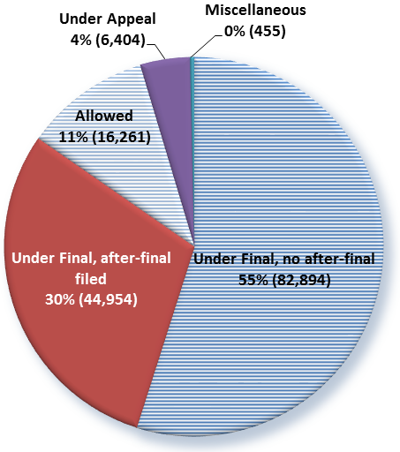
Condition of Application Prior to RCE Filing
Sample: RCEs filed Fiscal Year 2012 through September 20th.
Output: RCE filings as a function of the action that immediately preceded the RCE filing.
Finding: Two-thirds of RCEs filed were not prompted by action after final rejection.

Slide 7
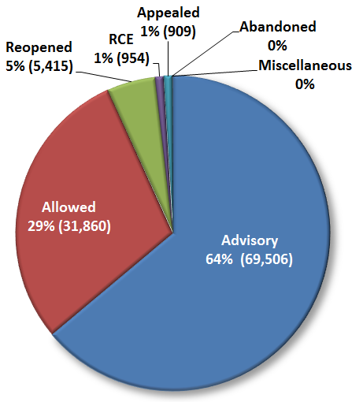
Next Action Following After-final Amendment
Sample: Responses to after-final filed Fiscal Year 2012 through September 20th.
Output: First response to an after-final amendment.
Findings: Nearly one-third of after-final submissions resulted in allowance or reopening of prosecution.

Slide 8
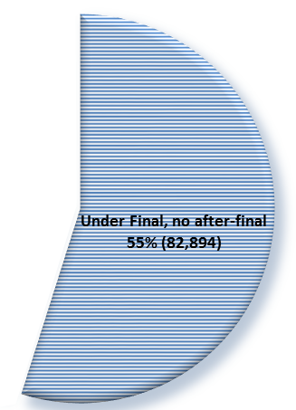
RCE with no Submission After-Final
Method:
The file history of a random sample of RCEs filed in fiscal year 2011 where no submission was filed under Rule 1.116 prior to the RCE filing was reviewed.
Findings:
27% of applications in which no response was filed after final were allowed in the first action after RCE. (Compare with 29% allowance rate after final.)
Assuming 25% of RCEs in this sample could have been allowed after final, more than 20,000 RCEs might have been avoided with after-final submissions.

Slide 9
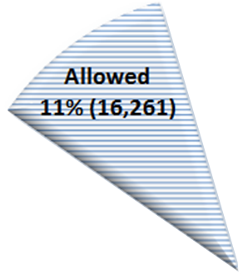
Sampling of RCEs Filed After Allowance
Method:
The file history of a random sample of applications having IDSs filed in fiscal year 2011 after allowance but prior to submission of the issue fee with or without an RCE was reviewed.
Findings
19% of RCEs filed after allowance included only an IDS and also included certification under 1.97(e). These submissions could have been made in the allowed application.
On average, a substantially larger number of references were cited in IDSs filed with an RCE (11 references) than without an RCE (3 references).
A substantially larger proportion of RCE filings (27%) included IDSs citing more than 20 references than without an RCE (4%).

