Slide 1
Data Strategy
PLEASE NOTE THAT THE DATA SHARING “BUBBLES” EXPLAINED IN THIS PRESENTATION ARE CONCEPTUAL. THEY ARE NOT CURRENTLY IN USE AND ARE NOT REQUIRED IN THE FACTS II BID PROCESSES AT THIS TIME.

Slide 2
FACTS II Interfaces Example of interfaces with at least 30 repositories
Delaware Courts systems: 5 systems / repositories.
Delaware Department of Justice systems: 1 system / repository.
• Delaware Department of Health and Social Services: 13 systems / repositories
Delaware Department of Education: 2 systems / repositories
• Delaware Department of Labor: 1 system / repository
• Delaware Department of Revenue: 1 system / repository
Delaware Department of Technology and Information: 1 system / repository
Delaware Office of State Planning Coordination: 1 system / repository
Office of Management and Budget: 3 systems / repositories.
Delaware Department of the Treasury: 1 system / repository
PNC Bank: 1 system / repository
Prevent Child Abuse Delaware: 1 system / repository
National Adoption Committee: 1 system / repository
Local Police Departments: 1 system / repository

Slide 3
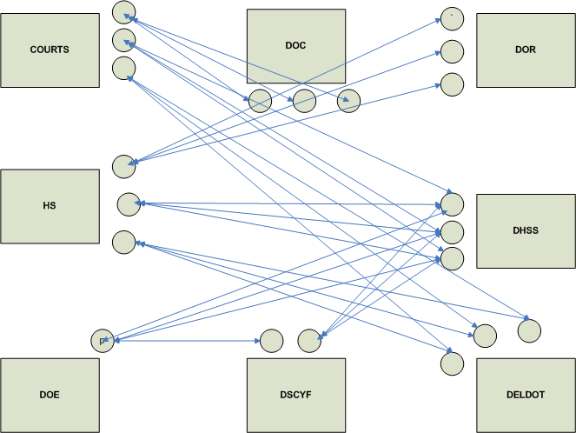
Current Data Sharing Interfaces - An Example( Simplified for Legibility)
Notes:
Current Data Sharing Interfaces - An Example
Highlighted above are some organizations with fairly large amount data. Each of these organizations have multiple data repositories indicated by the small circles. Each of these data repositories serve specific applications. Each of these applications in turn may need data from one or more of the similar data repositories within the same agency or across multiple agencies. This need is satisfied by the interfaces as pictured by the straight lines above. The above picture depicts only an example and in reality there are several hundred interfaces that exist today. The growth in this model is unsustainable. The next slide shows a picture of where we are heading.

Slide 4
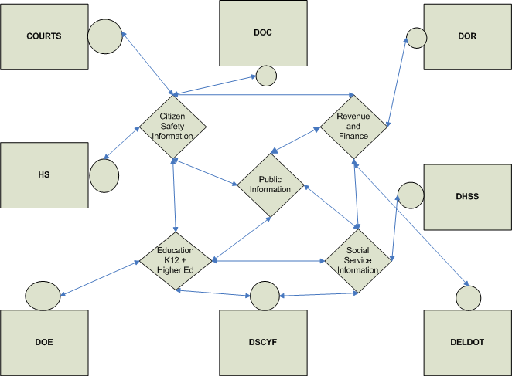
Future of Data Sharing and Interfaces – Proposed Path
Notes:
Future of Data Sharing and Interfaces – Proposed Path
In this picture the like data are identified as major shared-repositories. All the shared information pertaining to education stays in one repository enabling various applications(business functions) within DOE and outside of DOE to have access as authenticated. Similar Shared-repositories and access of data in them, would create a more sustainable, efficiency driven data model for the state.

Slide 5
Multiagency Applications and other User Applications
Public Information
Confidential Information
Agency Specific Information
OMB and labor | Environmental | Corporations | Revenue and Finance | Transportation | Education | Regulations and Permits | Social and Health | HS, Courts, Corrections
Notes:
A simplistic picture of all major shared-repositories providing to benefit the citizens. Applications from various agencies could have access to these repositories(as authorized) to allow effective use of data that already exists within the state.

Slide 6
Network Architecture

Slide 7
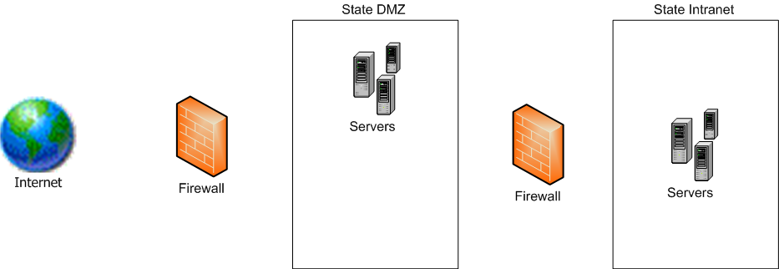

Slide 8
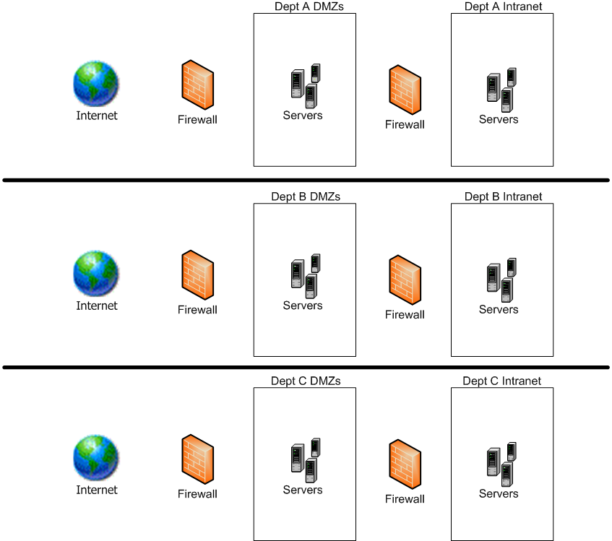
Managed Connectivity

Slide 9
Integration Options Across Depts
Utilize the State’s ETL solution
Web Services
File exchange via sftp

Slide 10
System Architecture

Slide 11
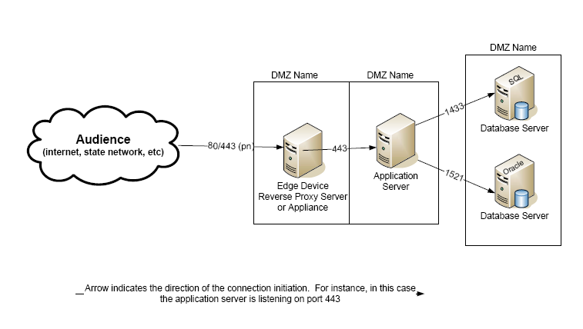
Network Template

Slide 12
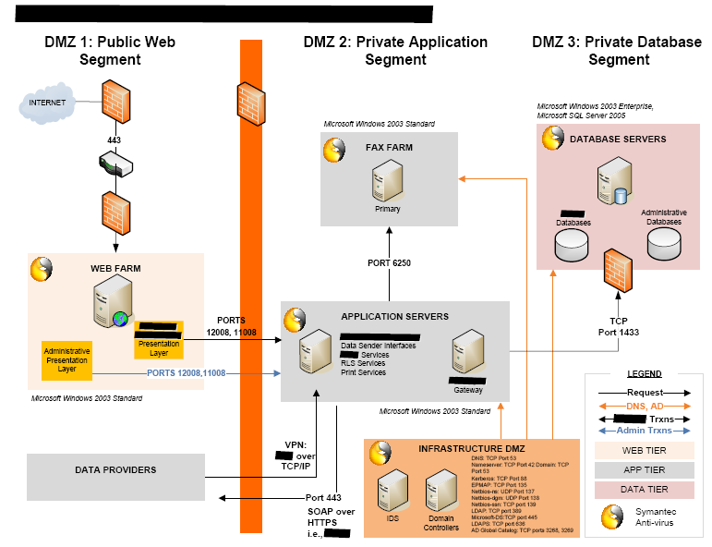
Sample Network Diagram

