Slide 1
Supportive Services for Veteran Families (SSVF)
www.va.gov/homeless
John Kuhn, LCSW, MPH
Acting National Director, SSVF

Slide 2
Presentation
Who should SSVF serve?
What do we know about population?
Outreach.
SSVF program features.

Slide 3
Design of SSVF
Focus on housing stability with resources and services designed to produce immediate impact.
Efficient use of resources concentrates efforts on securing and maintaining housing.
Grant funding weighted towards rapid re-housing.
Case management will assist Veteran and family with employment and benefit resources that will promote long-term stability.
Program able to address critical barriers to housing: legal issues, transportation, child care, family issues.

Slide 4
Who Is Served
Targeting, who is at-risk of becoming homeless?
Once at-risk are identified, how do we determine who at-risk would become homeless “but for” intervention. Even rapid re-housing can be unnecessary; one-third of Veterans stay in shelters less than 1 week & generally leave without special intervention.
Determining the appropriate (and efficient) response to support housing stability
Mainstream services
Intensive case management
Financial supports
Sustainability

Slide 5
Who Is Served
Case mix has implications for service needs and cost.
Primary Prevention
Veteran family still housed
Generally less costly to serve
May have no or few social service supports. Assess eligibility for mainstream entitlements, including those from VBA, and other income supports such as TANF
Secondary or Tertiary Prevention
Homeless will likely have greater needs, particularly for tertiary (often chronically homeless) prevention
Higher demands for financial assistance and case management
Will generally have some community support and access to services which can be integrated into planning.

Slide 6
Who Is Served
Assessment must address if SSVF is appropriate in the context of the range of available options in both VA (such as GPD & HUD-VASH) and the community.
Assessment based on Veteran’s needs, not program convenience.
Resources need to be well targeted so they are available for those in need.
SSVF has unique capacities to serve families and provide financial support.

Slide 7
Federal Strategic Plan to Prevent & End Homelessness
Interagency Council on Homelessness: Opening Doors
Knowledge Objective:
“Strengthen the capacity of public and private organizations by increasing knowledge about collaboration, homelessness, and successful interventions to prevent and end homelessness.”

Slide 8
Location of Homeless Veterans*
Almost half of homeless Veterans on a given night were located in four states: California, Florida, Texas, and New York. Only 28 percent of all Veterans were located in those same four states.
The share of homeless Veterans located in the densest urban areas (or principal cities) is more than twice that of all Veterans (72 percent compared to 31 percent).
During the course of the year, 33 percent of Veterans experiencing homelessness stayed in emergency shelter for less than one week, 61 percent stayed less than one month, and more than 84 percent Veterans stayed in emergency shelter for less than 3 months.
U.S. Department of HUD and U.S. Department of VA. Veteran Homelessness: A Supplemental Report to the The Annual Homeless Assessment Report to Congress. February 2011.

Slide 9
Homeless Veterans are Older Than General Homeless Population
39 percent of homeless Veterans are 51–61 years compared with 19 percent of homeless non-Veterans.
9 percent of homeless Veterans are 62 years and older compared with 4 percent of homeless non-Veterans.
Veterans are older and are more disabled. About 53 percent of individual homeless Veterans have disabilities, compared with 41 percent of sheltered homeless non-Veteran individuals.

Slide 10
Populations at Higher Risk
Ten percent of Veterans in poverty became homeless at some point during the year, compared to just over 5 percent of adults in poverty.
Rates of homelessness among Veterans living in poverty are particularly high for Veterans identifying as Hispanic/Latino (1 in 4) or African American (1 in 4).
Female Veterans are twice as likely to be in the homeless population as they are to be in the U.S. adult female population.
Younger Veterans, age 18-30, in poverty are 3.3 times more likely to be homeless that other adults of that age.

Slide 11
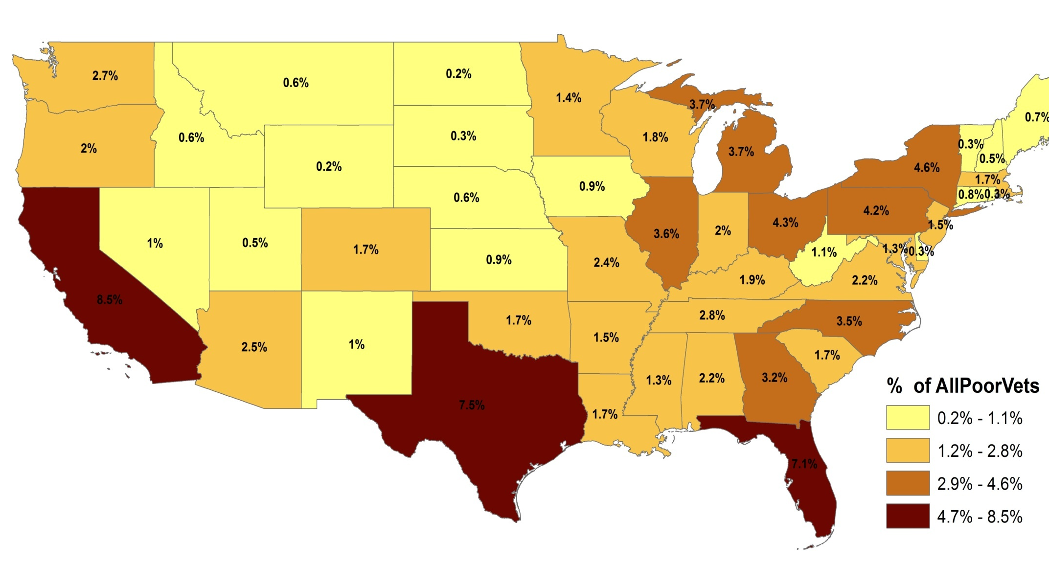
Distribution of the 1,356,610 Veterans in Poverty

Slide 12
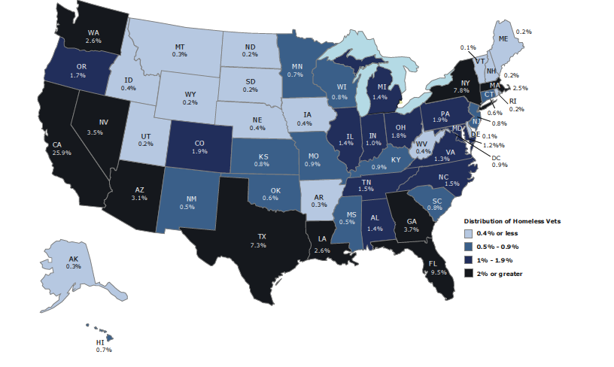
Distribution of Homeless Veterans

Slide 13
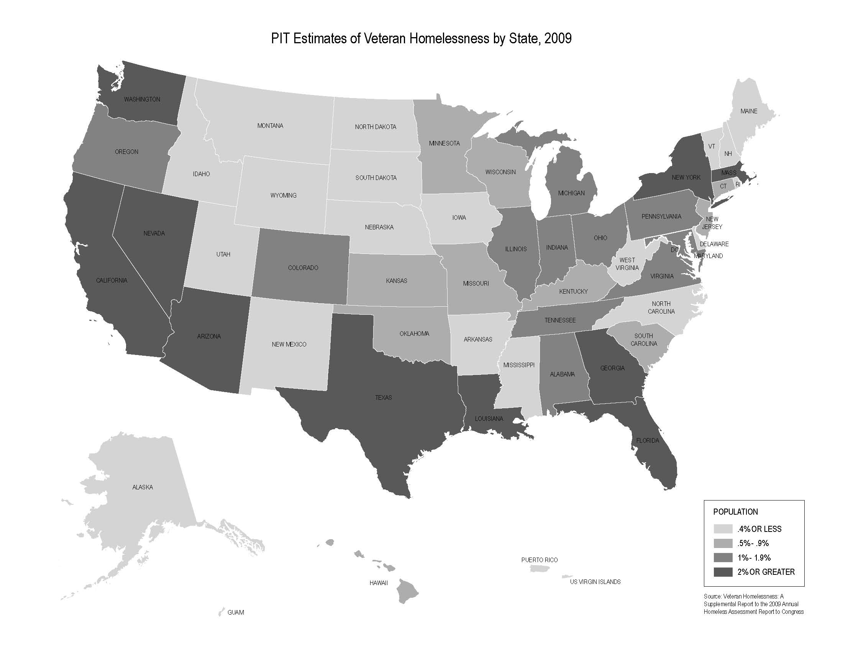
Sites Awarded SSVF Grant Funds

Slide 14
Consumer Choice
In many social service programs, recommendations for system designs have generally been made with little consumer input.
We begin with a recognition that every person/family who is homeless or at-risk has different concerns and needs to be addressed. These concerns may not match agency/provider interests.
Homelessness only describes living conditions, does not identify the individual needs and aspirations.
To get to Zero, must engage all Veterans - requires the development of a broad continuum of care that can address the needs identified by Veterans.
By making consumers active partners, clinicians are more likely to successfully engage them in care (Beck, 2010).

Slide 15
Top Ten Highest Unmet Needs as Ranked by Consumers (FY 2010)
Veterans Literally Homeless (shelter, street, unfit for habitation) (n=3,184) | Veterans in Transitional Housing (VA Grant and Per Diem and Domiciliary) (n=6,111) | Veterans in Permanent Housing (including HUD-VASH) (n=2,672)
Long-term, permanent housing Welfare payments Dental Care Guardianship (financial) Legal assistance for child support issues Job training Legal assistance for outstanding warrants/fines SSI/SSD process Family reconciliation assistance Job finding | Welfare payments Child care Legal assistance for child support issues Family reconciliation assistance Guardianship (financial) SSI/SSD process Long-term, permanent housing Legal assistance for outstanding warrants/fines Discharge upgrade Women’s health care | Dental care Legal assistance for child support issues Welfare payments Child care Legal assistance for outstanding warrants/fines Family reconciliation assistance Credit counseling Re-entry services for incarcerated Veterans Legal assistance to help restore a driver’s license Job training

Slide 16
Overview of SSVF Program
How SSVF Differs from Other VA Programs
Remember the goal is Housing Stability and is not contingent on treatment. A Housing First philosophy is focus of both the homelessness prevention and rapid re-housing interventions.
Grantees will be community-based organizations
Grantees will serve Veterans and their families. Families can continue to receive services for up to a full year if the Veteran leaves due to institutionalization, death, or other causes.
Temporary financial assistance payments may be provided to third parties on behalf of participants

Slide 17
SSVF Program Participant Eligibility
Veteran Family:
Veteran* who is a single person, or
Family in which the head of household, or the spouse of the head of household, is a Veteran
Very Low-Income: <50% area median income
Additional Focus on serving:
Veteran families earning less than 30% of area median income (AMI) as most recently published by HUD (http://www.huduser.org)
Veterans with at least one dependent family member
Chronically homeless Veteran families
Formerly chronically homeless Veteran families
*”Veteran” means a person who served in the active military, naval, or air service, and who was discharged or released under conditions other than dishonorable.

Slide 18
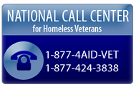
Outreach
Healthcare for Homeless Veterans
The Health Care for Homeless Veterans (HCHV) Program is designed to connect homeless Veterans to assistance through community outreach.
HCHV’s central goal is to reduce homelessness among Veterans by conducting outreach to those who are the most vulnerable and are not currently receiving services and engaging them in treatment and rehabilitative programs.
Stand-Downs
Collaborative, 1 to 3 day events
for homeless Veterans
Coordinated with other government
& community agencies
18
Notes:
18

Slide 19
Outreach
19
9% of all inmates are Veterans; 200,000 nationwide
15%+ of all inmates homeless; greater numbers at-risk
VA criminal justice programs: Health Care for Re-Entry Veterans (HCRV) and Veterans Justice Outreach (VJO).
HCRV designed to meet community re-entry needs. Resources are described in state guides www.va.gov/HOMELESS/Reentry_Guides.asp
VJO seeks to avoid unnecessary criminalization of mental illness by providing access to substance use treatment and mental health services. VA VJO contacts can be found at www.va.gov/HOMELESS/VJO.ASP
Notes:
19

Slide 20
SSVF Supportive Services (Universal)
Active outreach both in community and with local VA.
Case management services
Careful assessment of needs in developing plans
Providing identified services directly or through referrals
Deciding how resources are allocated to participants
Assist participants to obtain VA benefits
Service connected benefits and NSC pension
Educational benefits and vocational services
Health care
Obtaining mainstream entitlements and services
Legal assistance
Credit counseling & financial planning
Income assistance & health insurance
Housing counseling

Slide 21
SSVF Financial Assistance
(limited to 30% of budget)
Type of Temporary Financial Assistance | Time/Amount Limitation
Rental Assistance* | Max. of 8 months in a 3-year period; no more than 5 months in any 12-month period
Utility-Fee Payment* Assistance | Max. of 4 months in a 3-year period; no more than 2 months in any 12-month period
Security Deposits or Utility Deposits* | Max. of 1 time in a 3-year period for security deposit; Max. of 1 time in a 3-year period for utility deposit
Moving Costs* | Max. of 1 time in a 3-year period
Emergency Supplies* | Max. $500 during a 3-year period
Child Care** | Max. of 4 months in a 12-month period
Transportation** | Tokens, vouchers, etc. – no time limit Car repairs/maintenance – max. of $1,000 during 3-year period
*See § 62.34 of Final Rule for additional requirements and restrictions.
**See § 62.33 of Final Rule for additional requirements and restrictions.

Slide 22
SSVF Financial Assistance
Funding is limited. Careful stewardship necessary for funds to last through the grant period.
Develop clear criteria for eligibility.
Ad hoc decisions will create system where best case manager advocates get funds for clients.
Remember “but for” criteria.
Exhaust entitlements and community resources, such as TANF, first
Support based on a sustainability plan
What happens when subsidies end?
What can Veteran contribute, even if modest amount?

Slide 23
Overview of SSVF Program
How SSVF Complements Other Programs
In addition to VA supports, SSVF grantees access universal prevention services, entitlements, and other available community resources.
National Foundation for Credit Counseling, www.nfcc.org, a
counselor can be reached at (800)388-2227
Legal Assistance: www.lawhelp.org and
http://statesidelegal.org
SOAR (SSI/SSD):
www.prainc.com/SOAR/soar101/states.asp
Resource Directory: www.nationalresourcedirectory.gov
Available income, health, educational and other supportive
services benefits: www.govbenefits.gov
Notes:
HUD VASH
Replicate, partner with and learn from successful local scattered site supportive housing programs
Shelter + Care
Community Mental Health
Replicate what has worked with experienced PSH for homeless Veterans across the country
Use VASH vouchers to set aside units in new & existing supportive housing projects
Projects in development may need operating subsidies for units to serve homeless Veterans
Local funding partnerships integrate capital, operating and services resources to produce supportive housing
Partner with affordable housing providers who offer resident services to build healthy communities
Integrated housing opportunities for families and people with disabilities
Deliver effective supportive housing opportunities for homeless Veterans – invest in quality!
CTI
- This is a time limited case management model to ensure housing stability through transitional services tiered to be reduced over time as individuals exit from institutional systems of care.
- The premise is to strengthen an individual’s long-term ties to services, family, friends and other support networks to assist in reducing the possibility of an individual or family cycling out in to homelessness.
-CTI ideally lasts no more than 9 months and is broken down in to 3 phases that each last approximately 3 months.
- Consists of 3 phases
Transition to Community
Try-Out
Transfer of Care

Slide 24
Requirements for the Use of SSVF Grant Funds
Uses of SSVF Grant Funds
<10% Admin
<10%
Admin
20-35%
(Categ. 1: Residing in Perm. Housing)
60-75% (Categs. 2 & 3: Transitioning from Homelessness to Perm. Housing)
60-75%
*Note: Once placed, a category 2 or 3 participant, becomes a category 1 participant. For budgeting purposes, there is a 30 day transition period where previously homeless Veterans can still be expensed as a category 2 or 3 participant before these expenses must be shifted to Category 1.

Slide 25
Goals
Prevent and reduce homelessness
Offer critical new element to continuum of care, a time-limited intervention focused on housing stability (not contingent on treatment & rehabilitation).
Identify best practices and promising approaches. Using HMIS to collect comparable data. Implementation and impact assessed by National Center on Homelessness Among Veterans.
Improve targeting.

