Slide 1
Opiate Risk Mitigation in Primary Care
Ilene R. Robeck, MD
Bay Pines VA Healthcare System
Co Chair National VA Primary Care Pain Task Force
It’s Never Too Late to Start All Over Again
Every Challenge is an Opportunity for Growth

Slide 2
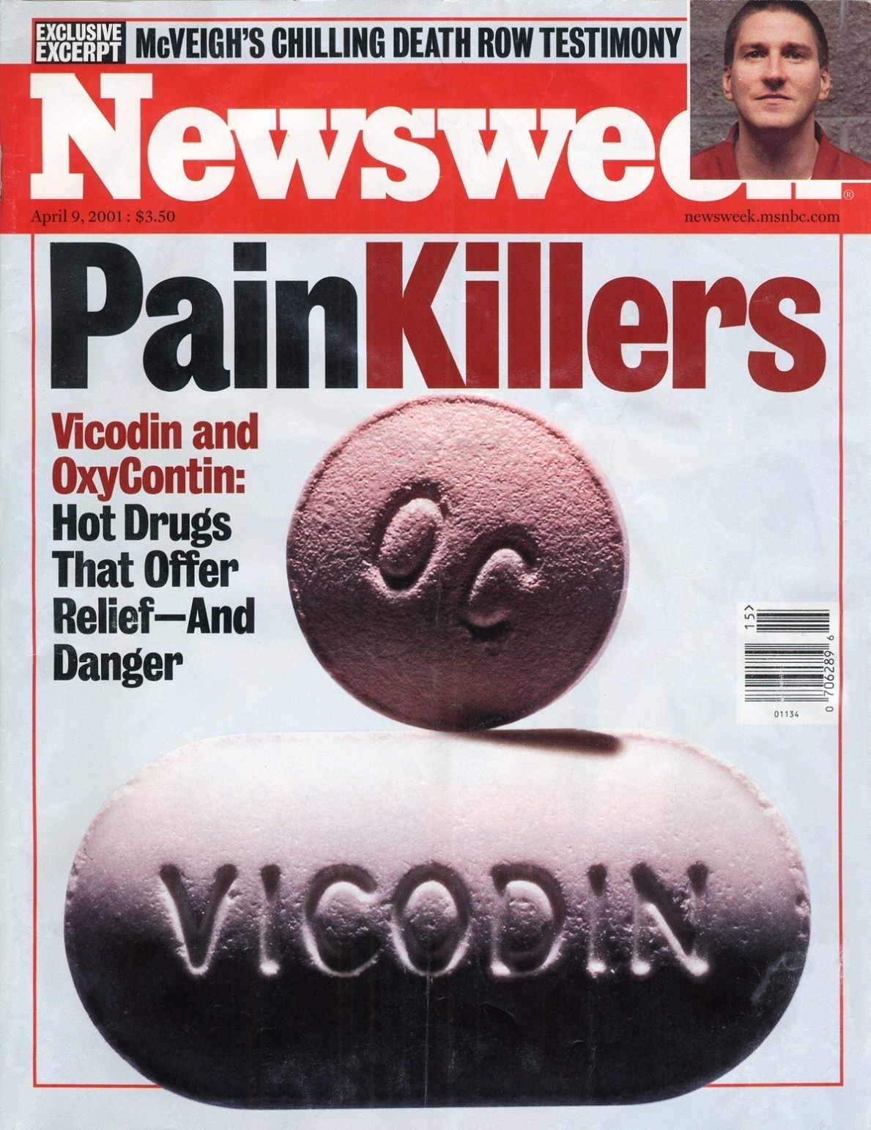

Slide 3
History of Opiate Addiction/Dependence Déjà Vu All Over Again
Sixteenth century-the first reports about addiction to opium throughout Europe, India and China.
Early 1800s, the chemist Seturner was able to isolate and identify the active ingredient in opium, which he named Morphine after the Greek god Morpheus. This was touted as the solution to Opium Addiction.
Throughout the early and mid-1800s, morphine was used during surgical procedures as a general anesthetic and as relief for chronic pain. By the end of the century there were just as many individuals addicted to morphine as there were to opium.
Late 1800s- medical profession’s creation of so many morphine addicts led to experiments with cocaine as a potential antidote.

Slide 4
A Brief History of Opiate Addiction
Chemists believed they discovered a non-addictive form of opiate around the turn of the nineteenth century –Heroin. The Bayer Company started the production of heroin in 1898.
Over the course of the next century, governments around the world, would begin to recognize the dangers of heroin, morphine and opium. Soon these drugs were outlawed for medicinal purposes, and pushed underground.
Late nineteenth century Laudanum (a tincture of raw opium in 50 percent alcohol) was prescribed to women complaining of “female problems”. Epidemiological studies conducted in Michigan, Iowa, and Chicago between 1878 and 1885 reported that at least 60 percent of the morphine or opium addicts living there were women.

Slide 5
A Brief History Opiate Addiction
Huge numbers of men and children, too, complaining of ailments ranging from acute pain to colic, heart disease, earaches, cholera, whooping cough, hemorrhoids, hysteria, and mumps were prescribed morphine and opium.
A survey of Boston’s drugstores published in an 1888 issue of Popular Science Monthly -of 10,200 prescriptions reviewed, 1,481, or 14.5 percent, contained an opiate.
During this period in the United States and abroad, the abuse of addictive drugs such as opium, morphine, and, soon after it was introduced to the public, cocaine constituted a major public health problem..

Slide 6
A Brief History Opiate Addiction
1960s Methadone Maintenance was established as a safer alternative to Heroine Addiction as it decreased crime, complications of iv drug use and sexually transmitted diseases associated with risky behavior linked to Heroine use. However, problems related to concomitant use of other drugs of abuse, overdose deaths and chronic pain in Methadone patients has created ongoing controversy.
In 1996 Purdue marketed a new opiate formulation felt to be less addictive than previous formulations and was touted as the new treatment for chronic pain with minimal side effects and risk of addiction. The name of that drug was Oxycontin.
2002 –Suboxone approved for Opiate Dependence and Addiction. However problems related to recreational use and overdose when mixed with other substances have raised concerns about Suboxone maintenance when not properly supervised.

Slide 7
The NEW ENGLAND JOURNAL of MEDICINE Flood of Opioids, a Rising Tide of Deaths
Prescription opioids caused 11,499 of the deaths in 2007 — more than heroin and cocaine combined
Admissions to substance-abuse treatment programs increased by 400% between 1998 and 2008
Prescription painkillers are the second most prevalent type of abused drug after marijuana
In almost every age group, men have higher death rates from drug overdoses than women
About half of those who died had a medical history of pain treatment

Slide 8
Opiate Related Deaths
Respiratory depression leading to an opioid-related death is exacerbated by the presence of additional substances, including alcohol, illicit drugs, and other prescription medications, particularly benzodiazepines
Benzodiazepine use has been found to contribute to life threatening sleep-disordered breathing
Examiner found benzodiazepines involved in more than a third of prescription drug deaths in 2006

Slide 9
Overdose and Prescribed Opioids
Estimated Annual Overdose Rates were
0.2% for patients receiving less than 20 mg per day
0.7% for patients receiving 50 to 99 mg per day
1.8 % for patients receiving 100 mg or more per day
Above doses all in Morphine equivalents
88 % of identified overdoses were nonfatal but required hospitalization
Higher in patients over 65 or had a history of substance abuse treatment or had a history of depression
Annual rate of overdose 148 per 100,000 person-years overall
Highest after a prescription refill or new prescription

Slide 10
Patients at Highest Risk
Patients over 65
Patients on 100 mg of Morphine or equivalent per day
Patients with underlying lung disease
Patients with underlying liver disease
Patients with comorbid substance use disorder
Patients with comorbid Mental Health Disorder
Patients on Benzodiazepines

Slide 11
: Trends in Emergency Department (ED) Visits Involving the Nonmedical Use of Narcotic Pain Relievers
2004 144,644
2005 168,376
2006 201,280
2007 237,143
2008 305,885

Slide 12
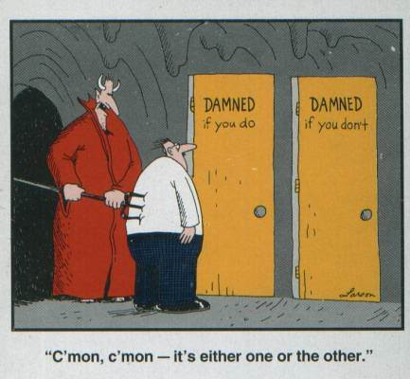

Slide 13
Primary Care
40% of all outpatient visits are related to pain¹
50% of male veterans and 75% of female veterans report presence of pain^{2,3}
More than half of all CNCP is managed by primary care providers ⁴
^{1.}Poleshuck, EL, Bair, MJ, Kroenke K. et al. Patients Presenting with Somatic Complaints: Epidemiology, Psychiatric Comorbidity and Management. Int J Methods Psychiatr Res. 2003; 12(1): 34-43.
^{2.} Kerns, R.D., Otis, J.D., Rosenberg, R. Veterans’ Reports of Pain and Associations with Ratings of Health, Health Risk Behaviors, Affective Distress, and Use of the Healthcare System. Journal of Rehabilitation Research and Development. 2003; 40, 371-380.
^{3.}Haskell SG, Heapy A, Reid MC, Papas RK, Kerns RD. The Prevalence and Age-Related Characteristics of Pain in a Sample of Women Veterans Receiving Primary Care. J Women's Health. 2006;15(7):862-869.
^{4.}Breuer, B, Cruciani, R, Portenoy, R K. Pain Management by Primary Care Physicians, Pain Physicians, Chiropractors, and Acupuncturists: A National Survey. Southern Medical Journal. 2010; 103(8):738-747.

Slide 14
Barriers to Pain Management in Primary Care
1. Inadequacies in education and training
2. Lack of consultant support
3. Psychosocial Complexity
4. Time Pressures
5. Skepticism
6. Systems Limitations

Slide 15
Approach to the Patient with High Opioid Risk
Be nonjudgmental in all interactions
Take a risk vs benefit approach in explanations for further treatment options
Show a commitment to continue to work with the patient for pain control whether opioids are used or a non opioid approach will be taken
Make appropriate referrals and schedule careful follow-up

Slide 16
Approach to the High Risk Opioid Patient
Whenever possible taper opioids slowly to prevent withdrawal symptoms
Understand non-opioid options for withdrawal when necessary
Educate about the possible benefits of a lower opioid dose or discontinuation of opioids when the decision is made that the risks outweigh the benefits
If the patient is resistant to Addiction Treatment and/or other Mental Health Treatment continue to offer this as an option at every visit. Untreated Addiction and Mental Health disorders remain added side effects of risky opiate prescribing in these populations.

Slide 17
Universal Precautions in Pain Medicine
Diagnosis with appropriate differential
Psychological assessment including risk of addictive disorders
Informed consent
Treatment agreement
Pre/Post Interventions Assessment of Pain level and Function
Appropriate TRIAL of opioid therapy with adjunctive therapy

Slide 18
Universal Precautions in Pain Medicine
Reassessment of pain score and level of functioning
Regularly asses the “Four As” of pain medicine: Analgesia, Activity, Adverse reactions, Aberrant behavior
Periodically review pain diagnosis and co- morbid conditions, including addictive disorders
Documentation

Slide 19
Opioid Agreement
Patients agree to comply fully with all aspects of the treatment program including behavioral medicine and physical therapy if recommended
A prohibition on use with alcohol, other sedating medications or illegal medications
Agreement not to drive or operate heavy machinery until medication-related drowsiness is cleared

Slide 20
Opioid Agreement
Opioid prescriptions are provided by only one Provider
Patients agree not to ask for opioid medications from any other doctor without the knowledge and assent of the provider
Patients agree to keep all scheduled medical appointments
Urine drug screens will be obtained as indicated

Slide 21
Opioid Adverse Effects
Hyperalgesia
Hypogonadism
Sedation
Cognitive Impairment
Constipation
Nausea/Vomiting
Pruritis
Respiratory Depression
Central Sleep Apnea

Slide 22
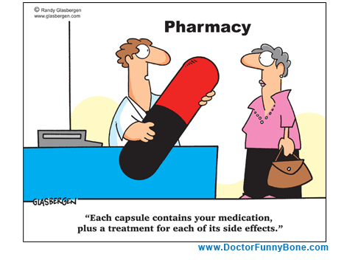

Slide 23
Behaviors More Suggestive of an Addiction Disorder
Selling prescription drugs
Prescription forgery
Stealing or “borrowing” drugs from others
Injecting oral formulations
Obtaining prescription drugs from nonmedical sources•
Concurrent abuse of alcohol or illicit drugs

Slide 24
Behaviors More Suggestive of an Addiction Disorder
Multiple dose escalations or other noncompliance with therapy despite warnings
Multiple episodes of prescription “loss”
Repeatedly seeking prescriptions from other clinicians or from emergency rooms without informing prescriber or after warnings to desist
Evidence of deterioration in the ability to function at work, in the family, or socially that appear to be related to drug use
Repeated resistance to changes in therapy despite clear evidence of adverse physical or psychological effects from the drug

Slide 25
Behaviors Less Suggestive of an Addiction Disorder-But Need to Be Addressed
Aggressive complaining about the need for more drug
Drug hoarding during periods of reduced symptoms
Requesting specific drugs
Openly acquiring similar drugs from other medical sources
Unsanctioned dose escalation or other noncompliance with therapy on one or two occasions
Unapproved use of the drug to treat another symptom
Reporting psychic effects not intended by the clinician
Resistance to a change in therapy associated with “tolerable” adverse effects with expressions of anxiety related to the return of severe symptoms

Slide 26
Explanations for Aberrant Behavior
Pseudoaddiction – Addictive behavior primarily motivated by poor pain control
Addiction –Loss of control, compulsive use, continued use despite harm, and craving.
Tolerance – Decreased effect from previously effective opioid dose. (Can a safe opioid dose be used?)
Diversion

Slide 27
Explanations for Aberrant Behavior
Self medication of underlying Psychiatric Symptoms
Hyperalgesia – The opioid has caused a worsening of pain control and the dose may need to be decreased or the opioid tapered and discontinued
Disease progression with the need for reevaluation

Slide 28
Urine Drug Screen
Urine drug screens typically check for evidence of opiate, alcohol, benzodiazepine, cocaine, marijuana, amphetamine and barbiturate use
Some opiates may need to be specifically requested such as oxycodone, fentanyl, and methadone

Slide 29
Length of Time Drugs of Abuse Can Be Detected in Urine
Alcohol 7-12 hours
Amphetamine 48 hours
Barbiturate 24 hours to 3 weeks
Benzodiazepines 3 days to 1 month
Cocaine 3 days
Marijuana 3 days to over 1 month
Opioids 48 hours to 4 days

Slide 30
Urine Drug Screens
Parameter | Diluted | Adulterated
Creatinine | Less than 20
ph |  | Less than 3 Greater than 11
s.g. | Less than 1.003
nitrite |  | Greater than 500

Slide 31


Slide 32
Marijuana’s Effects on the Brain
Cerebellum -Body movement coordination
Hippocampus-Learning and memory
Cerebral cortex –Higher cognitive functions
Nucleus accumbens –Reward
Basal ganglia – Movement control
Hypothalamus – Body housekeeping function
Amygdala – Emotional Response, fear
Spinal Cord – Peripheral sensation
Brain stem – Sleep and arousal, temperature regulation, motor control
Central gray – Analgesia
Nucleus of the solitary tract – Visceral sensation, nausea and vomiting

Slide 33
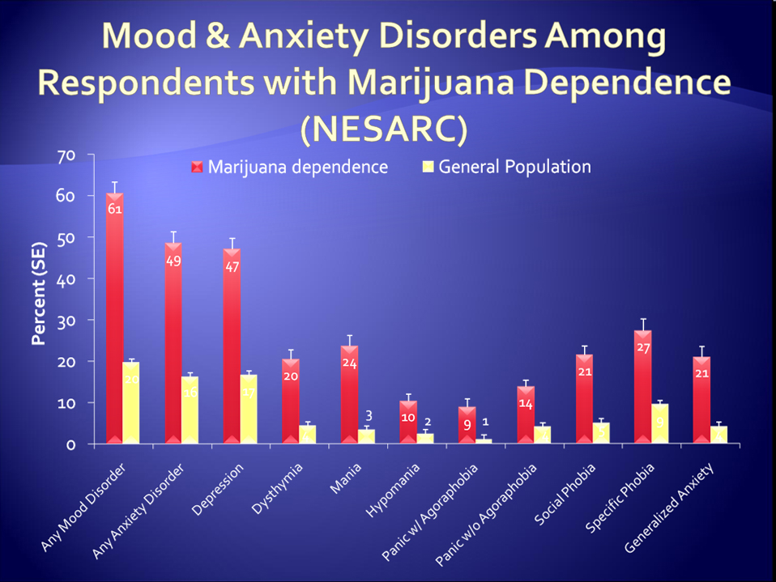

Slide 34
Clinical Considerations Regarding Veteran Patients Who Participate in State-Approved Marijuana Programs December 29, 2010
Controlled Substances Act classifies marijuana a Schedule I drug with no proven medical value and a 2006 FDA review found that marijuana had no legitimate medical uses.
Using a non-judgmental approach, the VA provider should ensure that the patient is aware of current evidence regarding the health effects of marijuana use, symptoms of marijuana withdrawal and marijuana use disorders, the availability of evidence-based treatments for marijuana use disorders and reduction of marijuana withdrawal symptoms, and other options for treatment of their condition.

Slide 35
Medical Marijuana and the VA
Providers should also remind patients that it is illegal to possess marijuana for any purpose on VA property.
VHA Directive 2010 - 035 prohibits denying Veterans access to most clinical programs solely because of their participation in State-approved marijuana programs and the VHA Pain Management Program Office strongly supports this policy. Veterans may be restricted from participating in some clinical programs when smoking any substance is an exclusion criterion (for example, organ transplant programs)

Slide 36
Medical Marijuana and the VA
When determining the appropriateness of a trial of an opioid, assessment of risk for development of prescription medication misuse and addiction or diversion should be specifically included. In most cases, when there is moderate to high risk of medication misuse, addiction and/or diversion, opioids should not be considered as part of the plan of care, and alternative methods to control the patient’s pain should be identified and considered.
When therapy with an opioid is being considered, Veterans should be fully informed of potential benefits and risks of using opioids for pain control, including the increased risks associated with combining use of opioids and marijuana such as motor vehicle operation and possible memory deficits that could affect medication adherence.

Slide 37
Methadone Risks
QTc Prolongation
Drug Interactions
Long and variable half life (15-60 hours) Can be as high as 120 hours
Possible persistence of metabolites after period of analgesia has worn off

Slide 38
Standards of Practice
A complete medical history and a physical examination should be conducted before beginning any treatment and must be documented in the medical record.
The medical record should document the nature and intensity of the pain, current and past treatments for pain, underlying or coexisting diseases or conditions, the effect of the pain on physical and psychological function, a review of previous medical records, previous diagnostic studies, and history of alcohol and substance abuse.

Slide 39
Standards of Practice
The medical record should also document the presence of one or more recognized medical indications for the use of a controlled substance.
Each provider should develop a written plan for assessing each patient’s risk of aberrant drug-related behavior, which may include patient drug testing.
Each provider should assess each patient’s risk for aberrant drug-related behavior and monitor that risk on an ongoing basis in accordance with the plan.

Slide 40
Standards of Practice
Each provider should develop an individualized treatment plan for each patient.
The treatment plan should state objectives that will be used to determine treatment success, such as pain relief and improved physical and psychosocial function, and should indicate if any further diagnostic evaluations or other treatments are planned.
After treatment begins, the physician should adjust drug therapy to the individual medical needs of each patient.
.

Slide 41
Standards of Practice
Other treatment modalities, including a rehabilitation program, should be considered depending on the etiology of the pain and the extent to which the pain is associated with physical and psychosocial impairment.
The interdisciplinary nature of the treatment plan should be documented
The physician should discuss the risks and benefits of the use of controlled substances, including the risks of abuse and addiction, as well as physical dependence and its consequences, with the patient, persons designated by the patient, or the patient’s surrogate or guardian if the patient is incompetent.

Slide 42
Standards of Practice
The physician should use a written controlled substance agreement between the physician and the patient outlining the patient’s responsibilities, including, but not limited to:
1. Number and frequency of controlled substance prescriptions and refills.
2. Patient compliance and reasons for which drug therapy may be discontinued, such as a violation of the agreement.
3.An agreement that controlled substances for the treatment of chronic nonmalignant pain shall be prescribed by a single treating physician unless otherwise authorized by the treating physician and documented in the medical record.

Slide 43
Standards of Practice
The patient should be seen by the physician at regular intervals to assess the efficacy of treatment, ensure that controlled substance therapy remains indicated, evaluate the patient’s progress toward treatment objectives, consider adverse drug effects, and review the etiology of the pain.
Continuation or modification of therapy should depend on the physician’s evaluation of the patient’s progress.
If treatment goals are not being achieved, despite medication adjustments, the physician should reevaluate the appropriateness of continued treatment.
The physician should monitor patient compliance in medication usage, related treatment plans, controlled substance agreements, and indications of substance abuse or diversion.

Slide 44
Standards of Practice
The physician shall refer the patient as necessary for additional evaluation and treatment in order to achieve treatment objectives.
Special attention shall be given to those patients who are at risk for misusing their medications and those whose living arrangements pose a risk for medication misuse or diversion.
The management of pain in patients with a history of substance abuse or with a comorbid psychiatric disorder requires extra care, monitoring, and documentation and requires consultation with or referral to an addictionologist or psychiatrist.

Slide 45
Opiate Induced Hyperalgesia
Long-term use of opioids may also be associated with the development of abnormal sensitivity to pain, and both preclinical and clinical studies suggest that opioid-induced abnormal pain sensitivity has much in common with the cellular mechanisms of neuropathic pain.
Opioid induced abnormal pain sensitivity has been observed in patients treated for both pain and addiction.

Slide 46
Opioid Contraindications
Severe respiratory instability
Acute psychiatric instability or uncontrolled suicide risk
Diagnosed substance use disorder not in remission or under treatment
True allergy to opioids
Prior trials of specific opioids discontinued due to serious adverse effects.
Potentially lethal drug-drug interaction
(methadone only) QTc interval > 500 milliseconds
Active diversion of controlled substances

Slide 47
Patients Who Will Weed Extra Monitoring if Opioids are Prescribed
Psychosocial factors
Unstable psychiatric disorder or suicide risk
Significant personality disorder
Social instability or other factor that may interfere with opioid adherence
Suspected cognitive impairment that might interfere with safe use of medications
Unwillingness to adjust at-risk activities resulting in serious re-injury

Slide 48
Patients Who Will Need Extra Monitoring if Opioids are Prescribed
Drug and medication use history
History of medication mismanagement or nonadherence
Evidence of recent illicit substance use, e.g., positive urine screen
Substance abuse/dependence history or current substance use disorder under treatment
No benefit from well-crafted prior opioid trials for the same clinical problem

Slide 49
Patients Who Will Need Extra Monitoring if Opioids are Prescribed
Pertinent medical history
Unresolved headache not responsive to other modalities
Untreated sleep apnea (suspected or verified)
Chronic pulmonary disease
Cardiac condition (QTc interval 450-500 milliseconds) that makes methadone a risk
Intestinal motility disorder (constipation, IBS, hx bowel obstruction, paralytic ileus)
Respiratory depression in unmonitored setting
Hepatic or renal insufficiency
History of falls or gait instability

Slide 50


Slide 51
PACT
Putting it
All
Cooperatively , Collegially, Compassionately, Collectively, Comprehensively, Cordially
Together

Slide 52
PACT – New Options for Treatment
Many providers can intervene for safer pain treatment
The case manager, social, worker, psychologist, physician, mid level practitioner, RN, and pharmacist all contribute to make sure that appropriate patient education and monitoring of therapeutic changes occurs

Slide 53
Considerations for the Present/Future
The creation of primary care based pain case management to aid with proper patient evaluation, documentation, patient education and titration of non opiate medication to minimize the use of opiates when not indicated or appropriate and to aid with adjuvant therapy when opiates are used.
Routine use of pain schools for patients with chronic pain.
Opiate renewal clinics to aid in proper medication renewal with emphasis on patient safety.
The use of templates for opiate initiation and renewal to assure safer opiate prescribing
Group Visits that combine education with follow-up for safe medication prescribing.

Slide 54
Chronic Pain
A complex process requiring time and frequent follow-up appointments.
Patient education is crucial for success.
Coordination of care with multiple specialties may be necessary.
Treatment works. Do not give up.
Treating addiction with ongoing opiate therapy will create more problems and eventually take more time.
Pain treatment and opiates are not necessarily the same thing.
Functional improvement is critical to ongoing success.

Slide 55


