Slide 1
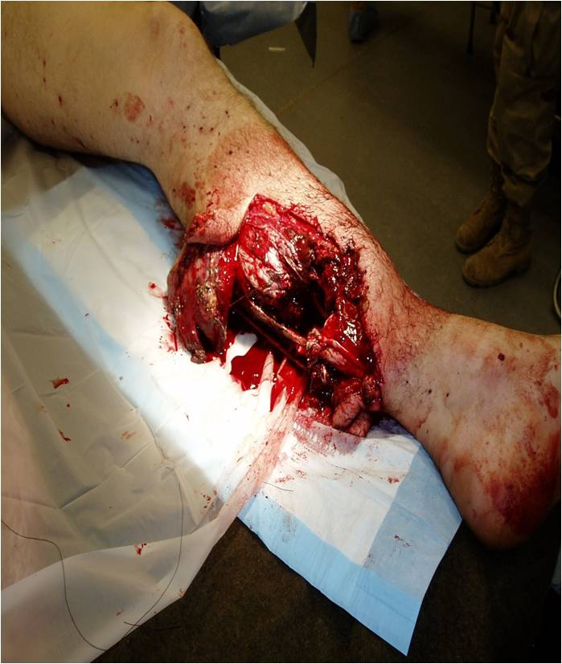
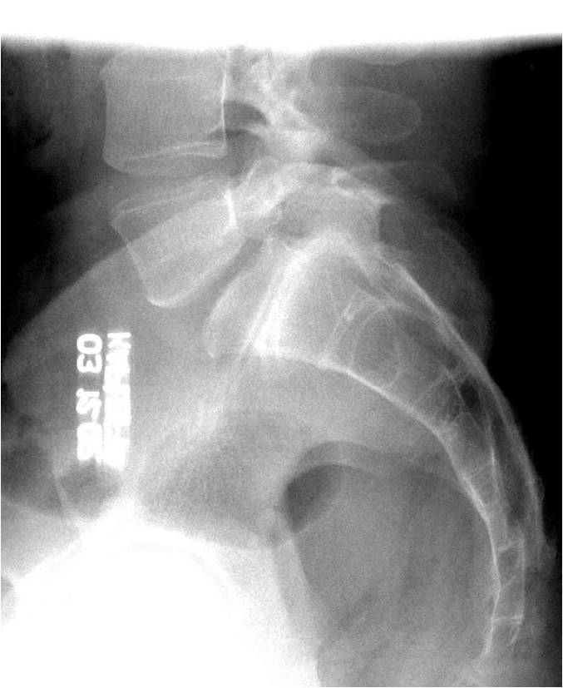
THE BEGINNING OEF-OIF Trauma and Axial Load Injuries
Courtesy of C. Buckenmaier, MD

Slide 2
WHY PAIN?
HIGH PREVALENCE (>50%) AND POOR CLINICAL OUTCOMES
Suffering and dissatisfied patients
Suffering and dissatisfied providers
BURDEN ON HEALTH SYSTEM
Costs
Suffering and dissatisfied administrators
BURDEN ON SOCIETY
Costs
Suffering and dissatisfied policy makers

Slide 3
Stepped Integrated Pain Care in the VHA: Meeting the Needs of Our Veteran Population
LECTURE 1: Anthony Mariano
Implementing a Biopsychosocial Model of Chronic Pain Care: The Collaborative Care Model
LECTURE 2 and LECTURE 3: Rollin Gallagher
The VHA’s Pain Management Strategy for providing a Continuum of Care
VHA Directive 2009-053: A systems approach to delivering biopsychosocial care, the Stepped Care Model
Standard Biopsychosocial Pain Assessment in Common Conditions (low back pain, neuropathic pain, headache): Linking Biopsychosocial Pathophysiology to Treatment Planning and Management
LECTURE 4: Anthony Mariano
Practical Suggestions for Helping Veterans with Complex Pain

Slide 4
FACULTY
Rollin M. Gallagher, MD MPH
Deputy National Program Director for Pain Management, VHA
Director for Pain Policy Research & Primary Care, Penn Pain Medicine
Clinical Professor of Psychiatry and Anesthesiology
University of Pennsylvania School of Medicine
Philadelphia, PA
Anthony J. Mariano, PhD
Puget Sound VA Health Care System
Clinical Director, Pain Clinic
Assistant Clinical Professor
Department of Psychiatry and Behavioral Sciences
University of Washington Medical School
Seattle, Washington

Slide 5
Provides: Concepts that integrate the process of care to the interaction with and management of the patient in the medical home model and ties them to core competencies.

Slide 6
Provides: Practical tips on history taking, physical examination and clinical decision-making and ties them to core competencies: - Anchored in illustrated pathophysiology, epidemiology - Case examples

Slide 7
Learning Objectives
LECTURE 1: Anthony Mariano
Implementing a Biopsychosocial Model of Chronic Pain Care: The Collaborative Care Model
Discuss chronic pain in context of new directions in primary care
Introduce concept of “complex” chronic pain
Identify shortcomings of traditional model and practices
Provide alternative model of chronic pain care that is more consistent with the principles of the Veteran-centered medical home

Slide 8
Overview
Pain and primary care: new directions
VHA Pain Management Directive 2009-053
Stepped-care strategy
Core competencies
Veteran-centered Medical Home
Why do we struggle so much with chronic pain?
Conceptual burdens: biomedical model
Collaborative Self-management Model
Integrated “total person” care

Slide 9
VA Stepped Pain Care (VHA Directive 2009-053)
Comorbidities
Tertiary,
Interdisciplinary Pain Centers
Advanced pain medicine diagnostics & interventions
CARF accredited pain rehabilitation
STEP
3
RISK
RISK
Treatment Refractory
Secondary Consultation
Pain Medicine
Rehabilitation Medicine
Behavioral Pain Management
Multidisciplinary Pain Clinics
SUD Programs
Mental Health Programs
STEP
2
Complexity
Primary Care
Routine screening for presence & intensity of pain
Comprehensive biopsychosocial pain assessment
Evidence-based management of common pain conditions
Support from MH-PC Integration, OEF/OIF, & Post-Deployment Teams
Expanded care management
Pharmacy Pain Care Clinics
STEP
1

Slide 10
Medical Home Principles 1
Comprehensive, Veteran-centered primary care
Whole person orientation
Team-based care directed and coordinated by PCP
Veteran as an active partner in the team
Shared decision making: interactive, dynamic and collaborative process
Incorporates patient preferences
Fosters shared responsibility for health care decisions and outcomes

Slide 11
Primary Care Competencies
Dr. Gallagher: Lecture #2 and #3
Conduct of comprehensive pain assessment, including diagnostic formulation
Conduct of routine physical/neurological examinations: differentiate pain generators and mechanisms
Judicious use of diagnostic tests/procedures and secondary consultation
Notes:
11

Slide 12
Primary Care Competencies
Dr. Gallagher: Lecture #2 and #3
Knowledge/use of common metrics for measuring function
Knowledge of accepted clinical practice guidelines
Rational, algorithmic based polypharmacy
Opioid management
Notes:
12

Slide 13
Learning Objectives
Identify causal models of disease
Recognize mechanisms underlying these models
Describe biopsychosocial formulation of these models for each unique disease population
Indicate evidence basis for treatment
Identify chronic disease management approaches

Slide 14
Adapted from Woolf & Mannion, Lancet 1999 Attal & Bouhassira, Acta Neurol Scand 1999
ANS activation < Stress < Pain < BRAIN PROCESSING
Spinal cord
Damage
Nerve
injury
Ectopic
discharge
Neuro-
plasticity
+++
C fiber
Central sensitization
Abeta fiber
Limb
trauma
Ectopic
discharge
Alteration
of modulatory
systems
Phenotypical
Changes

Slide 15
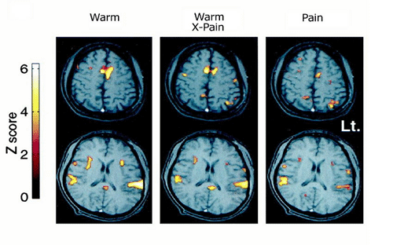
Expectation of Pain Activates the Anterior Cingular Gyrus
Third condition
Second condition
First condition
The Clinical Pain Experience is often paired with Fear-Anxiety which may be conditioned.

Slide 16
The Cycles of Pain: Acute Pain to Chronic Pain Disease
Pathophysiology of Maintenance:
Radiculopathy
Neuroma traction
Myofascial sensitization
Brain / SC pathology (loss, reorganization)
Secondary Pathology:
Muscle atrophy,
weakness;
Bone loss;
-Depression
-Cortical atrophy
Psychopathology
of maintenance:
Encoded anxiety
dysregulation
- PTSD
-Emotional
allodynia
-Mood disorder
Central
sensitization
Acute injury
and pain
Disability
- Less active, Kinesiophobia
- Decreased
motivation
- Increased
isolation
- Role loss
Neurogenic
Inflammation:
- Glial activation
- Pro-inflammatory
cytokines
- blood-nerve barrier
disruption
Peripheral
Sensitization:
Na+ channels
Lower threshold

Slide 17
Typical Case: Not Polytrauma
John, a 26 y/o tank commander:
Discharged 3 months ago
High school graduate, while deployed became a father of 2 y/o son but divorced by wife; they now live in the Midwest with her family
Daily low back pain
Notes:
17

Slide 18
Low Back Pain Assessment
5 Ps of Pain History:
Predisposition:
Prior episodes, cancer, systemic disease, occupational (vibration, heavy lifting) / recreational hazards, obesity, smoking, deconditioning
Precipitation:
Onset incident: forces (e.g., compression, twist), direction, context & co-occurring events
Pattern:
Temporal daily pattern
Physical: axial, radicular, weakness, sensory changes
Red flags: incontinence, fever, high pain after injury, recumbent pain, CA
Aggravators: activities, stressors
Effects on role function (work, home), relations (co-workers, family, spouse, sex)
Co-morbidities (sleep, depression, anxiety, substance abuse)
Patient beliefs: what do you think is wrong?
Prior treatments:
Medication trials, injections, physical therapy, CAM, adherence
Gallagher RM. Am J Phys Med & Rehab 2005;84(3):S64-76
Notes:
18

Slide 19
Low Back Pain Assessment
5 Ps of Pain History: John a 26 y/o tank commander
Predisposition:
Rigorous physical training and deployment with inherent risks for mechanical strain and spinal injury
Precipitation:
Prolonged sitting with vibration and heavy axial loads
Incident forces = repeat compression and twisting in high stress, urgent environment
Pattern:
Physical: axial pain; pain into hips and thighs suggestion of radicular pain or trigger points/muscular pain. No reported weakness, sensory symptoms (e.g., numbness, paresthesias)
Red flags: None
Notes:
19

Slide 20
Low Back Pain Assessment (cont’d)
5 Ps of Pain History: John a 26 y/o tank commander
Pattern (cont’d):
Aggravators: walking more than ¼ mile; sitting longer than 30-45 minutes
Effects on role function: unable to work, little interest in socializing
Co-morbidities: sleep disturbance; mild depression; anxiety about separation from son; 2-3 beers daily
Patient beliefs:
Not clear – “just get rid of the pain… there must be something wrong in there”
Prior treatments:
Medication trials on NSAIDS, gabapentin low dose, vicodin
Lumbar spine injections, probably epidurals under fluoroscopy
Notes:
20

Slide 21
Differential Diagnosis
Idiopathic / musculoskeletal 85%
Muscles
Facets
Discs
Herniated disc 7%
Compression Fracture 4%
Spondylolisthesis 3%
Malignancy 0.7%
Infection 0.05%

Slide 22
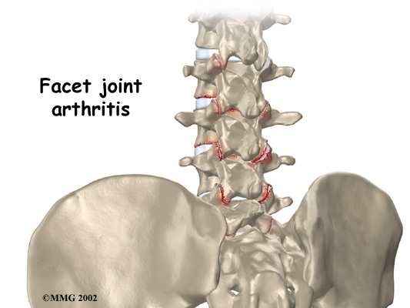
Facet Joint
15-40% LBP due to facet disease
May have normal x-ray
Synovial joint
Sensory fibers with mechanoreceptors and nociceptive fibers
Injury often with twisting heavy loads
Contribute to mechanical load redistribution so injury often from hyperextension against flexion loads
Physical Exam:
Ipsilateral pain on lateral spine flexion and tenderness on deep palpation
http://www.winchesterhospitalchiro.com/images/lumbar
Notes:
22

Slide 23
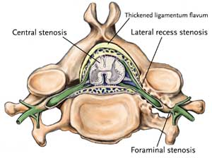
Radiculopathy
Pain radiating to leg, foot
R/o referred myofascial pain
Like greater trochanteric bursitis
Isolated disc herniation
Lateral recess stenosis from facet OA with disc
Physical exam:
Loss of segment-specific (e.g., L4, L5, S1) sensory, motor, or reflex (patella L4; achillies S1) function
Positive stretch signs (seated pt. straightens leg; pt. on back, examiner lifts straightened leg)
Notes:
23

Slide 24
Low Back Examination
http://www.healthquality.va.gov/index.asp
http://www.healthquality.va.gov/Low_Back_Pain_LBP_Clinical_Practice_Guideline.asp

Slide 25
Practical tips on formulation, goal-oriented management planning, and clinical decision-making: - Tips on developing a collaborative model with patient - Specific, office-based interventions such as PT - Medication guidelines and use of opioid analgesics

Slide 26
Collaborative Self-management
The essential clinical tasks are to
Establish a collaborative relationship
Shift the patient from a biomedical model to a biopsychosocial model
Identify long-term functional goals
Facilitate self-management
Support efforts to address other life problems

Slide 27
Therapy for Nonspecific Acute (0 - 4 weeks) Low Back Pain
Education and reassurance
Brief Rest (2-3 days) / Decrease Activity (be very detailed)
Prevent “kinesiophobia” (fear of movement) : provide effective pain control to facilitate graduated activity
Medications
Physical Therapy techniques
Goal: Resumption of activities as soon as possible

Slide 28
Things “Not to Do” for Acute (0 - 4 weeks) Low Back Pain
Avoid Prolonged Bed Rest
Avoid regular, round-the-clock use of opioid analgesics without exhausting other options (e.g., NSAIDs, tramadol, acetaminophen, muscle relaxants). Use opioid “rescue” dose for emergencies, 5-10 pills “on hand” so patient does not have to go to ER or can stay at work to avoid losing a job
Avoid expensive diagnostic imaging and its false positives, without suspicion for serious condition
Avoid specialty referral for non-serious conditions
Avoid injection therapy without specific indication and without pairing with other interventions
Avoid surgical referral in the absence of an identified anatomic lesion

Slide 29
Pain Management Options Based on Biopsychosocial Model
Therapeutic Objectives:
Empowerment: http://www. painfoundation.org;
http://www.theacpa.org
Increase mastery and control over fear, anxiety, stress reaction, environmental pain triggers
Pain Diary | Sleep Hygiene
Relaxation skills | Self hypnosis
Journal | Distraction
Cognitive training | Attitude adjustment
Distraction & problem solving | Acceptance of chronicity
Reframing | Mastery

Slide 30
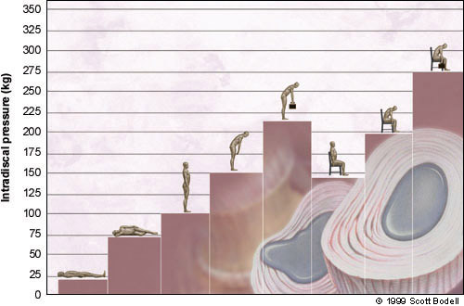
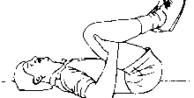
What physical therapy?
Williams flexion exercises
But did not work in everybody
Flexion caused increased intradiscal pressure
Nachemson AL 1981
Used now for stenosis patients

Slide 31
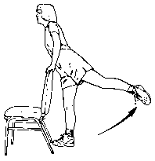
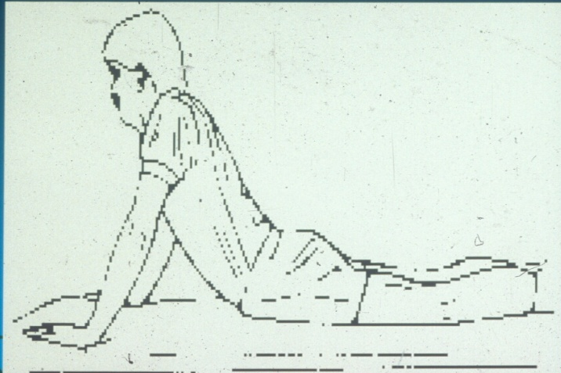
Mc Kenzie Extensions
Goal is centralization of leg pain
Decrease intradiscal tension
Decrease nerve root tension
76/87 patients achieved centralization and outcomes good-excellent in 83%

Slide 32

Q (quality): Recognizing Neuropathic Pain
YOU DO NOT NEED LABORATORY TESTS TO DIAGNOSE AND TREAT NEUROPATHIC PAIN!
Common signs and symptoms
Persistent burning sensation
Paroxysmal lancinating pains
Paresthesias
Dysesthesias
Hyperalgesias
Allodynias
Galer BS. Neurology. 1995;45(suppl 9):S17-S25; Backonja M-M et al. Neurol Clin.1998;16:775-789.

Slide 33
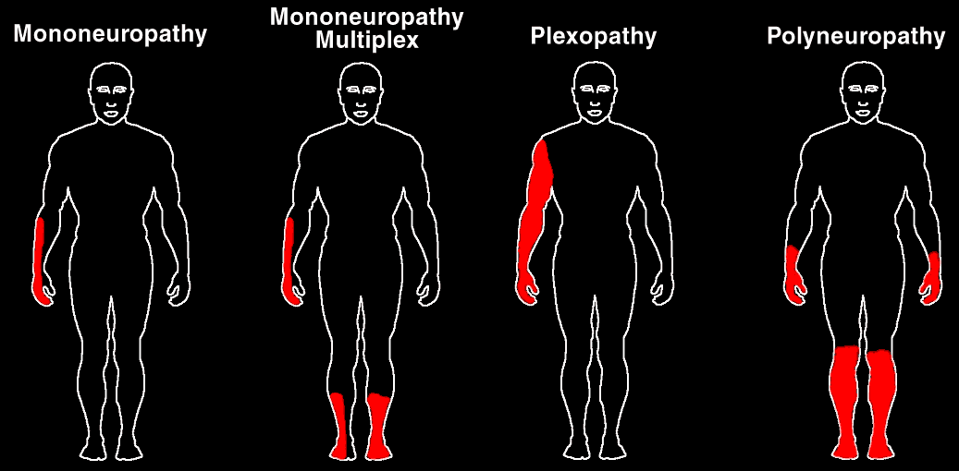
R (Radiating and pattern): Pain Drawing & Neuropathy Types
Adapted from: Boulton AJM et al. Med Clin North Am. 1998;82:909-929; Portenoy RK. Pain Management: Theory and Practice. 1996:108-113; Katz N. Clin J Pain. 2000;16:S41-S48

Slide 34
Differential Diagnosis of Pattern
Mononeuropathy:
Plexopathy:
One nerve distribution
Associated with:
Injuries:
Trauma / Surgery
Neuroma
Herniated disc
Disease
Post-herpetic neuralgia
Entrapment:
Carpal tunnel syndrome
Tarsal tunnel syndrome
Spinal stenosis
Nerve plexus distribution
Associated with:
Injuries
Brachial plexus injury
Cancer surgery
Radiotherapy
Disease
Cancer

Slide 35
Algorithm for Medication Selection in Chronic Pain with and without Co-Morbid Depression
Pain condition + depression
Nociceptive pain (arthritis)
Neuropathic pain (radiculopathy)
Secondary depression
Primary D.
Persists after adequate analgesia
Evaluate risks
Secondary sleep disturbance
Evaluate risks
Persists after adequate analgesia
Evaluate risks
SSRI trial
Short-term NSAIDs, Cox-II (?), tramadol, opioids
Evaluate risks
SNRIs: venlafaxine, duloxetine
Lidocaine patch; gabapentin & other AED (Ca+ & Na+ channels);alpha 2 agonists (tizanidine, clonidine); tramadol; opioid
Antihistamine, zolpidem, low-dose benzodiazepine
Trazodone
Low-dose TCA
Titrate TCAs (Na+ channels and SNRI) : desipramine, nortriptyline,
Gallagher RM, Verma S. Semin Clin Neurosurgery. 2004
This information concerns uses that have not been approved by the US FDA.

Slide 36
Opioids: rational prescribing
Help is on the way!
VA/DoD Clinical Practice Guidelines: Management of Opioid Therapy for Chronic Pain
http://www.healthquality.va.gov/Chronic_Opioid_Therapy_COT.asp
VA National Pain Management Strategy Committee has almost completed National Opioid Pain Care Agreement Policy
Several years in development, extensive contribution from the field; final stages of final admin review and concurrence
Educational tool, risks/benefits, mutual expectations

Slide 37
Primary Care Competencies
Lecture #4: Practical advice on the longitudinal care of the patient in the medical home, collaborative, biopsychosocial model of pain management. Dr. Mariano
Providing reassurance and validation
Facilitating self-management
Negotiating behaviorally specific and feasible goals
Helping Veterans with psychiatric/behavioral comorbidities
Notes:
37

Slide 38
Provides concepts that integrate the process of care and specific techniques in the clinic to the interaction with the patient in the medical home …..to achieve a satisfied patient, a gratified provider, and a happy director!

Slide 39
Disabling beliefs
Shared by patients who are overwhelmed by pain and providers who find these people overwhelming:
Belief that objective evidence of disease/injury is required for pain to be “real”
View of pain as the only problem
Expectation that urgent pain relief is the major goal of treatment
Overconfidence in medical solutions
Provider is the “expert” responsible for outcomes
Pt. is helpless “victim” of underlying disease/injury

Slide 40
It is impossible to help complex pain patients if you share these beliefs
Your efforts to help by providing short-term solutions and urgent pain relief will likely make long-term problems worse

Slide 41
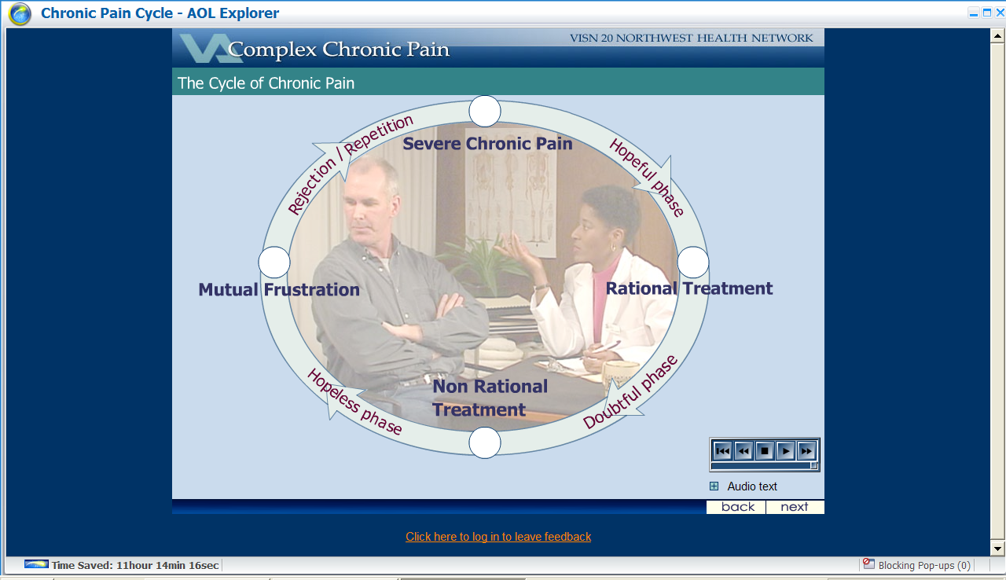
Iatrogenic cycle of complex chronic pain
Hopeful phase
Share disabling beliefs based on medical model
Pain is only problem
Goal: urgent pain relief
Medical solutions are possible if pain is “real”
Doubtful phase
Standard treatments fail
Increased demands in pursuit of validation and relief
Repeat and escalate

Slide 42
Iatrogenic cycle of complex chronic pain
Hopeless Phase
“gives in”:
non-rational treatment
reinforce beliefs in medical solutions
excessive risk
“gives up”:
nothing to offer
reject patient
another negative experience

Slide 43
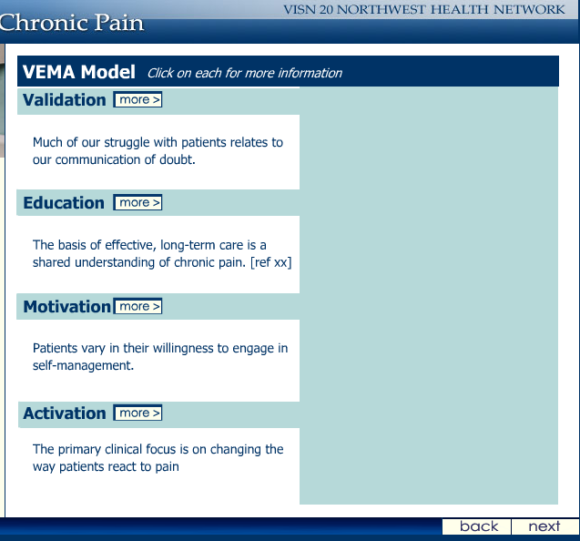
Collaborative self-management

Slide 44
VEMA: Validation
From the first interview, it is important to communicate that you believe the patient has a “real” problem
Quality care begins with the pt. feeling believed
Provide reassurance by
Educating them about the limits of objective tests
Informing them that many patients have significant pain and no objective findings (normalize)
Acknowledging their frustration with past medical efforts to evaluate and treat their problems

Slide 45
Avoid “hot” phrases
There’s nothing wrong with you. | We can’t measure pain with tests.
You shouldn’t have this much pain. | Stress “turns up the volume” of everyone’s pain.
Accept your pain. | Expect pain to be a small part of your life and it won’t be a large part.
You’ll have to live with the pain. | I want to help you live better with pain.
Nothing can be done. | “No medical solutions” does not mean no solutions.
“Degenerative”

Slide 46
Conclusions
The aggressive pursuit of urgent pain relief is harmful to complex pain patients and excessively costly to the health care system
Our most “difficult” patients require better care, not more invasive, experimental and expensive treatment

Slide 47
THANK YOU FOR LISTENING! QUESTIONS AND DISCUSSION

