Slide 1
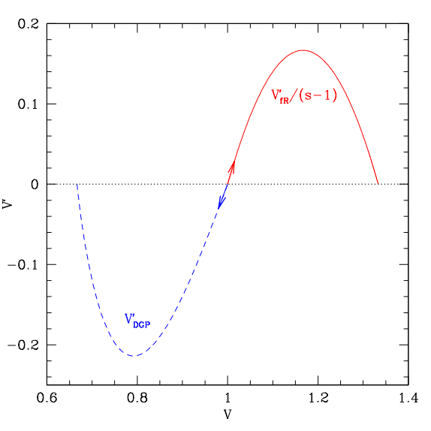

Chasing Down
Cosmic Acceleration
Eric Linder
7 June 2012
.
UC Berkeley & Berkeley Lab
GR
★
★

Slide 2
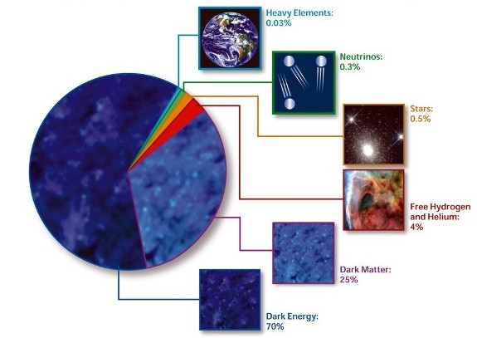
Describing Our Universe
Us
New Stuff
Old New Stuff
Us
STScI
95% of the universe is unknown!

Slide 3
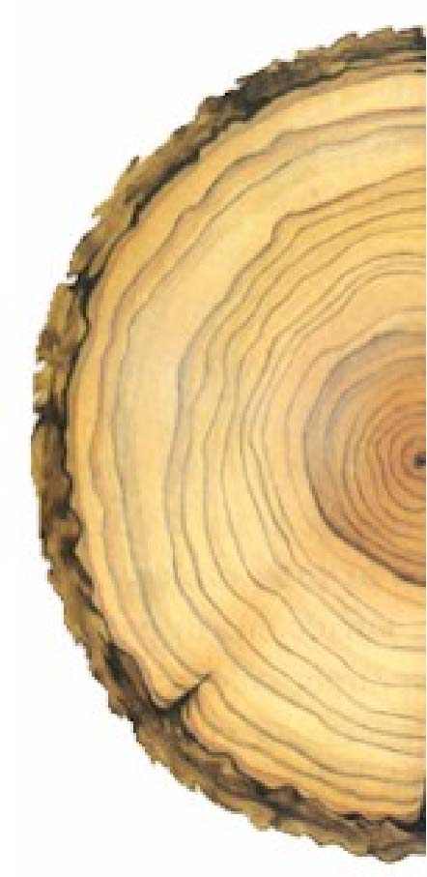
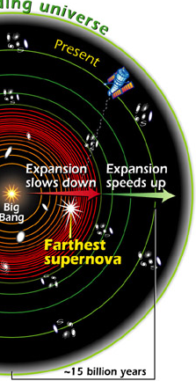
Mapping Our History
The subtle slowing down and speeding up of the expansion, of distances with time: a(t), maps out cosmic history like tree rings map out the Earth’s climate history.
STScI

Slide 4
Cosmic Coincidence
Why not just settle for a cosmological constant Λ?
→ For 90 years we have tried to understand why Λ is at least 10¹²⁰ times smaller than we would expect – and failed.
→ We know there was an epoch of time varying vacuum once – inflation.
(but see work by Bousso, Nomura)
We cannot calculate the vacuum energy to within 10¹²⁰. But it gets worse: Think of the energy in Λ as the level of the quantum “sea”. At most times in history, matter is either drowned or dry.
Dark energy
Matter
Size=1/4
Size=1/2
Today
Size=2
Size=4

Slide 5
On Beyond Λ!
“You’ll be sort of surprised what there is to be found Once you go beyond Λ and start poking around.” – Dr. Seuss, à la “On Beyond Zebra”
New quantum physics? Does nothing weigh something? Einstein’s cosmological constant, Quintessence, String theory
New gravitational physics? Is nowhere somewhere? Quantum gravity, extended gravity, extra dimensions?
We need to explore further frontiers in high energy physics, gravitation, and cosmology.

Slide 6
Dark Energy as a Teenager
14 years after discovery of the acceleration of the universe, where are we?
From 60 Supernovae Ia at cosmic distances, we now have ~800 published distances, with better precision, better accuracy, out to z=1.75.
CMB and its lensing points to acceleration. (Didn’t even have acoustic peak in 1998.)
BAO detected. Concordant with acceleration.
Weak lensing detected. Concordant with acceleration.
Cluster masses (if asystematic) ~1.5σ for acceleration.
Strong concordance among data: Ω_{DE}~0.73, w~-1.
Das+ 2011, Sherwin+ 2011, Keisler+ 2011, van Engelen+ 2012

Slide 7
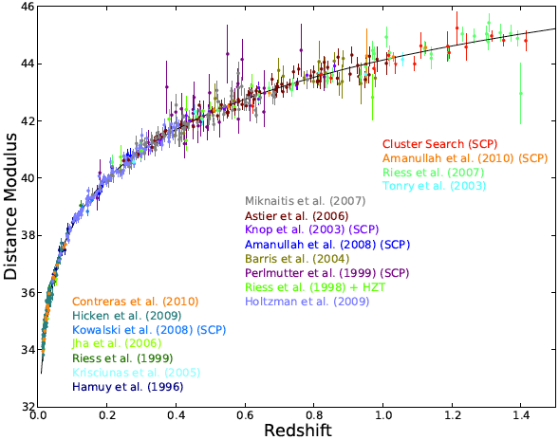
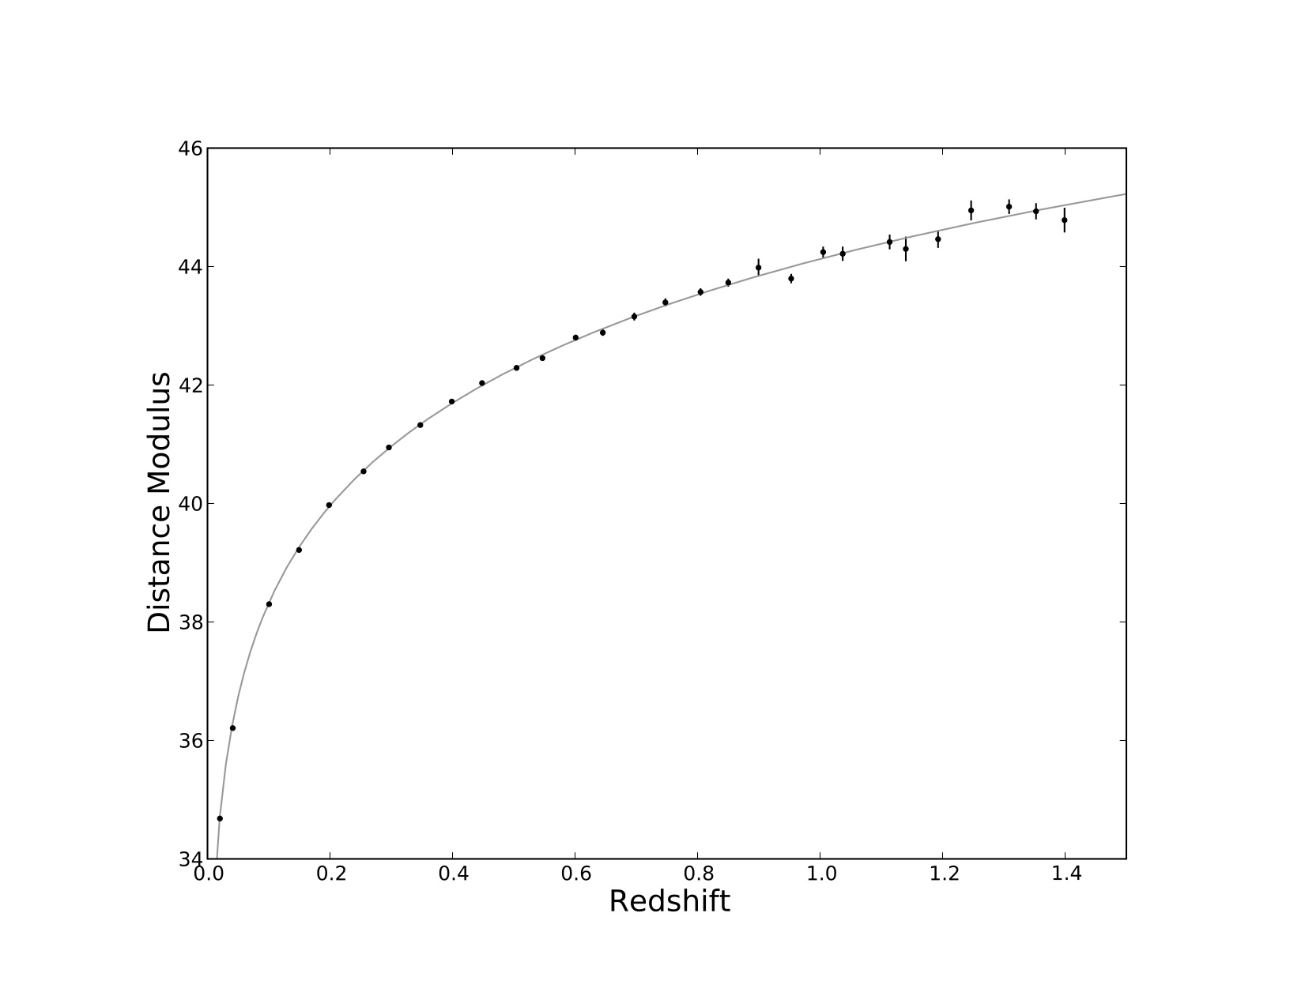
Latest Data
Union2.1 SN Set
Complete SALT2 reanalysis, refitting 17 data sets
580 SNe Ia (166+414) - new z>1 SN, HST recalib
Fit ΔM_{i} between sets and between low-high z
Study of set by set deviations (residuals, color)
Blind cosmology analysis!
Systematic errors as full covariance matrix
Suzuki et al, 1105.3470
David Rubin
Suzuki et al, arXiv:1105.3470
Suzuki et al, ApJ 2012, arXiv:1105.3470

Slide 8

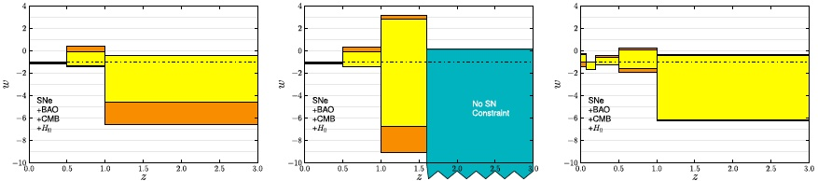
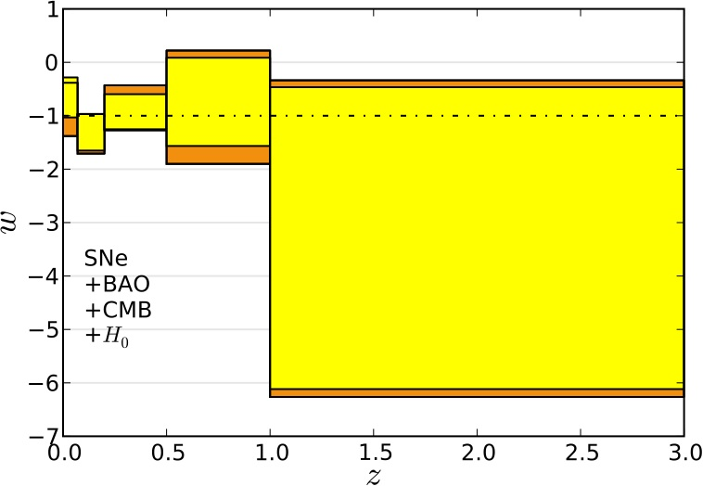
Are We Done?
(stat+sys)
w(z)?
z>1?
There is a long way to go still to say we have measured dark energy!
z<1?

Slide 9
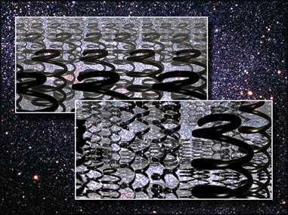
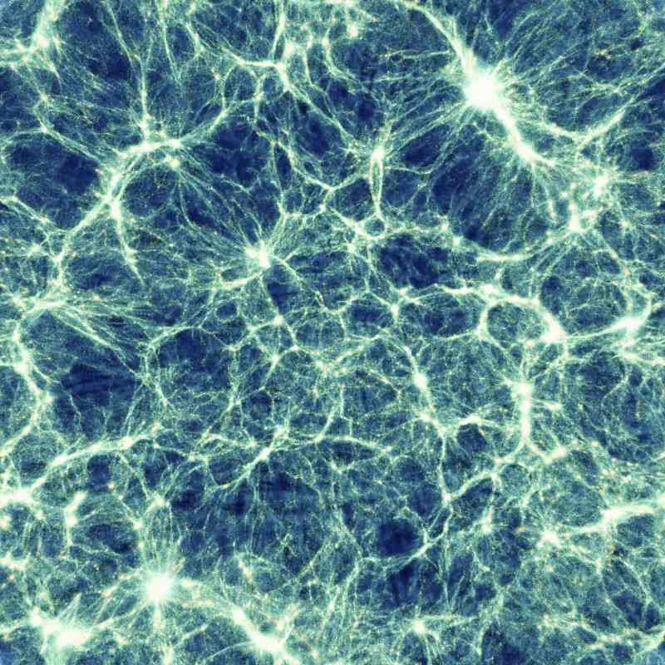
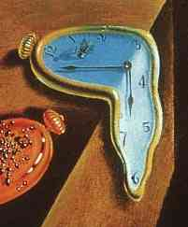
Dark Energy Properties
Dark energy is very much not the search for one number, “w”.
Dynamics: Theories other than Λ give time variation w(z). Form w(z)=w₀+w_{a}z/(1+z) accurate to 0.1% in observable.
Degrees of freedom: Quintessence determines sound speed c_{s}²=1. Barotropic DE has c_{s}²(w). But generally have w(z), c_{s}²(z). Is DE cold (c_{s}²<<1)? Cold DE enhances perturbations.
Persistence: Is there early DE (at z>>1)? Ω_{Λ}(z_{CMB})~10⁻⁹ but observations allow 10⁻².

Slide 10
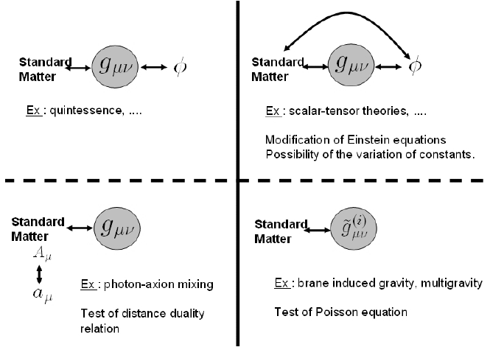
Beyond Einstein Gravity
Expansion is not the only determiner of growth of massive structure. “The Direction of Gravity”
Anisotropic Stress/Gravitational Slip
Metric fluctuations:
φ
ψ
Poisson equations
Euler equation
Energy-momentum:
δ
v
Continuity equation
Need to know:
Expansion DE perturbations Couplings Gravity
Uzan 2006

Slide 11
Observational Leverage
Dynamics: High+low redshift, complementarity (e.g. SN+SL, SN+CMB/BAO)
Degrees of freedom: Sensitivity to perturbations (CMB lensing, Galaxy clustering)
Persistence: High z probes (CMB lensing, Crosscorrelate CMB x Galaxies)
Test Gravity: Expansion vs growth (SN/BAO + CMBlens/Gal/WL)
Very much a program: Multiple, complementary, diverse observations. Equal weighting of Theory/Simulation/Observation essential.

Slide 12

The Direction of Gravity
Scalar field dark energy (and Λ) have problems with naturalness of potential and high energy corrections.
Can avoid both problems by having a purely geometric object with no potential.
Galileon fields arise as geometric objects from higher dimensions and have shift symmetry protection (like DGP).
They also have screening (Vainshtein), satisfying GR on small scales.
f(R)
.
GR
★
★
DGP
Nicolis+ 2009, Deffayet+ 2009
G

Slide 13
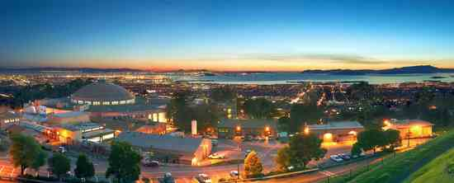
Galileon Gravity
Scalar field π with shift symmetry π→π+c, derivative self coupling, guaranteeing 2nd order field equations.
GR
Linear coupling
Derivative coupling
Standard Galileon
Coupled Galileons ruled out by Appleby & Linder 2012a due to instabilities.

Slide 14
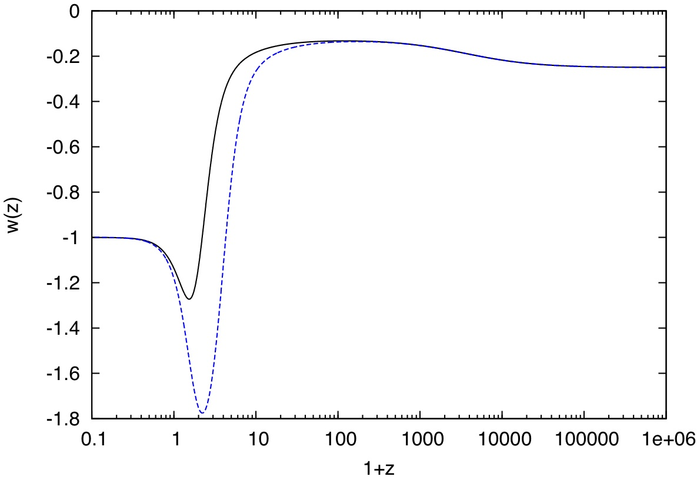
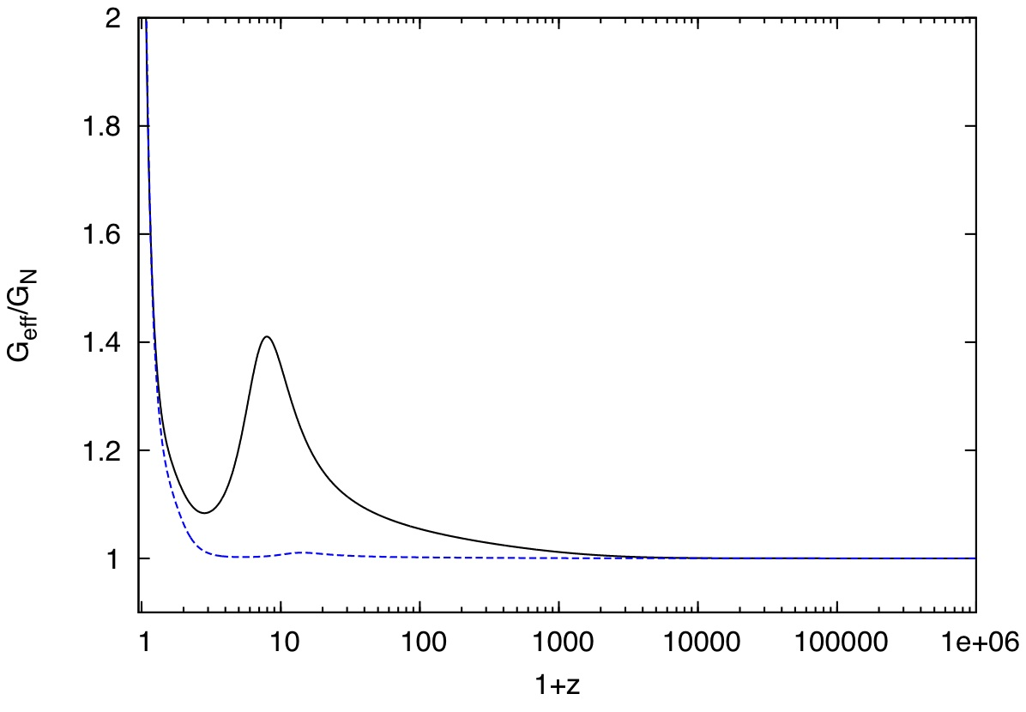
Data vs Gravity
Galileon cosmology has early time tracker solutions (no fine tuning) and late time de Sitter attractor. Beautiful class of theories!
Growth
Expansion
But Appleby & Linder 2012b rule out Standard Galileon with Δχ²_{LCDM}>30 from current data. Data kill entire class of gravity!

Slide 15


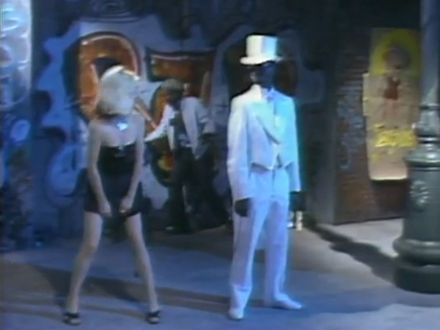
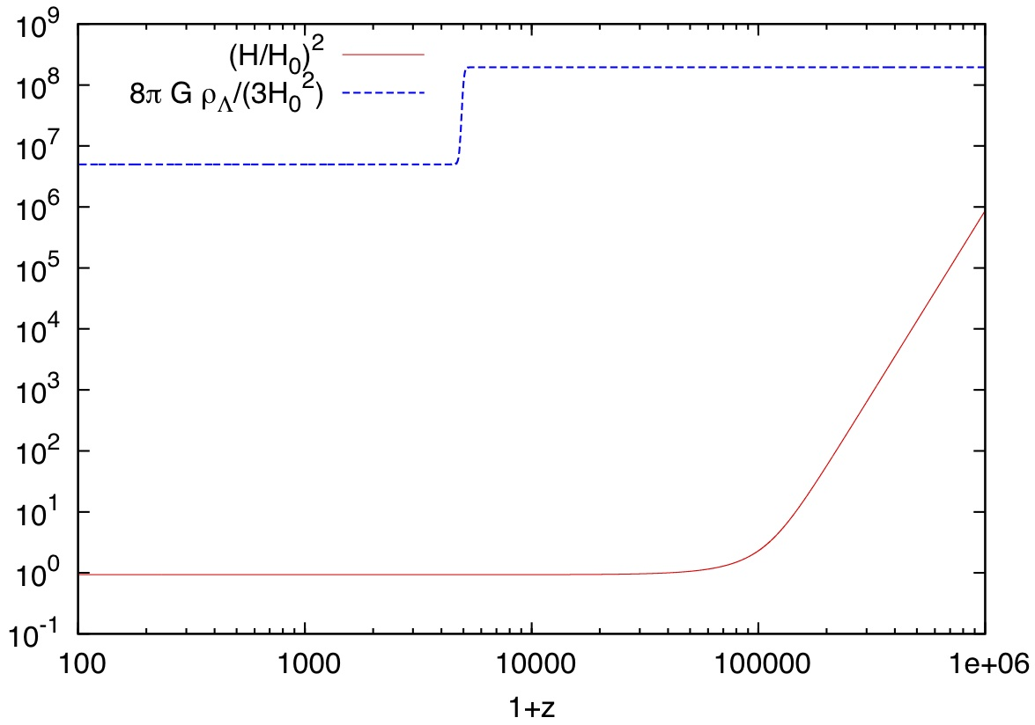
Weirder Gravity (and Λ)
Symmetries determine gravity action, e.g. Horndeski most general scalar-tensor theory with 2nd order EOM. Charmousis+ 2011 found “Fab 4” unique self tuning terms. Appleby, De Felice, Linder 2012 promote to nonlinear, mixed function.
“Fab 5 Freddy”
ρ_{Λ}
Has tracker, dS attractor, GW, no extra dof!, self tuning.
ϕ dynamically adjusts to cancel Λ, even thru phase transition.
Λ is invisible!
H²
1+z

Slide 16
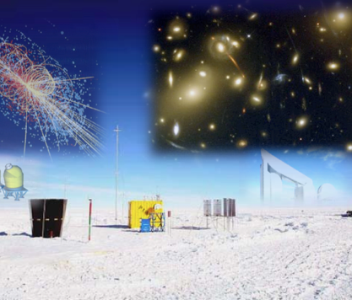
Chasing Down Cosmic Acceleration
How can we measure dark energy in detail – in the next 5 years?
New prospects in data (a partial, personal view):
Strong lensing time delays
Redshift space distortions
CMB polarization lensing
New prospects in theory (a partial, personal view):
Higher dimensional gravity/field theory/symmetry
Old school leverage (a partial, personal view):
Enhanced low z supernova data

Slide 17

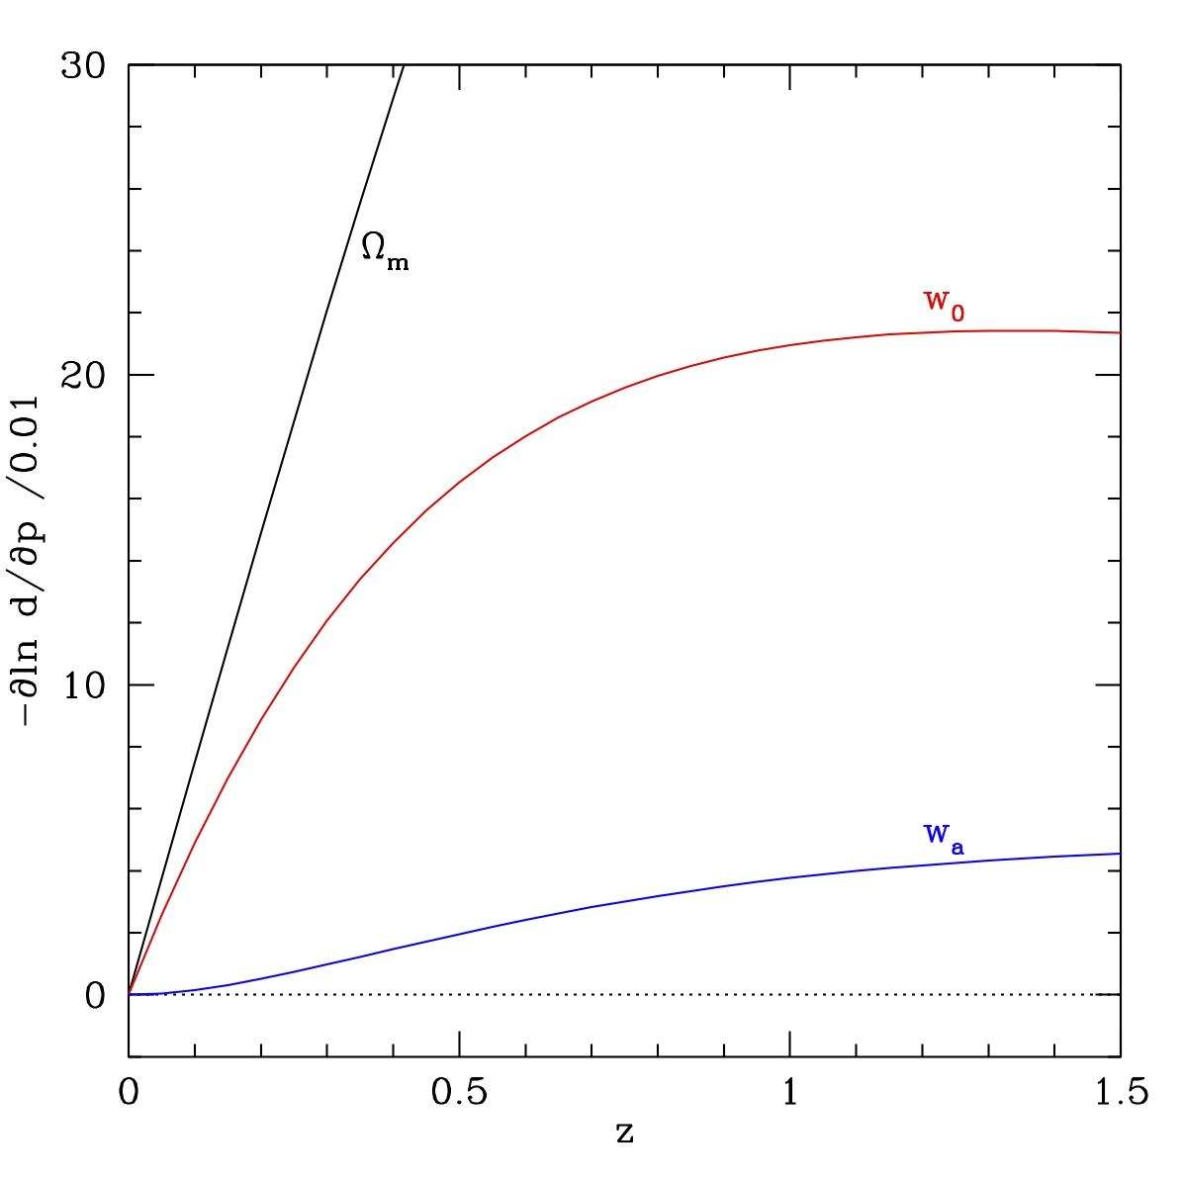
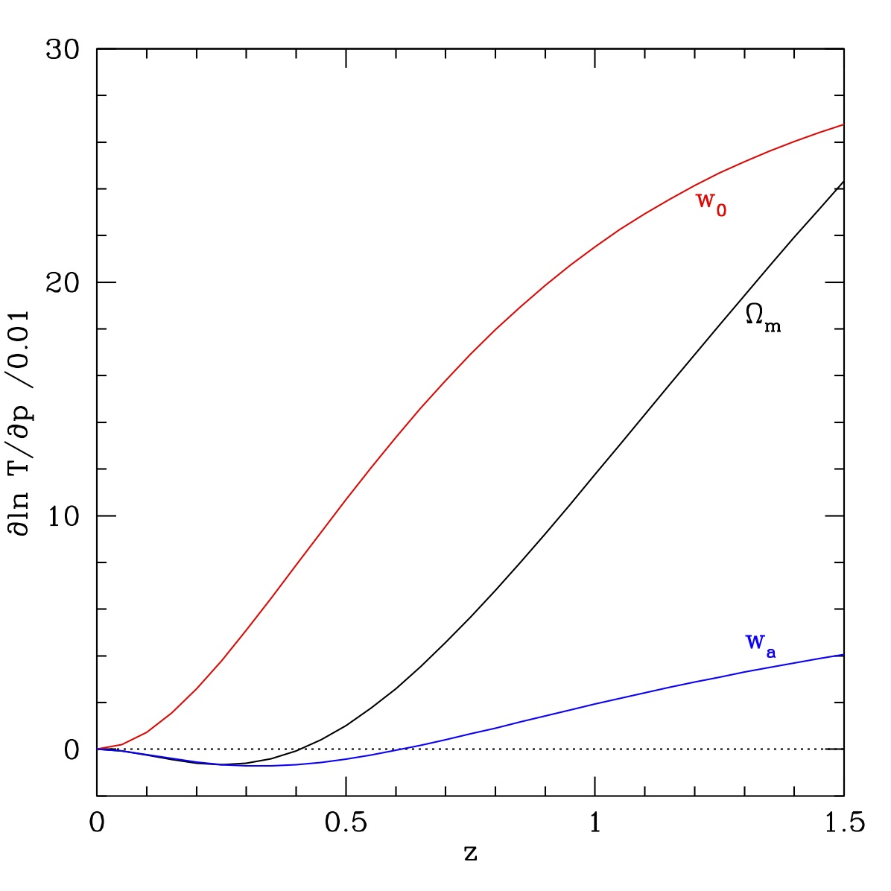
Strong Lensing Time Delays
Strong gravitational lensing creates multiple images (light paths) of a source. Time delays between paths probe geometric path difference and lensing potential. Key parameter is distance ratio
Solo Distance (e.g. SN)
Distance ratio
Sensitivity
Strong complementarity first id’d by Linder 2004, first used by WMAP7 (Komatsu+ 2011), modeling advances now make it practical.

Slide 18
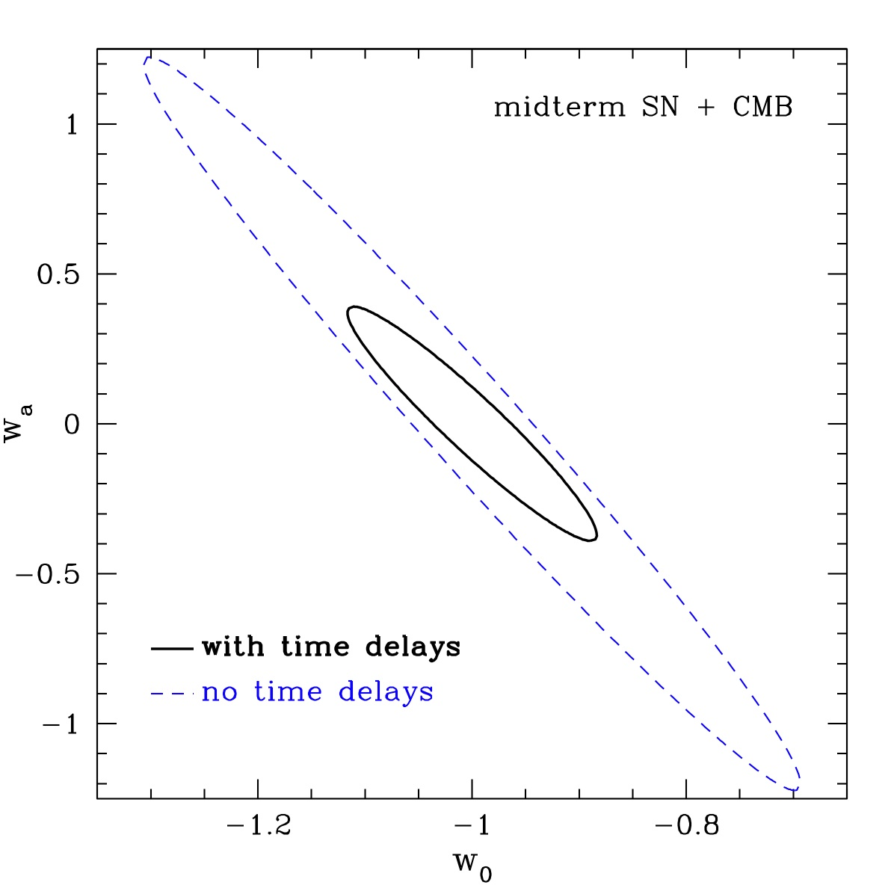
Time Delays + Supernovae
Lensing time delays give superb complementarity with SN distances plus CMB.
T to 1% for z=0.1, 0.2,… 0.6
SN to 0.02(1+z)mag for z=0.05, 0.15... 0.95
Factor 4.8 in area Ω_{m} to 0.0044 h to 0.7% w₀ to 0.077 w_{a} to 0.26

Slide 19
Time Delay Surveys
Best current time delays at 5% accuracy, 16 systems. 5 year aim: 38 systems, 5% accuracy = 230 orbits HST.
Need 1) high resolution imaging for lens mapping and modeling, 2) high cadence imaging, 3) spectroscopy for redshift, lens velocity dispersion, 4) wide field of view for survey.
Synergy: HST/Keck/VLT+ DES/BOSS. SN survey included. Only low redshift z<0.6 needed for lenses.
Systematics control via image separations, anomalous flux ratios (probe DM substructure!). Need good mass modeling, computationally intensive.

Slide 20
Higher Dimensional Data
Cosmological Revolution:
From 2D to 3D – CMB anisotropies to tomographic surveys of density/velocity field.
Notes:
Cosmology is growing in new, sophisticated directions, and data interpretation, synthesis, and visualization will play key roles and deliver unprecedented opportunities to understand the universe and fundamental physics.

Slide 21
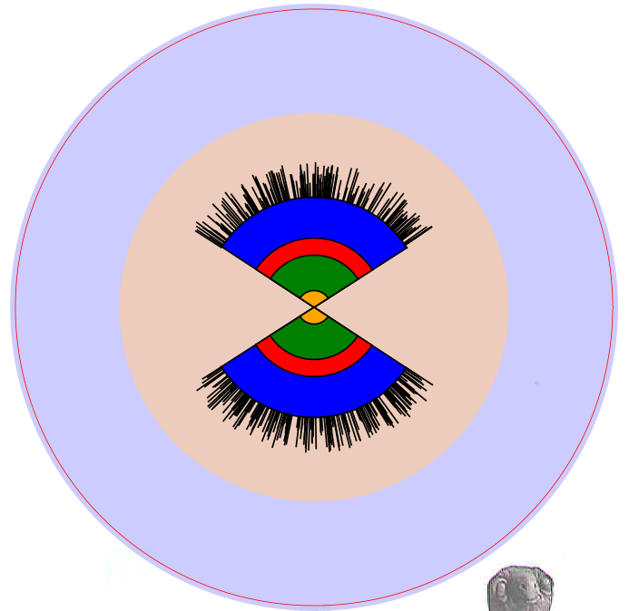
Data, Data, Data
As wonderful as the CMB is, it is 2-dimensional.
The number of modes giving information is l(l+1) or ~10 million.
BOSS (SDSS III) will map 400,000 linear modes.
BigBOSS will map 15 million linear modes.
N. Padmanabhan
conformal diagram
SDSS I, II, 2dF
BOSS (SDSS III)
Maps of density velocity gravity
BigBOSS 18 million galaxies z=0.2-1.5
600,000 QSOs z=1.8-3
courtesy of David Schlegel

Slide 22
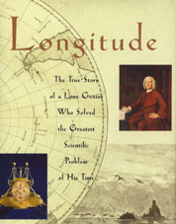
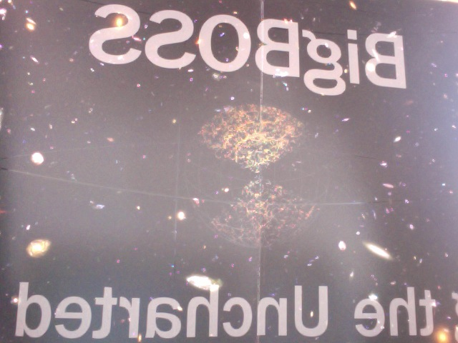
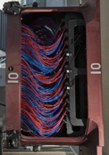
“Greatest Scientific Problem”
Redshift
“When I’m playful I use the meridians of longitude and parallels of latitude for a seine, drag the Atlantic Ocean for whales.” – Mark Twain, Life on the Mississippi

Slide 23
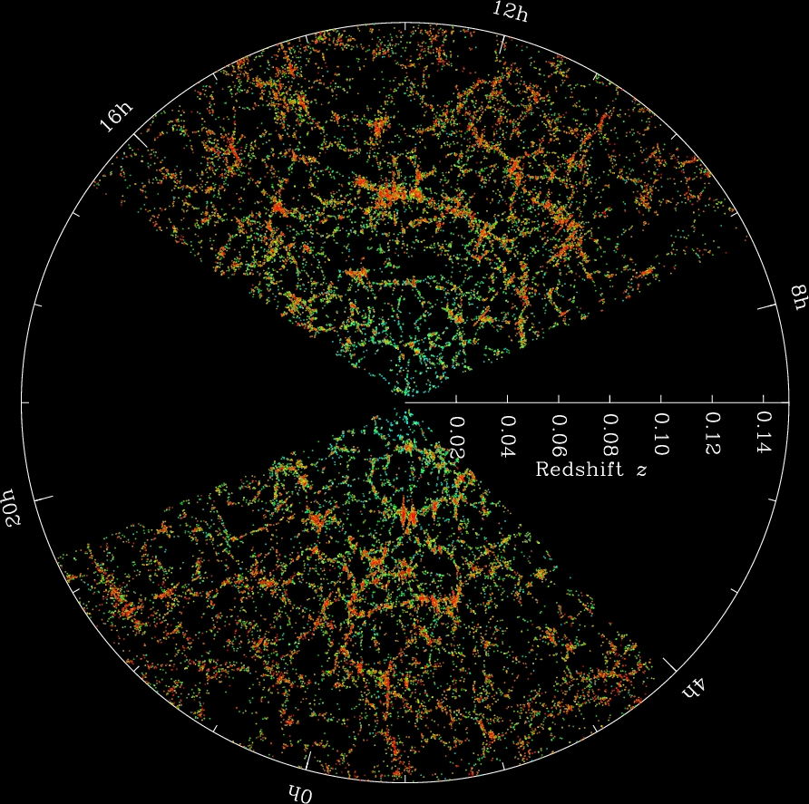
Cosmic Structure
Galaxy 3D distribution or power spectrum contains information on:
Growth - evolving amplitude
Matter/radiation density, H - peak turnover
Distances - baryon acoustic oscillations
Growth rate - redshift space distortions
Neutrino mass, non-Gaussianity, gravity, etc.
x25 (x7 LRG)
...

Slide 24
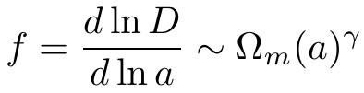
Redshift Space Distortions
Redshift space distortions (RSD) map velocity field along line of sight. Gets at growth rate f, one less integral than growth factor (like H vs d).
Ω_{m} =
gravitational growth index γ
Hume Feldman

Slide 25

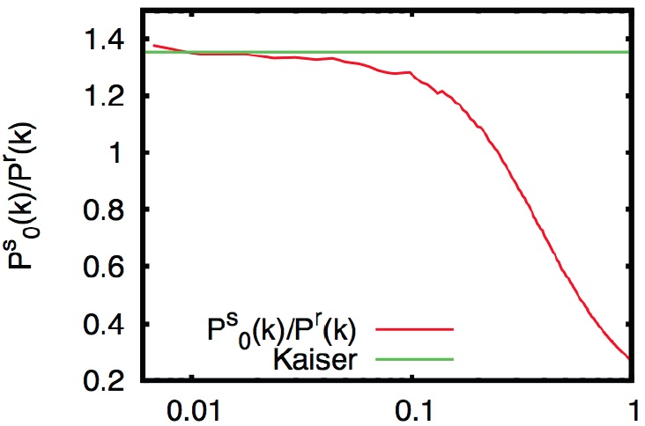
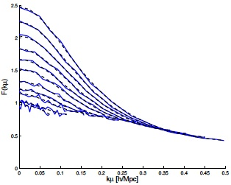
Redshift Space Distortions
Kaiser formula inaccurate
Even monopole (averaged over RSD) is poor.
Anisotropic redshift distortion hopeless – without better theory.
k (h/Mpc)
2.5
RSD reconstruction P^{true}(k,μ)=F(kμ) P^{form}(k,μ)
Simulation fitting function Kwan, Lewis Linder 2011 highly accurate to higher kμ.
F(kμ)
kμ
also see Okumura, Seljak, McDonald, Desjacques 2011; Reid & White 2011
0

Slide 26
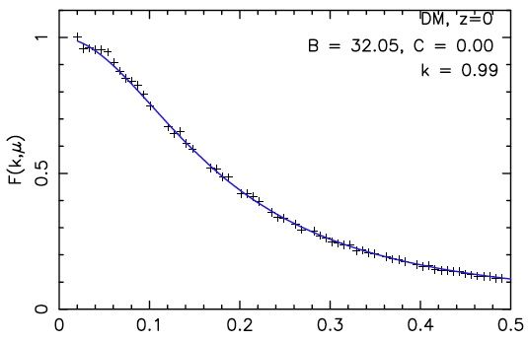
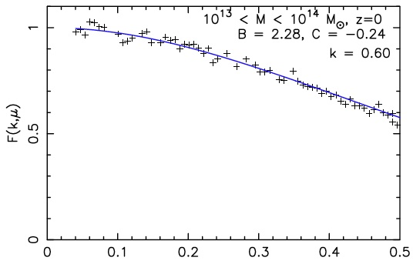
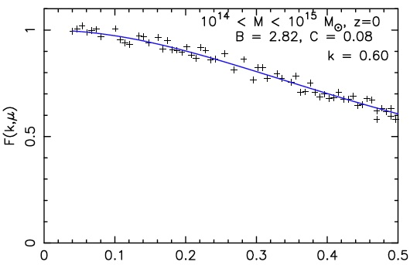
Redshift Space Distortions
Reconstruction function works great!
P^{true}(k,μ)=F(kμ) P^{form}(k,μ)
Kwan, Lewis, Linder 2012
kμ
Also for different z and halos

Slide 27
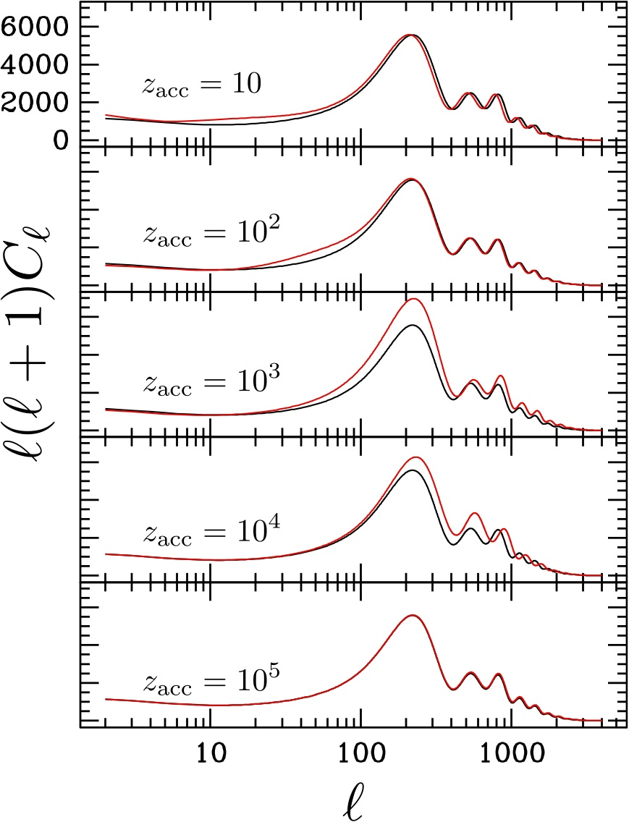
CMB Probes of Acceleration
How well do we really know the standard picture of radiation domination → matter domination → dark energy domination?Maybe acceleration is occasional. (Solve coincidence)
Effect of 0.1 e-fold of acceleration
Post-recombination, peaks → left and adds ISW. Pre-recombination, peaks → right and adds SW.
Current acceleration unique within last factor 100,000 of cosmic expansion!
Linder & Smith 2010

Slide 28
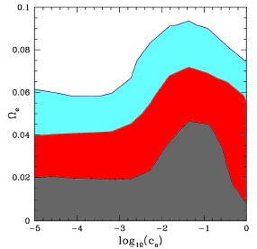
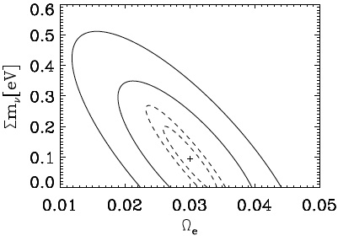
The Speed of Dark
Current constraints on c_{s} using CMB (WMAP5), CMB × gal (2MASS,SDSS,NVSS), gal (SDSS).
Future constraints from Planck or CMBpol
de Putter, Huterer, Linder 2010
Calabrese++ 2011
★
Best fit Ω_{e}=0.02, c_{s}=0.04, w₀=-0.95 but consistent with Λ within 68% cl.
“Early, Cold, or Stressed DE” cf. generalized DE Hu 1998

Slide 29
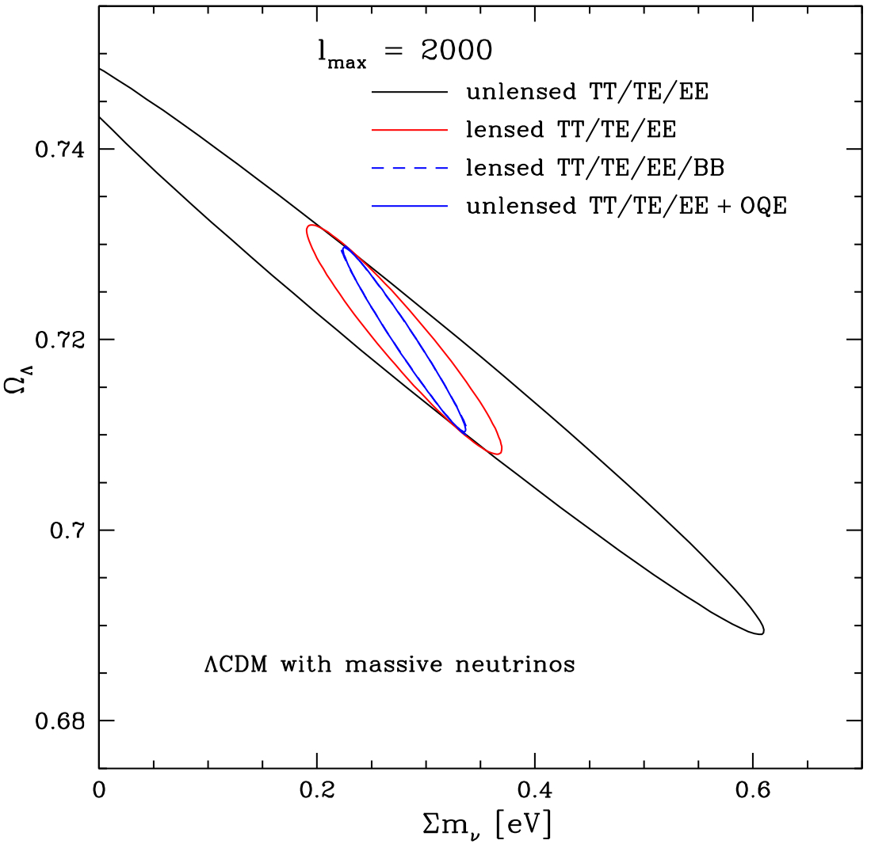
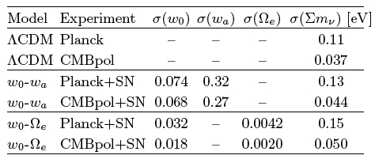
CMB Lensing
CMB as a source pattern for weak lensing. Probes z~1-5 effects, e.g. neutrino masses and early dark energy.
de Putter, Zahn, Linder 2009
SPT/ACT gets 8/3.2σ for Λ from CMB lensing. van Engelen+ 2012, Sherwin+ 2011

Slide 30
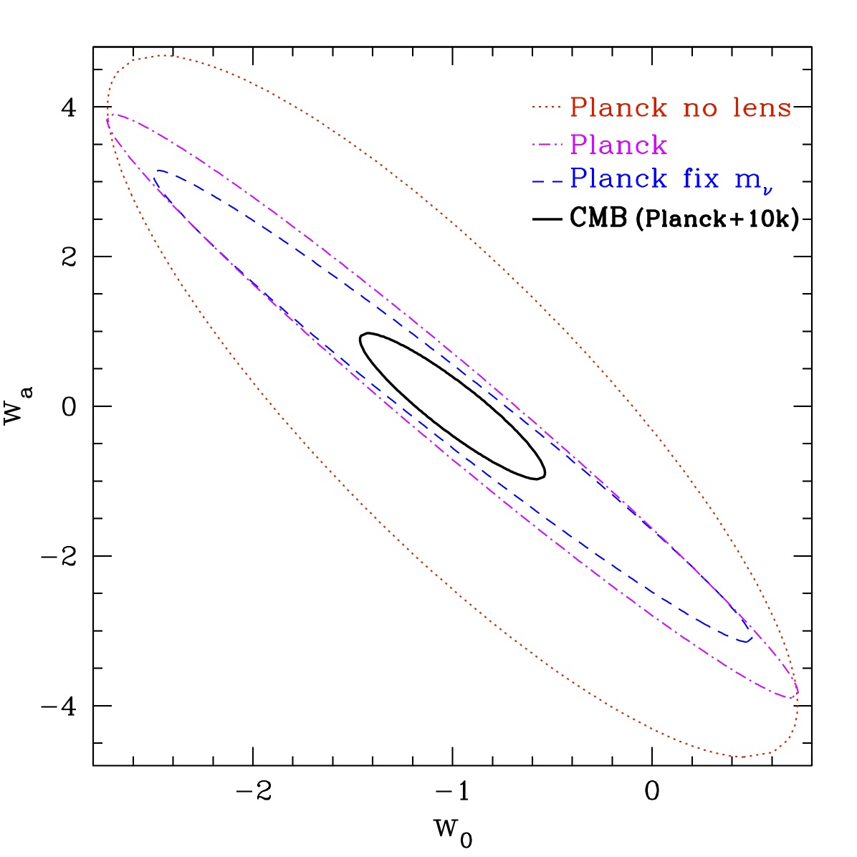
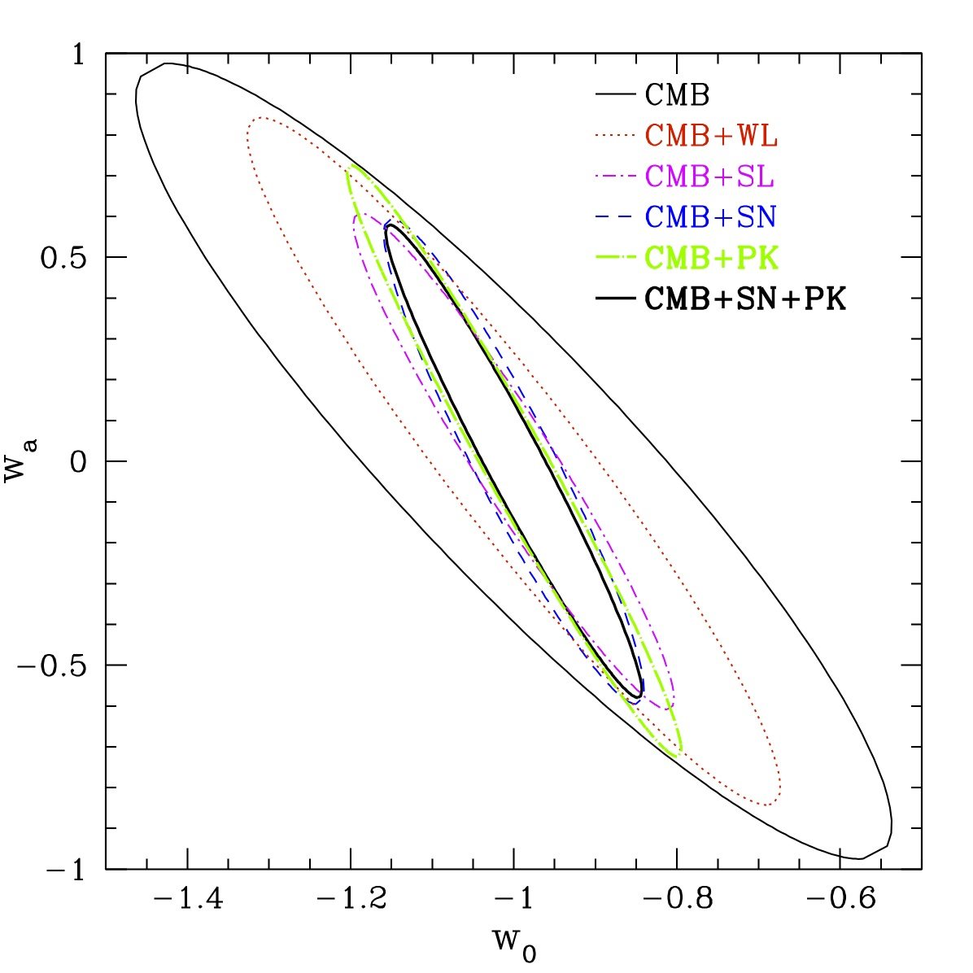
Dawn’s Early Light
Ground based experiments (ACTpol, Polarbear, SPTpol) are doing CMB lensing now. This changes the DE probe landscape.
Das & Linder 2012

Slide 31
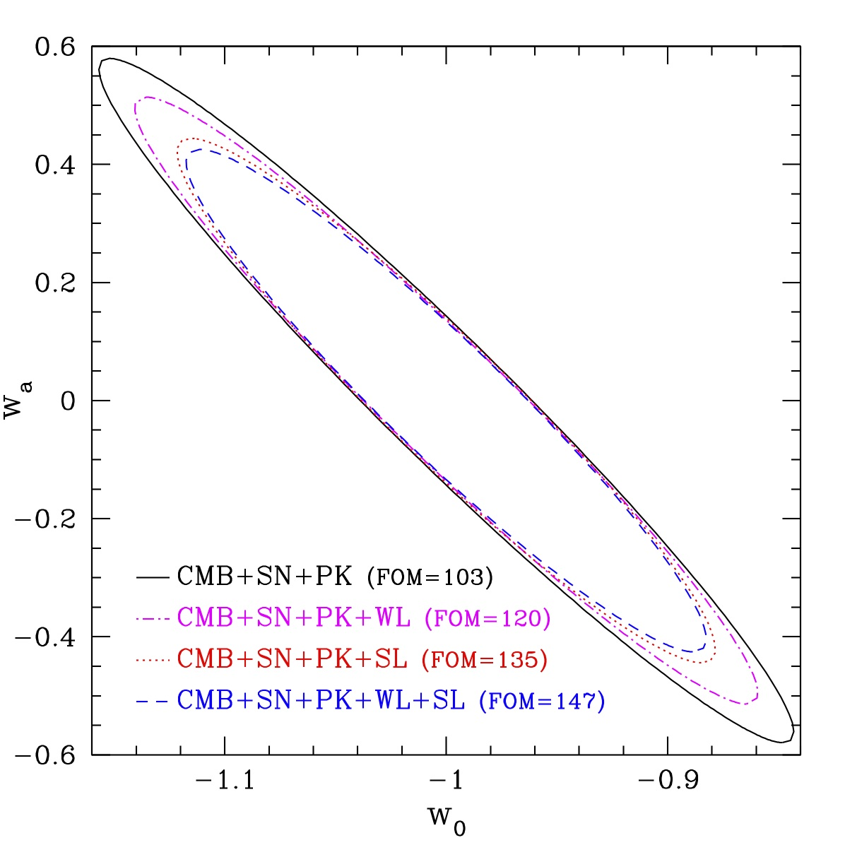
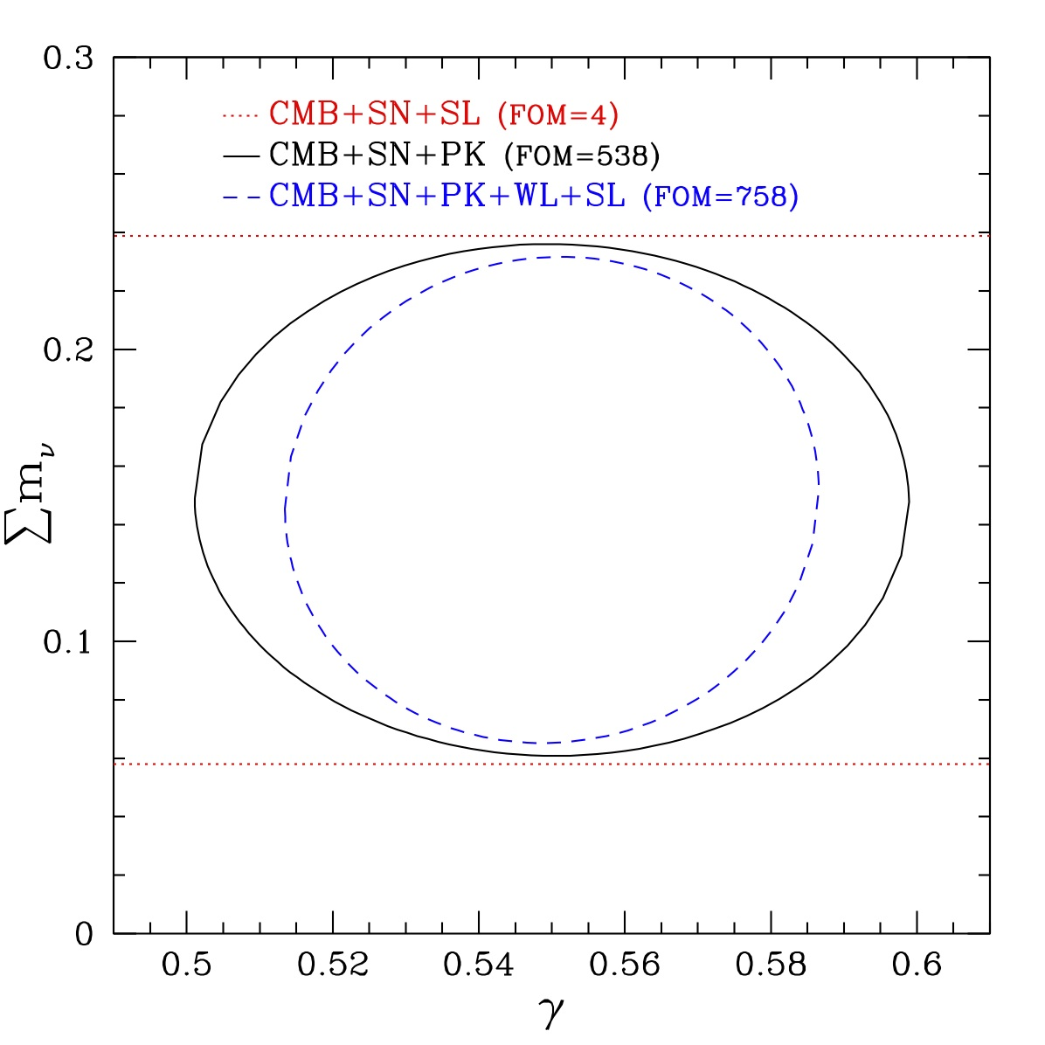
5 Year Realization (Cosmology 2017)
Supernovae (SN) ~ DES ; Galaxy Clustering (PK) ~ BOSS [Weak Lensing (WL) ~ DES ; Strong Lensing (SL) ~ HST?
SN: Linder; PK: Das, Linder; CMB: Das; WL: Das, de Putter, Linder, Nakajima; SL: Linder
Strong program in place, but also easy to do better!

Slide 32
Ideas/Trends/Lessons
Very much a program: multiple, diverse surveys. Ground CMB adds +67% (FOMw), +134% (FOMν).
Strong program in place + easy improvements exist!
Lensing time delays improve FOM by 32%, cost 150-230 HST orbits.
Enhanced low z SN (300 with dm=0.008) improve FOM by 26%.
If weak lensing falters, we can still learn a lot.
Must be realistic: fixing m_{ν}, γ projects FOM x 2.77!
Can learn σ(w_{a})=0.25, σ(m_{ν})=0.055 eV by 2017.

Slide 33
Summary
Much progress made: ruling out quintessence trackers, <w>~-1, robust GR tests/extensions.
Dark energy is not the search for one number “w”. Explore dynamics, degrees of freedom, persistence.
Gravity and particle physics informing DE models.
CMB polarization, mass power spectrum, (lensing time delays) are important upcoming probes.
Complementary probes: very much a program. Theory/simulate/observe equal weighting essential.
Data in next 5 years has us closing in on our chase of cosmic acceleration.

