Slide 1
State of SEWP Joanne Woytek
Notes:
1

Slide 2
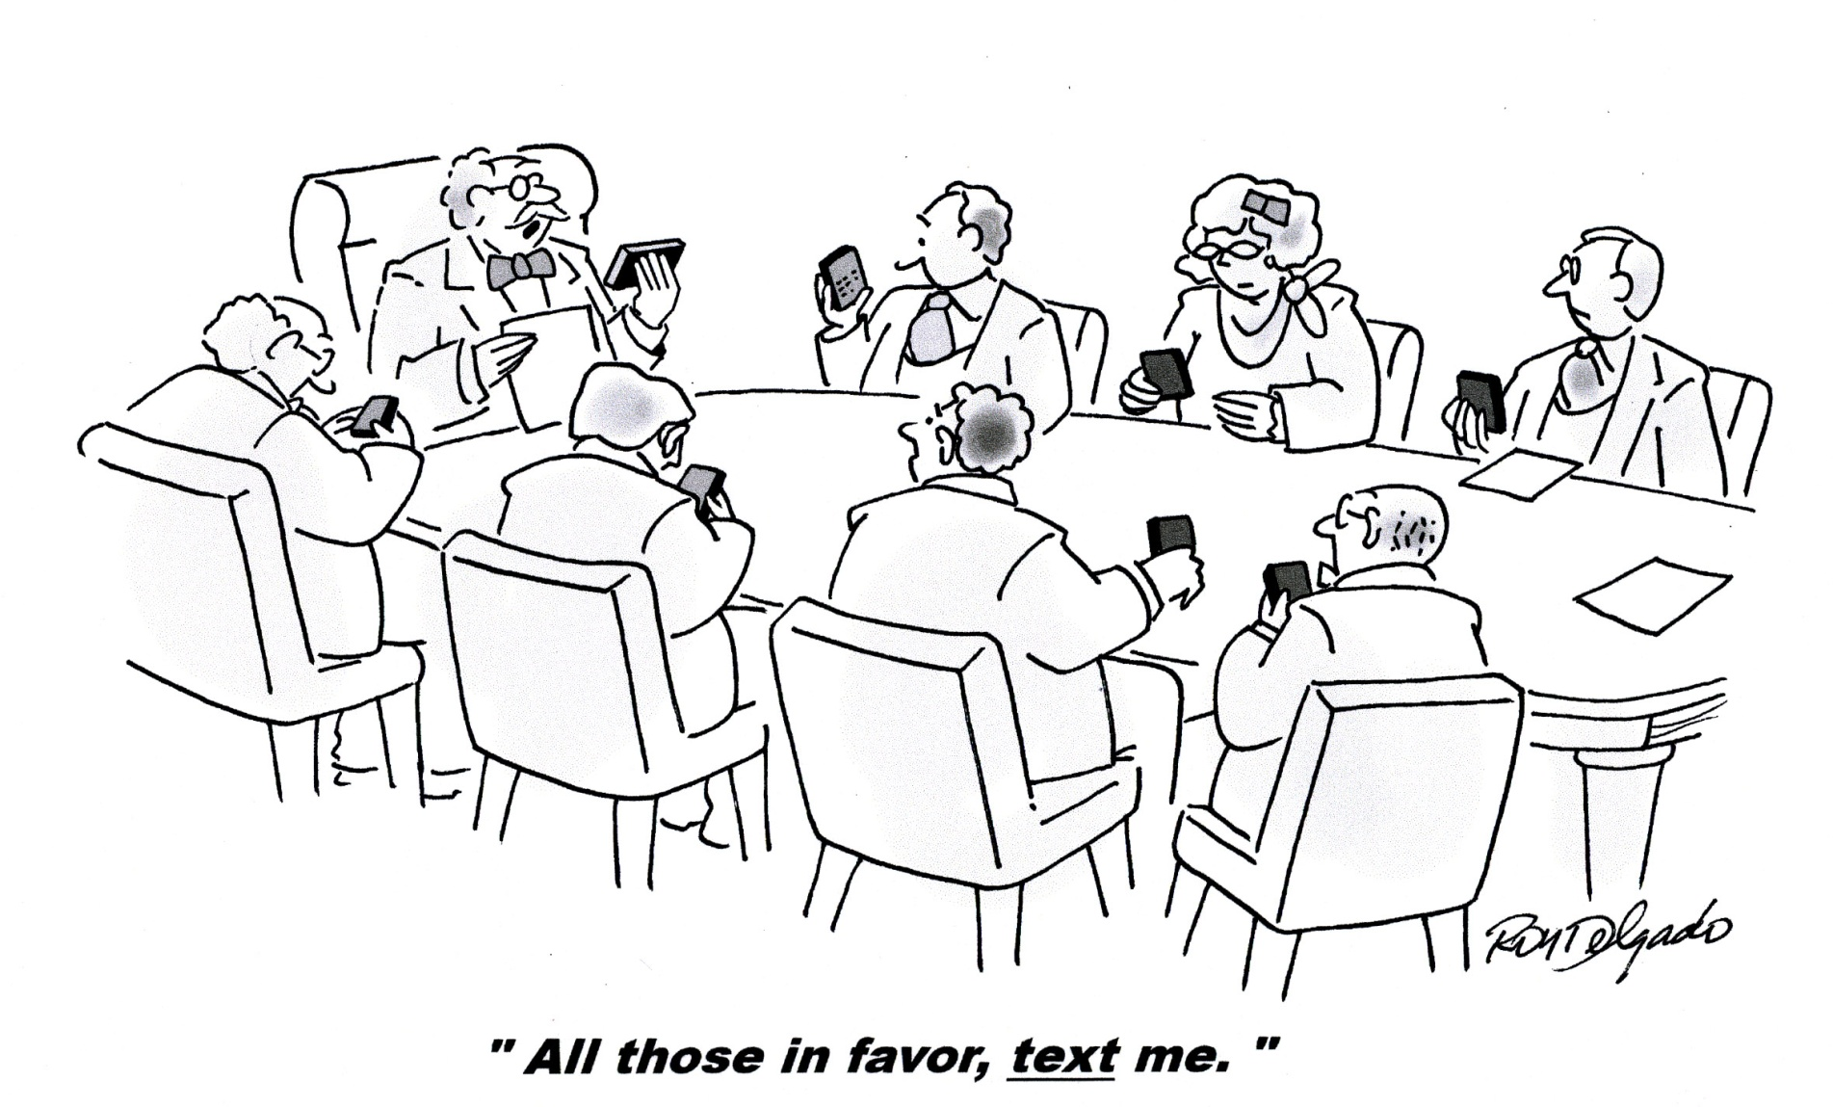

Slide 3
Keypad Question
Philadelphia is the home of?
1 => Duck SEWP and Cheese Cake
2 => Cheese steak sandwich, water ice, soft pretzels and TastyKakes
3 => Chili Fries, Ice Cream and Chocolate
4 => Beer, Wine and Whiskey

Slide 4
Symposium Overview
Meals / Breaks
Exhibitor Area
Networking Event
Evening Events
Tuesday Evening - Dinner / Bowling at Lucky Strike Lounge-n-Lanes
Options for Wednesday Evening:
On your own
Ghost Tour
Philly Tour
Dinner and Independence Hall

Slide 5
Symposium Overview
Plenary Sessions
Contract Updates – Tuesday 12:45 PM
Day 1 Recap, Evening Event Logistics - Tuesday 4 PM
Day 2 Opening Remarks – Wednesday 8:45 PM
Contract Holder Panel - Wednesday 12:45 PM
Demonstration of New Online Tools– Wednesday 2:00 PM
Recap/Q and A – Wednesday 3:15 PM
Government only session – Wednesday 3:45 PM
Tuesday Lunch and Learn
Quick overview of SEWP for first-timers

Slide 6
Symposium Overview
4 Breakout Sessions
The Customer Service Model
The Catalog By Request Model
The Quote Request Model
The Contractual Model
Thursday Morning Agency Sessions
DoD
NASA
VA
US Courts
Others

Slide 7
Who is Here?
Largest attendance ever
- 275 Pre-Registered Attendees
- 181 Government / 18 Agencies including:
US Courts – 38 Attendees
DoD including Army, Navy, Air Force, DISA – 35 Attendees
NASA – 35 Attendees
Veterans Affairs – 24 Attendees
GSA – 6 Attendees
Others: Commerce, Energy, EOP, EPA, Federal Retirement Thrift Investment Board (FRTIB), GAO, Interior, Justice, NIH, USAID
Notes:
Welcome - provide some insight into the size and significance of the event. Step through the welcome packet and explain contents??? Agenda -break timing and expectation -contract holder tables Wireless availability and expected use of Seating Comments welcome throughout (Microphone location and use) Evening plans - restaurants selected for each night Room/Building Logistics - Restroom Locations

Slide 8
Keypad Question
What has been your overall impression of the SEWP Program Office?
1 => Very Positive
2 => Somewhat Positive
3 => Neutral
4 => Somewhat Negative
5 => Very Negative
6 => Not Applicable

Slide 9
Keypad Question
What has been your overall impression of the SEWP Vendors?
1 => Very Positive
2 => Somewhat Positive
3 => Neutral
4 => Somewhat Negative
5 => Very Negative
6 => Not Applicable

Slide 10
SEWP Program Overview
SEWP: Solutions for Enterprise-Wide Procurement
NASA-Wide IDIQ Contract Vehicle for purchase of IT Product solutions
Authorized by OMB as a Government-Wide Acquisition Contract
Program is 19 years old
Version IV started in May 2007
FY11 Government-Wide: 24,000 Delivery Orders worth over $2.3 Billion
70 Agencies / Over 10,000 customers in past year

Slide 11
Keypad Question
What milestone will SEWP IV reach this year?
1 => 10th Year
2 => 1 Million Customers
3 => $10 Billion in Sales
4 => 100 Delivery Orders
5 => $100 Million in Sales

Slide 12
Product Solution Contracts
Emphasis on Product and Product Based Services
Broad Scope
IT Hardware and software
Audio-visual / Conferencing
Product based services
Warranty and maintenance
Training
Installation
Site Survey
Request Driven

Slide 13
SEWP By The Numbers
38 Competed Prime Contractors
4 8(a) Set aside Contractors
3800+ Manufacturers
Including Cisco, Sun, NetApp, EMC, APC, Microsoft, Oracle, etc.
2+ Million Products

Slide 14
SEWP Program Office
Post Contract Award Management
4 civil servants
Program Manager
Deputy Program Manager
Financial Manager
Contracting Officer
Contractor staff of over 35 personnel
Focus on customer support
Notes:
NOTE: This slide is hidden for NASA customer training ( See “Hide Slide” option on the Slide Show menu)
Intro now – who are we
who are you and knowledge of SEWP
sign in
Ask questions but may defer some discussions till we get to that section

Slide 15
SEWP Program Services
Help Desk
Pre-order support
Order processing and support
Post-order support
On-Line Information / Tools
RFQ, Search, FAQs, etc
Training
Free on-site and web-based training on proper use of Contracts
Outreach
Meetings / Retreats / Conferences
Order Processing/ Reports / Tracking
Quality Assurance / Surveys

Slide 16
SEWP Success
Large non-GSA Government-Wide Contract Vehicle
Utilized by every Federal Agency
Clean “Bill of Health” from DoD IG and GAO
Lowest Service Fee in Government
0.45% of order total (Typical fee is 0.75 to 1%)
Customer Service Survey by Outside Consultant
93% satisfaction rating for customer service
Can be leveraged by single customers; consolidated groups; up through CIO-level agency requirements
Tracking, support, training, oversight, insight along with up to date IT product solutions

Slide 17
Program Structure - Oversight
NASA
Direct oversight: Part of the GSFC CIO Directorate
HQ oversight:
CIO
Financial Office
Other Government Entities
Office of Management and Budget (OMB)
Congress / General Accounting Office (GAO)
Inspector Generals Everywhere
Others
Press / Public
Industry

Slide 18
Keypad Question
(Govt Only) Select the top reason you have used SEWP:
1 => Customer Service
2 => Available Technology
3 => Low Prices
4 => Low Fee
5 => Like the Duck
6 => Ease of Use

Slide 19
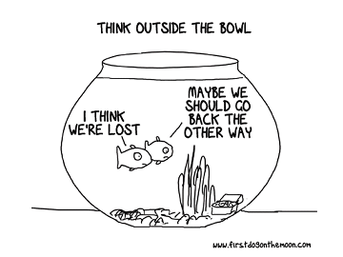
Innovation

Slide 20
Fourth SEWP Objective
SEWP embraces innovative procurement transactions and processes.
Automated processes
One business day turn-around
On-line tools
Database driven
Outreach

Slide 21
Top 12 Reasons Customers Use SEWP
Speed
New Product Availability
Customer Service
Tracking
Assistance
Low Price

Slide 22
Top 12 Reasons Customers Use SEWP
Small Business and the availability of Service Disabled Veteran Owned Businesses (SDVOSB)
Outstanding On-line Tool Set
Outstanding Tools for Contract
Government Oversight of the Entire Process
Free On-site Training (plus a free on-line training video)
Low Fee plus cap

Slide 23
Recent Updates
Tactical
New Quote Verification Tool
Enhanced FAQ, User Portal
Ticketing system
PRISM Implementation – Social Security
Contract modifications & small business recertification

Slide 24
Recent Updates
Staff
Several major new staff positions
Customer Service and Order Processing Teams
Technology Researcher
Outreach Coordinator
All CSRs are HDI (Help Desk Institute) certified
Strategic Focus
Solidifying back-office best practices and documentation
Embracing Leadership Role within IT Acquisition Community
Redefining SEWP’s Mission & Vision
Larger Strategic Role within Federal Agencies
Providing more proactive support; e.g. market research assistance

Slide 25
Keypad Question
SEWP IV’s largest Agency usage in order:
1 => Defense; NASA; VA; Justice
2 => NASA; Defense; GSA; VA
3 => Defense; VA ; Justice; NASA
4 => GAO; Executive Office of the President; HUD; Peace Corps

Slide 26
Month by Month Usage

Slide 27
Keypad Question
How many wagons escorted the Liberty Bell on its return to Philadelphia from Allentown?:
1 => 175 wagon caravan
2 => 5 Duck powered wagons
3 => 700 wagon caravan
4 => 500 wagon caravan

Slide 28

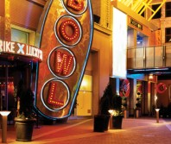
Evening Dinner Event
Lucky Strike Bowling / Dinner:
- Event Begins at 6:30pm, buses leave hotel at 6:15, 6:30 & 6:45
- $20 fee includes buffet, full bar and unlimited bowling and billiards
- Buses leave Lucky Strike at 9:15, 9:30 & 9:45
- Tickets available at Registration (Cash or Credit),cash only at door

Slide 29
Group A
Computer System OEMs and Value Added Resellers
Alliance Technology | Woman Owned, 8(a)
Dell Federal Systems
Force 3, Inc. | Small, Minority-Owned
Four Points Tech. | SDVOSB
Hewlett Packard (HP)
IBM
PC Mall Gov
Silicon Graphics Fed.
Unisys
Notes:
29

Slide 30
Group B: SDVOSB Set-Aside
Service Disabled Veteran-Owned Small Business
Value Added Resellers
Alvarez & Associates | SDVOSB
FedStore Corporation | SDVOSB
I3 Federal | SDVOSB
MicroTech LLC | SDVOSB, 8(a)
Three Wire Systems | SDVOSB
ThunderCat Technology | SDVOSB
Notes:
30

Slide 31
Group C: Small Business Set-Aside
Value Added Resellers
Affigent, LLC | Small / 8(a) / Alaskan Native Co.
Blue Tech, Inc. | Small / 8(a) / Woman-Owned / Hubzone
CounterTrade Products | Small / 8(a) / Woman-Owned
FCN Technology | Small / Woman-Owned
GC Micro | Small / Woman-Owned / Minority-Owned
Intelligent Decisions | Small / Minority-Owned
iGov | Small
immixGroup | Small
Merlin International | Small / 8(a) / Veteran-Owned
Red River | Small
Sword and Shield | Small
Technica Corporation | Small / Veteran-Owned / Minority Owned
Notes:
31

Slide 32
Group D: Full and Open
Value Added Resellers
Best Buy, Gov LLC
CDW*G
CounterTrade Products | (also Group C) | Small 8(a) / Woman-Owned
Emtec Federal
GovConnection, Inc.
GTRI
GTSI Corp.
immixGroup | (also Group C) | Small
Iron Bow Technologies
PC Mall Gov | (also Group A)
Presidio
Ricoh Americas Corp.
SoftChoice Corp.
Unisys | (also Group A)
WWT
Notes:
32

Slide 33
Group E: 8a Set-Asides (non-competed)
Non-Competed 8(a) Set-aside Contracts
Complement Prime Vendor (competed) contracts
Primarily product based services
Limited to $4.0 million per contract
Vaz Tech www.vaztech-inc.com
Copper River Information Technology www.copperriverit.com
Victory Global Solutions, Inc. www.victorygs.com
PSI Technology www.petrosys.com
Notes:
33
Along with the competed contracts which have an IT product scope, a limited services capability and a $4 Billion contract limit, there are 3 non-competed 8(a) set-asides listed here. Unlike the competed contracts there is no limit on services from these 3 contracts but there is an upper limit of $3 Million per contract. Further, Miratek and Eyak are limited to product purchases up to 30% of an order. Because of the mix of services and product in providing imaging and conferencing systems, there is no limit on product or service amounts on Petrosys.
Note these are meant to complement the competed contracts

