Slide 1
RPMS Immunization Package Training - Reports
Version 8.5*1
Amy Groom, MPH
IHS Immunization Program Manager

Slide 2
Some basic tips
To go back to a previous screen, enter “^” (shift 6)
To save changes and exit, hit the F1 key and “E” in quick succession
To quit and go back to the previous screen WITHOUT saving changes, hit the F1 key and “Q” in quick succession

Slide 3
Reports – Changes in Version 8.5
All reports can be run for User Pop, Active Clinical, Active Imm, or All registered users
Expanded Adult report (19 yrs +)
Adolescent
New UTD measure - 1 Tdap/Td and 1 Mening
Male HPV
Two year old Report
Hib and Rotavirus logic takes into account brand and # of doses needed
3-27 month Report
For Hib and PCV – children up to date per catch up schedule counted as UTD
Logic accounts for different Hib and Rotavirus formulations and different dose numbers needed when calculating UTD status
New PCV report
Allows sites to monitor uptake of PCV13 vaccine
VAC report
Can be run by lot number

Slide 4
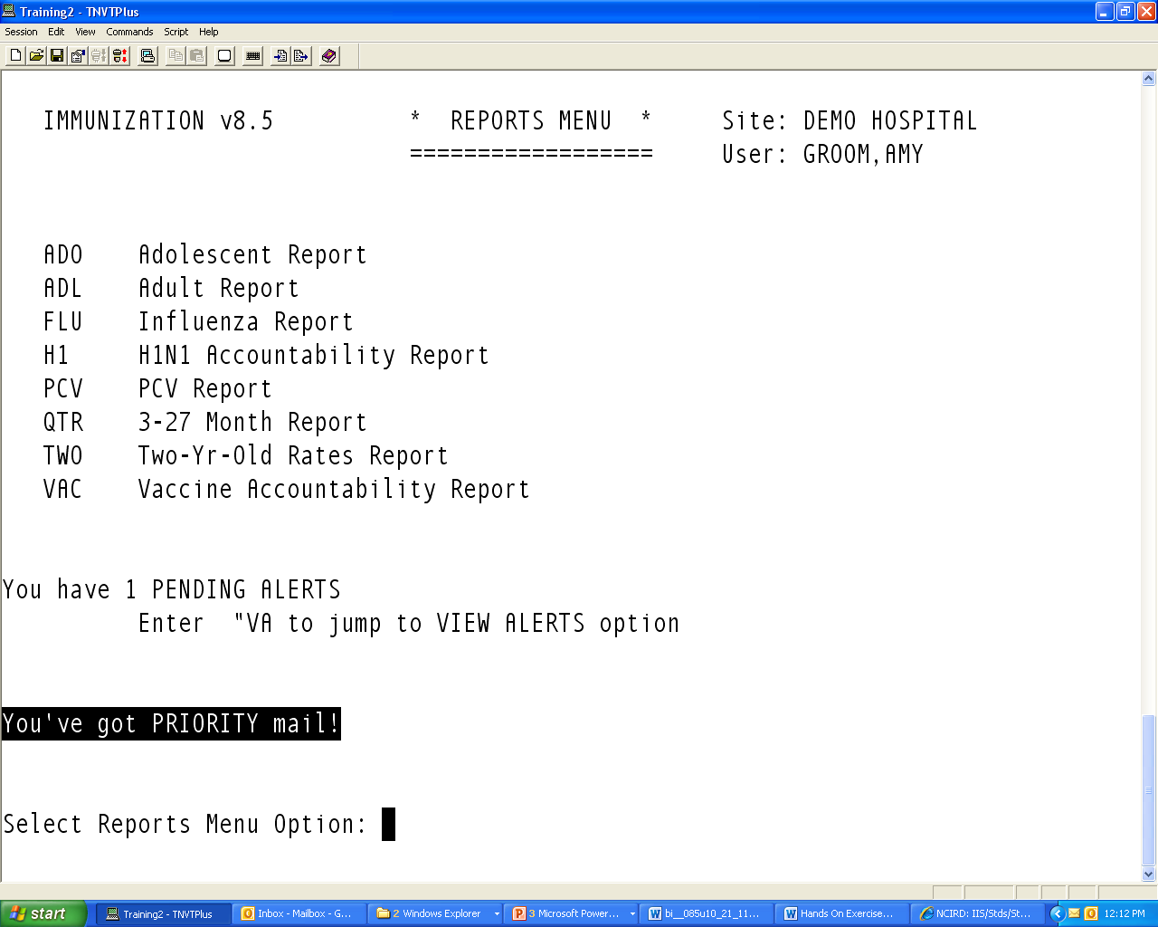
Reports Menu

Slide 5
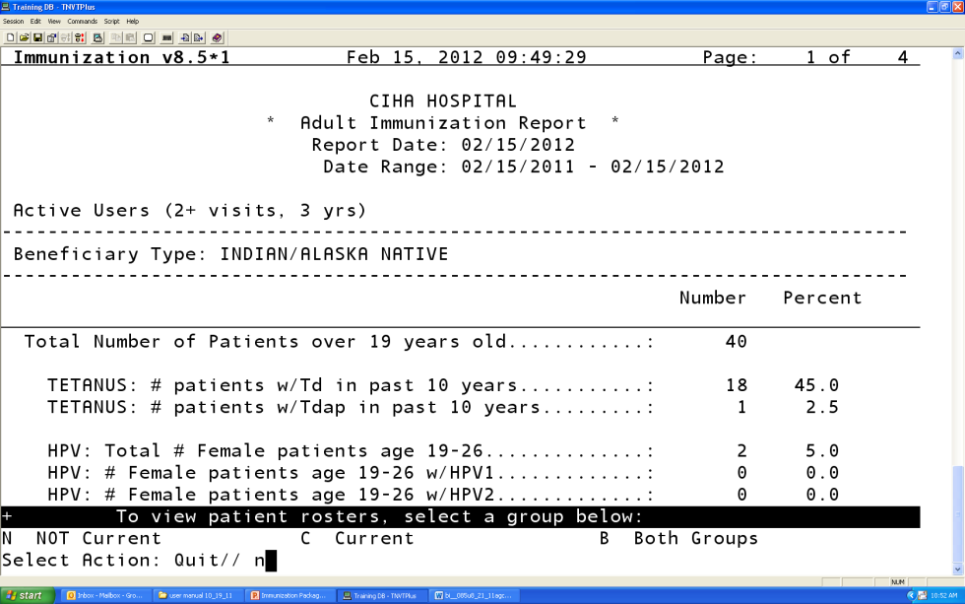
Current vs. Not Current
All patient reports allow you to generate a list of the patients who are Not Current, Current, or Both groups
To View, type in “N” for Not Current, “C” for current, or “B” for both groups

Slide 6
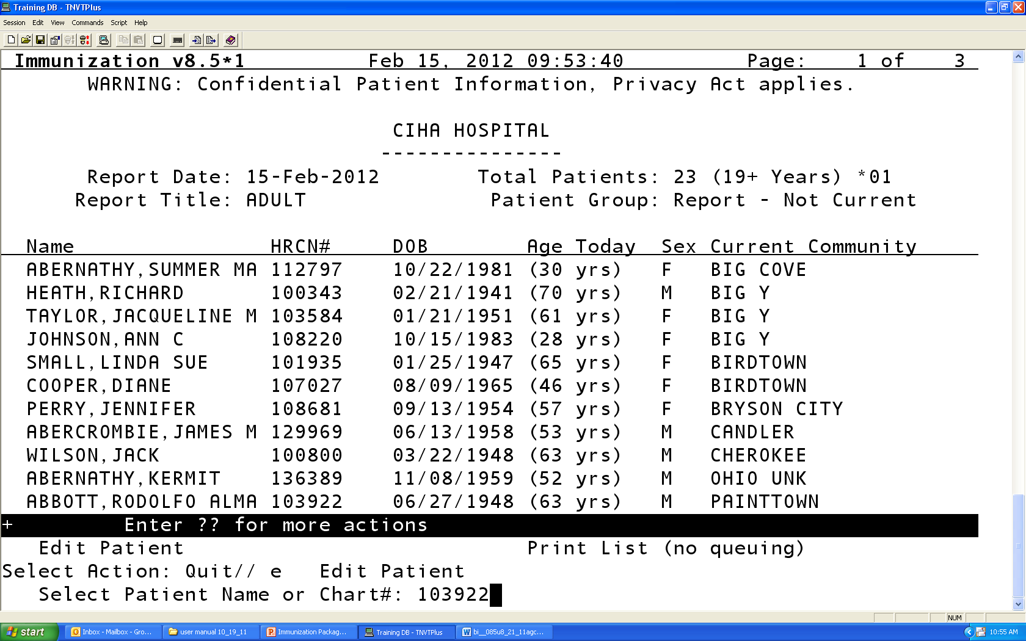
Patient Lists of “Not Current”
To view and individual patient record, select “E” for edit patient
Enter patient chart number
Enter forecast date (or accept default)
Patients Imm Record and complete history will be pulled up

Slide 7
3-27 Month Old Report
Changes in Version 8.5
Logic accounts for different Hib formulations and different dose numbers needed when calculating CURRENT status
For Hib and PCV – children up to date per catch up schedule counted as CURRENT

Slide 8
3-27 Month Old Report
Catch up schedule, vaccine brand included
Vaccine | 3-4mo | 5-6mo | 7-15mo | 16-18mo | 19-23mo
Hib
Pedvax (all doses <12mo) | 1 | 2 | 2 | 3 or 2 > 12 mo. 1 > 15 mo. | 3 or 2 > 12 mo. 1 > 15 mo.
ActHIB | 1 | 2 | 3 or 2 > 7 mo. | 4 or 3 > 7 mo. 2 > 12 mo. 1 > 15 mo. | 4 or 3 > 7 mo. 2 > 12 mo. 1 > 15 mo.
PCV (PCV7 and/or PCV13) | 1 | 2 | 3 or 2 > 7 mo. | 4 or 3 > 7 mo. 2 > 12 mo. 1 > 24 mo. | 4 or 3 > 7 mo. 2 > 12 mo. 1 > 24 mo.

Slide 9
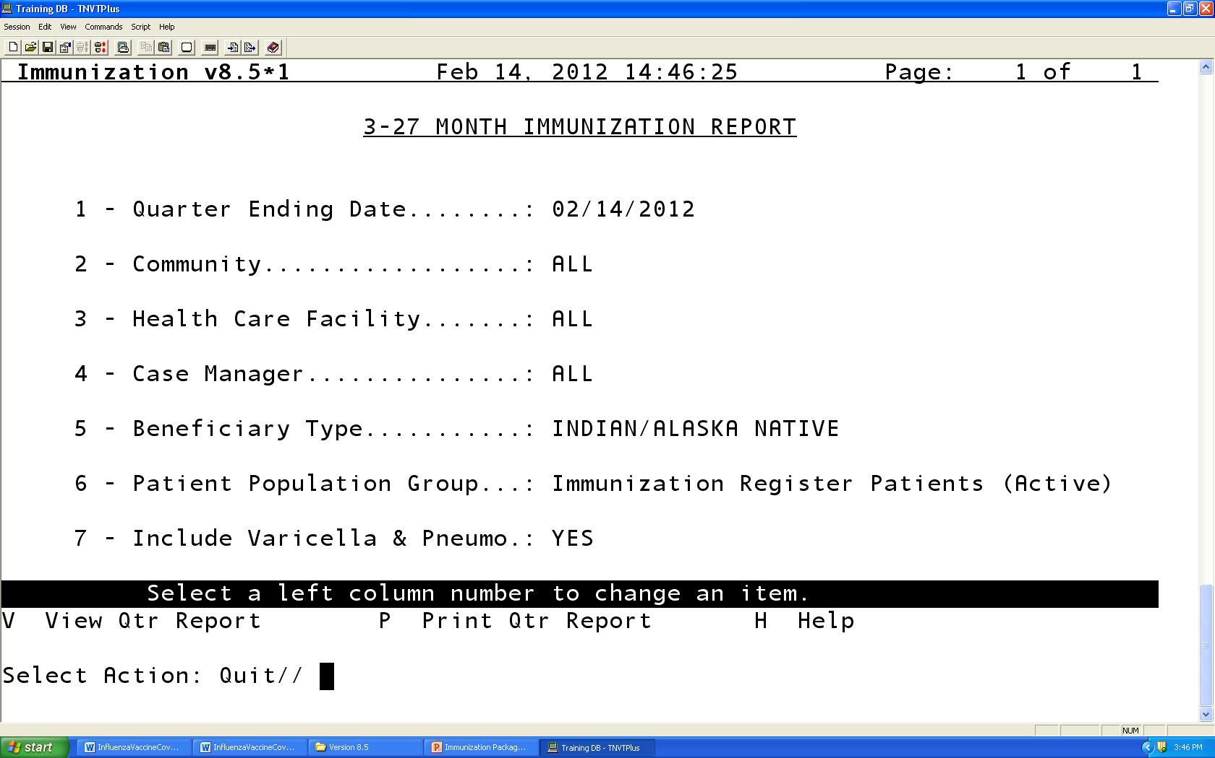
Image printscreen

Slide 10
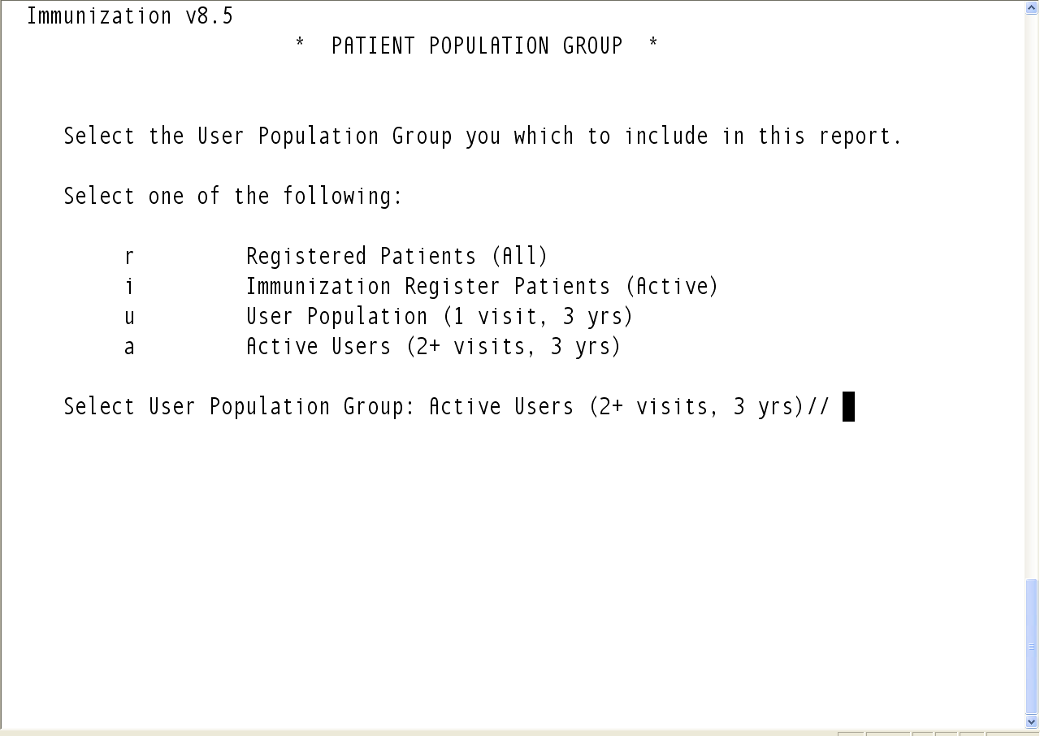
Choosing your Denominator

Slide 11
Active/Inactive in the Immunization Package – What does it mean?
Active/Inactive in the Immunization Package is independent of ‘Active” status in RPMS
Can be inactive in the immunization package, but still have an active chart
Active/Inactive ONLY AFFECTS the childhood reports
3-27 month, Two year old
All children <36 months who reside in one of your GPRA communities are automatically activated into the immunization package
Can Inactivate children who meet the Moved or Going Elsewhere (MOGE) criteria
Active/Inactive status DOES NOT affect inclusion in Adolescent or Adult reports
Active/Inactive DOES NOT affect forecasting – software forecasts for all patients, regardless of status

Slide 12
Image Printscreen of 3-27 month old report
3-27 month old report
*
Notes:
12
3-27 month old report

Slide 13
Two Year Old Report
Changes in Version 8.5
Report takes into account Hib brand to determine if 3 or 4 doses of vaccine are needed to be considered up to date with vaccine series combinations (e.g. 4313314)
If all PedvaxHib – 3 doses
If all ActHib or mix of Pedvaxhib and Acthib products 4 doses
Report also takes into account Rotavirus vaccine brand to determine if 2 or 3 doses of rotavirus are needed in the 431331423 and 4313314232 series measures
Children who do not have recommended number of vaccine doses will be NOT CURRENT, EVEN IF they are current per the catch up schedule

Slide 14
3-27 month old vs. 2 year old report
3-27 month old report is your “worksheet”, your to do list. You can run this every week and focus efforts to catch children up as soon as they are falling behind
If you have good coverage in your 3-27 month report, you WILL have good coverage in your 2 year old report
Meant to provide lists of children the provider can follow up on now, when child is most vulnerable
E.g if child is current per catch up schedule, then nothing the provider can do for that child, so child will be CURRENT in this report even if they didn’t receive the recommended number of doses.

Slide 15
3-27 month old vs. 2 year old report, cont.
Two year old report is more of a population level report that tells you how well you DID at MEETING THE RECOMMENDATIONS
E.g the recommendation is that a child receive 4 doses of pneumococcal conjugate vaccine. If a child only received 3, then we DID NOT meet the recommendation (and probably left the child unprotected during the most vulnerable time of life).
The two year old report is a way to look back at how we did, but is not as useful as the 3-27 month report in identifying children who are behind today and for whom you can actually do something
Once they are 2 yrs, if they didn’t get the vaccines, there isn’t much you can do.
Main Difference from 3-27 month old report:
IN the 2 year old reprot, even if a child is current per the catch up schedule, they will show up as NOT CURRENT in the 2 year old report.
e.g. if a child received 3 doses of PCV, and does not need a 4th dose because they started at 7 months, this child will show up as NOT CURRENT because they did not get the recommended # of vaccines

Slide 16
Image Printscreen of 2 yr old Report
Notes:
16
Two-Yr-Old Immunization Report

Slide 17
Image Printscreen of 2 yr old Report-cont
Notes:
17
Two-Yr-Old Immunization Report CONT

Slide 18
Adolescent Report
Adolescent
New UTD measure - 1 Tdap/Td and 1 Mening
Male HPV

Slide 19
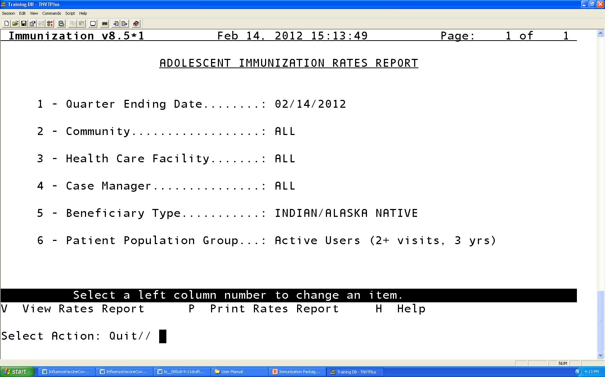
Image of Printscreen of Rates Report

Slide 20
Adult Report
Changes in Version 8.5
All Ages report – 19yrs +
Td/Tdap in last 10 yrs for 19 + yrs
HPV 1,2 and 3 in Males and Females 19-26 years
Tdap for 19-64 yrs
Zoster for 60+
PPSV23 for 65+
Ever
After 65+ yrs

Slide 21
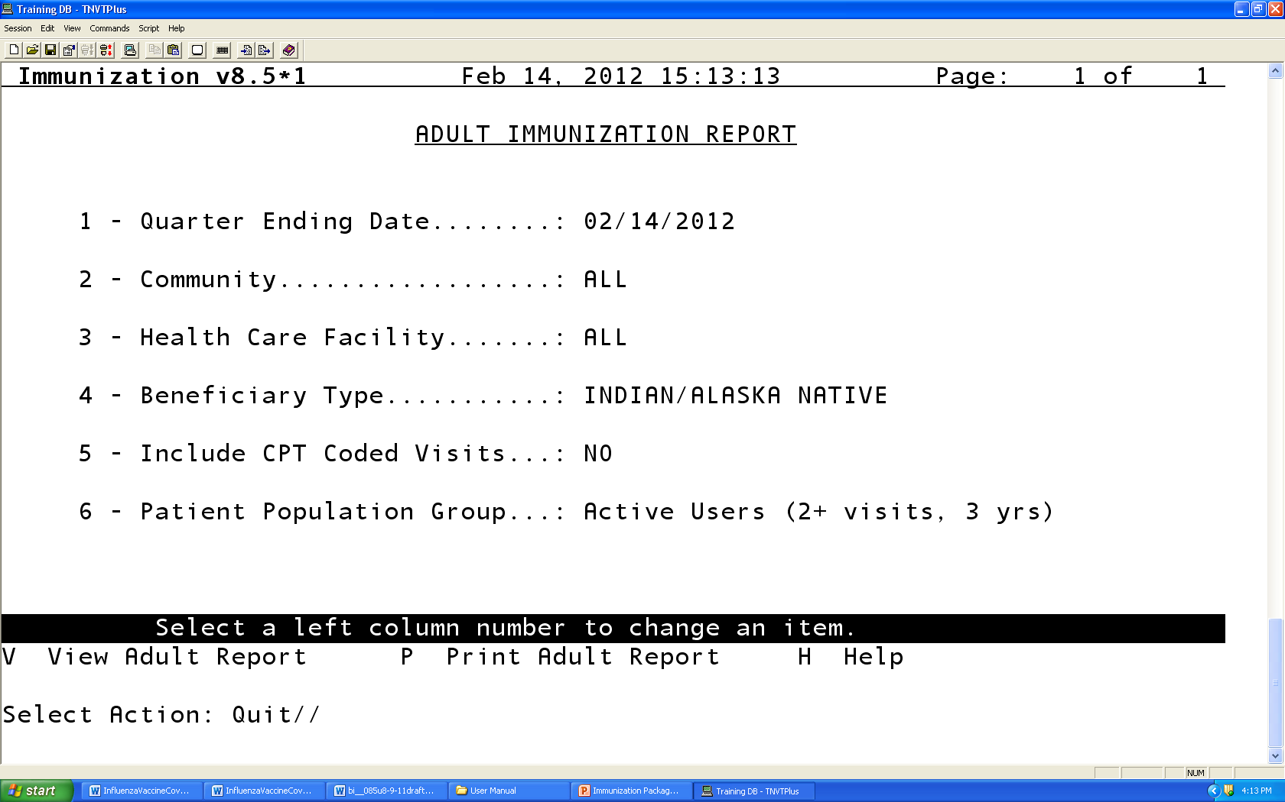
Image of Printscreen of Adult Immunization Report

Slide 22

Image of Printscreen of Report

Slide 23
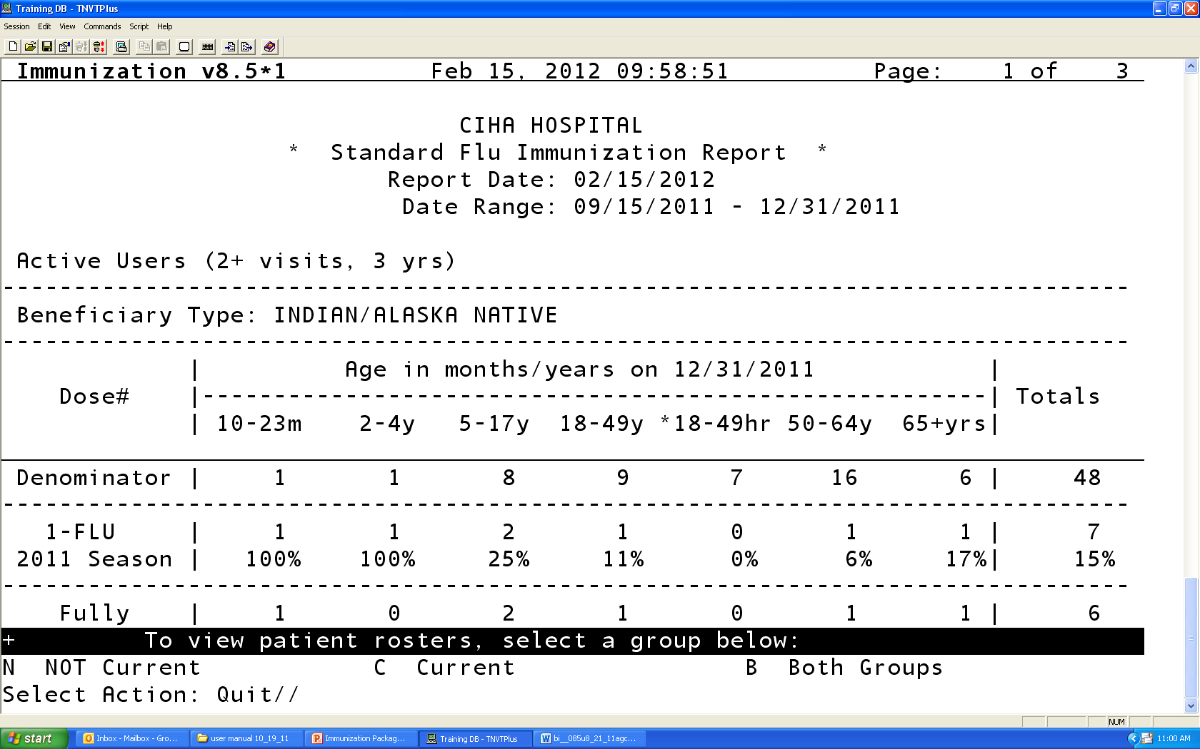
Influenza Report
The “18-49 y” and “18-49 HR” columns are mutually exclusive
18-49 HR are those who have a high risk medical condition, as defined in the Flu High Risk Taxonomy
18-49 yrs includes those WITHOUT a high risk condition

Slide 24
Vaccine Accountability Report
Used to track number of vaccines administered , by age group
If you want to use to look at shots ADMINSTERED at your facility, do not include Historical vaccines (#7)
Default is set ot “Yes”
Can be used for VFC inventory reporting
Can be displayed by individual lot# (parameter #8)

Slide 25
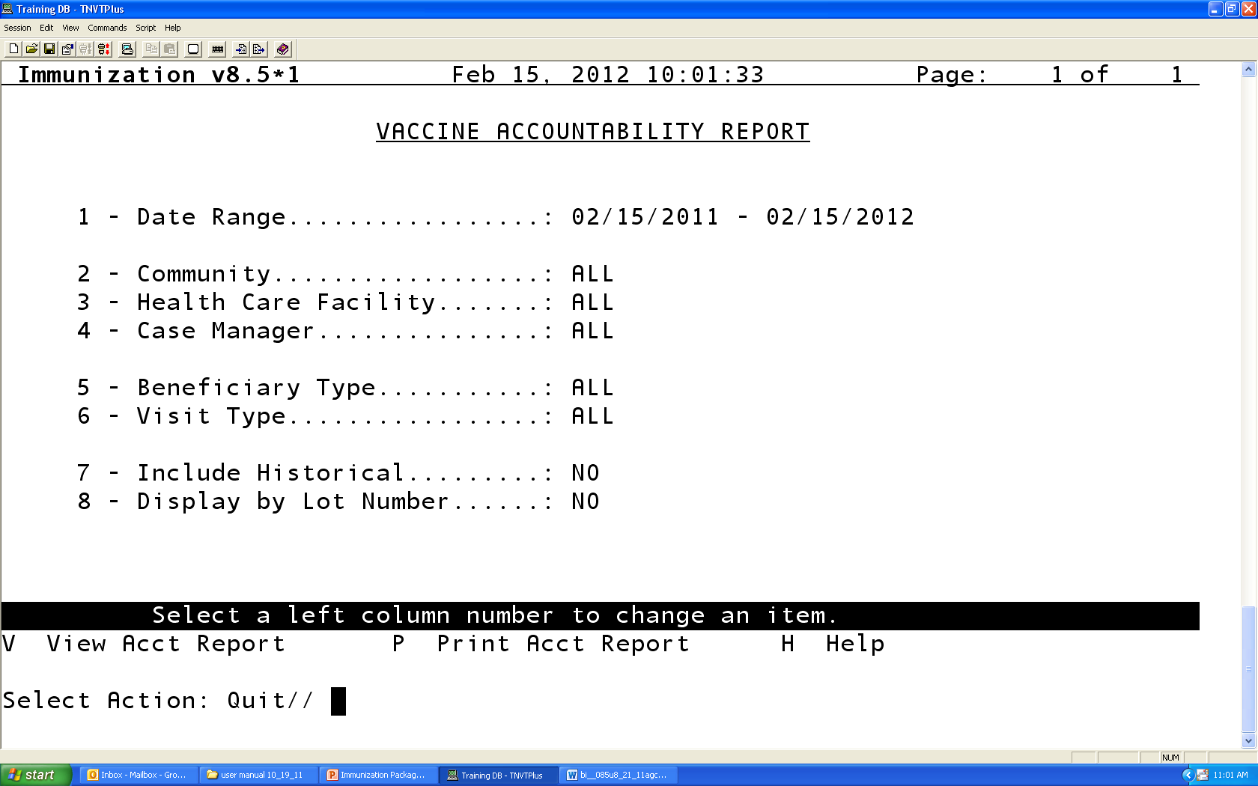
Vaccine Accountability Report

Slide 26
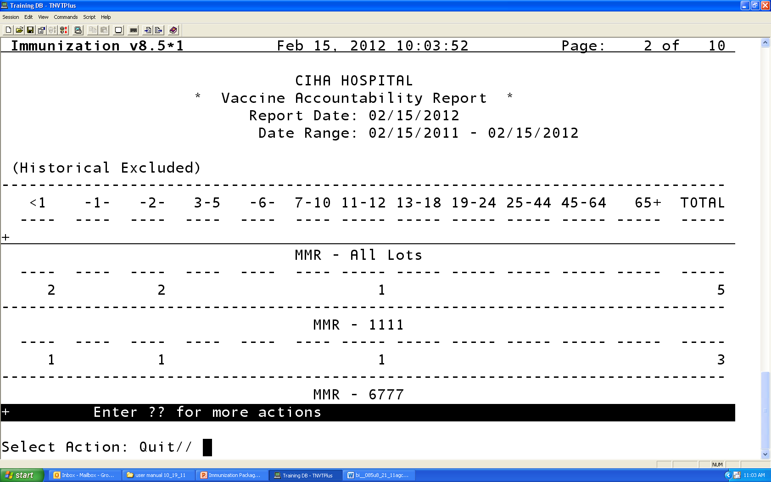
Vaccine Accountability – By Lot #

Slide 27
Immunization Resources
RPMS Immunization Package User Manual
RPMS Application Documents
http://www.ihs.gov/RPMS/index.cfm?module=home&option=documents
IHS vaccine preventable disease page
http://www.ihs.gov/epi
CDC vaccine resources
http://www.cdc.gov/vaccines
Immunization Action Coalition
http://www.immunize.org

