Slide 1
Fusion Nuclear Science and Technology (FNST) Challenges and Facilities on the Pathway to Fusion Energy
Mohamed Abdou Distinguished Professor of Engineering and Applied Science (UCLA) Director, Fusion Science and Technology Center (UCLA) Founding President, Council of Energy Research and Education Leaders, CEREL (USA)
With input from the FNST Community
Related publications can be found at www.fusion.ucla.edu
Remarks at the FPA Meeting ● Washington DC ● December 14-15, 2011

Slide 2
Over the past 3 decades we have done much planning and defining ambitious goals for the long term (power reactors) based on what we “perceive” the technical challenges are, and what may be attractive.
This planning has suffered from lack of fundamental knowledge on FNST
NOW it is time to focus on “actions” to perform substantial FNST R&D in the immediate and near-term futures: this will give us real scientific and engineering data with which we can:
evaluate our long-term goals (too ambitious? Realistic?)
define a practical and credible pathway
The Major Challenges NOW are in FNST
The major FNST challenges are not only the difficulty and complexity of the technical issues
But also how and where (facilities) we can do experiments to resolve these issues.

Slide 3
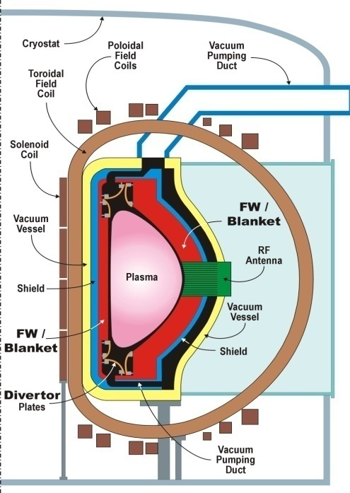
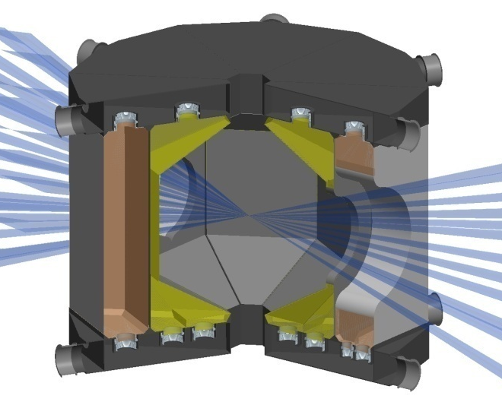
Fusion Nuclear Science & Technology (FNST)
FNST is the science, engineering, technology and materials for the fusion nuclear components that
generate, control and utilize neutrons, energetic particles & tritium.
In-vessel Components
Plasma Facing Components
divertor, limiter, heating/fueling
and final optics, etc.
Blanket and Integral First Wall
Vacuum Vessel and Shield
The nuclear environment also affects
Tritium Fuel Cycle
Instrumentation & Control Systems
Remote Maintenance Components
Heat Transport & Power Conversion Systems
These are the FNST Core
for IFE & MFE
T storage & management
Fueling system
DT plasma
Impurity separation, Isotope separation
Exhaust Processing
optics
T waste treatment
PFC & Blanket
T processing design dependent
PFCs
Blanket
3
Notes:
3
3
Three functions for an energy system: 1. Produce energy (D/T plasma), 2. Extract heat, 3. Regenerate tritium fuel
Do this safely and reliably – we propose that FNSF will do 2 and 3.

Slide 4
Fusion Nuclear Science and Technology (FNST) must be the Central element of any Roadmapping for fusion
ITER (and KSTAR, EAST, JT-60SU, etc) will show the Scientific and Engineering Feasibility of:
Plasma (Confinement/Burn, CD/Steady State, Disruption control, edge control)
Plasma Support Systems (e.g. Superconducting Magnets)
ITER does not address FNST (all components inside the vacuum vessel are NOT DEMO relevant - not materials, not design, not temperature)
(TBM provides very important information, but limited scope)
FNST is the major missing Pillar of Fusion Development
FNST will Pace Fusion Development Toward a DEMO.
Notes:
4

Slide 5
What are the Principal Challenges in the development of FNST?
The Fusion Nuclear Environment
Multiple field environment (neutrons, heat/particle fluxes, magnetic field, etc.) with high magnitude and steep gradients.
Nuclear heating in a large volume with sharp gradients
drives most FNST phenomena.
But simulation of this nuclear heating can be done only in DT-plasma based facility.
Challenging Consequences
Non-fusion facilities (laboratory experiments) need to be substantial to simulate multiple fields, multiple effects
We must “invest” in new substantial laboratory-scale facilities.
Results from non-fusion facilities will be limited and will not fully resolve key technical issues. A DT-plasma based facility is required to perform “multiple effects” and “integrated” fusion nuclear science experiments. So, the first phase of FNSF is for “scientific feasibility”.
But we have not yet built DT facility – so, the first FNSF is a challenge.

Slide 6
Fusion Nuclear Environment is Complex & Unique
Neutrons (flux, spectrum, gradients, pulses)
- Radiation Effects - Tritium Production
- Bulk Heating - Activation and Decay Heat
Heat Sources (thermal gradients, pulses)
- Bulk (neutrons) - Surface (particles, radiation)
Particle/Debris Fluxes (energy, density, gradients)
Multiple functions, materials,
and many interfaces in highly
constrained system
Magnetic Fields (3-components, gradients)
- Steady and Time-Varying Field
Mechanical Forces
- Normal (steady, cyclic) and Off-Normal (pulsed)
Combined Loads, Multiple Environmental Effects
- Thermal-chemical-mechanical-electrical-magnetic-nuclear interactions and synergistic effects
- Interactions among physical elements of components
Non-fusion facilities (Laboratory experiments) need to be substantial to simulate multiple effects
Simulating nuclear bulk heating in a large volume is the most difficult and is most needed
Most phenomena are temperature (and neutron-spectrum) dependent– it needs DT fusion facility
The full fusion Nuclear Environment can be simulated only in DT plasma–based facility

Slide 7
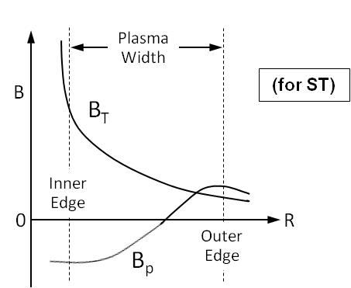
There are strong GRADIENTS in the multi-component fields of the fusion environment
Magnetic Field
Volumetric Heating
(for ST)
Tritium
Damage parameters in ferritic steel structure (DCLL)
Radial variation of tritium production rate in PbLi in DCLL
...........................
These gradients play a major role in the behavior of fusion nuclear components.
They can be simulated only in DT plasma-based facility.

Slide 8
Importance of Bulk Heating and Gradients of the fusion nuclear environment
Simulating nuclear bulk heating in a large volume with gradients is Necessary to:
Simulate the temperature and temperature gradients
Most phenomena are temperature dependent
Gradients play a key role, e.g. :
temperature gradient, stress gradient, differential swelling impact on behavior of component, failure modes
Observe key phenomena (and “discover” new phenomena)
e.g. nuclear heating and magnetic fields with gradients result in complex mixed convection with Buoyancy forces playing a key role in MHD heat, mass, and momentum transfer
for liquid surface divertor the gradient in the normal field has large impact on fluid flow behavior
Simulating nuclear bulk heating (magnitude and gradient) in a large volume requires a neutron field - can be achieved ONLY in DT-plasma-based facility
not possible in laboratory
not possible with accelerator-based neutron sources
not possible in fission reactors ( very limited testing volume, wrong spectrum, wrong gradient)
Conclusions:
Fusion development requires a DT-plasma based facility FNSF to provide the environment for fusion nuclear science experiments.
The “first phase” of FNSF must be focused on “Scientific Feasibility and Discovery” – it cannot be for “validation”.

Slide 9
CHALLENGE we must face in fusion development
Since the integrated fusion environment, particularly volumetric nuclear heating (with gradients) can be realized only in a DT-Plasma Based Facility:
Then we will have to build the nuclear components in the first DT plasma-based device (first FNSF) from the same technology and materials we are testing:
WITH ONLY LIMITED data from single-effect tests and some multiple-effect tests
Without data from single-effect and multiple-effect tests that involve Volumetric Nuclear Heating and its gradient
Without data from synergistic effects experiments
Conclusions:
1- The Primary Goal of the next step, FNSF (or at least the first stage of FNSF) is to provide the environment for fusion nuclear science experiments.
Trying to skip this “phase” of FNSF is like if we had tried to skip all plasma devices built around the world (JET, TFTR, DIII-D, JT-60, KSTAR, EAST, ,etc) and go directly to ITER (or skipping ITER and go directly to DEMO).
2- The next step, FNSF (or at least the first stage of FNSF) cannot be overly ambitious although we must accept risks. The DD phase of the first FNSF also plays key testing role in verifying the performance of divertor, FW/Blanket and other PFC before proceeding to the DT phase.

Slide 10
Reliability/Availability/Maintainability/Inspectability (RAMI) is a Serious Issue for Fusion Development (table from Sheffield et al)
Availability required for each component needs to be high
Component # failure MTBF MTTR/type Fraction Outage Component
rate Major Minor Failures Risk Availability
(1/hr) (yrs) (hrs) (hrs) Major
MTBF – Mean time between failures
MTTR – Mean time to repair
Two key parameters:
DEMO availability of 50% requires:
Blanket/Divertor Availability ~ 87%
Blanket MTBF >11 years
MTTR < 2 weeks
(Due to unscheduled maintenances)
Extrapolation from other technologies shows expected MTBF for fusion blankets/divertor is as short as ~hours/days, and MTTR ~months
GRAND Challenge: Huge difference between Required and Expected!!
10
Notes:
10
10
10

Slide 11
Carefully studying these FNST challenges lead to suggesting that we should plan on FNSF as the “Now + 1” (or “0+1”) facility. Not as “DEMO-1” facility.

Slide 12
Science-Based Pathway to DEMO Must Account for Unexpected
FNST Challenges in Current FNST and Plasma Confinement Concepts
D E M O
Engineering
Feasibility and Validation
Engineering Development
Scientific Feasibility
And Discovery
Preparatory R&D
III
I
II
Non-Fusion Facilities
Fusion Facility(ies)
FNSF
OR
FNSF-1
FNSF-2
Today, we do not know whether one facility will be sufficient to show scientific feasibility, engineering feasibility, and carry out engineering development
OR if we will need two or more consecutive facilities.
May be multiple FNSF in parallel?!
We will not know until we build one!!
Only Laws of nature will tell us regardless of how creative we are. We may even find we must change “direction” (e.g. New Confinement Scheme)
Notes:
12

Slide 13
Establish the base of the pyramid Before proceeding to the top
Testing in the Integrated Fusion Environment (100-1000’sM)
Functional tests: ITER TBM Experiments and PIE
Engineering Feasibility Testing in a Fusion Nuclear Science Facility
Multi-Effect Test Facilities (each ~5-20M class)
Blanket Mockup Thermomechanical/ Thermofluid Testing Facility
Tritium Fuel Cycle Development Facility
Bred Tritium Extraction Testing Facility
Fission Irradiation Effects Testing on Blanket Mockups and Unit Cells
Fundamental Research Thrusts (each ~1-3M per year)
PbLi Based Blanket Flow, Heat Transfer, and Transport Processes
Plasma Exhaust and Blanket Effluent Tritium Processing
Helium Cooling and Reliability of High Heat Flux Surfaces /Blanket/FW
Ceramic Breeder Thermomechanics and Tritium Release
Structural and Functional Materials Fabrication
We need substantial NEW Laboratory-scale facilities NOW
FNST Pyramid

Slide 14
Concluding Remarks
Launching an aggressive FNST R&D program now is essential to defining “informed” vision and “credible” pathway to fusion energy.
Most Important Steps To Do Now
Substantially expand exploratory R&D
Experiments and modeling that begin to use real materials, fluids, and explore multiple effects and synergistic phenomena
Major upgrade and new substantial laboratory-scale facilities
Theory and “FNST Simulation” project (parallel and eventually linked to “plasma simulation” project).
This is essential prior to any “integrated” tests (TBM, FNSF, etc.)
Move as fast as possible to “integrated tests” of fusion nuclear components – these can be performed only in DT plasma-based facility.
TBM in ITER
FNSF: Initiate studies to confront challenges with FNSF (think of “0+1” not “DEMO-1”).
Address practical issues of building FNSF “in‐vessel” components of the same materials and technologies that are to be tested.
Evaluate issues of facility configuration, maintenance, failure modes and rates, physics readiness (Quasi‐steady state? Q ~ 2‐3?). These issues are critical - some are generic while others vary with proposed FNSF facility.

