Slide 1
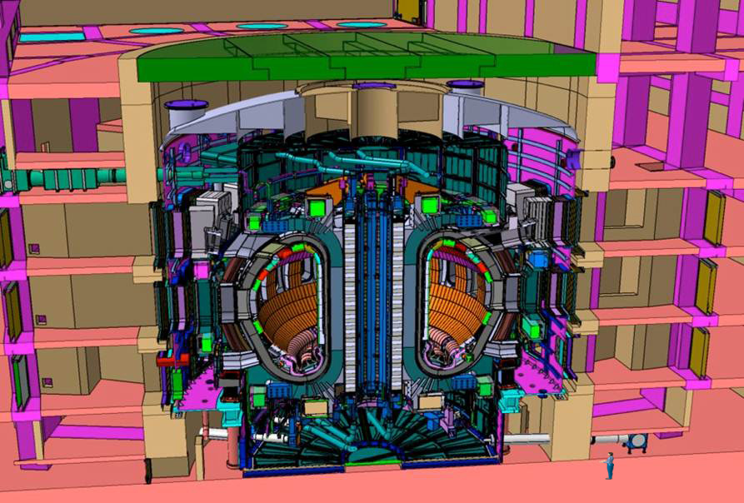
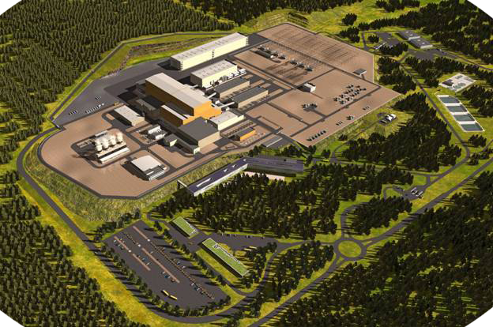
ITER
Achieve 500 MW of fusion power.
Demonstrate the scientific and technological feasibility and safety features of fusion energy.
Ned Sauthoff for Osamu Motojima
Notes:
In a global context of rising oil and gas prices, decreased accessibility to low-cost fossil fuel sources, and an estimated three-fold increase in world energy demand by the end of this century, the energy question finds itself propelled to the front of the stage. How will we supply all this new energy, and how can we do so without adding dangerously to atmospheric greenhouse gases?
To the sustainable energy mix of the future, fusion scientists believe that they can make an important contribution. Fusion, the nuclear reaction that powers the sun and the stars, would provide a safe, non-carbon emitting and virtually limitless source of energy. In the next thirty years in southern France, the world will be watching the ITER project, where a consortium of nations is building the world’s largest fusion device.

Slide 2
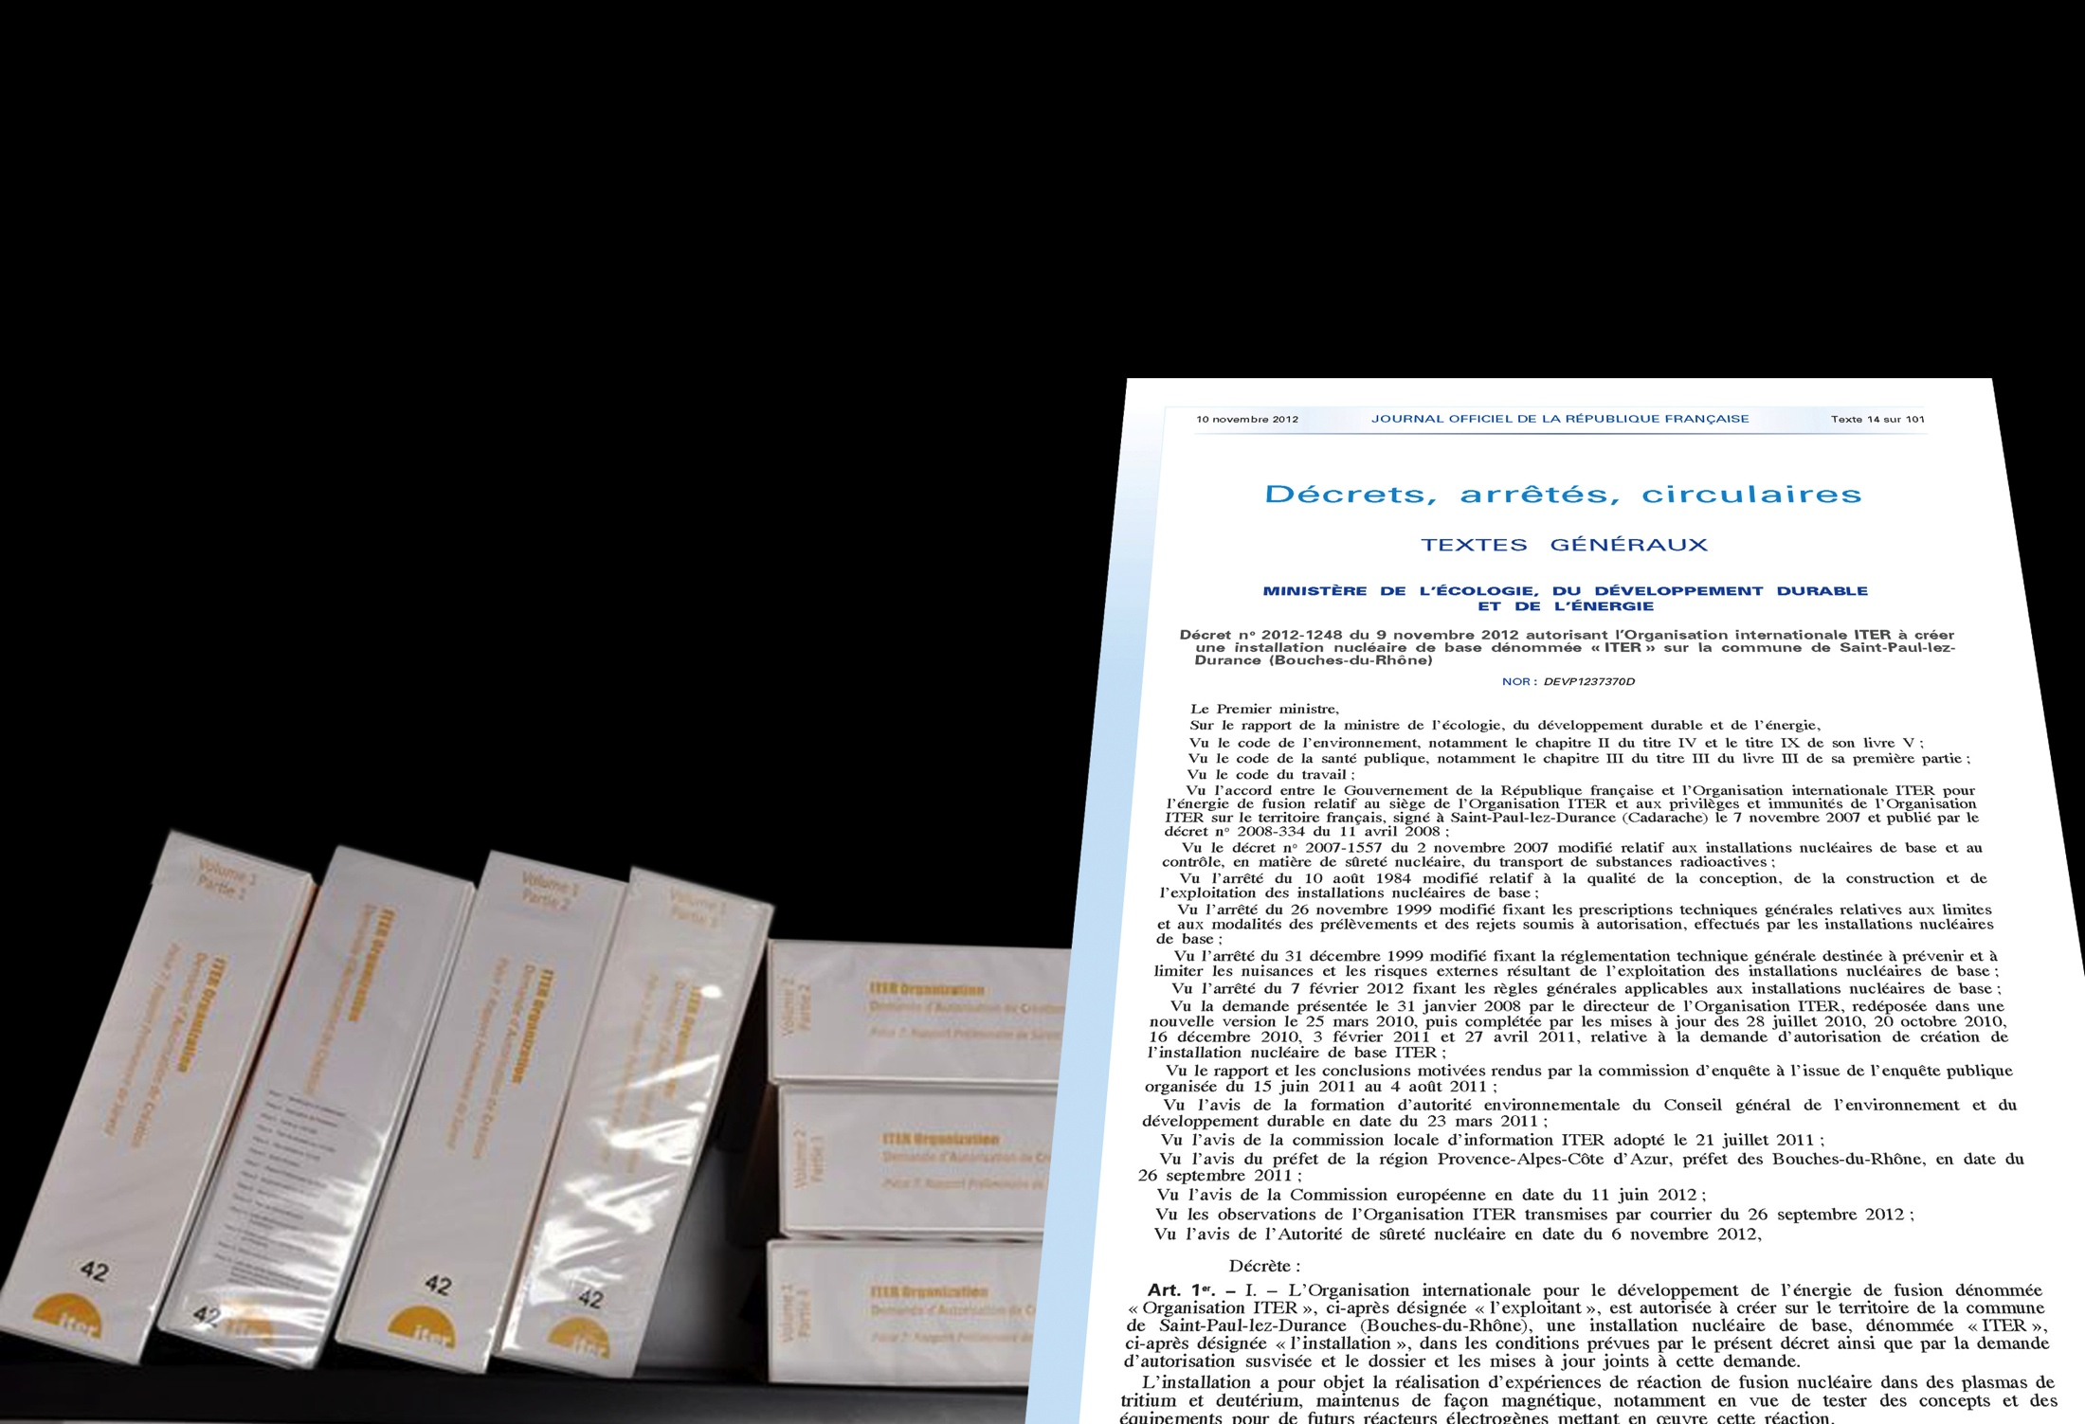
Construction Authorization Decreed
On November 10, 2012, the French Ministry of Environment signed a decree authorizing construction of the ITER nuclear facility.
ITER is the first fusion device to qualify as a nuclear installation.
Over two years of investigation and analysis were required as part of the review procedures.
τ
Notes:
Keep hot plasma KD: “will” transform
Hot to High energy,
alpha particles

Slide 3
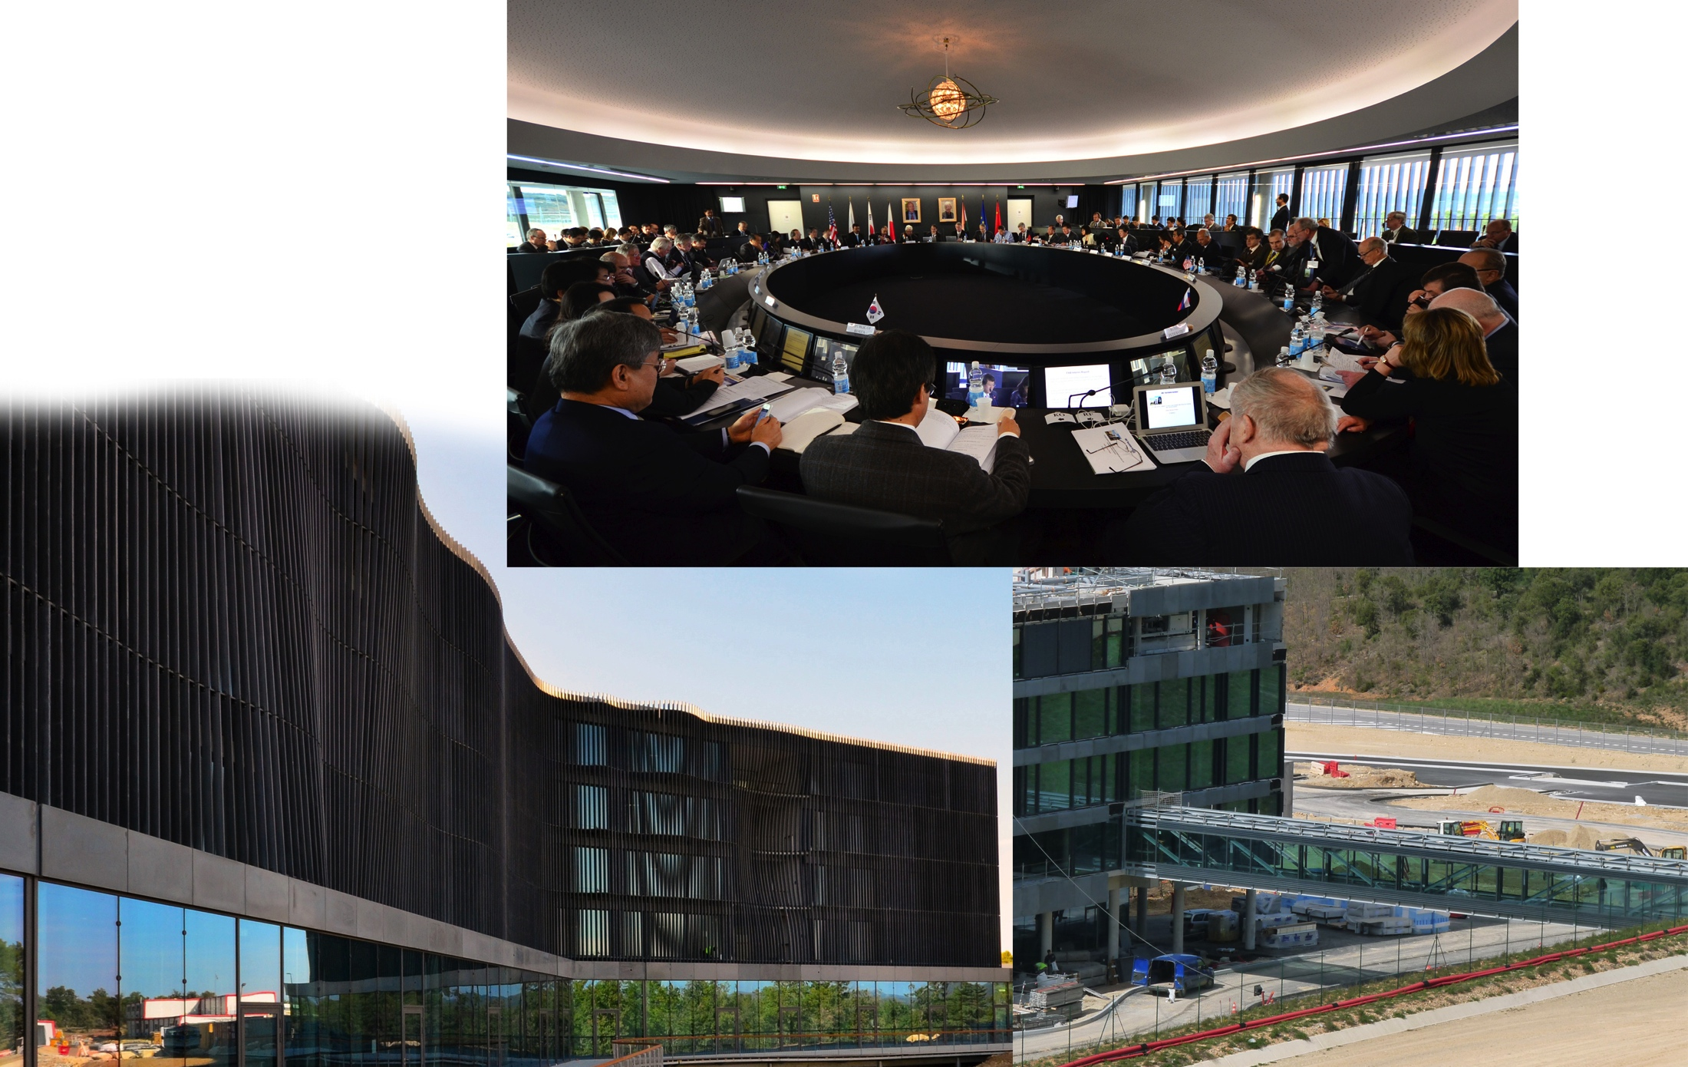
Site Construction Progress: Headquarters Building
ITER Council Room
ITER HQ Building
Bridge linking HQ Building and the Site
τ
Notes:
Keep hot plasma KD: “will” transform
Hot to High energy,
alpha particles

Slide 4
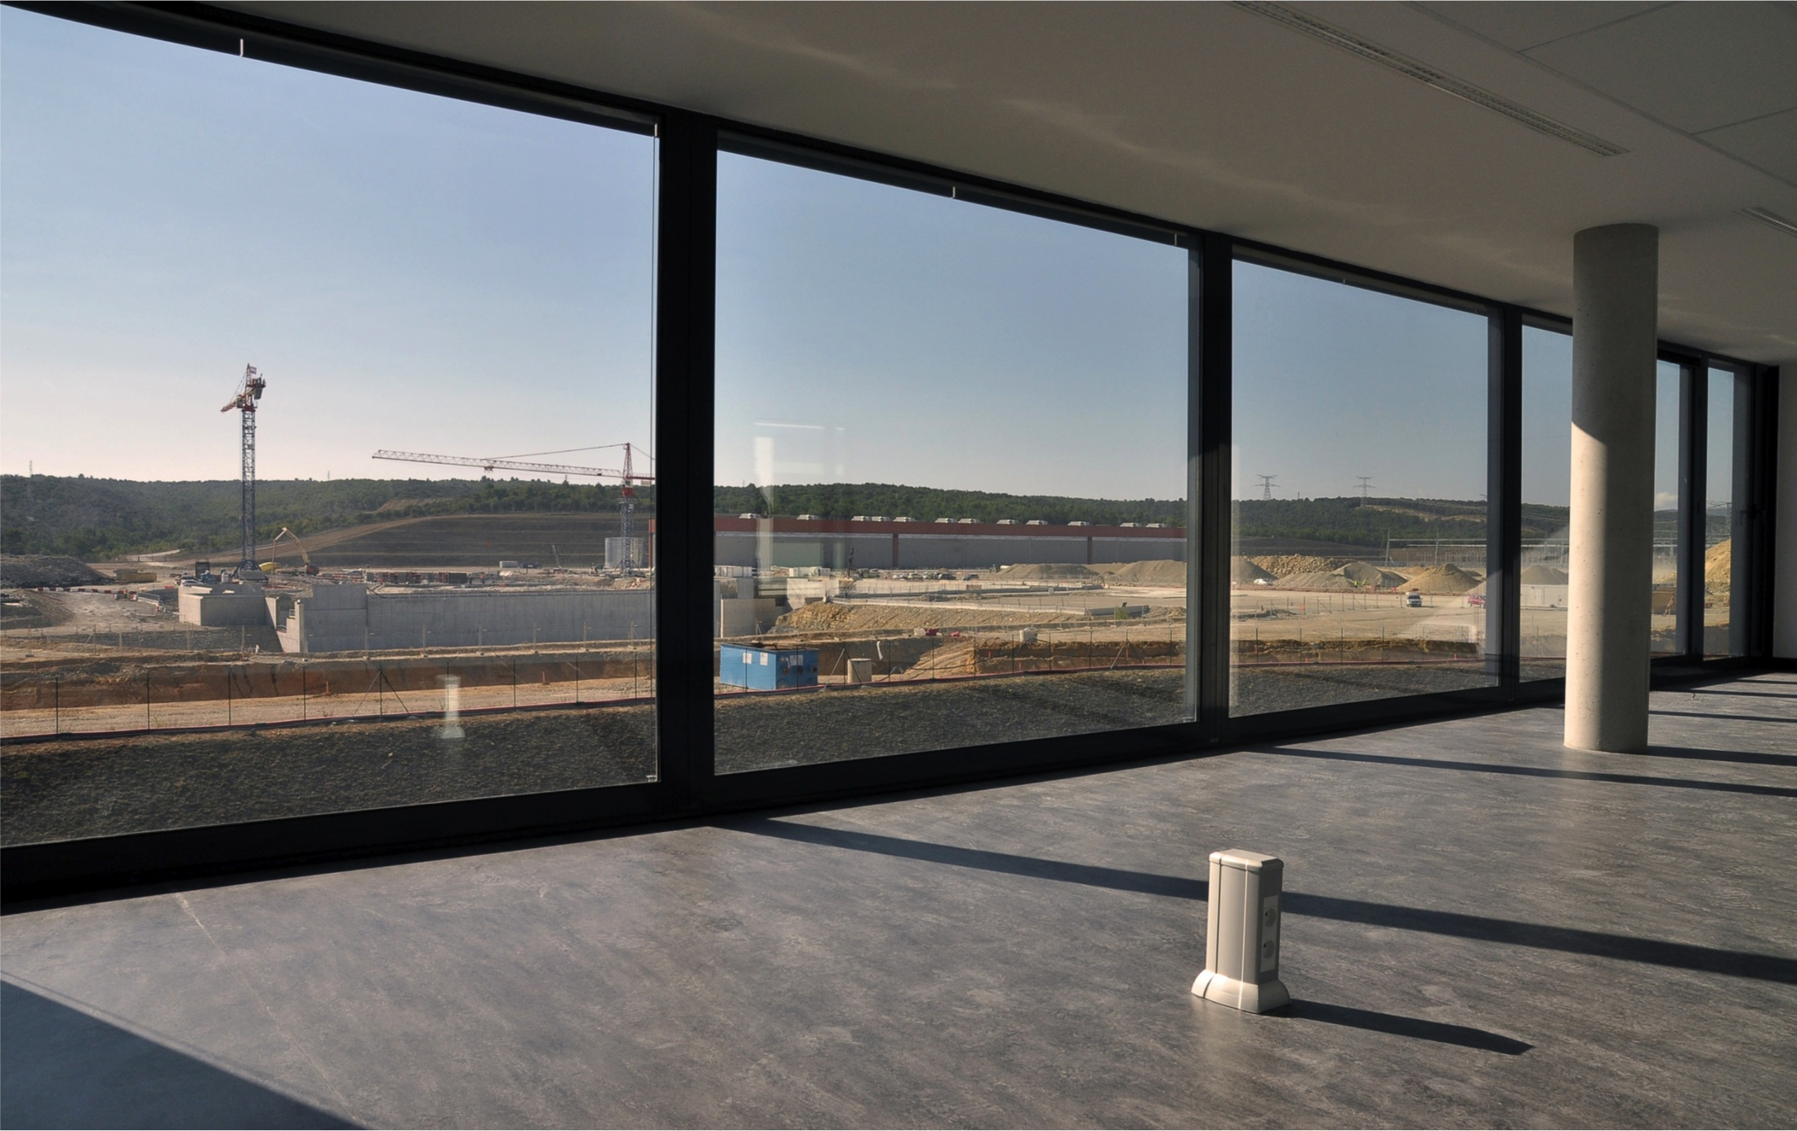
Construction Site Panoramic View from ITER Headquarters
τ
Notes:
Keep hot plasma KD: “will” transform
Hot to High energy,
alpha particles

Slide 5
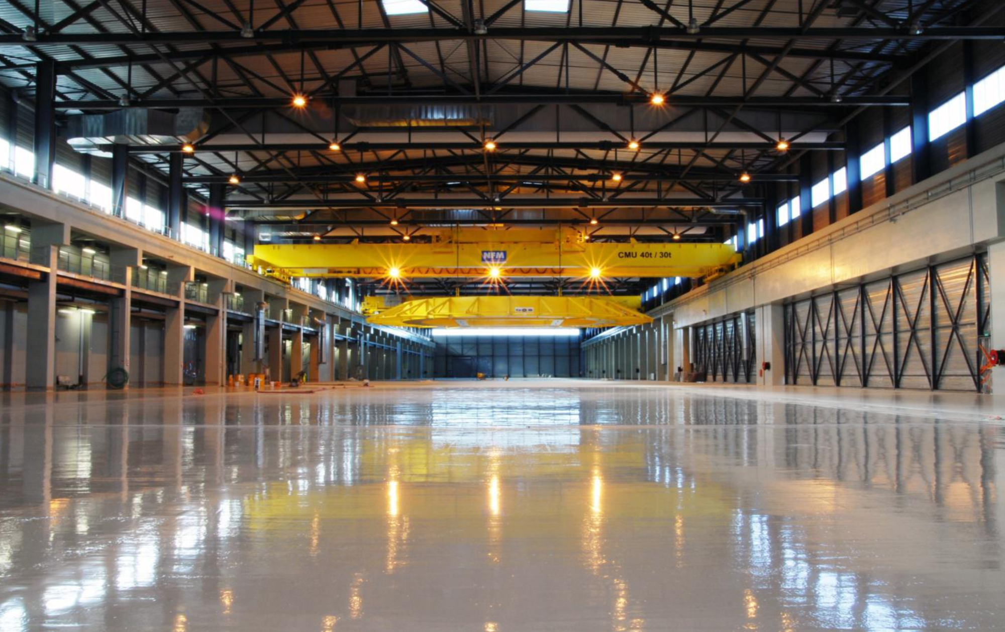
Inside PF Coil Building
τ
Notes:
Keep hot plasma KD: “will” transform
Hot to High energy,
alpha particles

Slide 6
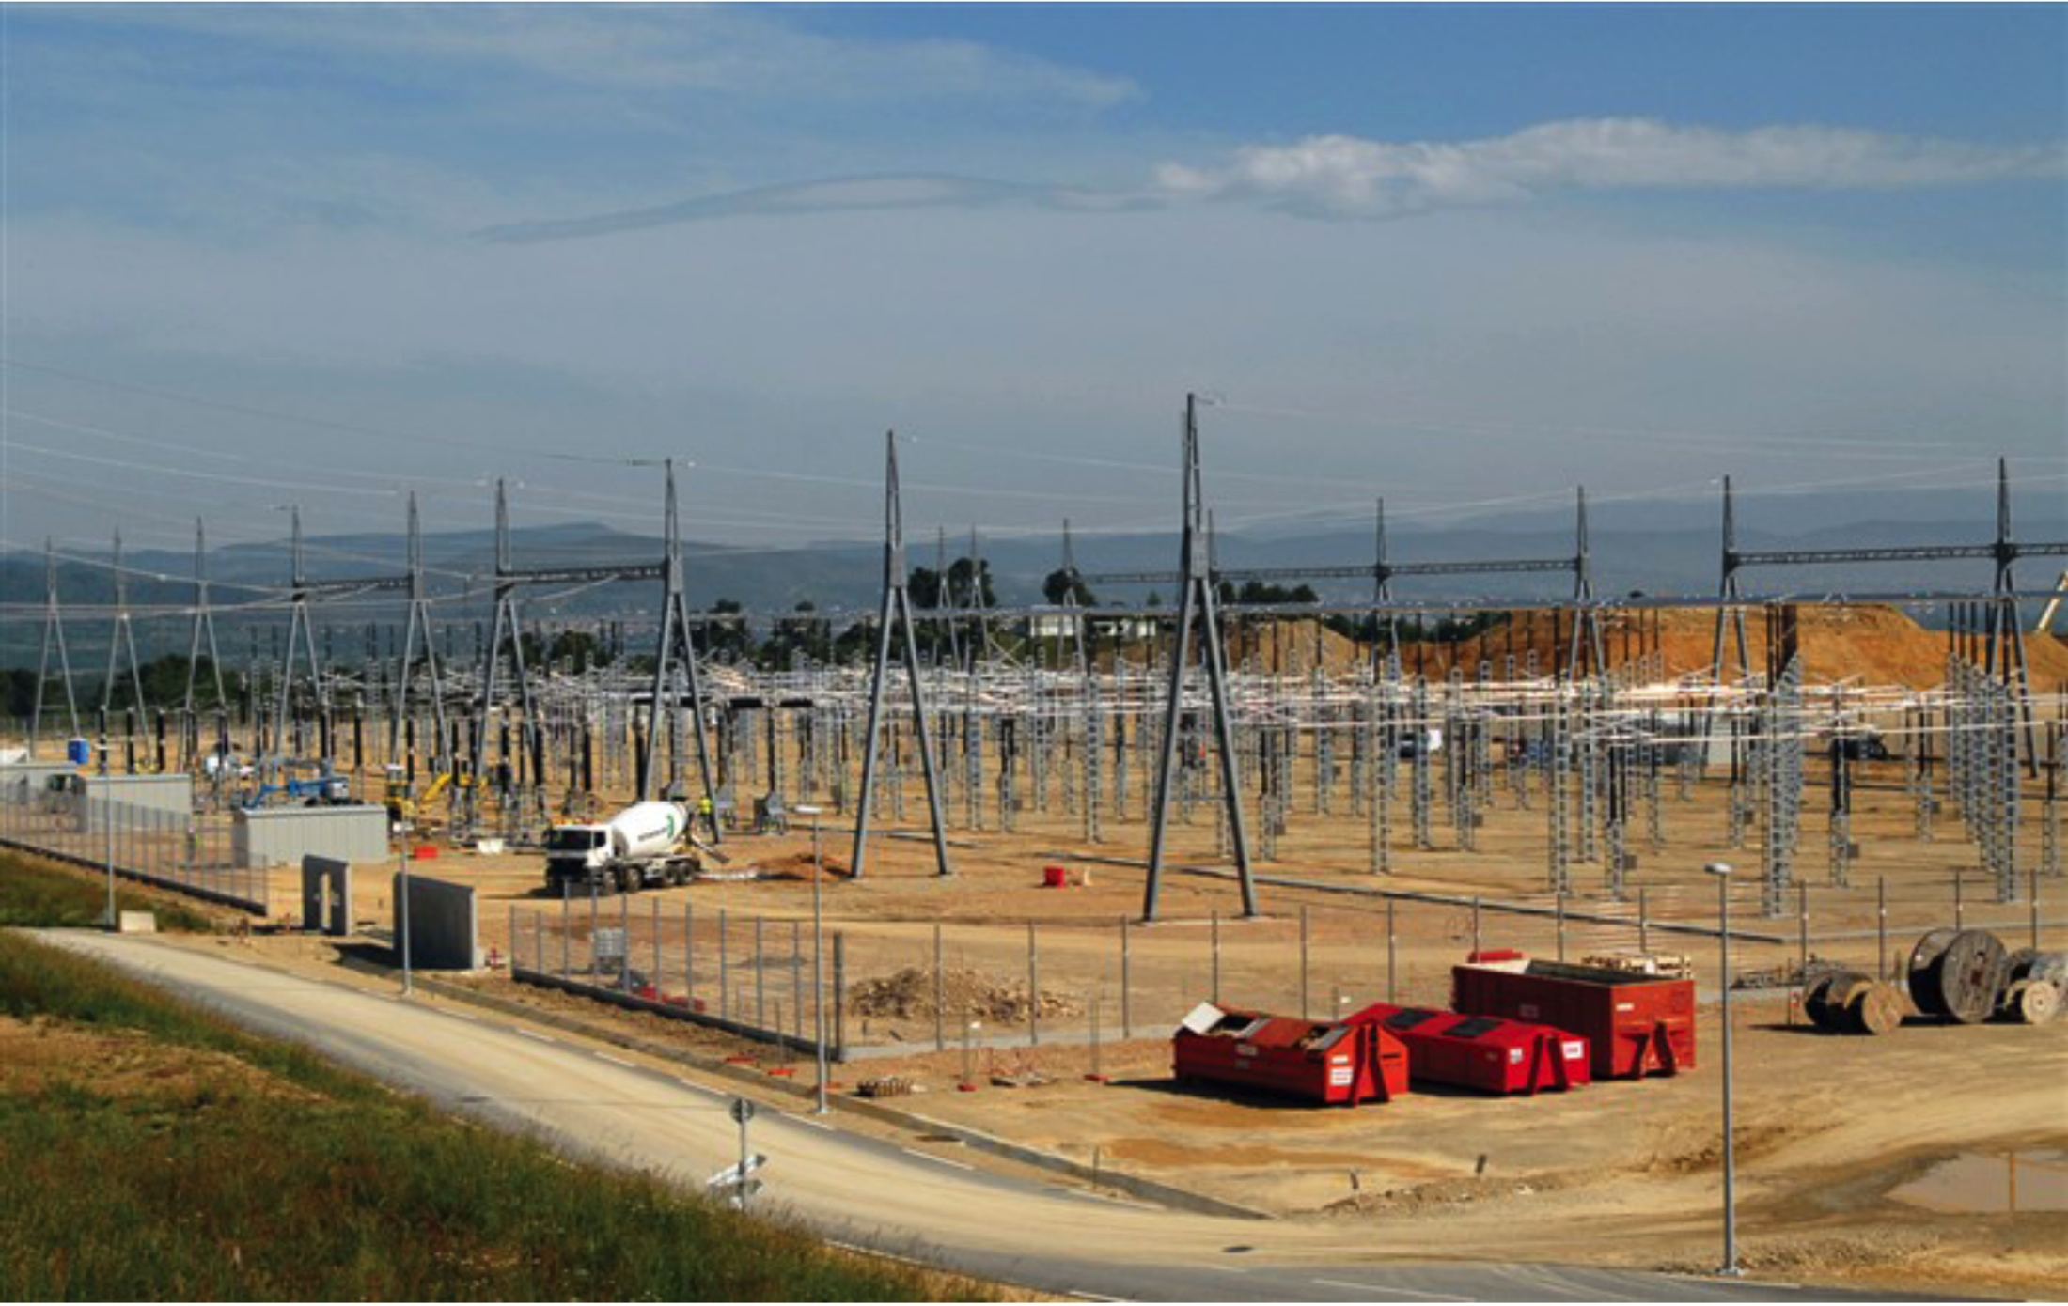
400 kV Electric Substation Energized June 2012
τ
Notes:
Keep hot plasma KD: “will” transform
Hot to High energy,
alpha particles

Slide 7
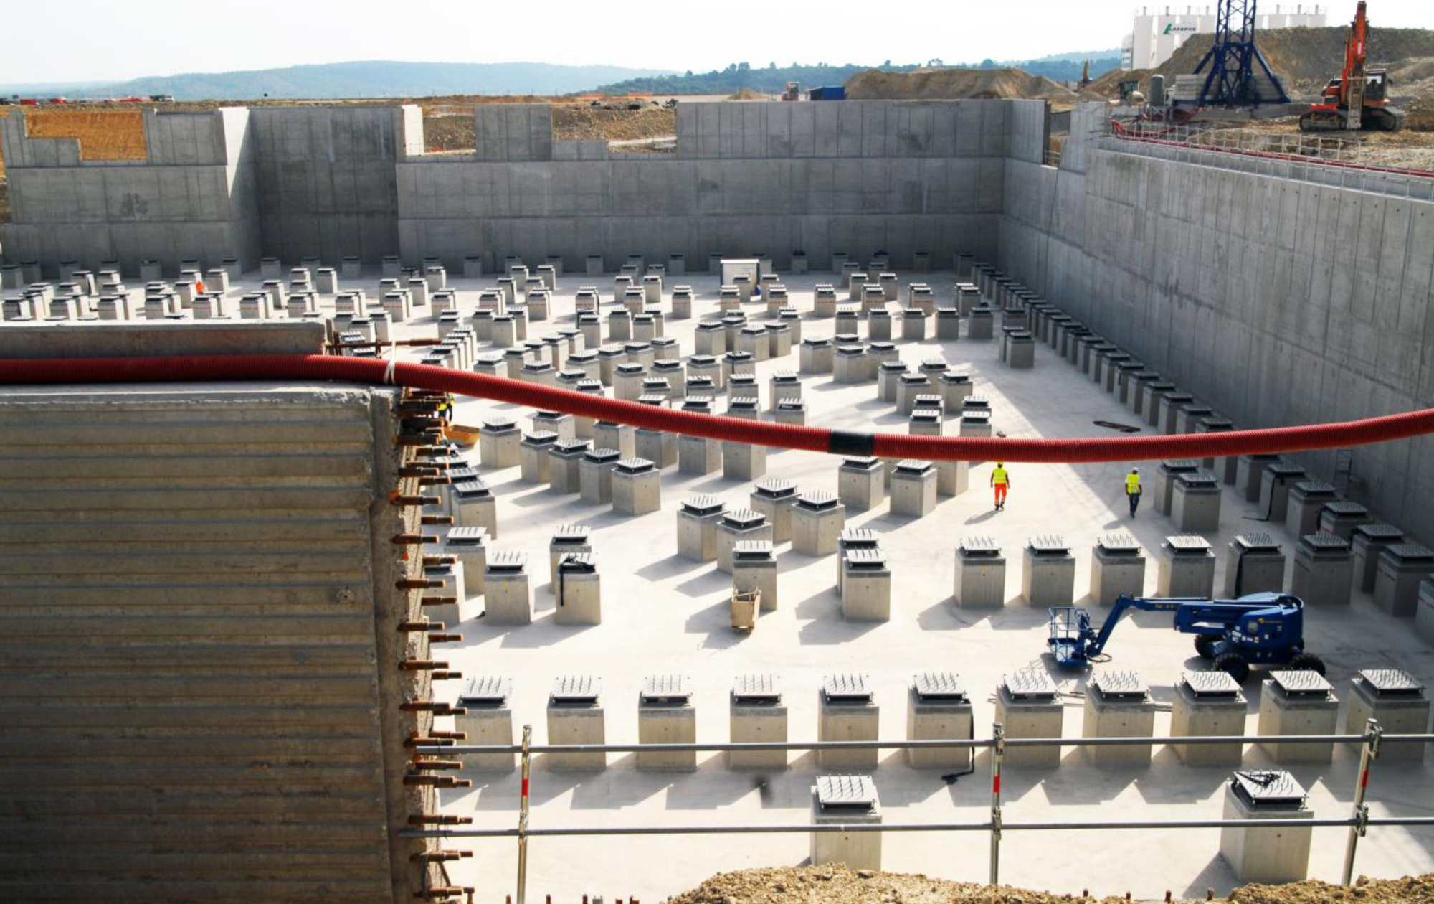
Tokamak Sub-Basement and Seismic Bearings
τ
Notes:
Keep hot plasma KD: “will” transform
Hot to High energy,
alpha particles

Slide 8
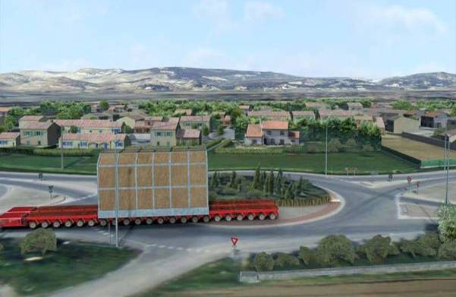
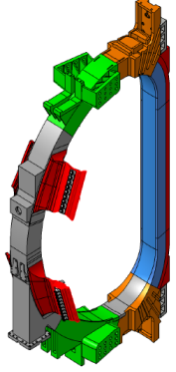
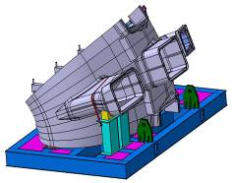
FRANCE
Itinerary – Local Communities Provided Road Upgrades
TF Coil ~360 t
16 m Tall x 9 m Wide
VV Sector ~400 t
12 m Tall x 9 m Wide
Heavy Component on Road
(TF Coils, VV Sectors, and PF1 Coil)
Paid with contributions from local area – ~467 M €
Itinerary: March 2013 Test Convey
Beginning of 2014 Real Large/Heavy Components will arrive at ITER
PF1 Coil ~200 t
9.4 m Dia
Notes:
10 October, March 2013にテストコンボイ, 2014から実際に動き出す。道路の39%に現状問題が発見、itinerary planは完成

Slide 9
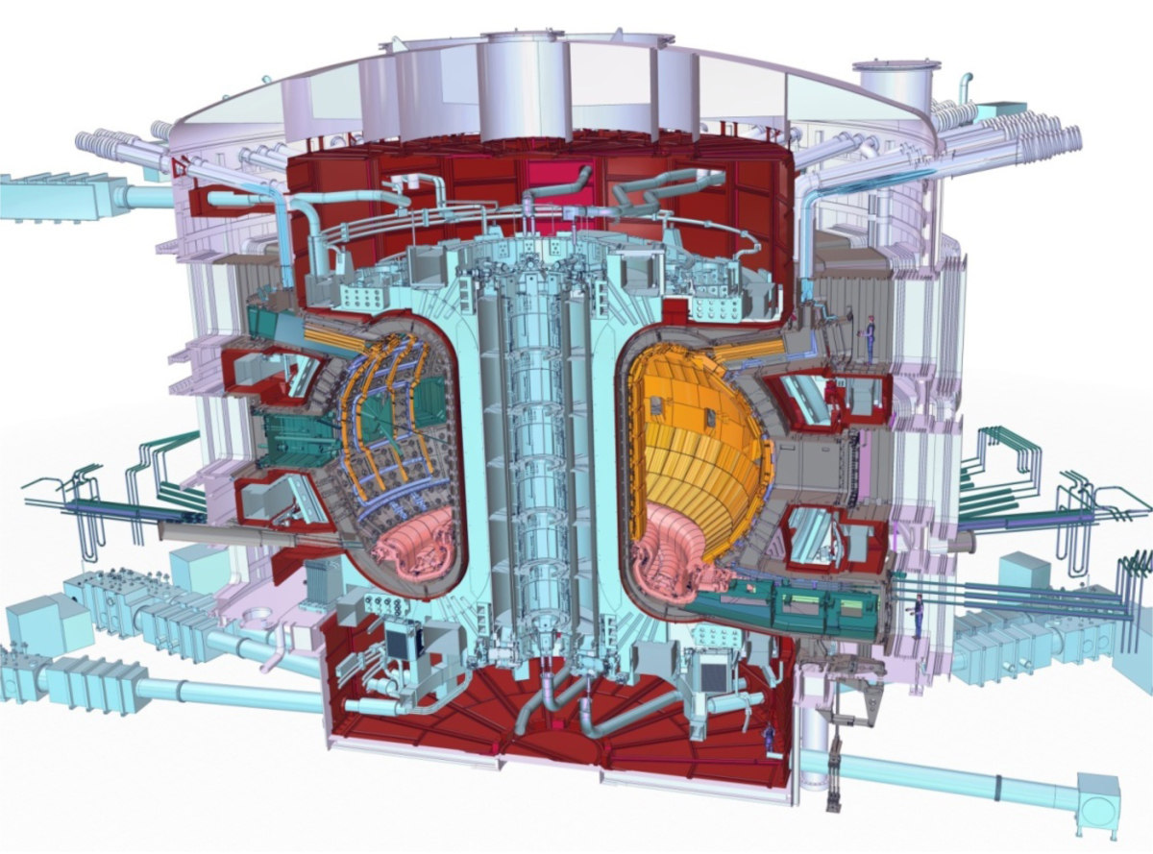
ITER is Addressing the Key Technical Challenges of the Tokamak
Tokamak
Large scale-up of many systems
High quality high tech components
Tight tolerances
Highly integrated design
Superconducting magnets
Unprecedented magnet size
High field performance ~12T
Conductor and magnet manufacturing
Vessel Systems
Large size
Safety boundary
Plasma facing components
High heat flux
Plasma-Material Interactions
Remote Handling requirements

Slide 10
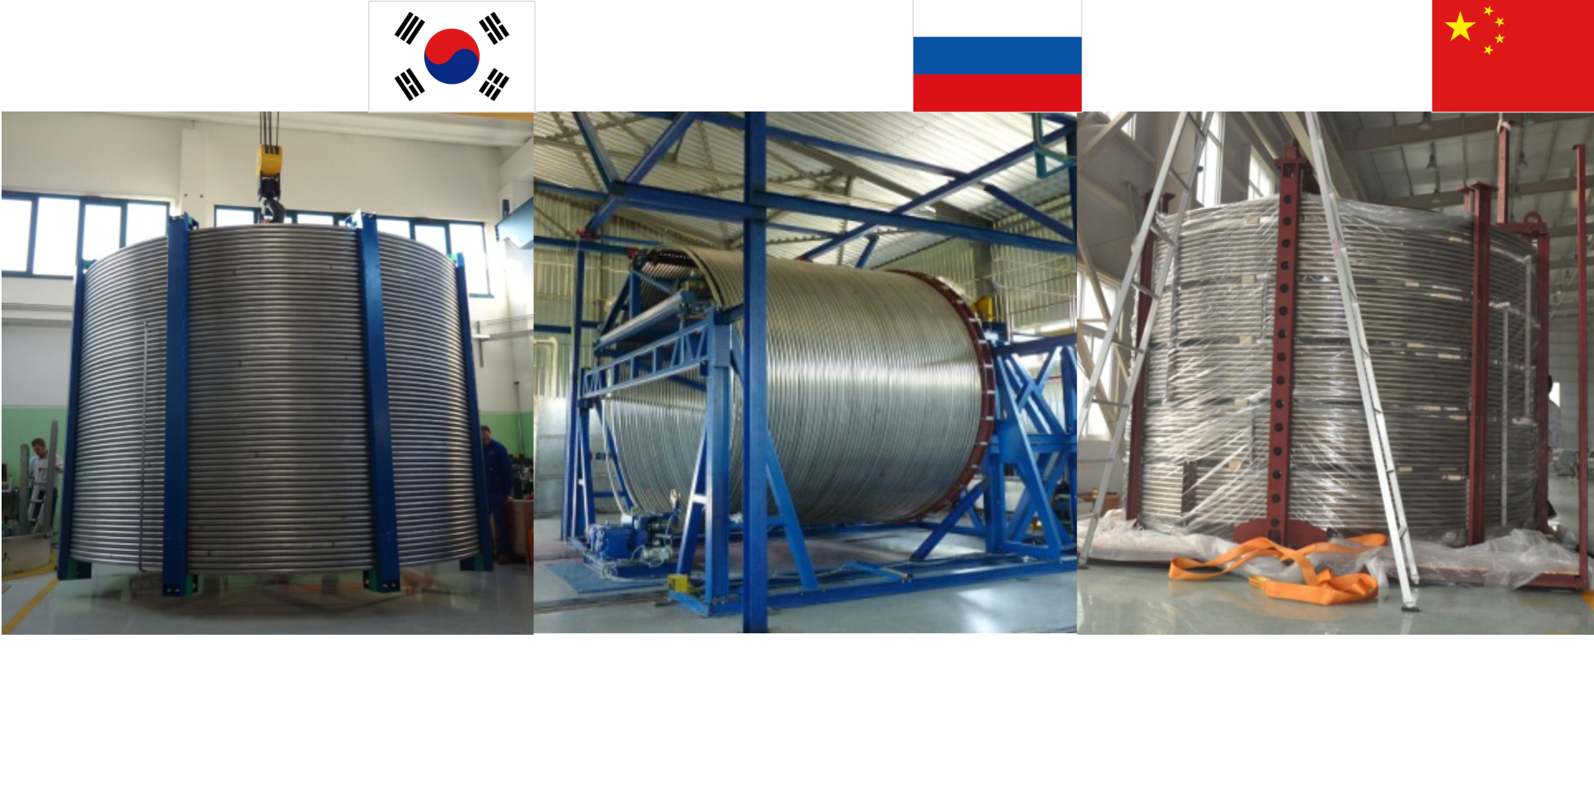
TF Conductor Ready to Ship
Korea
Russia
China
Toroidal field sample conductor fabrication completed. (Photo: KO DA)
760 m of Toroidal Field copper dummy conductor spooled on a transport solenoid (Photo: RU DA).
Toroidal Field sample conductor completed on time (Photo: CN DA).
τ
Notes:
Keep hot plasma KD: “will” transform
Hot to High energy,
alpha particles

Slide 11
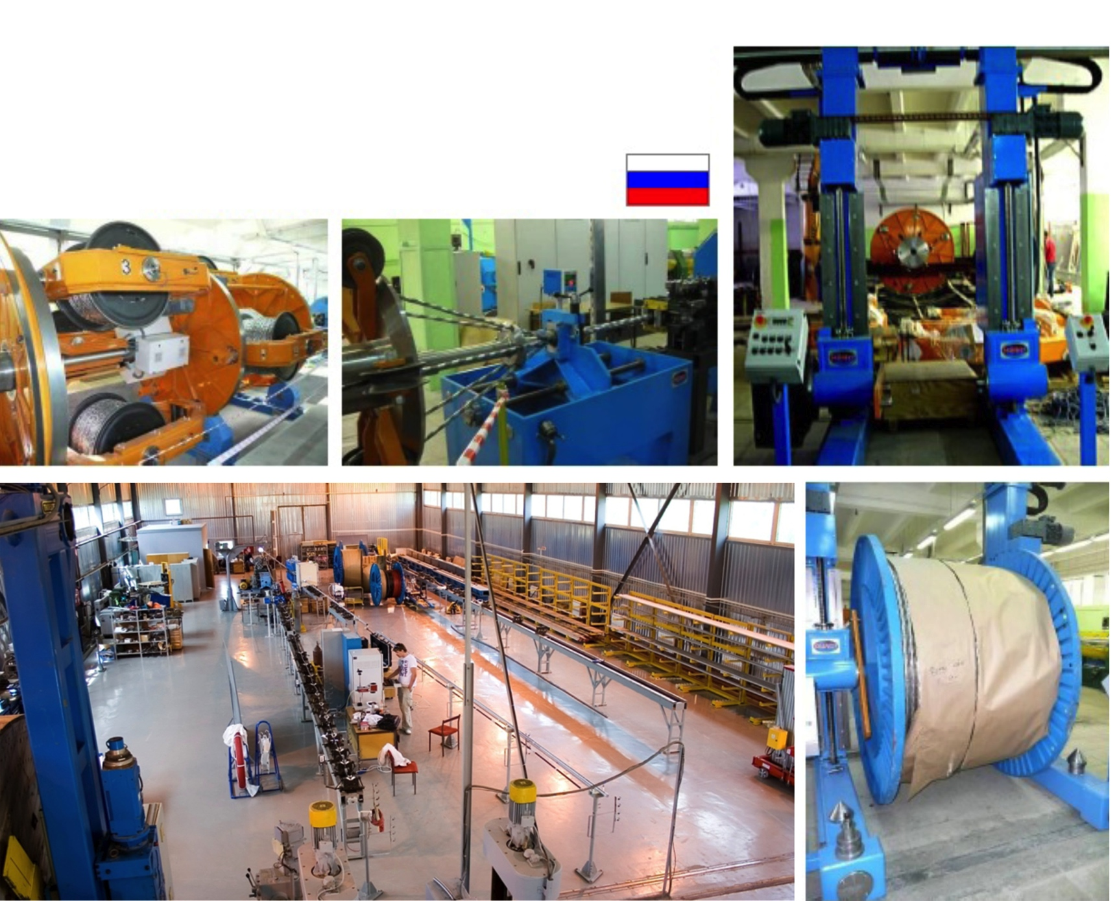
RUSSIA
TF Conductor Production In Russia
The jacketing installation at Moscow’s JSC VNIIKP Research Center where 760 metres of toroidal field dummy conductor were successfully produced in 2011.
Cabling of 760 m Cu Dummy at VNIIKP, RF
(Feb. 2009)

Slide 12
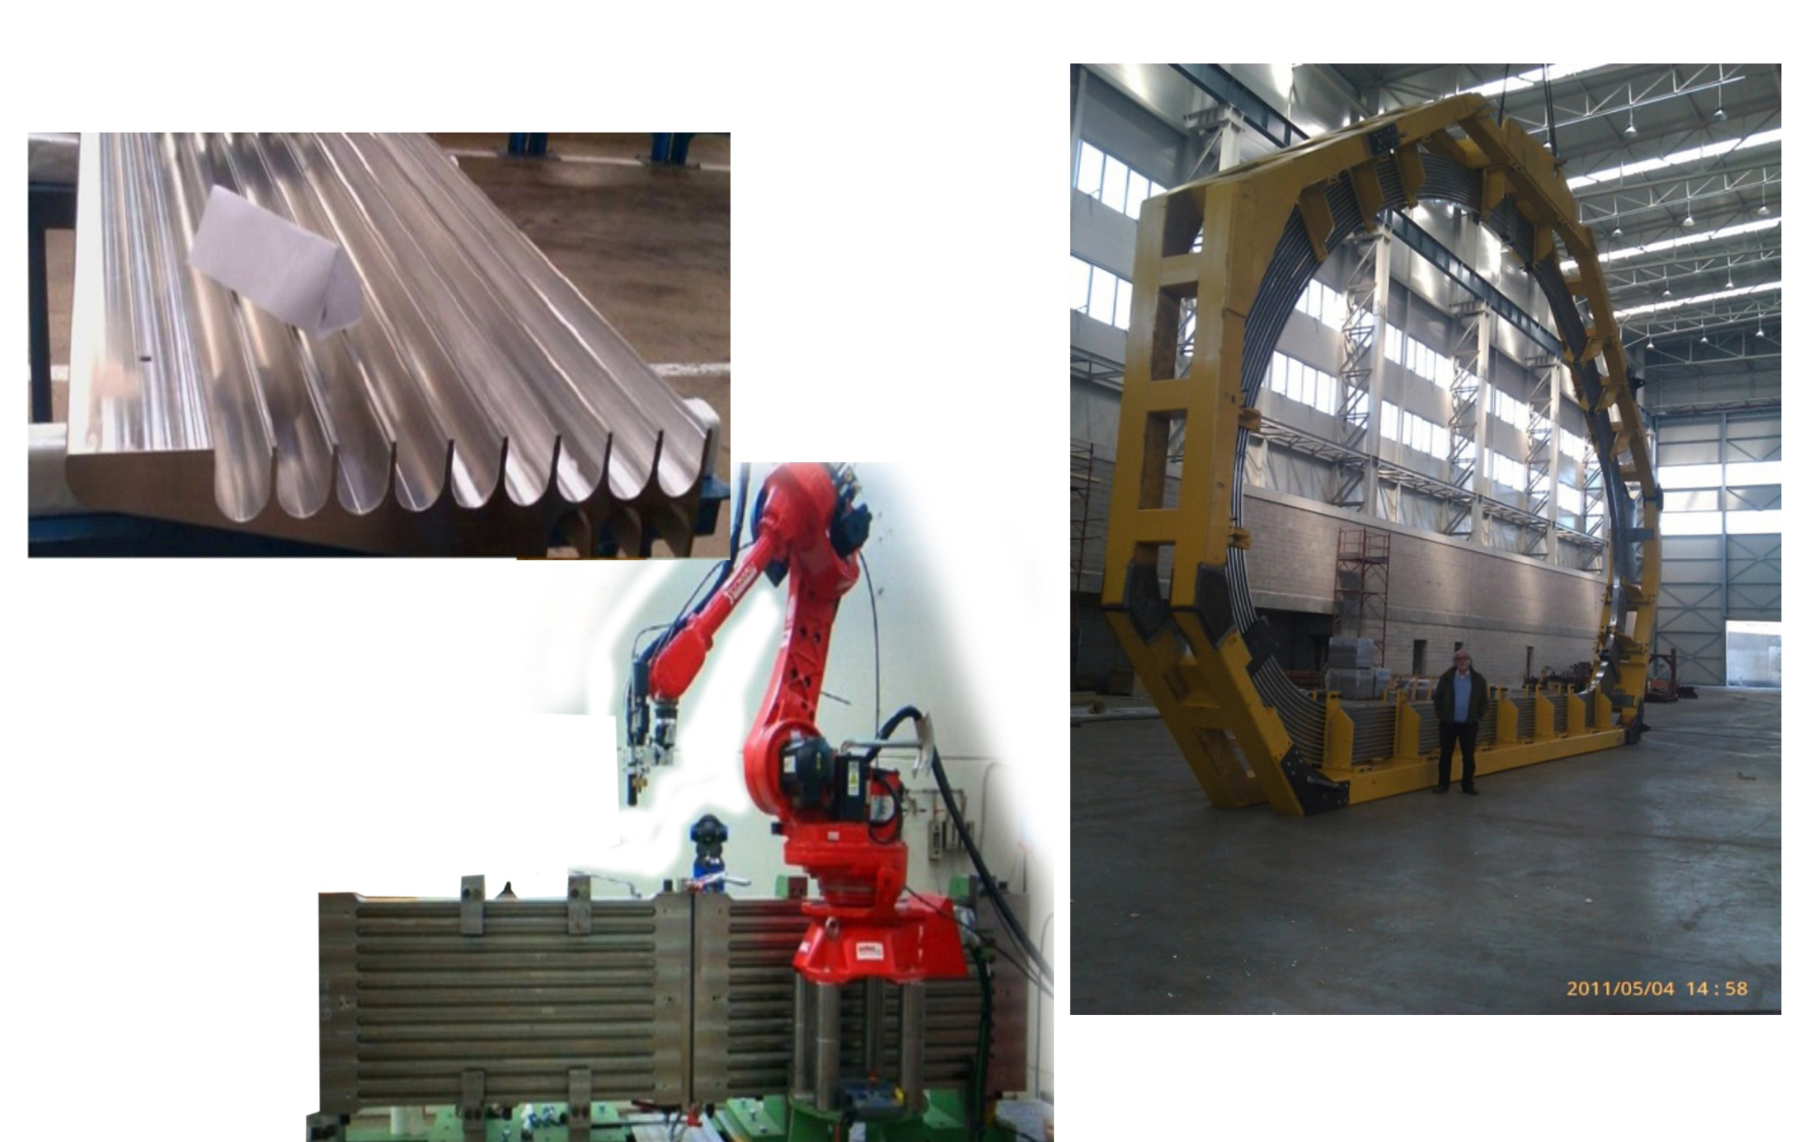
EU
TF Coil Production in Europe
Radial plate mock-up at CNIM (Forged segments jointed by EB welding)
Radial plate welding mock-up at SIMIC (Powder hipped segments joined by narrow gap TIG welding)
Prototype radial plate at CNIM

Slide 13
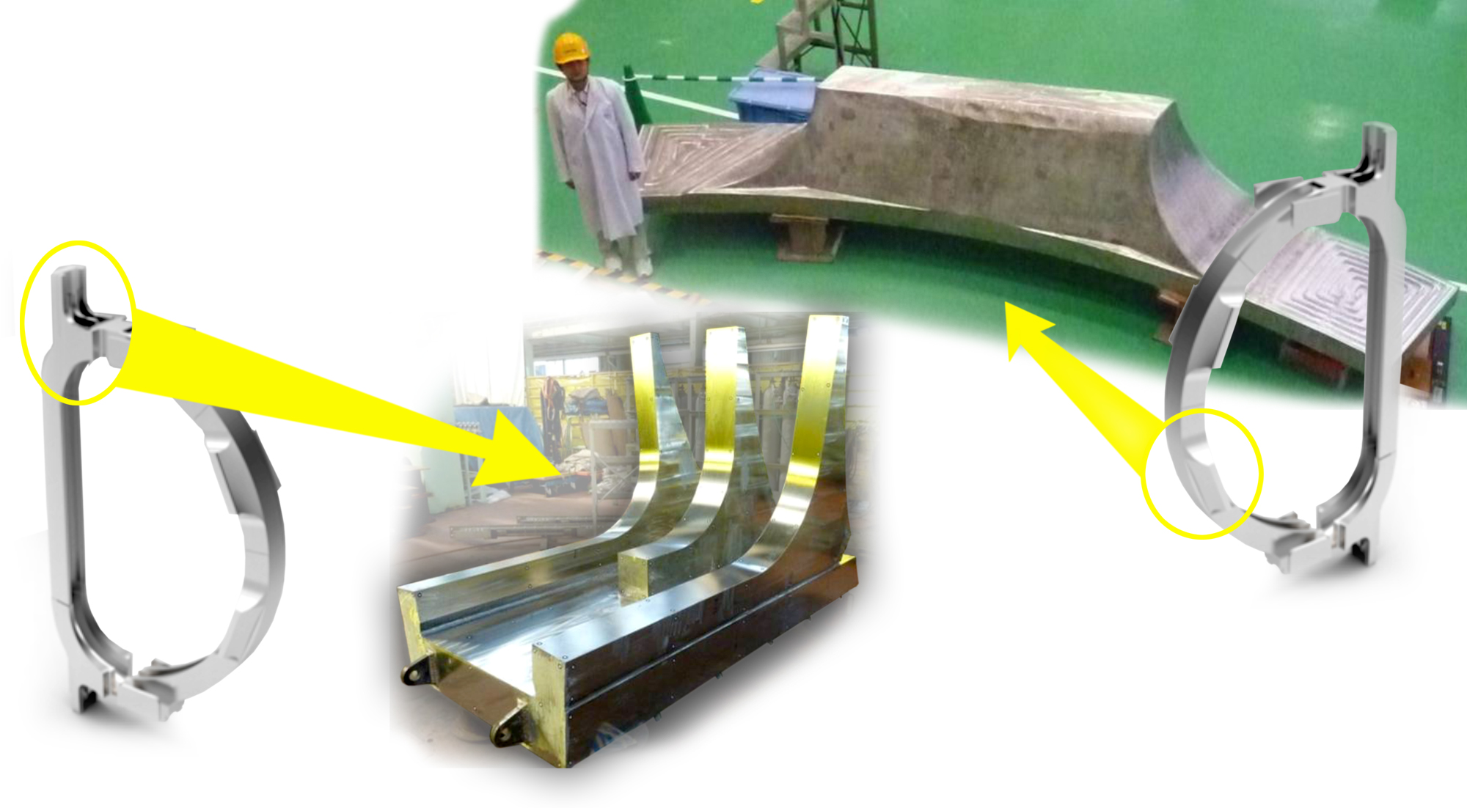
Japan – TF Coil Primary Structure Segment
A1 Segment
A1 Segment
B3 Segment
TF Coil ~360 T,
16 m tall x 9 m wide
(Photo: JA DA)
(Photos: JA DA)
Notes:
Keep hot plasma KD: “will” transform
Hot to High energy,
alpha particles

Slide 14
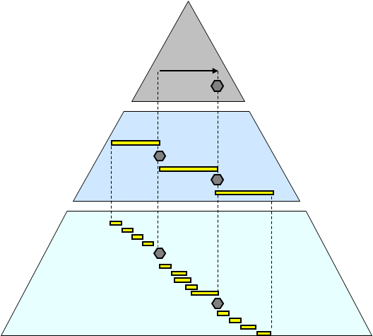
Completion of DWS
Schedule Structure and Management
Level 0 Overall Project Schedule (OPS):
~ 50 Activities……………..………………………….
Level 1 Strategic Management Plan (SMP):
~ 3000 Activities ……………………………
Level 2 Detailed Working Schedules (DWS): ~ 150k Activities…………....
(Including IO and DAs)
DWS completed on 28th June and reviewed
Milestones are monitored and controlled

Slide 15
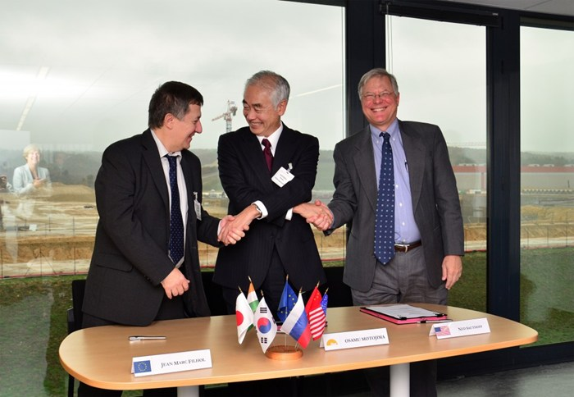
80 of 137 Procurement Arrangements signed, more than 80% of value achieved

Slide 16

Summary Headlines
Significant site-construction and civil infrastructure
French decree authorizing construction
Fabrication of early components (e.g., TF)
Procurment arrangements more than 80% of value
Integrated schedule hierarchy
Addressing schedule and cost challenges

