Slide 1
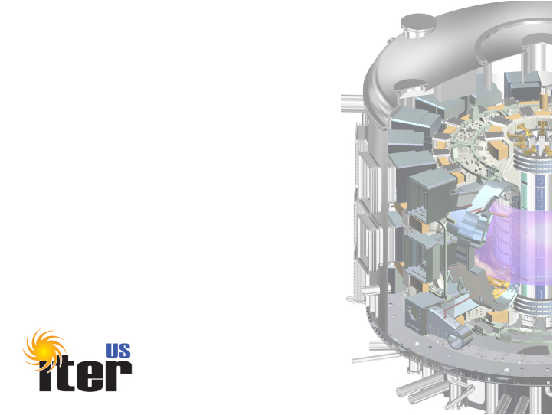
Report from
US ITER
Fusion Power Associates
December 15, 2011
Ned Sauthoff Project Manager

Slide 2
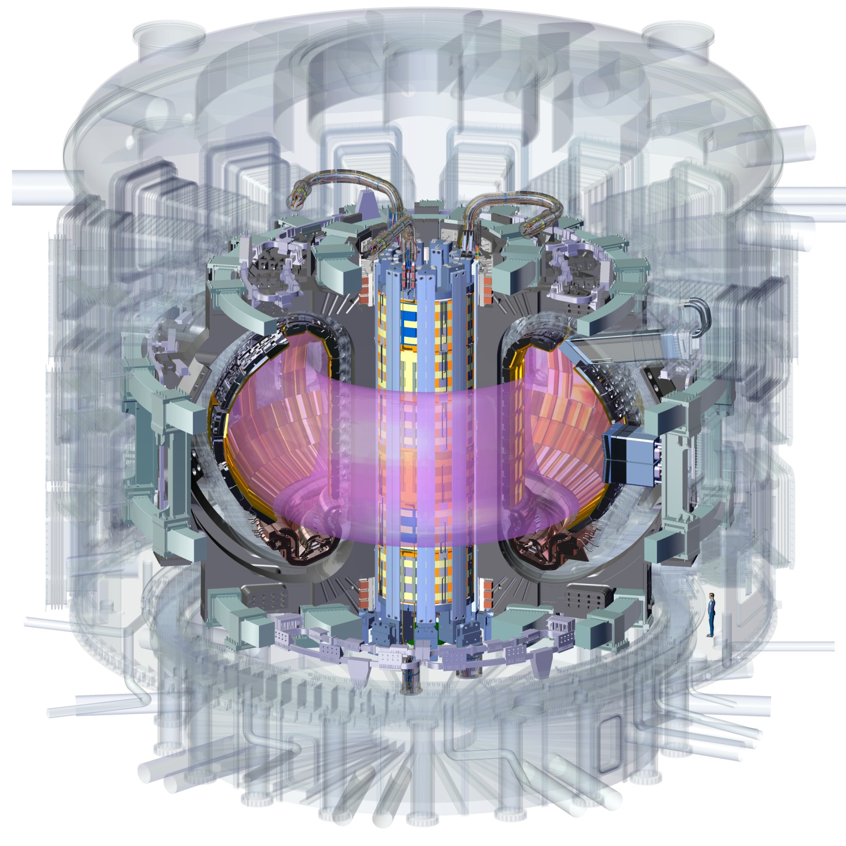
US In-kind Hardware Contributions
PPPL
15% of Port-based
Diagnostics
ORNL
88% Ion Cyclotron
Transmission Lines
ORNL
88% Electron
Cyclotron
Transmission Lines
PPPL
In-Vessel Coils
(prelim. design only)
ORNL
100% Roughing Pumps,
Vacuum Standard Components
SRNL
100% Tokamak Exhaust
Processing System
ORNL
100% Central Solenoid
Windings
+ JA Support
ORNL
8% of Toroidal
Field Conductor
+ JA Support
ORNL
100% Pellet Injector
100% Disruption Mitigation
ORNL
Blanket/Shield
(design only)
ORNL
100% Tokamak Cooling Water System
PPPL
75% Steady State
Electrical Network

Slide 3
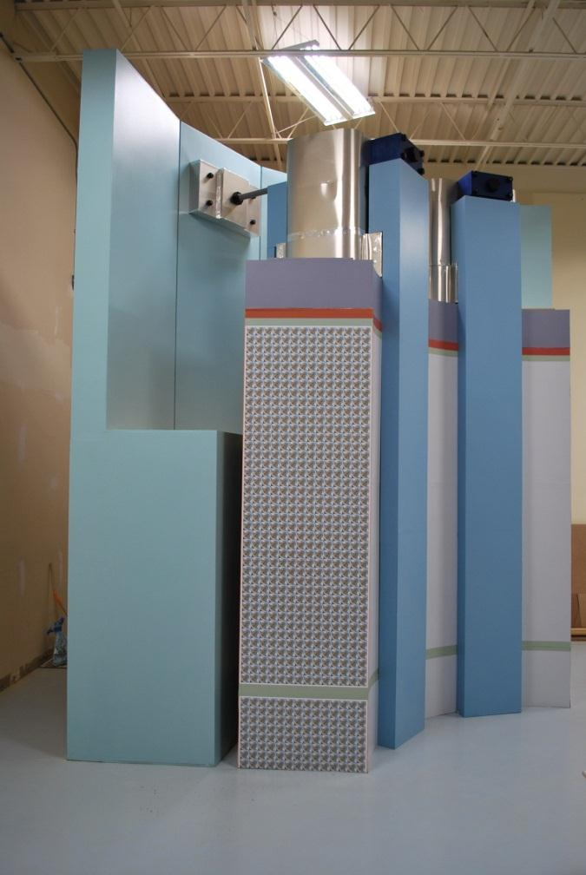
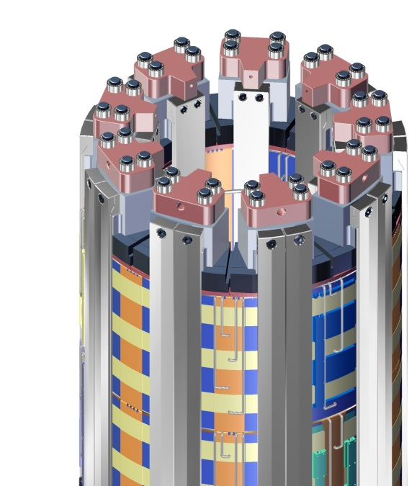
Progress and Plans Central Solenoid
Contract placed for module fabrication with General Atomics (July 2011)
Successful Preliminary Design Review
(September 2011)
Manufacturing input to structures design is being provided by industry
(4 BOA contractors)
Assembly tooling on track for Preliminary Design Review (February 2012)
Technical and schedule issues are being addressed
Notes:
Structure design selections have been made and have been confirmed by analysis and testing. These include:
Pre-compression system
Upper centering system
Module to module alignment.
Lower Gravity Support
Requirements have been documented and are stable.
Interfaces are being finalized with the IO during final design.

Slide 4
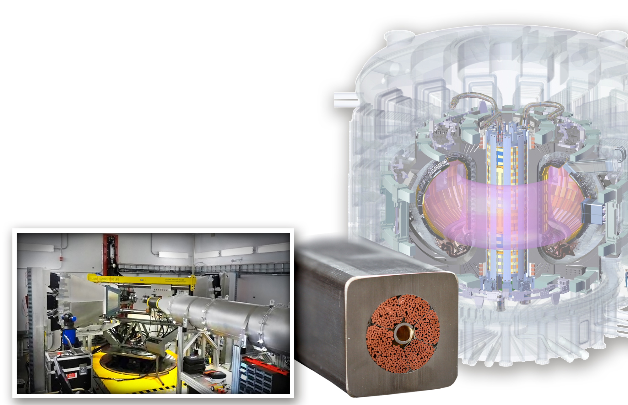
Central Solenoid Conductor Testing at ORNL’s Spallation Neutron Source (DOE/SC/BES)
Issue:
Past testing showed significant conductor degradation under cyclic electromagnetic (E-M) loading conditions
SNS VULCAN tests will:
Measure strain state of a CS conductor sample after high cyclic loads and compare regions that experienced high E-M loads and low E-M loads
Enhance understanding of the impact of strain on performance
Provide insight for improving design
VULCAN
Engineering Materials
Diffractometer
Notes:
Specifically, VULCAN will measure the strain state of the superconducting Nb₃Sn phase inside the thick-walled metal jacket, including:
Radial, hoop, and axial strains throughout the sample at room temperature and cryogenic temperatures
Weight fraction of material phases (e.g. Cu, Nb, Nb₃Sn)
The VULCAN instrument offers:
An open structure that can accommodate large samples and a large cryostat
Simultaneous mapping of strains and phases in the superconducting cable, allowing for development of a predictive model for degradation due to strain
Rapid diffraction measure compared to other facilities

Slide 5
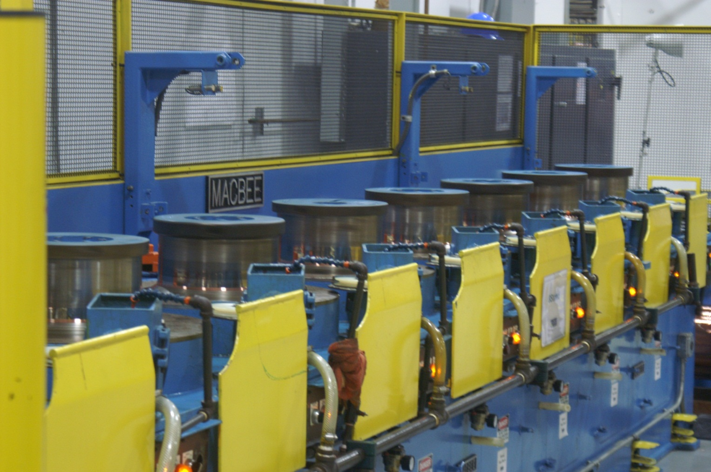
Progress and Plans Toroidal Field Conductor: Strand
Major contracts awarded to:
Oxford Superconducting Technology
Luvata
Waterbury, Inc.
New England Wire Technologies Corporation
CICEFT
(Cable in-Conduit Engineering, Fabrication and Testing), now called High Performance Magnetics
Photo: Oxford Superconducting Technology
Notes:
Photo: Oxford Superconducting Technology strand production line. This shows the ITER Nb₃Sn TF conductor strand being drawn on an 8 die drawing machine at Oxford.

Slide 6
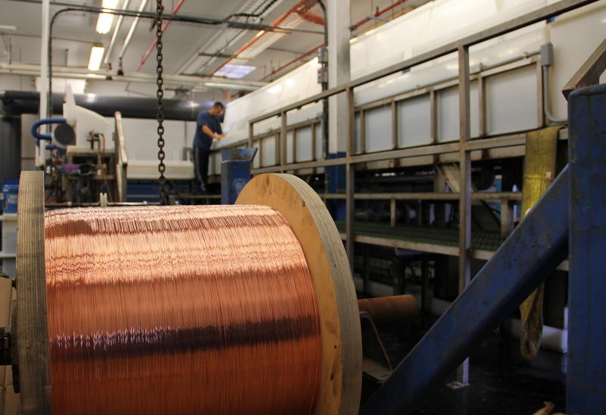
Progress and Plans Toroidal Field Conductor: Strand
Photo: Luvata Waterbury
Notes:
Photo: ITER strand being chrome plated for Luvata Waterbury.

Slide 7
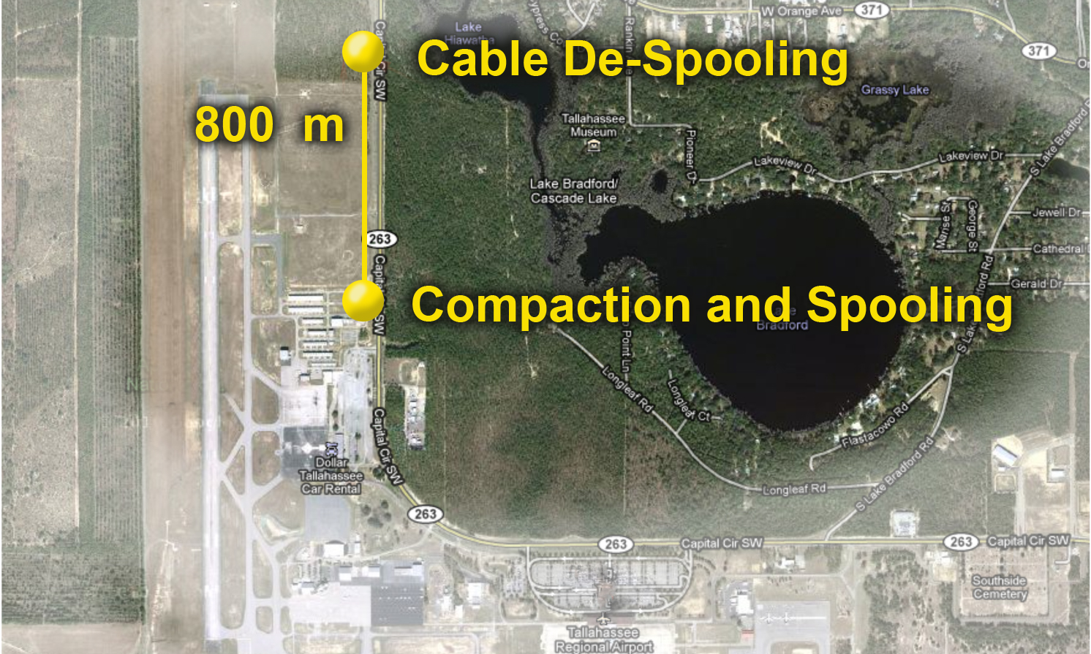
Progress and Plans Toroidal Field Conductor: Jacketing
CICEFT (Cable in-Conduit Engineering, Fabrication and Testing), now called High Performance Magnetics:
Superconducting Cable Jacketing Facility at the Tallahassee Regional Airport
Notes:
High Performance Magnetics specialized facility can handle the long unspliced lengths of superconducting cables required for ITER to maximize cryogenic efficiencies and stability of high field magnets.

Slide 8
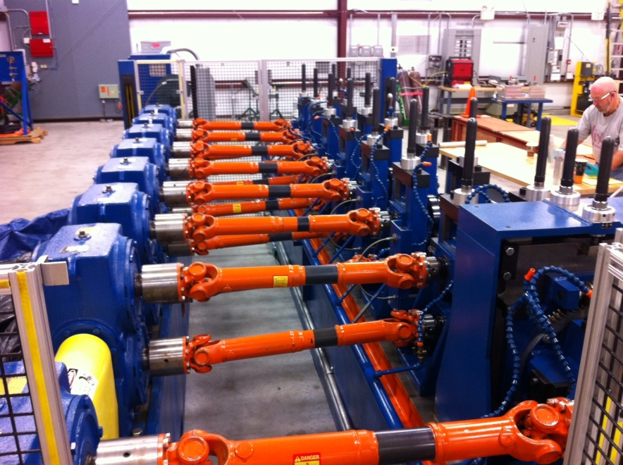
Progress and Plans Toroidal Field Conductor: Jacketing
Compaction Mill at CICEFT
(Cable in-Conduit Engineering, Fabrication and Testing), now called High Performance Magnetics
Photo: CICEFT

Slide 9
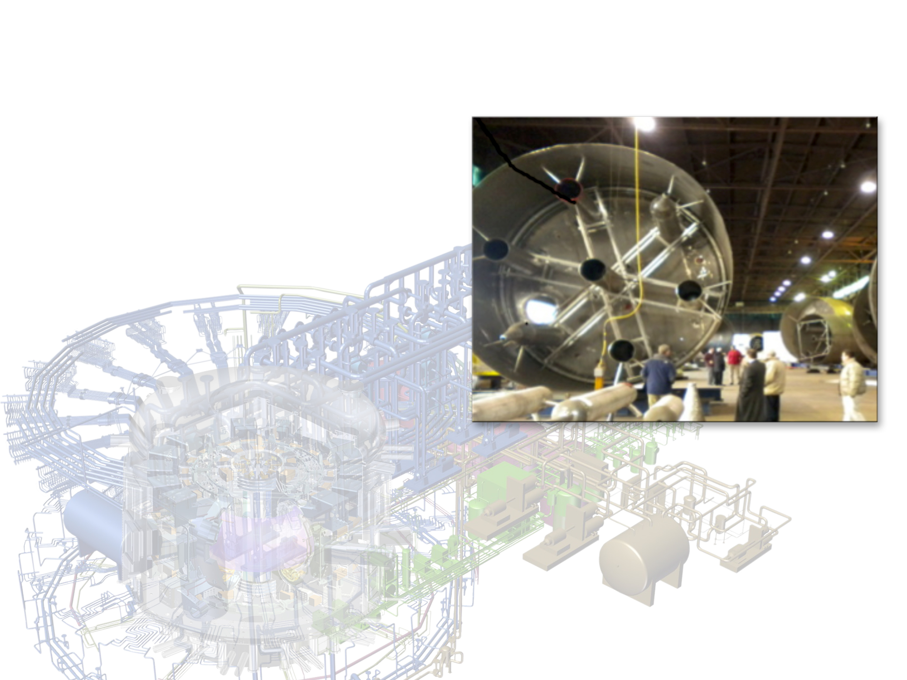
Progress and Plans Tokamak Cooling Water System
Basic Ordering Agreement with AREVA Federal Services (awarded December 2009)
Final Design for Drain Tanks (April 2011)
Contract to AREVA/Joseph Oat for Drain Tank Fabrication (September 2011)
Preliminary Design for All Other Systems (March 2012)
Drain Tank Vendor Prequalification Tours
[February 2011]
Notes:
The Tokamak Cooling Water System must be reliable, handle transient conditions and interface with 28 additional ITER systems. It is huge!
The TCWS requires an international CAD collaboration (Eight AREVA designers trained and using unique design process: CATIA/ENOVIA/SEE-VISO).
Drain Tank Notes from Bumgardner’s Lehman presentation:
Drain Tank Final Design Review and issue resolution complete.
Drain tank fabrication contract competed and awarded.
Multiple lessons learned and barriers passed, including Nuclear Indemnification and IO roles in the process.
Agreed Notified Body contract awarded to support drain tank fabrication process.

Slide 10
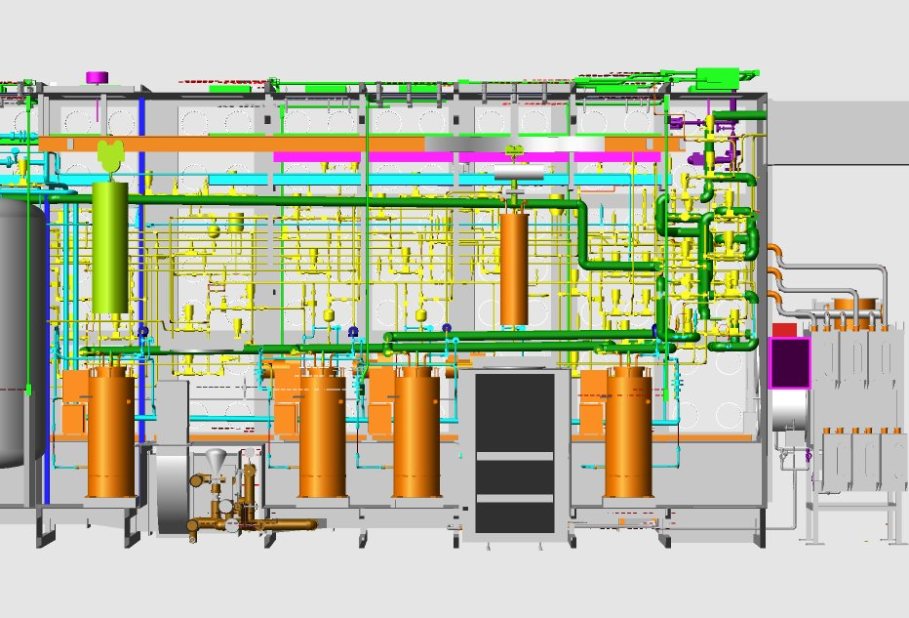
Progress and Plans Tokamak Exhaust Processing
Preliminary Design Review (October 2014)
Procurement Arrangement (May 2015)
Final Design (August 2018)
Typical glovebox with piping, electrical and instrumentation
Notes:
Scope: 100% of the final design, fabrication, assembly, testing, and shipment
Separates hydrogen isotopes from tokamak exhaust
State of the Fusion experimental program: TFTR had 10 g of tritium on site
ITER Requirements: 4kg of tritium on site, 10X throughput of other tritium facilities
Technical Challenges for TEP: - Scale-up from existing experience (~10x flowrate)
The US has performed these type of operations for many years. The ITER TEP technical challenge is to perform these operations ten times faster than it has been done before -- and still yield the same results of no impurities to the isotope separation system (ISS) and extremely low tritium to the delivery detritiation system (DS).

Slide 11
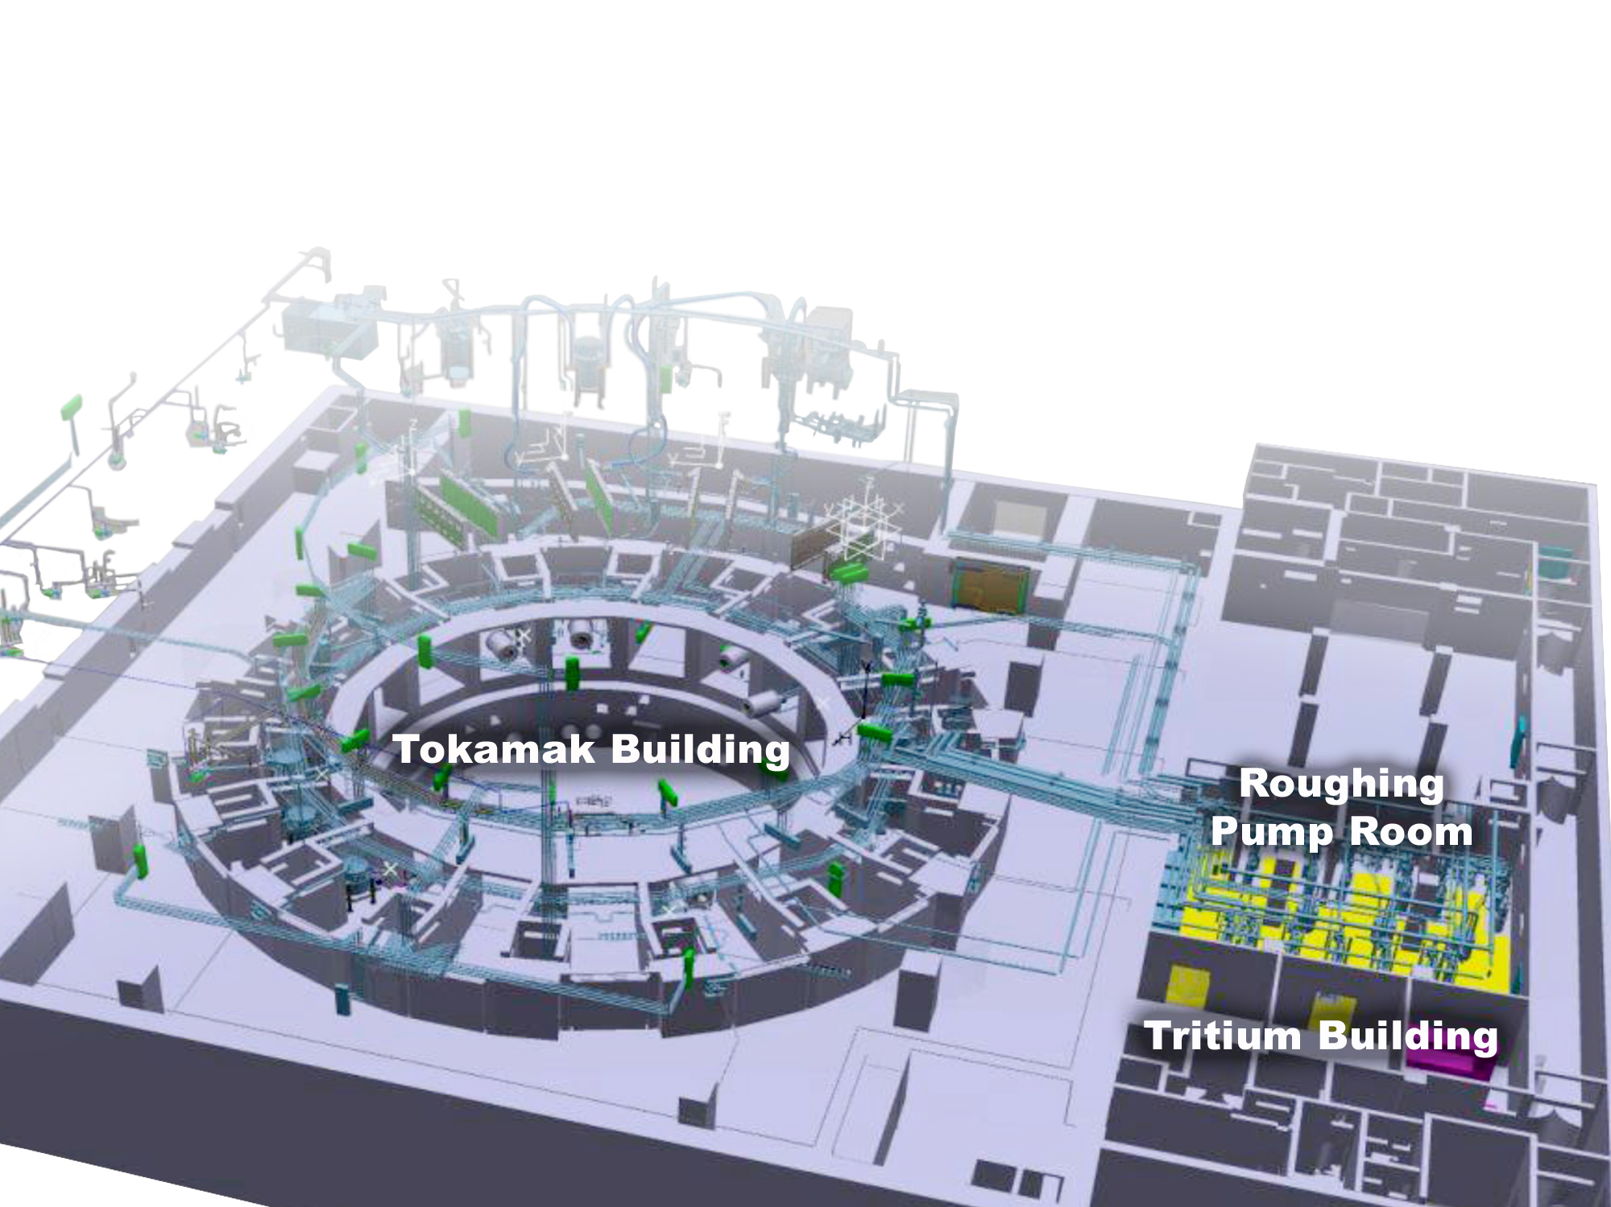

Progress and Plans Vacuum and Pumping
Standard Vacuum Components and System,
Preliminary Design Review (December 2011)
Tritium Compatible Roughing Pumps,
Conceptual Design Review (July 2013)
Notes:
PDR is happening in Cadarache week of December 5th.
The scope of the Standard Vacuum Components includes:
The design, fabrication and delivery of all the vacuum manifolds (stainless steel piping ranging in size from ½ to 12 inches in diameter).
The procurement and delivery of a large quantity of:
vacuum test equipment for the initial receiving test and inspection of ITER components. According to Mike H, this equipment will be the first USDA supplied items to ITER. This must be delivered by 3-Dec-2012 (but deliveries will occur through 2012).
vacuum valves (ranging in size from ½ to 12 inches in diameter).
vacuum pumps (both roughing and high vacuum).
vacuum related instrumentation and controls.
The vacuum system will include 2000+ clients.

Slide 12
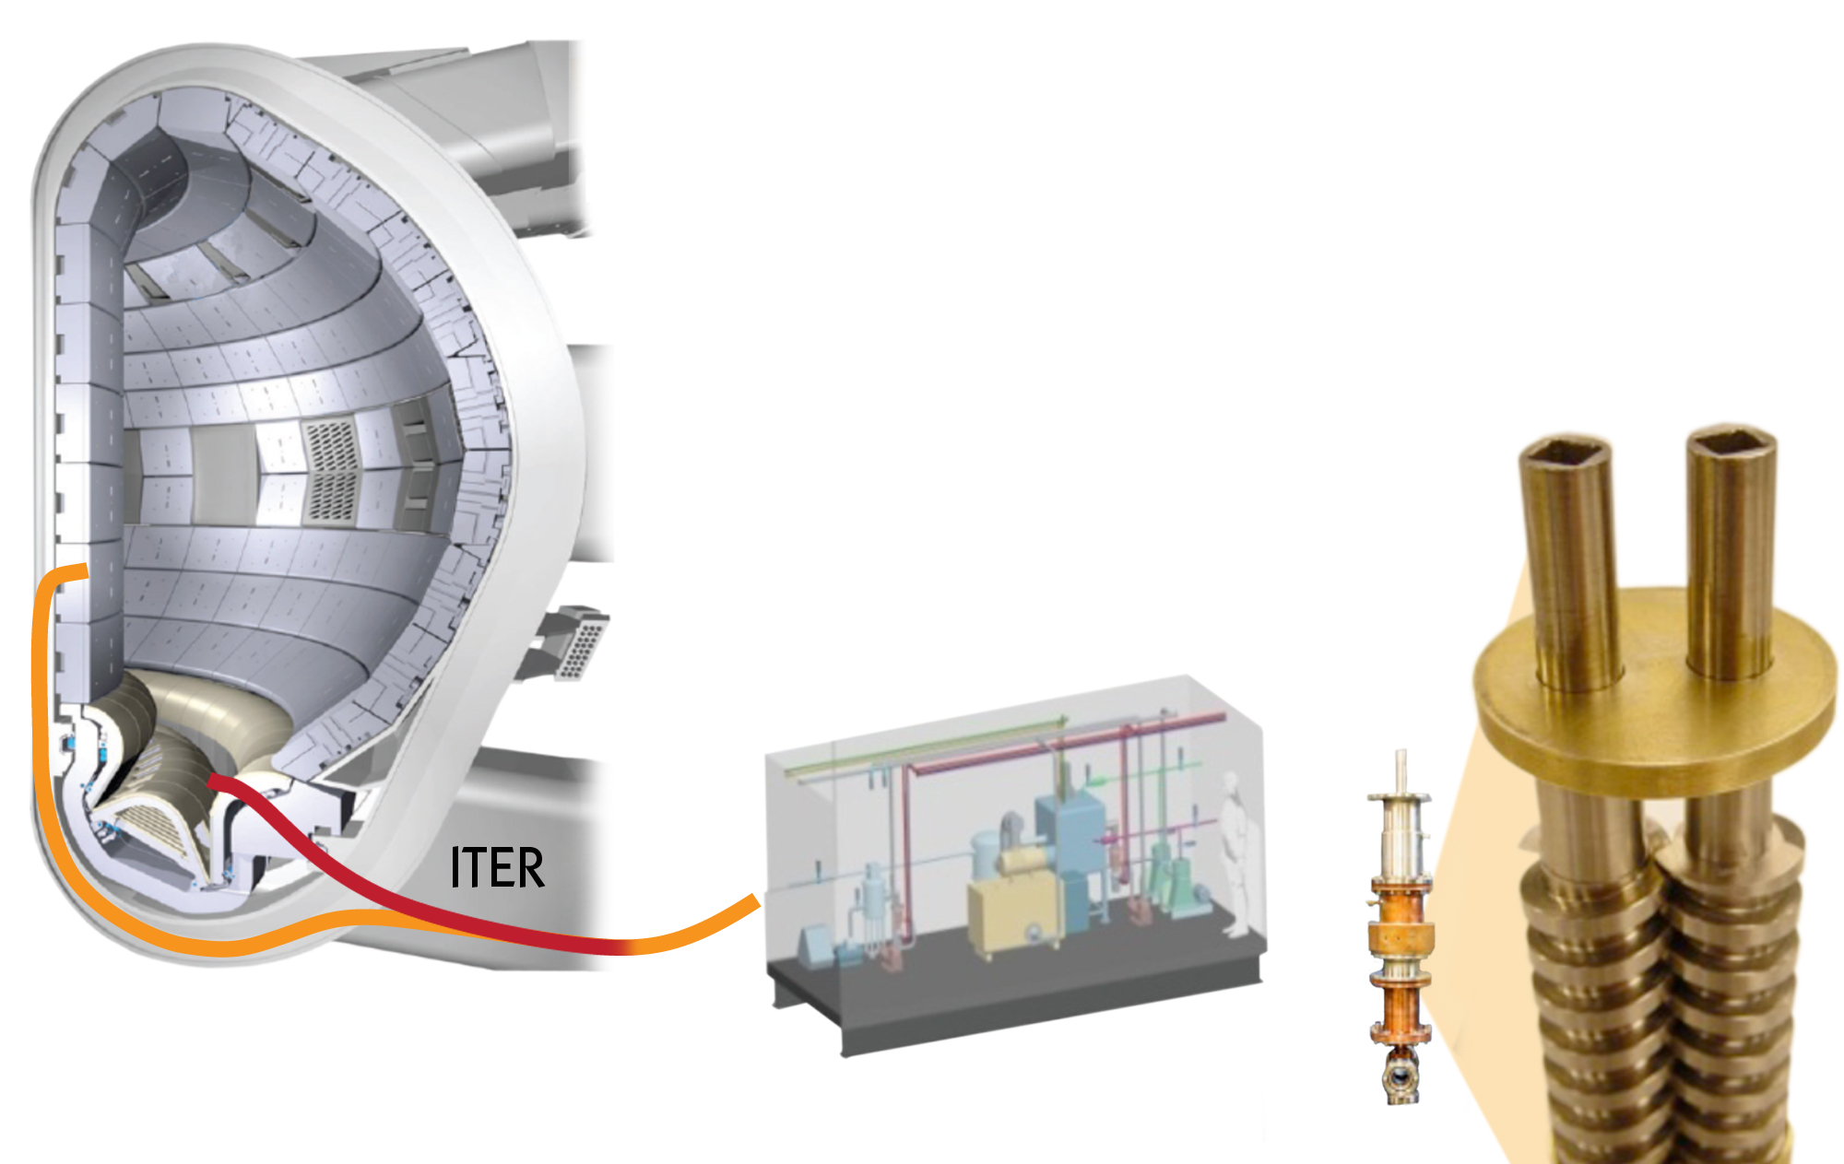
Progress and Plans Pellet Injection
Twin-screw extruder prototype for hydrogen isotope ice pellet formation
Pellet injectors
for fueling and ELM pacing
Notes:
Fueling System (US, China): US is handling pellet injection + disruption mitigation (new scope). China is responsible for the gas injection system and the glow discharge cleaning system. [Tritium Storage and Delivery System is Korea’s responsibility.]
Pellet Sizes
For Fueling:5.6 mm +/- 20%
For ELM Mitigation (pellet pacing): 3.4 mm +/- 20%
ITER fueling needs are significant: ITER plasma volume is 840 m³ and scrape-off layer is ~30 cm thick. This compares to 20 m³ and ~ 5 cm for DIII-D. ITER is designed to operate at high density (> 1x 10²⁰ m⁻³) for long durations in order to optimize Q. Gas will be introduced from 4 ports on outside and 6 in the divertor region (CHINA). NBI fueling will be negligible (< 2 x 10²⁰ atoms/s or < 3 torr-L/s ) (EU and JA). Inside wall pellet injection is planned for deep fueling and high efficiency. Reliability must be very high. Gas fueling will be limited by poor neutral penetration.
Pellet injection requirements and technical approach are relatively mature:
Functional specifications for plasma fueling and ELM mitigation are challenging but within our design, manufacturing and testing capability
Prototypes have been designed for pellet injection subsystems
Prototype subsystems will be tested in the laboratory and as needed on fusion devices. A prototype pellet gun mechanism is being test now on DIII-D. A full pellet injector prototype will hopefully be tested on a fusion machine in the future, but definitive plans are not yet made. Some possibilities are JT-60SA and W7-X. (Source: Larry Baylor, FED, ORNL).
Prototype ELM pacing system has been tested on DIII-D tokamak
Prototype guide tube tests have established pellet speed limits

Slide 13
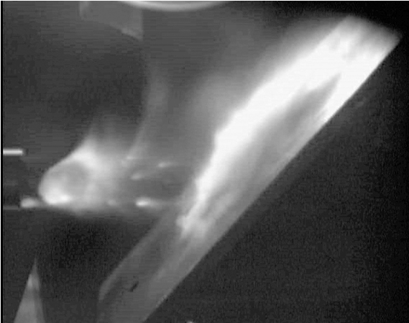
Progress and Plans Disruption Mitigation
Disruption Mitigation
Massive gas injection
Massive pellet injection
Runaway Electron Suppression
De-confinement
Collisional damping
Pellet fragments
V-shaped plate for shattering the pellet before injection into the plasma
Pellet exiting guide tube
Large (16 mm+) pellet testing for disruption mitigation at ORNL.
(Photo: Combs)
Notes:
Disruption Mitigation and runaway electron suppression is new US scope with evolving requirements and technical approaches.
Pellet Size [Source: Larry Baylor, FED, ORNL]
For Disruption Mitigation (and runaway electron suppression): 16-20 mm
DM and RE suppression is in conceptual design. R&D is addressing disruption mitigation through massive gas injection and massive pellet injection. Both neon pellets and neon gas injection are being studied. IO has provided R&D and conceptual design support to develop massive gas injection (MGI) and massive pellet injection (MPI) technologies. CDR is July 2013. Prototypes for MPI and MGI subsystems must be tested on fusion experiments to determine effectiveness. At this point, at least 10 devices have tested MGI, while DIII-D in the US is the only machine that has tested MPI. Experiments are performed by fusion community with their resources. Initial tests of DM techniques and technologies are promising. Present conceptual approaches for MGI are very challenging. MPI technology is within our design, manufacturing and testing capability.
Photo description:
Large (wine cork size) pellet in disruption mitigation testing at ORNL. The pellet is composed of pure deuterium (temperature ~10 K) and traveling >500 m/s (left to right). This was just a basic experiment to see how the pellets actually shatter when hitting a single plate. Note: Large solid pellets injected intact into the plasma would likely not fully ablate and present a hazard to the first wall materials, thus the pellet is purposely shattered before injection into the plasma. (Source: Baylor 2010)
The large (~16.5 mm diameter ) deuterium pellet was shot with high pressure (~70 bar) hydrogen gas. Some solid debris is generated when the pellet breaks away from the wall in the gun barrel and more gas/entrained solid is produced as the pellet accelerates in the gun barrel. Finally, some additional gas and solid is produced as the cold pellet impacts the guide tube. In this photo, the gas-like material is actually the deuterium solid that has been entrained with the propellant gas, and the smaller solid fragments are deuterium. This was a early shot in the testing program, and we later improved the technique to minimize any fragments.

Slide 14
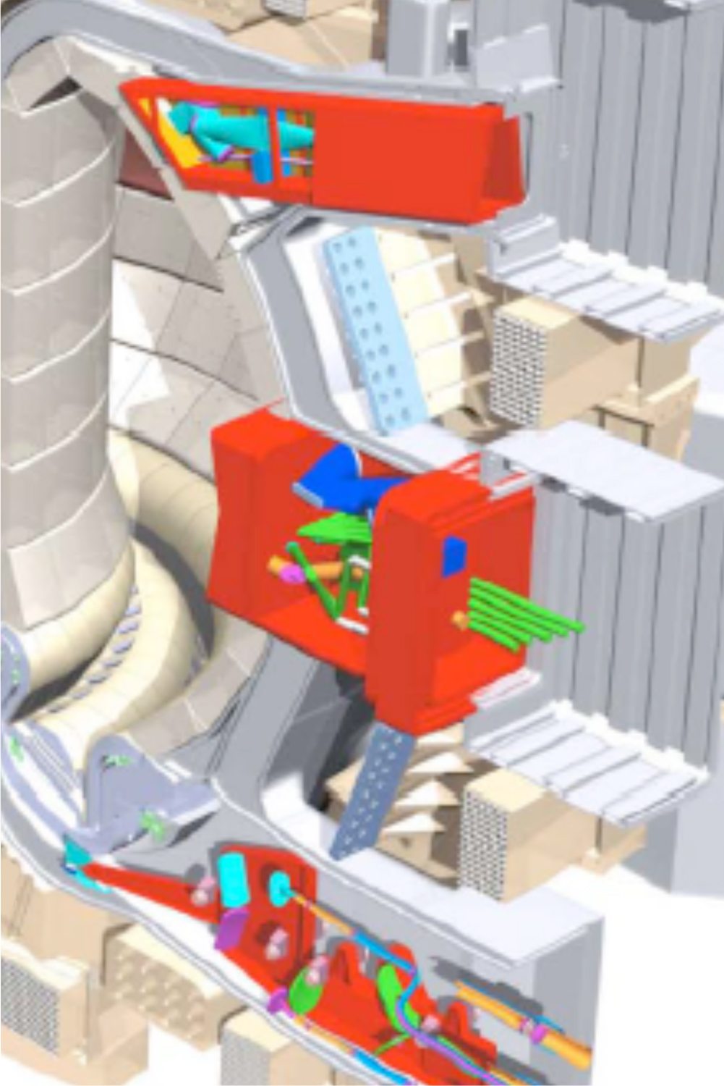
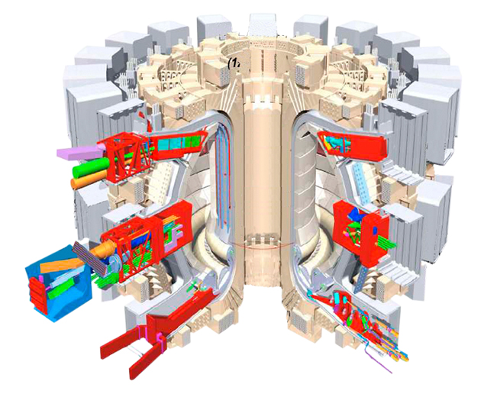
Progress and Plans Diagnostics
Scope: 16% of ITER diagnostics
Port Plugs
Upper Ports (U11, U14)
Equatorial Ports (E3, E9)
Lower Port Structures (L8)
Diagnostics
Upper IR/Visible Cameras
Low Field Side Reflectometer
Motional Stark Effect Polarimeter
Electron Cyclotron Emission Diagnostic System
Divertor Interferometer
Toroidal Interferometer/Polarimeter
Core Imaging X-ray Spectrometer
Residual Gas Analyzer
Successful review of drawer packaging design (June 2011)
First procurement arrangement signed, for residual gas analyzer (September 2011)
Notes:
The lists on the left show the US ITER diagnostic scope, which includes 8 diagnostic systems, and 5 port plugs.
The port plugs are the large structures shown in red in the figure. In addition to housing the diagnostics, they shield the magnets from radiation and provide a water-cooled first-wall facing the plasma. One of the major challenges in this scope is the engineering of first-of-a-kind diagnostic front-end components, which must operate with high reliability in the harsh radiation environment. Unlike the hands-on maintenance on most present devices, on ITER maintenance of port plugs will be done robotically, after extracting the plugs and bringing them to a hot-cell.
Compared to JET environment, ITER has:
Neutron and gamma fluxes up to x10
Pulse length up to x100
Neutron fluence >10⁶
Neutron heating (1MW/m²)
CX neutral particles up to x5

Slide 15
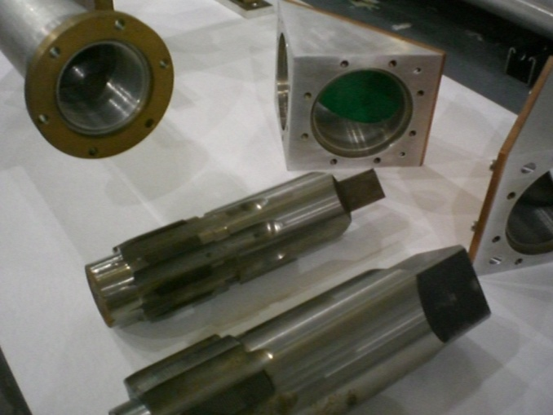
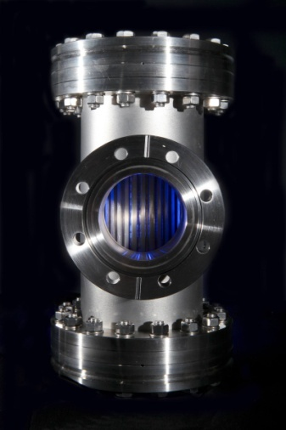
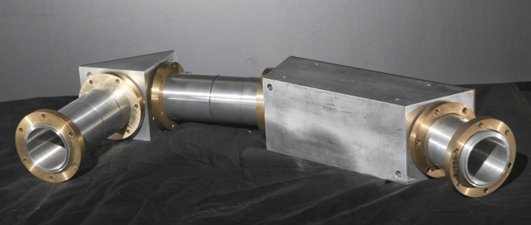
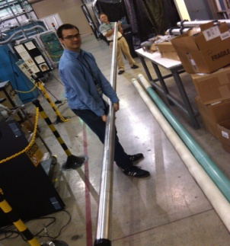
Progress and Plans
Electron Cyclotron Transmission Lines
Procurement Arrangement signed (May 2010)
Low-power mode-control tests underway with prototype components (ORNL, MIT)
Full power tests planned
(Spring 2012)
Alternate waveguide component designs and fabrication techniques developed
Notes:
15
State of the Art: ~ 1 MW / waveguide, 10 s
ITER need: ~ 2 MW / waveguide, 3000 s
Procurement Arrangement signed
Low-power mode-control tests underway with prototype components (ORNL, MIT)
Full power tests planned (per Dave R: still tentative, probably in May)
Alternate waveguide component designs and fabrication techniques developed

Slide 16
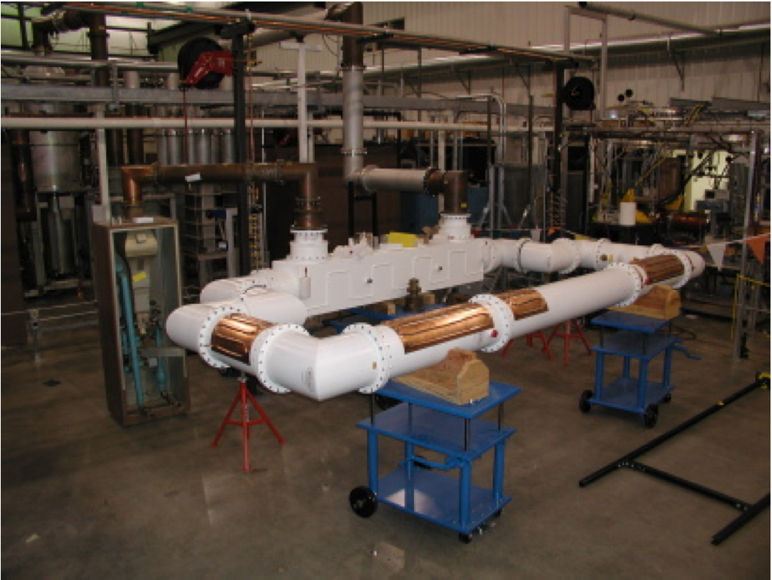
Progress and Plans
Ion Cyclotron Transmission Lines
Procurement Arrangement signed (April 2010)
Ongoing R&D and full- power, long-pulse prototype tests to develop/qualify industry components
Tests of mechanical assembly and 3 atm pressurization
Optimize matching system components and port cell layout
10 db Coupler
300 kW Dummy Load
Feed Line
Directional
Couplers
Cooling Panel
IR Viewing Port
ICH Component Test Stand
Notes:
16
Tests of mechanical assembly and 3 atm pressurization
Note from Dave R: We pressurize the coaxial transmission line with either nitrogen gas or "dry air". They are an insulating gas between the inner and outer conductors. We pressurize it to 3 atmospheres because the insulating properties are higher at higher pressure. 3 atm. provides sufficient margin for our operating voltage which goes up to 45 KV.
Prototype matching component design and tests
Insulator and gas barrier tests
Capacitor tests at high radio-frequency voltage and current

Slide 17
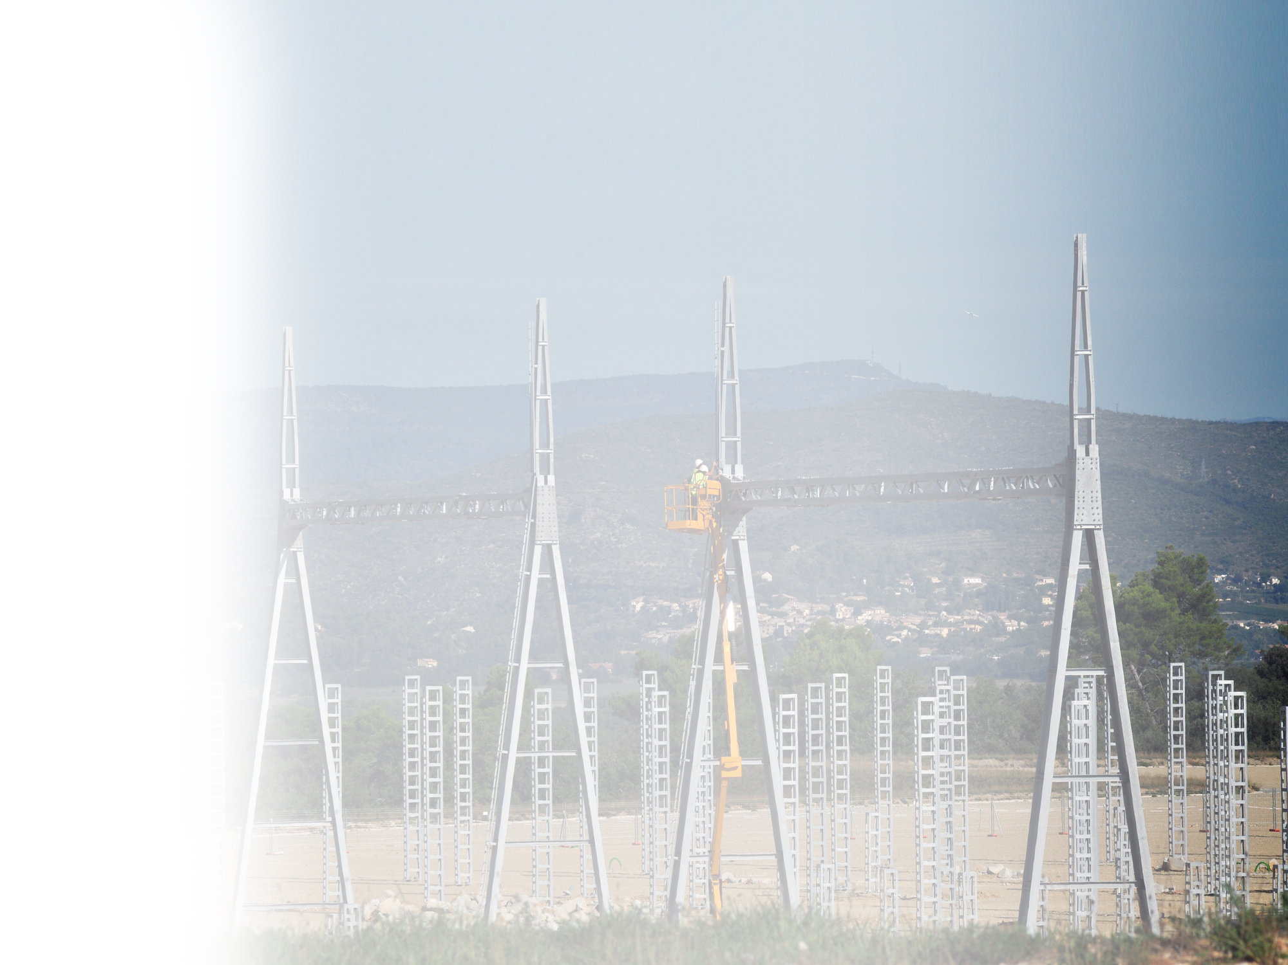
Progress and Plans
Steady State Electrical Network
Key developments with EU and
International Organization:
Scope sharing
Plan and schedule
Credit allocation
Load database
Upcoming:
RFP for engineering support
to be issued in early 2012
Final Design Review April 2012
PA to be issued by IO June 2012
Notes:
Photo: Four hectares for the ITER transformers
The 22-metre pylons in the foreground support five-ton crossbars; from here, electricity will be directed toward seven 400 kV transformers. Photo: ITER Organization (September 2011)
Recent Progress
Developed agreement with EU on scope sharing, line by line from the SSEN bill of materials, which satisfies 75%-25% split of ITER Agreement and allocates credit for each line item, to be submitted in a PCR by the IO
Developed new plan and schedule for equipment being supplied by US, based on above scope agreement, to be submitted in a PCR by the US to establish a new SMP baseline
Developed agreement with IO general aspects of the PA including method of communicating scope and technical requirements, hold points, milestones, and credit allocation
Advised IO on issues related to load database, in particular on load simultaneity and various aspects of the largest load which is the US's Tokamak Cooling Water System
Upcoming Activities
FDR to be conducted by IO and EU in April 2012
PA to be issued by IO in June 2012
RFP to be issued for contract award for Engineering Support Services prior to PA issuance in June 2012

Slide 18
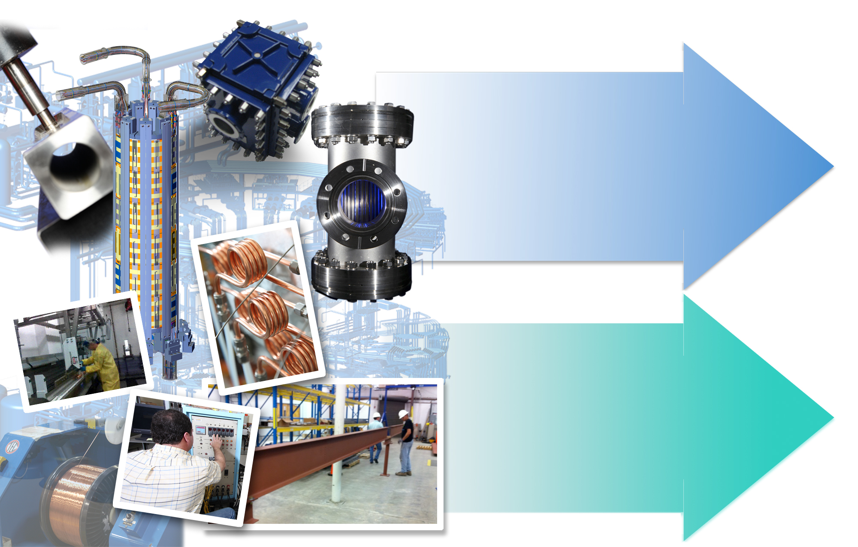
Steps Forward
2012
Complete R&D
Advance Design
with Industry
Baseline Domestic Project
2013
Engage Industry to Begin Fabrication

