Slide 2
Heterogeneous Computing and Real-Time Math for Plasma Control
Dr. Stefano Concezzi
Vice-President
Scientific Research & Lead User Program
National Instruments
Notes:
Abstract: Examine the different options for performing computationally intensive analysis in LabVIEW, including leveraging multicore CPUs, FPGAs, and GPUs. Special emphasis will be given to the topic of interfacing with GPUs using the new LabVIEW GPU Analysis Toolkit, including an overview of programming practices, suitable tasks for GPU hardware, and example applications & benchmarks. Capabilities in the new LabVIEW Multicore Analysis and Sparse Matrix Toolkit will also be discussed.

Slide 3
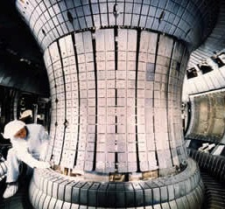
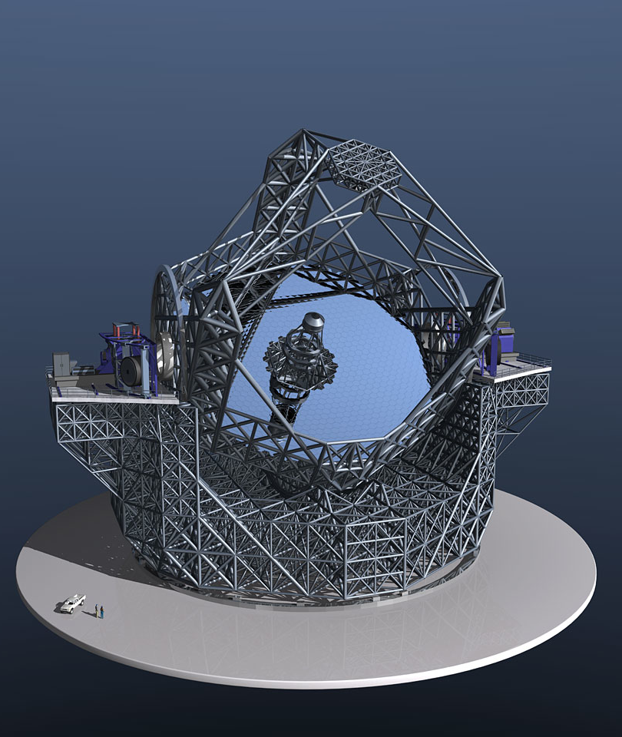
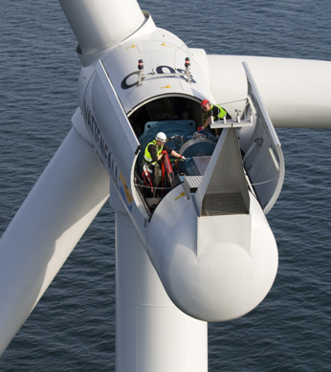
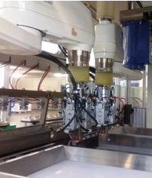
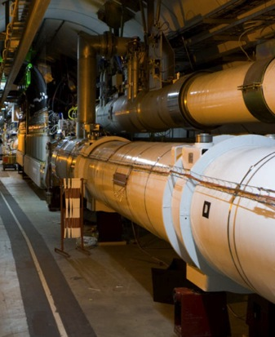

Today’s Engineering Challenges
Minimizing power consumption
Managing global operations
Getting increasingly complex products to market faster
Maximizing operational efficiency
Adapting to evolving application requirements
Protecting investments
Doing more with less
Integrating code and systems
Notes:
We are here to talk to you about solutions for some of the most common engineering challenges the industry is facing today. Walk through each of these challenges and focus on the specific ones that the customer is dealing with currently. Some examples of companies meeting these challenges with NI products include:
Doing More with Less – Visteon saved $13 million and reduced facility floor space by more than 1,300 square feet by standardizing on LabVIEW, NI LabWindows™/CVI, and NI TestStand software and replacing traditional rack-and-stack hardware with NI modular hardware.
Managing Global Operations – By standardizing on a single PXI test platform, Honeywell Aerospace unified its test
groups globally, increasing productivity and decreasing ownership costs.
Reducing Time to Market – With FPGA hardware as opposed to a fixed ASIC chip, OptiMedica reduced development time by 30 percent for its retinal-disease treatment device.
Maximizing Operational Efficiency – To reduce downtime and identify production-line inefficiencies, Kraft Foods uses a remote fault-detection diagnostic and servicing tool based on LabVIEW and COTS hardware components from NI.

Slide 4
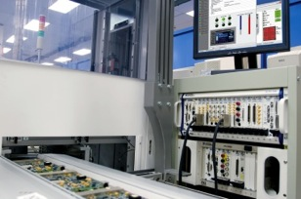
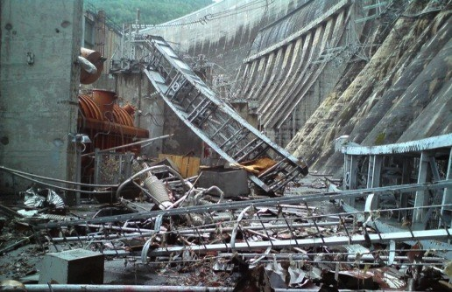
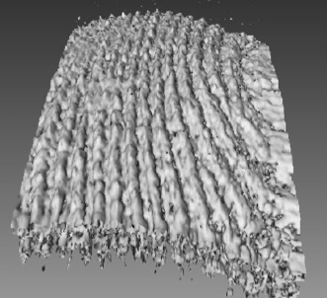
The Impact of Great Engineering
Saving time, effort, and money
Improving quality of life
Averting catastrophic damage
ni.com
Notes:
Today we’d like to share with you what we believe we can do to help contribute to the impact of great engineering and science, the work that you in the audience do every day.
We recently spent some time with the National Academy of Engineering in the United States, President Charles Vest who shared his concerns about not enough students going into the field of engineering. Apparently, they’re not connecting engineering with “making a difference in the world,” and that’s something that’s a critical factor in selecting a career. Not making a difference in the world?? What better way to change the world than through scientific discovery and engineering innovation??
Sometimes we forget what the impact of great engineering is on our world. Saving time, effort and money in design and test result in true value, creating solid wealth and jobs for society. Then, we improve everyday life through working on medical advances like early cancer detection, to something as mundane as making sure the chairs we’re all sitting on today don’t fall apart. Finally, we help avert disasters to humanity, earthquake proofing buildings and homes, early warning systems for tornados and tsunamis. Who else is going to help make these things work? We are the builders of our world.

Slide 5
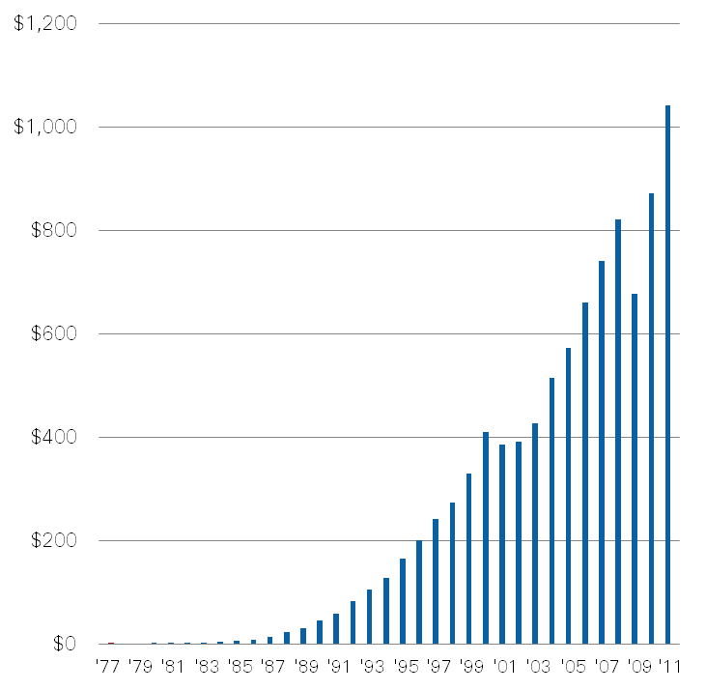
National Instruments—Our Stability
Long-Term Track Record of Growth and Profitability
Non-GAAP Revenue: $262 M in Q1 2012
Global Operations: Approximately 6,300 employees; operations in more than 40 countries
Broad customer base: More than 35,000 companies served annually
Diversity: No industry >15% of revenue
Culture: Ranked among top 25 companies to work for worldwide by the Great Places to Work Institute
Strong Cash Position: Cash and short-term investments of $377M as of March 31, 2012
Non-GAAP Revenue* in Millions
*A reconciliation of GAAP to non-GAAP results is available at investor.ni.com
Notes:
NI’s commitment stands on solid and stable ground.
Since we were founded we have focused on sustainability for the long term. We believe that the best way to serve our customers is to ensure a successful stable company you can rely on for products that will be of consistent good quality over time, and service to customers just the first time you buy from us – but always.
This is reflected in our growth, our breadth and our diversity. We also reflect it in our culture of being a consistently great place to work throughout our offices worldwide.

Slide 6


NI Global R&D Organizations
AWR CO
NI Toronto
NI Denmark
AWR WI
NI Boston
AWR Finland
Main Manufacturing
Facility - Hungary
NI Hungary
NI Aachen
NI Romania
NI Shanghai
NI Bangalore
NI Austin
NI Penang
NI Mountain View, Santa Rosa,
Berkeley, Phase Matrix,
AWR CA

Slide 7
Processor Landscape for Real-time Computation
Problem Size
10 μs
100 μs
1 ms
1 s
Cycle Time (Maximum Allowed)
Notes:
Since time will play a key role in real-time computation for RT HPC, a comparison of processors and how they fare in relation to cycle time is relevant. To augment the information, (relative) problem size is used. While plenty of other problem characteristics could be used here, size is sufficient to compare/contrast important processor strengths.
As processors are added to the graph and their abilities overlap, the ‘preferred’ one is moved to the top based on specific criteria or circumstances crucial to RT HPC success.

Slide 8
Processor Landscape for Real-time Computation
‘latency’ barrier
RT-GPU
GPU
Problem Size
FPGA
CPU
CPU
‘cache’ cap
10 μs
100 μs
1 ms
1 s
Cycle Time (Maximum Allowed)
Notes:
As each processor target is capable of solving problems when given more time (i.e. longer cycle times), many factors come into play
Development difficulty
Deployment options
power consumption vs cost per computation
This view of the processor landscape took time to mature.
The limitations are tied to system and processor architectures so they are 'immovable' objects - users cannot alter or avoid them by how they design their application(s). I think this is an invaluable high-level point to make.

Slide 9
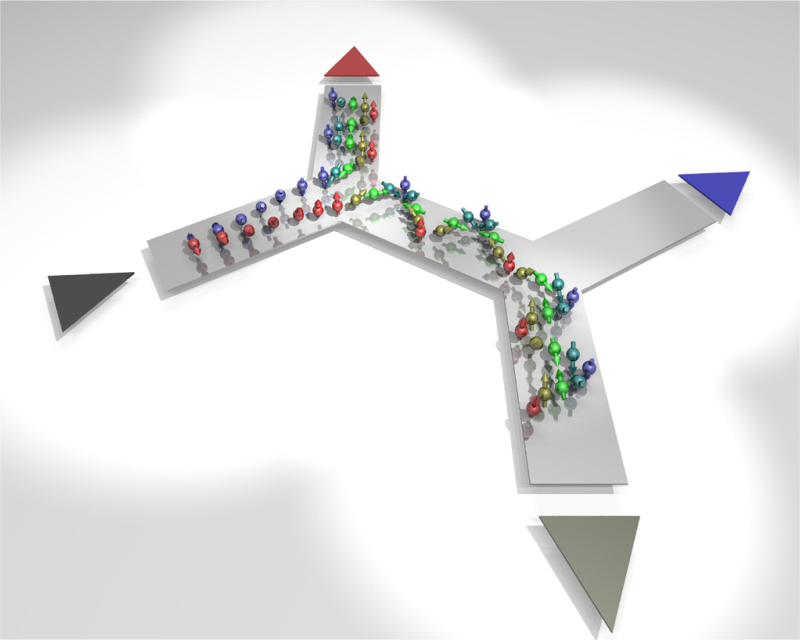
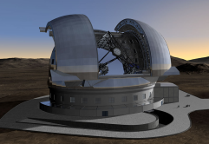
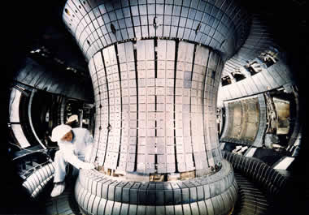

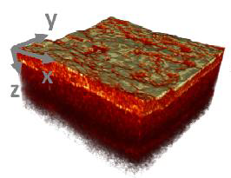
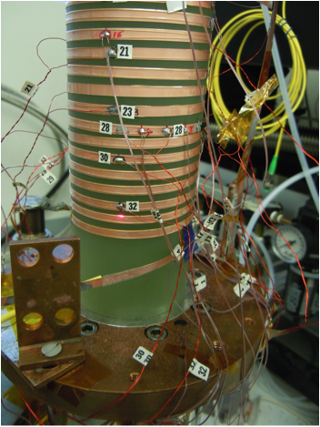
Real-Time HPC Trend
Quantum Simulation
ELT M4
Tokamak (GS)
DNA Seq
ELT M1
1 x 1M+ FFT
Tokamak (PCA)
1M x 1K FFT
Notes:
Over the past 5 years, exploration into time limited HPC-type computations has increased, particularly those impacting scientific applications . Scientists and engineers from multiple disciplines are solving cutting edge problems in RT HPC using LabVIEW and NI hardware. These application spaces include:
Medical Imaging (multi-channel FFTs)
Large system control (linear algebra, PDEs, large FFTs)
Massive simulations (image processing, linear algebra)
Live experiments (linear algebra, PDEs)
NOTE: The information below was not presented in detail as part of the presentation.
Tokamak (PCA): Plasma Shape Control in Fusion Reactor (Max-Planck) – 2007
Project involves fast matrix-vector operations to predict plasma shape using Principle Component Analysis (PCA) algorithm
Solution was optimized for 4- and 8-core CPUs to achieve required < 1ms loop rate.
1M x 1K FFT: Image Reconstruction for Optical Coherence Tomography (OCT) – 2008
Project required massive numbers of 1K FFTs per second. Final solution achieved 1.4M FFTs in the time allotted.
Real-time requirement was met using 8-core CPU system.
ELT M1: Extremely Large Telescope M1 Mirror Control (ESO) – 2008
Project worked towards 2010 goal of computing a large (symmetric) matrix-vector multiplication (3K x 6K) in less than 1 ms.
The M1 mirror is ~40m in diameter and made up of almost 1000 hexagonal mirror segments which must remain aligned to 10nm at each edge.
This application was solved on both a multi-core CPU and Tesla GPU. CPU version implemented and runs in LV RT using time-triggered deterministic network over ethernet in < 1ms. GPU solution solved in less than 1 ms using a single NVIDIA Tesla C1060 (GPU).
ELT M4: Extremely Large Telescope M4 Mirror Control (ESO) – 2009 Project based on adaptive optics control where image sensor data (840x840 pixels) was acquired for each of 4 calibration ‘stars’. Images were used to adapt the deformable mirror (2.5m diameter) using a large number of actuators. After reducing the image data 84x84 using FPGAs (computing centroids for each 10x10 pixel regions), the resulting data results in a matrix-vector problem (5K x 14K) solved using distributed computation on 16 computer nodes (each with an 8-core CPU).
The matrix-vector processing kernel on each system was optimized for 4-cores. This was the best possible solution maximizing performance as two CPU cores shared the same L2 cache. Computer nodes were connected via a custom deterministic networking over ethernet for communication and enabled a solution in 300us.
Tokamak (GS): Plasma Shape Control in Fusion Reactor (Max-Planck) – 2010
Project improved prior PCA solution to compute the true mathematical model for the ‘physics’ of the plasma shape. The new solver is a PDE-constrained optimization where the PDE constraint corresponds to a Grad-Shafranov PDE solver on a 32x64 grid. Because the PDE solver is used from an optimization routine, it was implemented to produce a solution 5-8x per ms. The solver was optimized for 2 and 4 cores.
1 x 1M+ FFT: Quench Detection of Superconducting Magnets in Particle Accelerators (Fermilab) – 2011 Project benchmarked the feasibility of performing a 512K to 1M sized FFT followed by the application of 512 to 1K FFTs of size 1K on the resulting spectrum. Real-time constraint was 10ms and was achieved using two different solutions: one running on an 8-core CPU (3-4ms) and another using a single NVIDIA Tesla C2070 GPU (< 1ms).
DNA Seq – 2011
Project involved a two stage process on images of size 2K x 2K for gene detection in DNA sequencing. The calibration phase operates on one image and finds 10K-20K features used in the second stage. The second phase of processing is performed in multiple cycles based on the experimental samples and detected matches among the 10K-20K features per image with shift invariance of 1-2 pixels and rotation invariance of 1-2deg.
While the results of the processing could be used in a real-time setting, the computation complexity exceeds current technologies so it currently exists as an off-line HPC process.
Quantum Simulation : Spintronics (Dr. Jacob, Univ. of Hamburg) – 2011=> On-going Research project exploring numerical simulations of (electron) transport through semiconductor nanostructures. Experiments involved iteratively more complicated models deployed to multi-core CPUs and eventually GPUs. Implementations ranged from multi-core dense operations to refined sparse matrix operations all designed to retain accuracy while reducing overall simulation time.
AHE : Anomalous Heat Effect – 2012
On-going research project into AHE experiments where modeling of temperature measurements is key. The current solution entails computing the PDE over 1000 nodes (non-regular grid) using an FEM method. A solution is produced every 20ms corresponding to an overall solver computing 5000 time steps per second.

Slide 10
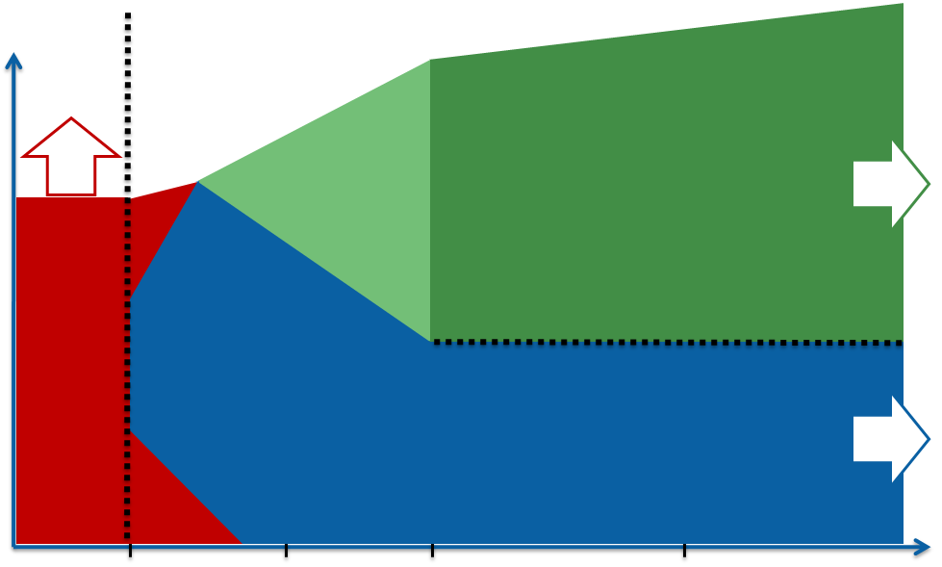
Real-Time HPC Trend
Quantum Simulation
ELT M4
Tokamak (GS)
DNA Seq
ELT M1
1 x 1M+ FFT
Tokamak (PCA)
1M x 1K FFT
Notes:
Each project has used multiple processor targets to achieve required cycle times. The colored bar is a relative comparison of the processor workload for each project. The color represents the processor target and its length the amount of processor ‘work’ based on size and/or complexity.

Slide 11
Real-Time HPC Trend
Quantum Simulation
ELT M4
Tokamak (GS)
DNA Seq
ELT M1
1 x 1M+ FFT
Tokamak (PCA)
1M x 1K FFT
Notes:
Each project has used multiple processor targets to achieve required cycle times. The colored bar is a relative comparison of the processor workload for each project. The color represents the processor target and its length the amount of processor ‘work’ based on size and/or complexity.
Some projects involved benchmarking multiple implementations using different processor targets. Although the GPUs are shown in only the most recent RT HPC projects, GPU performance has been benchmarked in earlier projects with promising results.

Slide 12

Real-Time HPC Trend
CPU ROLE
Solve G.S. PDE 5-8x/ms
Grid size = 32 x 64
Quantum Simulation
1 ms
ELT M4
Tokamak (GS)
DNA Seq
ELT M1
1 x 1M+ FFT
Tokamak (PCA)
1M x 1K FFT
Notes:
Tokamak (Grad-Shafranov Solver) – CPU Role
Enabled development of the first real-time PDE-constrained optimization routine based the Grad-Shafranov PDE (partial differential equation). Code is optimized for 2- and 4-core CPUs. This solution created in 2010 replaced a prior solution that lacked the quality needed to control the shape of the plasma in the reactor.

Slide 13
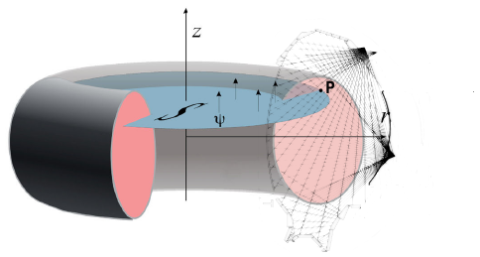
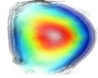


Tokamak – Shape Control
Soft X-Rays
Bolometric
Sensors
Tomography
Magnetic
Sensors
Grad-Shafranov
Solver
Shape Reconstruction
Controller
PID, MIMO
Target Shape
Notes:
13
This represents a standard process flow involved in plasma control – relevant to any design.
Soft X-ray tomography coupled with other sensor data feeds the Grad-Shafranov solver (i.e. a PDE-constrained optimization).
The boundary of the plasma is constructed from the solver solution and compared against the gold standard to determine how to adjust the magnetic field.

Slide 14
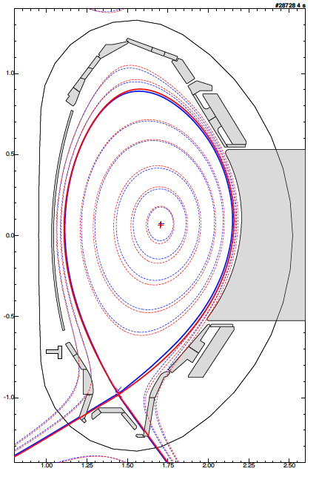
ASDEX Tokamak Upgrade - Results
Grad-Shafranov Solver using LabVIEW Real-Time on multi-core processors and LabVIEW FPGA for data acquisition
0.1 ms loop time for the PDE solver
Red line shows offline equilibrium constrcution
Blue line is real-time construction
Diagnostics for halo currents and real-time bolometer measurements using LabVIEW RT
*Dr. L Giannone et al, IPP Max Planck
Notes:
It is the result of a Lothar consultation how to do median filtering of halo currents in real time (divertor temperature) and a Qing consultation how to do Solvay-Gavitsky filtering of real-time bolometer measurements.
( ie) real time LabVIEW diagnostics were the basis for this control of power exhaust )
The other piece of news is that the GS Solver is now in routine operation and that in two weeks time we will be transferring operation to our 16 core Sandy bridge machine for a 1.5 ms cycle time.
( red is offline equilibrium reconstruction and blue is the real time reconstruction )

Slide 15

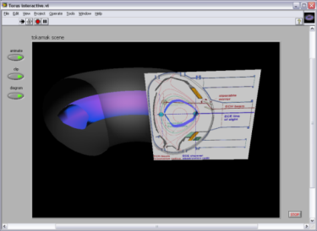
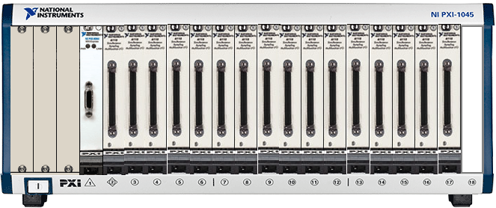
Example -Plasma Diagnostics & Control with NI LabVIEW RT
Max Planck Institute
Plasma control in nuclear fusion Tokamak with LabVIEW on an eight-core real-time system
“…with LabVIEW, we obtained a 20X processing speed-up on an octal-core processor machine over a single-core processor…”
Louis Giannone
Lead Project Researcher
Max Planck Institute
Notes:
15
The goal was to control the plasma in real time, which are in a state of constant flux and pressure. This plasma which is formed inside the tokamak should be controlled in real-time so that it does not touch the wall of the tokamak or lose its shape.
Computation in the loop for plasma control: PCA (Principal Component Analysis)
Coil measurement is done with PXI-based system

Slide 16
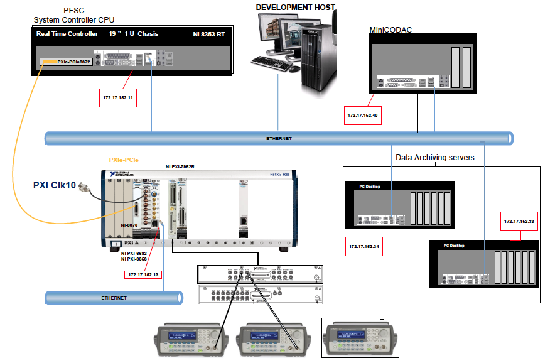
ITER Fast Plant Control System
Prototype jointly developed with CIEMAT and UPM (Spain)
NI PXIe based system with timing and synchronization, and FPGA-based DAQ modules
Interface with EPICS IOC

Slide 17
Summary
Heterogeneous systems with FPGAs, multi-core processors needed
COTS tools available for domain experts
ASDEX upgrade achieved stringent loop times using LabVIEW platform
Working with ITER for control and diagnostic needs

Slide 18
APPENDIX

Slide 19
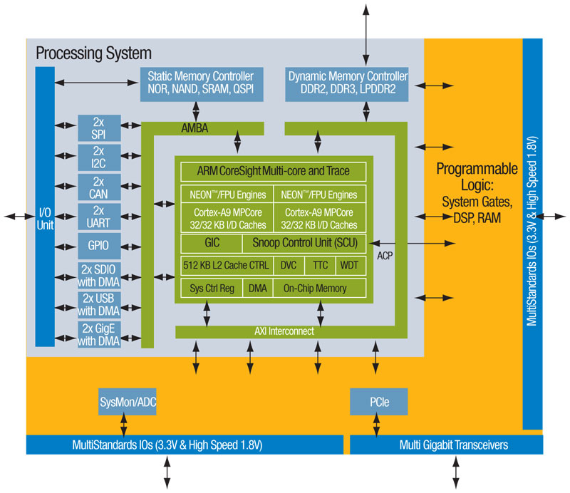
FPGA Advances
Xilinx Virtex-7 2000T:
6.8 x 10⁹ Transistors
1.95 x 10⁶ Logic cells
2 x 10⁷ Equivalent Logic Gates
1200 User I/Os
2.8 Tbps aggregate bandwidth
1.5 Tera MACs
<20Watts
Stacked Silicon Interconnect (layers with vias)
Dual ARM Cortex processors
Zynq 7000 SoC

Slide 20
Real-Time HPC
“Traditional HPC with a curfew.”
Processing involves live (sensor) data
System response impacts the real-world in realistic time
Design accounts for physical limitations
Implementations meet/exceed exceptional time constraints – often at or below 1 ms
Demands parallel, heterogeneous processing

Slide 21
Processor Landscape for Real-time Computation
FPGA
Purpose
Reconfigurable I/O
Strengths
Low latency
In the data stream
1D processing
Problem Size
10 μs
100 μs
1 ms
1 s
Cycle Time (Maximum Allowed)
Notes:
The FPGA is capable of solving problems across the entire spectrum of cycle times. As you give it more time to compute a result, it can solve larger problems. However, at some point the size is gated by its resources.

Slide 22
Processor Landscape for Real-time Computation
Problem Size
FPGA
10 μs
100 μs
1 ms
1 s
Cycle Time (Maximum Allowed)
Notes:
Because the FPGA is in the data stream, performing the computation in a distributed fashion is natural. As the problem size grows, so does the amount of DAQ hardware which can be associated with its own FPGA(s).

Slide 23
Processor Landscape for Real-time Computation
CPU
Purpose
General Processing
Strengths
Everywhere
Abundant tools
Multiple cores
Problem Size
FPGA
CPU
10 μs
100 μs
1 ms
1 s
Cycle Time (Maximum Allowed)
Notes:
CPUs are well understood from a programming tools perspective but less so in the area of multi-core performance. Because of their cache hierarchy, they are efficient at algorithms with limited parallelism in both the data and task arenas (e.g. random access memory schemes). The addition of multiple cores improves their perform on operations involving data and task parallelism.

Slide 24
Processor Landscape for Real-time Computation
‘latency’ barrier
Problem Size
FPGA
CPU
CPU
10 μs
100 μs
1 ms
1 s
Cycle Time (Maximum Allowed)
Notes:
CPUs that are part of a PC can’t perform low latency computations due to communication overhead. The worst-case memory latency corresponding to polling or interrupt-driven data transfers can be as large as 3-4us. Expecting the CPU to perform computations at cycle times of 10us or shorter is impractical.

Slide 25
Processor Landscape for Real-time Computation
Problem Size
FPGA
CPU
barrier  performance limitations
CPU
10 μs
100 μs
1 ms
1 s
Cycle Time (Maximum Allowed)
Notes:
Because of latency issues, an FPGA can be better suited than a CPU for processing in particular regions on the ‘CPU side’ of the latency barrier. In particular, for smaller problem sizes, the CPU’s processing speed (i.e. clock frequency) is less of an advantage when compared to FPGA processing as other overhead in the architecture dominates. A similar phenomenon happens for larger problem sizes but for a different reason. Sizes which grow beyond the size of the CPU cache also result in slower performance on that platform.

Slide 26
Processor Landscape for Real-time Computation
GPU
Purpose
Accelerator
Strengths
Low cost
Maturing tools
Many cores
Problem Size
FPGA
CPU
CPU
10 μs
100 μs
1 ms
1 s
Cycle Time (Maximum Allowed)
Notes:
GPUs are well suited for accelerating specific functions, especially those involving lots of data parallelism. The number of cores available are significantly more than those on CPUs and trends show that the gap is likely to widen even further in the future.

Slide 27
Processor Landscape for Real-time Computation
RT-GPU
Purpose
RT Accelerator
Strengths
Reduces jitter
Increase data size
Improve speed
GPU
Problem Size
FPGA
CPU
CPU
10 μs
100 μs
1 ms
1 s
Cycle Time (Maximum Allowed)
Notes:
If the GPU device were controlled from a real-time OS, its ability to process results at shorter cycle times is possible due in part to a reduction in I/O latency. Benchmarks show (from the worst-case scenario – a client OS) that GPUs are viable RT targets for processing in a real-time setting. Execution and I/O benchmarks supporting this are presented in later slides.

Slide 28
Processor Landscape for Real-time Computation
RT-GPU
GPU
Problem Size
FPGA
CPU
CPU
‘bus’ overhead
10 μs
100 μs
1 ms
1 s
Cycle Time (Maximum Allowed)
Notes:
As long as the GPU is not directly connected to the memory of the main processor(s) in the system, an overhead based on the bus architecture performing the data transfer is unavoidable.

Slide 29
Processor Landscape for Real-time Computation
GPU
RT-GPU
GPU
Problem Size
FPGA
CPU
overhead performance limitations
CPU
10 μs
100 μs
1 ms
1 s
Cycle Time (Maximum Allowed)
Notes:
Because of this overhead, certain problem sizes are impractical for deployment to GPUs.

Slide 30
Processor Landscape for Real-time Computation
RT-GPU
GPU
Problem Size
FPGA
CPU
CPU
10 μs
100 μs
1 ms
1 s
Cycle Time (Maximum Allowed)
Notes:
In fact, one of the main strengths of GPUs is data parallelism. Even problems sizes which are acceptable in terms of data transfer speeds may not require enough processing to overcome I/O costs. This is where the CPU takes over.
Question: Why doesn’t the CPU take over everywhere?

Slide 31
Processor Landscape for Real-time Computation
RT-GPU
GPU
Problem Size
FPGA
CPU
CPU
‘cache’ cap
10 μs
100 μs
1 ms
1 s
Cycle Time (Maximum Allowed)
Notes:
The CPU also has a limitation tied to its L1 cache. Once a problem size maximizes use of this cache, the computation throughput of the CPU levels off. An application where this occurs is presented towards the end of the presentation.

Slide 32
Processor Landscape for Real-time Computation
RT-GPU
GPU
Problem Size
FPGA
CPU
CPU
10 μs
100 μs
1 ms
1 s
Cycle Time (Maximum Allowed)
Notes:
As each processor target is capable of solving problems when given more time (i.e. longer cycle times), many factors come into play
Development difficulty
Deployment options
Power consumption / computational unit
This view of the processor landscape took time to mature.

Slide 33
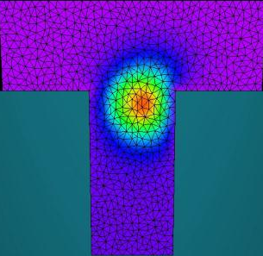
Real-Time HPC Trend
Quantum Simulation
ELT M4
Tokamak (GS)
DNA Seq
AHE
ELT M1
1 x 1M+ FFT
Tokamak (PCA)
1M x 1K FFT
Notes:
Over the past 5 years, exploration into time limited HPC-type computations has increased, particularly those impacting scientific applications . Scientists and engineers from multiple disciplines are solving cutting edge problems in RT HPC using LabVIEW and NI hardware. These application spaces include:
Medical Imaging (multi-channel FFTs)
Large system control (linear algebra, PDEs, large FFTs)
Massive simulations (image processing, linear algebra)
Live experiments (linear algebra, PDEs)
NOTE: The information below was not presented in detail as part of the presentation.
Tokamak (PCA): Plasma Shape Control in Fusion Reactor (Max-Planck) – 2007
Project involves fast matrix-vector operations to predict plasma shape using Principle Component Analysis (PCA) algorithm
Solution was optimized for 4- and 8-core CPUs to achieve required < 1ms loop rate.
1M x 1K FFT: Image Reconstruction for Optical Coherence Tomography (OCT) – 2008
Project required massive numbers of 1K FFTs per second. Final solution achieved 1.4M FFTs in the time allotted.
Real-time requirement was met using 8-core CPU system.
ELT M1: Extremely Large Telescope M1 Mirror Control (ESO) – 2008
Project worked towards 2010 goal of computing a large (symmetric) matrix-vector multiplication (3K x 6K) in less than 1 ms.
The M1 mirror is ~40m in diameter and made up of almost 1000 hexagonal mirror segments which must remain aligned to 10nm at each edge.
This application was solved on both a multi-core CPU and Tesla GPU. CPU version implemented and runs in LV RT using time-triggered deterministic network over ethernet in < 1ms. GPU solution solved in less than 1 ms using a single NVIDIA Tesla C1060 (GPU).
ELT M4: Extremely Large Telescope M4 Mirror Control (ESO) – 2009 Project based on adaptive optics control where image sensor data (840x840 pixels) was acquired for each of 4 calibration ‘stars’. Images were used to adapt the deformable mirror (2.5m diameter) using a large number of actuators. After reducing the image data 84x84 using FPGAs (computing centroids for each 10x10 pixel regions), the resulting data results in a matrix-vector problem (5K x 14K) solved using distributed computation on 16 computer nodes (each with an 8-core CPU).
The matrix-vector processing kernel on each system was optimized for 4-cores. This was the best possible solution maximizing performance as two CPU cores shared the same L2 cache. Computer nodes were connected via a custom deterministic networking over ethernet for communication and enabled a solution in 300us.
Tokamak (GS): Plasma Shape Control in Fusion Reactor (Max-Planck) – 2010
Project improved prior PCA solution to compute the true mathematical model for the ‘physics’ of the plasma shape. The new solver is a PDE-constrained optimization where the PDE constraint corresponds to a Grad-Shafranov PDE solver on a 32x64 grid. Because the PDE solver is used from an optimization routine, it was implemented to produce a solution 5-8x per ms. The solver was optimized for 2 and 4 cores.
1 x 1M+ FFT: Quench Detection of Superconducting Magnets in Particle Accelerators (Fermilab) – 2011 Project benchmarked the feasibility of performing a 512K to 1M sized FFT followed by the application of 512 to 1K FFTs of size 1K on the resulting spectrum. Real-time constraint was 10ms and was achieved using two different solutions: one running on an 8-core CPU (3-4ms) and another using a single NVIDIA Tesla C2070 GPU (< 1ms).
DNA Seq – 2011
Project involved a two stage process on images of size 2K x 2K for gene detection in DNA sequencing. The calibration phase operates on one image and finds 10K-20K features used in the second stage. The second phase of processing is performed in multiple cycles based on the experimental samples and detected matches among the 10K-20K features per image with shift invariance of 1-2 pixels and rotation invariance of 1-2deg.
While the results of the processing could be used in a real-time setting, the computation complexity exceeds current technologies so it currently exists as an off-line HPC process.
Quantum Simulation : Spintronics (Dr. Jacob, Univ. of Hamburg) – 2011=> On-going Research project exploring numerical simulations of (electron) transport through semiconductor nanostructures. Experiments involved iteratively more complicated models deployed to multi-core CPUs and eventually GPUs. Implementations ranged from multi-core dense operations to refined sparse matrix operations all designed to retain accuracy while reducing overall simulation time.
AHE : Anomalous Heat Effect – 2012
On-going research project into AHE experiments where modeling of temperature measurements is key. The current solution entails computing the PDE over 1000 nodes (non-regular grid) using an FEM method. A solution is produced every 20ms corresponding to an overall solver computing 5000 time steps per second.

Slide 34
Real-Time HPC Trend
Quantum Simulation
ELT M4
Tokamak (GS)
DNA Seq
AHE
ELT M1
1 x 1M+ FFT
Tokamak (PCA)
1M x 1K FFT
Notes:
Each project has used multiple processor targets to achieve required cycle times. The colored bar is a relative comparison of the processor workload for each project. The color represents the processor target and its length the amount of processor ‘work’ based on size and/or complexity.

Slide 35
Real-Time HPC Trend
Quantum Simulation
ELT M4
Tokamak (GS)
DNA Seq
AHE
ELT M1
1 x 1M+ FFT
Tokamak (PCA)
1M x 1K FFT
Notes:
Some projects involved benchmarking multiple implementations using different processor targets. Although the GPUs are shown in only the most recent RT HPC projects, GPU performance has been benchmarked in earlier projects with promising results.

Slide 36
Real-Time HPC Trend
Quantum Simulation
1 ms
1 ms
ELT M4
DNA Seq
20 ms
1 ms
Tokamak (GS)
AHE
ELT M1
1 ms
1 x 1M+ FFT
Tokamak (PCA)
1 s
10 ms
1M x 1K FFT
Notes:
Projects have used multiple processor targets to achieve required cycle times. Not all projects are associated with a time constraint. This is because the computational demands go far beyond today’s current computing technologies. They are still natural candidates for use in a real-time setting once technology permits so NI is involved in these to learn how the platform needs to evolve to meet their extreme computational needs.
It’s not possible to cover these projects in detail so the next few slides cover examples of each processor target in action in a specific project.

Slide 37
Real-Time HPC Trend
FPGA ROLE
Compute centroids (10x10 pixel regions)
Reduced data by 100x.
Quantum Simulation
1 ms
ELT M4
Tokamak (GS)
DNA Seq
AHE
ELT M1
1 x 1M+ FFT
Tokamak (PCA)
1M x 1K FFT
Notes:
M4 – FPGA Role
The FPGA plays a key role in this application. It performs an image processing step the reduces the data size by 100x making it possible for the problem to be solved using linear algebra techniques on multiple CPU systems. The remaining problem size still required 16 computer nodes each with an 8-core CPU to compute just 1/4th of the solution. Without the smart data reduction a solution (even a distributed one) would not have been possible given the time constraint (<2ms for the entire system).

Slide 38
Real-Time HPC Trend
CPU ROLE
Solve G.S. PDE 5-8x/ms
Grid size = 32 x 64
Quantum Simulation
1 ms
ELT M4
Tokamak (GS)
DNA Seq
AHE
ELT M1
1 x 1M+ FFT
Tokamak (PCA)
1M x 1K FFT
Notes:
Tokamak (Grad-Shafranov Solver) – CPU Role
Enabled development of the first real-time PDE-constrained optimization routine based the Grad-Shafranov PDE. Code is optimized for 2- and 4-core CPUs. This solution created in 2010 replaced a prior solution that lacked the quality needed to control the shape of the plasma in the reactor.

Slide 39
Real-Time HPC Trend
GPU ROLE
Offload dense kernels
10-25x speed-up
Quantum Simulation
ELT M4
Tokamak (GS)
DNA Seq
AHE
ELT M1
1 x 1M+ FFT
Tokamak (PCA)
1M x 1K FFT
Notes:
Quantum Simulation (Spintronics) – GPU Role
Produced the fastest solution to the Green’s Function at the heart of the simulation. The function evaluation remains the most challenging and time consuming computation. Use of a GPU to accelerate the computation results in a 3-5x improvement over an optimized CPU implementation. Because the GPU solution was able to solvie larger kernel sizes and deployed computations on multiple GPUs simultaneously, speed ups of 10-25x is possible when compared to the state-of-the-art.

Slide 40
Toolkits for Real-Time Computation
Multicore Analysis & Sparse Matrix Toolkit (MASMT)
GPU Analysis Toolkit
Notes:
Work on the RT HPC projects has revealed the LabVIEW platform is well-suited to solve such problems but certain function and performance limitations were identified. As a result, two toolkits targeting high performance computation have been released: MASMT in LV 2011 SP1 and GPU in LV2012.
The toolkits are sold individually and work with LabVIEW Full Development and Professional systems.

Slide 41
MASMT
Easy to use – similar to AAL
Support double and single precision
Windows (32/64-bit) & RT ETS
Thread control*
* - Windows only
Notes:
MASMT is easy to use relative to LabVIEW’s built-in analysis because it executes functions on the CPU. The functional interfaces supplied are similar to those used in the Mathematics and Signal Processing palettes.
Advanced performance controls are available under Windows only.

Slide 42
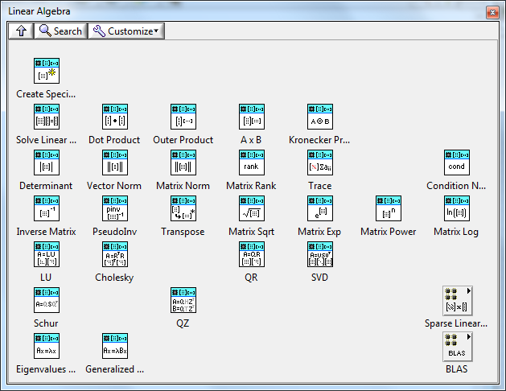
MASMT
Easy to use – similar to AAL
Support double and single precision
Windows (32/64-bit) & RT ETS
Thread control*
Linear Algebra
* - Windows only

Slide 43
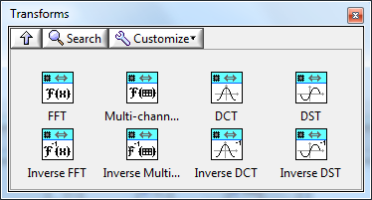
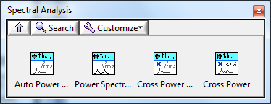
MASMT
Easy to use – similar to AAL
Support double and single precision
Windows (32/64-bit) & RT ETS
Thread control
Linear Algebra
Signal Processing

Slide 44
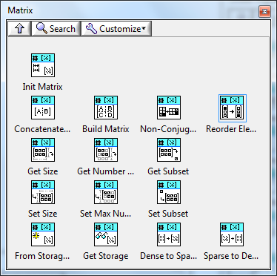
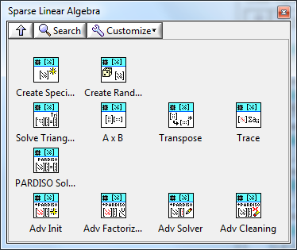
MASMT
Easy to use – similar to AAL
Support double and single precision
Windows (32/64-bit) & RT ETS
Thread control
Linear Algebra & Signal Processing
Sparse Matrix Support
Notes:
Sparse matrix support is new functionality not previously available from LabVIEW. These functions are incredibly important to deriving successful solutions to RT HPC applications.

Slide 45
Toolkits for Real-Time Computation
Multi-core Analysis & Sparse Matrix Toolkit (MASMT)
GPU Analysis Toolkit
Notes:
The GPU Analysis Toolkit is a new toolkit designed to support GPU computing from a LabVIEW application.

Slide 46
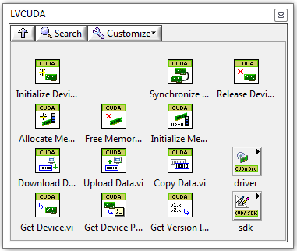
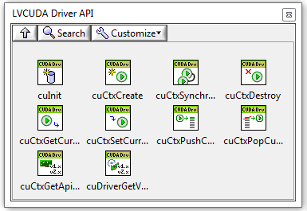
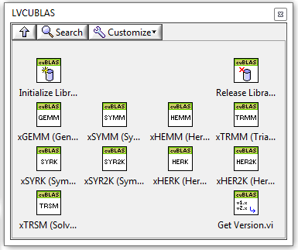

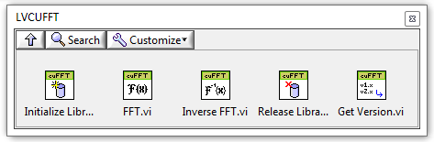
GPU Analysis Toolkit
Set of CUDA™ Function Interfaces
Device Management
CUDA Runtime API
CUDA Driver API
Linear Algebra (CUBLAS)
FFT (CUFFT)
Notes:
The Heat Equation demo utilizes the VI wrappers that ship with the toolkit. These wrappers call CUDA functions from several different NVIDIA libraries including a subset of functions for device management defined by CUDA’s Runtime and Driver APIs (ie. high-level and low-level device interfaces), Level-3 BLAS functions from CUBLAS library and all FFT functions (1D, 2D & 3D) from CUFFT library.

Slide 47
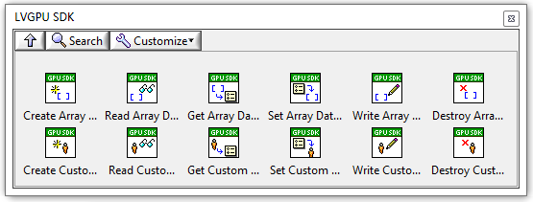
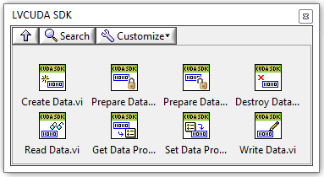
GPU Analysis Toolkit
Set of CUDA Function Interfaces
SDK for Custom Functions
User-defined CUDA libraries
Compute APIs
OpenCL™
OpenACC®
Accelerator targets
Xeon Phi™
Notes:
The CUDA interface VIs were built using an SDK included with the toolkit. The SDK allows building a VI wrapper for any custom GPU functions especially those previously compiled and tested outside of LabVIEW. Because the toolkit ships with a number of wrappers for CUDA-based functions, it is easier to wrap custom functions based on that API and architecture.
While suited for calling CUDA functions, the SDK is capable of calling functions based on other compute APIs and, as a result, execute functions on more than just NVIDIA GPU hardware.

Slide 48
GPU Analysis Toolkit
Set of CUDA Function Interfaces
SDK for Custom Functions
Designed for LabVIEW Platform
Notes:
The toolkit was designed to support GPU computing from LabVIEW. This required a special internal architecture to meet expectations.

Slide 49
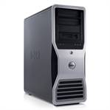
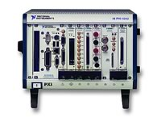


GPU Analysis Toolkit
Set of CUDA Function Interfaces
SDK for Custom Functions
Designed for LabVIEW Platform
Notes:
Expectation 1: GPU computing should be possible from any hardware platform where LabVIEW is supported.
With only a few exceptions (covered in a future slide), this is realized as long as the hardware platform (OS and driver) recognizes the GPU device doing the computation.

Slide 50
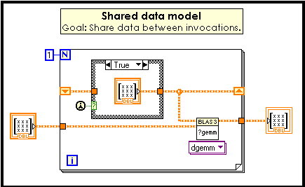
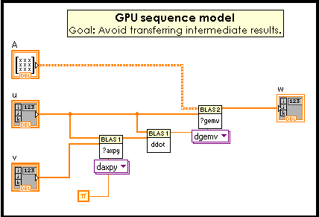
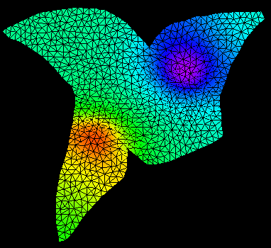
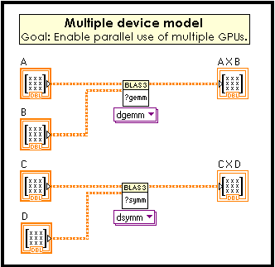
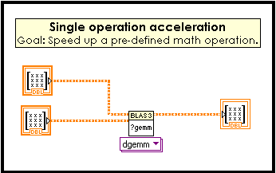
GPU Analysis Toolkit
Set of CUDA Function Interfaces
SDK for Custom Functions
Designed for LabVIEW Platform
Notes:
Expectation 2: GPU computing is implemented using standard programming practices and supports key programming patterns.
By design, the toolkit packages additional information when device resources are allocated. This technique has a number of advantages:
It avoids memory leaks on the device when an application ends unexpectedly.
It allows for concurrent execution across multiple GPU processes or devices by eliminating explicit device ID wires (similar to a device session ID).
It results in code that looks and behaves like external functions designed to run on the CPU.

Slide 51
GPU Analysis Toolkit
Set of CUDA Function Interfaces
SDK for Custom Functions
Designed for LabVIEW Platform
What it can’t do
Define and deploy a GPU function using G source code
Perform GPU computations under
LabVIEW RT OS
Linux/Mac
Notes:
A GPU function cannot be ‘sourced’ using a G diagram. A third-party tool is needed to define and compile the GPU functions. Once a binary has been created and an ANSI compliant C interface is declared, the SDK that ships with the toolkit can be used to call the function from a LabVIEW diagram.

Slide 52
GPU Analysis Toolkit
Set of CUDA Function Interfaces
SDK for Custom Functions
Designed for LabVIEW Platform
What it can’t do
Define and deploy a GPU function using G source code
Perform GPU computations under
LabVIEW RT OS
Linux/Mac
Why is RT-GPU feasible?
?
Notes:
In the processor target slides, a region relating to RT-GPU (i.e. a GPU controlled from a real-time OS like LabVIEW RT) was mentioned but not described in detail. Is such a ‘creature’ possible?

Slide 53
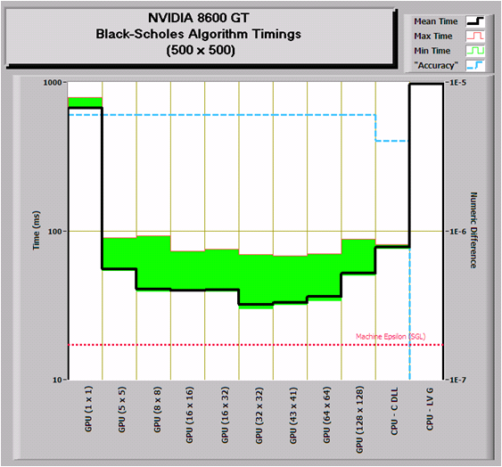

Why is RT-GPU feasible?
Reliable execution despite suboptimal configurations
Notes:
Initial GPU benchmarks from LabVIEW began in late 2007. Two aspects of GPU computing specific to real-time applications were targeted: efficient execution and I/O stability. Even the first benchmark results (shown on the right) were very promising!
The benchmark was run on a dual core PC with an NVIDIA 8600 GT GPU (~$125 at the time) and running 32-bit Windows XP.

