Slide 1
ITER Tokamak Cooling Water System Fusion Power Symposium Washington, DC Tom Coleman AREVA Federal Services December 15, 2011

Slide 2
Tokamak Cooling Water System (TCWS)
About AREVA
Project Scope
Accomplishments
Summary

Slide 3
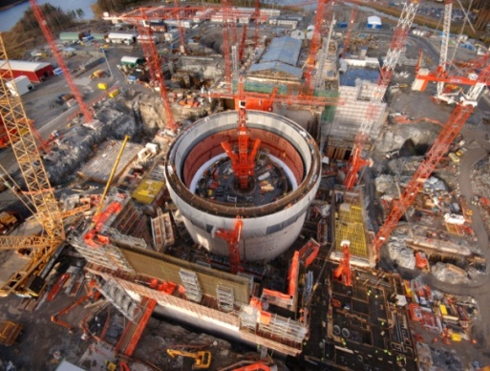
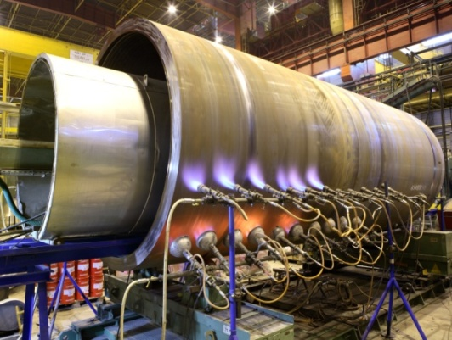
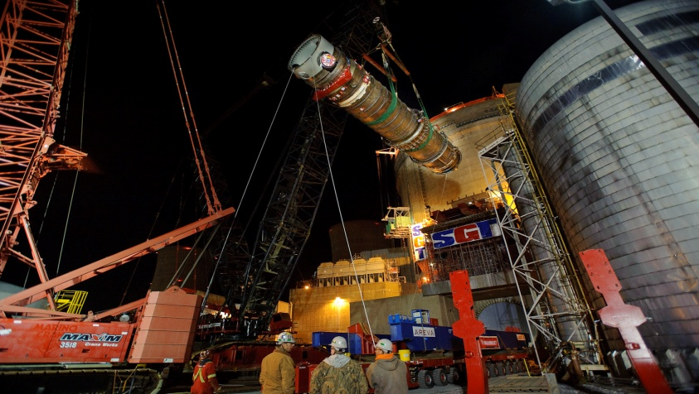
About AREVA
World Leader in Nuclear Power
Uranium mining to reactor design and related services to used nuclear fuel recycling
What we do in Nuclear Energy
Uranium exploration, mining and concentration
Uranium conversion and enrichment
Nuclear fuel design and fabrication
Design and construction of nuclear reactors
Products and services for nuclear power plant maintenance, upgrades and operations
Recycling of used nuclear fuel
Project management and support for work in a radioactive environment
Nuclear logistics

Slide 4
Project Scope
Primary Heat Transfer System for ITER
Thermal energy generated by plasma heating and neutron heat deposition
Auxiliary heating and radiated/transported power
Tritium and activated products
Design and Fabrication of TCWS Components
Heat exchangers, pumps, valves, piping, tanks, pressurizers, I&C and electrical
Over 33,000 meters of piping
Codes, Standards, and Requirements for Components
Dual certification (ASME and EuroNorm material certification)
U.S. commercial codes and standards (ASME, ASCE)
French Law certification (ESPN) with Agreed Notified Body Conformity assessment
ITER IO Quality System (safety class (SIC), seismic class (SC), quality class (QC), vacuum class (VQC) of cooling water subsystems)
Project Phases
Preliminary design complete November 17, 2011
Final design initiated with schedule to complete June 2013
Fabrication and procurement following final design with final deliveries in 2020

Slide 5
Design Considerations
Integration with ITER IO
Interface for system requirement with clients
Interface with Facility and Building Design
Totally integrated 3D Design via CATIA V5
Preliminary Design Studies
Transient Analysis - RELAP
System Pipe Line and Equipment Sizing – Fathom
Piping/Stress Analysis – ANSY/SuperPipe
RAMI/FMEA
Human Factors Engineering
Manufacturability and Constructability
Operating Conditions
Range of conditions is beyond conventional power plants
AREVA Federal Services LLC – All-Employee Road Show November 2010 - p.5
5

Slide 6
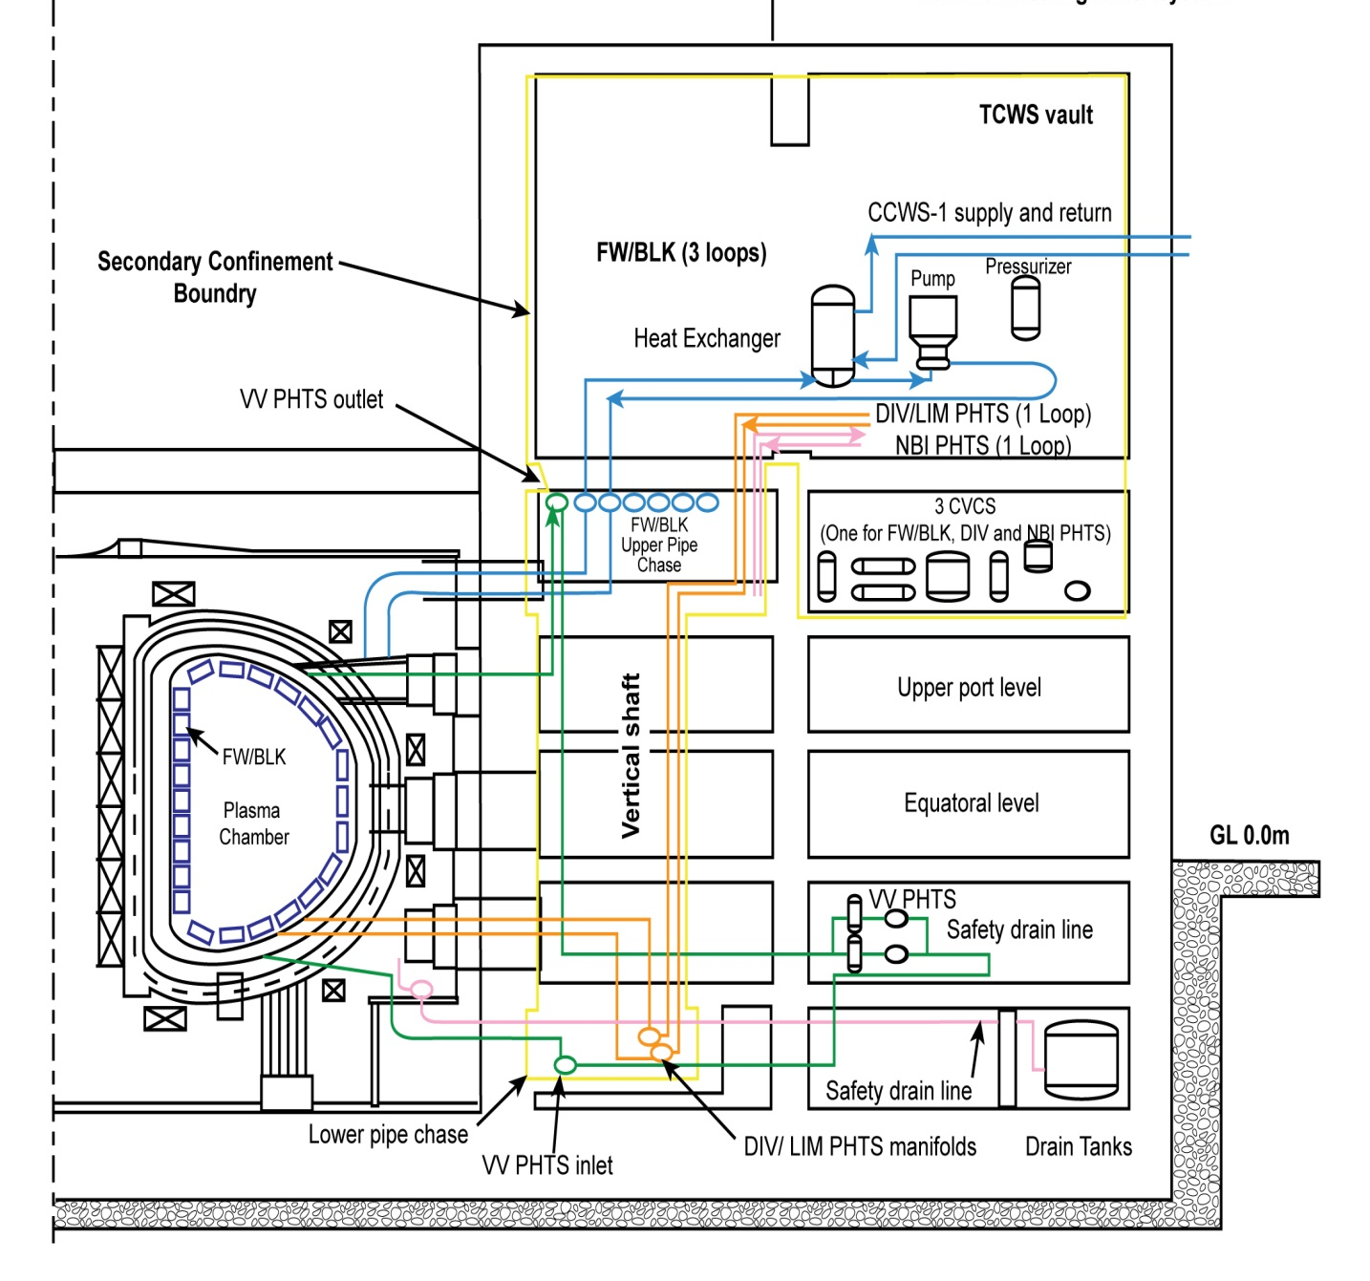
Tokamak Cooling Water System Functions
Capacity to remove ~1 GW of power
Integrated Blanket, Edge Localized Mode, Divertor (IBED): 880 MW combines:
First Wall/Blanket (FW/BLK)
Divertor (DIV)
Edge Localized Mode-Vertical Stabilization (ELM-VS)
Neutral Beam Injector (NBI): 85 MW
Vacuum Vessel (VV): 10 MW
Water and gas baking, drying, water chemistry, draining
Vacuum Vessel Water 200 C
IBED Water 240 C
Diverter Gas 350 C
Safety Functions
Confinement (tritium and activated corrosion products)
Fast Plasma Termination System Inputs
Primary Heat Transfer System (PHTS) Isolation Valves
Decay Heat Removal VV PHTS
6

Slide 7
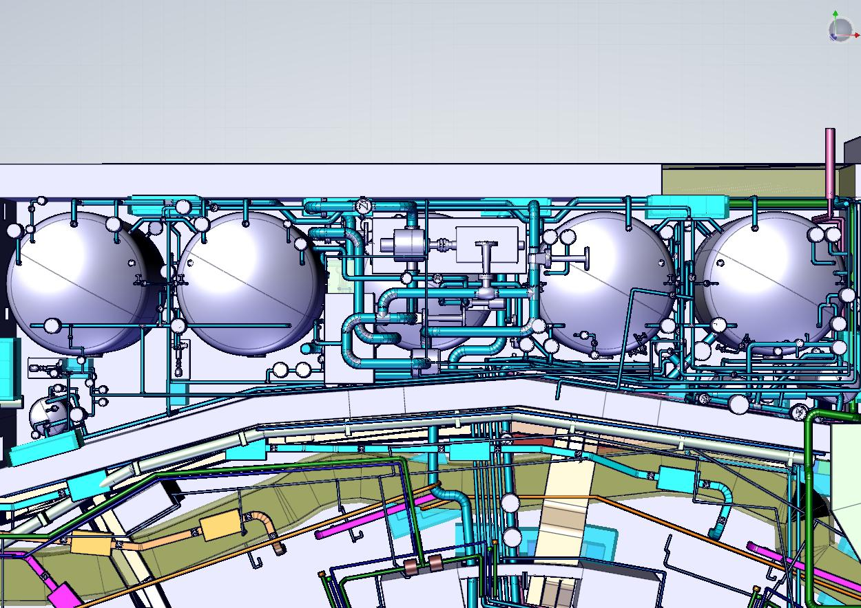
ITER TCWS Drain Tank Room Piping

Slide 8
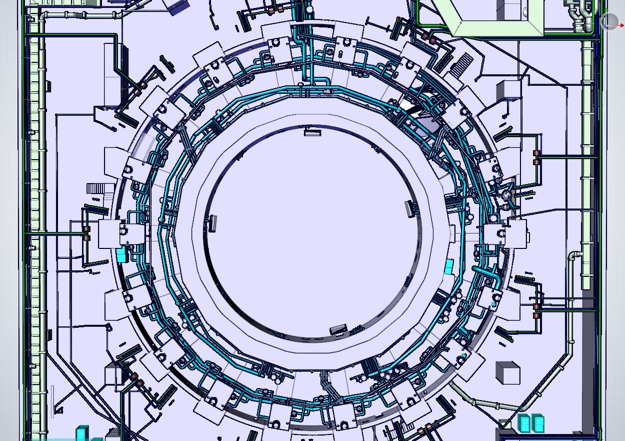
ITER TCWS Lower Pipe Chase Piping

Slide 9
Piping Analysis
Piping Analysis Requirements
All piping designed and analyzed to ASME B31.3 Code for Process Piping
Analysis addresses thermal, deadweight, seismic and any transients such as relief valve discharge, water hammer, etc.
Regulatory requirements for French nuclear plants as appropriate
Piping Analysis in the Drain Tank Room
Seventy five percent (75%) of current pipe routing in this area has been analyzed and qualified to the requirements
The piping is stiff due to limited space and subject to low seismic excitation due to its location in the lower levels of the plant resulting in few horizontal restraints
Piping Analysis in the Lower Pipe Chase
Characterized by ring headers that include IBED, Vacuum Vessel and Drain Piping
Greatest challenge is the high temperatures (240°C and 350°C) for baking
All current piping configurations have been successfully qualified for the requirements

Slide 10
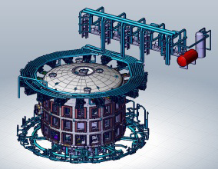
Catia CMM image of TCWS with Cryostat vessel inserted
AREVA Federal Services LLC – All-Employee Road Show November 2010 - p.10

Slide 11
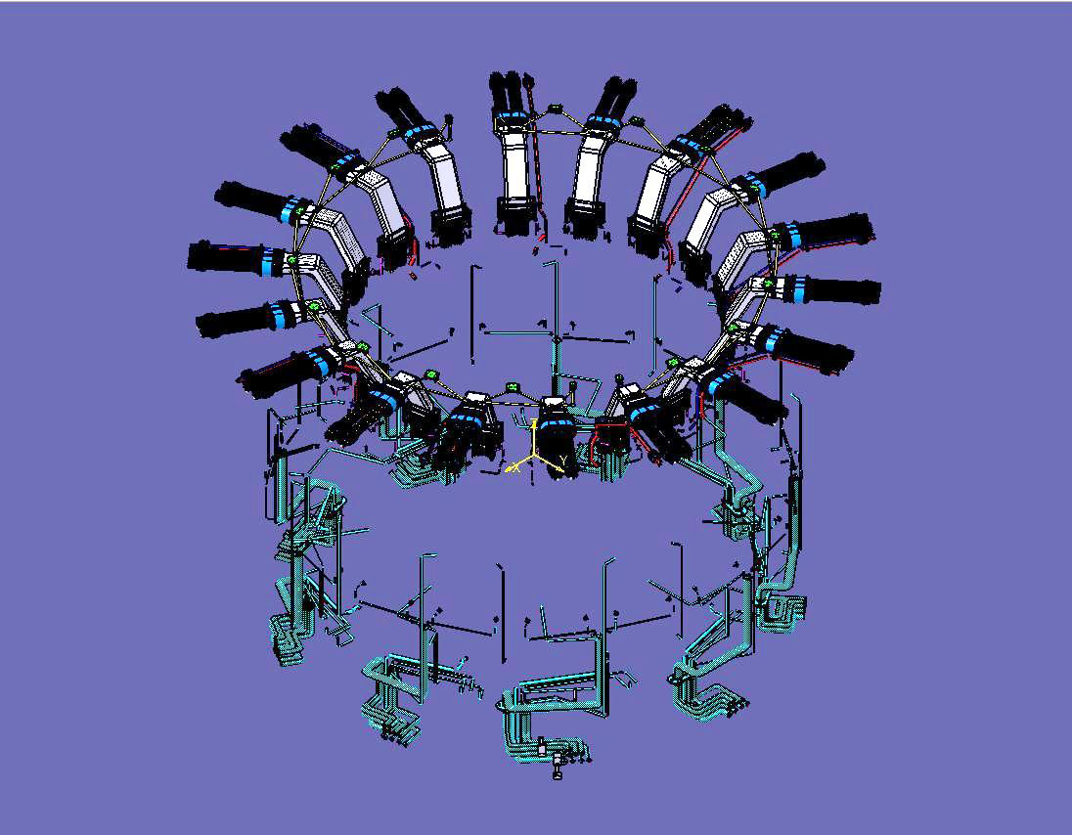
In-Cryostat Piping

Slide 12
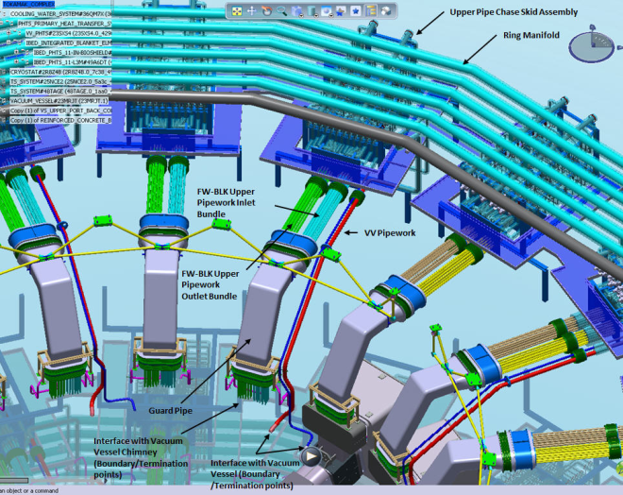
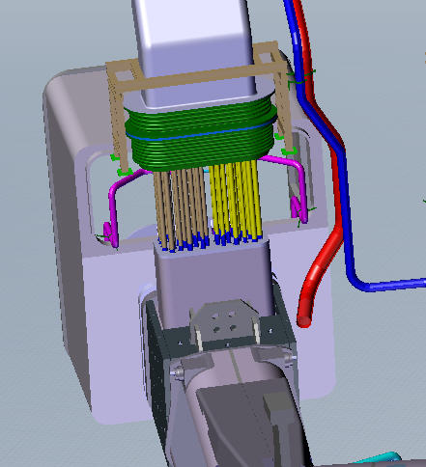

In-cryostat Piping
Design Conditions
Large potential temperature range (in-cryostat temp of -193°C vs baking temperature >240°C of cooling water lines)
Upset conditions at vacuum vessel chimney
Environmental growth and movement of cryostat structure and coolant lines
Confinement barrier required for leak protection
In-service inspection and Loss of Coolant event leak monitoring
Overview of In-Cryostat Piping, IO CMM baseline in 2011,
(Cryostat and Bioshield Omitted for Clarity of Piping)
18 in-cryostat modules and each freeze guard assembly (FGA) comprise two sections, the in-cryostat FGA and the upper pipe bundles
Vacuum Vessel Chimney Region, CATIA CMM 2010

Slide 13
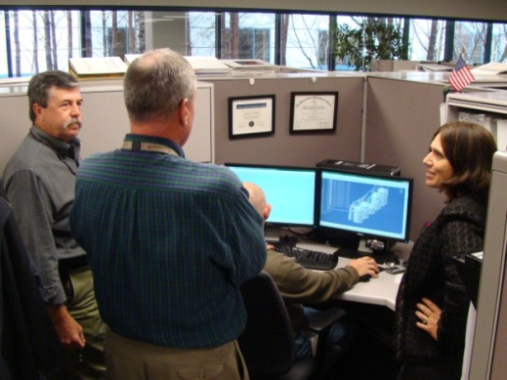
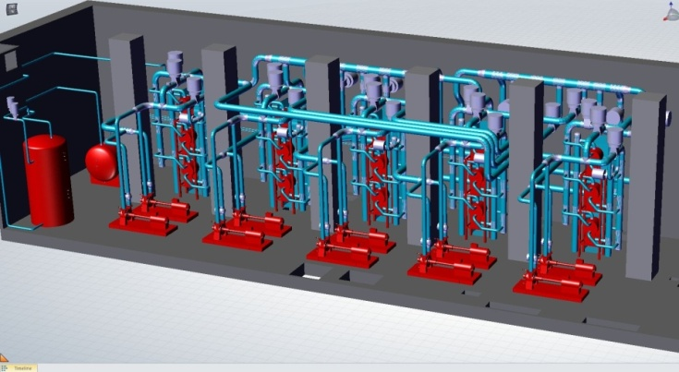
Accomplishments
Contract award early 2010
Immediate Immersion into U.S. ITER and ITER IO Project Team
Staffing Complete – 90 FTEs - SMEs
RELAP
System engineering, discipline engineers
RAMI/FMEA HFE
3D design team
Design optimization
Heat exchanger selection
Pressure control
Meeting Schedule and Needs
Completion of preliminary design
Supporting long lead procurement
Providing data needs for building interface

Slide 14
Summary
Experienced design team integrated with US ITER and ITER IO to produce preliminary design of TCWS
Challenging operating conditions for the equipment/materials to be addressed in final design
Significant future procurement opportunities exist

