Slide 1

Summary of the 1st IAEA DEMO Programme Workshop UCLA, 15-18 October 2012
Hutch Neilson
Princeton Plasma Physics Laboratory
Fusion Power Associates Annual Symposium
Washington, DC
5-6 December 2012

Slide 2
Topics
Context and background.
Workshop data
Workshop highlights
Summary

Slide 3
Context: MFE in Transition
ITER: Landmark accomplishments by the world MFE community:
Established ITER’s scientific & technical (S&T) basis.
Developed the design.
Formed an international project.
Started construction.
With ITER, MFE R&D has crossed a threshold to a programme increasingly focused on demonstrating electricity generation from fusion, or DEMO.
Making ITER succeed is the first big task of the new “DEMO era”
Several countries are planning major facilities and next steps beyond ITER on the path to DEMO.
IAEA launched the DEMO Programme Workshop series to promote international collaboration toward MFE DEMO.

Slide 4
1st IAEA DEMO Programme Workshop- Data
60+ registered attendees from 16 countries or international entities, including all ITER parties.
3.5 days. 30 talks, 13 posters, 3 topic summaries, 1 general summary. Posted at: http://advprojects.pppl.gov/roadmapping/iaeademo/.
Workshop topics & summarizers:
Fusion power extraction and tritium fuel cycle- M. Abdou, U.S.A.
Plasma power exhaust and impurity control- M. Wischmeier, Ger.
Magnetic configuration and operating scenario for a next-step fusion nuclear facility– T. Todd, UK.
Summary for Nuclear Fusion in preparation.

Slide 5
An international Technical Program Committee shaped the workshop goals and agenda.

Slide 6
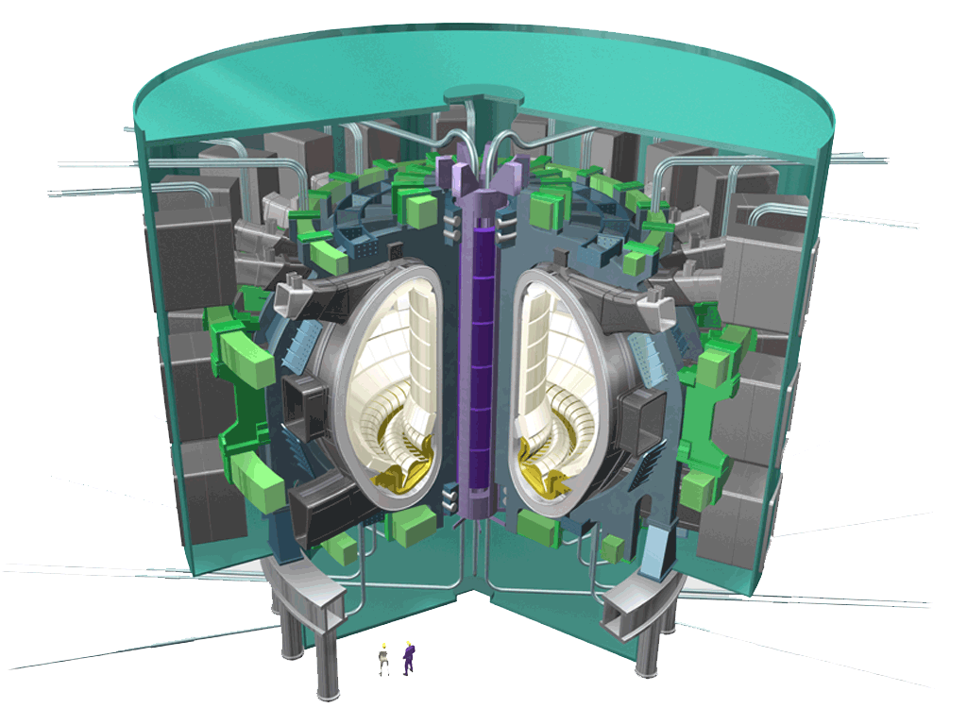
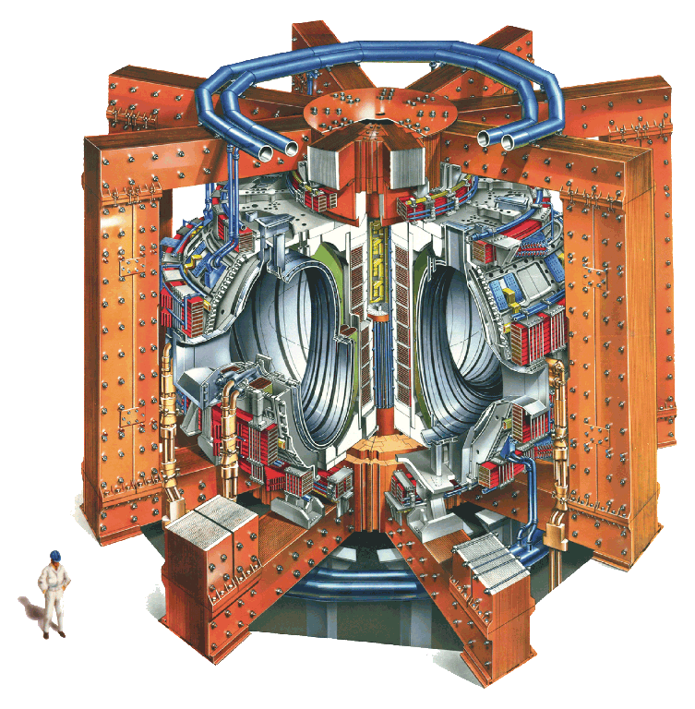
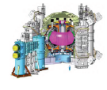
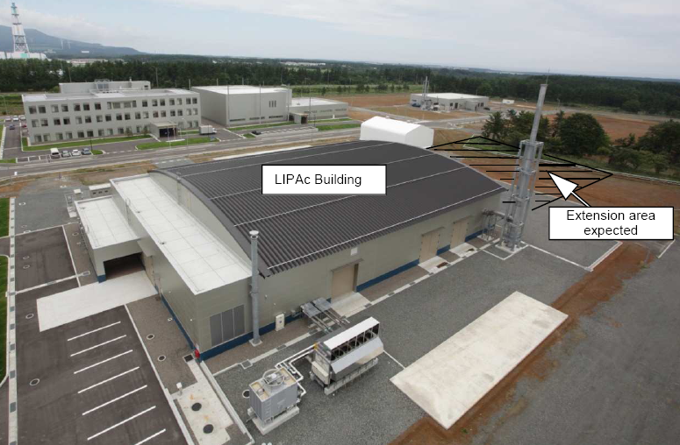
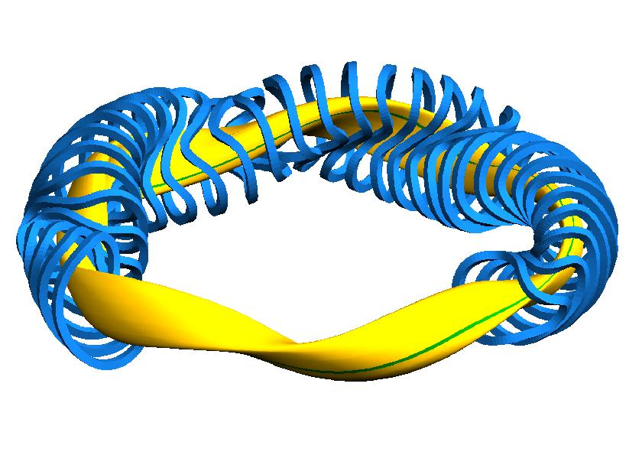
EU Roadmap in a
nutshell
EU
Plasma operation
Heat exhaust
Materials
Tritium breeding
Safety
DEMO
Low cost
Stellarator
Inductive
Steady state
European MST+ IC
MST = Mid-scale tokamak
IC = International Collaboration
DTT = Divertor Test Tokamak
Baseline
Advanced configuration and materials
European MST +linear plasma + DTT + IC
ITER Test blanket programme
Parallel Blanket Concepts
CFETR (CN)
FNS (US)
DEMO decision
Fusion electricity
CDA +EDA
Construction
Operation
Low capital cost and long term technologies
Burning Plasma
Stellarator
Stellarator optimization
2010 2020 2030 2040 2050

Slide 7
Topic 3.
Magnetic Configuration and Operating Scenario for a Next-Step Fusion Nuclear Facility.

Slide 8
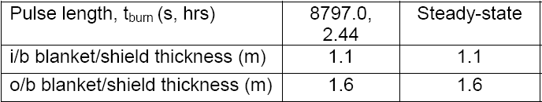
Definition of Early DEMO
EU
‘Early DEMO’ based on the expected performance of ITER with reasonable improvements in science and technology.
Typified by:
a large, modest power density, long-pulse inductively supported plasma in a conventional plasma scenario.
Output of ‘PROCESS’ code (D Ward, R Kemp – CCFE) gives a ~ 2GW_{th} machine with R~9m, β_{N} ~2. The divertor (unshielded) power loading peak is ~ 13 MW.m⁻² (plasma has 60% radiation → for a conservative estimate,we take ≥ 20 MW.m⁻².
Take neutron damage from latest, most sophisticated simulations.

Slide 9
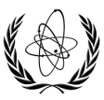
1th IAEA-DEMO Program workshop
China
The mission and design goal of CFETR
(China Fusion Engineering Test Reactor):
A good complementarities with ITER
Demonstration of fusion energy with a minim P_{f} = 50～200MW；
Steady-state or long pulse operation with duty cycle time ≥ 0.3- 0.5；
4. Demonstration of full cycle of T self-sustained with TBR ≥ 1.2
5. Relay on the existing ITER physical ( k<1.8, q>3, H～1 ) and
technical bases (higher B_{T} , diagnostic, H&CD);
6. Exploring options for DEMO blanket & divertor with an easy
changeable capability by RH.
CFETR will be the important facility to bridge from ITER to
DEMO in China, which is necessary step to go to DEMO and
then the fusion power plant.

Slide 10
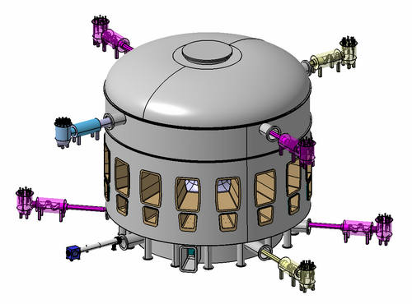
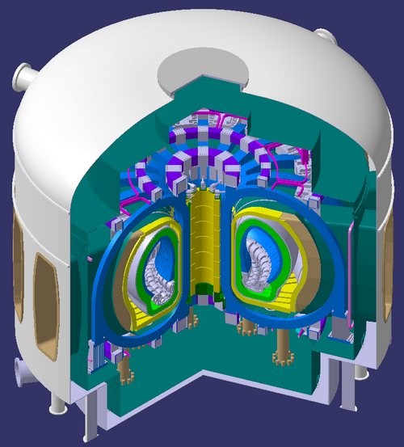
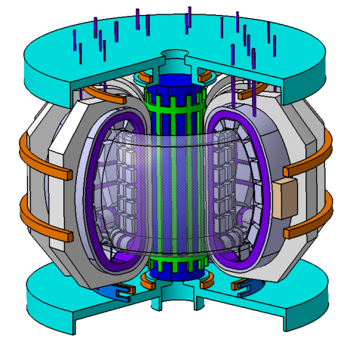
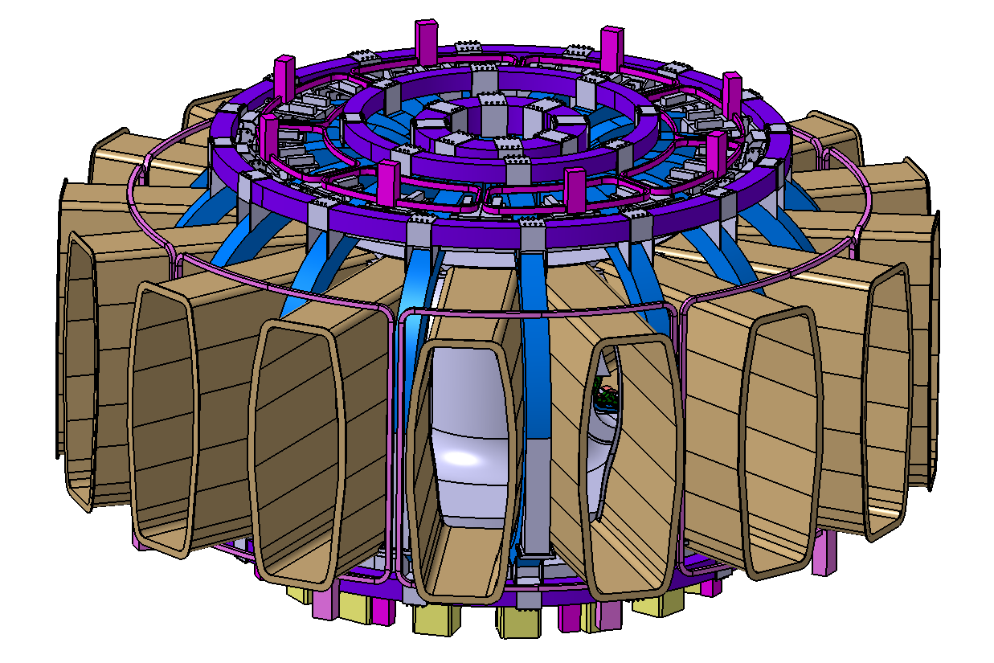
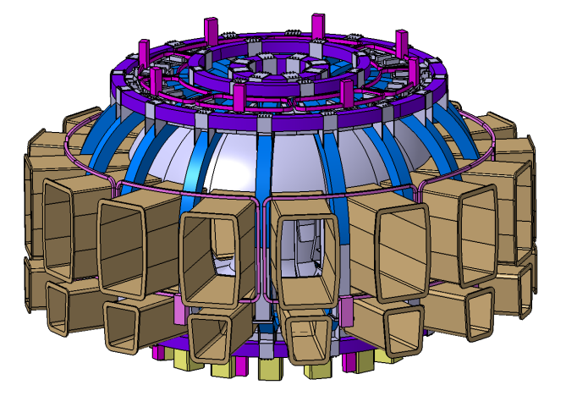
1th IAEA-DEMO Program workshop
China
Range of key parameters and
several design versions of CFETR are under comparison
B_{t} = 4.5-5.0 T
R₀ = 5.5-5.7
b/a ~ 1.8
a = 1.6
δ ~ 0.5
I_{P} = 7.5-10MA
β_{N} = ~ 2
P_{ad} ~100MW

Slide 11
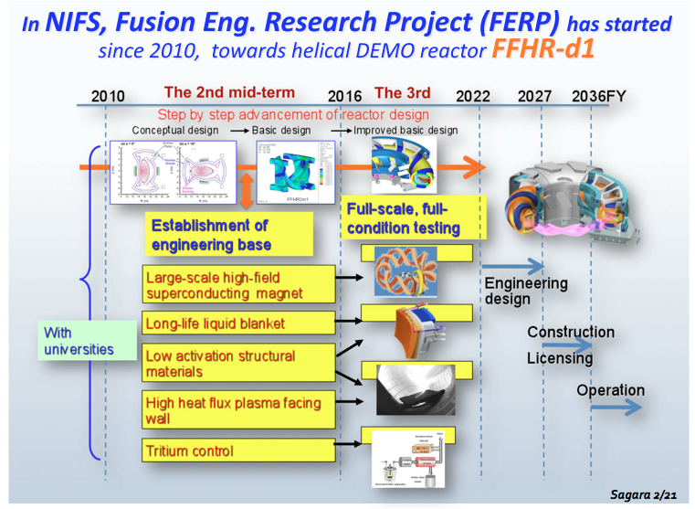
Japan

Slide 12
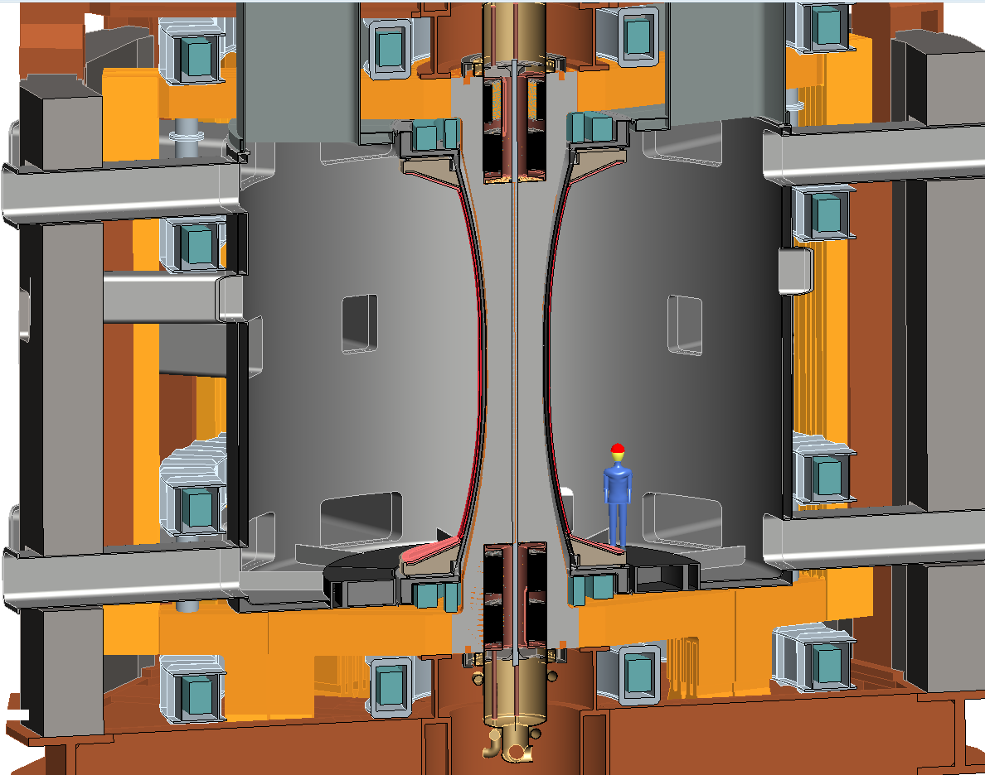
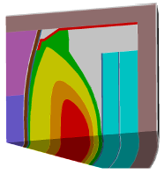
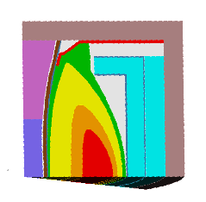
Large cylindrical vessel of R=1.6m FNSF could be used for PMI R&D (hot walls, Super-X?), other blanket configurations
U.S.
NOTE: TBR values do not include stabilizing shells or penetrations
Straight blanket
TBR = 0.8
Straight blanket
with flat top
TBR = 1.047

Slide 13
Topic 1.
Fusion Power Extraction
and Tritium Fuel Cycle.

Slide 14


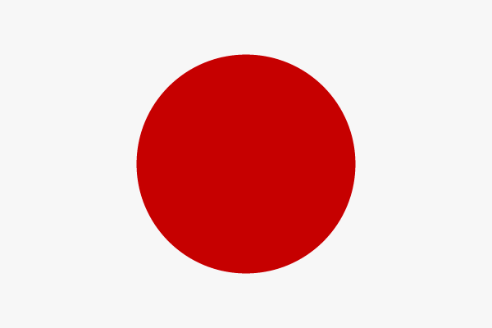


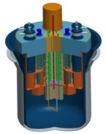
Future Large Scale Materials Irradiation Facilities Being in advanced design or construction phase
Accelerator driven spallation source MTS, at Los Alamos
Accelerator driven spallation source MYRRHA/XT-ADS, at MOL
Accelerator driven D-Li source source IFMIF, presently bilateral

Slide 15
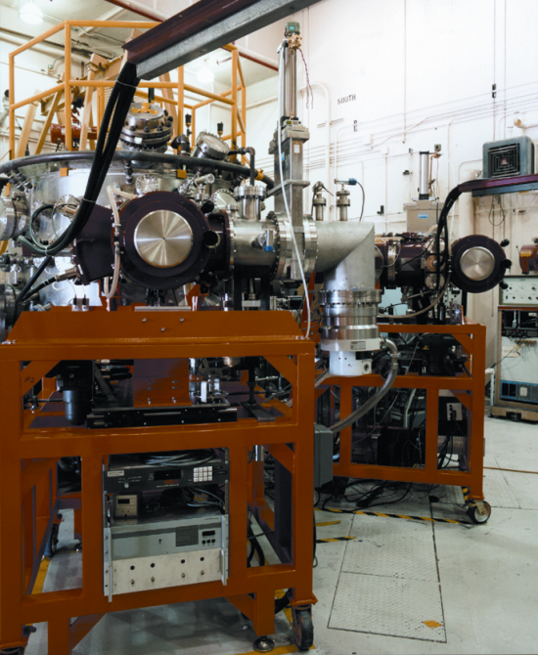
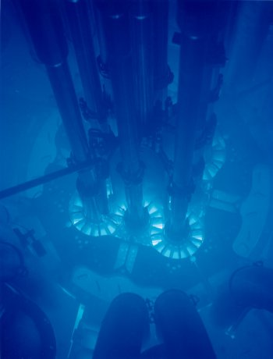
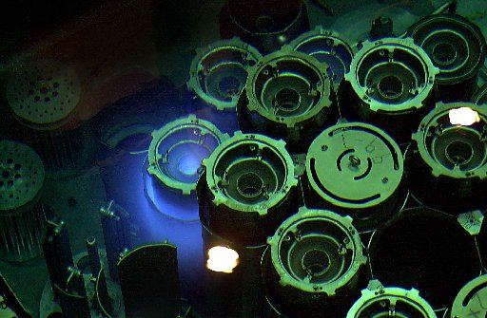
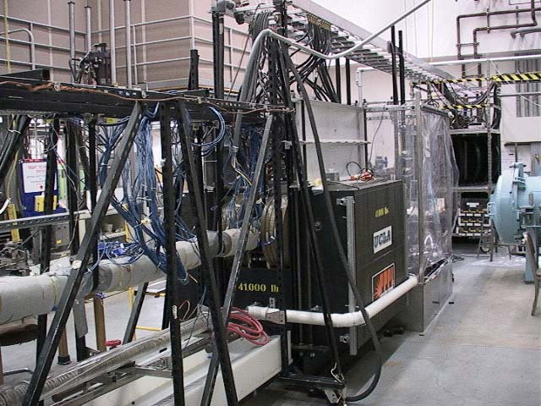
Role of multiple-effect R&D and test facilities
PMTF-1200 high heat flux facility
The performance and reliability of FW/blanket and tritium extraction systems must be understood, demonstrated and made predictable
with prototypic geometry, multi- material unit cells and mockups
under simulated combined loads (thermal, mechanical, chemical, nuclear and EM load conditions) where phenomena studied in separate effects tests can produce unanticipated synergistic effects
with development of coupled models and predictive capabilities that can simulate time-varying temperature, mass transport, and mechanical response of blanket components and systems
HFIR and ATR Test Reactors
MTOR Thermofluid/MHD facility

Slide 16
Requires a handful of multiple effect facilities
Blanket Thermomechanics Thermofluid Test Facility
simulated surface and volume heating, reactor like magnetic fields
test mockups and ancillary systems of prototypical size, scale, materials
Tritium Breeding and Extraction Facility
unit cell mockups exposed to fission neutrons
PbLi loop coupled to ex-situ tritium processing and chemistry systems
Fuel Cycle Development Facility
DEMO relevant plasma exhaust pumping, processing and fueling techniques
Remote Handling Development Facility
Develop, test, improve remote handling and maintenance systems and operations
Notes:
Between lab scale and full fusion environment
Reactor like magnetic fields, directions, gradients,
Basically going to talk about the first one or two, willms will talk about fuel cycle

Slide 17
Topic 2.
Plasma Power Exhaust
and Impurity Control

Slide 18
Topic 2: Big picture
Large gaps in power exhaust requirements, e.g., in power density, pulse length, operating temp., between ITER and DEMO.
A self-consistent strategy must integrate core plasma physics; power exhaust through edge, SOL, and divertor; PFC materials and heat removal technologies.
Needs more diagnostics, people, maybe even a dedicated machine (“Divertor Test Tokamak”).

Slide 19
Topic 2 Summary
Plasma exhaust physics
Reliable predictive numerical capability needs to be developed; none exists.
ITER-like divertor geometries need continued assessment; alternatives, e.g., super-X and snowflake, need to be investigated.
Better diagnostic coverage and more human resources are needed to accelerate progress.
Plasma Facing Components (PFCs)
Tungsten and steel are lead DEMO candidates.
Tungsten improvement (fiber–reinforced composites, self-passivating alloys) are being developed to increase operating limits.
Power density may be limited to 5 MW/m² in a fully engineered component, even with innovative materials and heat removal technologies, under irradiated conditions.
Lack of relevant irradiation sources and long time scales for existing sources are an issue.

Slide 20
The Roadmap?

Slide 21
Large and Modest Facilities Are Needed to Develop Fusion
Increasing System Integration
ITER
FNF(s)
DEMO
Large Facilities
Will define the roadmap and timeline to fusion, once initiatives are taken.
Fusion Knowledge Base
DEMO Science and Technology R&D
Large Mat’ls. Irradiation Facilities
Modest Facilities
More affordable opportunities to accelerate progress and collaboration
ITER TBM, Blanket Thermomechanics Thermofluid Test Facility, Tritium Breeding and Extraction Facility, Fuel Cycle Development Facility, Divertor test facility, Linear PMI facilities, Non-nuclear tokamaks and stellarators

Slide 22
Summary
Workshop highlighted some themes that hint at characteristics of a DEMO program still in its early planning stages.
ITER a critical element.
The roadmap and modes of collaboration will become clearer as parties take initiatives to construct major facilities.
Integrated fusion nuclear facilities (FNF)
Fusion material irradiation facilities (FMIF)
Meanwhile, there are needs and ample opportunities to accelerate progress with smaller facilities and initiatives.
Parties will continue to value international collaboration, given the breadth of expertise and the scale of facilities and activities required to develop fusion.
Next DEMO Workshop: 19-20 Nov. 2013, Vienna.

