Slide 1
From ITER to DEMO – Technology Towards Fusion Power
MIT
LANL
INL
GIT
Illinois
LLNL
ORNL
Stan Milora, ORNL
Director Virtual Laboratory for Technology
20th ANS Topical Meeting on the Technology of Fusion Energy
August 27, 2012
SRL
UCB
VLT
PNNL
UCSD
SNL
UCSB
PPPL
UCLA
Maryland
Purdue
CPI
Wisc.
FSU
Boeing
GA

Slide 2
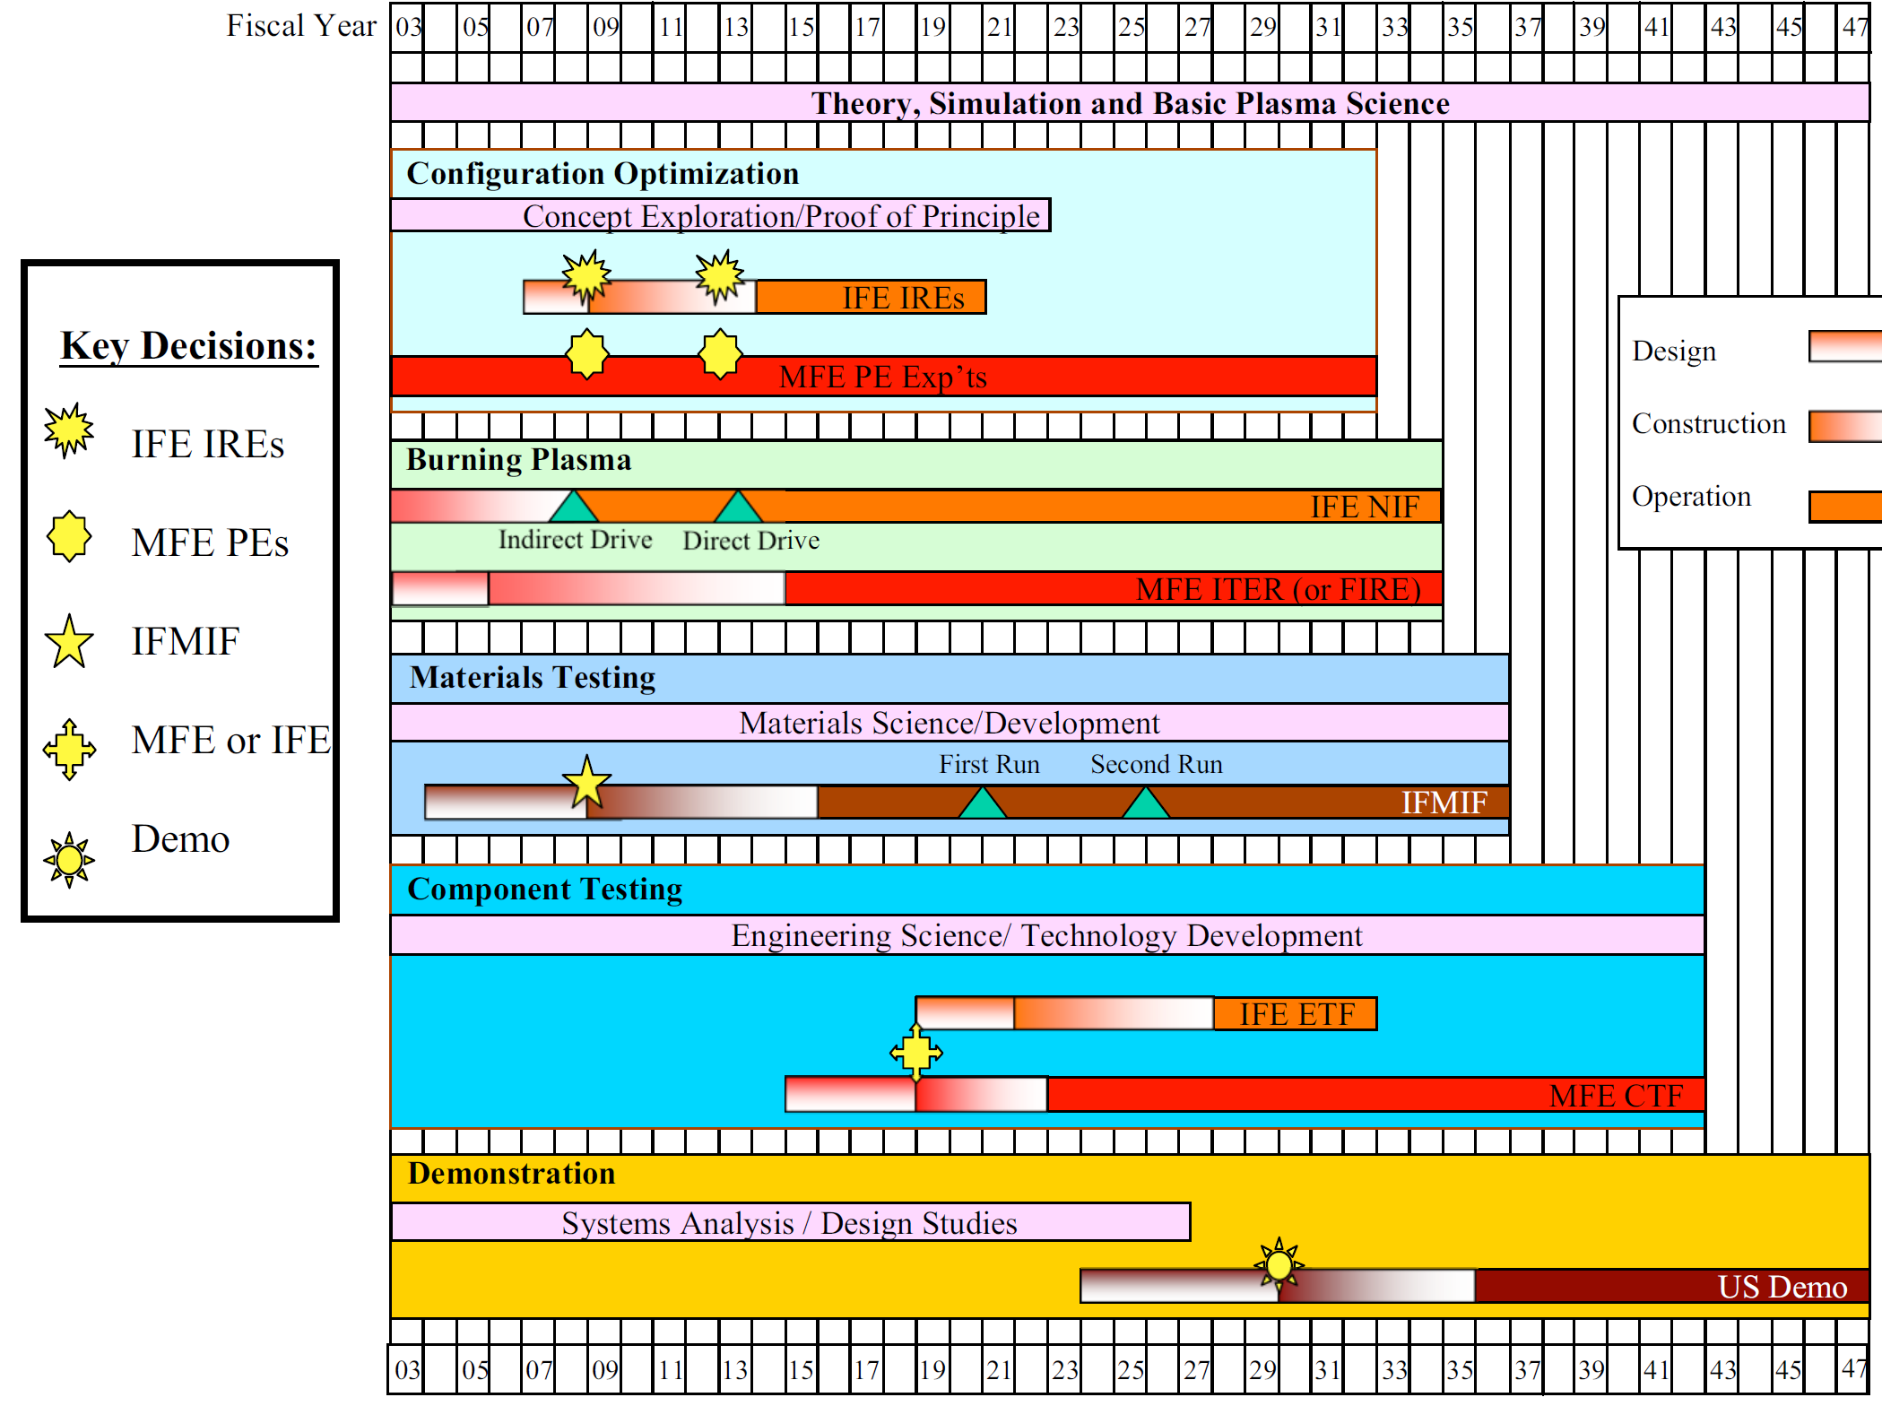

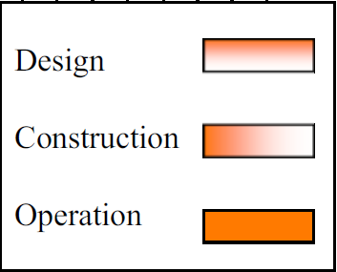




2003 FESAC Fusion Development Path Study
High Level Goal #1
NSTX Upgrade
X
?
High Level Goal #2
?
t= 0
Notes:
Turned out to be a blue print for the future.
New strategy began in FY10

Slide 3
Current Plan (taken from “On the FES Vision”, E.Synakowski ISFNT 2011)
#1 Plasma dynamics and control :
Fusion: understanding the dynamics and stability of the burning plasma state. Developing a robust control strategy.
#2 Materials in a fusion environment :
Plasma/surface interactions establishing boundary of a fusion plasma. Plasma facing surface survival, renewal: cracking, annealing. Fuel retention.
Nuclear effects on materials and structures, including the effects of > 100 dpa on structure integrity, helium creation in situ, and time evolving properties
Harnessing fusion power depends on the nuclear material science above and is extended to tritium breeding and extracting fusion power
This requires the launching of a vigorous materials and nuclear science program that will be part of defining and constructing a fusion nuclear sciences facility, and will fill gaps en route to a DEMO.

Slide 4
The 2003 Plan Specified Substantial Increases in Materials and Technology Research

Slide 5
ITER will demonstrate the scientific and technological feasibility of fusion energy
Science mission focuses on demonstration and control of high gain (Q=10) energy producing plasmas, not power generation
High availability for research program but with a duty factor < 10% its internal components will not be subject to neutron fluences exceeding 0.3 MW-yr/m².
Reactor scale technology demonstrations
Superconducting magnets
Heating and current drive technologies (IC, EC, NB)
First assessment of tritium breeding and high temperature operation in mockups deploying advanced materials and various breeding materials and coolants at ~1 MW/m² neutron wall loading.
Strong core fueling to maintain DT density consistent with production of several hundreds of MW of fusion power
Divertor with 10 MW/m² steady state heat removal capability operating in the tightly coupled regime to reduce net erosion and plasma contamination
Technologies to mitigate the effects of ELMs and disruptions
Remote handling systems capable of installing, removing and maintaining very large components (50 tons)
Torus pumping, exhaust gas cleanup, isotope separation and tritium delivery systems of unprecedented scale.

Slide 6
Going beyond ITER
 | I_{p} (MA) | B (T) | β_{N} | β (%) | P_{fusion} (MW) | P_{elec} (MW_{e}) | Plant Efficiency
ITER Scenario 2 | 15 | 5.3 | 1.8 | 2.4 | 400 | - | -
ITER AT DEMO | 9 | 5.6 | 5 | 3.8 | 1240 | - | -
EU Model D reactor | 14.1 | 5.6 | 4.5 | 5.4 | 2530 | 1518 | 0.6
Optimized current and pressure profiles: precision plasma heating fueling and current drive tools, edge density control
High plasma density (2x10²⁰/m²): efficient core plasma fueling and particle exhaust
Low plasma contamination and low net erosion: high density divertor operation
High magnetic field:
HTS magnets
Low recirculating power: plasma rotation tools for high confinement, high efficiency high power density H&CD systems.
High thermal efficiencies: advanced high temperature blanket (DCLL) and divertor, and materials (W, ODS steels, SiC/SiC). High temperature Brayton cycle.
High duty factor: reliability, control/mitigation of off normal events, maintainability and RAMI
Notes:
Beta = betaN *I/(aB)

Slide 7
Conclusion
Large new fusion science facilities like ITER drive facility specific R&D (> $1 B) that advances the state of the art in technologies needed to achieve their performance objectives. Follow through and long term technology commitment is lacking.
A larger and sustained research and development program in fusion engineering science, plasma and fusion energy technologies and materials science will be required to deliver fusion power and major nuclear facilities such as CTF/FNSF and DEMO.

