Slide 1
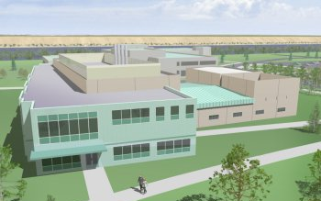

BSEL BioProducts, Sciences, and Engineering Laboratory
The Direction of Research at BSEL: Bioproducts, Bioprocesses & Bioenergy

Slide 2
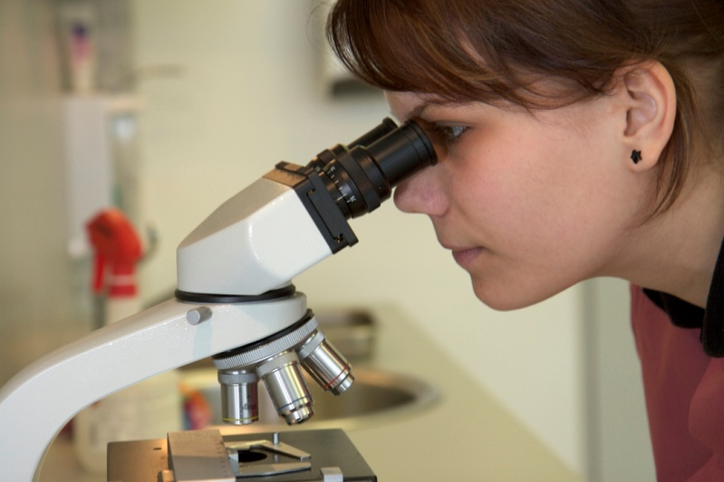
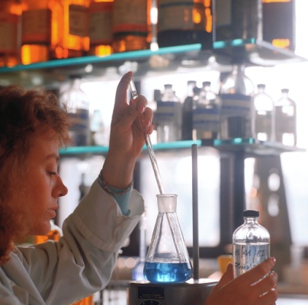

The BSEL Mission
To develop and transform abundant and renewable bioresources through targeted research, development, demonstration and commercialization of bioproducts, bioprocesses and bioenergy supported by a wide variety of public and private partnerships.
To provide a quality and rigorous education in the sciences and engineering required to conduct an active program of research, discovery and commercialization while integrating the teaching and research missions; and to provide for all students experiences that will facilitate their becoming and continuing to be scientifically and mathematically literate citizens.

Slide 3
Partnerships are Essential
BSEL/PNNL Research Programs
Other Universities (US & International)
US Government Research Programs
Grant Agencies
NGO Research Programs
Public & Private Sector Stakeholders
Research Foundations
Private Sector Research
Other Research Programs

Slide 4
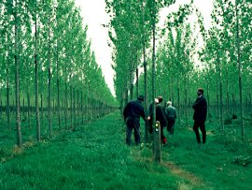
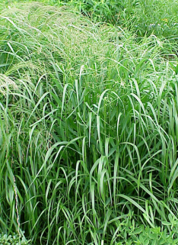
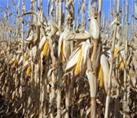
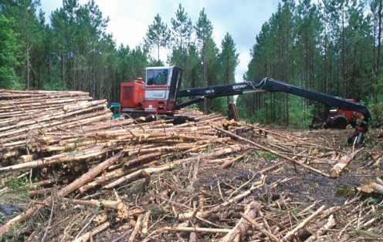
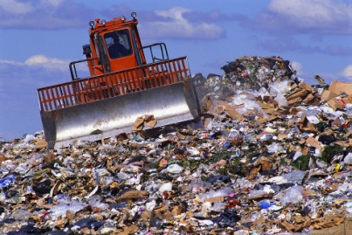
Why the Focus on “Bio” Resources
Bioresources can be used as feedstocks for:
Bioproducts: useful non-energy products derived from bioresources.
Biopower: biomass power systems that use biomass feedstocks instead of traditional fossil fuels (natural gas, oil or coal) to produce electricity.
Biofuels: liquid or gaseous fuels derived from biomass which substitute for petroleum products such as gasoline or diesel.

Slide 5
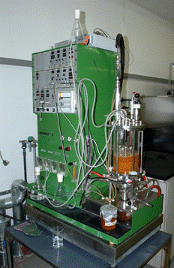
Advantages of Bioresources
Can be more sustainable than traditional alternatives (focus on lignocellulosic wastes rather than food-chain crops)
Domestically produced and support the State’s agriculture economy
Help reduce dependency on foreign energy
Support farmers and rural communities (improved economics, new markets, improved competitive position, etc.)

Slide 6
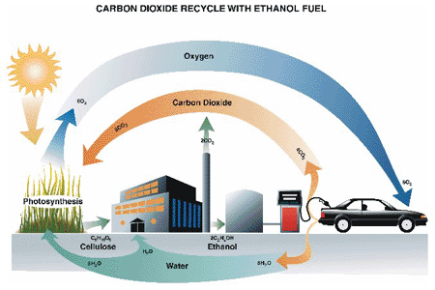
Research Areas at BSEL
Bioprocesses (biological, chemical and thermal conversion methods, improved process engineering, etc.)
Biofuels (oils, biodiesel, ethanol and other alcohols, biogas, syngas, etc.)
Biochemicals (specialty chemicals such as enzymes, catalysts, proteins, paints, inks, surfactants, polymers, lubricants, solvents, plant-made pharmaceuticals, etc.)
Biomaterials (fiber products, lumber, leather, processed foods, laminates, roofing, plastics, insulation, etc.)

Slide 7
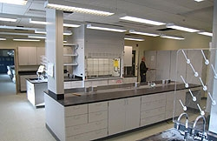
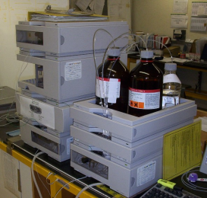
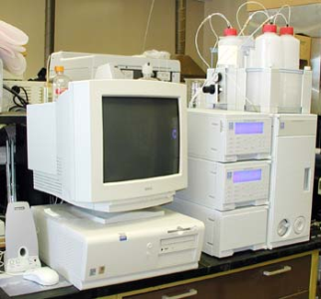
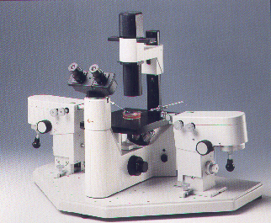
Research Capabilities
Lignocellulosic bioethanol laboratories
High-pressure catalytic reactor rooms for hydrogenation and other chemical processing
Bioprocessing laboratories for developing and engineering fungal fermentations supporting wet chemical laboratories for synthesis and preparation of catalysts and feedstocks
Combinatorial Catalysis Research Laboratory, which houses PNNL’s state-of-the-art, rapid-throughput catalyst discovery instrumentation
2,500-square-foot high-bay facility for integration and scale-up of the various processing steps in bioproducts manufacture

Slide 8
Why is This Research Important?
Renewable Portfolio Standard. Ballot initiative 937 set renewable energy standards. Utility companies serving 25,000 people or more required to produce 15 percent of their energy using renewable sources by 2020. Sources of energy that count toward the standard include water, wind, solar, geothermal, landfill gas, wave, ocean, tidal power, gas from sewage treatment facilities, biodiesel fuel that is not derived from crops raised on land cleared from old growth or first-growth forests, and qualifying biomass resources.
Petroleum Dependency Reduction. State requires that all gasoline contain 2% ethanol by 2008, and increased up to 10% if no adverse ozone pollution levels result and sufficient raw materials are available within the state; 2% of all diesel sold to be biodiesel by 2008. To be increased to 5% if there is sufficient in-state biodiesel production.
Washington Climate Plan. By 2020, reduce emissions to 1990 levels, and, after a thorough evaluation of all the options, reduce them by another 25 percent by 2035. By 2050, further reduce emissions to at least 50 percent below 1990 levels.
Greenhouse Gas (GHG) Reduction. Using bioresources instead of fossil fuels reduces GHG emissions. Also, conversion of landfill gas to energy and the adoption of animal waste conversion systems can substantially reduce fugitive methane emissions, a powerful greenhouse gas.
Air Quality. Most biofuels are naturally low in sulfur, aromatics, and other toxic compounds that impact human health. Decreased reliance on traditional fuels will improve overall air quality, particularly in urban areas.

Slide 9
Why is This Research Important (Cont.)
Forest Health and Wildfire Prevention. Forest thinning and other improvements in forest health, when coupled with bioenergy production, can create a statewide wildfire prevention strategy that reduces fire suppression costs and enhances the supply of renewable energy.
New Opportunities for Agriculture. Biomass constitutes new potential opportunities for agriculture, both in terms of improved use of the non-crop portion of current production and in new crops addressing new markets in energy, fuels, chemicals, and bio-based products.
Landfill Diversion. Washington disposes over 9.75million tons of waste annually, approximately 70 percent of which is composed of various forms of biomass. Biomass conversion technologies have the potential to return a significant portion of this post-recycled fraction of the waste stream to an economic stream in the form of power, fuels, and chemicals.
Economic Development. Creation of a diversified bio-based economy in Washington will help to revitalize rural communities and the State’s agricultural base by creating new value-added markets and new local jobs.
Water Quality and Watershed Protection. Petroleum-based fuels and chemicals are toxic to the environment and continue to constitute a major source of pollution to surface- and ground-waters. In contrast, biofuels, such as ethanol and biodiesel, are less toxic and are biodegradable.

Slide 10
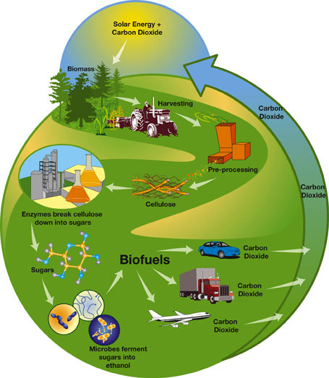
Conclusion
BSEL represents an exciting new joint venture between WSU and PNNL
Successful partnerships will be the key to success
New facility with many opportunities to participate in the research
Research will open many new avenues to better utilize the State’s bioresources
Focus on sustainable, renewable resources
End results: economic growth, improved competitive position, better environment

