Slide 1



Nuclear waste vitrification efficiency: cold cap
Pavel Hrma
Albert A. Kruger
Richard Pokorný

Slide 2
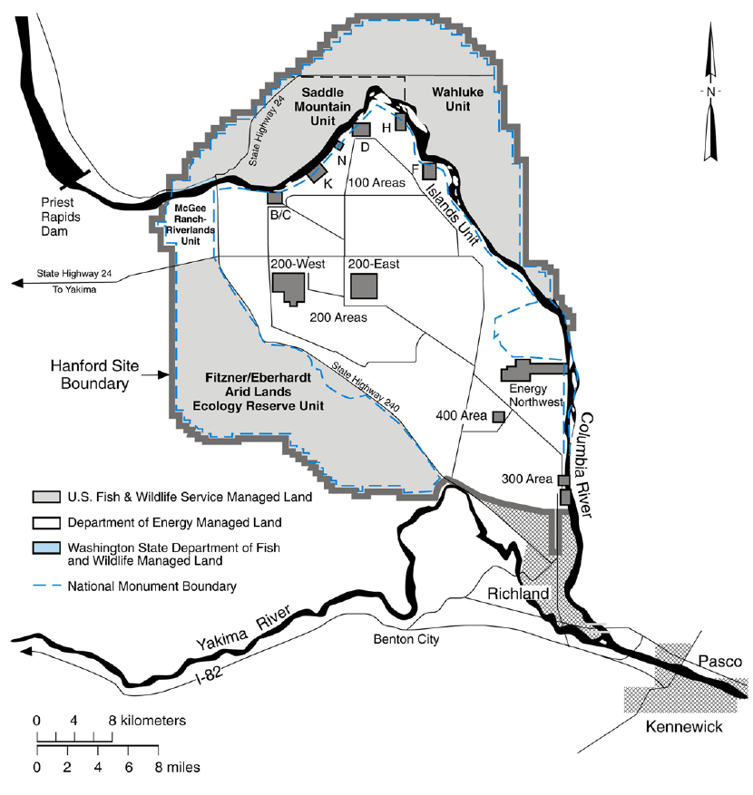
Hanford site
Manhattan project
Washington, USA
B – reactor
1. nuclear reactor
Plutonium production (World War II.)
Peak production reached during cold war
9 running nuclear reactors
The legacy of Pu production: Nuclear waste
Today – clean up process

Slide 3
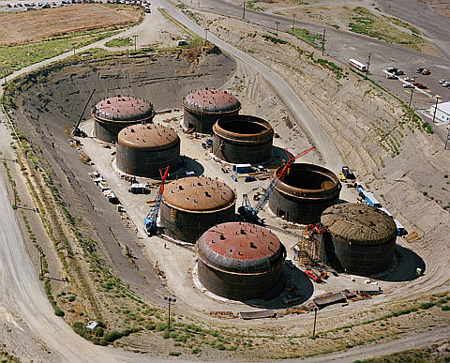
Nuclear waste
177 underground tanks
206 630 m³ of nuclear waste

Slide 4
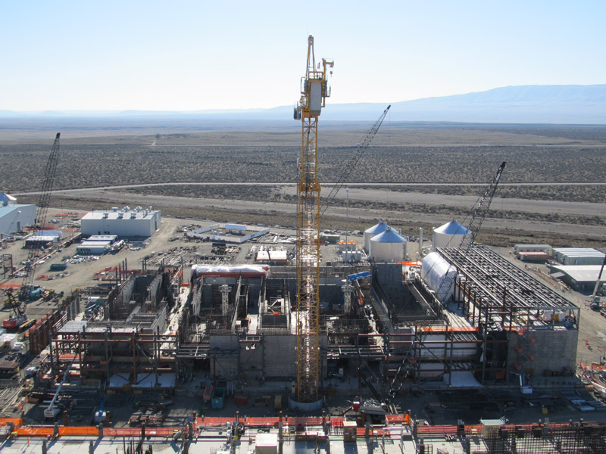
Waste treatment plant (“Vitrification plant”)
Vitrification
Immobilization of the waste in the form of glass
Waste + Glass forming additives --> heated to 1150 C
The melt then poured to stainless steel canisters to cool and solidify
In this form, the waste is stable and safer for the environment
Current state (February 2011)

Slide 5
Glass melting
Waste glass melter – a schematic image
Slurry feed
Bubbler
Cold cap
Electrodes
Molten glass

Slide 6
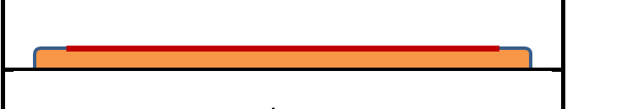
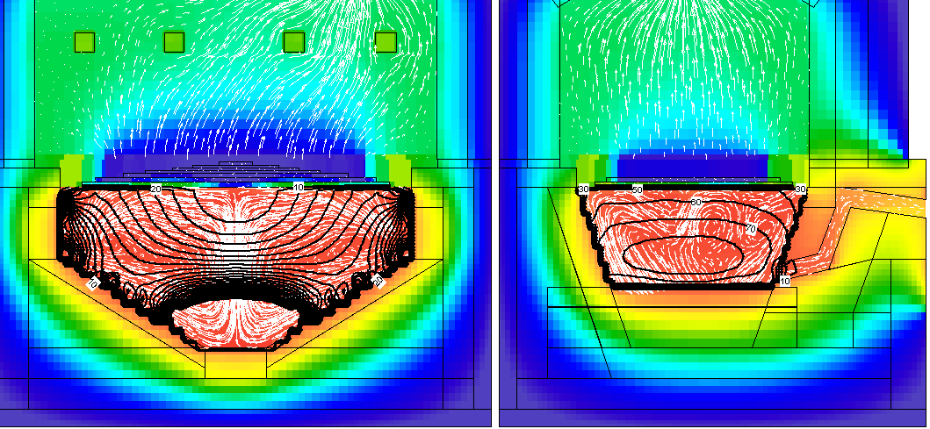
Mathematical modeling of cold cap
Slurry feed
Cold cap
Molten glass
Final goal – implementation of the cold cap mathematical model to the glass melter model
Mathematical models of melters are commonly used for the simulation of melter behavior under different conditions

Slide 7
Mathematical modeling of cold cap
Slurry feed
Cold cap
Molten glass
The feed is charged into the melter in the form of slurry containing 50 to 60 mass% of water.
Water is boiling and evaporating on the top of the cold cap.
The cold cap of nearly uniform thickness is spreading over the pool of molten glass.
Only enough feed is being charged to maintain a cold cap that covers ~90% of the surface.
Should not cover more than 95% from technological reasons

Slide 8
Mathematical modeling of cold cap
As the feed materials move down through the cold cap, their temperature increases from 100˚C to the temperature of molten glass (∼1100˚C).
The batch reactions include
water evaporation,
release of bonded water (crystalline water, water from hydroxides , oxyhydrates, and boric acid),
melting of oxyionic salts and borates,
reaction of nitrates with organics,
molten salt migration,
reactions of melts with amorphous oxides and hydroxides,
reaction of molten salts with solid silica,
formation of intermediate crystalline phases (e.g., spinel),
formation of a continuous glass-forming melt,
volatilization,
expansion and collapse of foam,
dissolution of residual solids (mainly silica).

Slide 9

Cold cap structure
Simplifications:
1D representation
2 phases
condensed phase
gas phase
x is the vertical coordinate
h is the cold cap thickness

Slide 10
Mathematical modeling of cold cap
The development of the algorithm to calculate the 1D temperature field in the cold cap:
Mass balance + Energy balance
Constitutive equations for material properties
Boundary conditions
Finite difference method was chosen for its simplicity and comprehensibility

Slide 11
Mass balance
Neglecting the diffusion, the mass balances of the condensed phase and the gas phase are
By the mass conservation law, the total mass balance is
ρ is the spatial density
v is the velocity
r is the mass change rate (via chemical reactions)
subscripts c and g denote the condensed phase and the gas phase, respectively

Slide 12
Energy balance
In a steady state, the energy balance equations are
By the Fourier’s law, the conductive heat fluxes are:
c is the heat capacity
q is the conductive heat fluxes
H is the heat source/ sink due to chemical reactions
s is the heat transfer between gas phase and condensed phase
subscripts c and g denote the condensed phase and the gas phase, respectively

Slide 13
Boundary temperatures and fluxes
Q_{U} and Q_{B} are the heat fluxes
T_{U} and T_{B} are the boundary temperatures

Slide 14
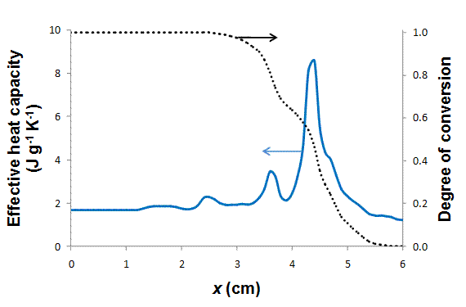
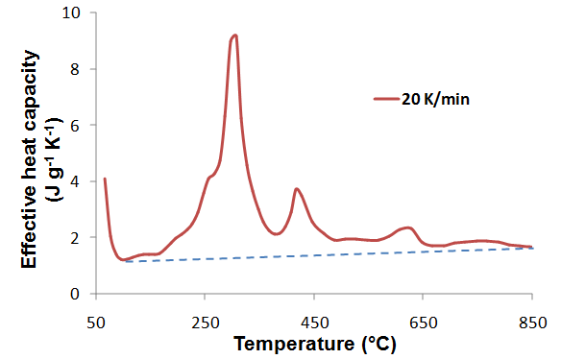

Material properties
A typical HLW melter feed has been chosen
Its properties, such as heat capacity, were measured or estimated based on the literature

Slide 15
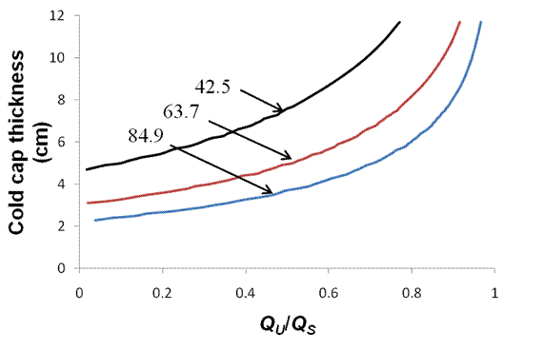
Results preview
Effect of upper heating on the cold cap thickness
The cold-cap thickness decreases as the total heat flux delivered to it increases
The more heat is delivered from above, the thicker the cold cap becomes
Total heat flux to cold cap in kW m⁻²
Q_{U} is the heat flux delivered to the cold cap from above
Q_{S} is the heat flux to convert the slurry to 100˚C (~60% of total heat flux for melting)

Slide 16
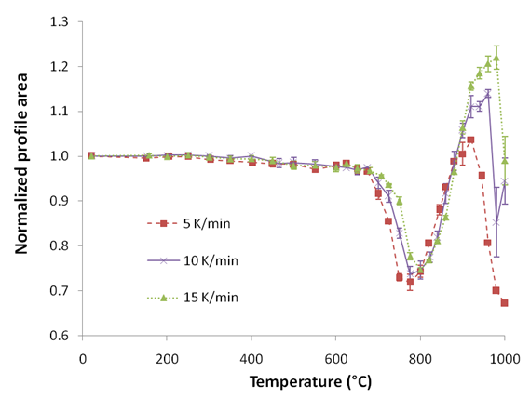
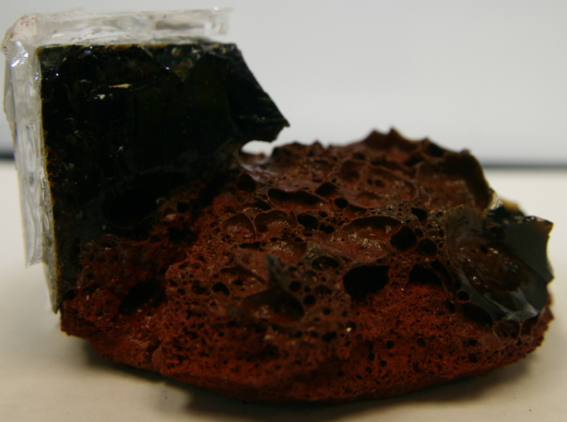
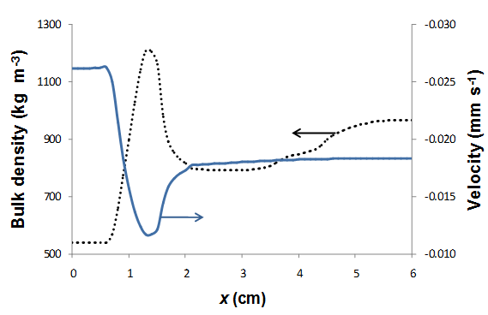
Foam layer
Expansion experiments show presence of foaming
Picture of bubble layer structure under cold cap
X-ray tomography image of foam after melting
Picture of bubble layer structure under cold cap
X-ray tomography image of foam after melting

Slide 17
Foam layer models
Structure of foam layer
Understanding of foam is essential for the cold cap modeling

Slide 18
Conclusions
The preliminary 1D model of the cold cap has been developed
The thickness of the cold cap decreases as the feat flux to the cold cap increases and increases as the fractional heat flux from above increases
Empirical data indicate that foaming has a strong impact on the melting rate
Further experimental investigation and mathematical modeling of foaming is underway

