Slide 1
Waste Loading Enhancements for Hanford Low-Activity Glasses
wP - 59018
Presented by: Albert A. Kruger
Glass Scientist
Supervisor, Vitrification Group of the
DOE WTP Project Office Engineering Division
ICEM’ 11– Reims France
26 Septembre 2011

Slide 2
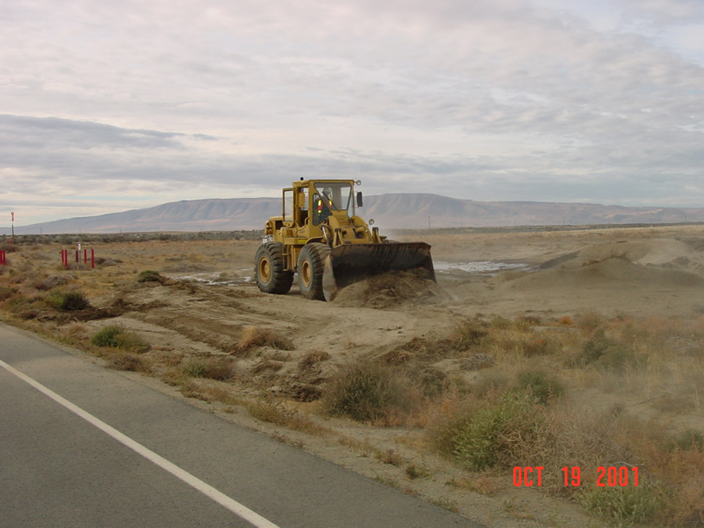

Slide 3
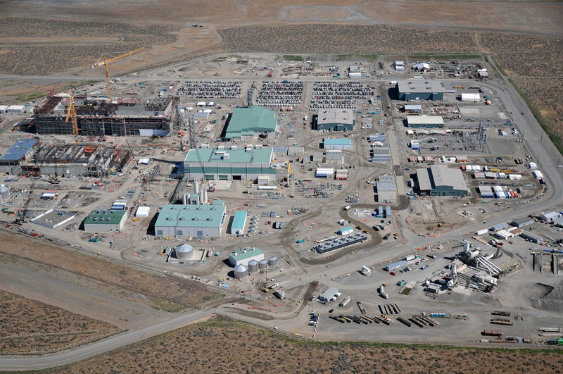
July 2011

Slide 4
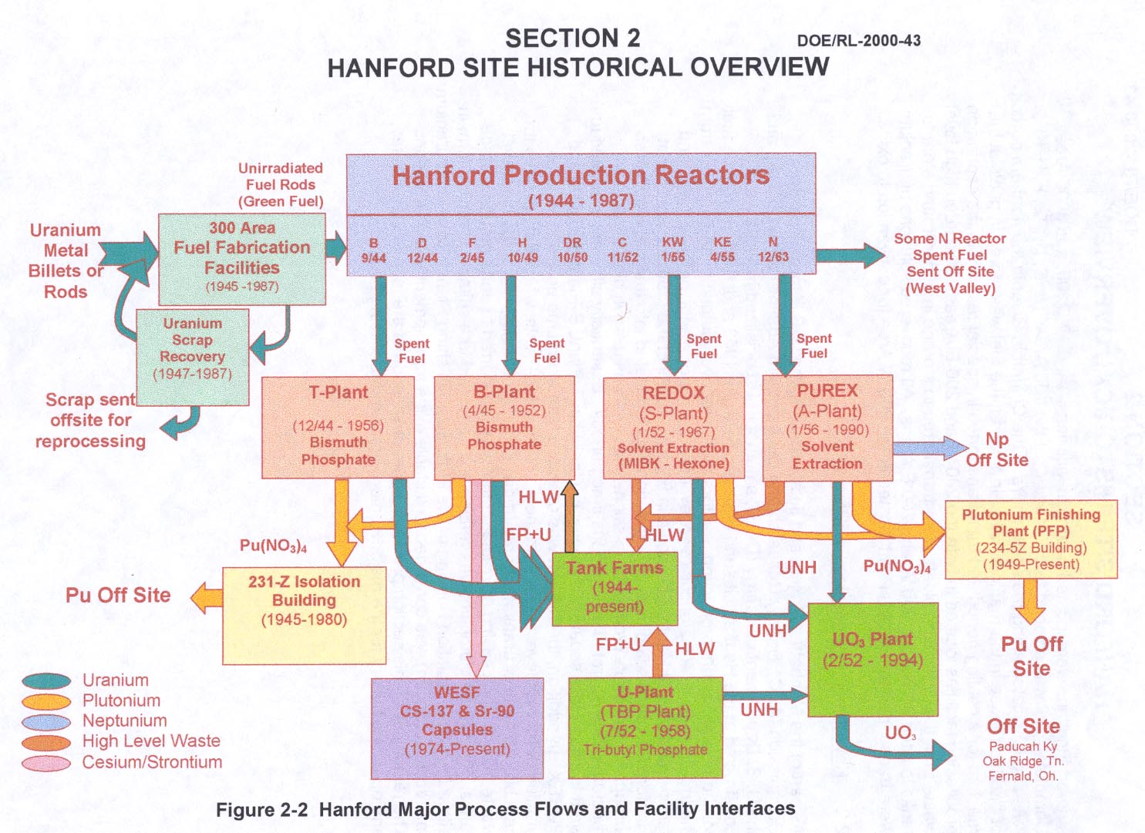
Generation of Hanford Tank Wastes
9 Reactors; 4 Fuel Reprocessing Flowsheets; 100,000 MT Fuel Processed

Slide 5
Glass Formulation for HLW & LAW Treatment
In Fiscal Year 2007, ORP initiated a testing program to develop and characterize HLW & LAW glasses with higher waste loadings, and where possible higher throughput, to meet the processing and product quality requirements.
This effort spans the investigation of the melt dynamics and cold cap properties to vitrification processes at the conditions close to those that exist in continuous waste glass melters.

Slide 6
Glass Formulation for Waste Treatment
Background:
Current estimates indicate that the number of HLW canisters to be produced in the WTP is 13,500 (equivalent to 40,500 MT glass). The ca. 50,000 MT of sodium to be processed into glass equates to 588,000 tons of ILAW glass.
The current glass formulation efforts have been conservative in terms of achievable waste loadings.
These formulations have been specified to ensure the glasses are homogenous, preclude secondary phases (sulfate-based salts or crystalline phases), are processable in joule-heated, ceramic-lined melters and meet WTP Contract terms.

Slide 7
WTP Flow Sheet - Key Process Flows
LAW
Vitrification
(90+% of
waste mass)
Maximize
Mass
Pretreatment
(solid/liquid
separation – Cs,
Sr, TRU removal)
HLW
Vitrification
(90+% of
waste activity)
SUPERNATANT
Maximize
Activity
SLUDGE
Hanford Tank
Waste

Slide 8
It is likely that the capacity of the LAW vitrification plant can be increased incrementally by implementation of a variety of low-risk, high-probability changes, either separately or in combination. These changes include:
Operating at the higher processing rates demonstrated at the LAW pilot melter
Increasing the glass pool surface area within the existing external melter envelope
Increasing the glass waste loading
Operating the melter at a slightly higher temperature

Slide 9
These approaches successfully demonstrated increases in glass production rates and significant increases in sulfate incorporation at the nominal melter operating temperature of 1150° C.
Subsequent tests demonstrated further enhancement of glass formulations for all of the LAW waste envelopes, thereby reducing the amount of glass to be produced by the WTP for the same amount of waste processed.
This approach was subsequently applied to an even wider range of LAW wastes types, including those with high potassium concentration. The feasibility of formulating higher waste loading glasses using SnO₂ and V₂O₅ in place of Fe₂O₃ and TiO₂ as glass former additives was also evaluated.
The next phase of testing determined the applicability of these improvements over the expected range of sodium and sulfur concentrations for Hanford LAW.

Slide 10
Melter Scale Comparison
Savannah River
DWPF-SRS
2.4 m²
West Valley
2.2 m²
WTP Low Activity Waste
RPP-LAW 10 m²
EnergySolutions M-Area Mixed Waste DM-5000 5m²
WTP High Level Waste 3.75 m²
LAW Pilot
DM-3300 3.3 m²
Hanford HLW Pilot
DM-1200 1.2 m²
EnergySolutions/VSL Test Melters DM-100 0.11 m²
EnergySolutions/VSL Test Melters DM-10 0.02 m²

Slide 11
LAW: The Good News
A glass composition previously developed and tested at VSL for LAW from tank AN-105 (LAWA187) was varied by substituting Mg for other glass former additives such as Ca, B and Si in an attempt to formulate a glass with improved properties, such as higher waste loading and greater sulfur tolerance. The results were used to reformulate another glass (ORPLG9) developed for LAW from tank AP-101 that contains high concentrations of alkalis (Na and K).

Slide 12
Glass Formulation for LAW Treatment
Waste Loading Enhancement for Hanford ORP LAW Glasses VSL-10R1790-1, Rev. 0

Slide 13
Summary of Test Results for Selected ORPLA Glass Formulation ORPLA38-1
and Comparison to ILAW Requirements.
Test | Requirement | Test Result for ORPLA38-1
Density of glass | < 3.7 g/cc | 2.60 to 2.69 g/cc*
Crystalline Phase | Phase identification | Clear homogeneous glass after heat treatment at 950ºC for 20 hours
Liquidus | < 950ºC | < 950ºC
Centerline Container Cooling | Phase identification | Not measured
PCT B (g/m²) | < 2.0 g/m² | 0.73 g/m²
PCT Na (g/m²) | < 2.0 g/m² | 0.68 g/m²
PCT Si (g/m²) | < 2.0 g/m² | 0.23 g/m²
VHT at 200°C (g/m²/day) | < 50 g/m²/day | 8 g/m²/day
Viscosity (poise) at 1100°C | 10 to 150 P | 98 P
Conductivity (S/cm) at 1100°C | 0.2 to 0.7 S/cm | 0.552 S/cm
T_{G} (°C) | Report for modeling | Not measured
*Density measured for melter glass J10-G-24B (2.60 g/cc) and crucible glass ORPLA38-1 (2.69 g/cc).

Slide 14
Oxide Composition of LAW AN-105 Simulant and ORPLA38-1 Glass
Composition Used in Melter Tests (wt%)
Component | AN-105 waste contribution | Glass former additives | ORPLA38-1 (for AN-105)
Loading | 31.5% | 68.5% | -
Al₂O₃ | 5.44 | 1.51 | 6.95
B₂O₃ | 0.02 | 8.20 | 8.22
CaO | - | 3.13 | 3.13
Cr₂O₃ | 0.02 | 0.47 | 0.49
Fe₂O₃ | - | 0.26 | 0.26
K₂O | 0.52 | - | 0.52
MgO | - | 0.98 | 0.98
Na₂O^{(a)} | 23.35 + 0.62⁽¹⁾ + 0.03⁽²⁾ | - | 24.00
SiO₂ | 0.03 | 41.52 | 41.55
SnO₂ | - | 2.67 | 2.67
V₂O₅ | - | 0.92 | 0.92
ZnO | - | 2.82 | 2.82
ZrO₂ | - | 6.03 | 6.03
Cl | 0.66 | - | 0.66
F | 0.00 | - | 0.00
P₂O₅ | 0.00 | - | 0.00
SO₃^{(b)} | 0.80⁽¹⁾ | - | 0.80
SUM | 31.5 | 68.5 | 100.0
(a) Simulant was prepared at a concentration of 23.35 wt% Na2O and modified before each melter test with (1) Na2SO4 and (2) NaOH additions to obtain 24 wt% Na2O in the glass. (b) Concentration of SO3 was increased in steps during the melter tests from 0.5 wt% SO3 in the glass up to 0.9 wt% and back to 0.8 wt%. – Empty data field

Slide 15
LAW Sulfate and Sodium Optimization Results

Slide 16
A 75°C increase in melt pool temperature can increase LAW production rate by as much as 75%
3.5
German and Japanese JHCMs operate at 1175°C - 1200°C with the same materials of construction
3.0
/day
2
2.5
Glass Production Rate, MT/m
2.0
1.5
1.0
1150°C
Baseline
1175°C
1200°C
1225°C
Glass Pool Temperature

Slide 17
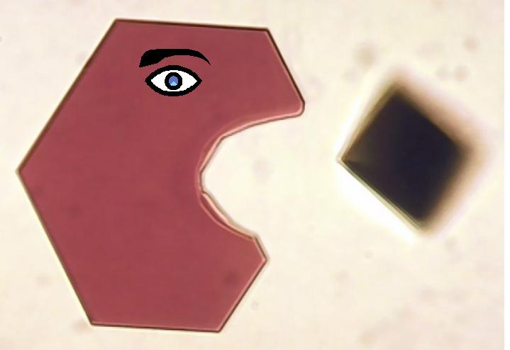

Slide 18
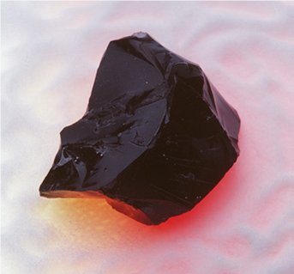
Questions?

Slide 19
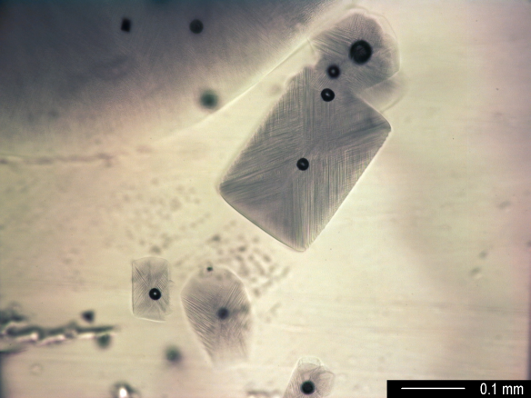
Backup Information

Slide 20
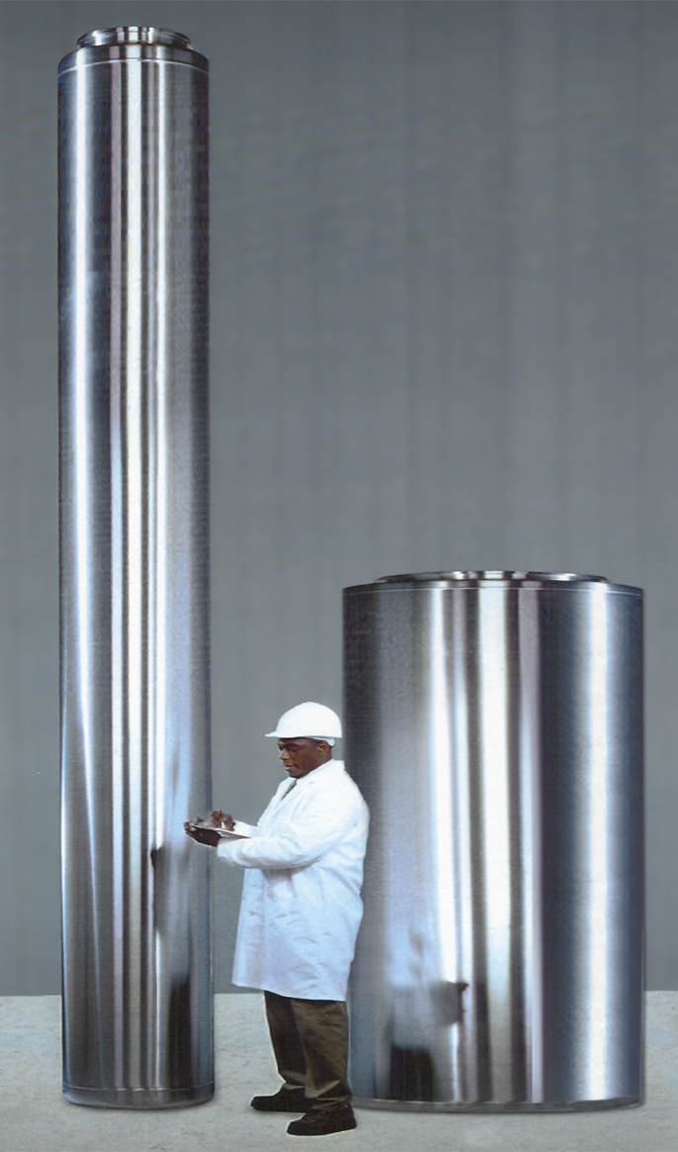
How is the Vitrified Waste Dispositioned?
High-Level Waste Canisters
2’ x 14.75’ (0.61 x 4.5 m)
6,600 pounds of glass
600 canisters to be produced/year
Temporarily stored at Hanford until National Repository opened
Low-Activity Waste Containers
4’ x 7.5’ (1.22 x 2.286 m)
13,000 pounds of glass
1,300 containers to be produced/year
Disposed on Hanford Site

Slide 21
Table TS-7.1 Low-Activity Waste Chemical Composition, Soluble Fraction Only
Maximum Ratio, analyte (mole) to sodium (mole)
Chemical Analyte | Envelope A | Envelope B | Envelope C³
Al | 2.5E-01 | 2.5E-01 | 2.5E-01
Ba | 1.0E-04 | 1.0E-04 | 1.0E-04
Ca | 4.0E-02 | 4.0E-02 | 4.0E-02
Cd | 4.0E-03 | 4.0E-03 | 4.0E-03
Cl | 3.7E-02 | 8.9E-02 | 3.7E-02
Cr | 6.9E-03 | 2.0E-02 | 6.9E-03
F | 9.1E-02 | 2.0E-01 | 9.1E-02
Fe | 1.0E-02 | 1.0E-02 | 1.0E-02
Hg | 1.4E-05 | 1.4E-05 | 1.4E-05
K | 1.8E-01 | 1.8E-01 | 1.8E-01
La | 8.3E-05 | 8.3E-05 | 8.3E-05
Ni | 3.0E-03 | 3.0E-03 | 3.0E-03
NO₂ | 3.8E-01 | 3.8E-01 | 3.8E-01
NO₃ | 8.0E-01 | 8.0E-01 | 8.0E-01
Pb | 6.8E-04 | 6.8E-04 | 6.8E-04
PO₄ | 3.8E-02 | 1.3E-01 | 3.8E-02
SO₄ | 1.0E-02 | 7.0E-02 | 2.0E-02
TIC¹ | 3.0E-01 | 3.0E-01 | 3.0E-01
TOC² | 5.0E-01 | 5.0E-01 | 5.0E-01
U | 1.2E-03 | 1.2E-03 | 1.2E-03
Notes: 1. Mole of inorganic carbon atoms/mole sodium. 2. Mole of organic carbon atoms/mole sodium. 3. Envelope C LAW is limited to complexed tank wastes from Hanford tanks AN-102 and AN-107.

Slide 22
Table TS-7.2 Low-Activity Waste Radionuclide Content, Soluble Fraction Only Maximum Ratio, radionuclide to sodium (mole)
Radionuclide | Envelope A |  | Envelope B |  | Envelope C
 | Bq | uCi | Bq | uCi | Bq | uCi
TRU | 4.80E+05 | 1.30E+01 | 4.80E+05 | 1.30E+01 | 3.00E+06 | 8.11E+01
¹³⁷Cs | 4.30E+09 | 1.16E+05 | 2.00E+10 | 5.41E+05 | 4.30E+09 | 1.16E+05
⁹⁰SR | 4.40E+07 | 1.19E+03 | 4.40E+07 | 1.19E+03 | 8.00E+08 | 2.16E+04
⁹⁹Tc | 7.10E+06 | 1.92E+02 | 7.10E+06 | 1.92E+02 | 7.10E+06 | 1.92E+02
⁶⁰Co | 6.10E+04 | 1.65E+00 | 6.10E+04 | 1.65E+00 | 3.70E+05 | 1.00E+01
¹⁵⁴Eu | 6.00E+05 | 1.62E+01 | 6.00E+05 | 1.62E+01 | 4.30E+06 | 1.16E+02
Notes:
1.The activity limit shall apply to the feed certification date.
2. TRU is defined as: Alpha-emitting radionuclides with an atomic number greater than 92 with half-life greater than 20 years.
Some radionuclides, such as ⁹⁰Sr and ¹³⁷Cs, have daughters with relatively short half-lives. These daughters have not been listed in this table. However, they are present in concentrations associated with the normal decay chains of the radionuclides.
1Bq = 2.703 e-5 uCi

