Slide 1
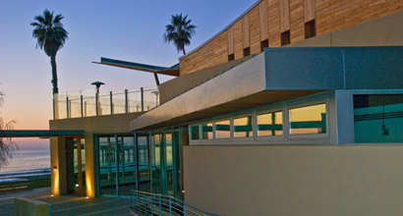
Welcome
2010 NASA Terrestrial Ecology Science Team Meeting

Slide 2
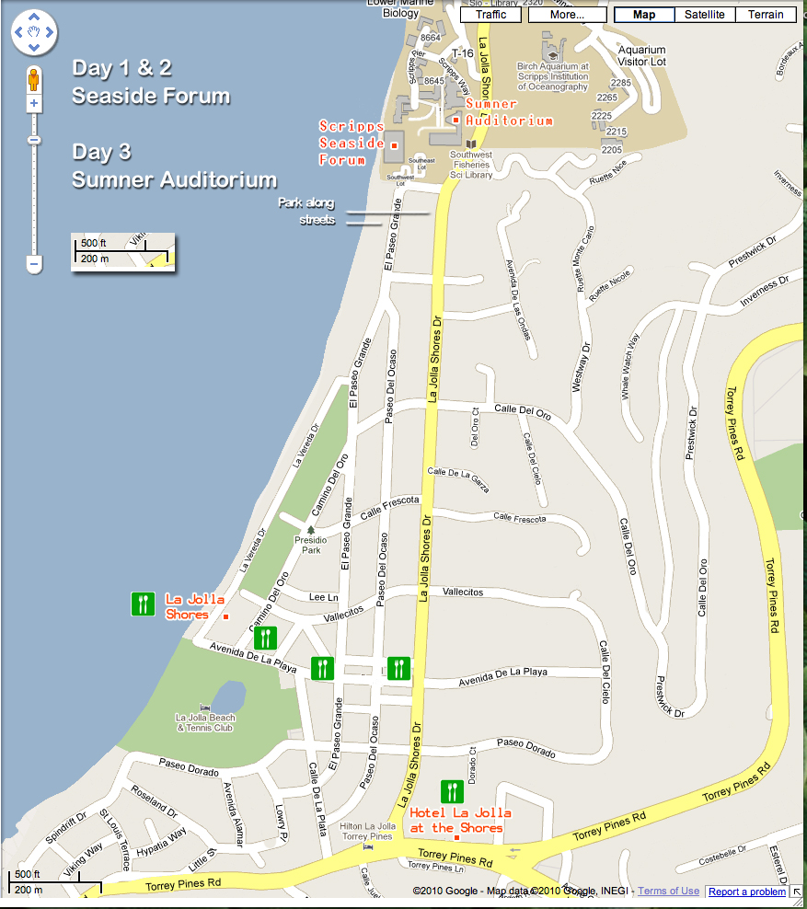
Map of Area

Slide 3
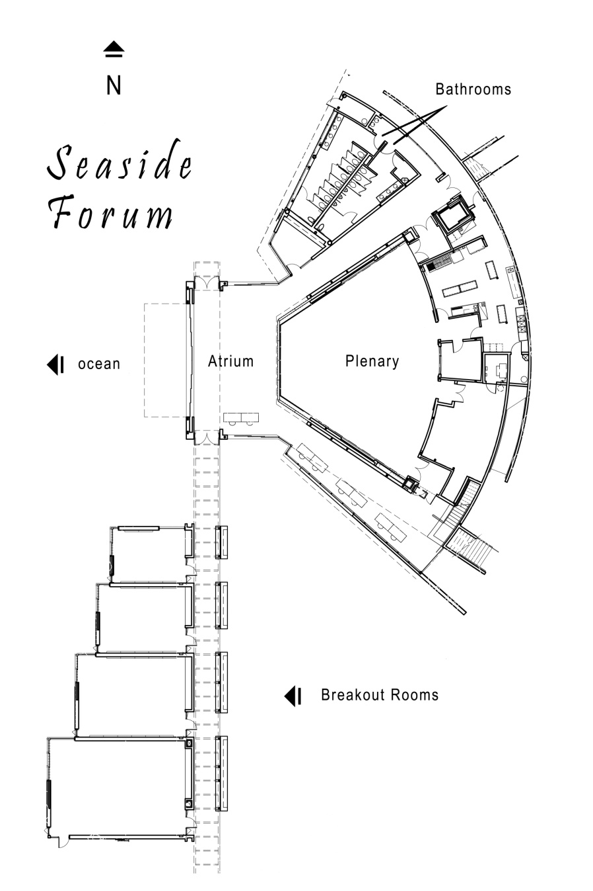
Scripps Seaside Forum Layout

Slide 4
Monday AM Science: Terrestrial Ecology and Global Change
Plenary - Seaside Forum Auditorium
8:30 AM Welcome - logistics - (Peter Griffith) (10 min)
8:40 AM NASA Earth Science view from HQ (Michael Freilich) (20 min)
9:00 AM Report on Outcomes of 2009 United Nations Climate Change Conference
(Josef Kellndorfer) (30 min)
9:30 AM Why did Scripps go to Copenhagen? (Tony Haymet) (30 min)
10:00 AM Terrestrial Ecology Program Update (Diane Wickland) (30 min)
10:30 AM Break
11:00 AM Terrestrial Ecosystems Research Synthesis (Scott Ollinger) (30 min)
11:30 AM Poster Session I and Lunch

Slide 5
Monday PM Science: Terrestrial Ecology and Global Change
Plenary - Seaside Forum Auditorium
1:00 PM Carbon Cycle Research Synthesis (Anna Michalak) (30 min)
1:30 PM North American Carbon Program Synthesis (Ken Davis) (30 min)
2:00 PM US Carbon Cycle Science and IPCC AR5 (Michael Prather) (30 min)
2:30 PM Panel Discussion+ Audience Q/A: Opportunities for Terrestrial Ecology
Research in a Changing World (How do we align the Program in response
to national and international scientific priorities?)
3:00 PM Charge to Breakouts
3:15 PM Break
3:30 PM Breakout Session I - Terrestrial Ecology Research Opportunities,
Priorities, and Challenges
5:00 PM Poster Session I and Welcome Reception
7:00 PM Adjourn for the day

Slide 6
Breakout Session I (Monday) Terrestrial Ecology Research Opportunities, Priorities, & Challenges How can the NASA Terrestrial Ecology Program address national and international scientific priorities?
3:30 PM Rooms assigned at Charge to Breakouts
1. Terrestrial Ecosystem Research Chair: Phil Townsend
2. Carbon Cycle Research Chair: Steven Wofsy
3. Modeling Chair: Kevin Schaefer
4. Scientific Applications of New Satellite Data Products Chair: John Kimball
5. Support for Scientific Assessments Chair: Stephen Ogle

Slide 7
Tuesday AM Approach: Implementation of NASA Terrestrial Ecology Program
Plenary - Seaside Forum Auditorium
8:30 AM Breakout Session I Reports
9:00 AM Overview and discussion of Decadal Survey Missions relevant to Terrestrial
Ecology Program *OCO-2, SMAP, ICESat-2 + DESDynI, HyspIRI, ASCENDS (Mike Gunson, Kyle McDonald, Amy Neuenschwander, Ralph Dubayah, Simon
Hook, Randy Kawa) (60 min.)
10:00 AM Overview & Discussion: Ongoing and Continuity Missions relevant to Terrestrial
Ecology Program *EOS, EO-1, LDCM, NPP/NPOESS (Jon Ranson) (30 min)
10:30 AM Break
10:50 AM Overview & Discussion: Airborne & Suborbital Venture Class Mission
*AVIRIS, UAVSAR, LVIS, MAS, MASTER, New developments under stimulus
program (Tony Freeman) (40 min)
11:30 AM Data Products and Data Systems *CDRs, LTDRs, Critical Variables, and DAACs
(Jeff Masek) (30 min)
12:00 PM Poster Session II and Lunch

Slide 8
Tuesday PM Approach: Implementation of NASA Terrestrial Ecology Program
Plenary - Seaside Forum Auditorium
1:30 PM Opportunities for Terrestrial Ecology Field Campaigns
ABoVE (Eric Kasischke), Global Savannas (Niall Hanan), Future Satellite Missions (Forrest Hall)
2:15 PM Observation Networks and Collaboration Opportunities
(Michael Keller) (30 min)
2:45 PM Panel Discussion + Q&A: Issues and Opportunities for Terrestrial Ecology
Research (How can the Terrestrial Ecology Program make better use of its observational
assets and support infrastructure? What opportunities are out there for new science?)
3:10 PM Charge to Breakouts II
3:15 PM Break
3:30 PM Breakout Session II
5:00 PM Poster Session II
7:00 PM Adjourn for the day

Slide 9
Breakout Session II (Tuesday)
3:30 PM Rooms assigned at Charge to Breakouts
1. TE Science for Venture Class Missions Chair: Ralph Dubayah
2. Effective Use of Airborne Remote Sensing Chair: Dar Roberts
3. Data Needs, Products, Distribution, and Stewardship Chair: Bob Cook
4. Observation Networks and Collaboration Opportunities Chair: Joanne Nightingale

Slide 10
Wednesday AM Next Steps & New Directions for Terrestrial Ecology Program
Plenary - Sumner Auditorium
8:30 AM Is Biodiversity Doomed by Climate Change? (Brendan Mackey) (45 min)
9:15 AM Synthesis: New Directions for NASA Terrestrial Ecology Research
(includes terrestrial ecosystems and carbon cycle research)
(Compton Tucker) (45 min)
10:00 AM Break
10:15 AM Breakout Session II Reports
10:35 AM Panel Discussion (led by 'designated listeners') and Open Mic, Breakouts I & II 'Reports to Actions‘ (Nancy French, Doug Morton,
James Randerson, Erika Podest)
11:00 AM Feedback from HQ
12:00 PM Adjourn

