Slide 1
CBRFC February 2011 Water Supply Webinar
1pm, February 7, 2011
Kevin Werner
These slides: www.cbrfc.noaa.gov/present/present.php

Slide 2
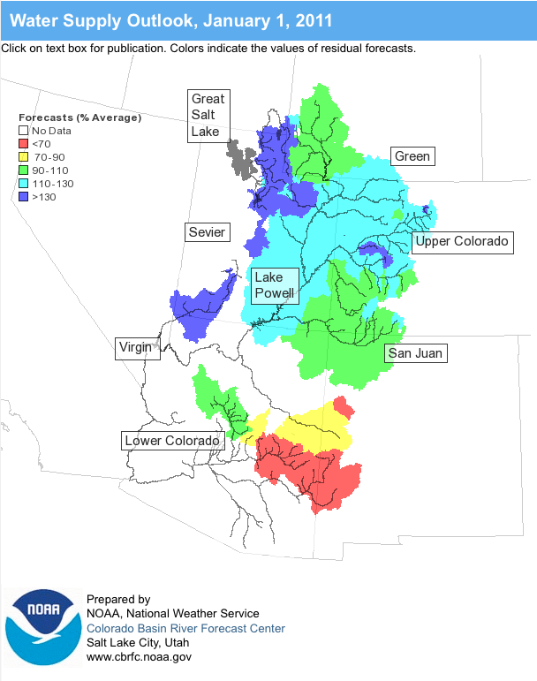
Outline
January Weather Review
Snow States
Water Supply Forecasts
Web Reference: www.cbrfc.noaa.gov/wsup/pub2/map/html/cbrfc.1.2011.html

Slide 3
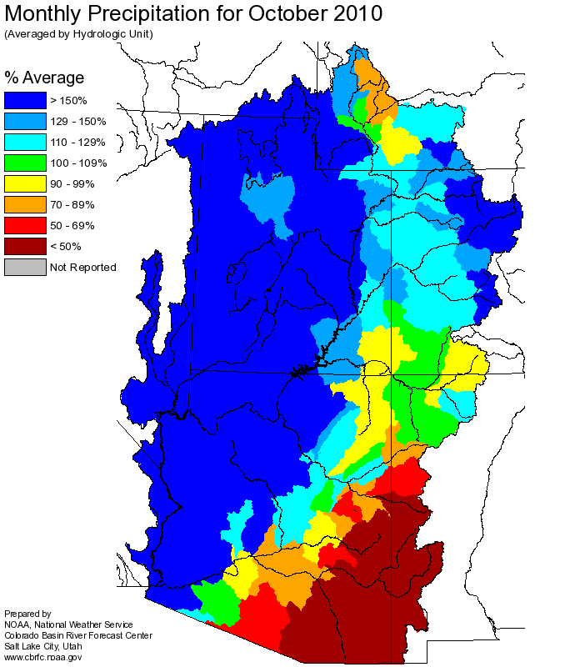
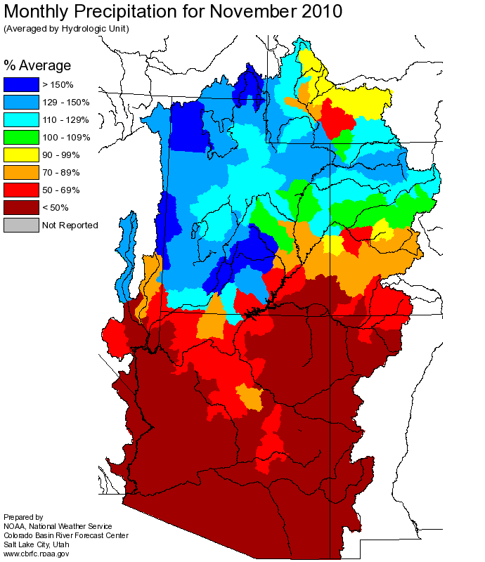
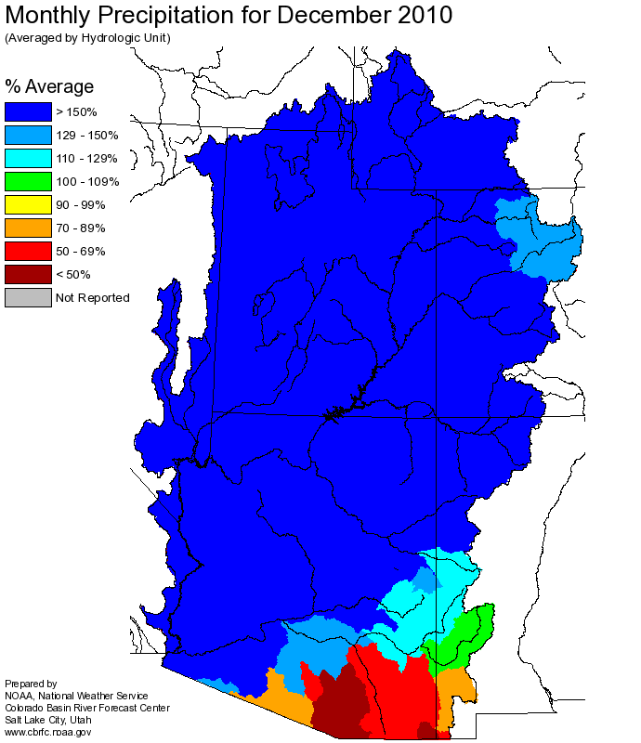
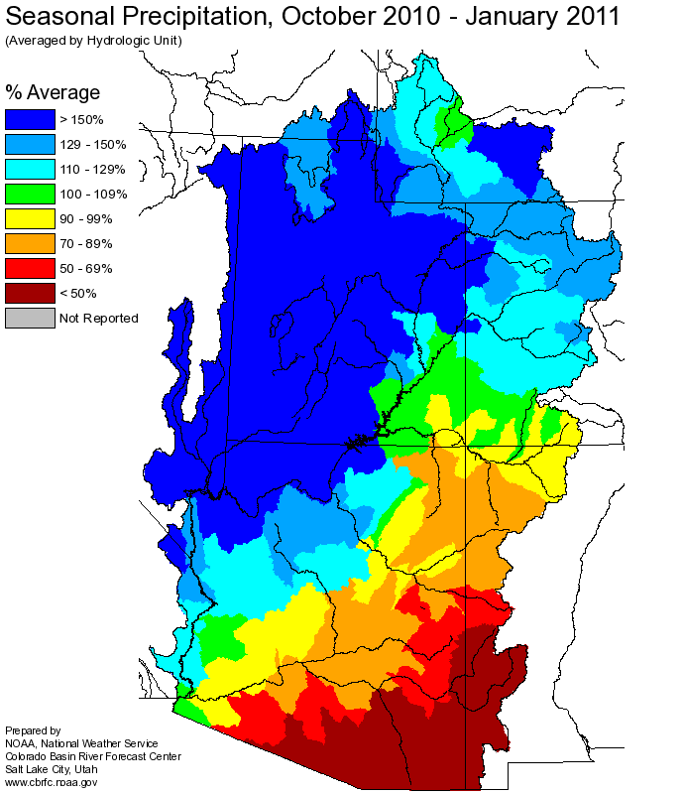
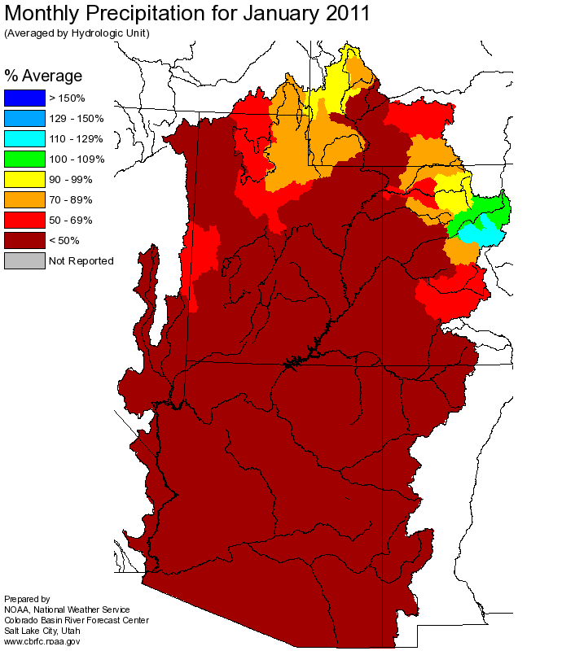
Web Reference: http://www.cbrfc.noaa.gov

Slide 4
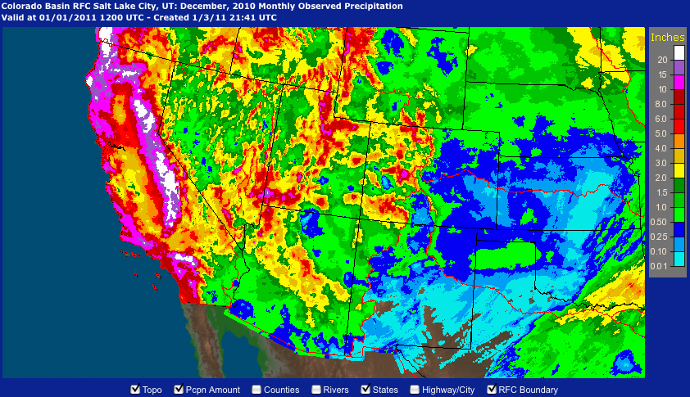
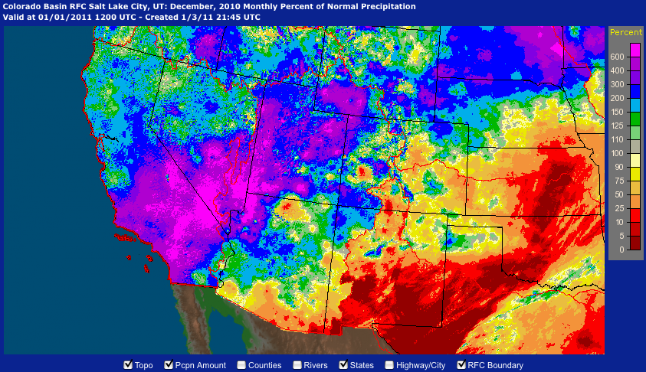

Slide 5
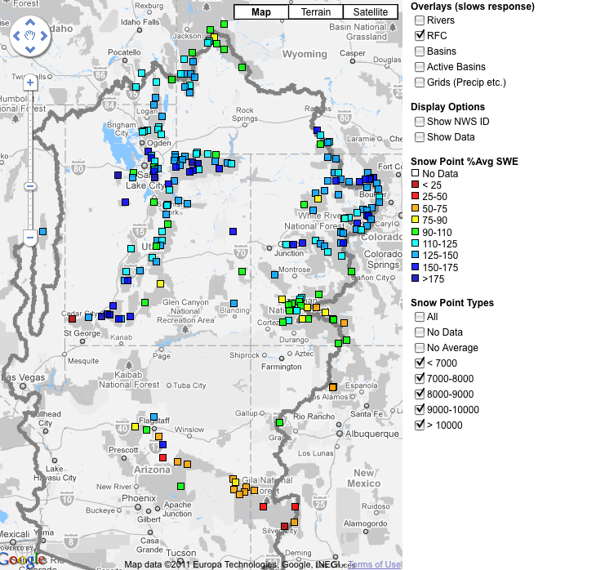
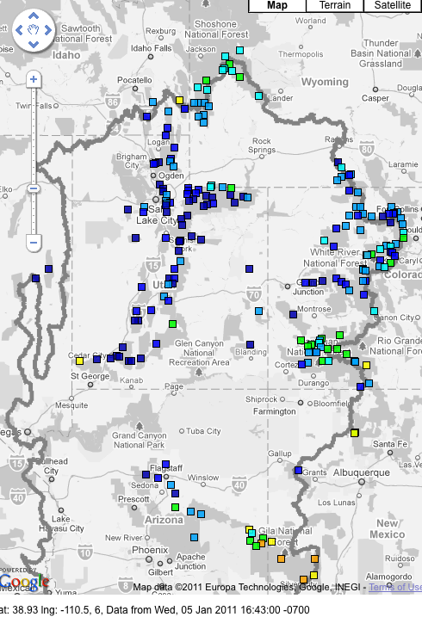
Snow
January 6 (above)
February 7 (right)
Web Reference: http://www.cbrfc.noaa.gov/gmap/gmapm.php?scon=checked

Slide 6
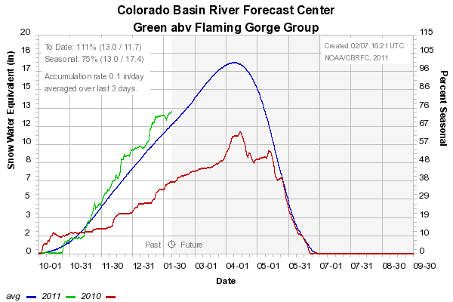
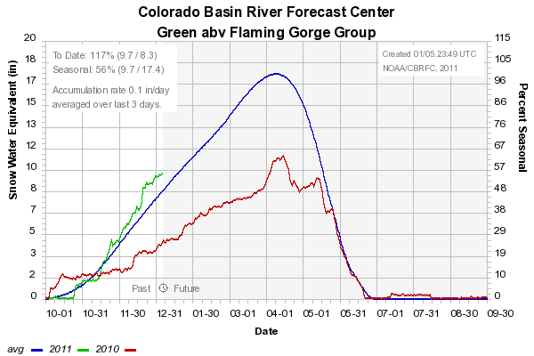
Snow: Upper Green Basin (above Flaming Gorge)
Web Reference: http://www.cbrfc.noaa.gov/station/sweplot/sweplot.cgi???open

Slide 7
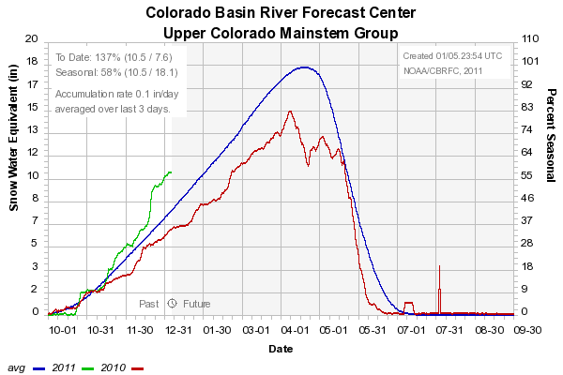
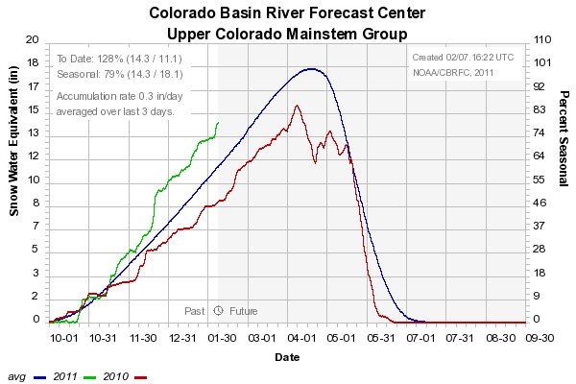
Snow: Colorado Mainstem (above Cameo)
Web Reference: http://www.cbrfc.noaa.gov/station/sweplot/sweplot.cgi???open

Slide 8
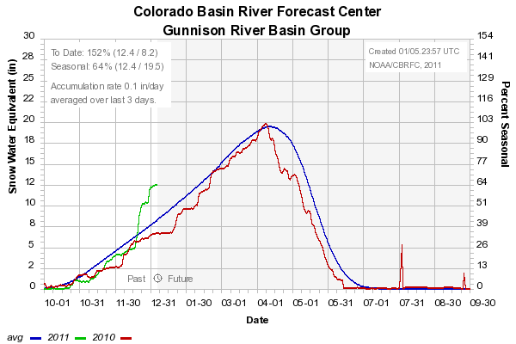
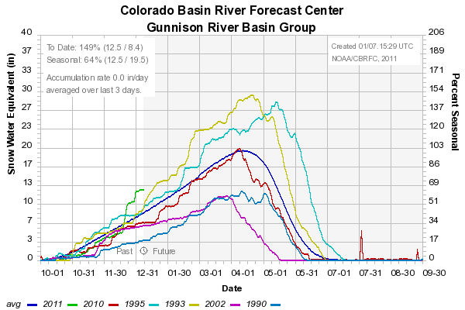
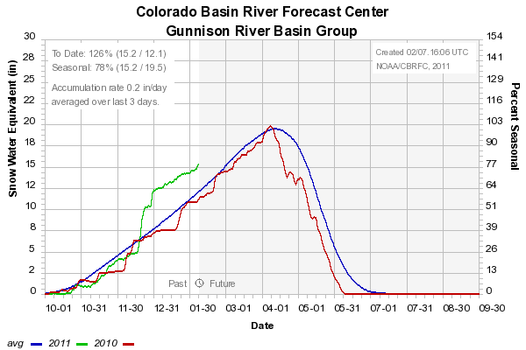
Snow: Gunnison Basin
Web Reference: http://www.cbrfc.noaa.gov/station/sweplot/sweplot.cgi???open

Slide 9
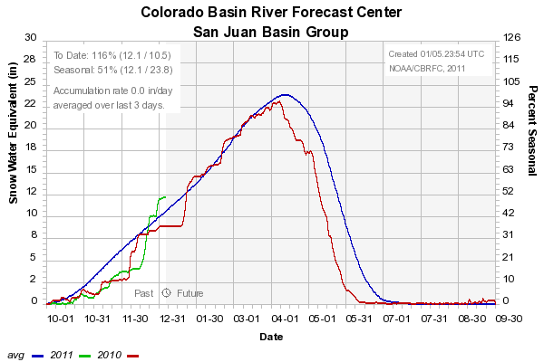

Snow: San Juan Basin
Web Reference: http://www.cbrfc.noaa.gov/station/sweplot/sweplot.cgi???open

Slide 10
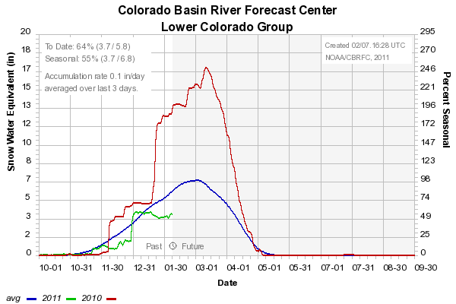
Snow: Lower Colorado
Web Reference: http://www.cbrfc.noaa.gov/station/sweplot/sweplot.cgi???open

Slide 11
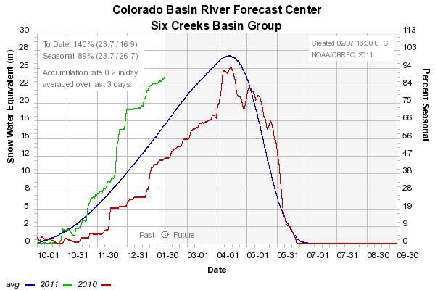
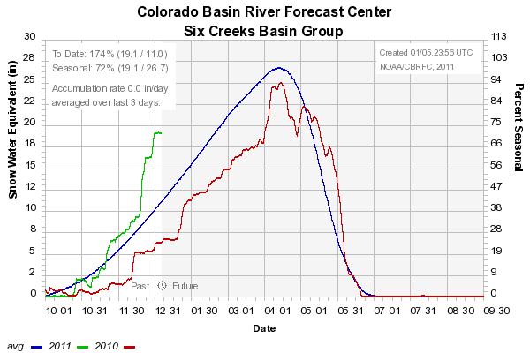
Snow: Six Creeks in Salt Lake County
Web Reference: http://www.cbrfc.noaa.gov/station/sweplot/sweplot.cgi???open

Slide 12
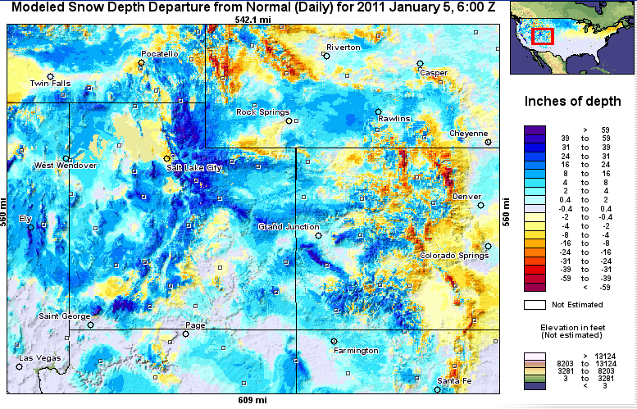
Snow Maps
Web Reference: http://www.nohrsc.nws.gov

Slide 13
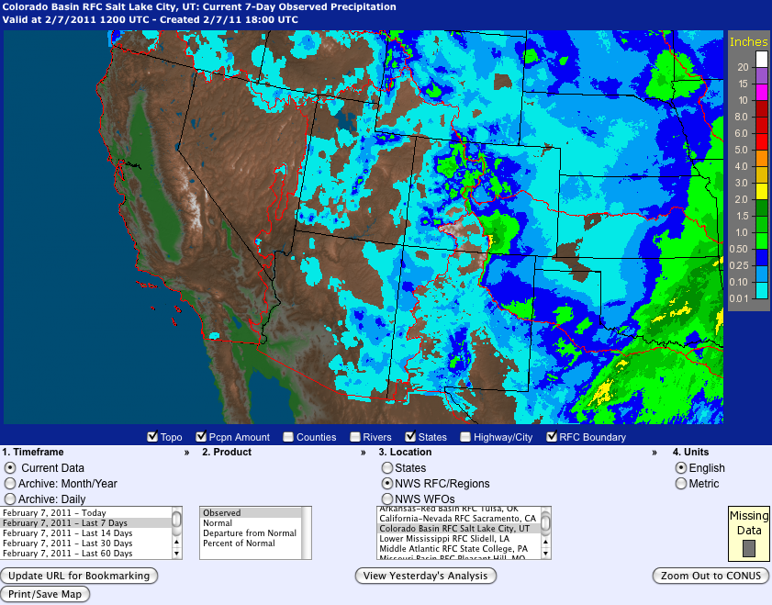
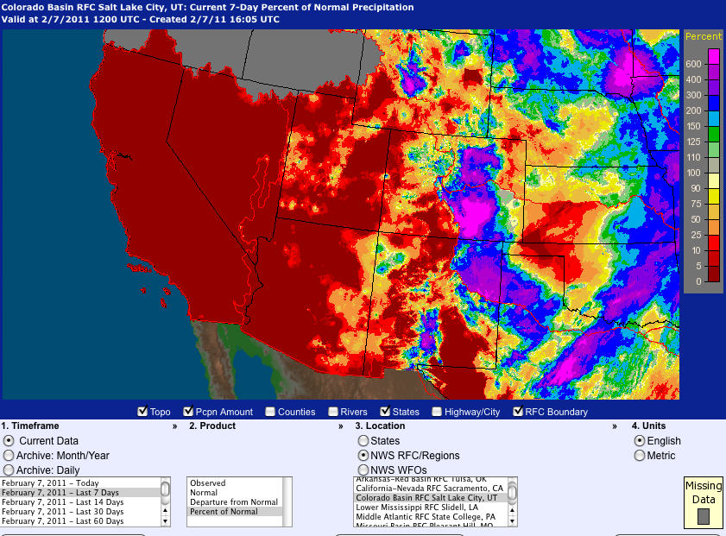
Last 7 days…
Web Reference: http://water.weather.gov

Slide 14
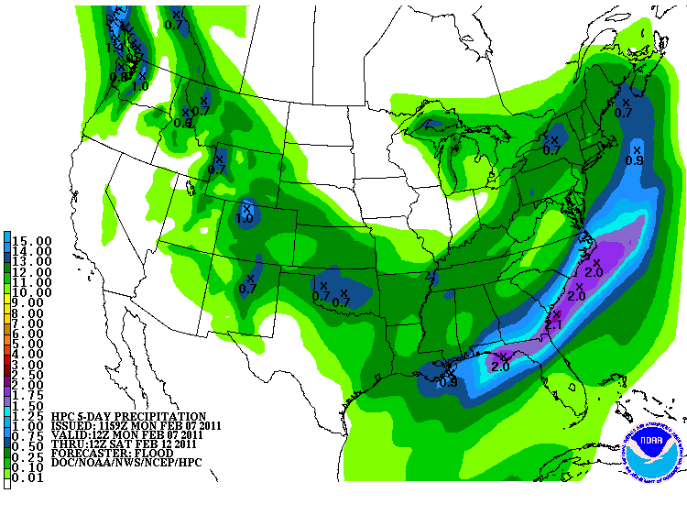
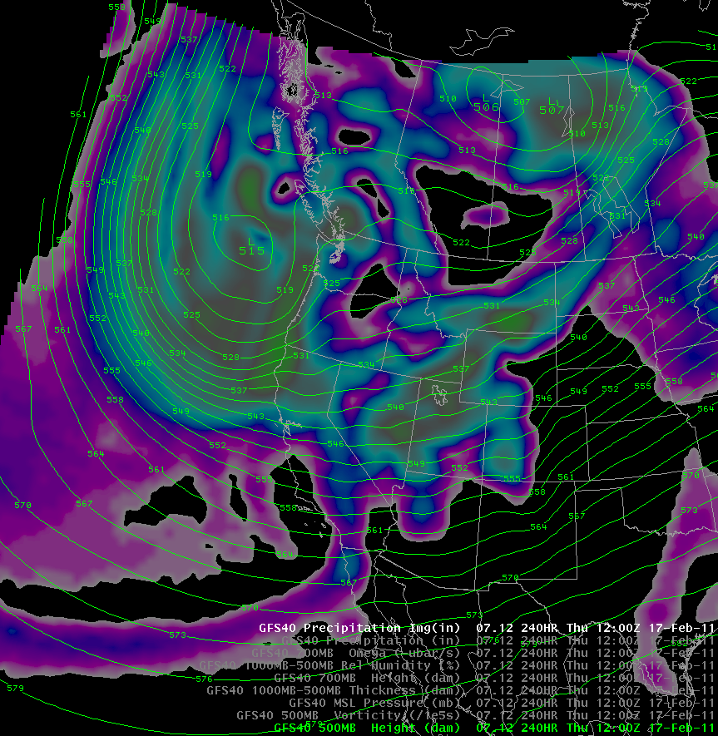
Forecast Precipitation
One storm Mon/Tues/Wed (max SWE ~1”)
Second small storm early next week (max SWE ~1/2”)
Third, more major, but uncertain, storm late next week
Web Reference: www.hpc.noaa.gov

Slide 15
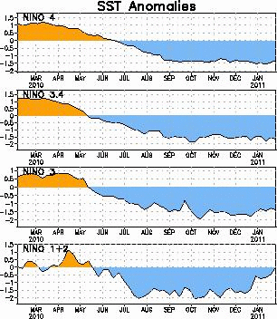
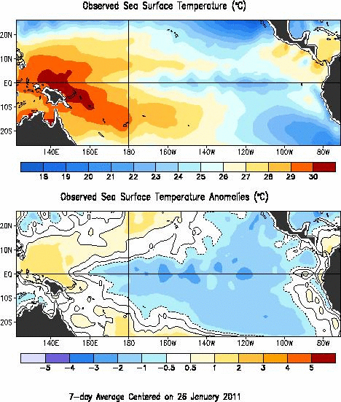
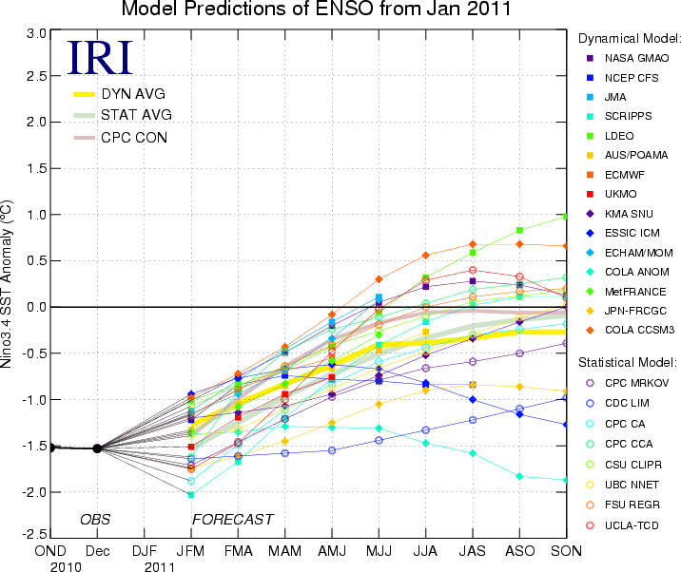
La Nina Update
Web Reference: http://www.cpc.noaa.gov and iri.columbia.edu/climate/ENSO

Slide 16
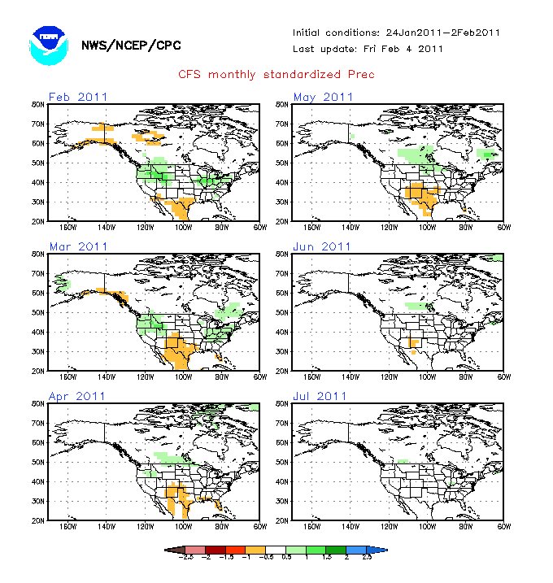
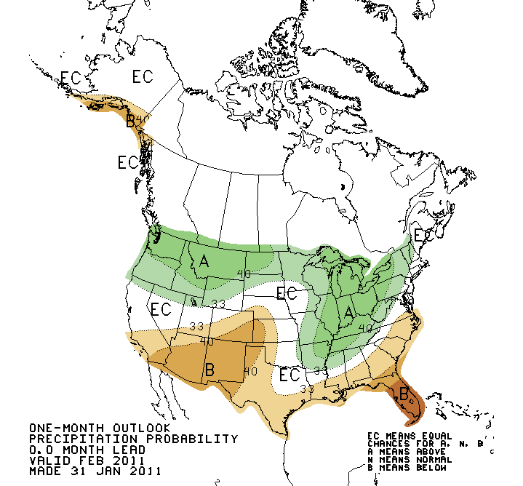
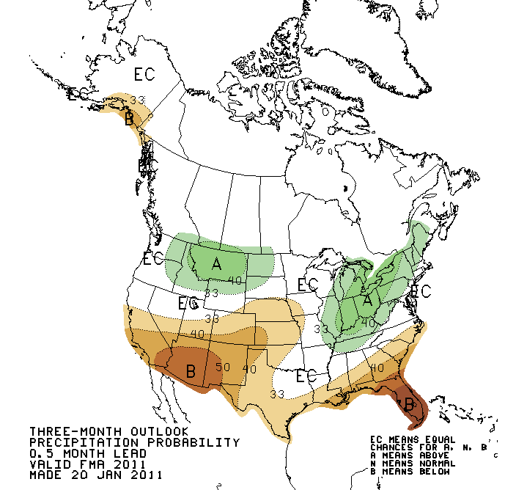
Web Reference: http://www.cbrfc.noaa.gov/climate/climoForecasts.cgi

Slide 17
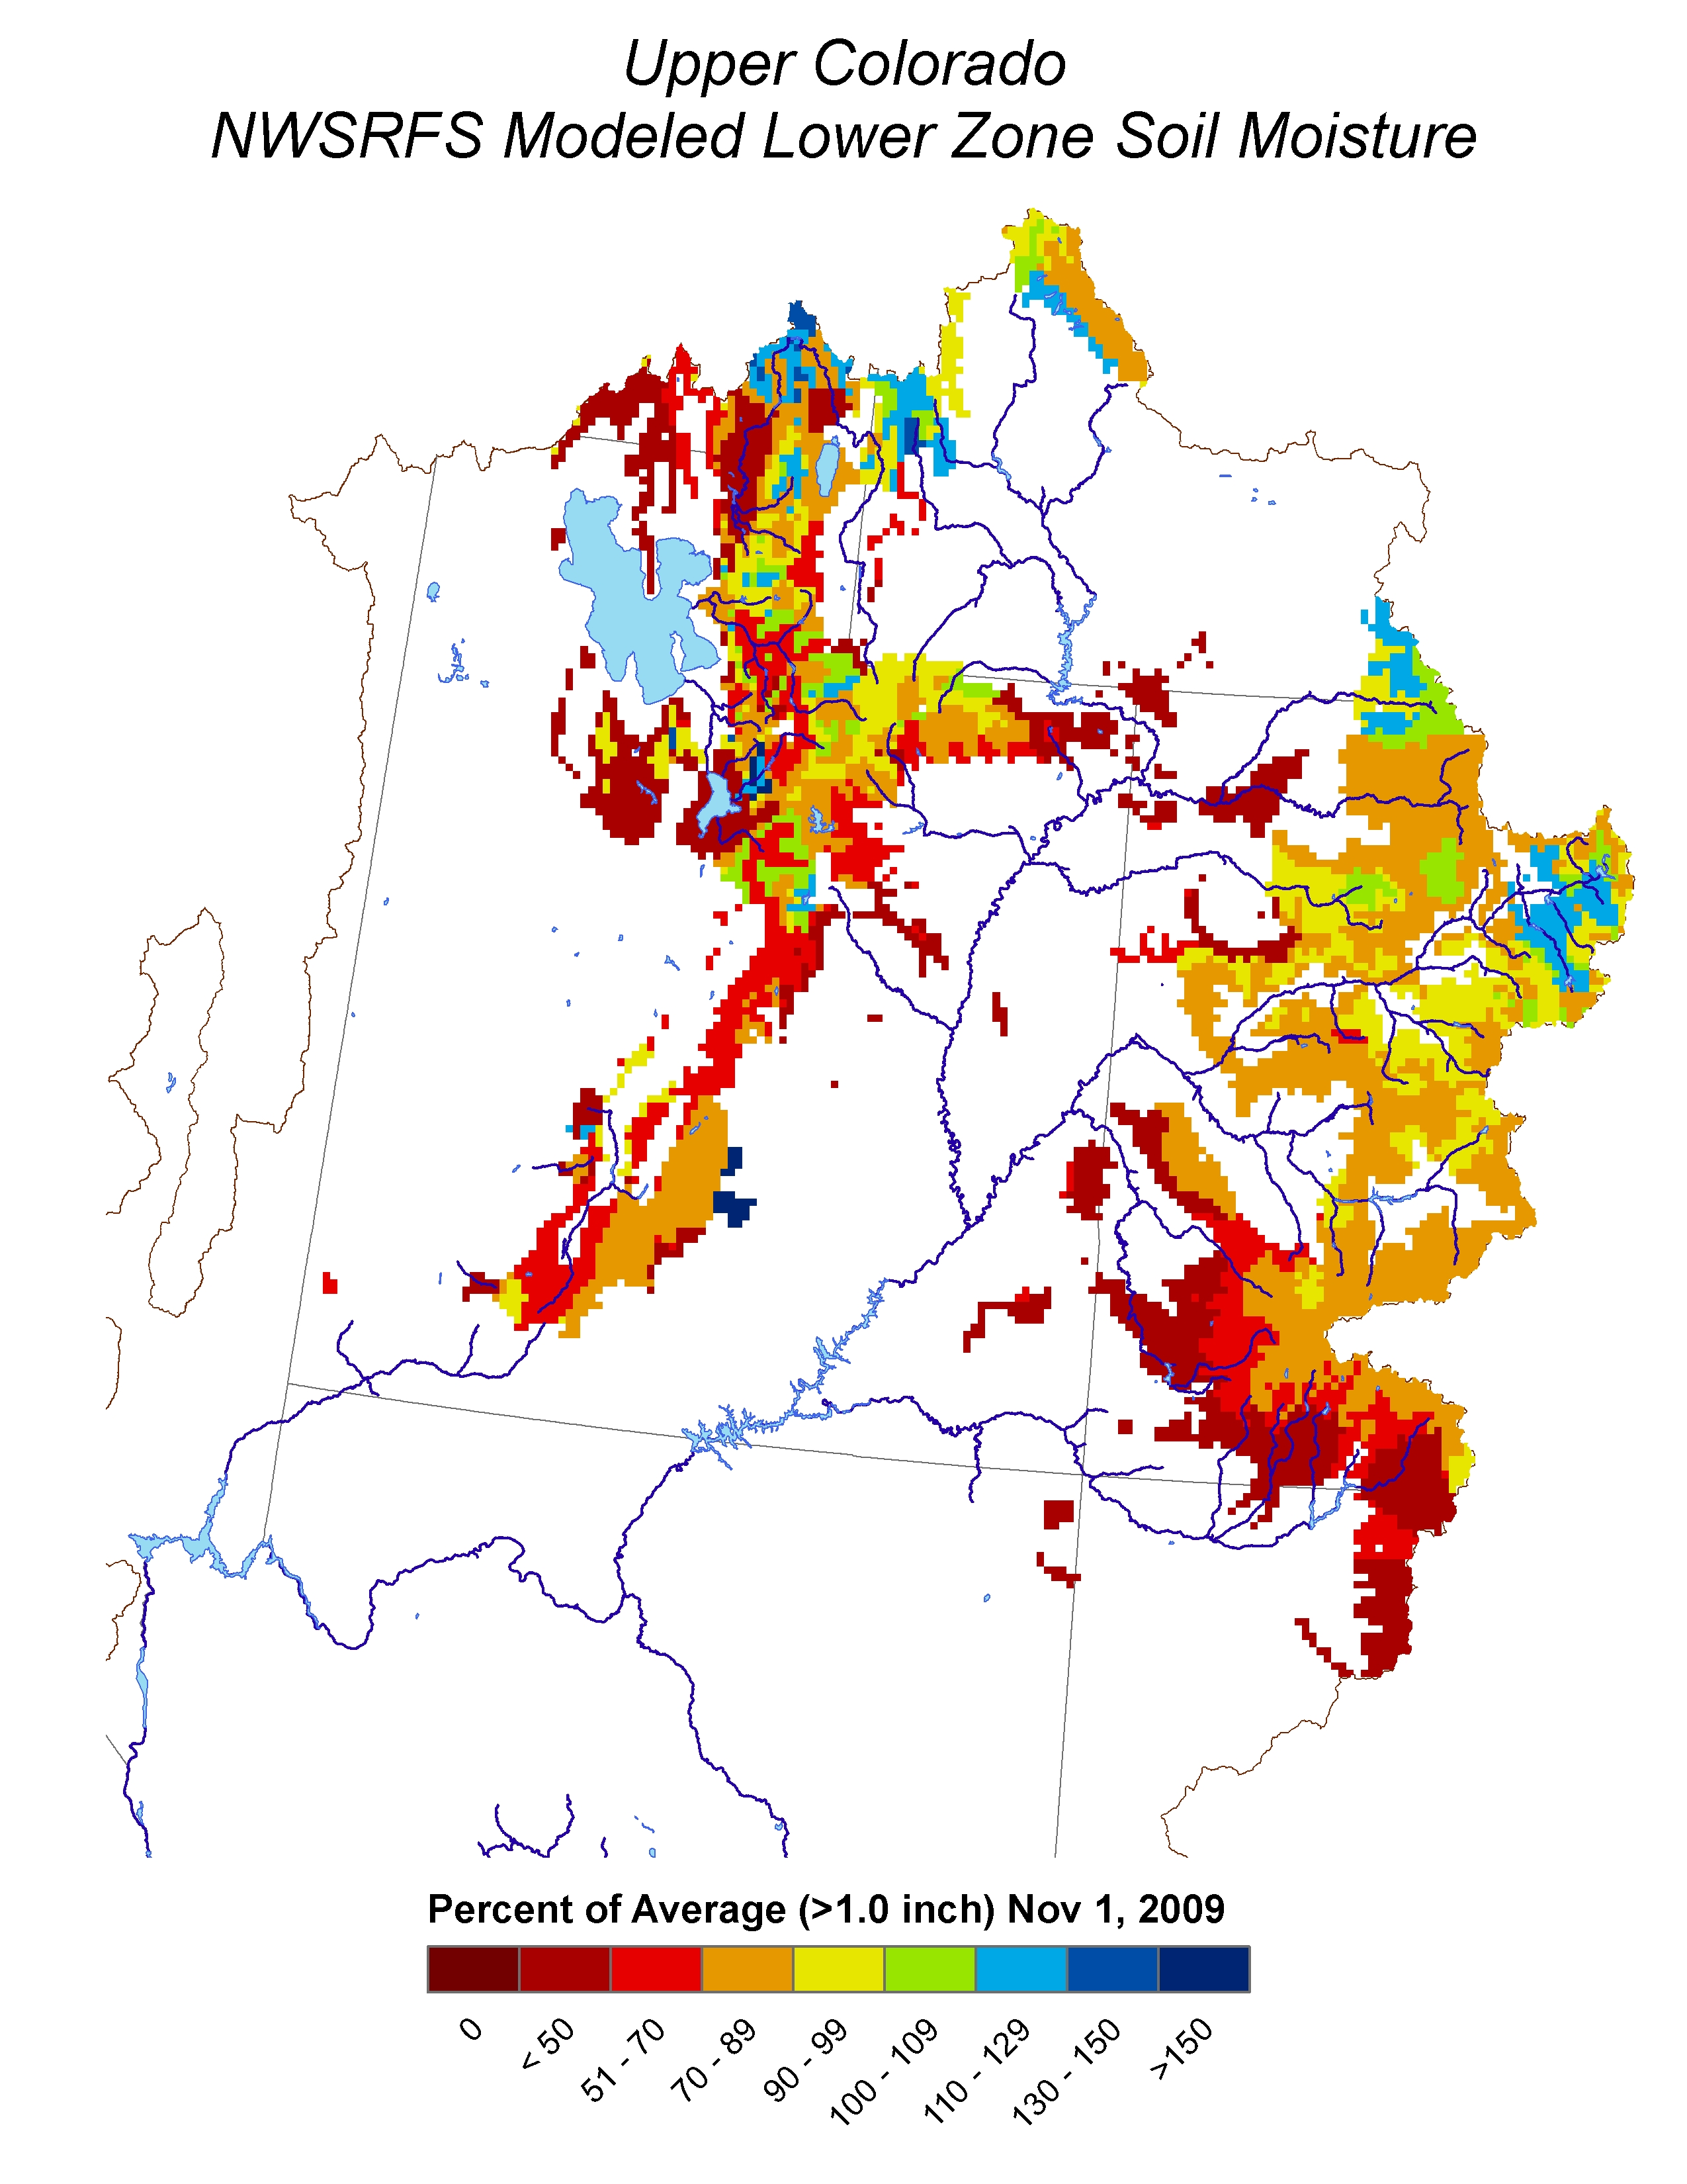
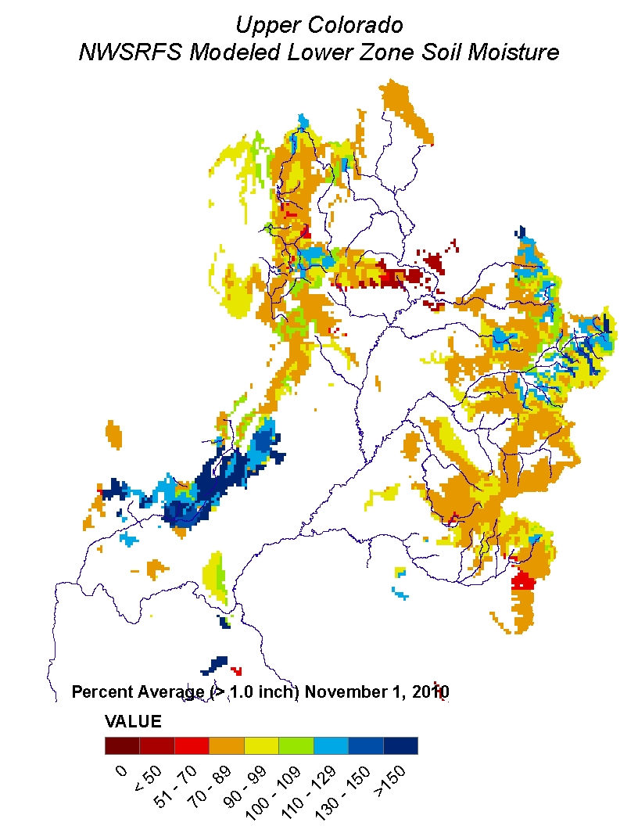
Soil Moisture

Slide 18
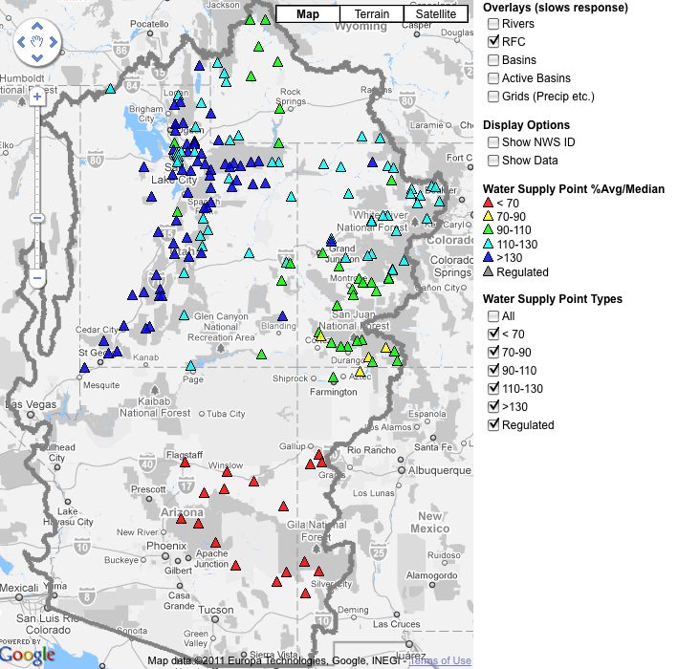
February 1, 2011
Water Supply Forecasts
Highlights:
Forecasts generally lower than Jan 1 forecasts
Upper Colorado forecasts are little changed
San Juan and lower basin forecasts are much lower
Great Basin and Upper Colorado forecasts still mostly above average values
Lower basin quite dry (except Virgin)
Web Reference: www.cbrfc.noaa.gov/gmap/gmapm.php?wcon=checked

Slide 19
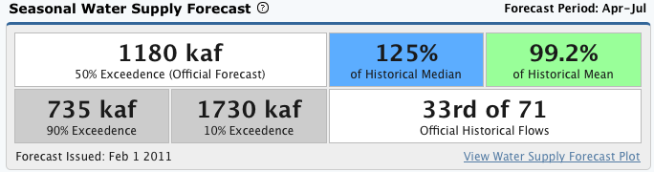
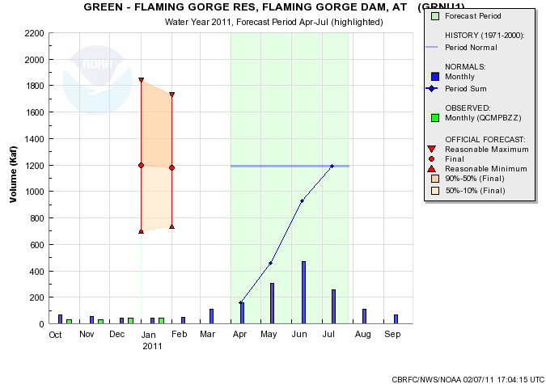
Web Reference: www.cbrfc.noaa.gov/gmap/gmapm.php?wcon=checked

Slide 20
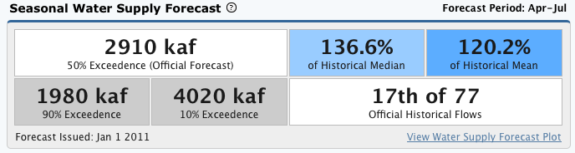
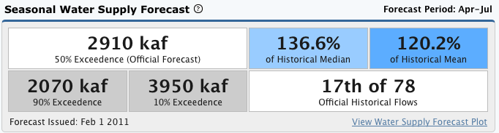
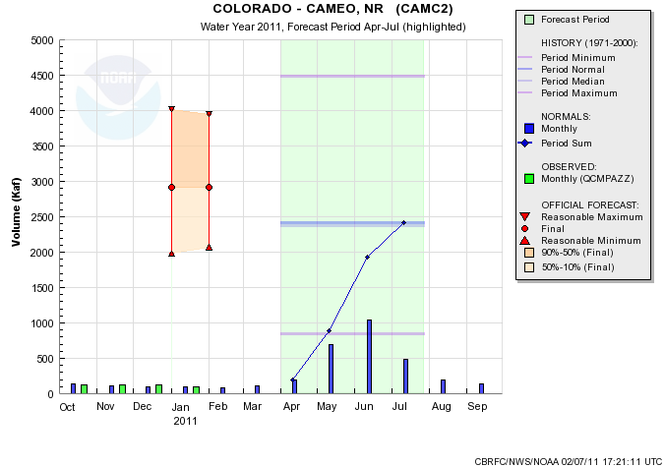
Web Reference: www.cbrfc.noaa.gov/gmap/gmapm.php?wcon=checked

Slide 21
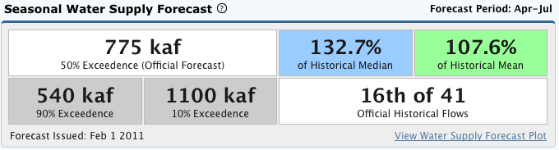
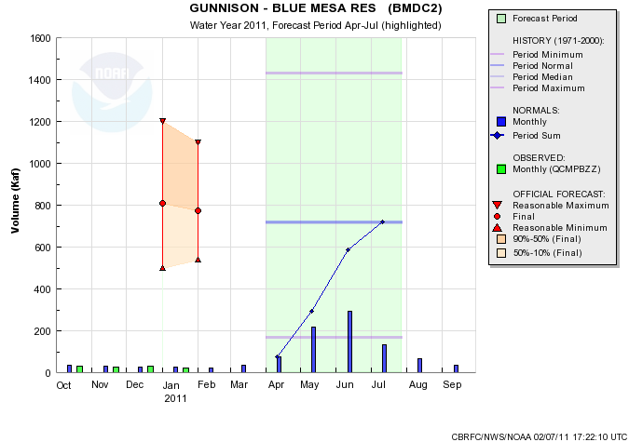
Web Reference: www.cbrfc.noaa.gov/gmap/gmapm.php?wcon=checked

Slide 22
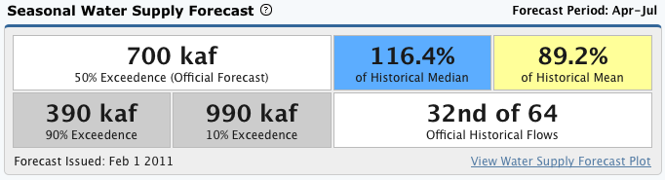
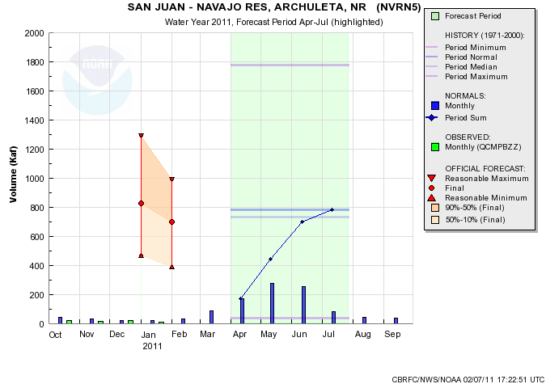
Web Reference: www.cbrfc.noaa.gov/gmap/gmapm.php?wcon=checked

Slide 23
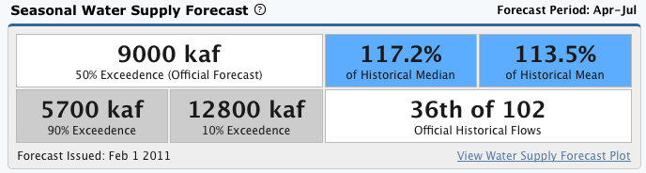
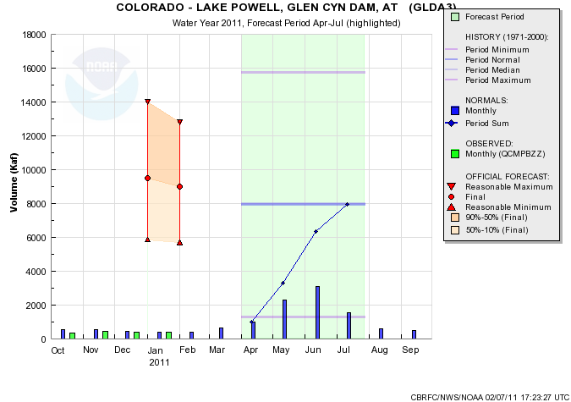
Example ESP guidance:
Official Forecast: 120%
ESP with QPF: 125%
ESP no QPF: 131%
ESP with GFS/CFS: 125%
ESP with GFS: 131%
Web Reference: www.cbrfc.noaa.gov/gmap/gmapm.php?wcon=checked

Slide 25
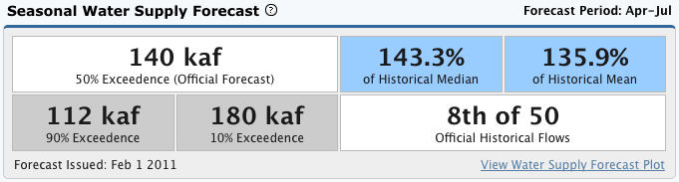
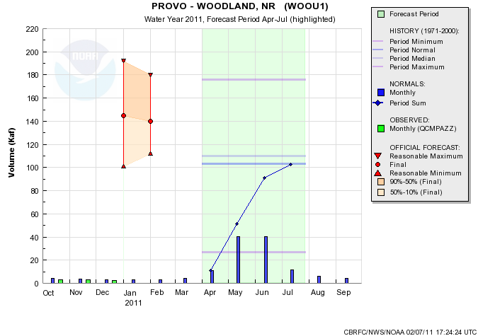
Web Reference: www.cbrfc.noaa.gov/gmap/gmapm.php?wcon=checked

Slide 26
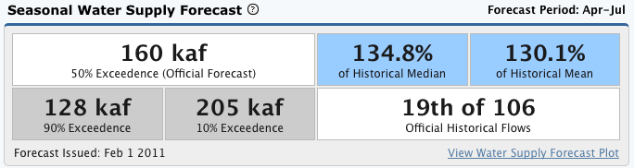
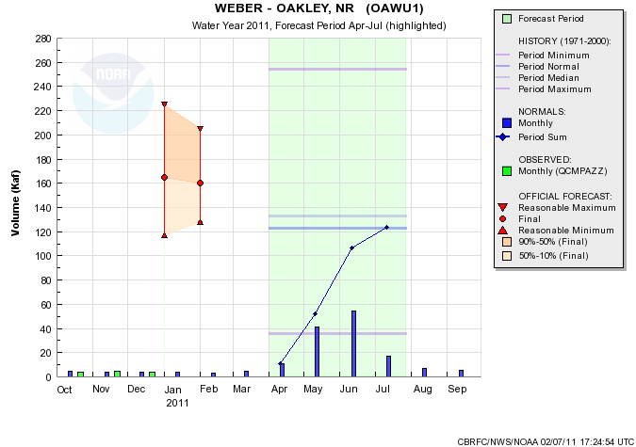
Web Reference: www.cbrfc.noaa.gov/gmap/gmapm.php?wcon=checked

Slide 27



Web Reference: www.cbrfc.noaa.gov/gmap/gmapm.php?wcon=checked

Slide 28


Web Reference: www.cbrfc.noaa.gov/gmap/gmapm.php?wcon=checked

Slide 29
Online Publication
Web Reference: www.cbrfc.noaa.gov/wsup/pub2/map/html/cpub.php

Slide 30


Web Reference: www.cbrfc.noaa.gov/wsup/pub2/map/html/cpub.php

Slide 31

CBRFC News
Basin Focal Points (Available to discuss forecasts: 801.524.5130)
Upper Colorado: Brenda Alcorn
Green: Ashley Nielson
San Juan / Gunnison: Tracy Cox
Great Basin: Brent Bernard
Lower Colorado (below Lake Powell): Greg Smith
Here now:
Sign up for all webinars through May 2011
Weekly ESP model guidance
Email product updates via govdelivery (can add more products / webpages upon request)
Changes to CBRFC webpage
Blog (blog.citizen.apps.gov/cbrfc)
Coming soon:
New water supply publication – will share next month

Slide 32
More Resources
www.cbrfc.noaa.gov
Wateroutlook.nwrfc.noaa.gov
Tentative March webinar: 1pm Mar 7

Slide 33


Feedback, Questions, Concerns always welcome….
Kevin Werner
CBRFC Service Coordination Hydrologist
Phone: 801.524.5130
Email: kevin.werner@noaa.gov

