Slide 1
Digital Coast: Facilitating Coastal Data Sharing and Collaboration
Joshua Murphy
NOAA Coastal Services Center
March 18, 2011

Slide 2
Digital Coast
Approach: Bring the geospatial and coastal management communities together
Outcome: A constituent-driven, integrated, enabling platform supporting coastal resource management

Slide 3
Addressing Geospatial Barriers
Coastal data
Data accessibility
Intergovernmental coordination
Techie and non-techie tools
Training
Case studies
Outreach and awareness

Slide 4
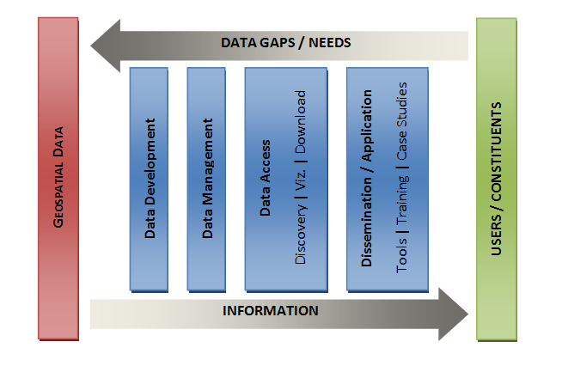
Supporting Data Stewardship
DIGITAL COAST

Slide 5








Digital Coast Partnership

Slide 6
Digital Coast Contributors
Mississippi State Coordinating Council on Remote Sensing and GIS
NOAA National Geodetic Survey
U.S. Army Corps of Engineers
U.S. Geological Survey
NASA/NOAA/USGS Airborne Lidar Assessment of Coastal Erosion (ALACE)
Federal Emergency Management Agency
National Geospatial-Intelligence Agency
U.S. Department of Agriculture
Northwest Florida Water Management District
Southwest Florida Water Management District
St Johns River Water Management District
Maryland Department of Natural Resources
Oregon Department of Geology and Mineral Resources
Texas Natural Resources Information System
Mississippi Department of Environmental Quality
Scripps Institute of Oceanography
University of Texas
Delaware Department of Natural Resources and Environmental Control
South Carolina Department of Natural Resources
Florida Division of Emergency Management
Minnesota Department of Natural Resources
Management Association for Private Photogrammetric Surveyors (MAPPS)

Slide 7
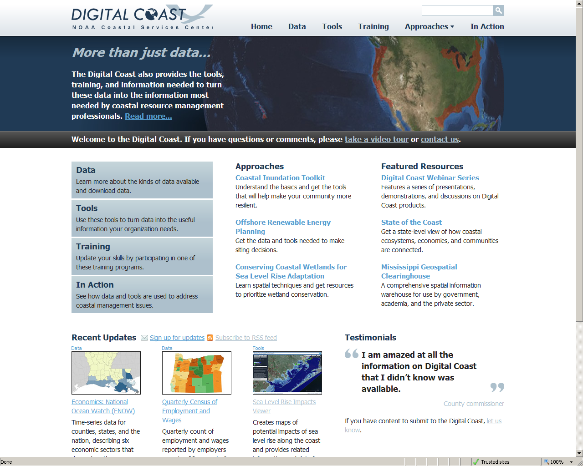
Notes:
Digital Coast Website
Provides effective and efficient access to coastal geospatial data, tools, training, and case studies
Facilitates linkages between elements to enhance utility and application
Provides opportunity to demonstrate role of geospatial information in decision-making

Slide 8
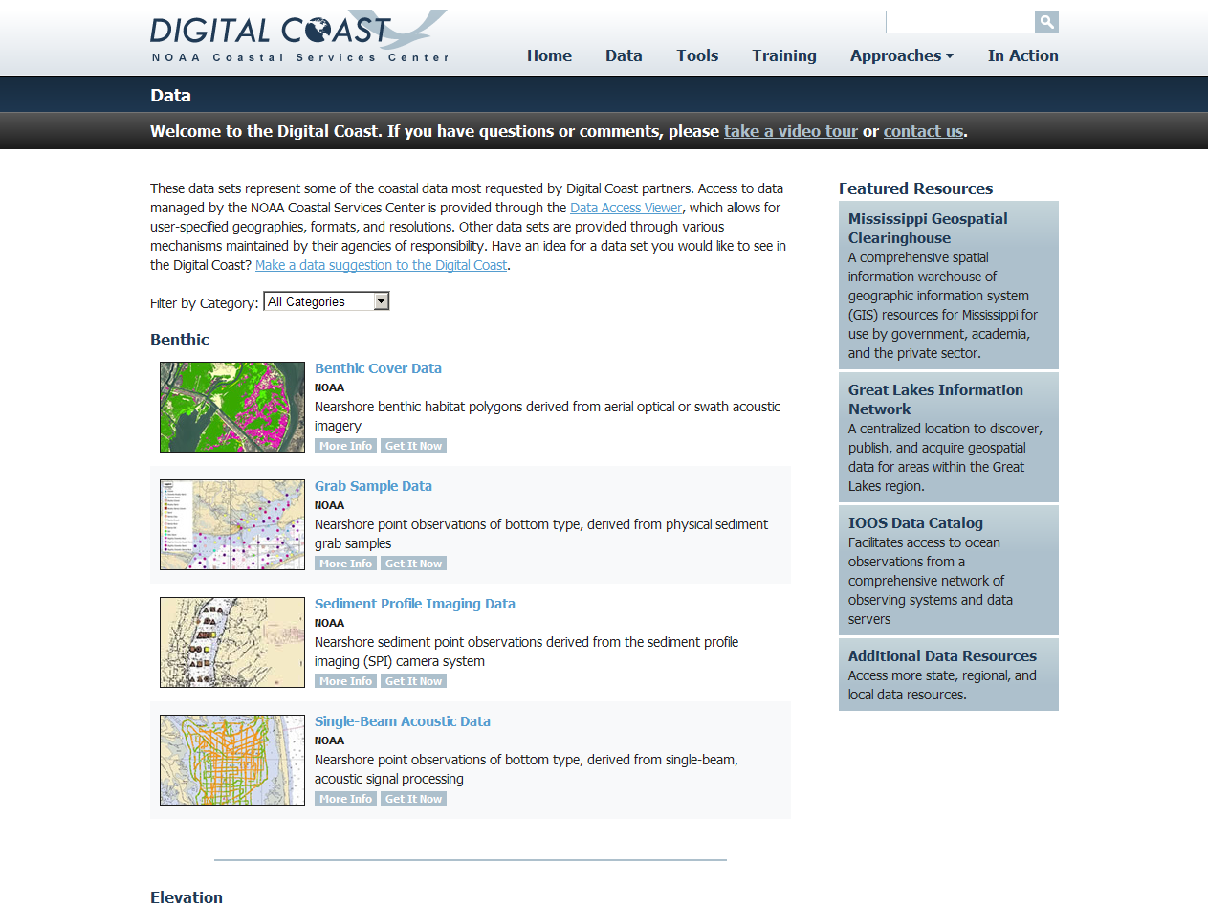

Slide 9
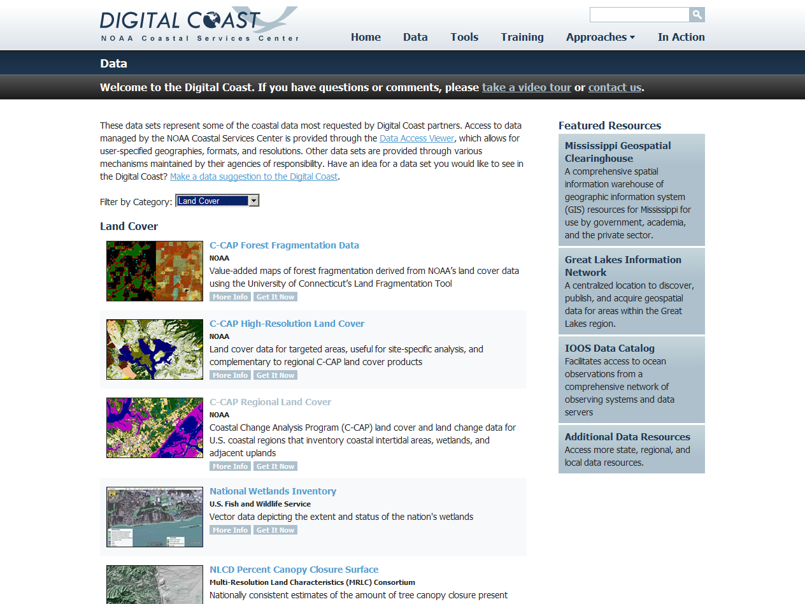

Slide 10
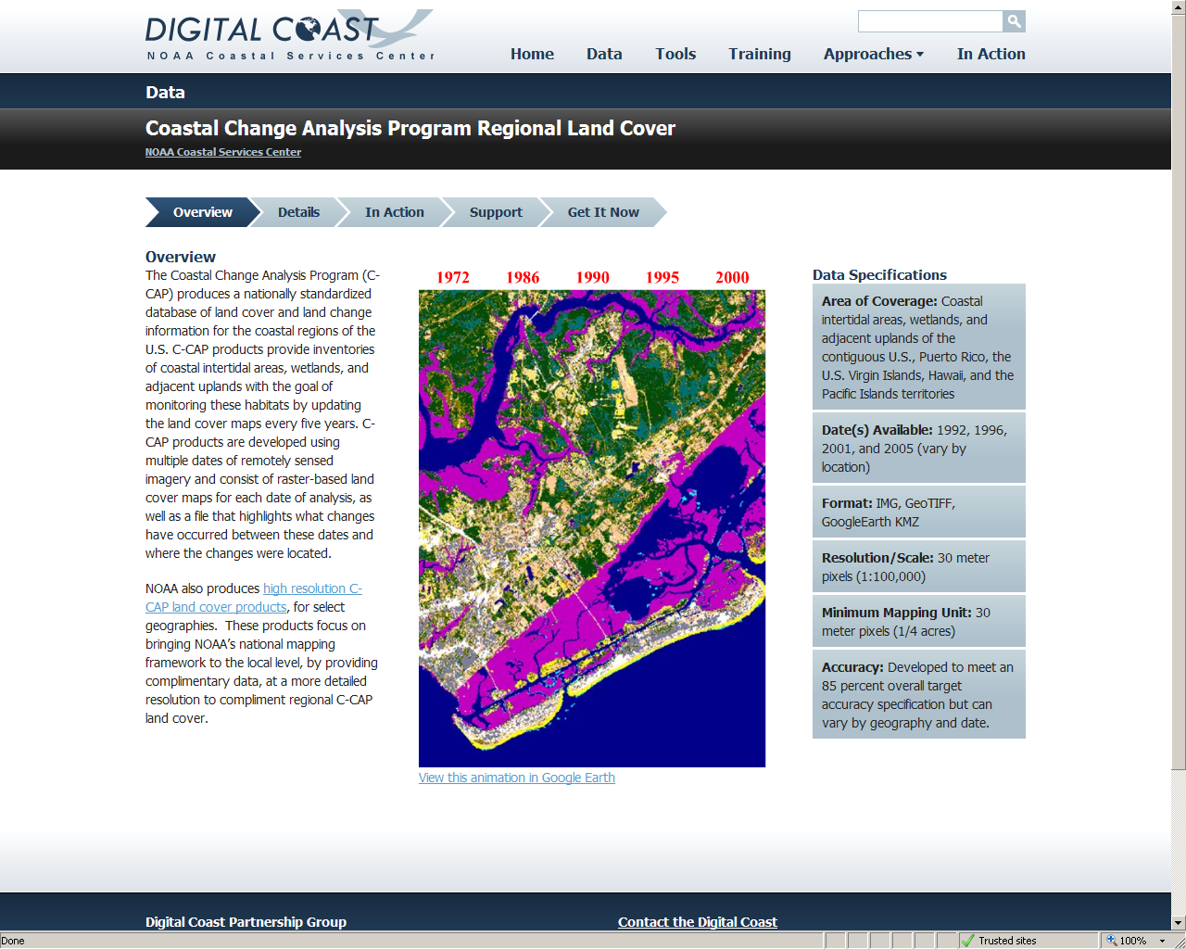

Slide 11
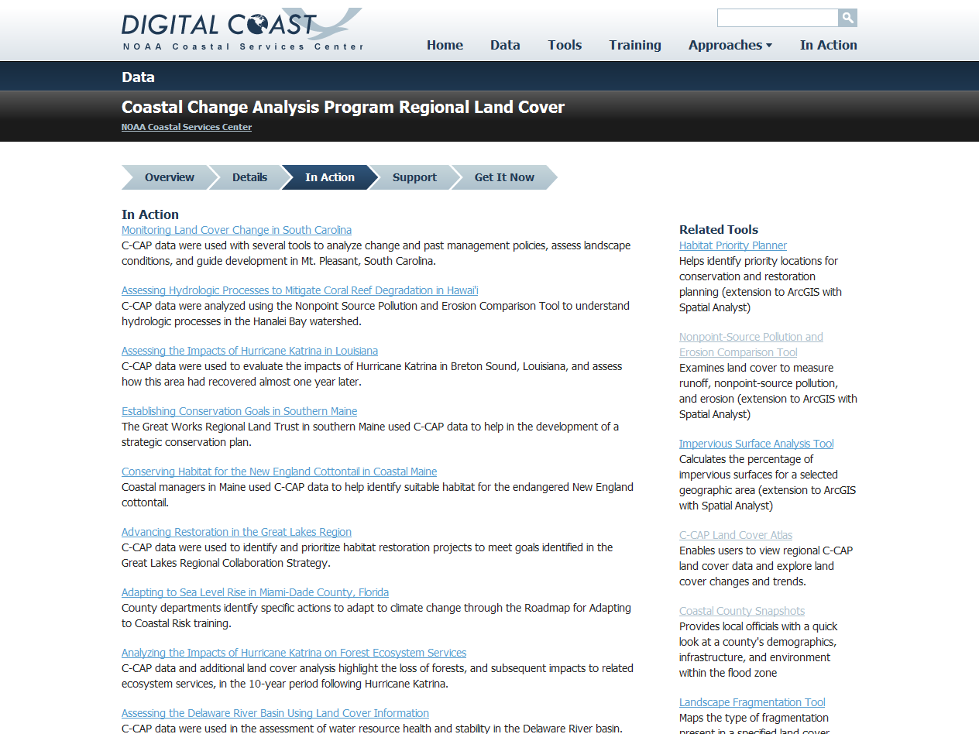

Slide 12
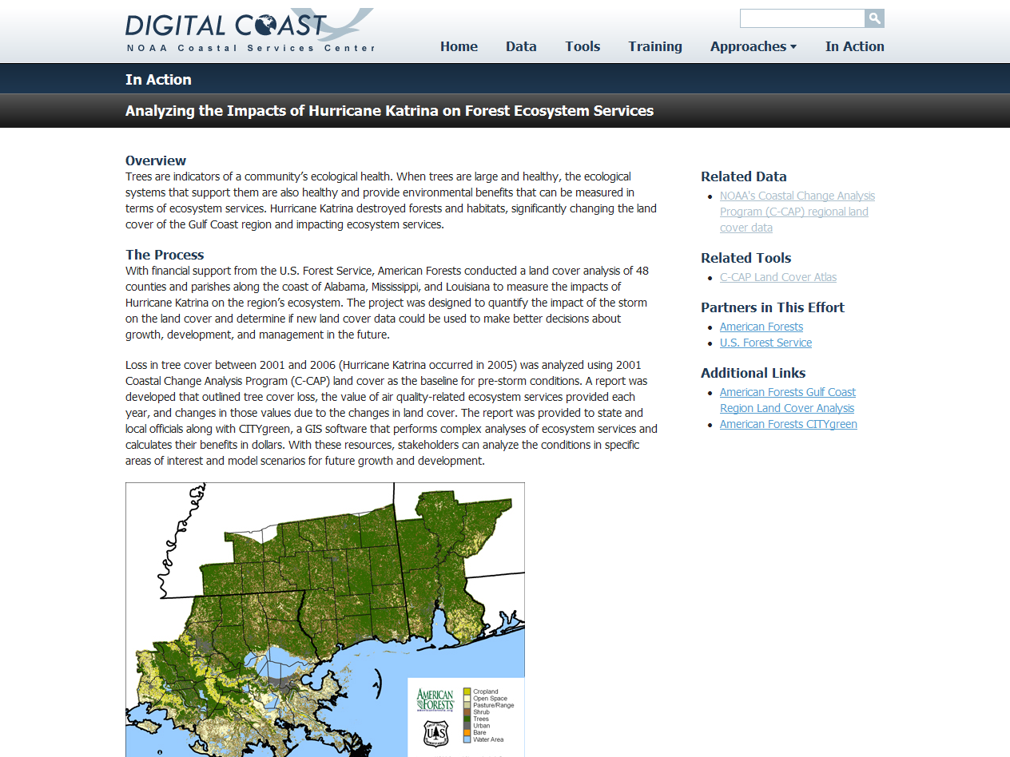

Slide 14
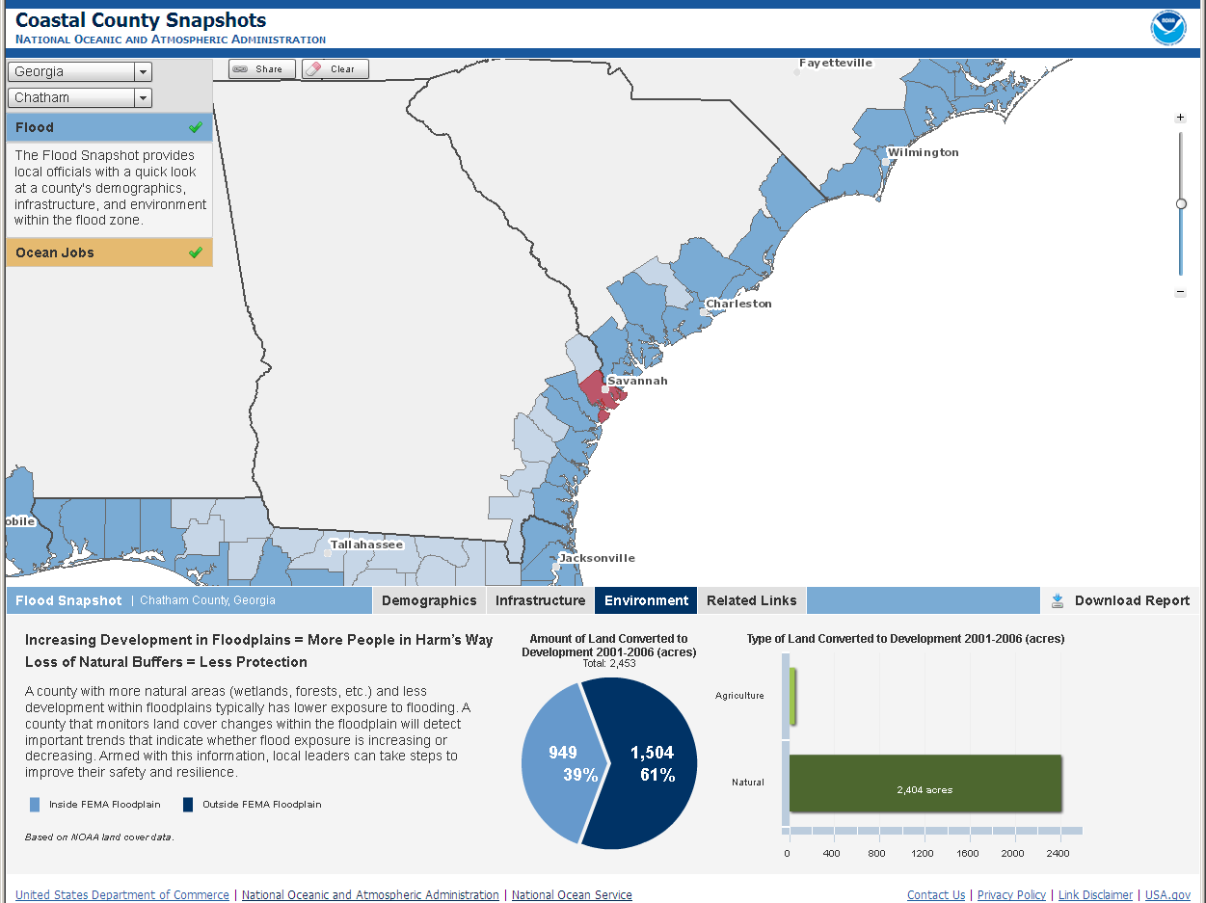

Slide 16
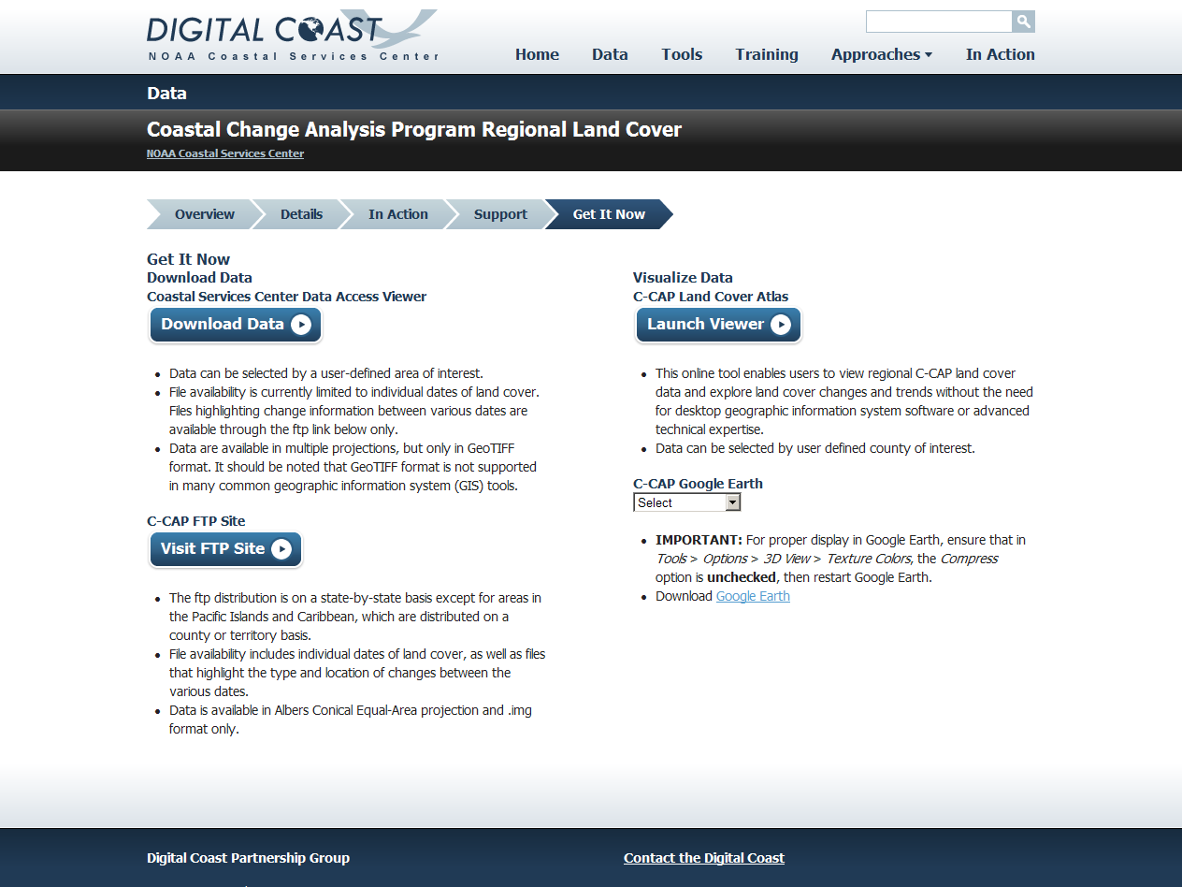

Slide 17
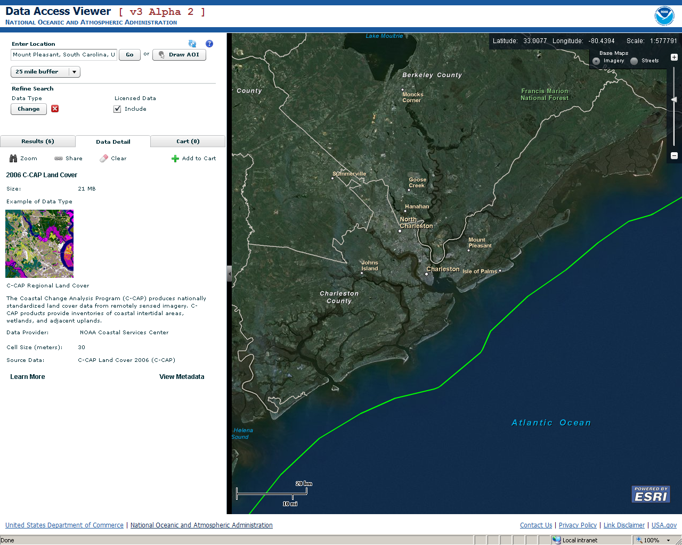

Slide 19
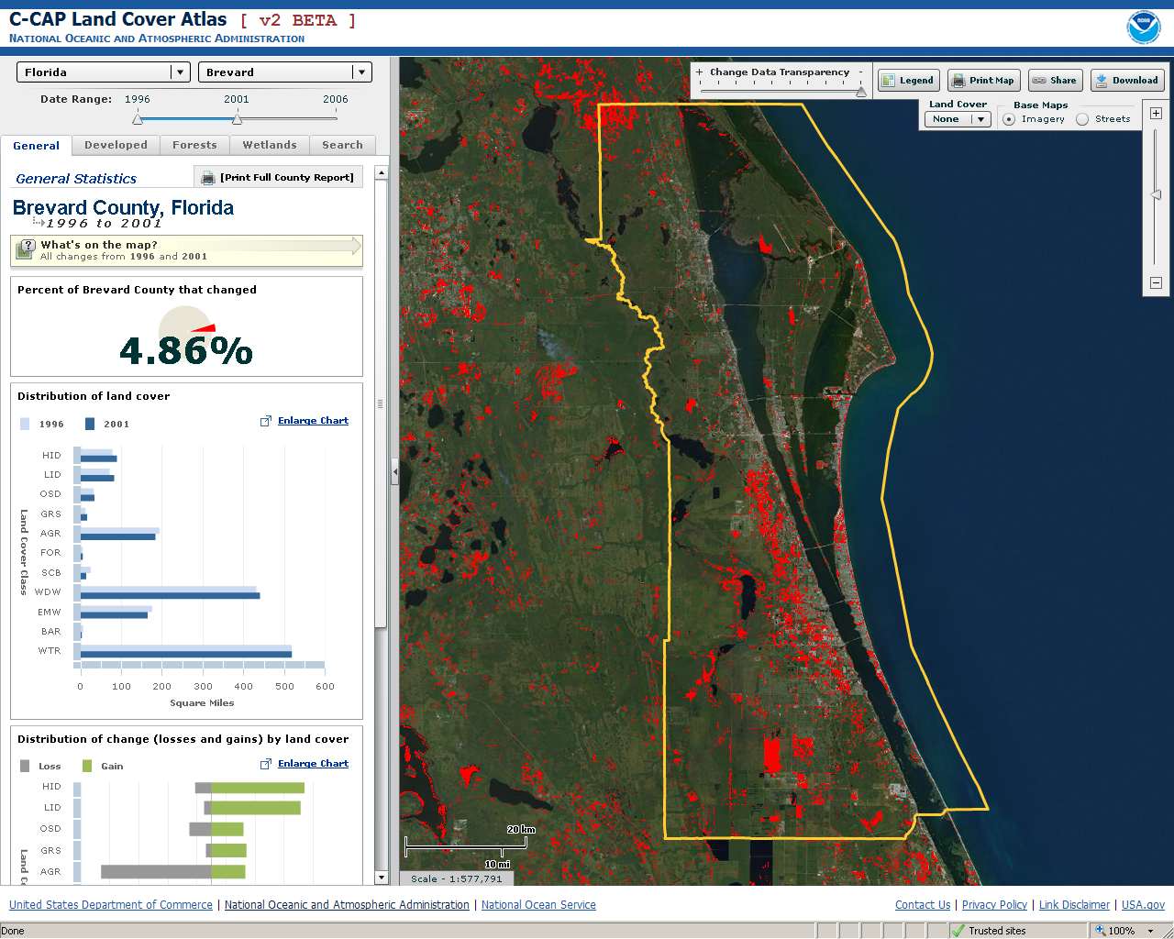

Slide 20
Why it’s Working
Making geospatial information accessible to all levels of technical proficiency
Focusing on outcomes, not just data access
Maintaining community-focused approach: listening and taking action
Building relationships with federal agencies to facilitate transparency in government
Prioritized and targeted audience as resources allow

Slide 21
For More Information
Visit
http://www.csc.noaa.gov/digitalcoast
Or Contact
Miki Schmidt 843-740-1237
Nicholas.schmidt@noaa.gov

