Slide 1
Introduction: “Cowen’s List of Interesting Stuff”
Dr. David Cowen
NGAC Chair
NGAC Meeting, June 8, 2011

Slide 2
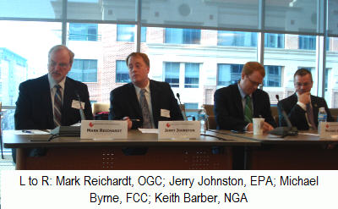
1. National Academy of Public Administration (NAPA) forum on Place Based Initiatives May 20 – Included NGAC members Mark and Jerry http://www.napawash.org/initiative-on-place-based-public-management/
Kris Marcy, president and CEO of NAPA said that "a perfect storm of events happening ... we have terrific budget cuts coming in 2012 and we're going to have to be doing different things."

Slide 3



2. Congressional Research Service Highlights NGAC in three new reports
http://www.fas.org/sgp/crs/misc/R41826.pdf
http://www.fas.org/sgp/crs/misc/R40717.pdf
http://www.fas.org/sgp/crs/misc/R41825.pdf

Slide 4
Changing Landscape
In its January 2009 report, The Changing Geospatial Landscape, NGAC noted that as geospatial data production has shifted from the federal government to the private sector and state and local governments, new partnerships for data sharing and coordination are needed. Specifically:
“the hodgepodge of existing data sharing agreements are stifling productivity and are a serious impediment to use even in times of emergency.... When the federal government was the primary data provider, regulations required data to be placed in the public domain. This policy jumpstarted a new marketplace and led to the adoptions of GIS capabilities across public and commercial sectors. However, these arrangements are very different when data assets are controlled by private companies or local governments”.

Slide 5
NGAC Recommendations to the Obama Administration
In October 2008, NGAC sent recommendations to the 2008-2009 Presidential Transition Team:
• establish a geospatial leadership and coordination function immediately within the Executive Office of the President; the geospatial coordination function should be included in the reauthorization of the E-Government Act;
• require OMB and FGDC to strengthen their enforcement of OMB Circular A-16 and EO 12906;
• establish/designate Geographic Information Officers with each department or agency with responsibilities stipulated within OMB Circular A-16;
• establish and oversee an Urgent Path43 forward for implementation of geospatial programs necessary to support current national priorities and essential government services underpinning the NSDI; and
• continue NGAC.

Slide 6
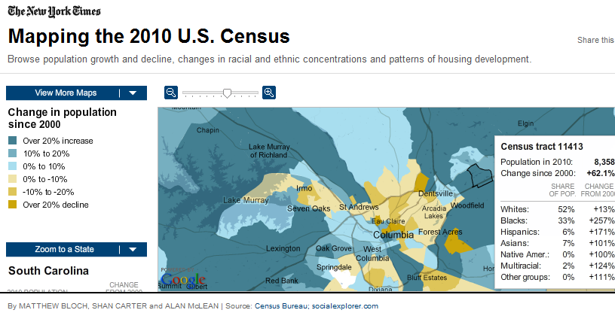
3. New York Times Releases Cool Census Application
http://projects.nytimes.com/census/2010/explorer

Slide 7
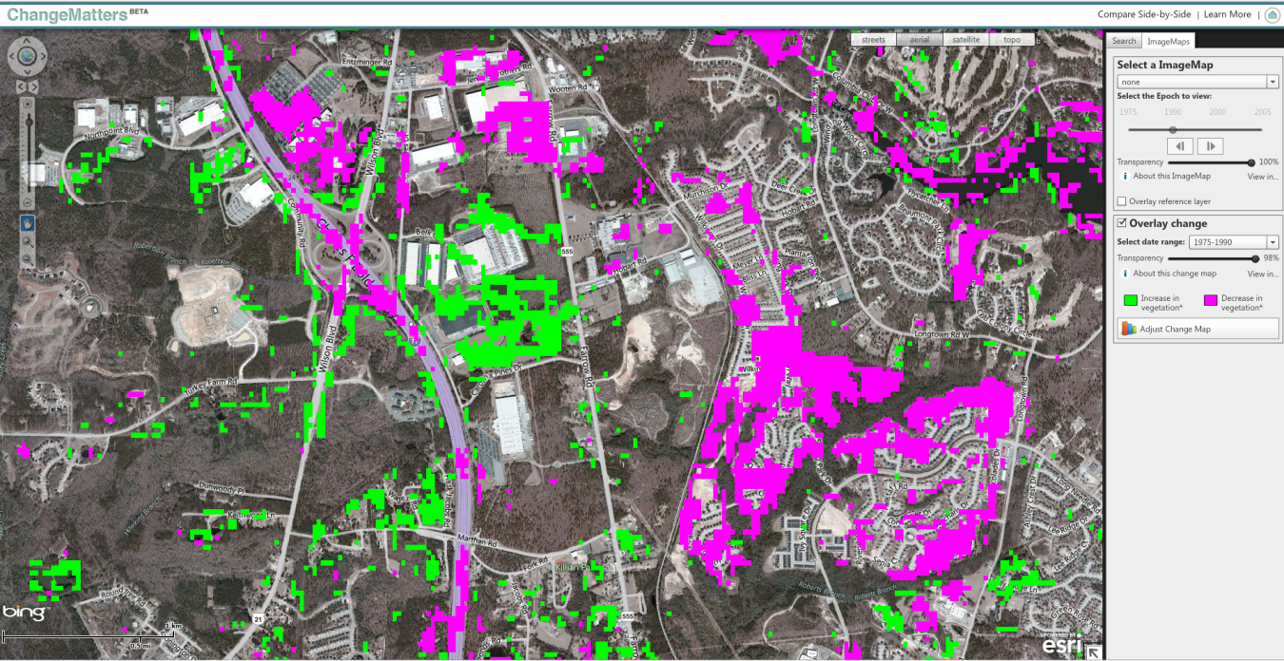
4. Esri Releases Change Matters http://www.esri.com/landsat-imagery/index.html Richland County SC Example

Slide 8
DOI Deputy Sectary David Hayes
"Esri's website achieves the kind of thing we had hoped to see happen by making USGS's Landsat dataset available to the public. The website will enable people and scientists around the world to more quickly and easily see how landscapes have changed over the years. Nearly four decades of continuously acquired data provide a remarkable window to our planet."

Slide 9
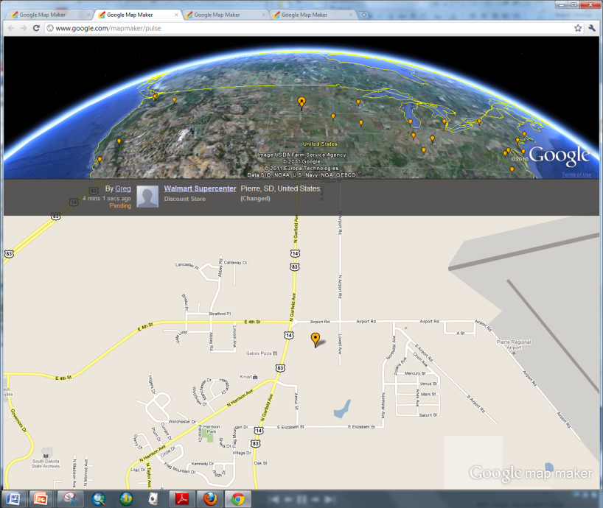
5. Google Releases Map Maker For USA – Crowd Sourcing is here
http://www.google.com/mapmaker/pulse

Slide 10
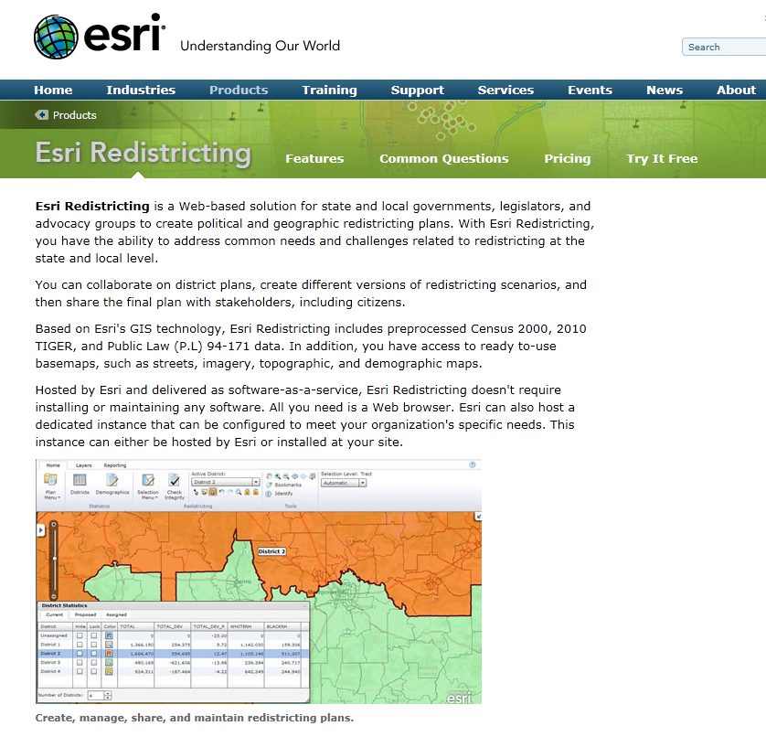
6. Esri Releases Redistricting App as a Cloud Based Software as a Service http://www.esri.com/software/redistricting/index.html

Slide 11
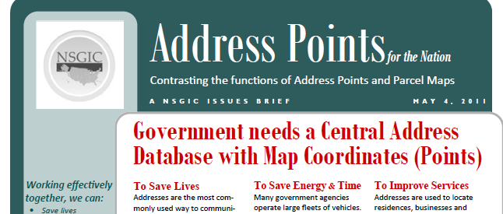
7. NSGIC Publishes Address Point Position Paper
http://nsgicftp.gisinventory.net/download/Address_Points_FTN_Brochure_050411_Final.pdf

Slide 12

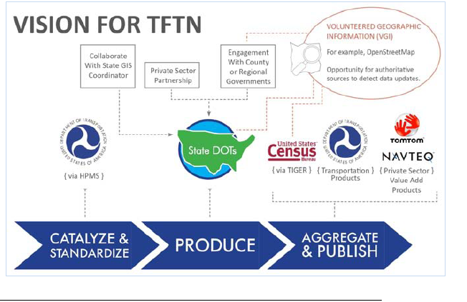
8. Transportation For The Nation Strategic Plan Released
http://nsgicftp.gisinventory.net/download/TFTN_StrategicPlan_v8DraftFinal.pdf

Slide 13
GEoEye / NGA NextView IMAGERY END USER LICENSE AGREEMENT
b. Licensed Users
The imagery may be used by the U.S. Government (including, all branches, departments, agencies, and offices).
2. The U.S. Government may provide the imagery to the following organizations:
State Governments
Local Governments
Foreign Governments and inter-governmental organizations
NGO's and other non-profit organizations

Slide 14
10 FGDC Steering Committee Yesterday
http://www.fgdc.gov/fgdc-news/steering-committee-meeting-june-2011
11 of 26 NGAC Members Attended
Dialog Began - Promise to provide feedback on our recommendations

Slide 15
Focus of our meeting Parcels, Address Points and Roads
The following examples were generated from data in Charleston South Carolina as part of a research project for the Bureau of the Census
Links to these projects
Reporting the State and Anticipated Future Directions of Addresses and Addressing.
Reporting on the Use of Handheld Computers by Statistical Agencies And Other Applicable Users
Identifying The Current State And Anticipated Future Direction Of Potentially Useful of Developing Technologies
Researching Address and Spatial Data Digital Exchange and Data Integration
Measuring Data Quality
http://www2.census.gov/geo/research/

Slide 16
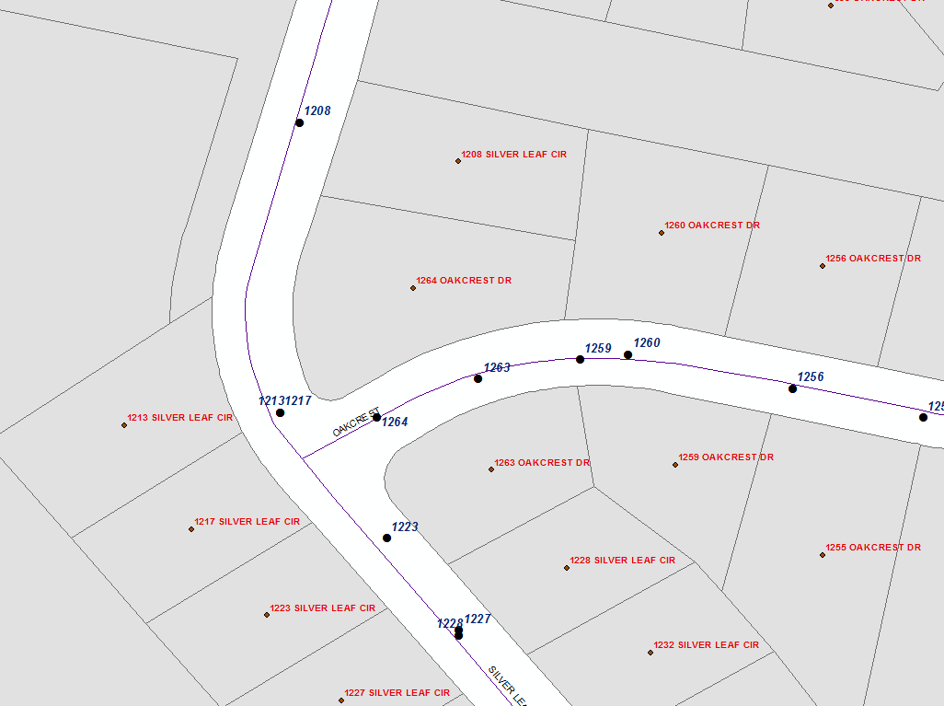
Parcel Centroids with situs Addresses are geometrically assigned as navigation points on centerlines

Slide 17
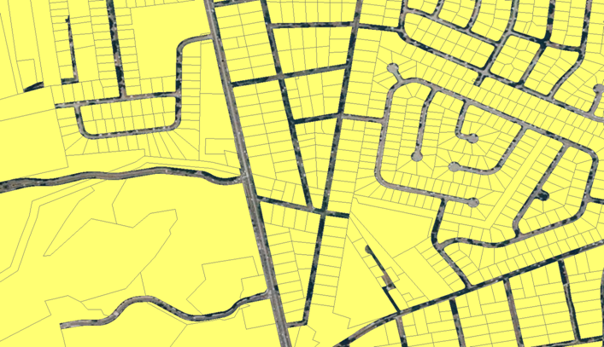
Parcels with Imagery

Slide 18

Dissolved Parcels = Blocks

Slide 19
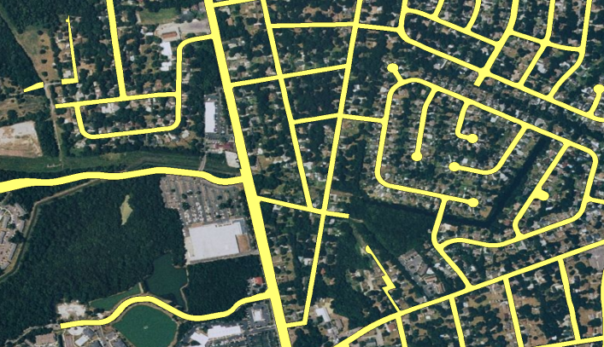
Non Parcels (Public) with Image

Slide 20
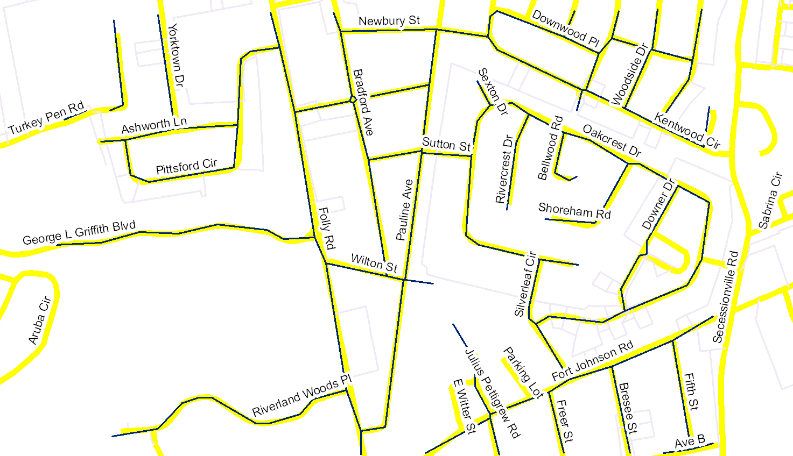
Generalized (Douglas / Peucker) Vectors of thinned grids With TIGER (Yellow)

Slide 21
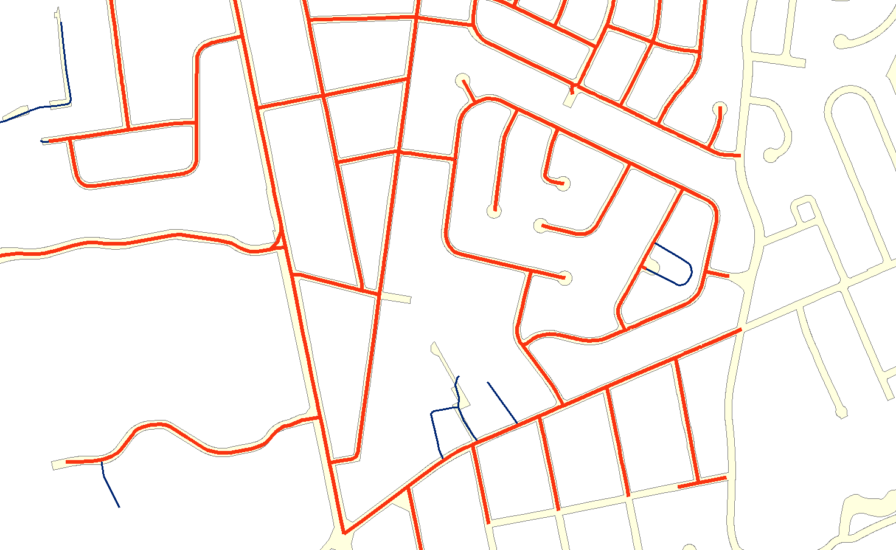
TIGER Segments not in agreement with public roads
TIGER does not conform to cul de sac
TIGER does not follow public land. Potential conflict
TIGER inside a private parcel. Check to see if private road or driveway

Slide 22
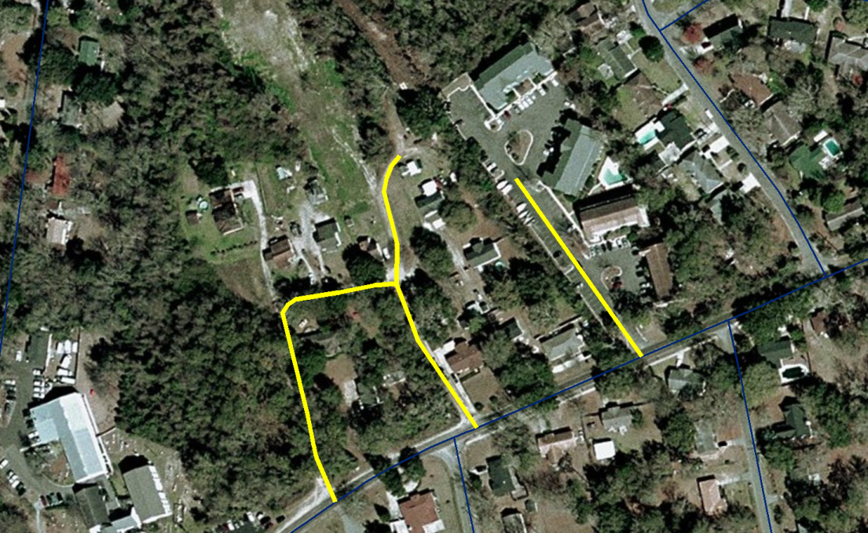
Questionable TIGER segments

Slide 23
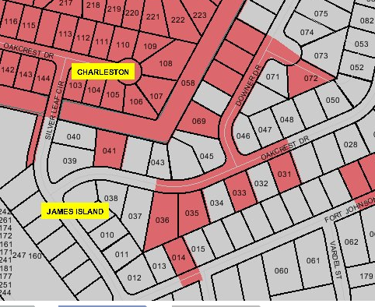
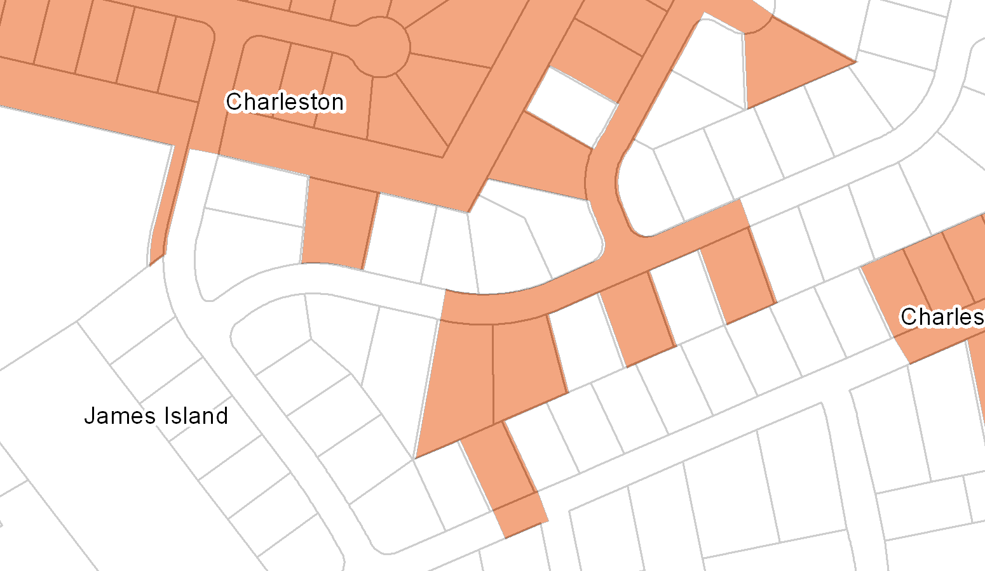
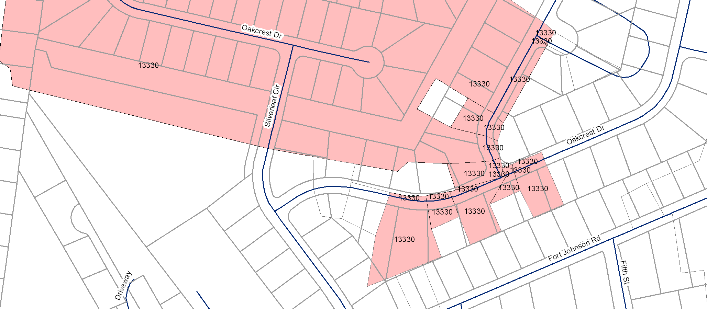
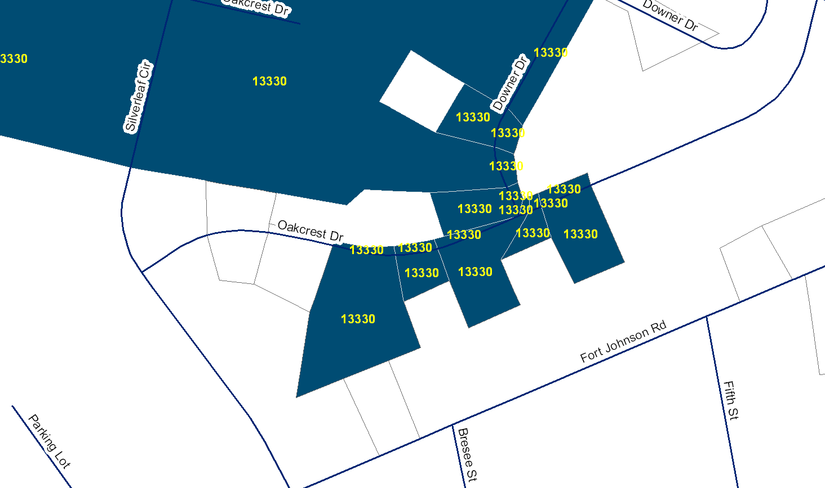
Boundary Comparison – County
Private Parcels
County Official
Census
Census with Parcels Note misalignment

