Slide 1
HUD Parcel Data Activities Exploratory
Develop Tools for Neighborhood Recovery in the Gulf Region – focus on parcel boundaries
County Data Records Project– focus on assessment information
Ad hoc research projects/contracts
Exploratory/ lessons learned
NRC Report 2002 – Urban Spatial Data Infrastructure
NRC Report 2007 – National Land Parcel Data
HUD/PD&R County Records Project 2011
Jon Sperling
June 2011 NGAC Meeting

Slide 2
HUD Thumbnail Sketch
40 billion dollars/ 9,000 employees
Works with ~23000 organizations
Community-based (over 90 offices)
Safe Affordable Housing+ Vibrant Sustainable Inclusive Livable Communities
Holistic approach - housing, transportation, environment, health, education, employment, energy – regional, metropolitan
Fiscal constraints; leveraging data & technology to focus priorities, measure impacts and target funding (foreclosures, neighborhood blight, disasters)
Geoenabling performance, HUDStat

Slide 3
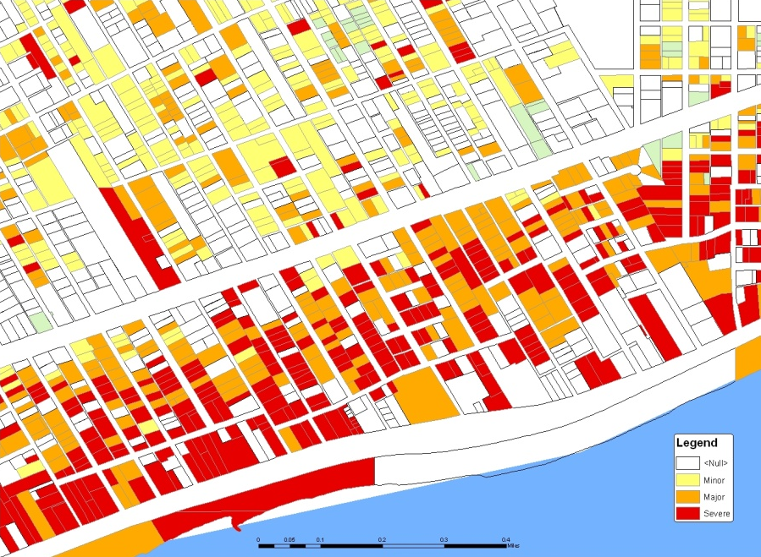
Parcel Project: Gulf Coast: Multi-Agency Disaster Recovery Coordination
Two-fold: Damage Assessment, Recovery Grants & Loans
Neighborhoods need majority of properties in recovery in order to stabilize entire neighborhood
Need to find damaged properties that have NOT applied for recovery grants
Requires parcel maps to identify neighborhoods
Requires ability to link addresses with parcels

Slide 4
With HUD’s unique access to data sources, can we contribute ways to measure and track recovery and still protect individual privacy?
Damage assessment by address - FEMA
Flood depth by address – NOAA/HUD
Recovery grants by address - FEMA, SBA, HUD, State, etc.
Building permit – City
Vacancy data – USPS
Utility data
If we can analyze at micro level, we can aggregate and present multiple views of recovery

Slide 5
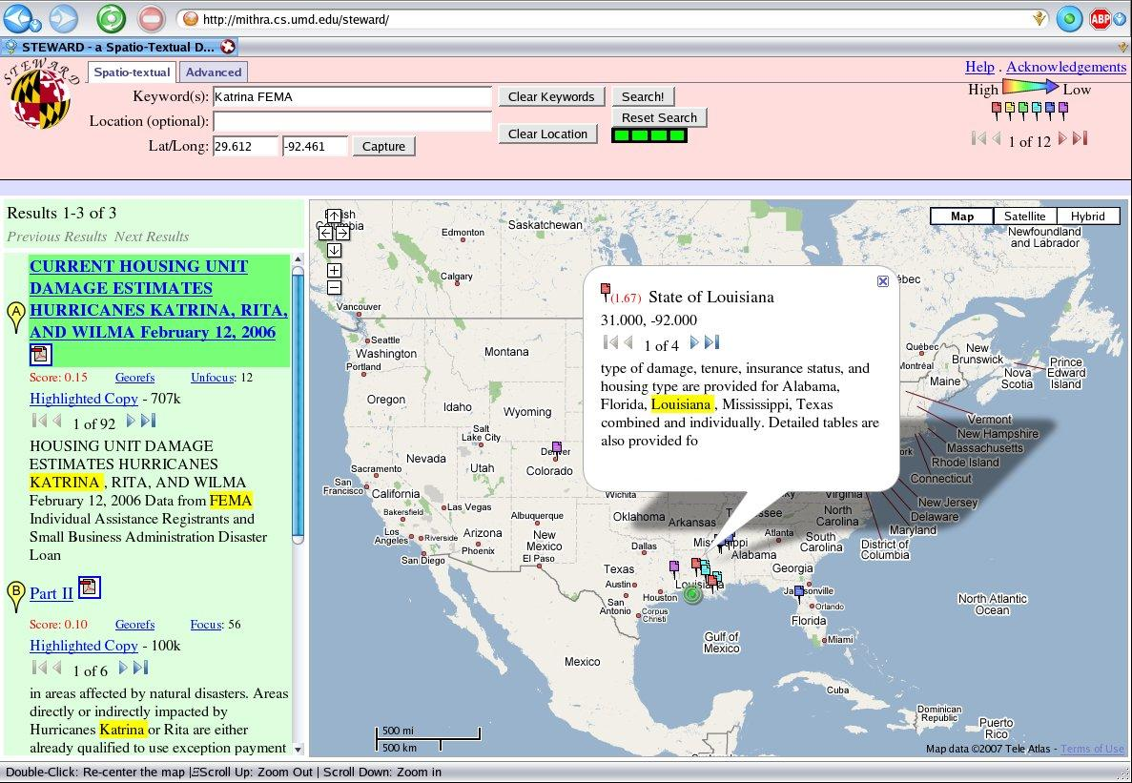

Slide 6
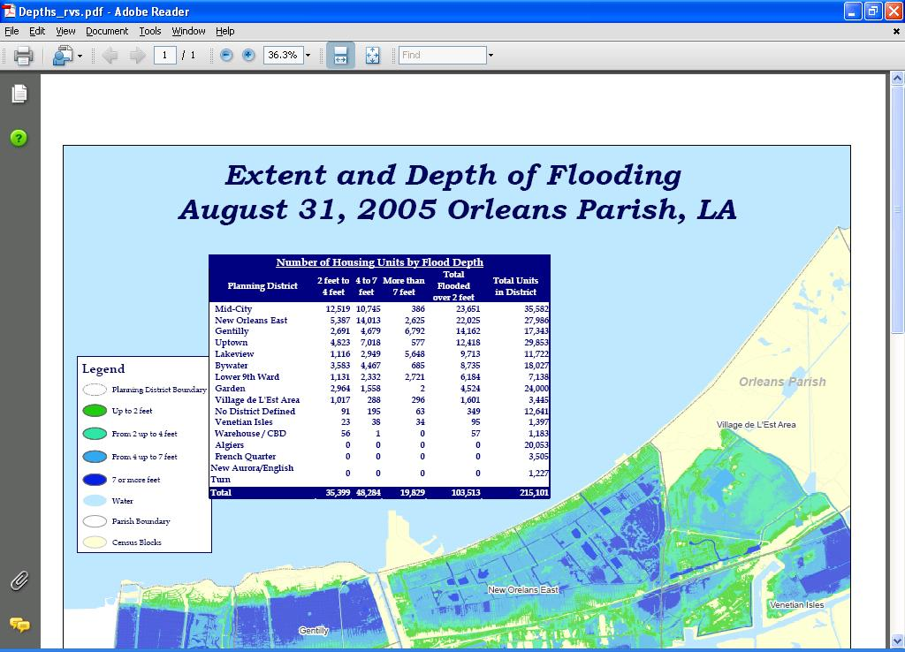

Slide 7
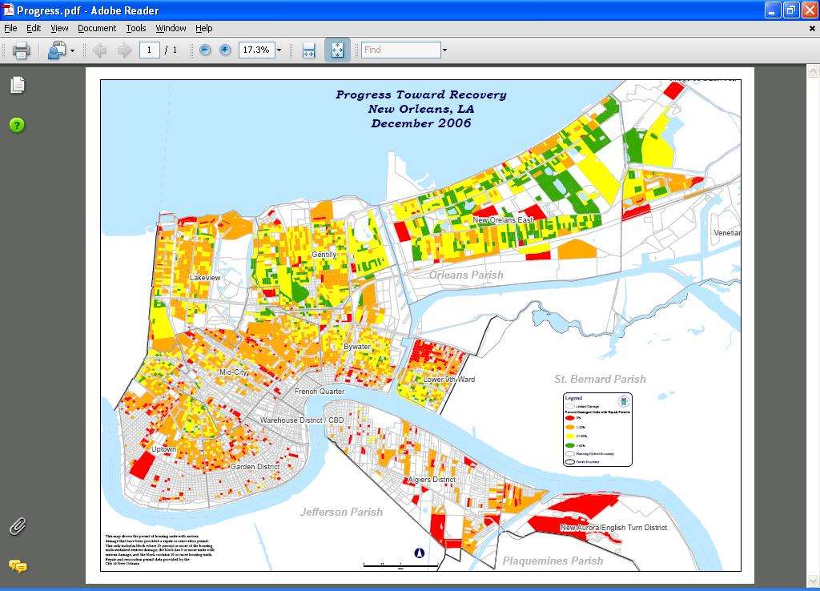

Slide 8
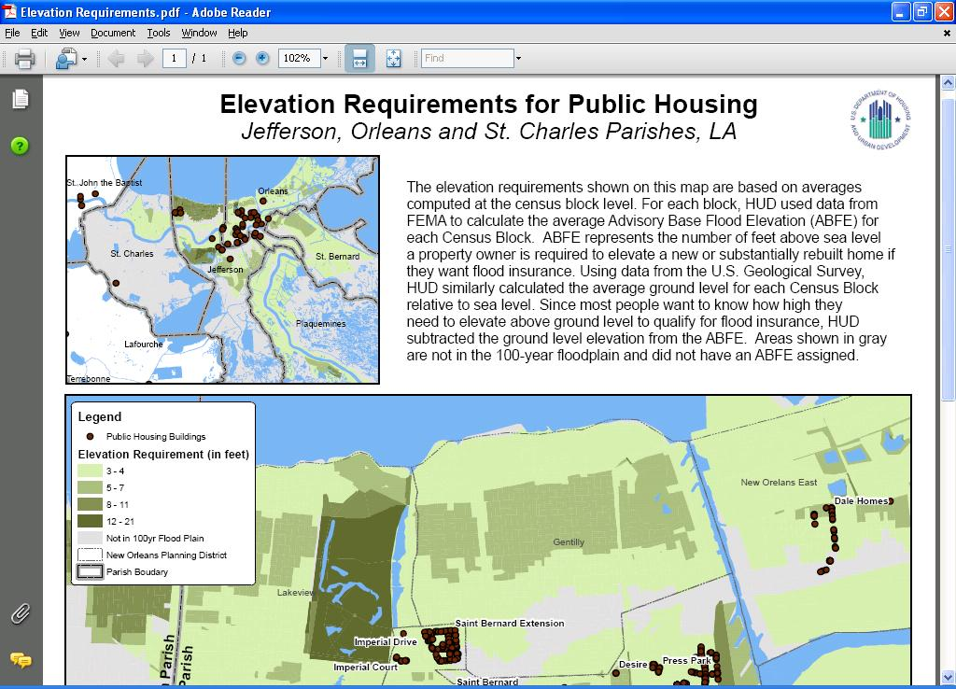

Slide 9
Key Lessons – Gulf Parcel Project
Built on Successful Methodologies to Estimate Damages – linking FEMA, HUD, Census, NOAA and Other Datasets
Availability of Digital Parcel Data
Content, Coverage, Data Quality
Property/Situs Address (vs owner address) – Key Enabling Variable
Address Matching Capability: HUD’s “Geocode Service Center” - Key Enabling Resource
Link postal, parcel and census data (MAF/TIGER?)
Value of (govt) data often goes beyond its original purpose
Local partnerships

Slide 10
County Data Records Project
Collect and standardize most recent residential assessor data from 127 NSP counties and 27 corresponding states to evaluate performance
Assist programs to alleviate foreclosures, stabilize communities, and help recovery efforts after natural disasters
Assess feasibility for a national parcel database
Status: Pilot Data Collection completed. Waiting OMB approval for Main Data Collection.
10
10
Notes:
Purpose: Acquire, assemble and analyze data obtained from local agencies for tracking housing stock. Trends in vacancies, sales, sale prices. Feasibility for maintaining a national database. Short-medium, long-term needs. Evaluate impact of NSP, analyze other HUD programs that help alleciate foreclsoures, stabilize communities and help in recovery efforts after disasters.

Slide 11
Parcels+: Local Assessment Information
Acquire, assemble, analyze data from local county agencies
Home sales data, current value, housing stock conditions,
Vacancies
Multi-unit housing
Feasibility/ Sustainability

Slide 13
Stay Tuned …..

