Slide 1
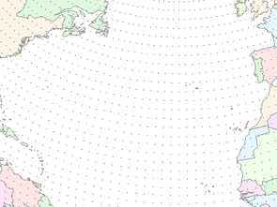



June 23, 2011
NOAA / CBRFC
Water forecasts and data in support of western water management
Kevin Werner
NWS Colorado Basin River Forecast Center

Slide 2
Outline
River Forecast Center overview
Water Year 2011

Slide 3

The Global Water Imperative
Protect Life and Property
Support Economic Security
Water has always been a critical component in the success of any economic endeavor
Protect Health and Environment
Water is the lifeblood of this planet
Triple Threat: Scarcity and floods, climate change, and aging infrastructure
Mitigate Escalating Risk
Floods and droughts cause more U.S. economic losses than any other type of natural disaster
“Nearly half of the streams and lakes in the U.S. are not clean enough to sustain swimming and fishing and our infrastructure has been given a D grade”

Slide 4


Who we are…
Mission: To understand and predict changes in the Earth’s environment … to meet our Nation’s economic, social, and environmental needs
Mission: The NWS provides weather, hydrologic, and climate forecasts and warnings … for the protection of life and property and the enhancement of the national economy
The Colorado Basin River Forecast Center generates streamflow forecasts and related datasets for the Colorado and eastern Great Basins

Slide 5
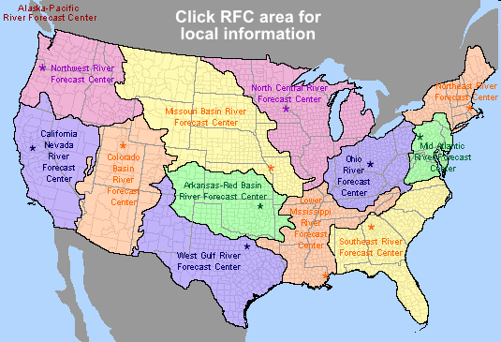
Colorado Basin River Forecast Center
One of 13 River Forecast Centers
Established in the 1940s for water supply forecasting
Three primary missions:
1. Seasonal Water supply forecasts for water management
2. Daily forecasts for flood, recreation, water management
3. Flash flood warning support
www.cbrfc.noaa.gov

Slide 6
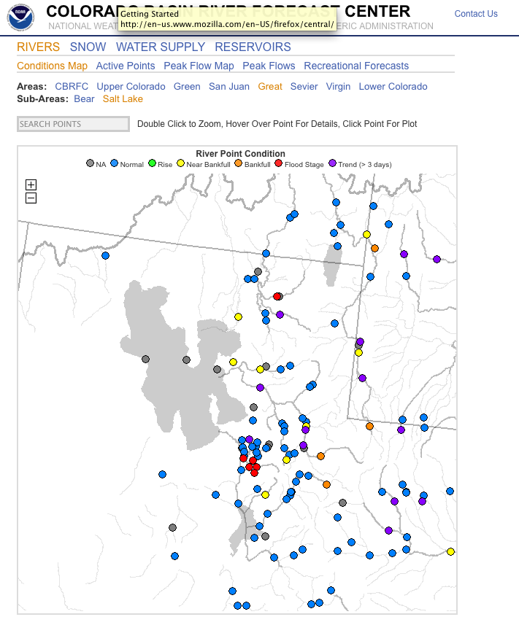
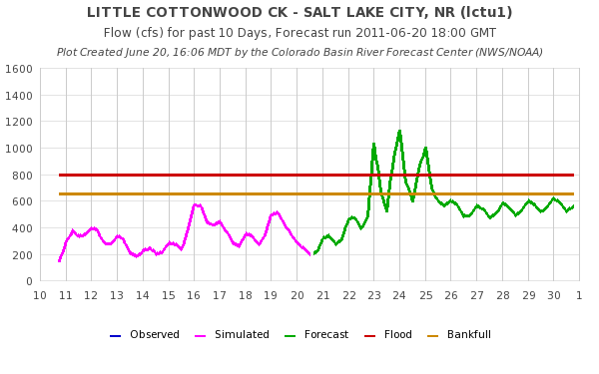
Flood Forecasts / Routine Forecasts
Nominally provided at ~400 points every 6 hours out to 14 days.
Flexible web interface to forecasts and data
Requires large amounts of data (e.g. snow, precip, temps, streamflow)

Slide 7
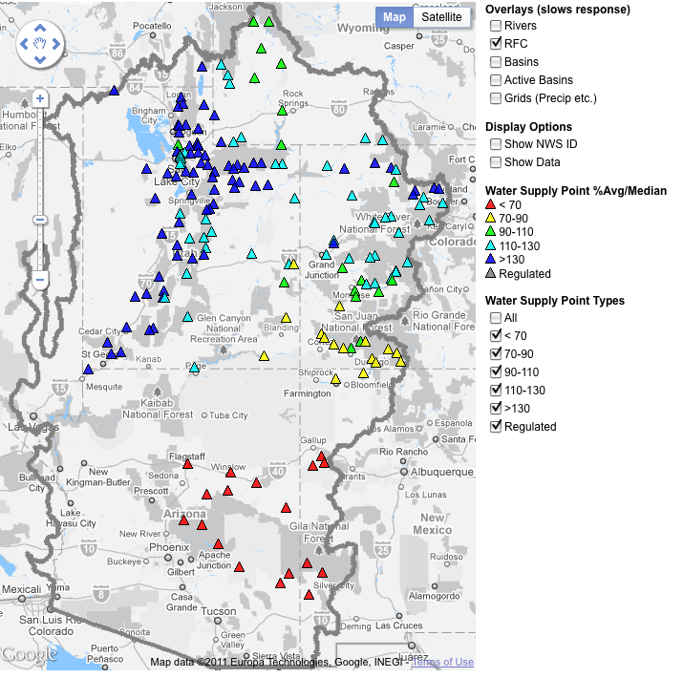
Water Supply Forecasts
Generated seasonally
Typically January through June
Updated monthly or as needed
Forecast runoff volume (usually April – July)
Probabilistic

Slide 8
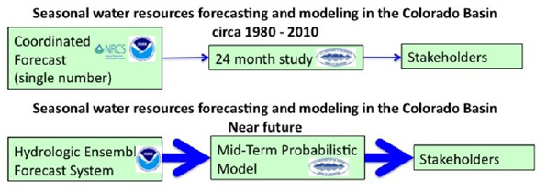
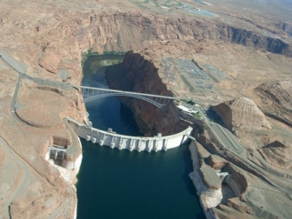
Water Supply Decision Support
The
past
The
future
Efforts in parallel --
CBRFC working to improve probabilistic flow forecasts
BOR working to implement probabilistic water management model

Slide 9
General RFC Model
Hydrologic Model Analysis
hydrologic
expertise &
judgment
model
guidance
Weather and Climate Forecasts
River
Forecast
System
Forecast
precip / temp
Outputs
Graphics
River Forecasts
Analysis &
Quality Control
parameters
Observed
Data
Calibration

Slide 10
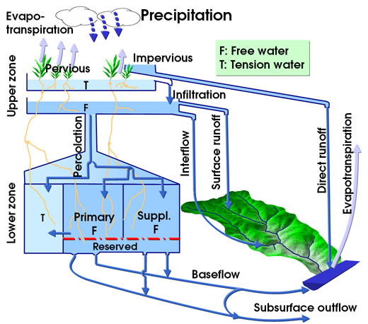

RFC Models
Snow Model: SNOW-17 Temperature Index Snow model
RFC forecast uses a snow model and a rainfall-runoff model:
Snow model: Temperature index model for simulating snowpack accumulation and melt
Hydrologic model: Conceptual hydrologic model used to generate runoff

Slide 11
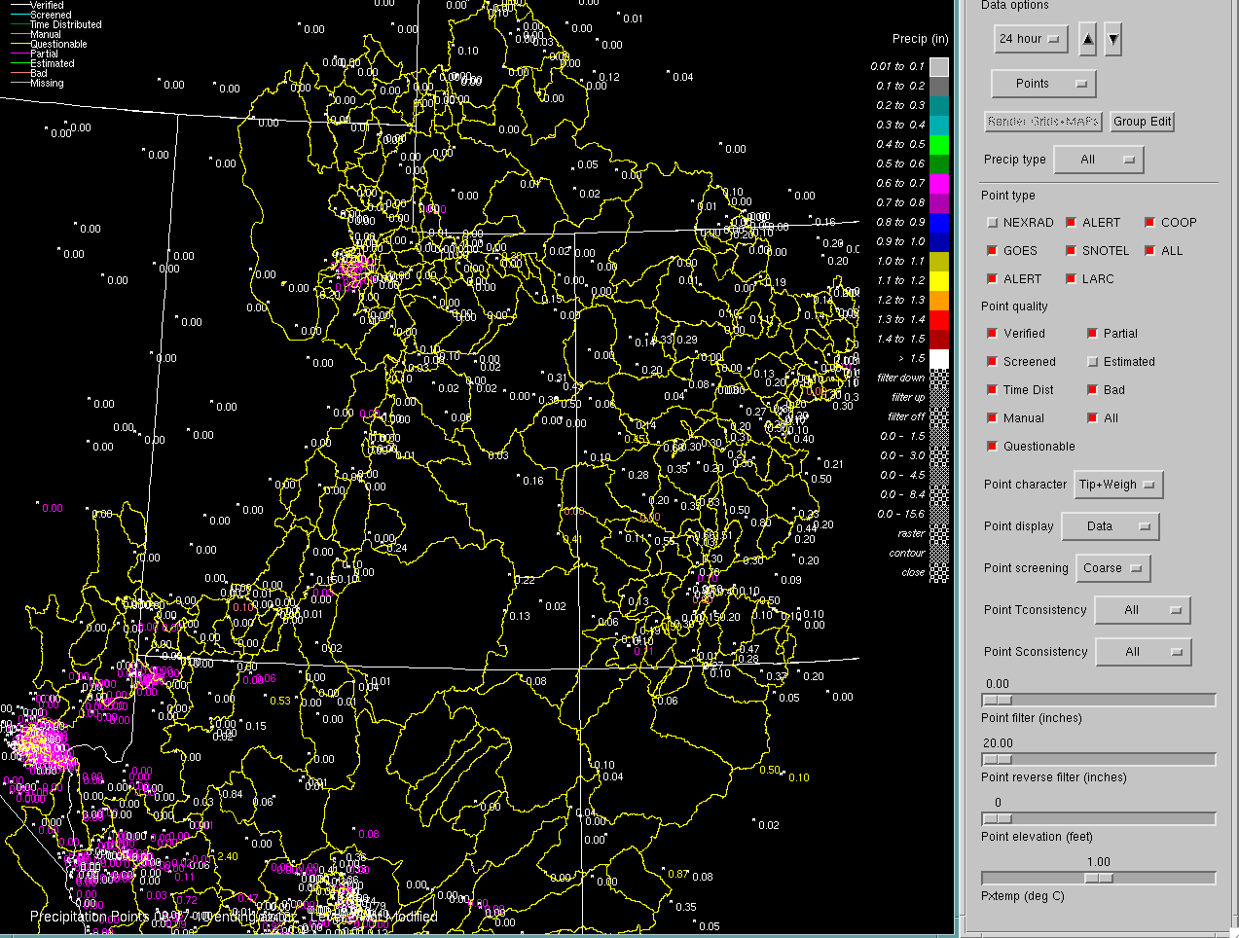

Slide 12
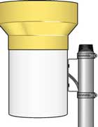
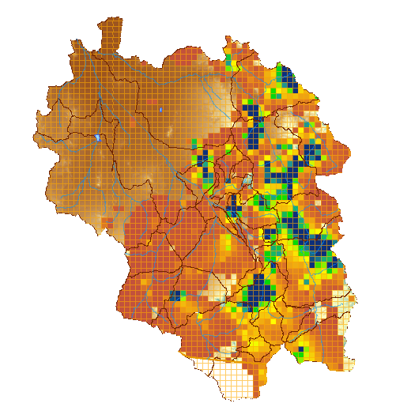

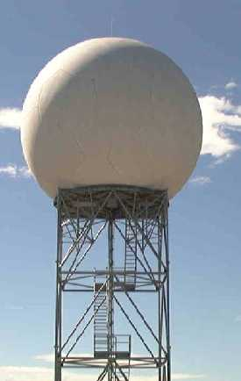
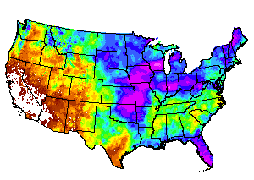

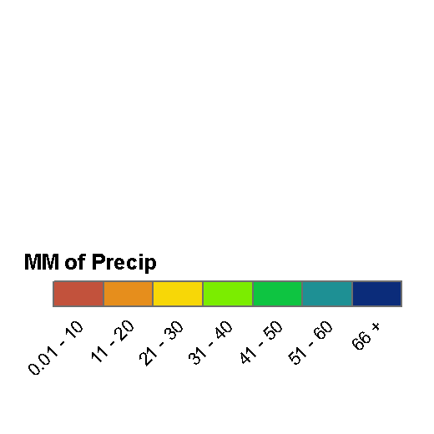
Quantitative Precipitation Estimates (QPE)
Rain Gage Measurement
Gridded Precipitation Estimate
GOES Satellite Estimate
Radar Estimate
Climate patterns
Forecaster Analysis

Slide 13
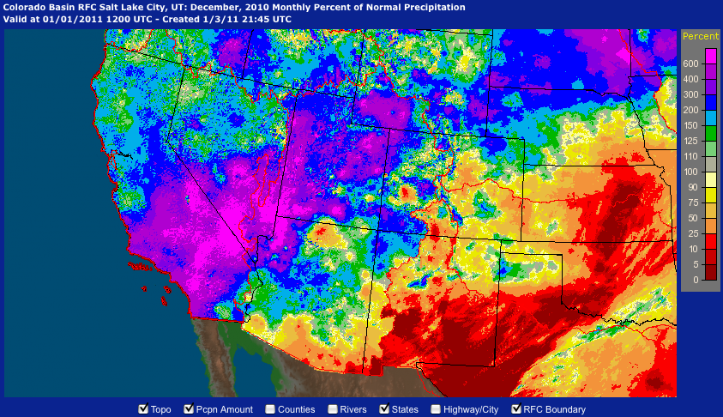
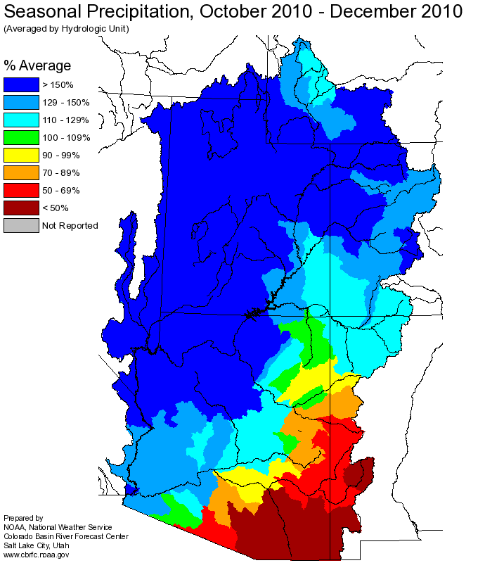
Source: water.weather.gov
Source: www.cbrfc.noaa.gov

Slide 14
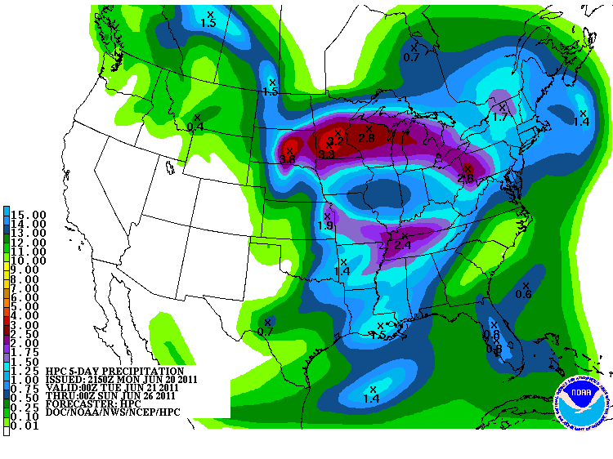
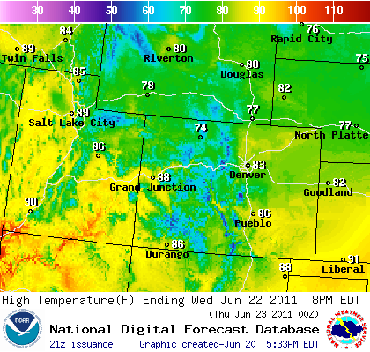
Weather and Climate Forecasts
RFC forecast system incorporates both weather and climate forecasts:
Weather forecasts integrated into daily operations with forecaster control over point and basin average values
Water supply forecasts typically only use QPF during late season or in lower basin
When QPF is used, it is used in a deterministic manner
Climate forecasts integrated into seasonal water supply forecasts through probability shifts of forcing ensemble
Climate forecasts are typically only considered in lower basin and only in ENSO years

Slide 15
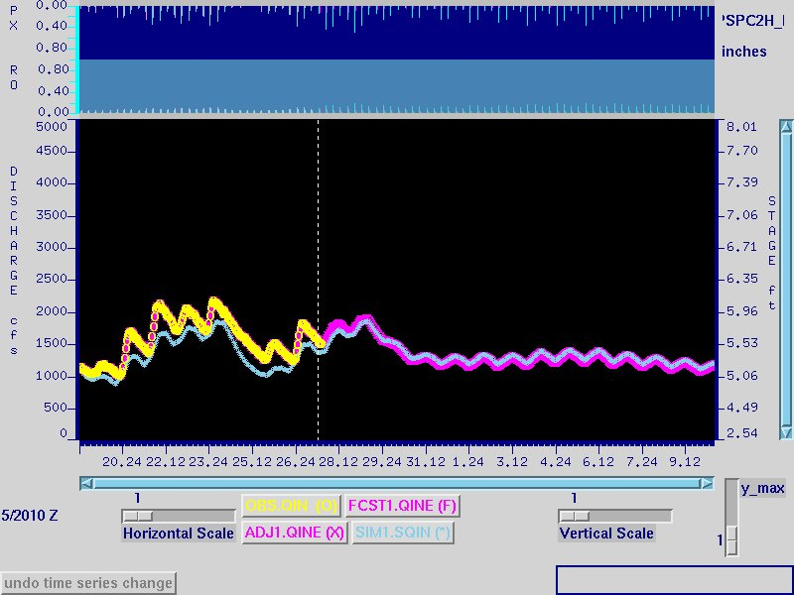
Forecast hydrograph
‘Adjusted’/‘Forecast’ is a single time series broken into observed and future pieces.
It equals obs when available, otherwise patterned with sim
Can control how quickly it blends into the actual values of the sim
Observed
Simulated

Slide 16
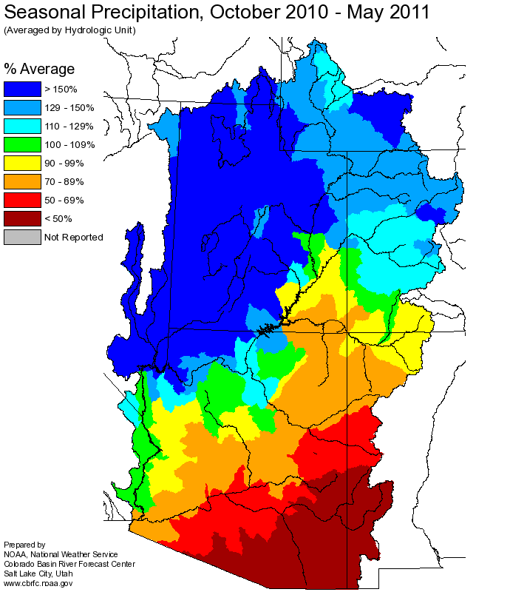
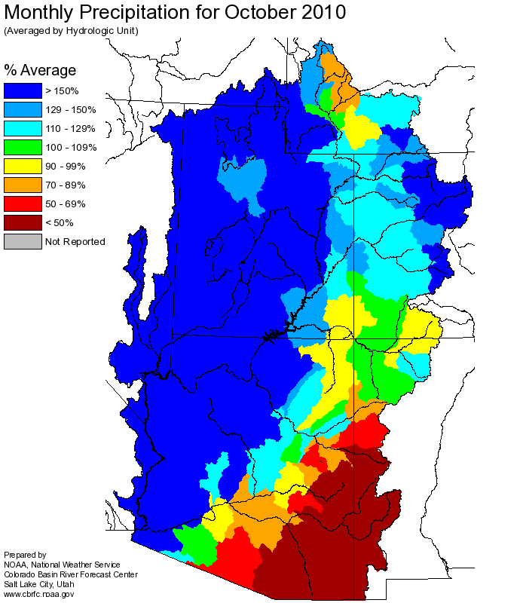
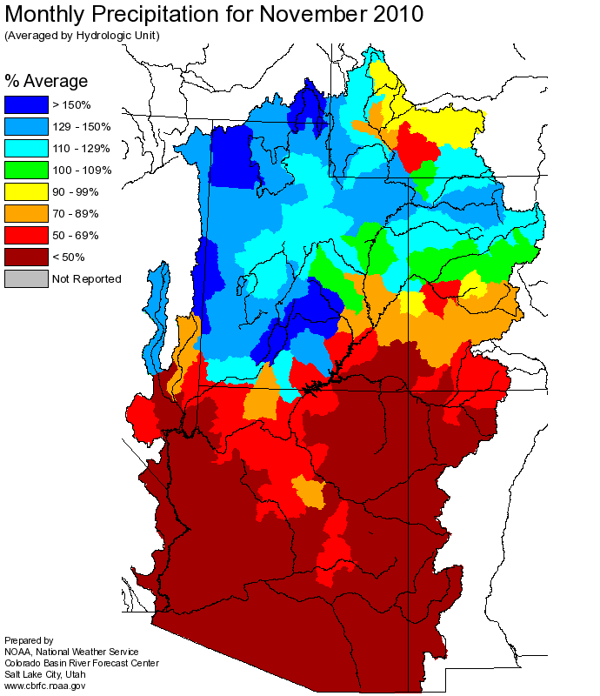
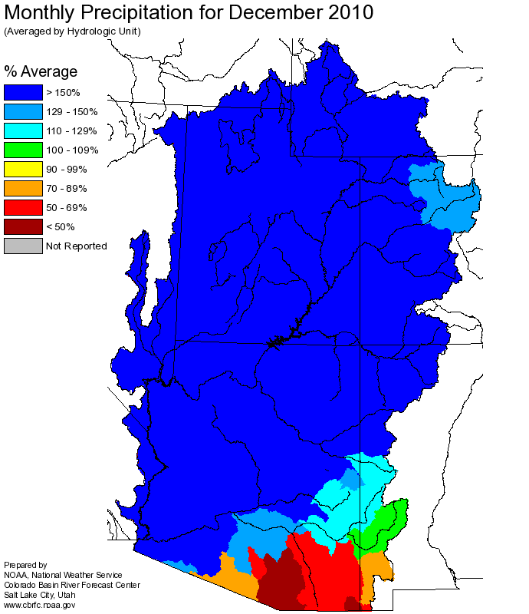
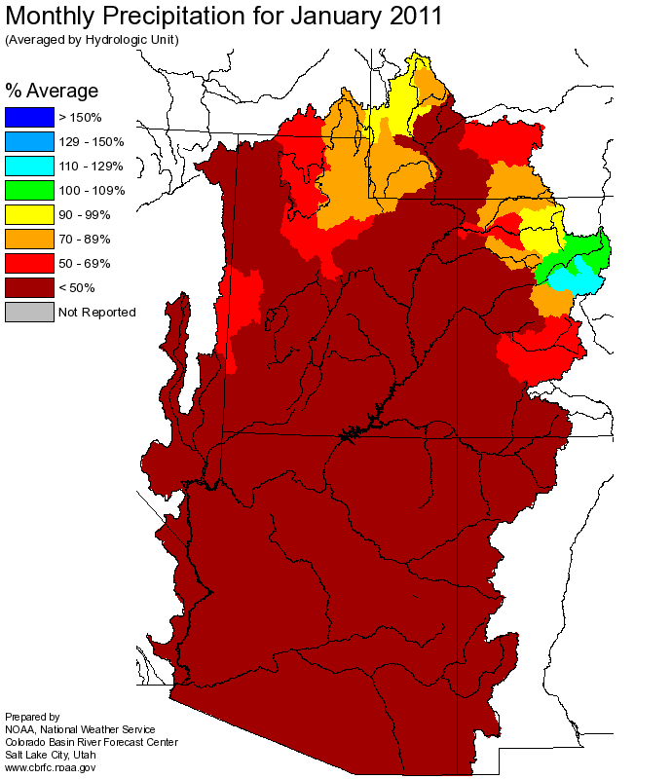
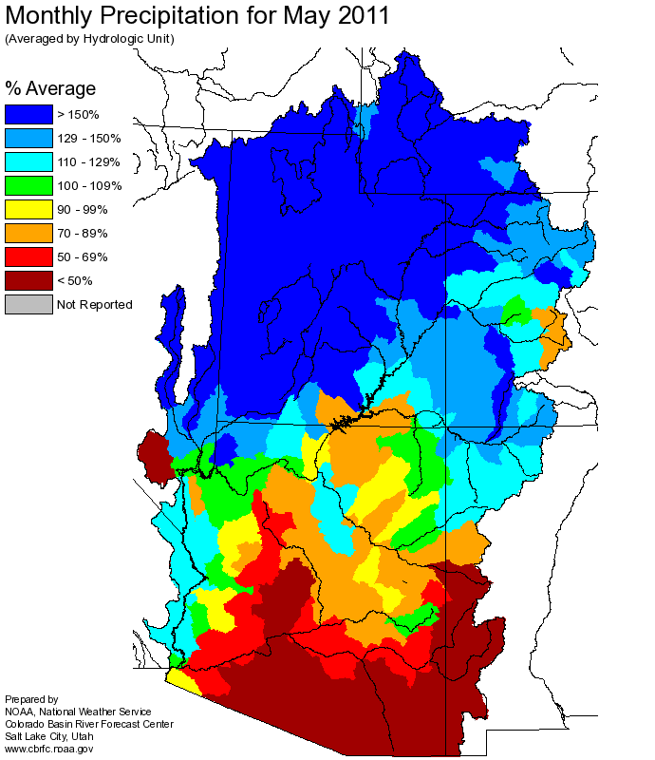
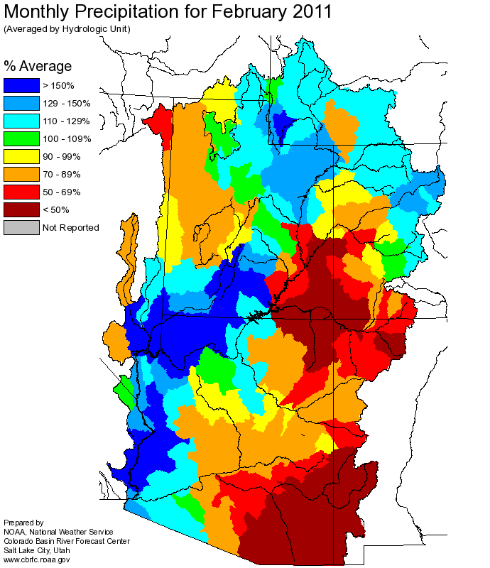
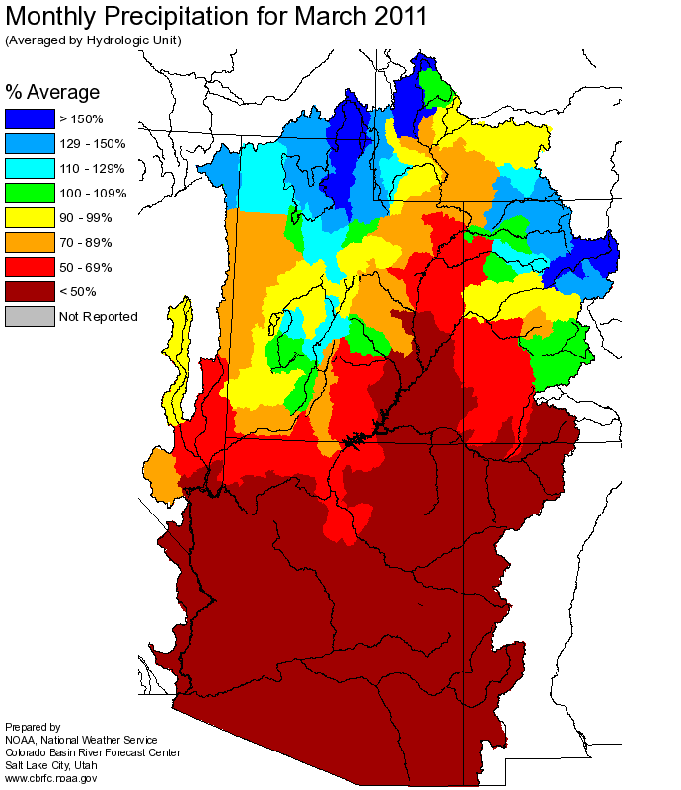
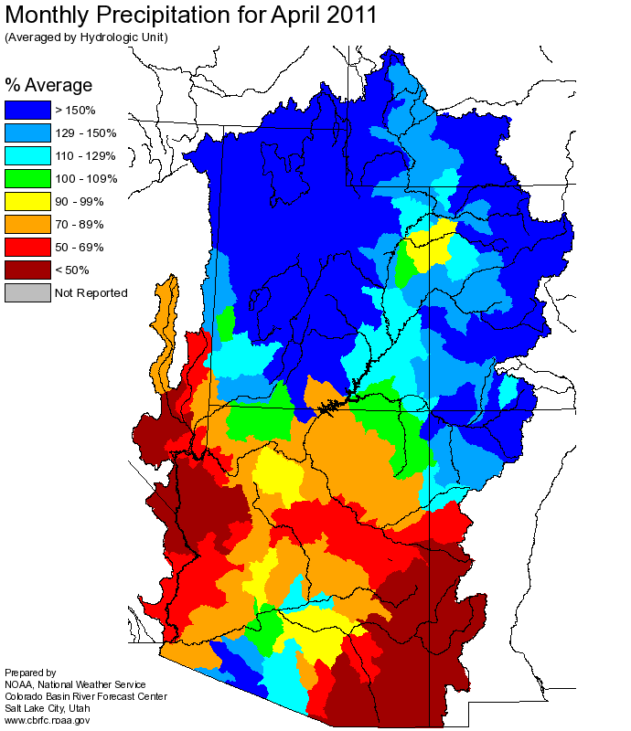
Web Reference: http://www.cbrfc.noaa.gov

Slide 17
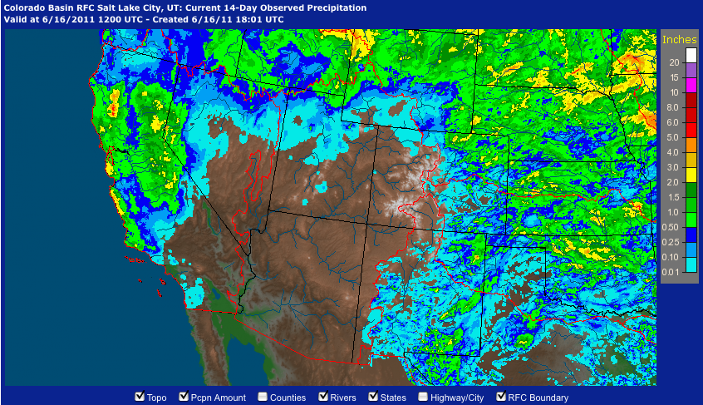
June 1-15 Precipitation
Web Reference: http://water.weather.gov/precip

Slide 18
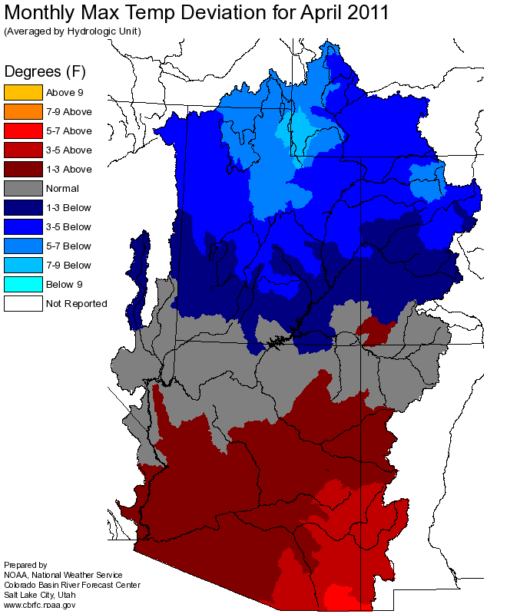
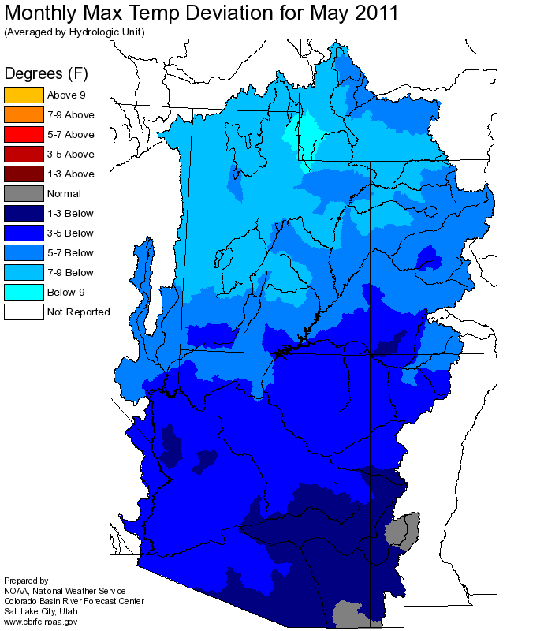
Temperature

Slide 19
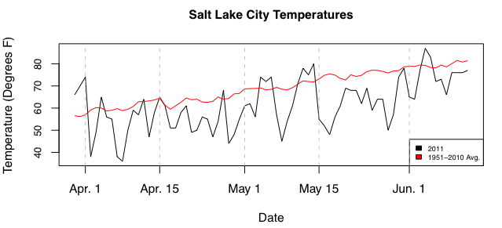
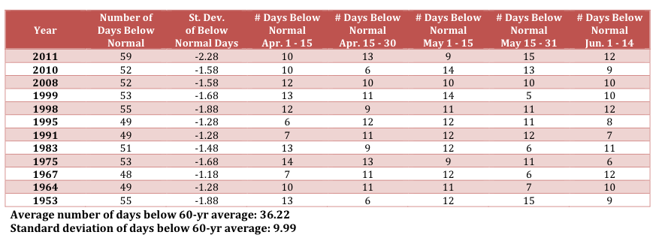

Slide 20
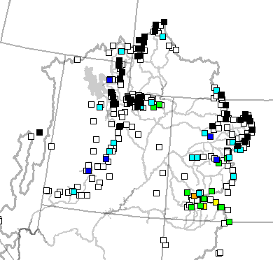
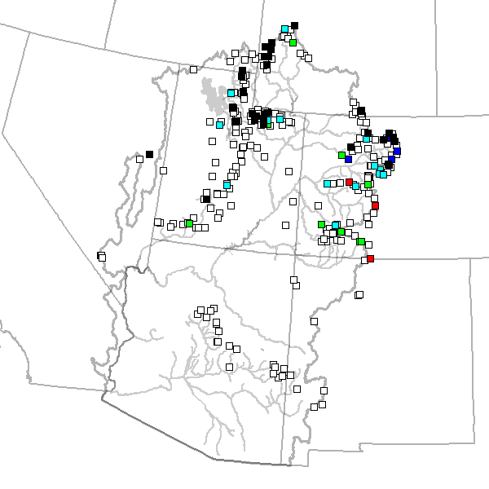
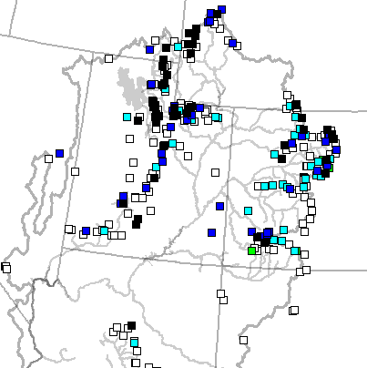
June 2 June 9 June 22

Slide 21
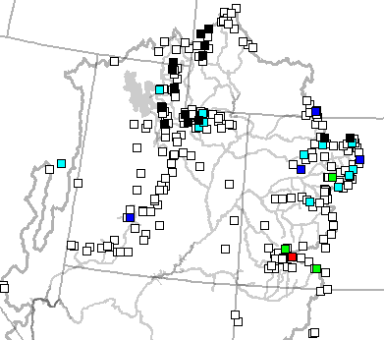
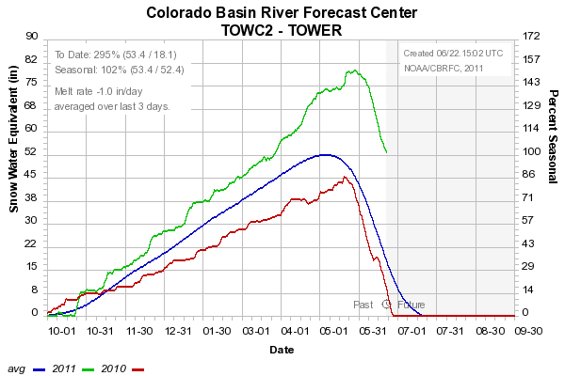
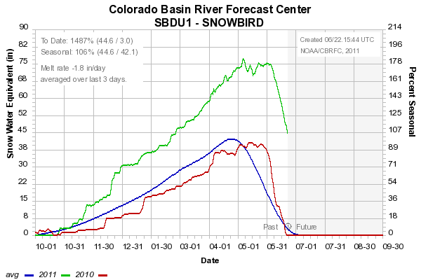
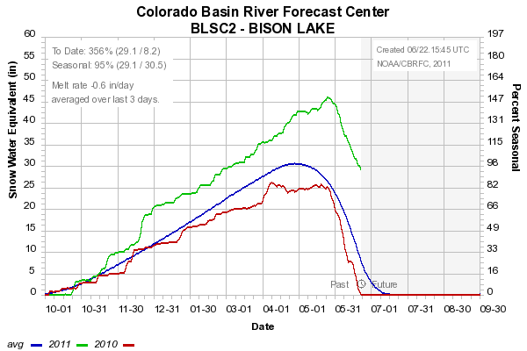

Slide 22
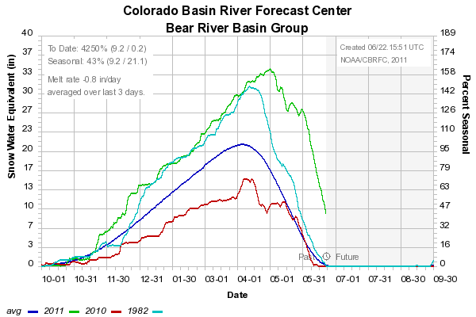
Snow: Bear River Basin
Web Reference: http://www.cbrfc.noaa.gov/station/sweplot/sweplot.cgi???open

Slide 23
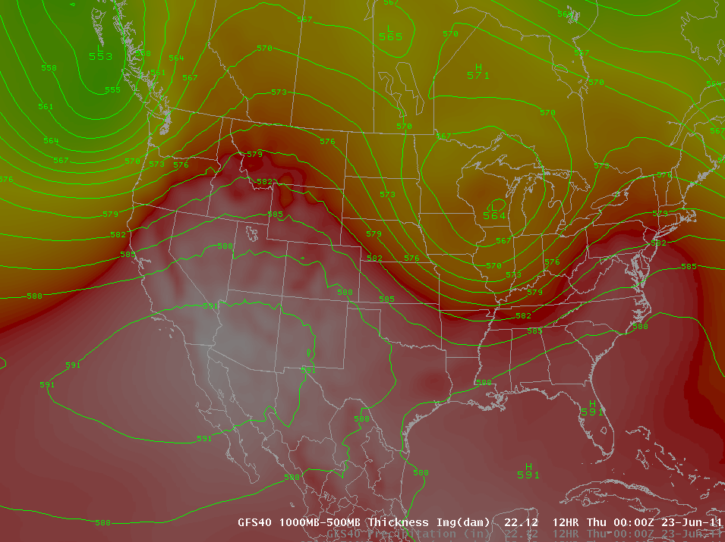
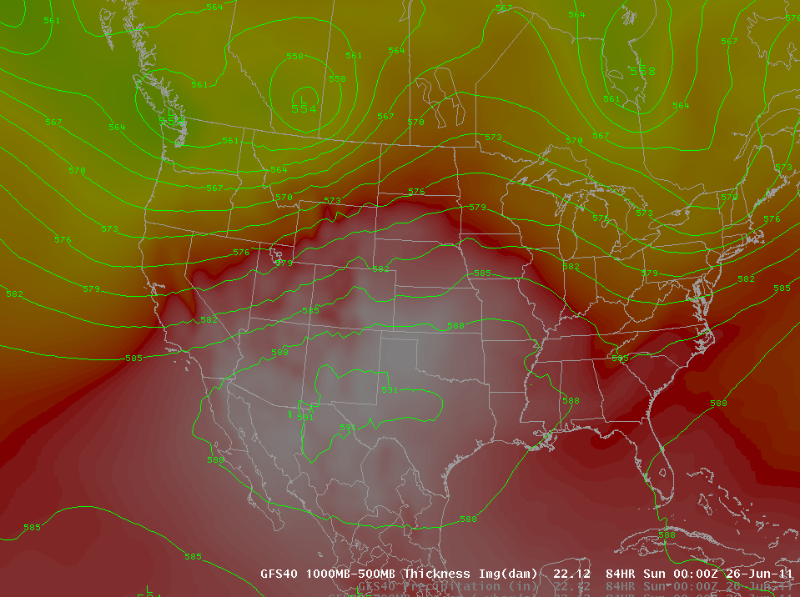
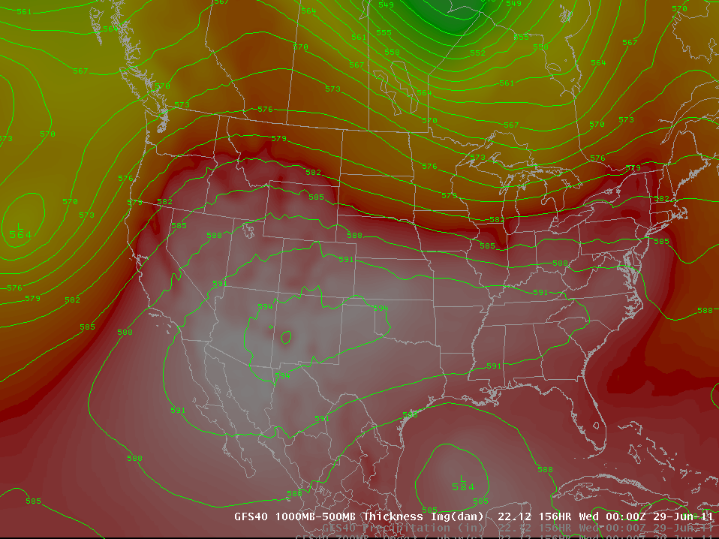
Weather Forecast
<- Today (Thursday)
Saturday PM
Tuesday PM
Heat is coming!!
Above normal temperatures today, tomorrow, Friday
Slight cooling for Utah over the weekend
Colorado stays warm

Slide 24
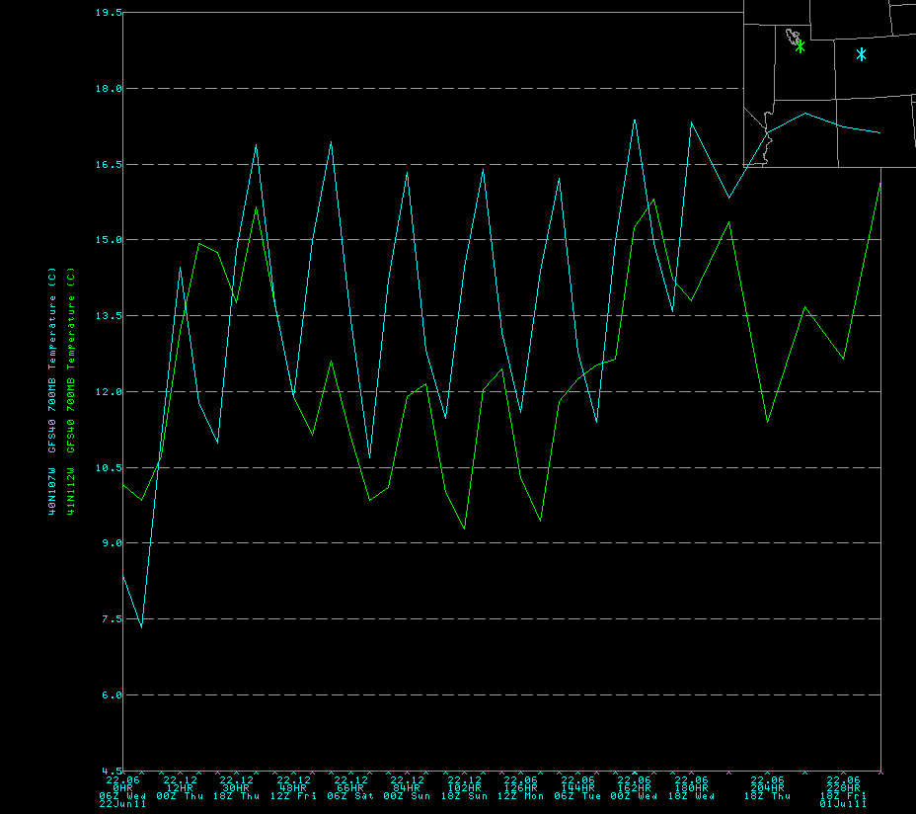

Slide 25

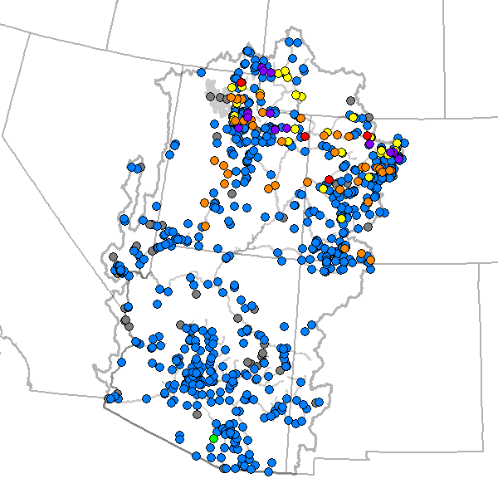
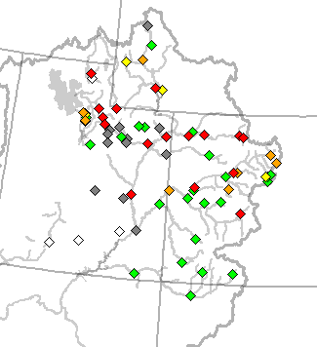
Current Forecasts
May 24 Forecasts
June 22 daily Forecasts

Slide 26
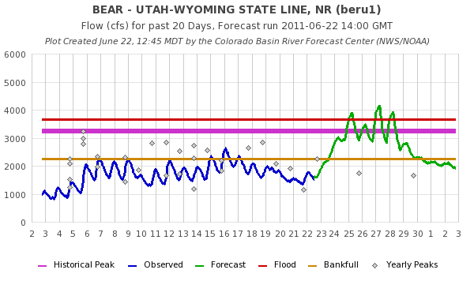
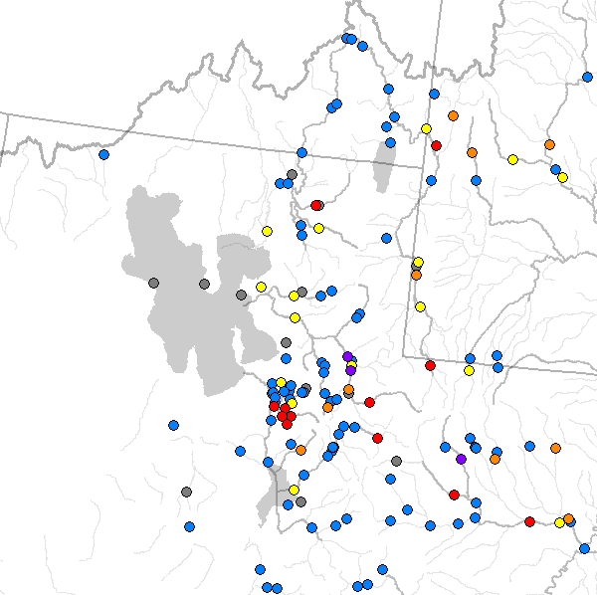
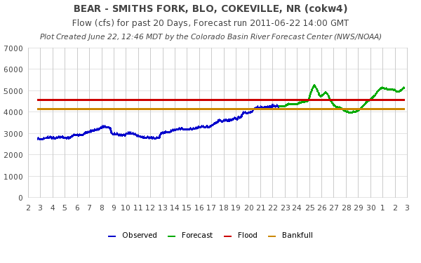

Slide 27



Slide 28



Slide 29

Experimental Daily Ensembles
Ensemble forecasts that incorporate weather forecasts are run daily for Upper Colorado Basin forecast points
Prototype web tool available
Does NOT work correctly downstream of reservoirs yet
NOT available for the Great Basin yet
URL: www.cbrfc.noaa.gov/devel/hefs

Slide 30


Feedback, Questions, Concerns always welcome….
Kevin Werner
CBRFC Service Coordination Hydrologist
Phone: 801.524.5130
Email: kevin.werner@noaa.gov

