Slide 1
CBRF June 16 Forecast Webinar Please Mute Your Phones: *6
1pm, June 16, 2011
Kevin Werner
These slides: www.cbrfc.noaa.gov/present/present.php

Slide 2
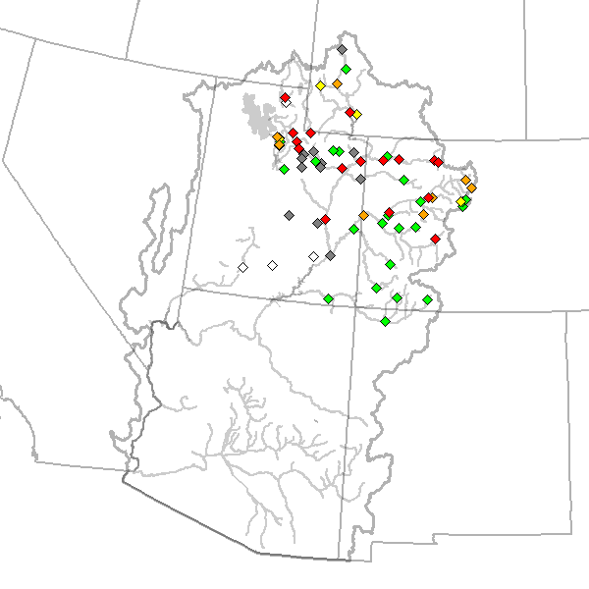
Outline
Recent and Upcoming Weather Review
Snow States
Streamflow forecasts:
Long Lead Peak
Daily
Water Supply
Web Reference: www.cbrfc.noaa.gov/wsup/pub2/map/html/cbrfc.1.2011.html

Slide 3
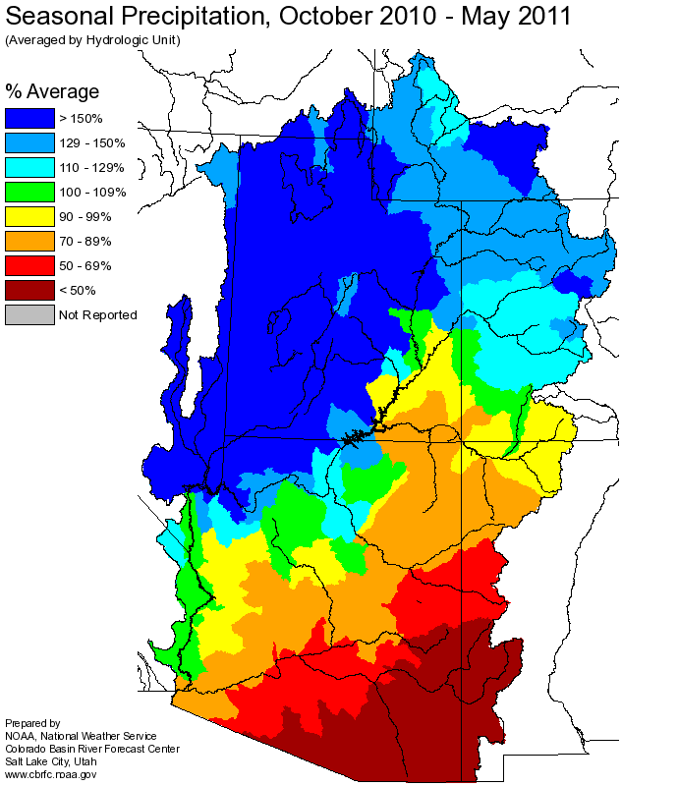
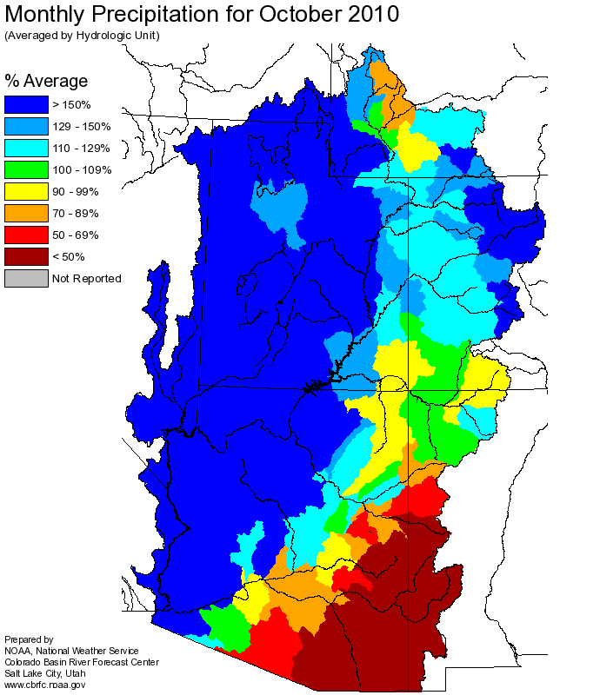
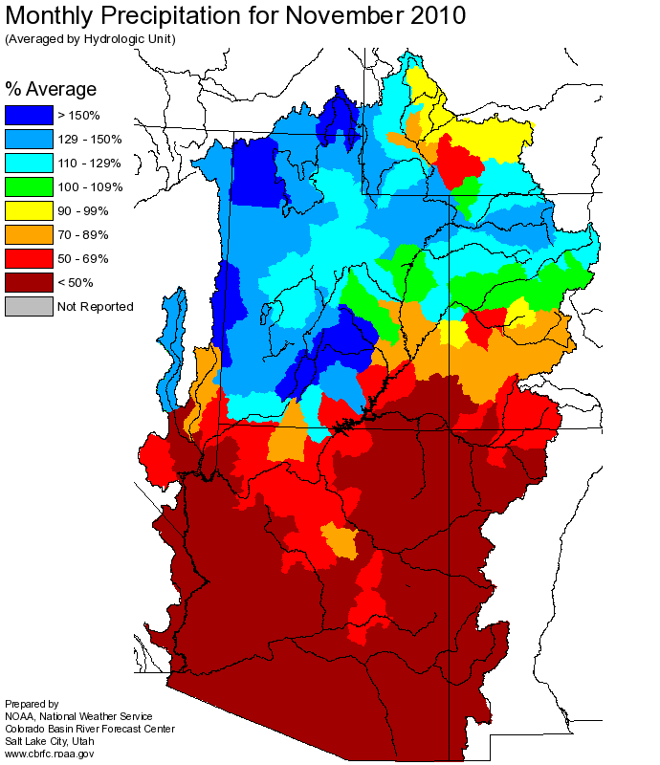
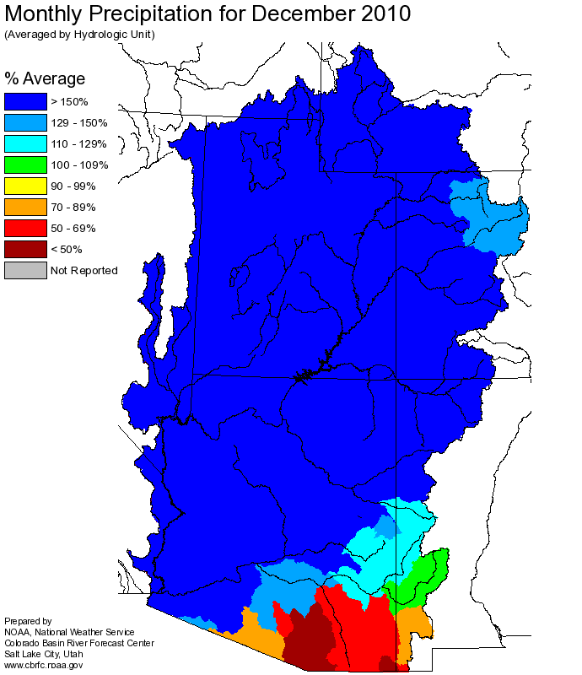
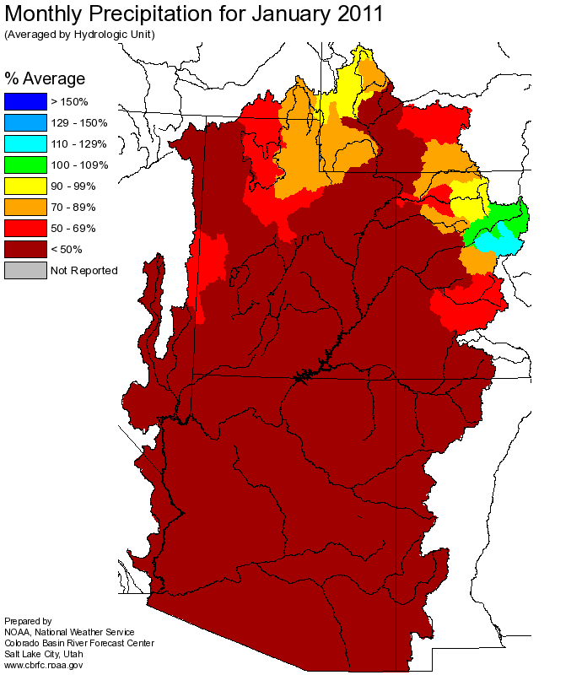
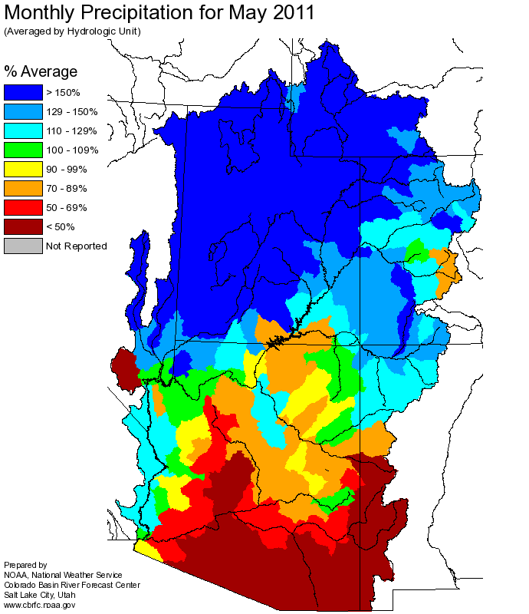
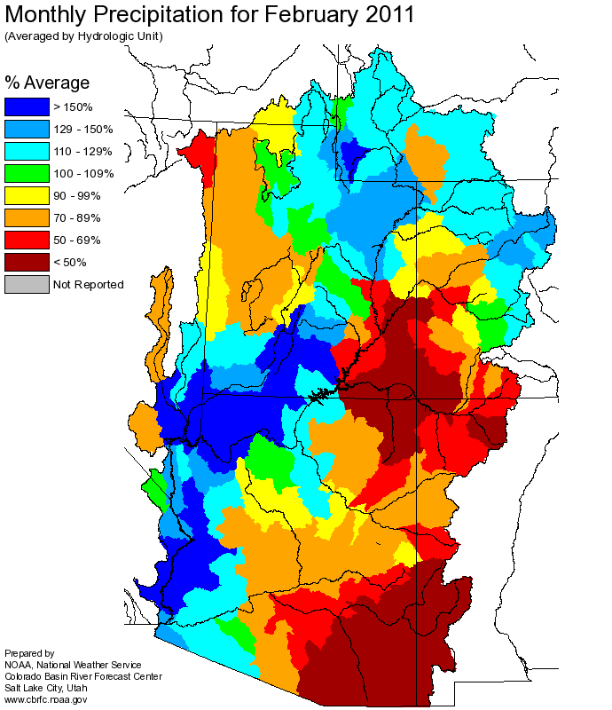
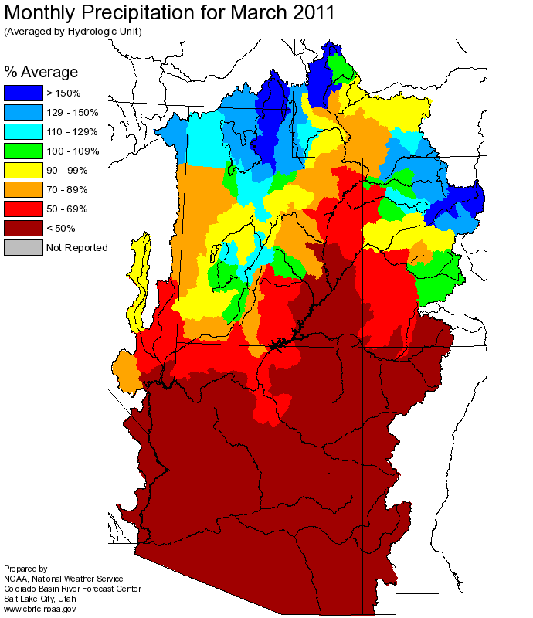
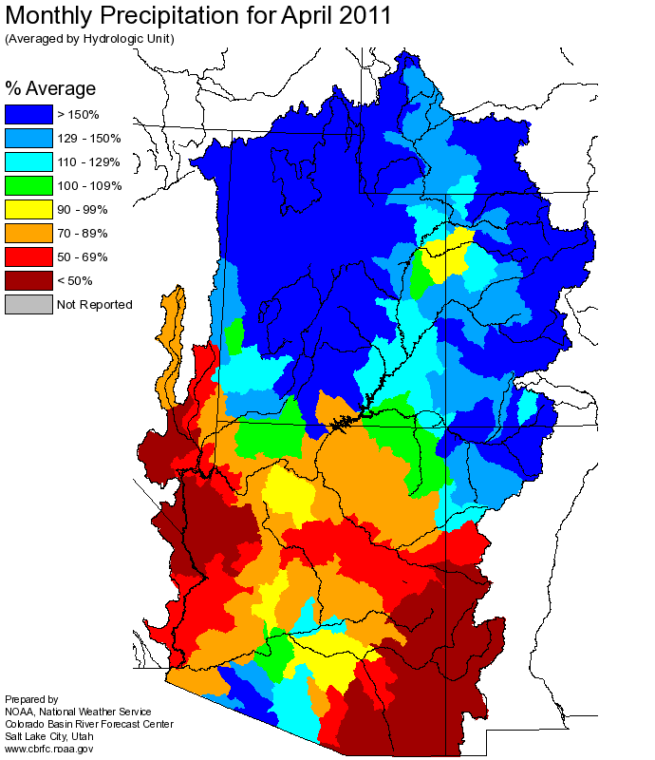
Web Reference: http://www.cbrfc.noaa.gov

Slide 4
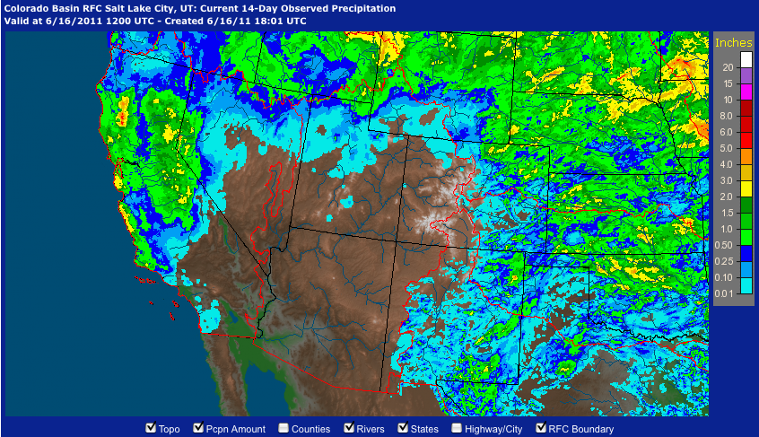
June 1-15 Precipitation
Web Reference: http://water.weather.gov/precip

Slide 5
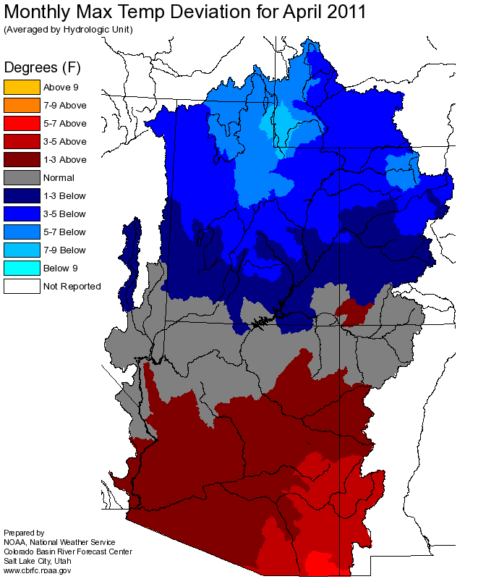
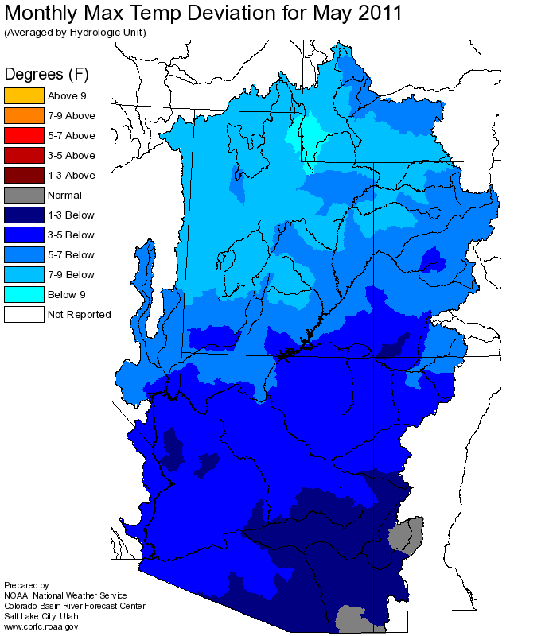
Temperature

Slide 6
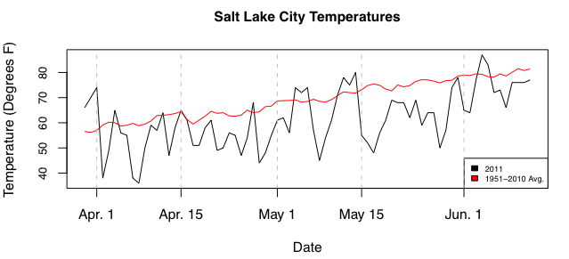
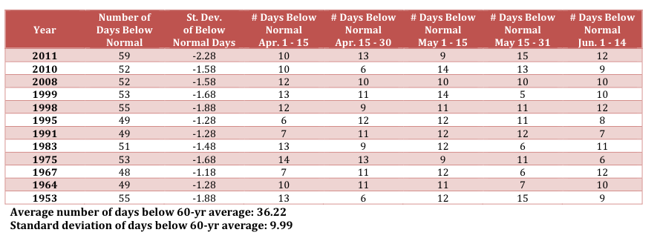

Slide 7
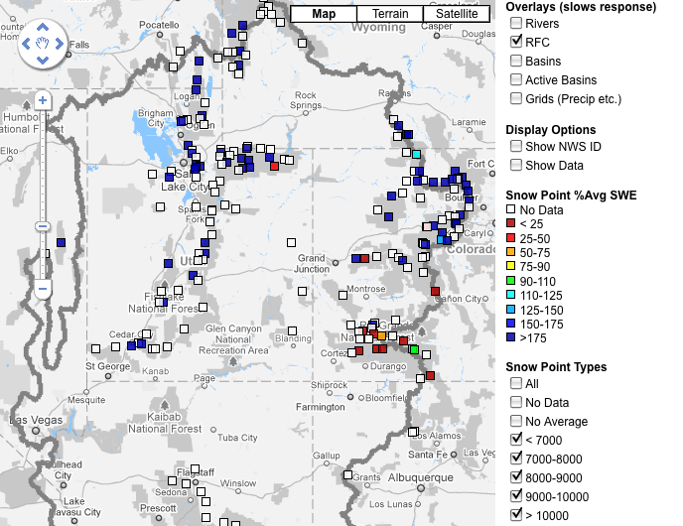
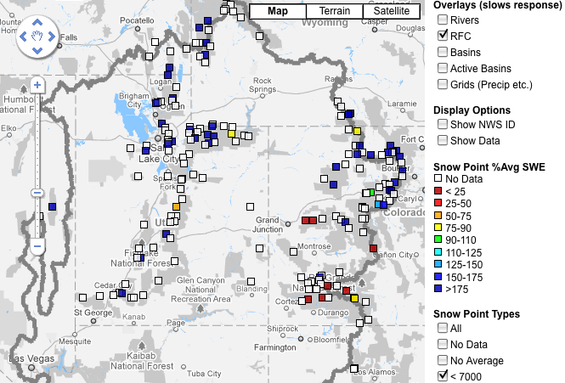
Snow
June 9 June 16
Web Reference: http://www.cbrfc.noaa.gov/gmap/gmapm.php?scon=checked

Slide 8
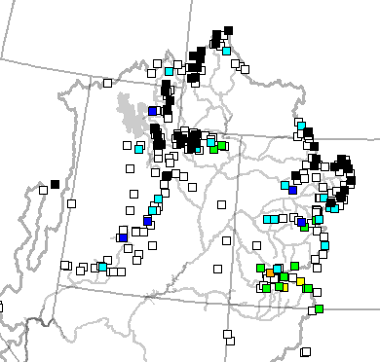
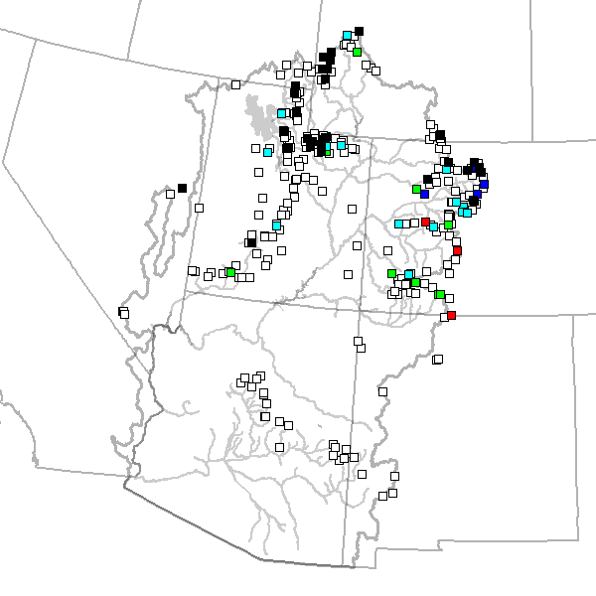
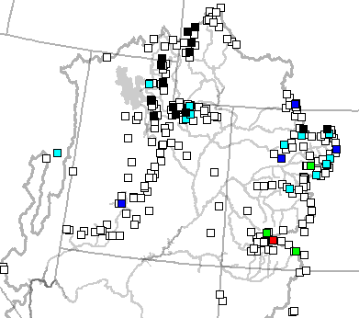
June 2 June 9 June 16

Slide 9
120 sites showing highest value for today!!

Slide 10
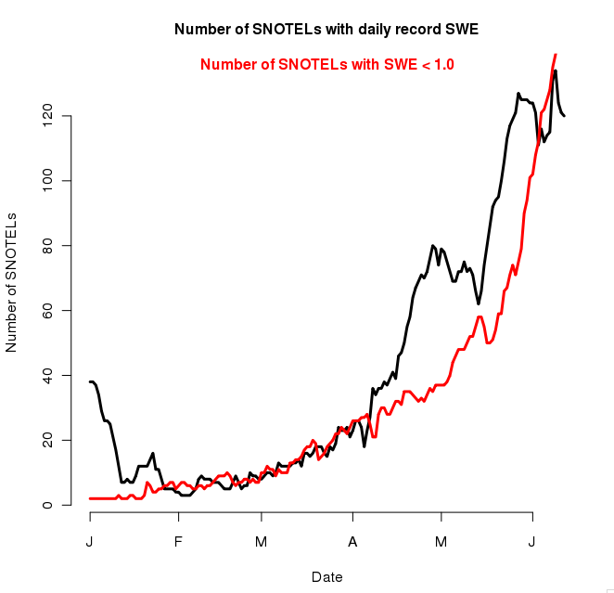
229 sites with 10+ years of record; 127/229 or 55% of sites with daily record as of 5/31

Slide 11
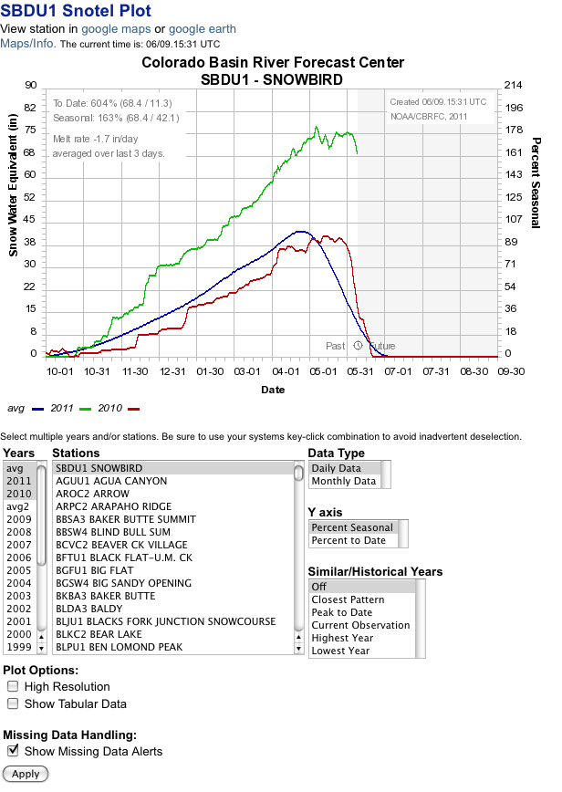
% average daily
% average seasonal peak
Melt or accumulation rate
Historical years
Analogue years

Slide 12
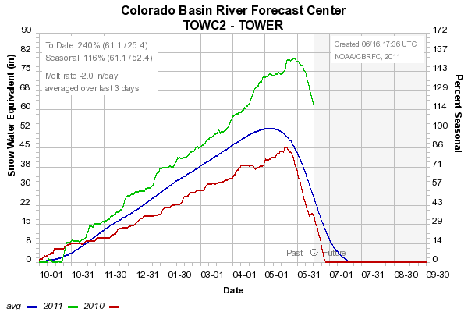
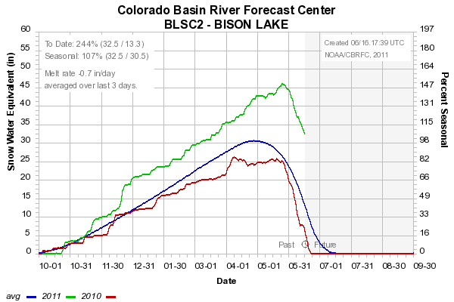
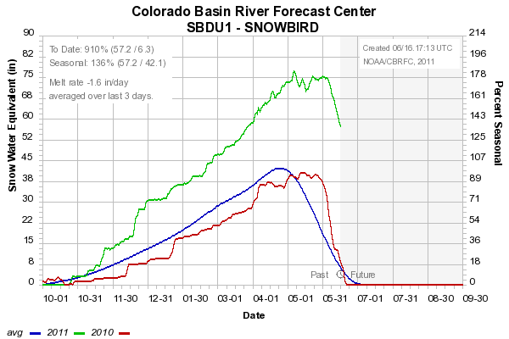

Slide 13
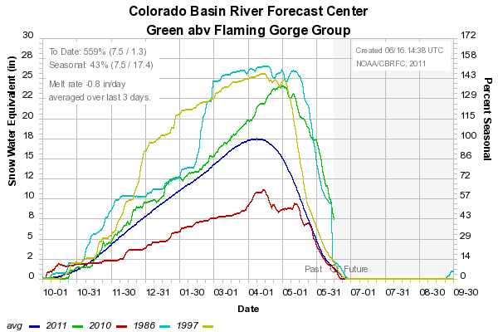
Snow: Upper Green Basin (above Flaming Gorge)
Web Reference: http://www.cbrfc.noaa.gov/station/sweplot/sweplot.cgi???open

Slide 14
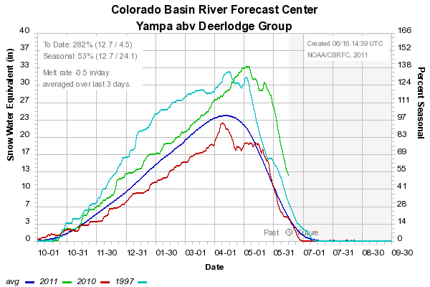
Snow: Yampa
Web Reference: http://www.cbrfc.noaa.gov/station/sweplot/sweplot.cgi???open

Slide 15
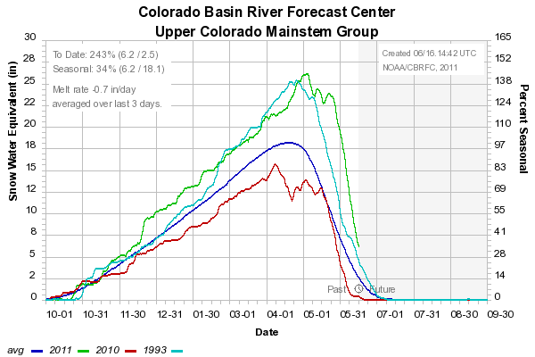
Snow: Colorado Mainstem (above Cameo)
Web Reference: http://www.cbrfc.noaa.gov/station/sweplot/sweplot.cgi???open

Slide 16
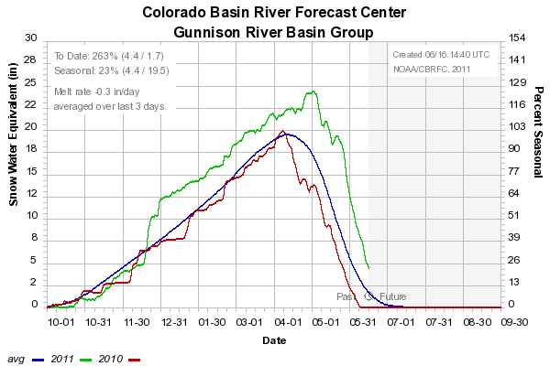
Snow: Gunnison Basin
Web Reference: http://www.cbrfc.noaa.gov/station/sweplot/sweplot.cgi???open

Slide 17
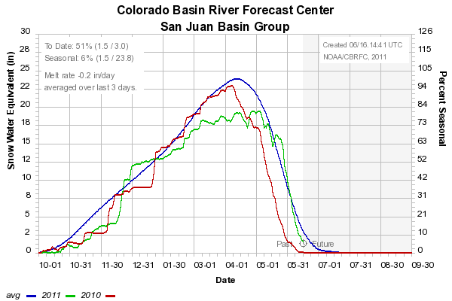
Snow: San Juan Basin
Web Reference: http://www.cbrfc.noaa.gov/station/sweplot/sweplot.cgi???open

Slide 18
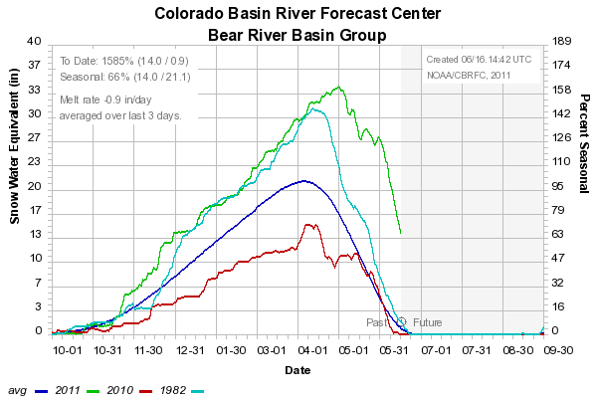
Snow: Bear River Basin
Web Reference: http://www.cbrfc.noaa.gov/station/sweplot/sweplot.cgi???open

Slide 19
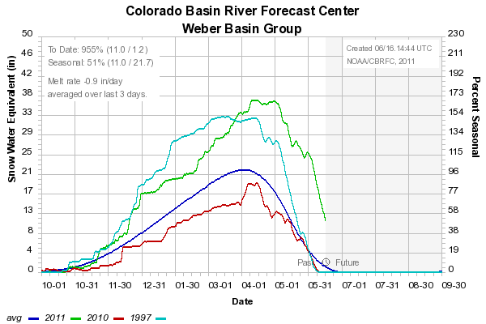
Snow: Weber River Basin
Web Reference: http://www.cbrfc.noaa.gov/station/sweplot/sweplot.cgi???open

Slide 20
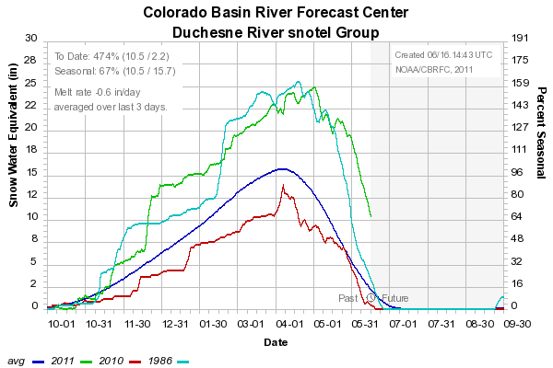
Snow: Duchesne River Basin
Web Reference: http://www.cbrfc.noaa.gov/station/sweplot/sweplot.cgi???open

Slide 21
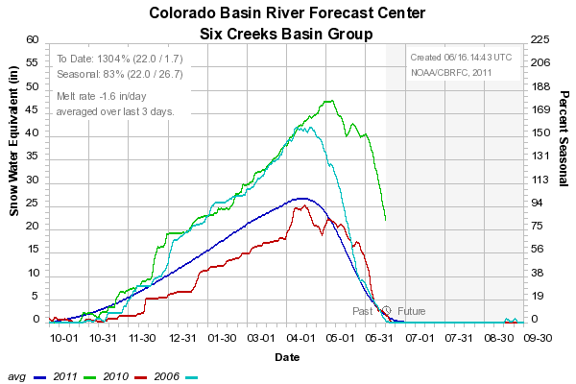
Snow: Six Creeks in Salt Lake County
Web Reference: http://www.cbrfc.noaa.gov/station/sweplot/sweplot.cgi???open

Slide 22
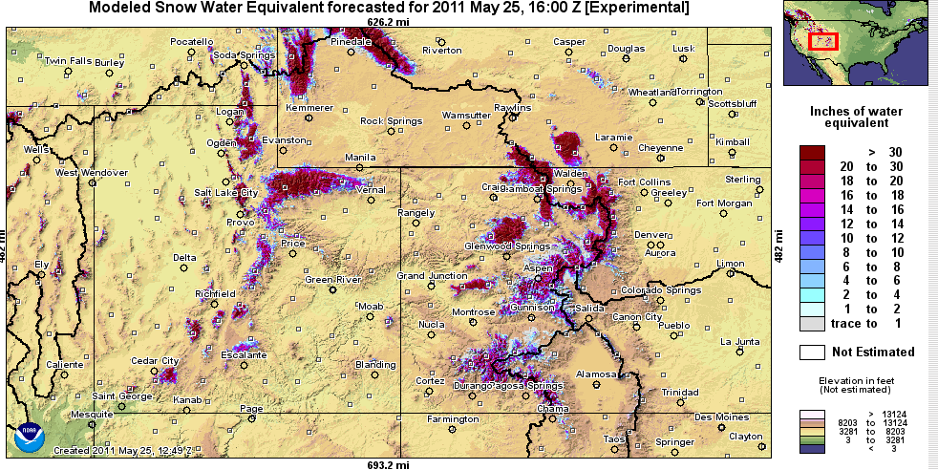
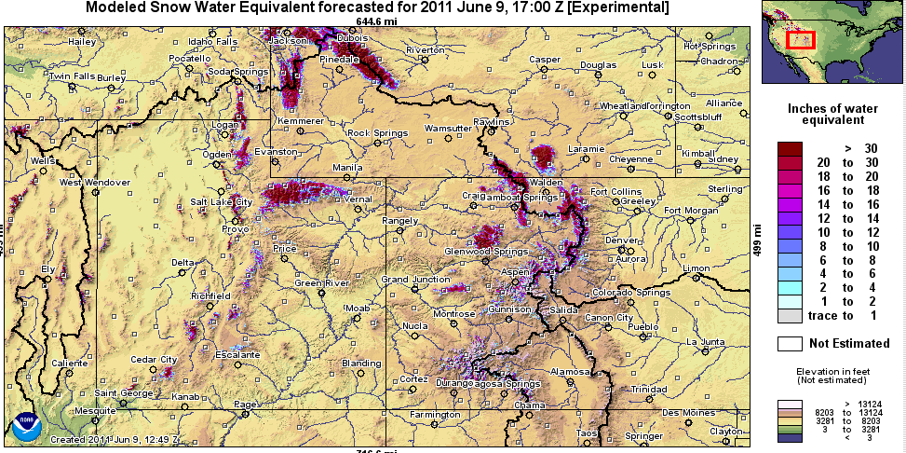
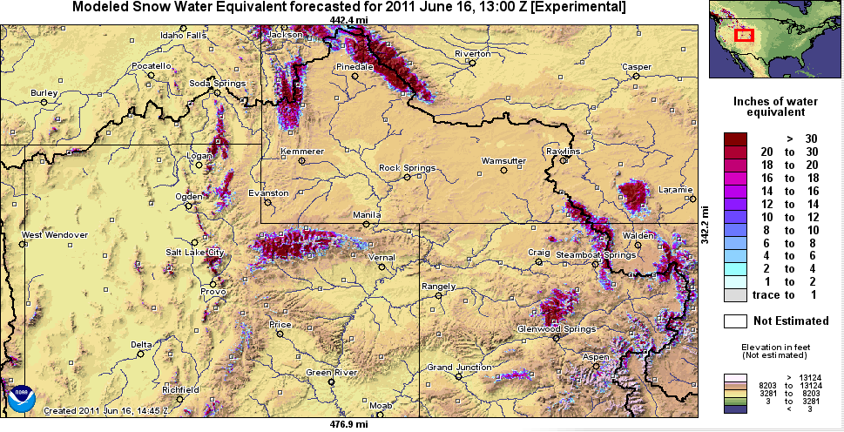
Snow Maps
Web Reference: http://www.nohrsc.nws.gov

Slide 23
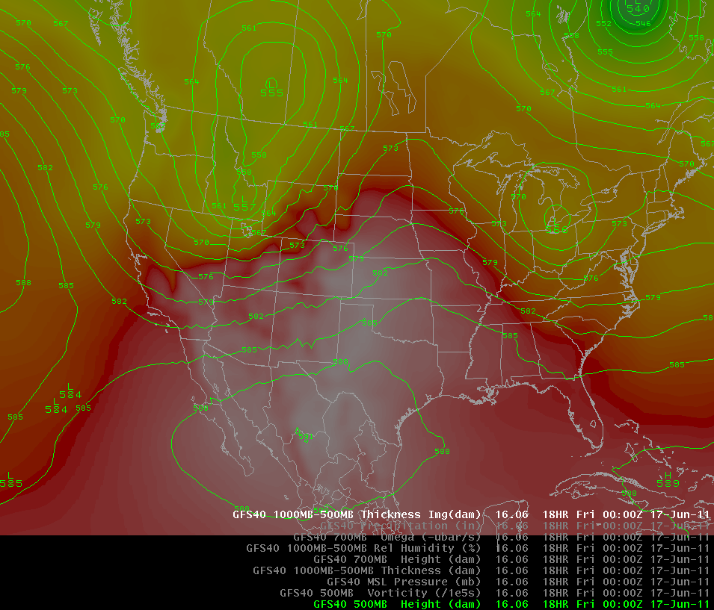
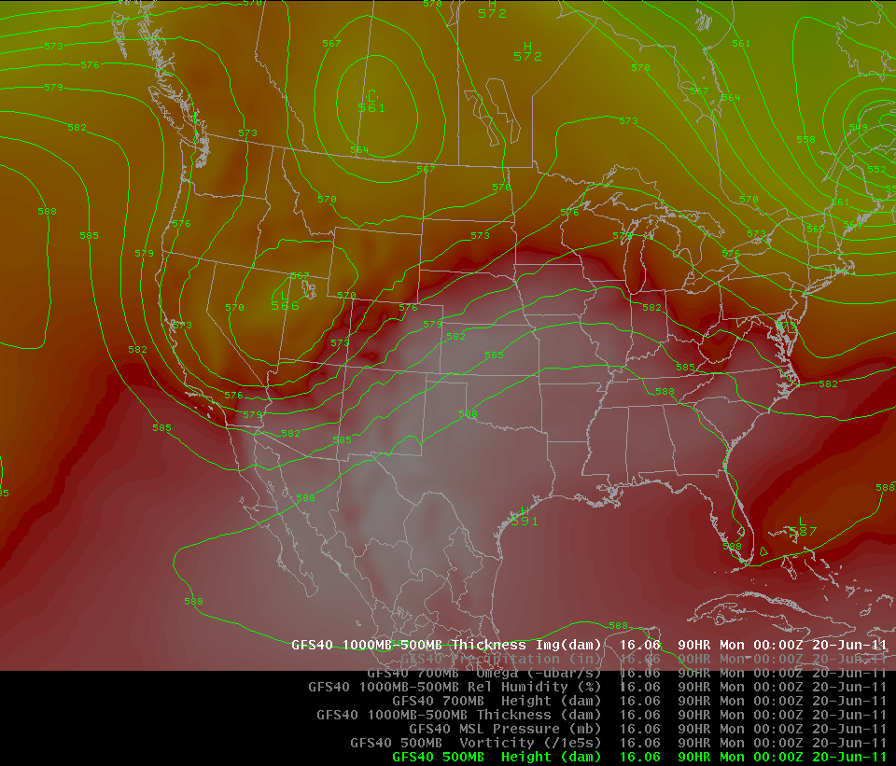
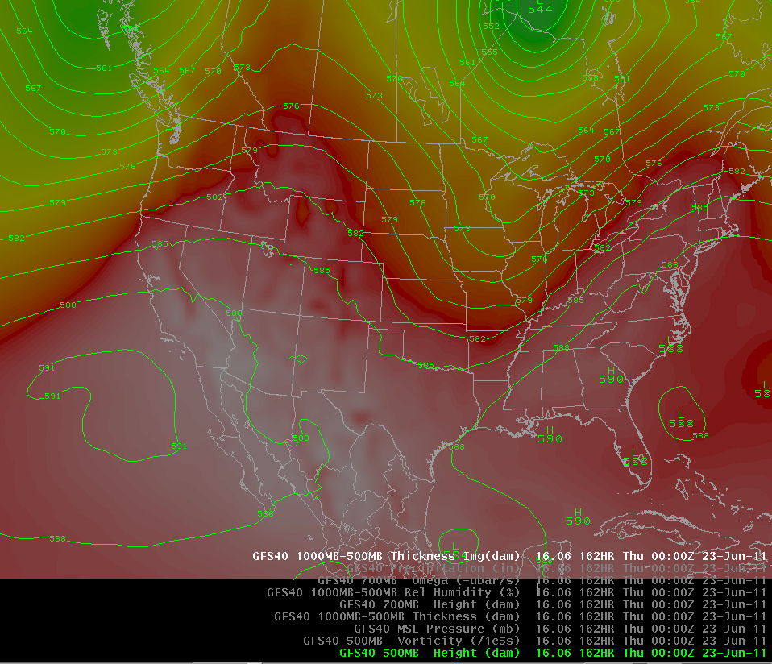
Weather Forecast
<- Today (Thursday)
Sunday PM
Wednesday PM
Low Pressure moves in today through weekend bringing cooler temperature
Warming by middle of next week

Slide 24
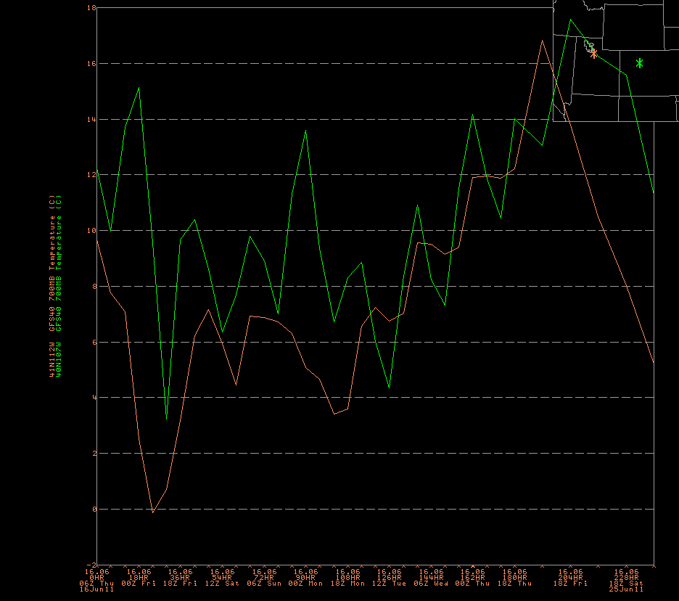

Slide 25
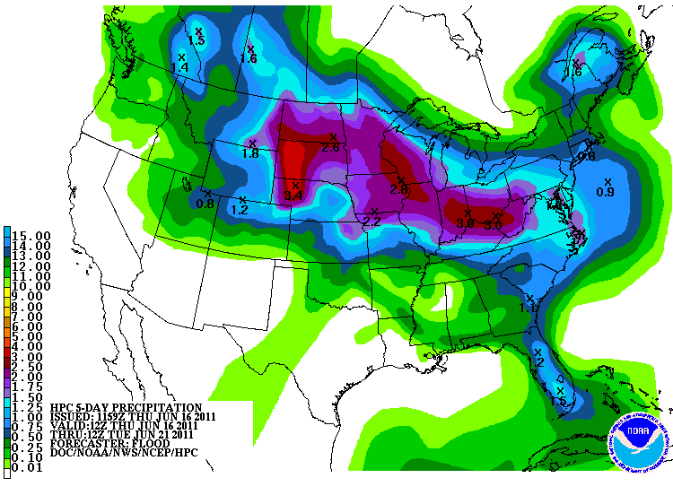
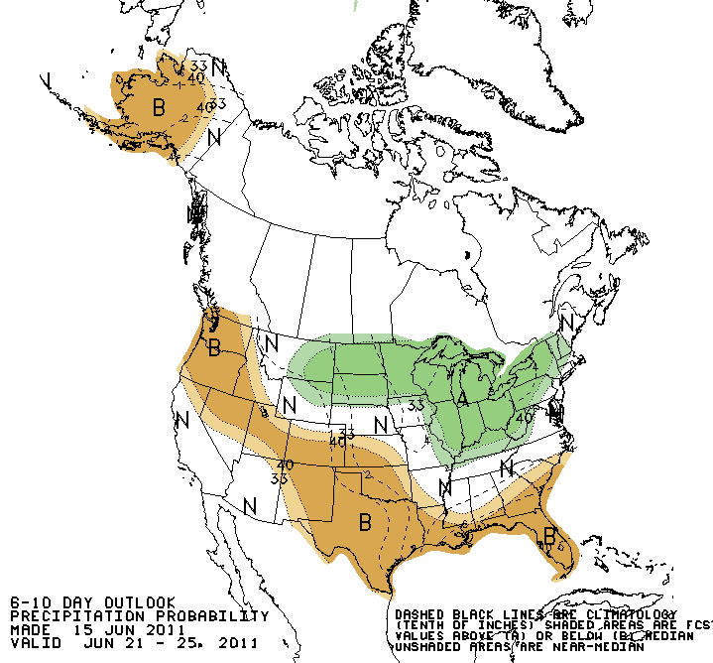
Forecast Precipitation
Showery weather pattern associated with low pressures
Drier next week
Web Reference: www.hpc.noaa.gov

Slide 26
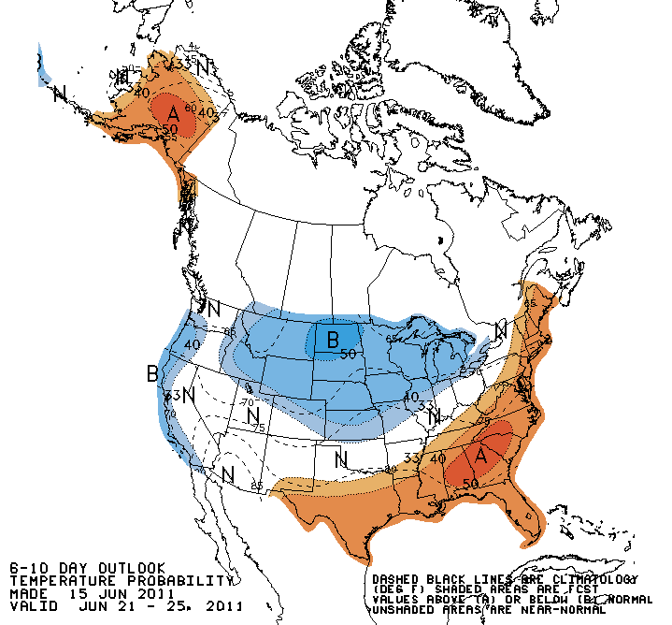
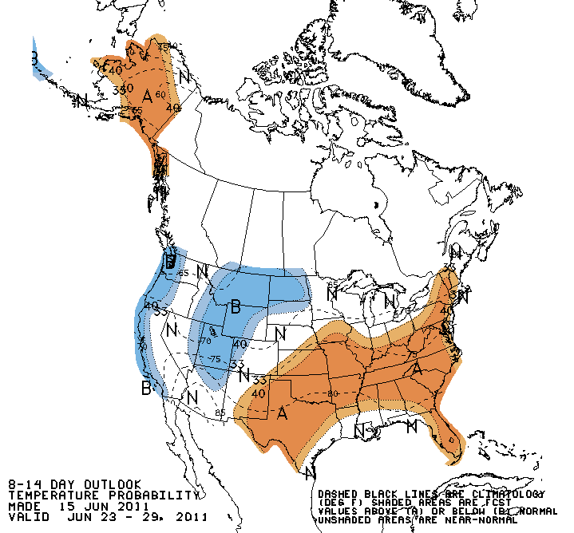
Forecast Temperature

Slide 27
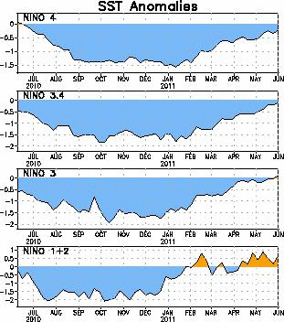
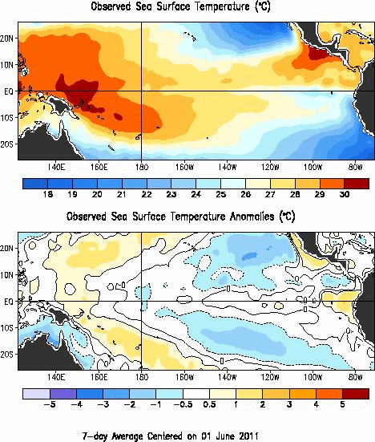
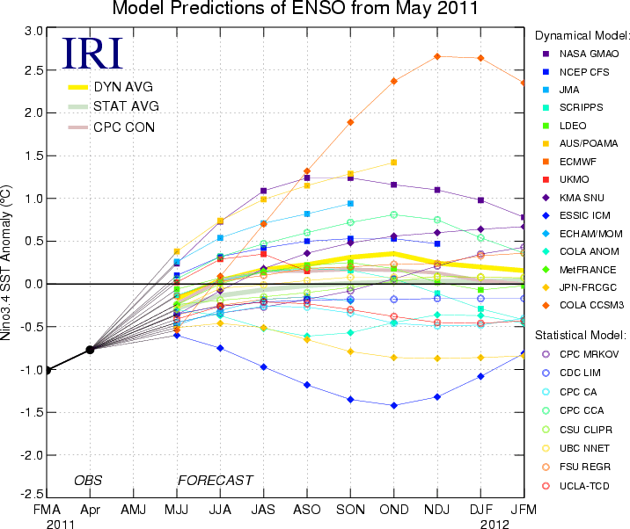
La Nina
Web Reference: http://www.cpc.noaa.gov and iri.columbia.edu/climate/ENSO

Slide 28
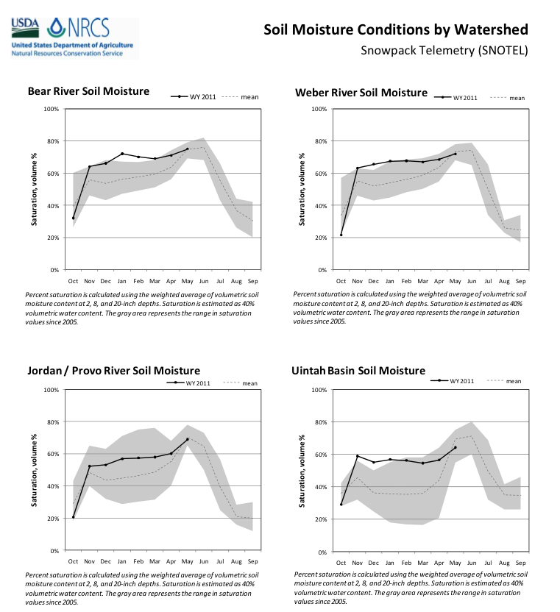
Soil Moisture

Slide 29
Peak Flow Forecasts
Long Lead Peak Flow Forecasts
Snowmelt Mean Daily Maximum Flow (April-July)
Probabilistic Forecasts
Exceedence Probabilities -10%,25%,50%, 75%, 90%
Issued (at least) monthly from March-June (this year weekly starting April 19)
~60 forecast points – some unregulated, some regulated
Daily Forecasts
Full Hydrograph out 14 days
Includes temperature (10 days) and precipitation (5 days) forecast
Includes any knowledge of future regulation (e.g. reservoir release)
Single value forecast
Issued daily by 10am MDT and updated throughout day
~450 forecast points

Slide 30
Spring Weather Really Matters (and has mitigated high flows this year)
Runoff characteristics are largely determined by the day-to-day spring weather.
While large snow pack years increase chances for flooding, it is not an inevitability
Small snow pack years (like last year) can flood with the right sequence of spring temperatures

Slide 31
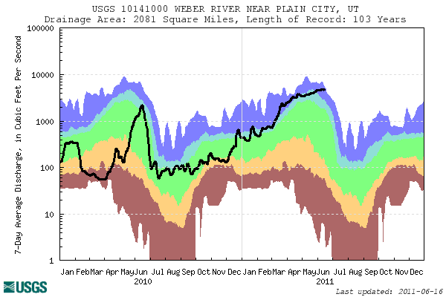



Slide 32


CBRFC Website Mini Tutorial
Current website
Extensive in scope
Slower, cumbersome
www.cbrfc.noaa.gov

Slide 33


CBRFC Website Mini Tutorial
“Beta” website
Faster
Easier access to key information
Actively being developed
www.cbrfc.noaa.gov/gmap/cmap.php

Slide 34
Peak Flow Charts
Flood Stage
Forecast Creation Time
Long lead peak forecast
Observed streamflow since April 1
Daily forecast
Bankfull
web reference: www.cbrfc.noaa.gov/gmap/cmap.php

Slide 35


Current Forecasts
May 24 Forecasts
June 16 daily Forecasts

Slide 36




Slide 37



Slide 38



Slide 39



Slide 40



Slide 41



Slide 42



Slide 43



Slide 44



Slide 45



Slide 46



Slide 47



Slide 48



Slide 49


Experimental: Peak Flow Forecast Evolution
Daily long lead peak forecasts from ESP reflect changing weather forecasts and hydrology.
Started in late May and comparing to official forecasts
Little Cottonwood Creek (top)
Yamap near Deerlodge (bottom)
Comments welcome
Web reference: http://www.cbrfc.noaa.gov/devel/dly_peak/

Slide 50


Snowpack (and elevation) really matter
Ensemble forecasts for:
Yampa River
Middle elevation
Significant melt already occurred
Little Cottonwood Creek
Higher elevation
Most melt forthcoming

Slide 51

Experimental Daily Ensembles
Ensemble forecasts that incorporate weather forecasts are run daily for Upper Colorado Basin forecast points
Prototype web tool available
Does NOT work correctly downstream of reservoirs yet
NOT available for the Great Basin yet
URL: www.cbrfc.noaa.gov/devel/hefs

Slide 52


NWS Flood Warnings, Watches
NWS Weather Offices are responsible for setting flood stage and issuing flood warnings and watches based on CBRFC forecasts. Key personnel for snow melt floods:
Salt Lake City – Brian McInerney
Grand Junction – Aldis Strautins
Riverton – Jim Fahey
Boulder – Treste Huse

Slide 53
Peak Flow Decision Support
Peaks are coming soon!!
Long lead peak forecasts will no longer be updated this year because most rivers are peaking within the 14-day daily forecast window
Daily forecasts posted by ~10am MDT each (and updated later during the day). When temperatures are forecast to warm, please check here for the latest peak flow forecasts.
“beta” website developments:
SNOTEL percentiles
Simplified peak flow chart
Publication referencing forecasts above historic peaks
New peak flow forecast points added
Webinars: Weekly until peak flows are passed. Thursday, June 16 at 1pm
Discussion:
Anything else you need??

Slide 54

CBRFC Blog
Blog.citizen.apps.gov/cbrfc

Slide 55

CBRFC Contacts
Basin Focal Points (Available to discuss forecasts: 801.524.5130)
Upper Colorado: Brenda Alcorn
Green: Ashley Nielson
San Juan / Gunnison: Tracy Cox
Great Basin: Brent Bernard
Lower Colorado (below Lake Powell): Greg Smith

Slide 56


Feedback, Questions, Concerns always welcome….
Kevin Werner
CBRFC Service Coordination Hydrologist
Phone: 801.524.5130
Email: kevin.werner@noaa.gov

