Slide 1
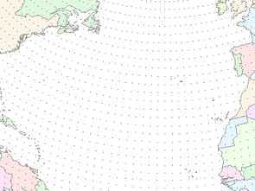



CBRFC Recalibration and Average Update
Kevin Werner
NWS Colorado Basin River Forecast Center

Slide 2
Outline
30 year average period update
Recalibration

Slide 3
Average and Recalibration Update
30 year averages are updated once every 10 years
WY2011 Used:
1971-2000 for averages
1971-2000 for statistical prediction
1976-2005 for ESP
Update for WY2012 will be based on 1981-2010 time series
New averages based on 1981-2010
Averages done for USBR data; mostly done elsewhere
New statistical prediction equations based on 1981-2010 period
Will be completed in Nov/Dec
Recalibration of 458 river basin modes to the 1981-2010 period
Nearly complete for Upper Colorado Basin (done early Nov)
CBRFC will debut all of this for January 2012 forecasts

Slide 4
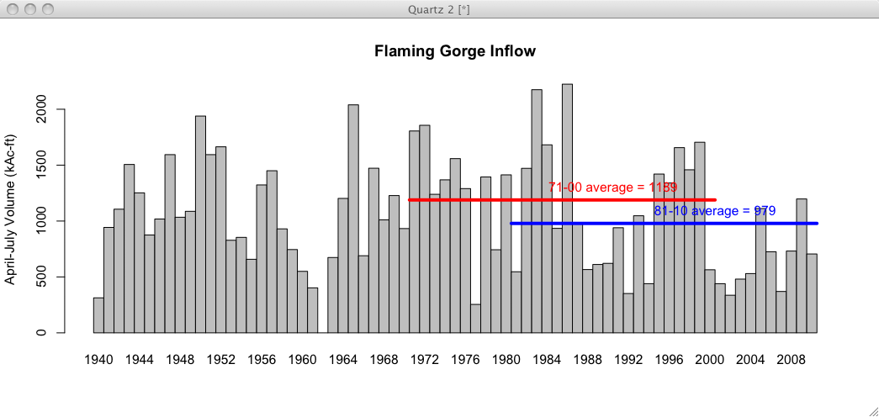
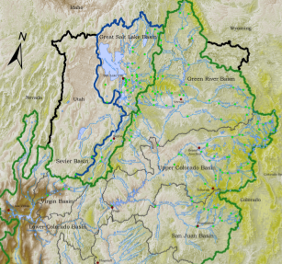
Preliminary Data
18% reduction in mean

Slide 5
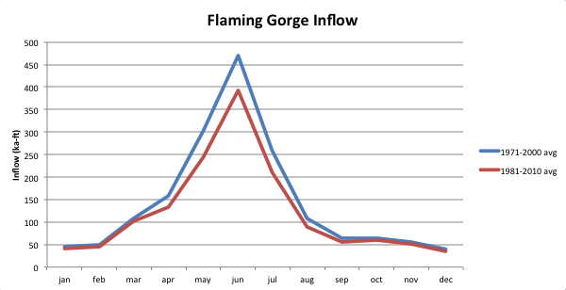
Flaming Gorge Monthly

Slide 6
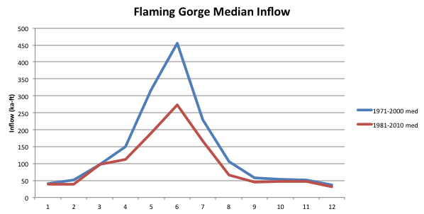

Slide 7
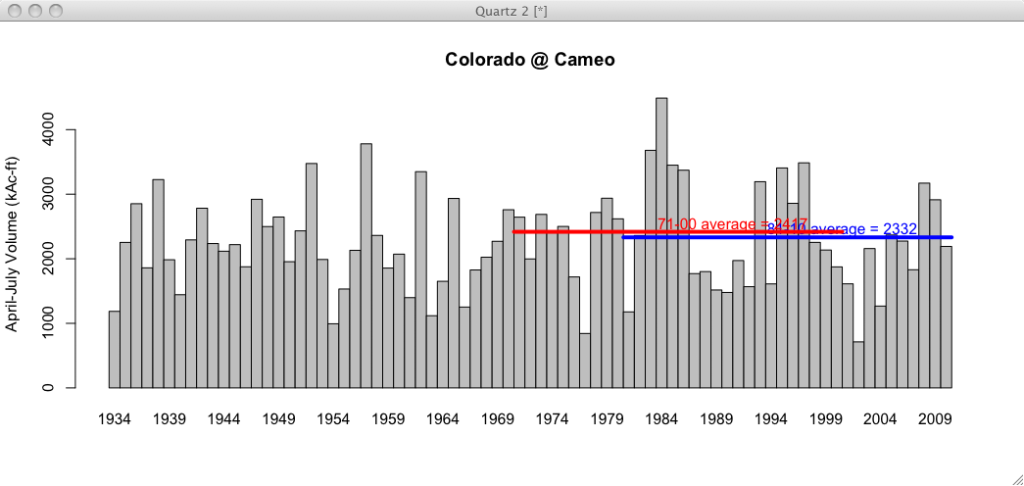
Preliminary Data
4% reduction in mean

Slide 8
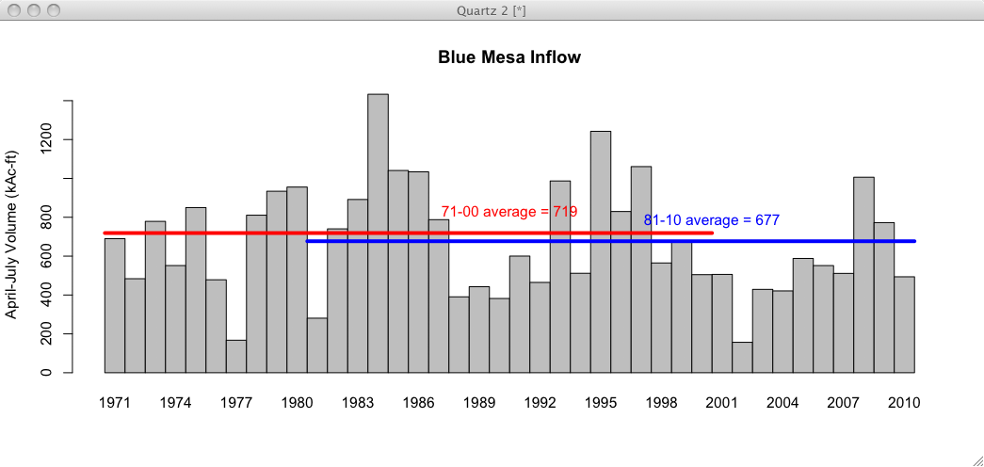
Preliminary Data
6% reduction in mean

Slide 9
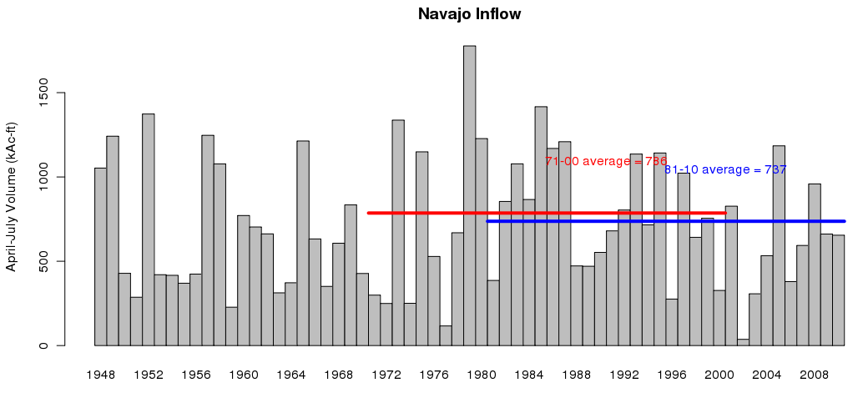
Preliminary Data
6% reduction in mean

Slide 10
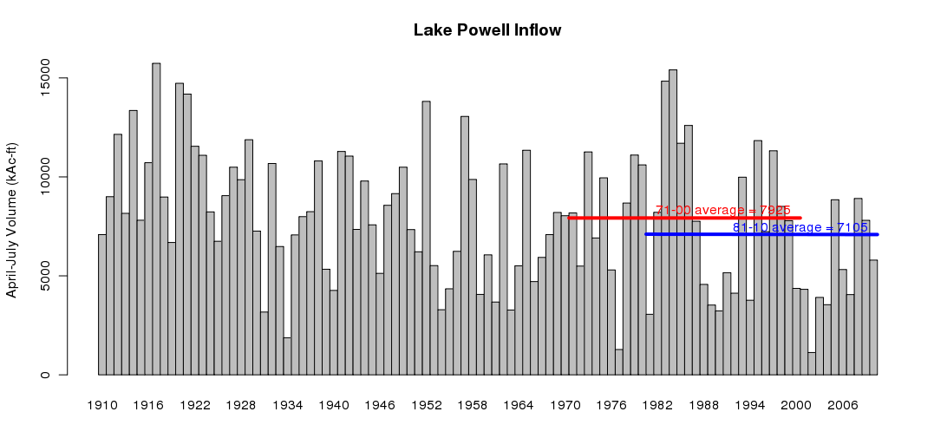
3 Gage Method
Mass Balance:
71-00 = 7927 MAF
81-10 = 7158 MAF
Preliminary Data
11% reduction in mean

Slide 11
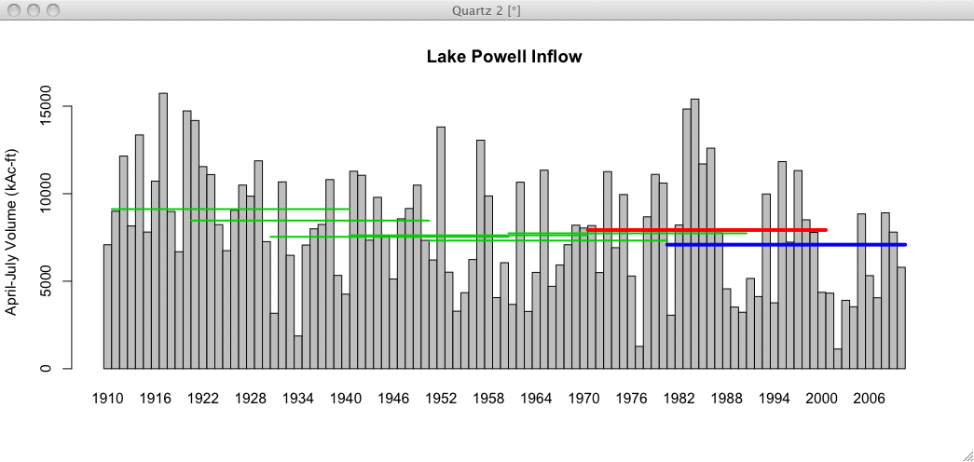
Preliminary Data
All 30 year means since 1911-1940

Slide 12
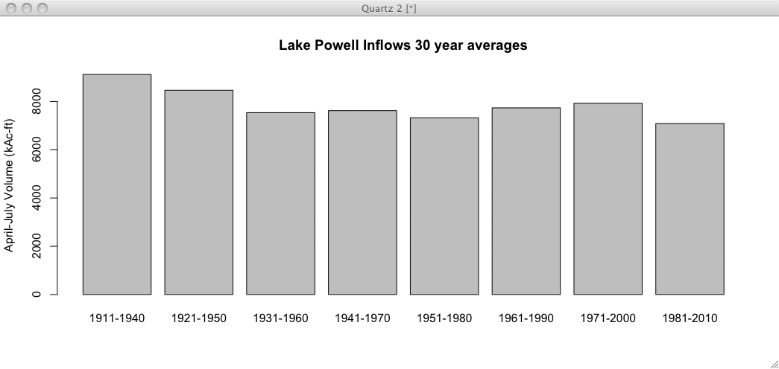
1981-2010 is the driest 30 year period on record

Slide 13
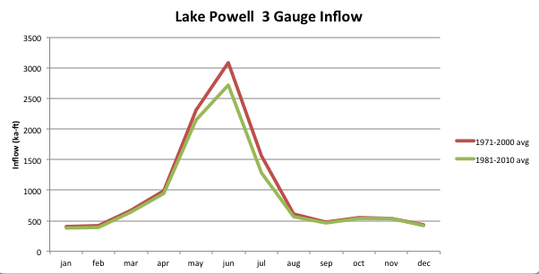
Lake Powell Monthly

Slide 14
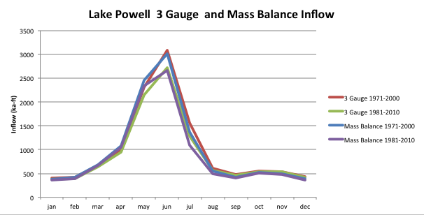
Lake Powell Monthly

Slide 15
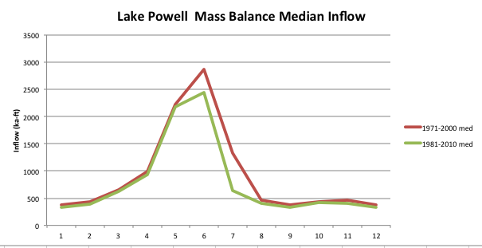

Slide 16
Effect on Forecasts
WY2012 forecasts will be based on 1981-2010 inputs in both forecast models
ESP and SWS will both use the same period
SNOTEL network much stronger for 1981-2010 period than in 1970s. This network is critical for forecast skill.
All things equal, these forecasts will be lower since input data sets are drier in the 30 year average
Especially true in early season forecasts
Later season forecasts more controlled by observed snowpack
Percent of normal forecast values should remain largely unchanged (since normals AND forecasts will be lower)

Slide 17
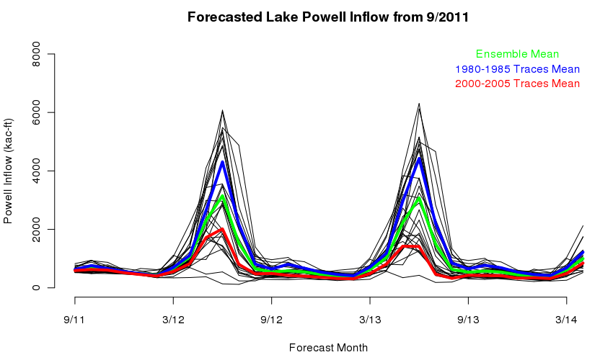
Example: ESP forecasts Mean influencing year out forecast

Slide 18
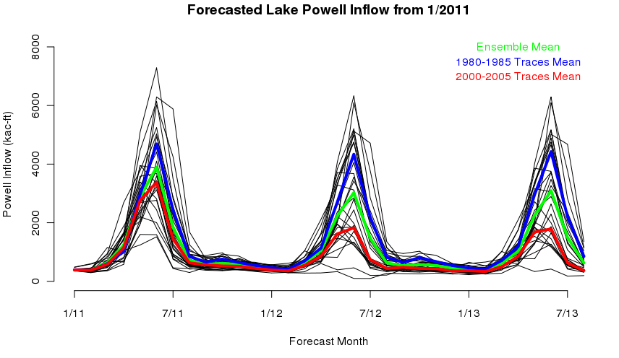
Example: ESP forecasts Mean influence to early season forecasts somewhat less

Slide 19
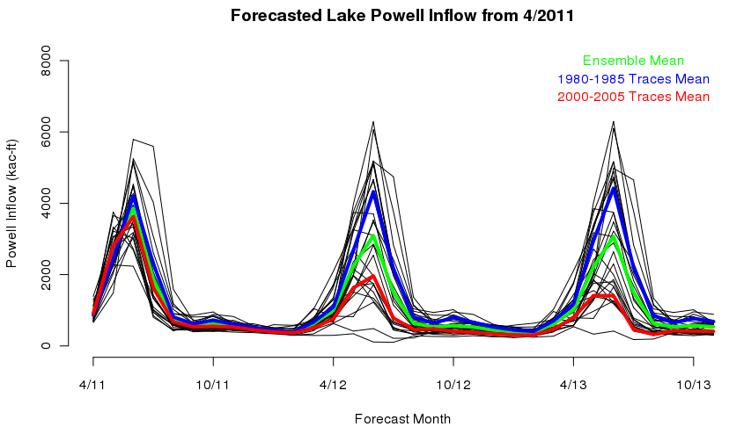
Example: ESP forecasts Mean influence to late season forecasts small

Slide 20
Discussion
CBRFC in the midst of recalibration; expected to be completed in Nov.
CBRFC and NRCS will coordinate (and round) averages
USBR requested update occur on August 1 or on January 1 but not in between
Change will occur on January 1
Comments / Questions?

Slide 21


Kevin Werner
CBRFC Service Coordination Hydrologist
Phone: 801.524.5130
Email: kevin.werner@noaa.gov
www.cbrfc.noaa.gov

