Slide 1
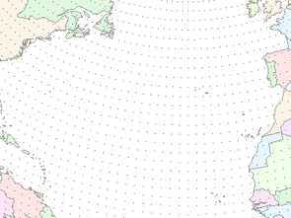



Stakeholders: Who are they and what do they want?
A three year report on the NWS Service Coordination Hydrologist program
Kevin Werner
NWS Colorado Basin River Forecast Center

Slide 2
Outline
Background
Successes
Challenges

Slide 3
Background
Service Coordination Hydrologist (SCH) position established at River Forecast Centers (RFCs) beginning in 2008
SCH program intended to manage and enhance RFC stakeholder interactions
SCH is a management level hydrologist at each of the 13 RFCs
CBRFC was one of the first RFCs to fill new position in March 2008

Slide 4
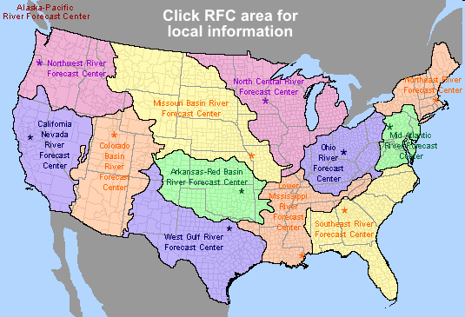
Colorado Basin River Forecast Center
One of 13 River Forecast Centers
Established in the 1940s for water supply forecasting
Three primary missions:
1. Seasonal Water supply forecasts for water management
2. Daily forecasts for flood, recreation, water management
3. Flash flood warning support
www.cbrfc.noaa.gov

Slide 5
Water Resources Vision 2020
Deliver a broader suite of improved water services to support management of the Nation’s Water Supply
Provide resources and training to:
Enable RFCs to run high-resolution models and produce gridded forecasts of streamflow, salinity, and soil moisture for the 4-D cube
Expand role of the WFOs to help local decision makers to use enhanced water forecasts, and function as decision-support experts for high-impact flood, drought, and water quality events

Slide 6
RFC Forecast Process
BLACK BOX
Hydrologic Model Analysis
hydrologic
expertise &
judgment
model
guidance
Weather and Climate Forecasts
River
Forecast
System
Forecast
precip / temp
Outputs
Graphics
River Forecasts
Analysis &
Quality Control
parameters
Observed
Data
Calibration

Slide 7
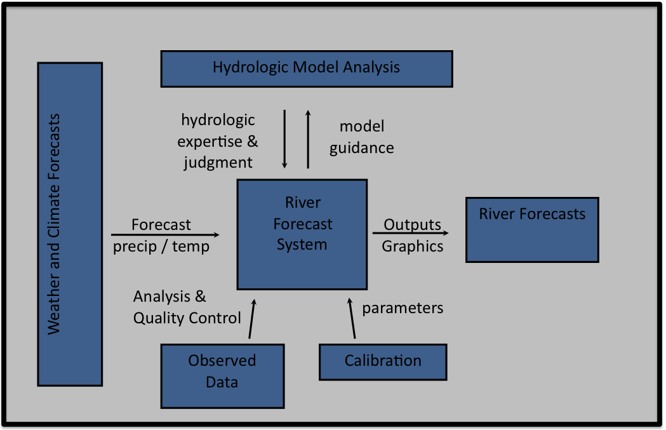
RFC Forecast Process
Organization #1 Decisions
Organization #2 Decisions
Rules, values, politics, technical ability, vulnerability, other factors
Service Coordination Hydrologist
Organization #n Decisions

Slide 8
Previous Research on Water Management and Forecast Usage
Study | Method(s) | Geographic Area(s)
(Rayner et al., 2005) | Field Research: Semi-structured Interviews | USA: Pacific Northwest, Southern California, and Washington, DC
(O'Connor et al., 2005) | Survey | USA: South Carolina and Susquehanna River Basin of Pennsylvania
(Lemos, 2008) | Field Research: Observation of Meetings | USA and Brazil
(Dow et al., 2007) | Survey (building on earlier work (O'Connor et al., 2005)) | USA: South Carolina and Susquehanna River Basin of Pennsylvania
(Callahan & Miles, 1999) | Field Research: Semi-structured interviews | USA: Pacific Northwest
(Ziervogel et al., 2010) | Case Study | South Africa
(Pulwarty & Redmond, 1997) | Field Research: Semi-structured interviews | USA: Pacific Northwest
Forecasts generally not used. Water management agencies value reliability and quality above all else. Unless those are threatened, agencies have little incentive to use forecasts.
Forecast use correlates with perceived risk. Forecast usage not dependent on agency size or on understanding of forecast skill and reliability.
Policy and infrastructure in USA limit use of forecasts. Many operating decisions are tied to observed data and do not allow flexibility.
Hopeless?
No! Long term drought, increasing demands, and climate change projections for less water each present opportunities for increasing forecast usage.
8

Slide 9
Colorado River Supply and Demand
Credit: USBR
Notes:
9
9

Slide 10
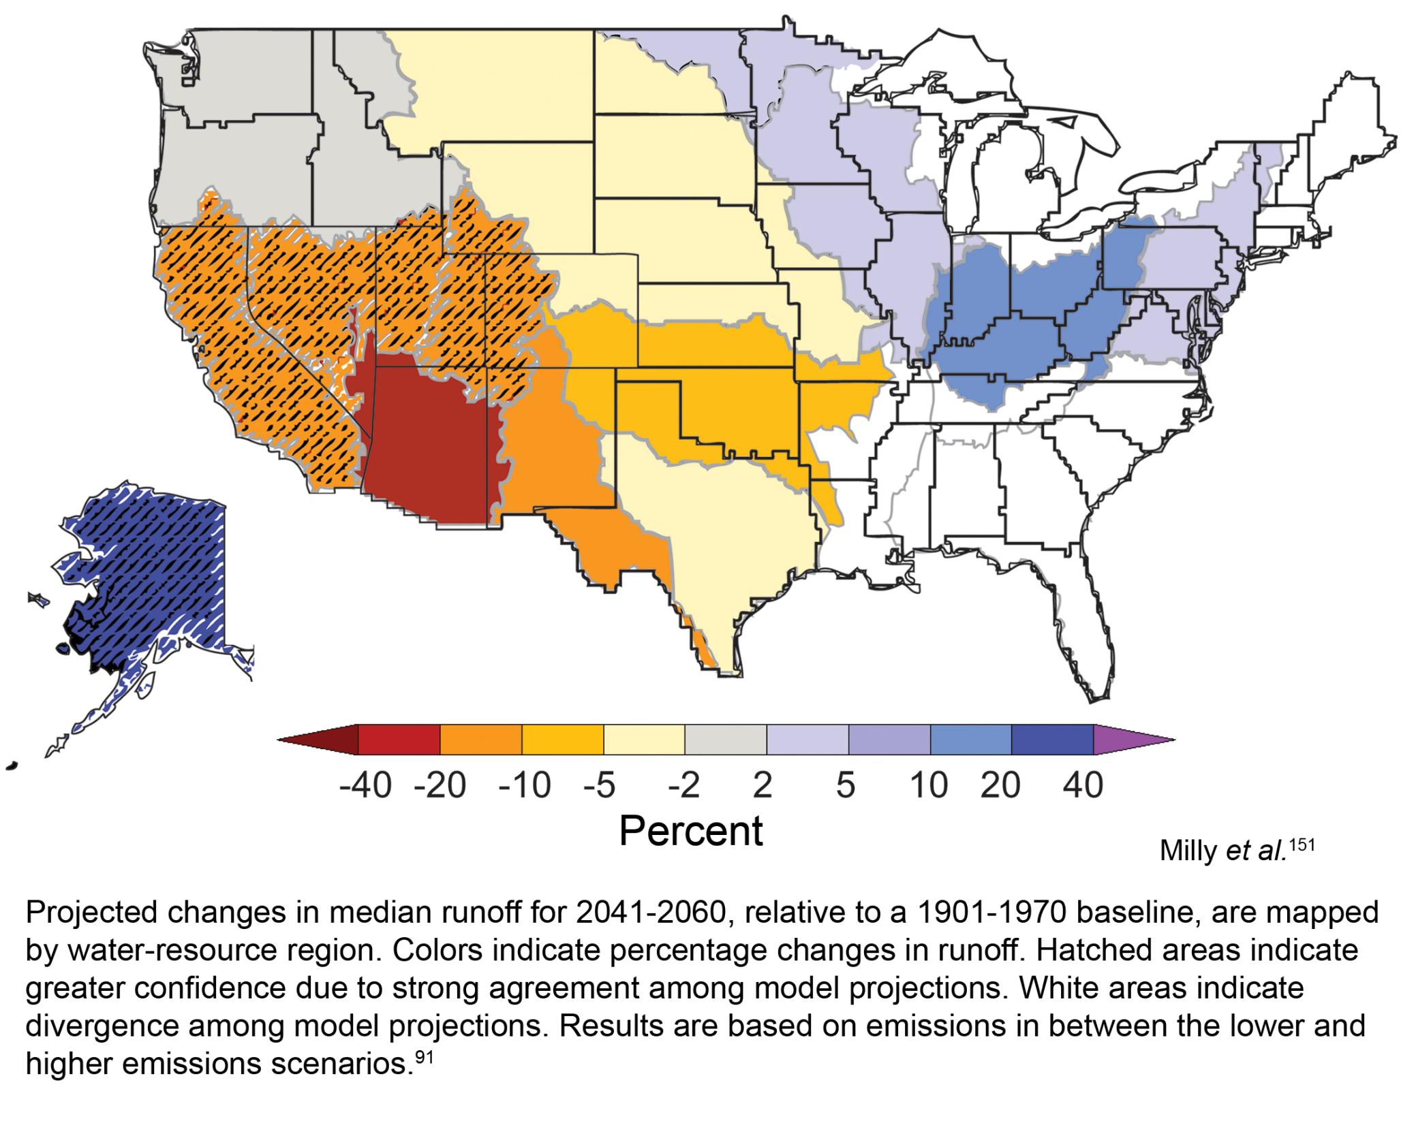

Slide 11
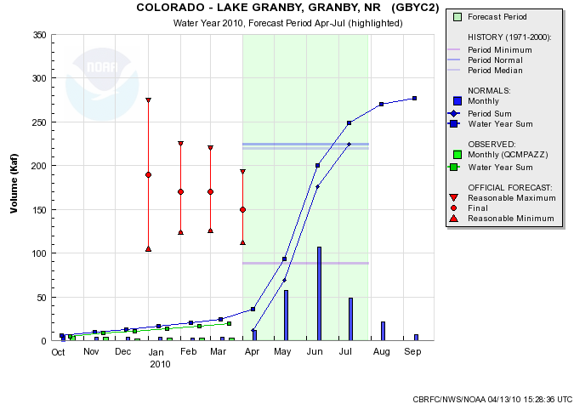

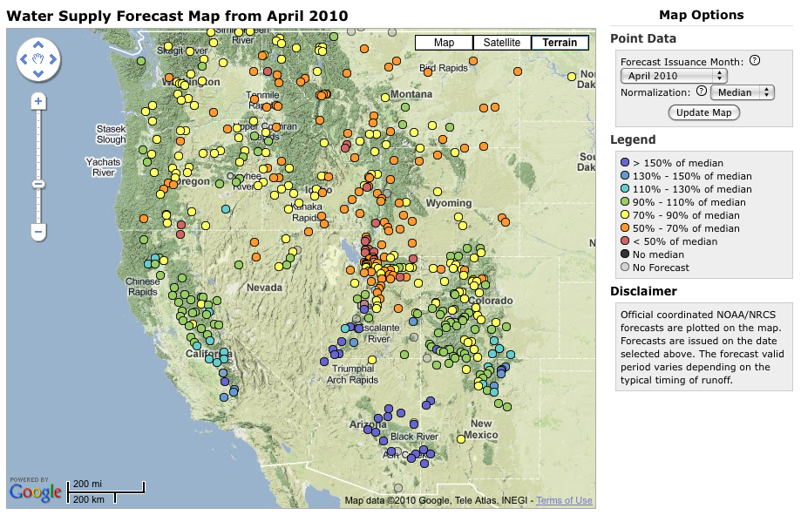


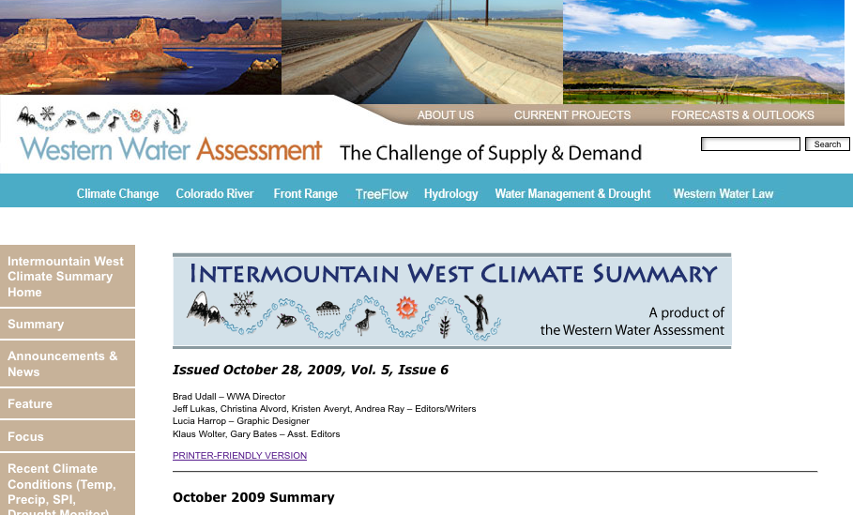

Strategy: Integrated and Iterative
Science / development
START
Research & Science
Better Climate and Water Information
Users + Existing Information
Product Developers
Information Providers
(RFCs)
Information Providers
(RFCs)
More Informed Stakeholders
Workshops
Education
Stakeholder Engagement
Notes:
This diagram represents the RISA concept of climate services– emphasize that RISA do not deliver climate services, but prototype and document processes– they are research entities
It is neither top down or bottom up, but is best described as integrated and iterative
And the emphasis here is on process over product
First start with available climate information and those interested in using that information
Information and the users enter into the climate services machine
Machine represents the interactions that occur among the users, scientists, researchers, developers of climate information
The challenge is to build the most efficient machine that will result in more informed users and more useful information
But this doesn’t end here; users continue to be entrained as part of the system, and they have to be
as users understanding of climate evolves, so do their needs for climate information
Consequently, the climate machine can’t be static, but rather dynamic and adaptable
So as people and information change as they move through the cycle, the machine can also change

Slide 12
CBRFC Strategies
Science and Development (DOH function)
Implementing new modeling software
Enhancing ensemble forecast capabilities
Web tool development
Evapotranspiration
Distributed modeling
Etc.
Stakeholder Engagement (SCH function)
Annual stakeholder forum
Monthly water supply and peak flow forecast webinars
Stakeholder engagements workshop
Promoting ensemble forecasts
Blog
Website analytics
Time with stakeholders – understand their operations

Slide 13
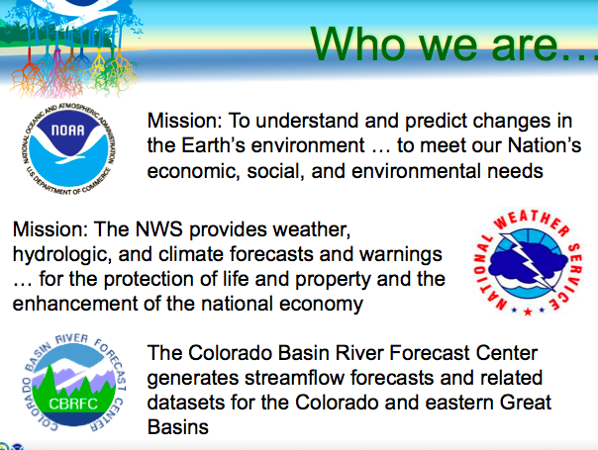
CBRFC 2010 Stakeholder Forum
3 Day Event at CBRFC in August 2010
Participants from all over CO basin attended
Main focus on water supply and peak flow forecast needs in the basin
Key requirements from forum:
Simple ways to communicate forecasts relative to important thresholds
Post-mortems
More info on the 30 year average update
Objective water supply forecast system
Greater CBRFC participation in stakeholder meetings
2 year forecast for Colorado
Greater transparency in forecast process
Full report online (under papers and presentations -> reports)
A stakeholder forum of some sort is likely for summer 2011

Slide 14
CBRFC Webinars
Monthly webinars discuss water supply and peak flow forecasts January through June
Annual webinar to review previous year and look ahead to next
Started in February 2009
Poll participants each time
Recently started central Utah specific webinar
Results:
Participation ebbs and flows with climate
Stakeholders value forecast verification
Stakeholders value climate and streamflow forecasts that are connected
Stakeholders value discussion time

Slide 15
Stakeholder Engagement Workshops
March 2008: Forecast Verification Workshop, Boulder CO
70 stakeholders focused on forecast verification
May 2009: Soil Moisture Workshop, Tucson AZ
Handpicked 10 stakeholders for early look at CBRFC soil moisture
April 23, 2010: Grand Junction, CO
30 outside stakeholders with interests in water
May 2010: NWS SAFER Workshop
40 mostly NWS meteorologists
January 2011: AMS Short Course
Short Course on water supply prediction for 30 outside stakeholders
March 2011:Utah Water Users Workshop
Half day session focused on CBRFC webpage usage
June 2011: Utah Workshop
Full day workshop at in SLC
**All workshops collaborative with WWA and/or CLIMAS
Climate Literacy and Information Use Survey
(Pre- and Post-Workshop)
Computer-based web usability evaluation
Scenario Exercises
Used to evaluate how the tool might be used & what information people use to make decisions
Notes:
A few weeks ago, workshop working with water resource managers on the West Slope:
Introduced participants to new Water Resources Outlook tool
Used climate literacy survey, computer-based usability survey and new iteration of the scenarios.

Slide 16
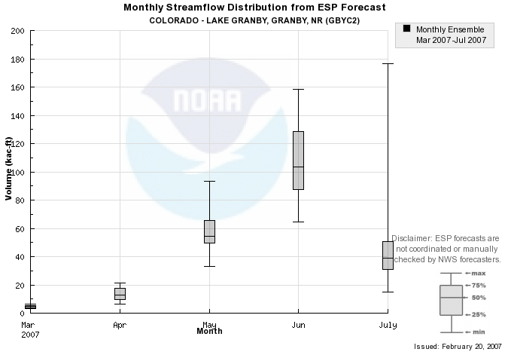
Scenarios
Simulate decision making based on forecasts
Decision making using probabilistic forecasts
Participants given a single forecast and asked to make a single decision
Participants given a series of forecasts and asked to make decisions from each
Notes:
Idea behind the scenarios was to create an activity in which we could understand individual decision-making processes given a controlled scenario, a particular piece of information and individual background knowledge.
Three scenarios tied to recreation, and three tied to water managers…
One in each set was tied to a decision a month out, one to seasonal (3-month) decisions, and one to 50 year planning decisions….
Also tied to a specific product BUT more about how people process visual representations of streamflow data and forecasts AND how they use it to make a decision.

Slide 17
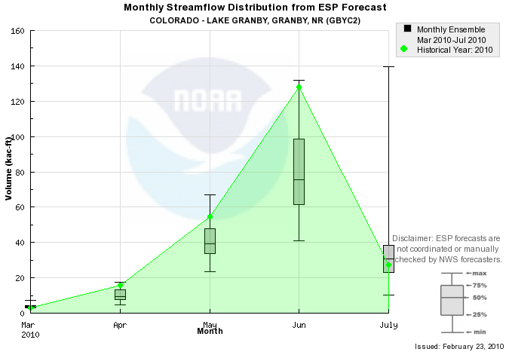
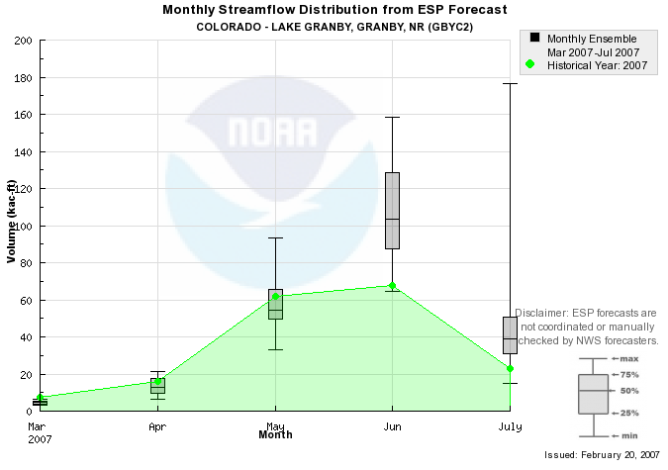
AMS Short Course Scenarios
Group 1a:
Actual forecasts for Lake Granby 2010
Underforecast peak flow (June)
Group 1b:
Actual forecasts for Lake Granby 2007
Overforecast June and July volumes

Slide 18
AMS Short Course Scenario Results
Underforecast scenario
9 of 11 overtopped reservoir
Participant who drew down reservoir early was not familiar with water management or probabilistic forecasts
Overforecast scenario
No one overtopped
Participants most familiar with water management drew down reservoir early

Slide 19
Literacy Survey: Findings So Far
Meteorologists more confident in weather forecasts and less confident in climate forecasts than outside stakeholders (literacy survey)
Stakeholders typically rely on forecast agencies to tell them when forecast skill is sufficient (usability survey)
Stakeholders interested in flooding and high flows are interested in “worst” case scenarios (scenarios)
Water management stakeholders tend to plan to median forecast (scenarios)
People – regardless of background – have difficulties applying probabilistic forecasts to deterministic decisions (scenarios)

Slide 20
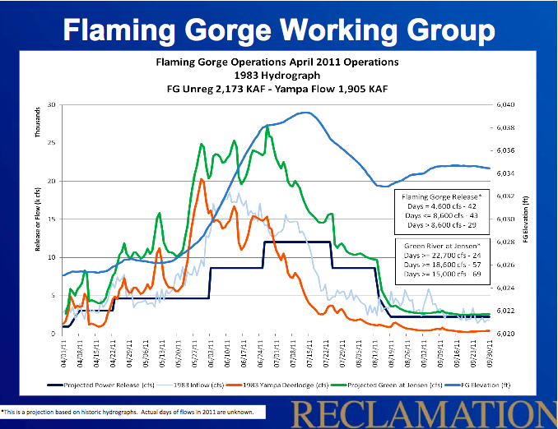
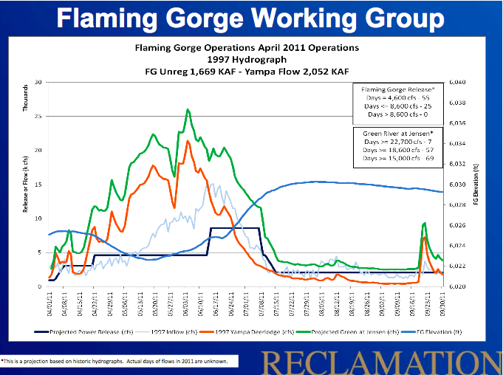
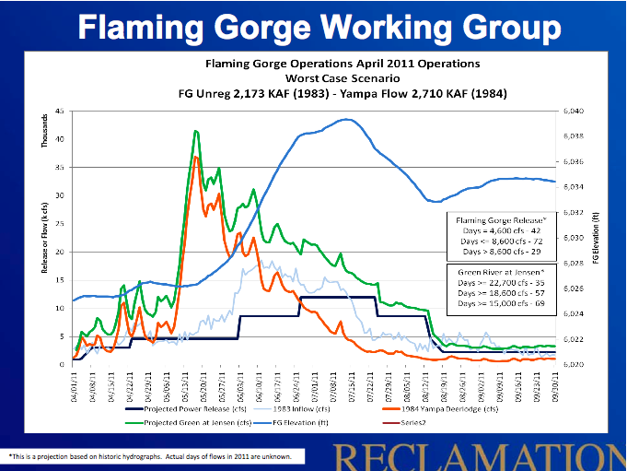
Promoting Ensemble Forecasts
Many water managers use historical streamflow sequences to inform management decisions.
Opportunities abound for successful application of RFC ESP forecasts
Example: “This projection is based on historic hydrographs. Actual spring streamflow is unknown”

Slide 21
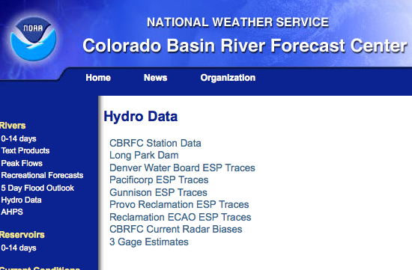
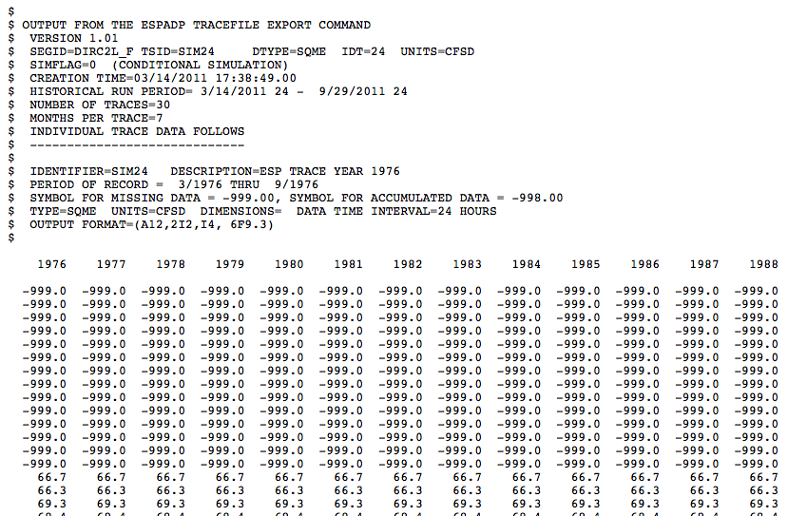
ESP applications
CBRFC currently provides “raw” ensemble time series forecasts to several groups:
Denver Water
Pacificorps (Bear River)
USBR (Gunnison, Utah, and MTOM)
Forecasts updated daily in winter/spring
Available via CBRFC webpage

Slide 22
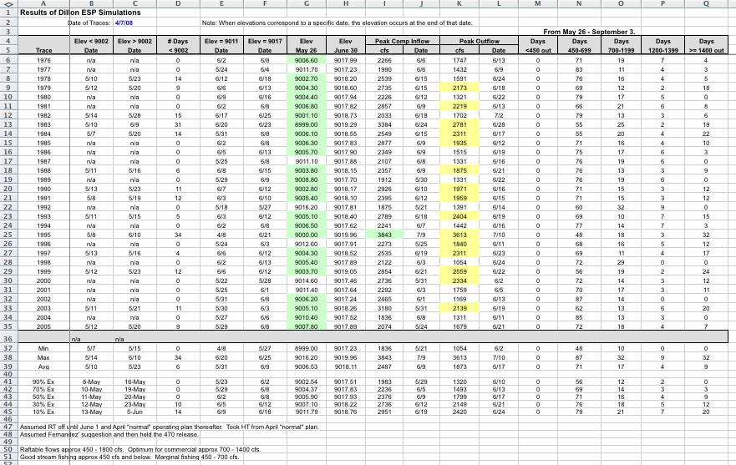
Applications of Probabilistic Flow Forecasts
Denver Water:
Long history of using ensemble forecasts for risk management
Download CBRFC ensemble forecasts into reservoir operations spreadsheet (right)
Optimize reservoir operations by minimizing negative impacts
Southern CA MWD:
Requested forecast for probability of equalization releases from Lake Powell
USBR determines inflow volume required to trigger equalization from 24 month study
CBRFC uses regulated ESP forecast to determine probability of reaching the required volume

Slide 23
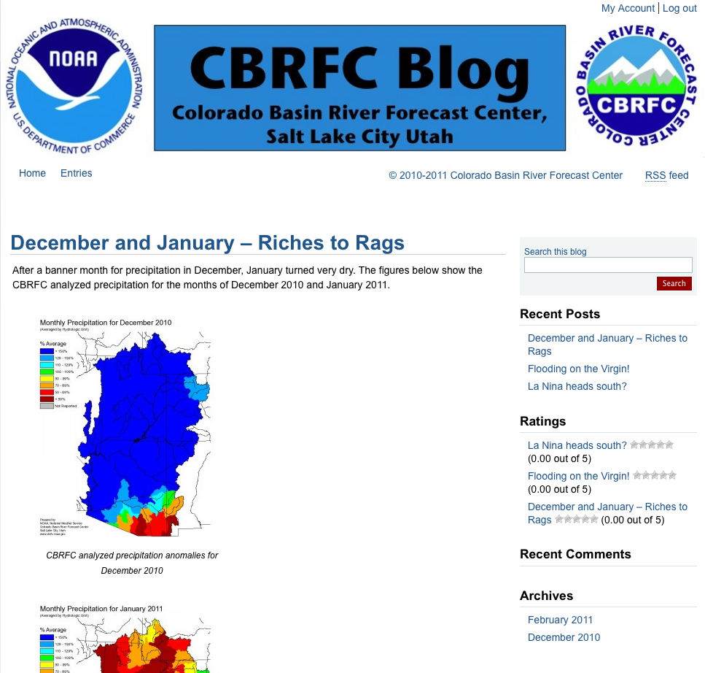
CBRFC Blog
Forum for:
communicate weather and climate information and forecasts
Present new products and technologies
Hear feedback / questions from stakeholders
Debuted Feb 2011
Will evaluate effectiveness following this year’s runoff
Blog.citizen.apps.gov/cbrfc

Slide 24
Challenges
Culture change – getting NOAA staff buy in for service mentality
Coordination with other NOAA entities
External barriers – Political, educational, and awareness all prevent stakeholders from taking advantage of forecasts
Partnerships – Multi-agency partnerships needed to fully address stakeholder needs

Slide 25
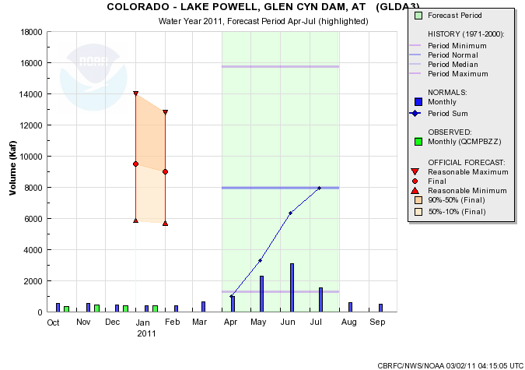
An Example: Lake Powell Probability of Equalization Forecast
Colorado River operating criteria specify a threshold above which extra water (“equalization”) is released from the upper basin to the lower basin
Threshold is determined by (1) Forecasted lake elevations (USBR) and (2) April 1 forecast (CBRFC)
In 2010 Lower basin stakeholders began requesting a probability of equalization releases forecast
Forecast is worth up to $110 million for CA, AZ, and NV
Science problems:
Ensemble forecast must be reliable
Forecast must predict April 1 forecast (not actual inflow)
Forecast must account for reservoir management
2010 Equalization trigger volume
?

Slide 26
Example (Con’t)
Culture change – Many NOAA (and USBR) staff uninterested in addressing stakeholder request (“not our job” or “SCH promises too much to stakeholders”)
External barriers – Stakeholders did not know what forecast to ask for or what was possible
Partnerships – Equalization is determined by information “controlled” by USBR (forecasted reservoir management) and NOAA (forecasted inflow). Constructing a probability of equalization forecast is inherently a bi-agency problem

Slide 27


Questions?
Kevin Werner
CBRFC Service Coordination Hydrologist
Phone: 801.524.5130
Email: kevin.werner@noaa.gov

