Slide 1
Step-by-step guidance on how to submit a proposal to the National Spatial Data Infrastructure (NSDI) Cooperative Agreements Program

Slide 2
Learning Objectives
After completing this module the student can:
Access the NSDI CAP program announcement
Plan and execute proposal preparation in accord with the CAP schedule
Download the application package from Grants.gov
Complete each CAP proposal form and address each requirement
Identify contacts and resources that can aid in developing the CAP proposals
Submit a complete CAP proposal via Grants.gov
Outline the steps of the CAP review process

Slide 3
Access CAP Grant Information
Where to find the CAP announcement
NSDI CAP Web site http://www.fgdc.gov/grants includes schedule information and brief descriptions of the categories
Grants.gov Web site http://www.grants.gov/ centralized site for federal government grant programs

Slide 4
Access CAP Grant Information
Where to find help
Grants.gov Applicant Resources http://www.grants.gov/applicants/app_help_reso.jsp tutorials and documents to help with Grants.gov
CAP Frequently Asked Questions http://www.fgdc.gov/grants/2013CAP/FAQ_2013NSDICAP
USGS Geospatial Liaisons http://liaisons.usgs.gov/geospatial/ great resource for support and helping with collaborations

Slide 5
Schedule
Proposal Submission
Submittal period varies between sixty and ninety days after the Announcement opens
Program Announcement will be posted by November 2012
2013 program expected to close on January 29, 2013 at 2 pm
All proposals must be submitted electronically via Grants.gov therefore you must register with Grants.gov before you can submit your proposal
the registration process requires 1-4 weeks so register early… register now!
once registered, you can apply to all federal grant programs

Slide 6
Schedule
Proposal Review and Award
Proposal review period requires four to six weeks after the closing date
CAP Awards are announced as soon as the reviews are completed and a final decision is made
2013 CAP Awards will be announced in Spring 2013

Slide 7
Schedule
Project Implementation
Project Start Date
based on the date listed by recipient in the proposal
must start before end of fiscal year (September 30)
Category-specific Orientation Workshops or Kick-Off Meetings
generally scheduled within 60 days of award
Category Lead coordinates workshop site and date with recipients
in 2013 these will be held via teleconference/webinar
purpose is to meet, collaborate, review schedule and reporting requirements
if necessary, CAP funding is used to cover travel costs and is considered part of the award

Slide 8

Submitting Your Proposal via Grants.gov
Submitting a proposal application package:
Register with Grants.gov
http://www.grants.gov/
Registration takes 1 to 4 weeks so start early. Once registered, your organization can use the same information for all other Grant.gov applications
Prepare proposal
Pay attention to CAP and category specific requirements
Submit package to Grants.gov

Slide 9
Register with Grants.gov
Grants.gov
A centralized location to explore, access and apply to U.S. federal government grant opportunities
ALL CAP proposals must be submitted via Grants.gov
NO hardcopy proposals are accepted
Grants.gov application process requires prior registration with external federal and business registries – so plan ahead and register now
More information is available at: http://www.grants.gov/

Slide 10
Register with Grants.gov
Steps for registration on Grants.gov
Obtain DUNS Number
- Same day
Register with SAM (System for Award Management)
- Three to five business days or up to two weeks
Complete AOR (Authorized Organization Representative) profile on Grants.gov
- Same day
AOR Authorization by E-Business Point of Contact (E-Biz POC)
- Time depends on responsiveness of your E-Biz POC
Information at http://www07.grants.gov/applicants/organization_registration.jsp

Slide 11
Register with Grants.gov
Step 1: Access your DUNS Number
A Data Universal Number System (DUNS) Number is required to submit a CAP Proposal
A DUNS Number is a unique nine-digit sequence recognized as the universal standard for identifying and keeping track of over 100 million businesses worldwide
If your organization does not have a DUNS Number request one from: http://www.dnb.com/

Slide 12
Register with Grants.gov
Step 2: Register with System for Award Management (SAM)
Registrant database for government contractors (it replaces CCR)
For information and to register
https://www.sam.gov/
877-252-2700
Additional link - https://www.uscontractorregistration.com/

Slide 13
Register with Grants.gov
Step 3: Complete AOR (Authorized Organization Representative) profile on Grants.gov
Need organization’s DUNS Number to complete this step
Create your username and password

Slide 14
Register with Grants.gov
Step 4: AOR Authorization by E-Biz POC
The E-Business Point of Contact (E-Biz POC) at your organization must login to Grants.gov to confirm you as an Authorized Organization Representative (AOR)
There can be more than one AOR for your organization
In some cases the E-Biz POC is also the AOR for an organization

Slide 15
Prepare Proposal
While the Grants.gov registration process
is being completed
you can prepare your NSDI CAP proposal

Slide 16
Prepare Proposal
Steps for Preparing and Submitting Proposal on Grants.gov
Download Application Package
Complete the Application Package
Submit the Completed Application Package
Track the Status of a Submitted Application Package
Information at http://www.grants.gov/applicants/apply_for_grants.jsp

Slide 17
Prepare Proposal
Step 1: Download the NSDI CAP Application Package from Grants.gov
Downloading a grant application package allows you to complete it offline and route it through your organization for review before submitting
Download the application package from: http://www.grants.gov/applicants/apply_for_grants.jsp
Provide the CFDA Number, ‘15.809’ to access the NSDI CAP application package

Slide 18
Prepare Proposal
Step 2: Complete the NSDI CAP Application Package
Complete the application on your own computer
Instructions on how to open and use the forms in the package are on the application package cover sheet
Edits to your application are saved locally
The package cannot be submitted until all required fields have been completed
A narrated tutorial on how to complete a grant application package is provided at: http://www.grants.gov/applicants/apply_for_grants.jsp

Slide 19
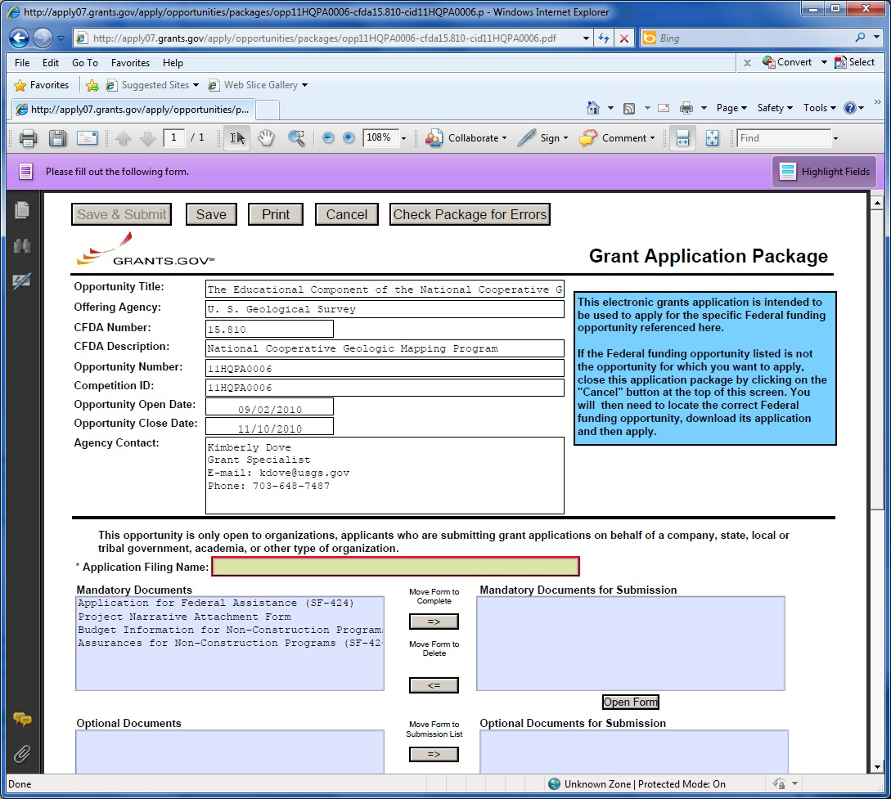
Example Application Cover Sheet

Slide 20
Prepare Proposal
Summary of Required Proposal Components
Application for Federal Assistance - SF 424
Budget Information - SF 424A
Assurances – SF 424B
Project Narrative
Budget Breakdown
Negotiated Rate Agreement for State and university applicants
Other category-specific requirements as specified in the CAP announcement
Format for submittal
Adobe Acrobat (.pdf)

Slide 21
Proposal Components
Summary of Optional Components
Letters of Support or Participation
Related Reports
Documents that affirm leadership role
Memoranda of Understanding or other formal agreements
Project personnel resumes or Curriculum Vitae
Format for submittal
Adobe Acrobat (.pdf)
Tagged Image File Format (.tif) or other scanned document format

Slide 22
Required Proposal Components
Application for Federal Assistance SF-424
The core government-wide standard forms for grant application packages
SF424 Core Form
A general information page that documents the:
contact information for submitting organization
CAP category to which the proposal is submitted
project title
project duration
geographic impact of the project
amount of funding requested

Slide 23
Required Proposal Components
Application for Federal Assistance SF-424
SF424 Core Form (cont’d)
Once registered at Grants.gov much of the required information automatically loads into the form
Item 8f: Name and Contact Information
provide information for the NSDI CAP project lead, all project correspondence will go to this person
Item 15: Descriptive Title of Applicants Project
be sure to preface your project title with the NSDI CAP Category
Item 17: Proposed Project
the start and end date can be modified after the award is granted, sometimes this is to accommodate the CAP orientation workshop but grant period should not exceed one year

Slide 24
Required Proposal Components
Application for Federal Assistance SF-424
SF424-A: Budget Information Non-Construction Programs A summary of the project budget by:
tasks
expense categories (salary, travel, supplies, etc.)
In Column 1 - cost category allocation of federal funds
In Column 2 - cost category allocation of applicant in-kind match
This is addition to the detailed Budget Breakdown document
SF424-B: Assurances Non-Construction Programs A listing of varied assurances that the applicant must make with regard to eligibility for funding and compliance with federal laws

Slide 25
Required Proposal Components
Project Narrative
A brief (max. 5 page, about 3000 words) project description
Primary document evaluated by the review panel
Exact content specified for each CAP Category but generally includes:
project scope
expected benefits
technical approach
deliverables
project and/or NSDI-related experience
commitment to effort
organizational capacity and resources
budget breakdown

Slide 26
Required Proposal Components
Budget Breakdown
An explanation of the specific individuals, events and/or materials that are supported by the following SF 4242-A
This expands on the information provided in the SF-424A and is required if the proposal is awarded
See the CAP Announcement for budget breakdown details

Slide 27
Required Proposal Components
Budget Breakdown (con’t)
Budget Items:
Salaries and wages
Travel/field expenses
Other direct costs such as:
supplies
equipment
contracted services
Indirect / overhead charges
Example of a Budget Breakdown is in the 2013 CAP announcement

Slide 28
Required Proposal Components
Budget Breakdown (con’t)
Itemize the costs to the greatest extent possible
Travel expenses need to be justified
Examples:
Give presentation on the project at a conference
Attend training
For contractual services provide the criteria by which contractors will be or have been selected.
If purchasing hardware, software, or supplies these need to be dedicated to the project
Example of a Budget Breakdown is in the 2013 CAP announcement

Slide 29
Required Proposal Components
Budget Restrictions
Individual CAP Categories may exclude or limit the use of funds for expenditures such as:
Data collection
Data purchase
Hardware purchase
Software purchase
Contractor support
Read the CAP Announcement carefully to determine funding restrictions that may apply to your project

Slide 30
Required Proposal Components
In-kind Resource Match
Requirement varies for each category and ranges between 30% to 50%
Funding commonly used as In-kind Match:
salaries
funds from non-federal contributors
hardware and/or software dedicated to the project
indirect costs
Funding that cannot be used as In-kind Match:
funding from other federal agencies
value of geospatial data holdings (some exceptions)
Read the CAP Announcement carefully to determine the In-kind Match requirements specific your project

Slide 31
Required Proposal Components
Category-specific Requirements
Each CAP Category may require specific proposal components. For example:
Category 4: Fifty States Initiative: Business Plan Development and Implementation is not open to institutions that have received a Category 4 CAP award in 2011 or 2012
Category 7: Geospatial Platform Cloud Service Test-bed is not open to institutions that have received a Category 7 CAP award in 2012
State Geospatial Strategic Plan
Letters of Support or Participation
Negotiated Rate Agreement for state and university applicants

Slide 32
Optional Proposal Components
Optional Proposal Components
Letters of Support/Commitment
from collaborators and/or project stakeholders
may be required for Categories focused on partnership and collaboration
Federal employees cannot provide letters
Related Reports
related project summaries that exhibit capabilities and capacity
annual reports that demonstrate engagement in the NSDI

Slide 33
Optional Proposal Components
Optional Proposal Components
Other supporting documents
organizational documents that affirm leadership role
items that support statements made in the Project Narrative
Project personnel resumes or Curriculum Vitae
Principal Investigator
key technical personnel
consultants (if allowed by the category)

Slide 34
Prepare Proposal
Remember to read
the CAP Announcement
carefully to determine
the application requirements
specific your project

Slide 35
Help with Proposals
Topic Development and Collaborative Resources
Contact your regional USGS Geospatial Liaisons at: http://liaisons.usgs.gov/geospatial
Review reports from past CAP recipients available from: http://www.fgdc.gov/grants
Contact the CAP Coordinator or CAP Category Lead identified in the CAP Announcement
Review a successful, past proposal by:
sending a formal request for the proposal information via the FOIA office (http://www.usgs.gov/foia/index.html), or
sending an informal request to the CAP Coordinator who will request permission from the submitting organization to share the document

Slide 36
Prepare Proposal
Step 3: Submit the Completed NSDI CAP Application Package
This cannot be done until the Grants.gov registration process has been completed
The AOR (Authorized Organization Representative) does this step
The AOR could be you, the E-Biz POC, or someone else in your organization

Slide 37
Prepare Proposal
Step 3: Submit the Completed NSDI CAP Application Package (con’t)
Click the submit button located at the top of the application package cover page. It will not be active until you have:
completed all required forms
attached all required documents
saved your application package
Log in to Grants.gov using your AOR username and password
Click the "Sign and Submit" button on the summary page
A Grants.gov tracking number will be provided at the bottom of this screen, as well as the submission's official date and time - record the tracking number

Slide 38
Prepare Proposal
Step 4: Track the Status of a Submitted Application Package
Once your application has been submitted, you can check the status on the Track My Application
https://apply07.grants.gov/apply/checkApplStatus.faces
You can identify your application by
CFDA Number
Funding Opportunity Number
Competition ID
Grants.gov Tracking Number

Slide 39
Submitting Multiple Proposals
Organizations may submit proposals for more than one category.
A complete and separate application package is required for each category submission.

Slide 40
Proposal Selection Process
CAP Coordinator and Category Leads review proposals to ensure compliance to all requirements
Category Leads recruit individuals with Category-specific expertise to serve on Review Panels
Compliant proposals are shared with Review Panel members
Each Review Panel member reviews the assigned proposals individually using a provided score sheet
scoring is based on the exact criteria and point allotment specified in the CAP Announcement
completed score sheets are preserved so that the selection process can be revisited at any time

Slide 41
Proposal Selection Process
The panels meet either in person or via teleconference to discuss the proposals and their scores
The Category Lead compiles all the reviews and scores and ranks the proposals
The information is passed to the FGDC Secretariat Director for final selection

Slide 42
Proposal Selection Process
Review Panels
Category leads recruit volunteers from:
previous CAP recipient organizations
USGS Geospatial Liaisons
FGDC Coordination Group
Federal, state and local government
University, non-profit and private sector organizations
Recruitment attempts to diversify the type of organizations represented by review panel members
Panels are composed of 5 to 16 individuals depending on the number of proposals to review and the CAP category

Slide 43
Proposal Selection Process
Hints for Successful Proposals
Address all criteria and provide all requested items and information
Comply with proposal size/length limitations
Follow the proposal format provided in the CAP announcement
Observe CAP and category-specific funding restrictions
Budget work and expenditures to meet both project objectives and funding limits
Clearly state the source and value of in-kind match

Slide 44
Proposal Selection Process
Hints for Successful Proposals (con’t)
Include Letters of Support for organizations indicated as project collaborators or prime benefactors
Discuss how your organization will sustain the project outcomes after the CAP project ends
Focus on partnerships with other organizations
Discuss plans to share the project outcomes
Proposed realistic, achievable goals
and…
did we mention?
Read the CAP Announcement carefully

Slide 45
Proposal Selection Process
Notification of Awards
Successful applicants receive:
informal notification from the CAP Coordinator or Category Lead
formal notification from the USGS Office of Acquisitions and Grants
Selected projects are posted to the FDGC Web site and announced to the public via email
Unsuccessful applicants receive notification from the CAP Coordinator that includes:
reason(s) the project was not selected
suggestions for other funding venues, if known
USGS Geospatial Liaisons or other organizations that could help move the project forward

Slide 46
Proposal Selection Process
Award Processing
Award processing requires two to four weeks to complete
A requisition is issued to authorize the expenditure of CAP funds to support the project
The Office of Acquisitions and Grants (OAG) assigns a Federal Project Number
An OAG Grants Officer is assigned to the project to review the budget and complete the award package
An audit report is performed if the CAP recipient has expended over $500,000 in federal awards in a fiscal year
Award package is signed by USGS Contracts Officer
Completed award package is sent to the CAP recipient

Slide 47
Summary
This is the conclusion of “NSDI Cap Proposal” You now should be able to:
Access the NSDI CAP program announcement
Plan and execute proposal preparation in accord with the CAP schedule
Complete each CAP proposal form and address each requirement
Identify contacts and resources that can aid in developing the CAP proposals
Download the application package from Grants.gov
Submit a complete CAP proposal via Grants.gov
Outline the steps of the CAP review process

Slide 48
Conclusion
Successful submittal of an NSDI CAP proposal requires:
Advanced planning and registration
Careful review of the CAP Announcement
Collaboration and partnership
Demonstrated capabilities

Slide 49
Conclusion
For more information
Visit
www.fdgc.gov/grants
http://www.fgdc.gov/grants/2013CAP/2013CAPDescriptions
Contact CAP Coordinator
Gita Urban-Mathieux
burbanma@fgdc.gov
703-648-5175

Slide 50

Finally ....
Start writing your proposal …

Slide 51
Other Lessons
NSDI Cooperative Agreements Program:
Introduction to CAP
How to Implement Your NSDI CAP Project
Notes:
Refer to http://www.fgdc.gov/training/training-materials.

