Slide 1
An introduction to the program and how to submit a proposal
Notes:
Webinars held November 14 and December 1
Thank you for joining this Webinar that will provide an introduction to the National Spatial Data Infrastructure Cooperative Agreements Program or NSDI CAP for short. I am Gita Urban-Mathieux, the coordinator for the program. Also with me is Vaishal Sheth who will be running to slides as well as other technical aspects of the presentation. We are both members of the Federal Geographic Data Committee Office of the Secretariat or FGDC Secretariat located in Reston, Virginia. I expect the presentation to last about an hour with some time for questions at the end. If you have a question during the presentation you may send it in at any time using the chat feature. We will try to get to as many of these as we can at the end. I will be posting these slides on the FGDC web site.

Slide 2
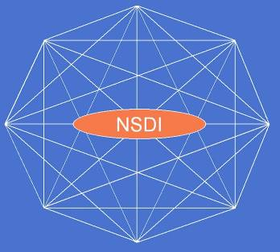
Objectives
Webinar Agenda
What is the NSDI CAP?
Why is there an NSDI CAP?
Who can participate?
NSDI CAP categories
NSDI CAP funding
Steps for proposal submission via Grants.gov
Proposal components and forms
Where to get help
Proposal tracking
Proposal review and selection
Notes:
Here are the topics that I will cover during this Webinar. It includes the what, the why, the who, and the how of the program. So let’s get started.

Slide 3
What is the NSDI CAP?
The NSDI Cooperative Agreements Program (CAP) is:
an annual program to assist the geospatial data community in implementing the components of the NSDI by providing funding and other resources
Federal Geographic Data Committee (FGDC), U.S. Geological Survey
benefit the overall geospatial community
Notes:
First, what is the NSDI Cooperative Agreements Program? It is an annual program with the purpose of assisting the geospatial community in implementing the components of the NSDI through funding and support services from FGDC personnel. It is sponsored by the FGDC which is hosted by the U.S. Geological Survey. It is intended to benefit both the Federal agencies as well as the overall geospatial community. Now you may be asking what the NSDI is. A simple definition is that it is a physical, organizational, and virtual network designed to enable the development and sharing of U.S. digital geographic information resources.

Slide 4
What is the NSDI CAP?
NSDI CAP areas of emphasis :
Documenting
Expanding
Promoting
Advancing
Implementing
Notes:
The NSDI CAP program has been around since 1994 and over this time the type of projects funded has varied as the concept of the NSDI matures. The areas of emphasis have included documenting, implementing, and providing outreach for metadata and other standards, expanding geographic information coordination across and between organizations, promoting geospatial best practices, advancing geospatial related Web services, advancing NSDI framework data, and creating online applications to support geospatial data discovery and exchange.

Slide 5
What NSDI CAP is Not
The NSDI CAP does not support projects that are:
data collection efforts
data purchases
GIS start-ups
agency specific or of limited value to other NSDI stakeholders
Notes:
The program does not fund data collection, data purchases, or GIS start-ups. In addition, since the purpose of the NSDI CAP is to build partnerships the CAP does not fund projects that benefit only a single agency or are of limited value to other stakeholders.

Slide 6
Why is there an NSDI CAP?
The NSDI CAP is intended to:
Support
Market
Outreach
Implement
Institutionalize
Seed Effort
SDI Model
Notes:
Why does the FGDC sponsor the program? Well – for a variety of reasons. Among them are supporting outreach and communications, getting the word out about the NSDI, providing a helping hand to small organizations that may have trouble getting the funding to do NSDI related work, reaching new organizations that would benefit by participating in the NSDI, and helping to create a network of NSDI partners and contacts.

Slide 7
What is a ‘Cooperative Agreement’?
Cooperative Agreement
Substantial involvement by the Federal Government
regular teleconferences
technical support
administrative assistance in resolving issues
Not involved in day-to-day business
Cooperative Agreement
Grant
Notes:
So what is a Cooperative Agreement and how is it different from a traditional grant? The Federal Government’s definition of cooperative agreement is that there is substantial Federal Government involvement in the funded project. This means that the FGDC works with the CAP recipient by hosting regular teleconferences, providing technical support, and providing administrative assistance in resolving issues. With a grant the recipient is left on their own to accomplish the work.
In a Cooperative Agreement the Federal Government is not involved in the day to day business of the project.

Slide 8
Who can participate in the NSDI CAP?
The NSDI CAP Program is open to all non-federal organizations
State governments
Local governments
Tribal governments
Academia
Commercial businesses
Nonprofit organizations
Notes:
The NSDI CAP is open to any organization except the Federal Government and foreign organizations. Through the years the FGDC has made awards to State governments, local governments, Tribal governments, consortia of organizations, educational institutions, and organizations in the commercial and nonprofit sector. Federal agencies can be partners in a project but they cannot use funds from this program. The FGDC encourages you to include Federal partners in your projects.

Slide 9
NSDI CAP Categories
CAP award categories are based upon FGDC/NSDI programs of work:
standards implementation and outreach
collaboration in geospatial communities
geo-enabling non-traditional data communities
integration of framework data
participation in national initiatives like Geospatial Platform or The National Map
Categories vary annually to support current NSDI priorities and initiatives
Notes:
Every year the NSDI CAP makes awards in a variety of categories depending on the areas of emphasis for a particular year.
Suggestions for the CAP categories come from the FGDC Coordination Group which is the Federal interagency group that advises the day-to-day business of the FGDC and the implementation of the NSDI.
The suggestions are evaluated against several criteria. These include
alignment with FGDC and NSDI strategic goals
appropriateness with respect to the funding authority and cooperative agreements requirements
alignment with existing categories
potential to seed on-going activities beyond the initial effort
supporting or implementing standards, and
the success of previous category efforts.
After discussions are held with the appropriate folks, recommendations are made to FGDC management and the final categories are approved by the FGDC Executive Director.

Slide 10
NSDI CAP Categories
2012 NSDI CAP Categories | Award Amount | In-kind Match | Approx Number of Awards
Category 1: Metadata Trainer and Outreach Assistance | $25,000 | 30-50% | 3
Category 2: ISO Geospatial Metadata Standards Implementation | $30,000 | 30-50% | 3
Category 3: Expanding Use of the GIS Inventory System | $7,500 to $15,000 | 50% | 10-20
Category 4: Fifty States Initiative: Business Plan Development and Implementation | $40,000 | 50% | 8
Category 5: FGDC-endorsed Standards Implementation Training and Outreach | $25,000 | 30-50% | 2
Category 6: FGDC Standards Development Assistance | $25,000 | 30-50% | 2
Category 7: Geospatial Platform Cloud Service Testbed | $25,000 | 50% | 3
Notes:
This year there are seven award categories.
Category 1 is Metadata Trainer and Outreach Assistance and it has been around for the past several years. This category provides assistance to organizations with NSDI expertise and experience in helping other organizations with the training and implementation of metadata. Up to 3 awards may be made with each project getting up to $25,000.
Category 2 is new and is for ISO Geospatial Metadata Standards Implementation. Projects in this category are intended to explore and test the process and procedures involved in transitioning from the FGDC Content Standard for Digital Geospatial Metadata (CSDGM) to the international geospatial metadata standard, ISO 19115 Geographic Information – Metadata. Projects in this category can focus on technical and (or) organizational issues. Up to 3 awards may be made with each project getting up to $30,000.
Category 3 is also new this year and is directed toward State and regional governments. The goal for these projects is to populate the National States Geographic Information Council’s GIS Inventory System (also known as Ramona) with metadata that will be available for harvesting by the NSDI Clearinghouse Catalog. There will be up to 20 awards made, ranging from $7,500 to $15,000 each. The award amount will depend on the level of effort.
Category 4 is part of the FGDC’s Fifty States Initiative and is focused on development and implementation of statewide business plans. The awarded projects in this category will develop and implementation state business plans that advance the state’s spatial data infrastructure or the NSDI while increasing Federal involvement in statewide geospatial planning and implementation activities. This year the FGDC is looking for projects focused on business plans for cadastral, elevation, or orthoimagery data. I expect up to 8 awards may be made with each project getting up to $40,000.
Category 5 this year is Implementation Training and Outreach for FGDC-endorsed Standards. It is similar to Category 1. The goal of these projects is to facilitate implementation of an FGDC-endorsed standard in user communities. There may be 2 awards made with each project getting up to $25,000.
Category 6 will make awards to projects that will assist organizations in the development of standards registered in the FGDC standards program of work which are list on the FGDC web site. Up to 2 awards may be made with each project getting up to $25,000.
Lastly is another new category - category 7 is for the Geospatial Platform Cloud Service Testbed. This category will support State, local, and/or Tribal governments who have formal data exchange agreements with Federal agencies for the collection and local management of nationally significant geospatial data and seek to deploy geospatial cloud services. The result of each award in this category will be an operational geospatial Cloud service whose deployment costs and performance characteristics are known and documented. There will be up to 3 awards made with each project getting up to $25,000.
The recipient organizations will need to contribute either 30 to 50 percent or at least 50 percent of the award amount as an in-kind match. I will discuss in-kind matches later.
Complete information about the categories are in 2012 NSDI CAP announcement that is posted on Grants.gov. A copy is also available via the FGDC Web site.

Slide 11
Eligibility
Category | Specific Eligibility Requirement
Category 1: Metadata Trainer and Outreach Assistance | Not eligible if had a Metadata Trainer and Outreach Assistance award within the past 3 years Organization should be skilled and resourceful in implementing metadata
Category 2: ISO Geospatial Metadata Standards Implementation | Organization should own and publish significant numbers of geospatial metadata records Organization should be skilled and resourceful in implementing metadata
Category 3: Expanding Use of the GIS Inventory System | State and regional government organizations that participate in statewide GIS coordination activities Need obtain letters of support from their statewide GIS Council
Category 4: Fifty States Initiative: Business Plan Development and Implementation | Coordinated multi-sector responses are strongly encouraged A regional entity must have the support of the State’s geospatial coordination council
Notes:
As I mentioned in a previous slide all entities but the Federal Government are eligible to apply. Within each category there are specific eligibility requirements. This table and the table on the next slide summarize the particulars for each category. This information is listed in the CAP announcement for each category.
You may apply for category 1 if you have not received a metadata training and outreach award within the past 3 years, which is 2011, 2010, or 2009. In addition, the organization applying needs to demonstrate their metadata expertise.
For category 2 the applicant organization should own and publish a significant number of metadata records and demonstrate their metadata expertise.
Category 3 is for State and regional government organizations that participate in statewide GIS coordination activities and it is necessary for the applicant to provide a letter of support from their statewide GIS Council.
Category 4 is related to the 50 States Initiative business plan development and implementation. Coordinated multi-sector responses are strongly encouraged. If the applicant is a regional entity a letter of support from the State’s geospatial coordination council is required.

Slide 12
Eligibility
Category | Specific Eligibility Requirement
Category 5: FGDC-endorsed Standards Implementation Training and Outreach | Not eligible if had an FGDC-endorsed Standards Implementation Training and Outreach award within the past 3 years
Category 6: FGDC Standards Development Assistance | Not eligible if had an FGDC Standards Development Assistance award within the past 3 years
Category 7: Geospatial Platform Cloud Service Testbed | State, local, and/or Tribal governments who have formal data exchange agreements with Federal agencies for the collection and local management of nationally significant geospatial data Must be the entity officially responsible for the collection and/or dissemination of the geospatial data layer Preference will be given to projects that already operate public-facing Web services
Notes:
For the FGDC standards categories, 5 and 6, you are eligible if you organization has not received an award in related to FGDC standards within the past 3 years, which is 2011, 2010, or 2009.
Geospatial Platform Cloud Service Testbed category is for State, local, and/or Tribal governments who have formal data exchange agreements with a Federal agency for the collection and local management of nationally significant geospatial data that are listed in OMB Circular A-16. The applicant organization must be the entity officially responsible for the collection and/or dissemination of the geospatial data layer. Preference will be given to projects that already operate public-facing Web services.

Slide 13
CAP Funding
CAP funds can be used to support:
salaries and wages
training
travel
labor
hardware and software that are dedicated to the project and its sustainability
fees for consultants, facilitators or recorders
publication costs
Notes:
The CAP award funds can be used to for salaries and wages of the project personnel, training, travel, hardware and software that are dedicated to the project and its sustainability, fees for consultants, facilitators, or recorders, and publication costs. If there are any restrictions they are described in the CAP announcement.

Slide 14
CAP Funding
CAP funds cannot be used to support:
data collection
data purchases
equipment purchases that are not dedicated to the project
Notes:
CAP dollars cannot be used to support data collection or data purchases. If equipment, hardware, or software is to be purchased it needs to be dedicated to the project both during the project and in the follow on work. Category 7 specifically states that funding cannot be used for hardware purchases.

Slide 15

Project Time Frame
Performance period and
expenditures are
limited to one year
Notes:
The performance period for all projects is limited to one year. It would be great if the performance period were longer but USGS regulations don’t allow this. Fortunately, no cost extensions are a possibility.

Slide 16
CAP Proposal Submission
Where to view the 2012 announcement
Grants.gov
“Find Grant Opportunities”, search Keyword NSDI CAP
FGDC Web site
http://www.fgdc.gov/grants/2012CAP/2012CAPDescriptions
Notes:
Now I will begin the discussion of how to submit a CAP proposal. The 2012 NSDI CAP announcement can be found on Grants.gov and on the FGDC Web site.

Slide 17
CAP Proposal Submission
Proposal Submissions
All proposals must be submitted electronically via Grants.gov
Submittal period ends January 24, 2012
No hardcopy proposals accepted
Do not email softcopy proposals
help is available from http://www.usgs.gov/contracts/grants/grantsgov.html
Notes:
All proposals must be submitted electronically via Grants.gov by the closing date which is January 24, 2012. Please do not send any hardcopies or softcopies via email. There is help on the USGS Web site. You can find this link and other links that I will mention during the presentation on the CAP FAQ page.

Slide 18
CAP Proposal Submission
Submitting a proposal application package:
Register with Grants.gov
http://www.grants.gov/
Registration takes 1 to 4 weeks so start early. Once registered, your organization can use the same information for all other Grant.gov applications
Prepare proposal
Pay attention to CAP and category specific requirements
Submit package to Grants.gov
http://www.grants.gov/
Notes:
There are 3 basic procedures for submitting a proposal application package.
Register with Grants.gov. Registration takes between 1 to 4 weeks so start early. Once registered, your organization can use the same information for all other Grants.gov applications. So if your organization has already submitted applications in the past to Grants.gov you may be able to skip this step.
Prepare the proposal application package. Make sure to pay close attention to category specific requirements.
Submit the proposal application package electronically via Grants.gov.

Slide 19

Submitting Your Proposal via Grants.gov
Grants.gov
A centralized location to explore, access, and apply to U.S. Federal Government grant and cooperative agreement opportunities
More information is available at: http://www.grants.gov/
Notes:
If you do not already know -- Grants.gov is a centralized location to explore, access, and apply to U.S. Federal Government grant and cooperative agreement opportunities. Now I will explain in more detail the procedures for using Grants.gov to submit your CAP application.

Slide 20
Registration on Grants.gov
Steps for registration on Grants.gov
Obtain DUNS Number
Register with CCR
Create AOR Username & Password
AOR Authorization
Track AOR status
More information at http://www07.grants.gov/applicants/organization_registration.jsp
Notes:
There are five steps to registering on Grants.gov. These steps are not necessary done by you. They need to be completed by the person who is considered an authorized representative for your organization.
Step 1 is obtaining a DUNS Number. Step 2 is registering with CCR. Step 3 is completing the Authorized Organization Representative or AOR profile on Grants.gov and creating a username and password. Step 4 is the confirmation by your organization’s E-Business Point of Contact for who is an AOR. This is the person who will submit the proposal. The final step is tracking the AOR status.
Details about these steps are on the Grants.gov web site and now I will review some of the details.

Slide 21

Registration on Grants.gov
Step 1: DUNS Number
A Data Universal Number System (DUNS) Number is required to submit a CAP Proposal
A universal standard for identifying businesses
If your organization does not have a DUNS Number request one from: http://www.dnb.com/
Notes:
Step 1 in the registration process is obtaining a Data Universal Number System number or DUNS number. A DUNS Number is a unique nine-digit sequence recognized as the universal standard for identifying and keeping track of businesses worldwide. If your organization does not already have a DUNS Number the appropriate person in your office will need to request one from the Dun and Bradstreet web site.

Slide 22


Registration on Grants.gov
Step 2: Register with the Federal Central Contract Registry (CCR)
CCR is a database containing business information about the Federal Gov’t trading partners
Your organization must be registered and an E-Business Point of Contact (E-Biz POC) designated
Check with organization’s grant administrator, chief financial officer or authorizing official if your organization is already registered
Must be renewed yearly
Notes:
The next step is to register with the Federal Central Contract Registry or CCR. The CCR is a Web-enabled government wide application that collects, validates, stores, and disseminates business information about the federal government's trading partners in support of the contract award, grants, and the electronic payment processes. Your organization must be registered and an E-Business Point of Contact designated. You should check with your organization’s grant administrator, chief financial officer or authorizing official and ask if your organization is already registered and who is your E-Business Point of Contact. CCR registration must be renewed yearly.

Slide 23
Registration on Grants.gov
Step 2 (con’t): Register with the Federal Central Contract Registry (CCR)
E-Biz POC will have a Marketing Personal Identification Number (MPIN) to login into Grants.gov
E-Biz POC will identified who in your organization is an Authorized Organization Representative (AOR) and may submit applications via Grants.gov
More information is available from: http://www.ccr.gov
Notes:
The E-Business Point of Contact uses a Marketing Personal Identification Number or MPIN given by the CCR to login to Grants.gov and to designate who in your organization may submit applications electronically through Grants.gov. Staff members from your organization designated to submit applications to Grants.gov are called Authorized Organization Representatives or AOR.
The CCR web site has more detailed information.

Slide 24
Registration on Grants.gov
Step 3: Username and password
Complete your AOR profile on Grants.gov
Create your username and password
Need your organization’s DUNS Number https://apply07.grants.gov/apply/OrcRegister.
Notes:
Step 3 is completing the Authorized Organization Representative or AOR profile on Grants.gov and creating a username and password. The AOR may or may not be you. The organization’s DUNS Number is necessary to complete this step.

Slide 25
Registration on Grants.gov
Step 4: AOR Authorization
E-Business Point of Contact needs to confirm who is an AOR
An organization have more than one AOR
The E-Biz POC can be an AOR
Notes:
In step 4 the E-Business Point of Contact or E-Biz POC in your organization must login to Grants.gov and confirm who the AOR are for the organization. There can be more than one AOR within an organization. Sometimes the E-Biz POC is also the AOR for an organization.

Slide 26
Registration on Grants.gov
Step 5: Track AOR status
The link is http://www07.grants.gov/applicants/applicant_profile.jsp
Login as an Applicant using username & password you obtained in Step 3
Notes:
The final step in the Grants.gov registration is tracking the AOR status by logging in with the username and password that was set up in Step 3.

Slide 27
Prepare CAP Proposal
Download the NSDI CAP Application Package from Grants.gov
Downloading a grant application package allows you to complete it offline and route it through your organization for review before submitting
Download the application package from: http://www.grants.gov/applicants/apply_for_grants.jsp
Provide the CFDA Number, ‘15.809’ to access the NSDI CAP application package
Need correct version of Abobe Reader
App to test your version at http://www.grants.gov/applicants/AdobeVersioningTestOnly.jsp
Notes:
While you are waiting for all the Grants.gov registration steps to be completed you can download the NSDI CAP Application Package from Grants.gov. Downloading an application package allows you to complete it offline and route it through your organization for review before submitting it.
Please note that you will need the correct version of Adobe Reader to complete the forms. On the Grants.gov web site there is an app that can test your version Adobe Reader. A link to this app is on the CAP FAQ page. You can use Adobe Acrobat Standard or Professional if they are installed on your computer. If you are collaborating with others to complete the package make sure their Adobe software is compatible.

Slide 28
Prepare CAP Proposal
Complete the NSDI CAP Application Package
Complete the application on your own computer
Instructions on how to open and use the forms in the package are on the application package cover sheet
Edits to your application are saved locally
A narrated tutorial on how to complete a application package is provided at: http://www.grants.gov/applicants/apply_for_grants.jsp
The package cannot be submitted until all required fields have been completed
Notes:
The instructions on how to open and use the forms in the package are on the application package cover sheet. All your application edits are saved to your local system.
There is a narrated, animated, tutorial on how to complete an application package on the Grants.gov web site. I highly recommend you view this tutorial.
The package cannot be submitted until all required fields have been completed.

Slide 29
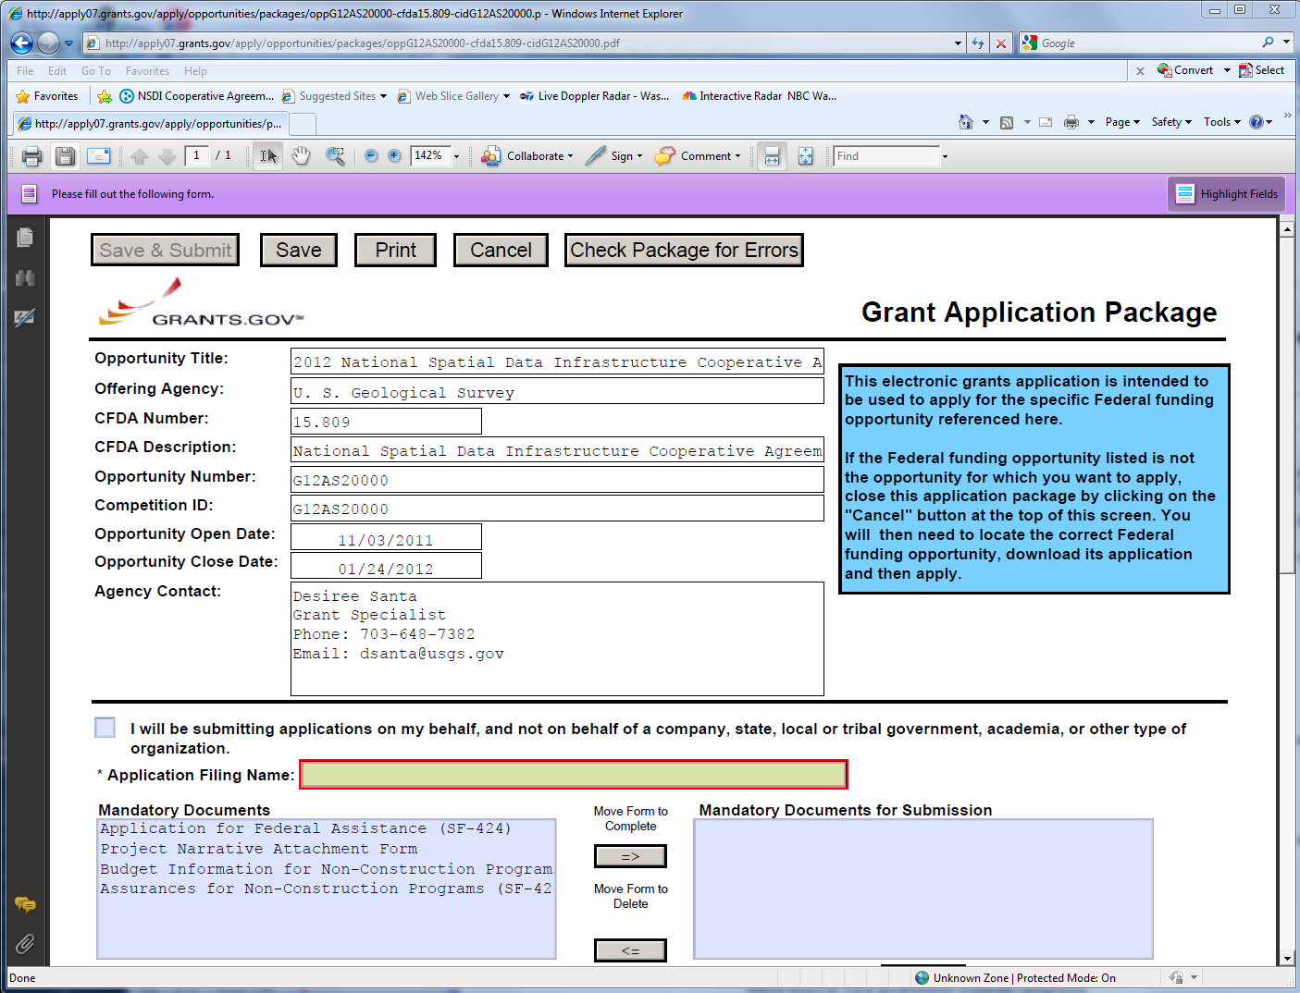
Notes:
Here is an example of the application package cover sheet.

Slide 30
Proposal Components
Summary of Required Components
Application for Federal Assistance - SF 424
Budget Information - SF 424A
Assurances – SF 424B
Proposal Narrative
Budget Breakdown
Other category-specific requirements as specified in the CAP announcement
Format for submittal
Adobe Acrobat (.pdf)
Notes:
Now I will go over the required documents that make up NSDI CAP application package. There are 3 standards forms - SF 424, SF 424A, and SF 424B. Next is the Proposal Narrative. Then there is a detailed budget breakdown. And finally there may be other category-specific requirements that are specified in the CAP announcement.

Slide 31
Proposal Components
Summary of Optional Components
Letters of Support or Commitment
Memoranda of Understanding
Related reports
Other supporting documents
Project personnel resumes or Curriculum Vitae
Format for submittal
Adobe Acrobat (.pdf)
Tagged Image File Format (.tif) or other scanned document format
Notes:
There are optional documents that you may provide such as Letters of Support or Commitment, related reports, other supporting documents, or resumes. It is helpful if these are in a PDF format. If there is a scanned document it can be in TIFF or JPEG format. It is best not to overwhelm the reviewers with too many supporting documents.

Slide 32
Required Proposal Components
Application for Federal Assistance SF-424
The government-wide form for grant application packages
contact information for submitting organization
CAP category to which the proposal is submitted
project title
project duration
geographic impact of the project
amount of funding requested
Notes:
The SF-424 or Application for Federal Assistance form is the core government-wide form for grant and cooperative agreement application packages. This is where you record general information such as contact information for the submitting organization, CAP category to which the proposal is submitted, project title, project duration, geographic impact of the project, and funding amount requested.

Slide 33
Required Proposal Components
Application for Federal Assistance SF-424 (cont’d)
Item 8f: Name and Contact Information
NSDI CAP project lead
all project correspondence will go to this person
Item 15: Descriptive Title of Applicants Project
Example: Category 4: Implementing a Business Plan for our State
Item 17: Proposed Project
the start and end date can be modified after the award is granted
project period should not exceed one year
end date should not be later than September 30, 2012
Notes:
I would like to highlight a few of the fields in the 424 form.
The name and contact information in Item 8f should be the person that will be the project lead or primary investigator. Whoever is listed here will receive all the project correspondence that comes from me, CAP coordinator, and the USGS grants office.
Under Item 15 be sure to preface your project title with the NSDI CAP Category number. An example would be Category 4: Implementing a Business Plan for the Commonwealth of Virginia.
The project start and end dates are listed in Item 17 and can be modified after the award is granted. The project period should not be more than one year and the start date should be no later than September 30, 2012.

Slide 34
Required Proposal Components
Application for Federal Assistance SF-424 forms
SF424-A: Budget Information for Non-Construction Programs
SF424-B: Assurances for Non-Construction Programs
Notes:
In addition to the SF 424 there is the SF 424-A budget information form and SF 424-B called the Assurances for Non-Construction Programs form. The budget form is for a summary of the project budget by tasks and expense categories such as salary, travel, and supplies. This is in addition to the detailed budget information the USGS grants office requires.
The form SF 424-B only requires a signature and is a listing of varied assurances that the applicant must make with regard to eligibility for funding and compliance with Federal laws.

Slide 35
Required Proposal Components
Proposal Narrative
Primary document evaluated by the review panel
Includes:
project scope
expected benefits
technical approach
deliverables
project and/or NSDI-related experience
commitment to effort
organizational capacity
resources
Notes:
The next required component is the Proposal Narrative. This is the primary document that will be evaluated by the review panel and describes all aspects of the project. What goes into this is described fully in the CAP announcement. It contains the project scope, expected benefits, technical approach, deliverables, experience, commitment to effort, organizational capacity, and resources. It is very important to read the CAP announcement to find the format to use and details that are required. If all the applications follow the same format they can be scored equitably which really aids the review process.
The CAP announcement contains the evaluation criteria for each category that will be used during the review.

Slide 36
Required Proposal Components
Budget Breakdown
This expands on the information provided in the SF-424A
Budget Items:
Salaries and wages
Travel/field expenses
Other direct costs such as:
supplies
equipment
contracted services
Indirect / overhead charges
CAP Announcement contains the details
Notes:
Part of the Proposal Narrative is the detailed budget breakdown and it is required. This breakdown is in addition to the SF-424A budget form since it contains more details and explanations about the specific individuals, events, and materials that are needed for the project. The USGS requires this before an award can be made. The items include salaries, travel expenses, other direct costs such as supplies, equipment, and contracted services, and finally, indirect or overhead charges. Contracted services will need to be explained. The CAP Announcement contains an explanation and an example budget.

Slide 37
Required Proposal Components
In-kind Resource Match
In 2012 it varies from 30% to 50%
Example:
$40,000 Federal Funds = $20,000 In-kind Funds
The match should be what is reasonable for the accomplishment of project objectives
What cannot be used:
funding from other Federal agencies
value of geospatial data holdings
Notes:
An important part of the budget breakdown is the in-kind match by the applicant. The ‘In kind’ match demonstrates the cooperative spirit of the program. This year the match is between 30% to 50%. To find the required match check the category in which you are applying. For a 50% match you will need to provide $20,000 for $40,000 requested in federal funding.
The match should be what is necessary and reasonable for the proper and efficient accomplishment of project objectives. A good test for this is to ask yourself: "Would it be necessary to buy the service or property in order to accomplish the project objectives, and is the cost or value reasonable for this purpose?"
The match should be verifiable from your records.
Funding that cannot be used as in-kind match includes funding from other Federal agencies and the value of geospatial data holdings.

Slide 38
Required Proposal Components
In-kind Resource Match (con’t)
What can be used:
salaries
cash/funds from non-federal contributors
contract support
equipment or software dedicated to the project
computer servers hosting data
student assistance fees
travel expenses
venue costs
production of outreach materials
indirect costs or overhead charges
Notes:
Allowable expenses that can be used as in-kind match include salaries, cash from non-federal contributors, contract support, equipment or software dedicated to the project, computer servers hosting data, student assistance fees, travel expenses, venue costs, production of outreach materials, and indirect costs or overhead charges.

Slide 39
Proposal Components
Additional Required Proposal Components
The required components are noted in the CAP announcement
Letters of Support or Commitment
Partners, collaborators or project stakeholders
Geographic Information Council
GIS Coordinator
Memoranda of Understanding or other formal agreements
Negotiated Rate Agreement – State and university applicants
Notes:
There may be additional proposal components that are required. These will be noted in the CAP announcement – generally under the Commitment to Effort section. Common elements that may be required are Letters of Support and Memoranda of Understanding. These can come from project partners, collaborators, or stakeholders. Federal employees may not provide letters of support.
State and university applicants will need to provide their negotiated rate agreement which has do with indirect costs.

Slide 40
Proposal Components
Optional Proposal Components
Other supporting documents
Memoranda of Understanding
letters of support
letters of commitment
affirm leadership role
support statements made in the Proposal Narrative
Resumes or Curriculum Vitae
Notes:
There are other items you can include with your proposal package if they directly support the proposal narrative. These could be organizational documents that affirm leadership role or level of support and commitment. In addition, resumes or Curriculum Vitae for the principal investigator or other key technical personnel can be included.

Slide 41
Proposal Components
Letters of support or commitment
may not
be provided by any Federal employee
Notes:
Recently I spoke with the USGS Ethics Officer and he confirmed that USGS Geospatial Liaisons and any other Federal employee may not provide letters of support or commitment. During the review period the FGDC is able to ask the liaisons and other appropriate Federal authorities to assess the proposals.

Slide 42
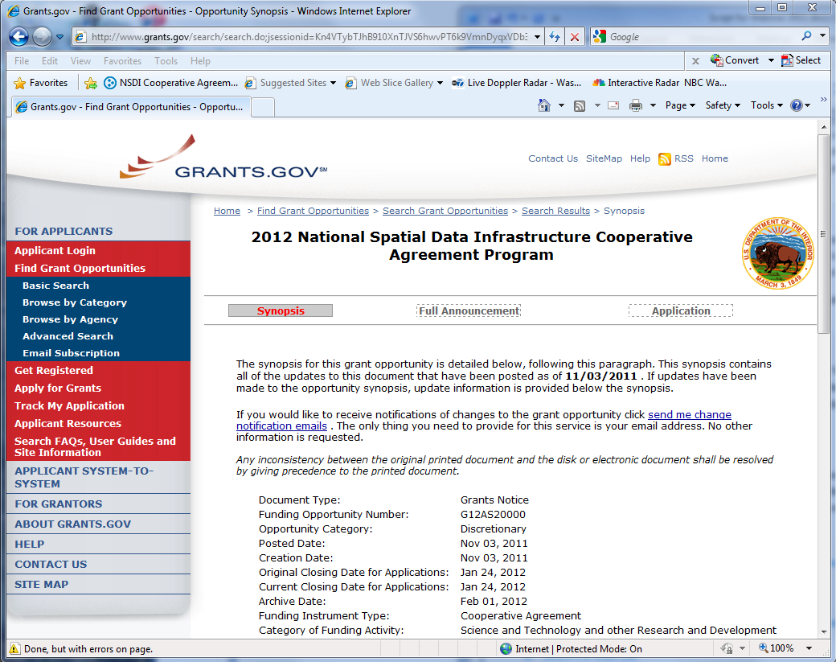
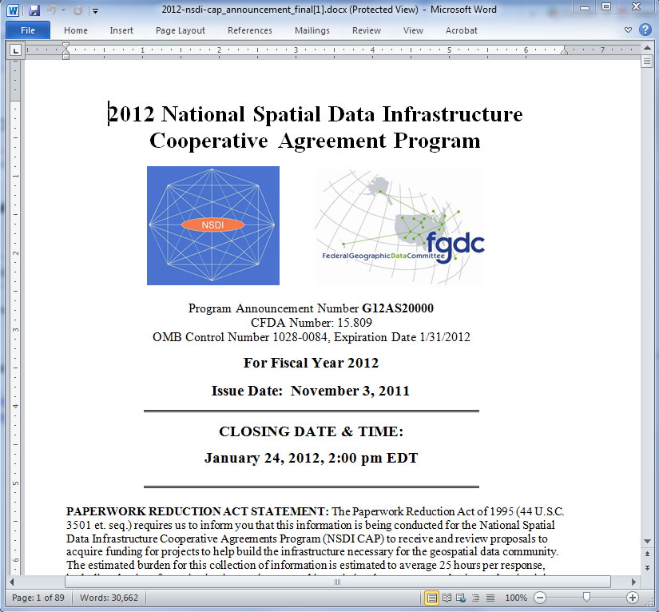
Demonstration
Application package from Grant.gov
CAP Announcement
Notes:
Now I will demonstrate downloading the application package and we will look at the CAP announcement.
<Demo – downloading grants.gov application package>
Go to grants.gov
Click Find Grant Opportunities on the left side of the page
Click Basic Search
Find in the keyword search type NSDI CAP
Select the NSDI CAP which will display the synopsis page. You can select Full Announcement to see it. But now I will
Click Application button on the right
Click Download in the table
Then click and save application instructions and package to your computer
Now you are ready to start filling in the package.
<Demo open file oppG12AS20000-cfda15.809-cidG12AS20000.pdf >
Show buttons
Save & Submit
Save
Check Package for Errors
In SF 424 - Show field 8F, 15 and 17
Show Project Narrative Attachment Form – how to attach proposal and other supporting documents.
Show SF 424-A – Please, on page 2 use Column 1 for the Federal funds allocation and column 2 for the your in-kind match allocation.
Show SF 424-B
<Demo open file 2011_NSDI_CAP_Announcement.pdf>
Now let us take a look at the CAP announcement. You can use the table of contents to find your way around the document. Everyone should read the General Information section and the category that you will be applying to. The details for the budget breakdown are on page 9. The format for the Proposal Narrative is given at the end of each category section and the scoring criteria for the reviews is included here.
On page 77 there is a blank budget breakdown form you can use. This is the form required by USGS. An example budget is on page78. You can see how the breakdown can be done. When there is a large budget item like in this example for $19,000 contract services -- it need to be explained as it is here in the example.
Now back to the slides.

Slide 43
Summary of What to Submit
Application Package
SF-424 Application for Federal Assistance
SF-424A Budget Information
SF-424B Assurances–Non-Construction Programs
Proposal narrative
Budget Breakdown
Other required documents
Optional documents
Notes:
We have covered a lot of information. Here is a summary of the documents that make up an NSDI CAP application package.
SF-424 Application for Federal Assistance form
SF-424A Budget Information form
SF-424B Assurances form
Proposal Narrative
Budget Breakdown
Other required documents described in the announcement
and optional supporting documents
And as I have said before please read the CAP Announcement carefully to determine specific category requirements.
Finally if possible please try to put the Narrative, budget breakdown, other required documents, and optional documents into a single PDF file and attach that to the application.

Slide 44
Submitting Your Proposal via Grants.gov
Submit the Completed NSDI CAP Application Package
Click the submit button on the application package cover page
Log in to Grants.gov using your username and password.
Click the "Sign and Submit" button on the summary page
Grants.gov tracking number will be provided
Check for errors
Notes:
Once you have completed the application package and you or your office have registered on Grants.gov you are ready to submit your NSDI CAP Application Package. First use the Check Package for Errors button and if no errors are returned use the submit button is located at the top of the application package cover page. This button will not work until you have completed all required forms, attached all required documents, and saved your application package.
After clicking the submit button a grants.gov login window will appear. This is where the AOR username and password is entered. Then click the "Sign and Submit" button on the summary page.
You will be given a Grants.gov tracking number at the bottom of this screen, as well as the submission's official date and time. You need to record the tracking number since this is the number that is used to track your application and I use this number too. Make sure to check for errors in the submission. If there are no errors then NSDI CAP application process is complete on your end.

Slide 45
Proposal Tracking
The status of a proposal can be checked in Grants.gov
https://apply07.grants.gov/apply/checkApplStatus.faces
Help is at http://www.grants.gov/assets/TrackingYourApplicationPackage.pdf
Each submitted proposal receives a tracking number from Grants.gov
Grants.gov will provide emails
submission was received
submission was validated or there were errors
USGS retrieved proposal
Notes:
You use the tracking number provided by Grants.gov to check on the proposal status on the Grants.gov web site. Grants.gov will provide emails when the submission is received, when submission is validated or if there are errors, and when USGS retrieves the proposal. It is critical that you make sure there were no errors in the submission.

Slide 46
Proposal Tracking
After the closing date of the CAP announcement status information from
Gita Urban-Mathieux
burbanma@fgdc.gov
Notes:
After the closing date of the NSDI CAP announcement on Grants.gov which is January 24, 2012. I can provide status information.

Slide 47
Submitting Multiple Proposals
Organizations may submit proposals for more than one category.
A separate application package is required for each category submission
If an applicant receives awards in more than one category the projects will be combined into a single assistance award and the funding will be a combined total of all the awards.
Notes:
Your organization may submit proposals for more than one category but you will need to submit a complete and separate application package for each category submission.
If you receive awards in more than one category the projects will be combined into a single assistance award and the funding will be a combined total of all the awards. This will, hopefully, ease the burden of managing the awards on your end.

Slide 48

Help with Proposals
Topic Development and Collaborative Resources
Contact your USGS State Geospatial Liaisons http://liaisons.usgs.gov/geospatial
select ‘Partnership Contact List’ from upper banner
Review reports from past CAP recipients http://www.fgdc.gov/grants
Contact the CAP category lead http://www.fgdc.gov/grants/2012CAP/2012CAPDescriptions
Review a successful, past proposal
Notes:
At this point I bet you are wondering what help is available. A great place to start is with your USGS State Geospatial Liaison. They can be found via this link. Select “Partnership Contact List” from upper banner to find the liaison for your State.
Next you can check reports from past CAP recipients. They contain information that describes the work accomplished. These can be found on FGDC grants web pages.
You can also contact the CAP category lead who in listed on 2012 CAP description web page and in the announcement.
In addition, you could review a successful, past proposal. The best way to do this is to make direct contact with the CAP award recipient. Their contact information is included with their project information on the FGDC grants web site.

Slide 49
Proposal Review and Selection
Review proposals to ensure compliance to all requirements
Category Leads sets up Review Panels
Review Panel member reviews the assigned proposals individually
Scored proposals are given to FGDC Executive Director
Awarded proposals are announced
2012 CAP Awards will be announced in March 2012
Notes:
Once the NSDI CAP announcement closes all the application packages come to me and the Category Leads for the review process. They are reviewed to ensure compliance with all the requirements. The Category Leads set up the review panels that are comprised of subject matter experts. The proposals are reviewed individually using a score sheet. The scoring is based on the criteria and point allotment specified in the CAP Announcement under the Proposal Narrative. This is why it is important to follow the format given in the CAP announcement. The completed score sheets are preserved so that during and after the selection process they can be revisited at any time.
The scored and ranked proposals are given to FGDC Executive Director to make the final selections. The award announcements are made as soon as they are known and on a category by category basis. The review process takes 4 to 8 weeks and I expect the 2012 CAP awards to be announced in March 2012.

Slide 50
Proposal Selection Process
Notification of Awards
Both successful and unsuccessful
applicants receive letters
Selected projects are posted to the FDGC Web site
Notes:
Once the awards are determined I send letters to both the successful and unsuccessful applicants. For those that are not getting an award, the letter will provide some information about why the proposal was not accepted. I will post on the FDGC Web site a list of all the selected proposals.

Slide 51

Proposal Review and Selection
Hints for Successful Proposals
Address all criteria
Provide all requested items and information
Comply with proposal size/length limitations
Observe CAP and category-specific funding restrictions
Budget meets both project objectives and funding limits
Clearly state the source and value of in-kind match
Read the CAP Announcement thoroughly
Notes:
Now for some hints for a successful proposal. First address all criteria in the CAP announcement and provide all the requested items and information. Comply with proposal narrative size and length limitations – 5 pages or 3000 words. Observe CAP and category-specific funding restrictions – no data collection or purchases. Check that your budget meets both project objectives and funding limits. Clearly state the source and value of your in-kind match.

Slide 52
Proposal Review and Selection
Hints for Successful Proposals (con’t)
Include Letters of Support from organizations indicated as project collaborators or prime benefactors
Discuss how your organization will sustain the project outcomes after the CAP project ends
Focus on partnerships with other organizations
Discuss plans to share the project outcomes
Notes:
Include Letters of Support or Commitment from organizations that are listed as project collaborators or prime benefactors. In your proposal narrative you should discuss how your organization will sustain the projects outcomes after the CAP project ends. Project sustainability is critical. Demonstrate your partnerships with other organizations. And finally, include information about plans to share the outcomes of the project at conferences, online, or through other venues.

Slide 53
Summary
The NSDI CAP supports programs that
Lead to sustainable projects
Introduce and extend the NSDI
Implement proven solutions
Encourage partnerships
Focus on infrastructure development
Notes:
Now we are coming to the end of my presentation. To summarize the purpose of the NSDI CAP is to support geospatial programs that lead to sustainable State/regional/community projects, introduce and extend the NSDI, implement proven solutions for metadata, standards, and Web services; encourage partnerships and leveraged resources; and focus on infrastructure development. It is not for data collection or GIS start-ups.

Slide 54
Important Web Sites
NSDI CAP Web site http://www.fgdc.gov/grants
Grants.gov Web site http://www.grants.gov/
Grants.gov Applicant Resources http://www.grants.gov/applicants/app_help_reso.jsp
USGS Help for Grants.gov http://www.usgs.gov/contracts/grants/grantsgov.html
2012 NSDI CAP FAQ page
http://www.fgdc.gov/grants/2012CAP/FAQ_2012NSDICAP
Notes:
Throughout the presentation I have mentioned several useful web sites. This is a summary of them.
The first is the NSDI CAP Web site. It contains contact information for me and the Category Leads, current and past CAP announcements, CAP administration guidance, information about previous awards, and schedules for proposal submissions.
Next is the Grants.gov Web site that is the centralized site for Federal Government grant and cooperative agreements programs.
The 3rd site is applicant resources located on Grants.gov. It includes links for animated tutorials, FAQs, user guides, and check lists.
The USGS via the 4th link provides help for getting started with Grants.gov.
These and other helpful links are posted on the FGDC web site under the 2012 NSDI CAP FAQ page.

Slide 55
Conclusion
Successful submittal of an NSDI CAP proposal requires:
Advanced planning and registration
Careful review of the CAP Announcement
Collaboration and partnership
Demonstrated capabilities
NSDI CAP Coordinator:
Gita Urban-Mathieux
burbanma@fgdc.gov
703-648-5175
Notes:
So in conclusion the successful submittal of an NSDI CAP proposal requires advanced planning and registration on Grants.gov, careful review of the CAP Announcement, proof of collaborations and partnerships, and demonstration of capabilities.
As the NSDI CAP Coordinator I am available to help you as much as I can in the process. I appreciate your attention to this presentation.

Slide 56

Finally ....
Get to work!!!
Notes:
Now I hope you are ready to start your NSDI CAP application. But before we end, I have a simple poll question and then we will respond to some of your questions.
A Man Writing a Letter, c. 1664–1666, Gabriel Metsu from http://www.nga.gov/exhibitions/2011/metsu/fullscreen.shtm

Slide 57
Poll Question
The information presented in this webinar will help me develop and submit an NSDI CAP proposal.
Strongly Disagree
Disagree
Neutral
Agree
Strongly agree
Notes:
Vaishal are you ready with the poll question? Please response to this statement “The overall experience of this webinar training was positive. 1 is strongly disagree, 2 is Disagree, 3 is Neutral, 4 is Agree, and 5 is strongly agree. We will give you a minute or so to respond.
The poll is now closed. I will be glad to get any comments or suggestions you have about this webinar, so please send me an email. Now we can move to questions and answers.

Slide 58

Questions
Questions?
Gita Urban-Mathieux - burbanma@fgdc.gov
2012 NSDI CAP FAQ page
http://www.fgdc.gov/grants/2012CAP/FAQ_2012NSDICAP
Notes:
I will try to respond to as many as I can. If there are any we cannot get to or need to do further research I will post these on the web site later under FAQ.
Thanks to Vaishal Sheth for his support running this webinar and thank you for your time and attention.

