Slide 1
CBRFC June 22 Forecast Webinar Please Mute Your Phones: *6
2pm, June 22, 2011
Kevin Werner
These slides: www.cbrfc.noaa.gov/present/present.php

Slide 2
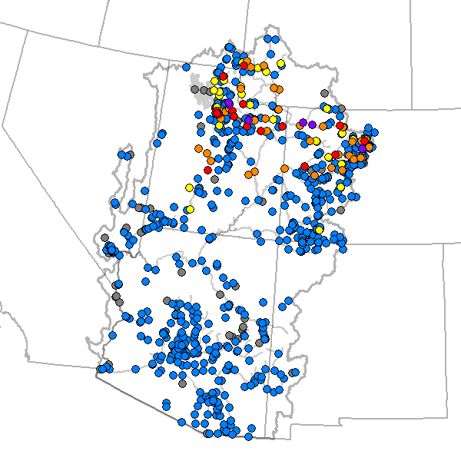
Outline
Recent and Upcoming Weather Review
Snow States
Streamflow forecasts
Web Reference: www.cbrfc.noaa.gov/wsup/pub2/map/html/cbrfc.1.2011.html

Slide 3
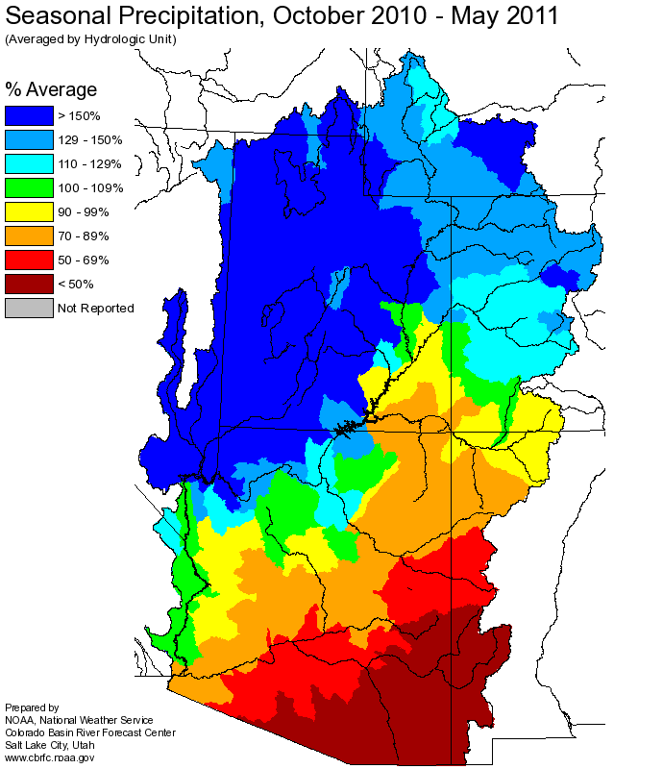
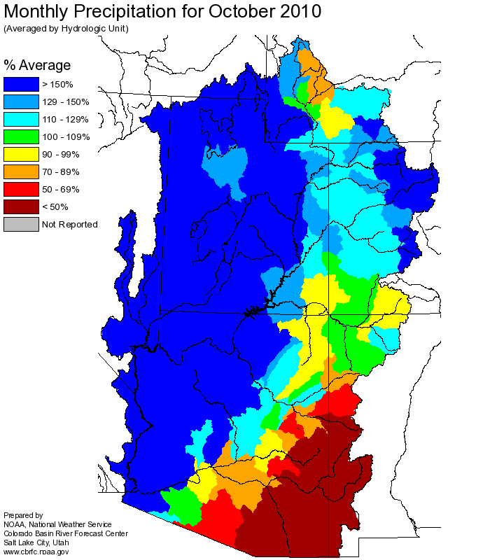
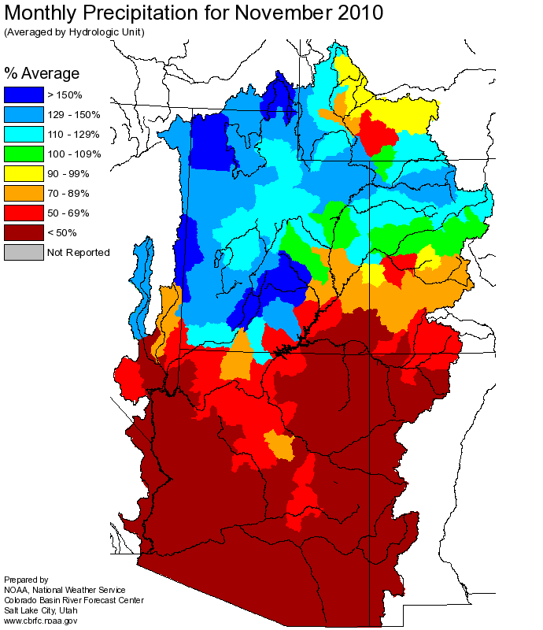
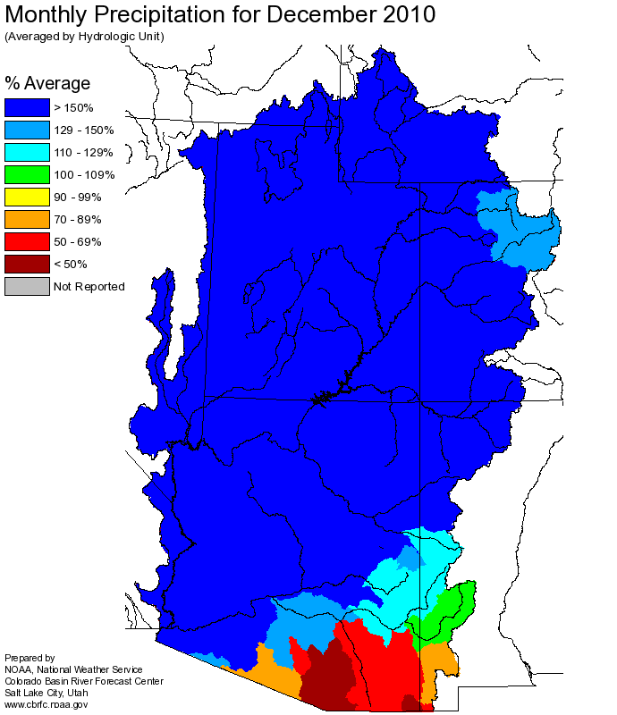
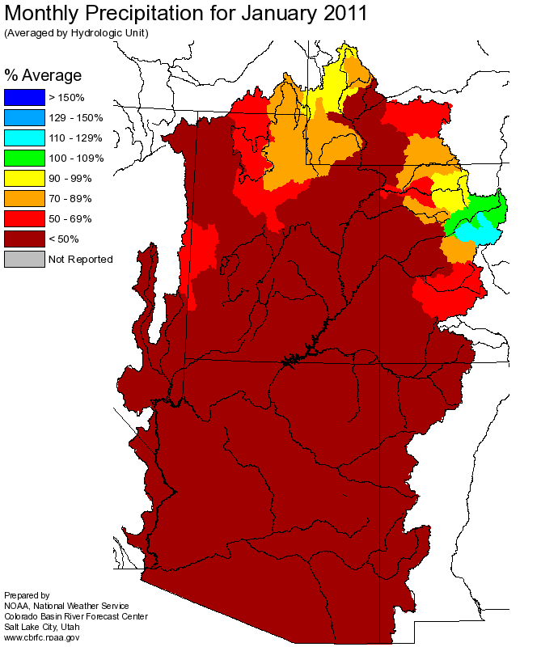
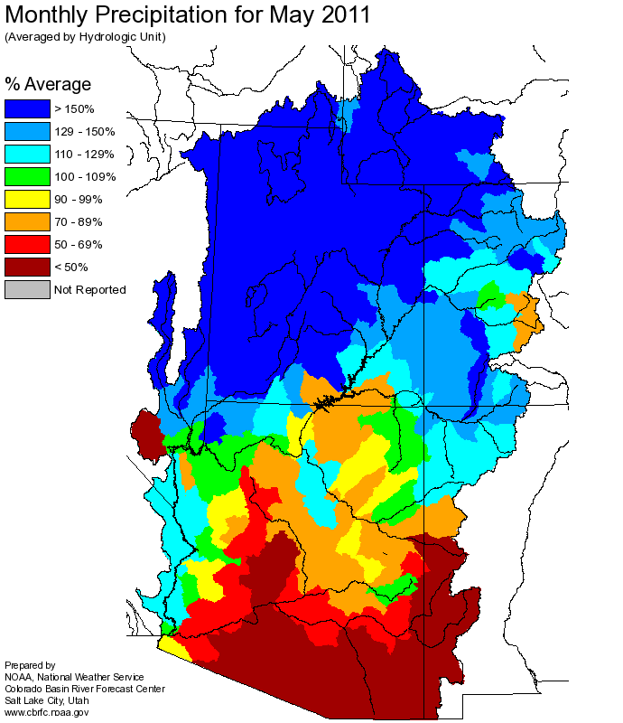
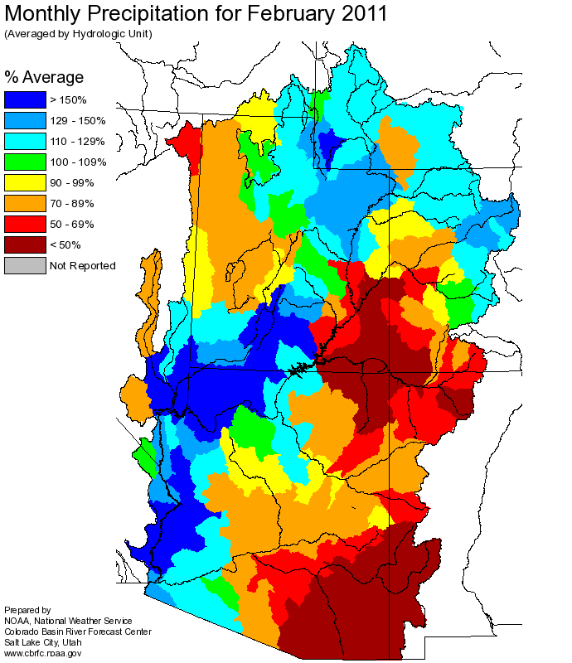
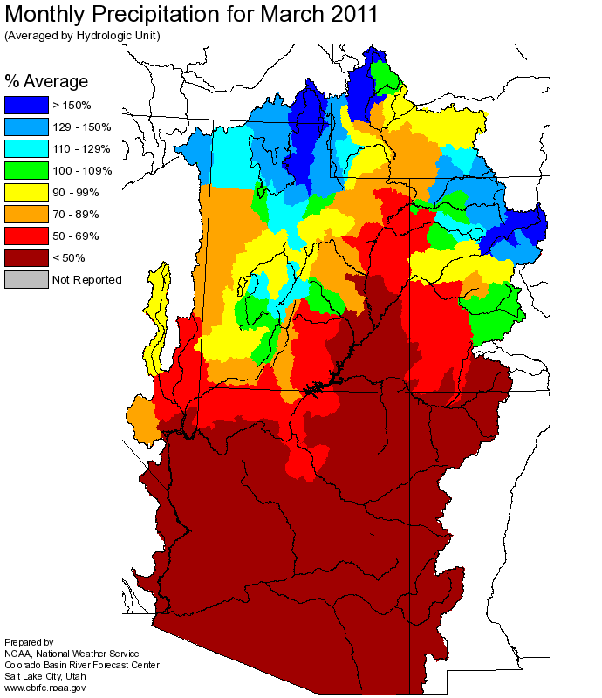
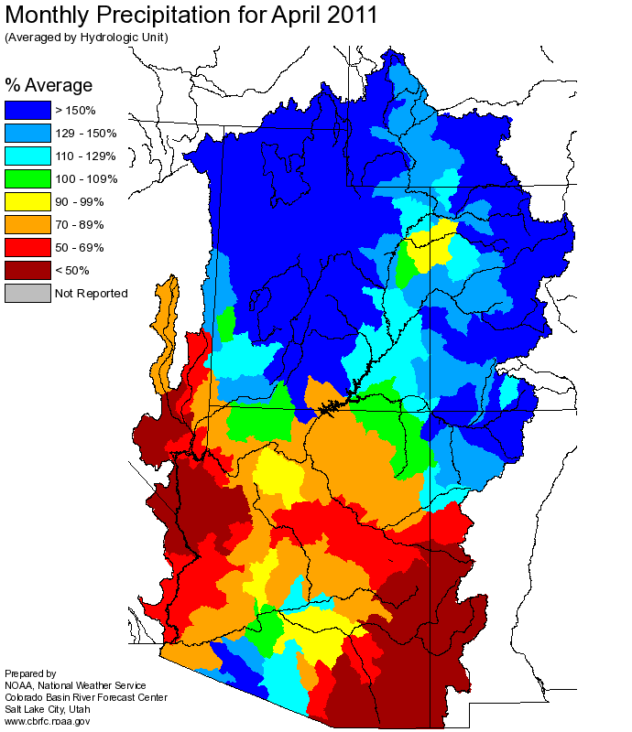
Web Reference: http://www.cbrfc.noaa.gov

Slide 4
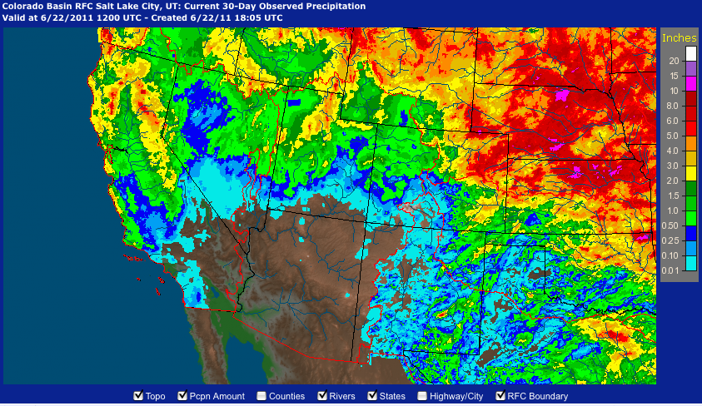
Last 30 days Precipitation
Web Reference: http://water.weather.gov/precip

Slide 5
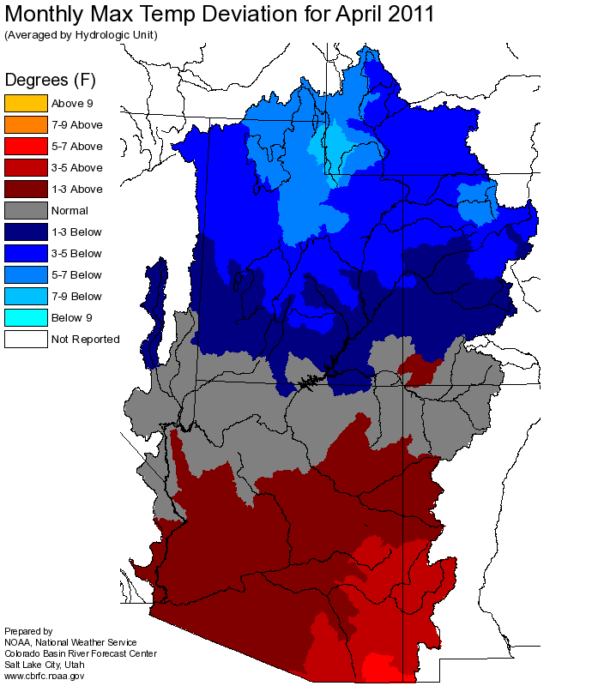
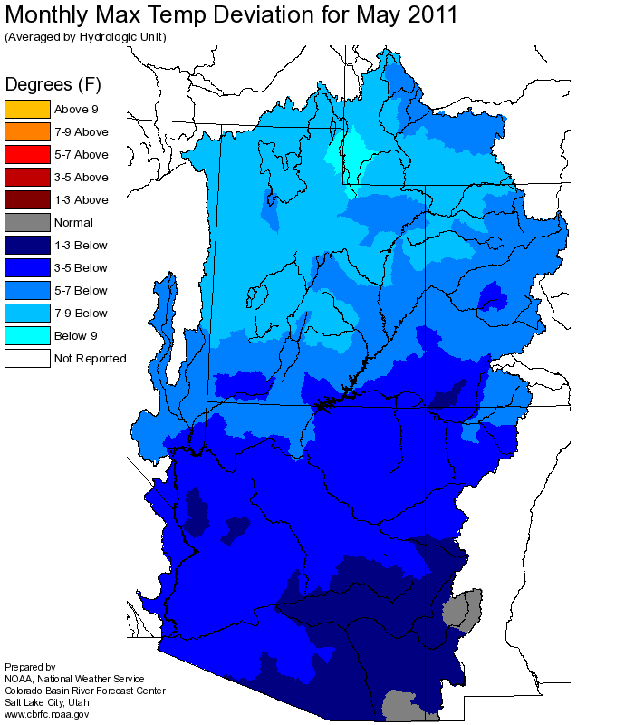
Temperature

Slide 6
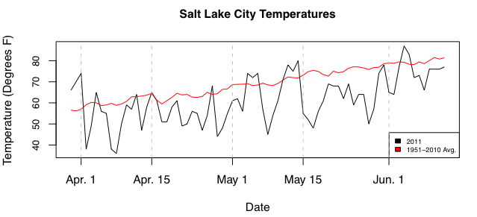
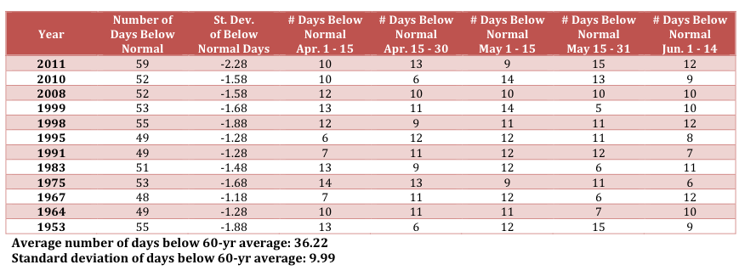

Slide 7
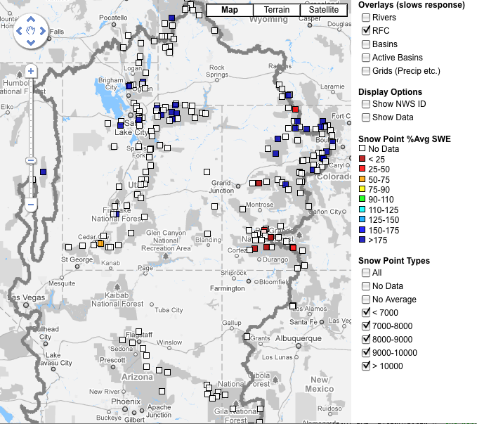
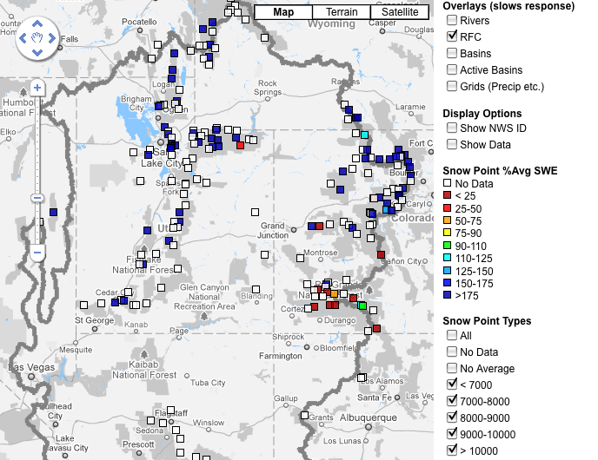
Snow
June 9 June 22
Web Reference: http://www.cbrfc.noaa.gov/gmap/gmapm.php?scon=checked

Slide 8
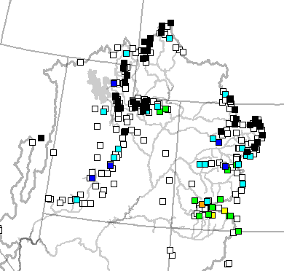
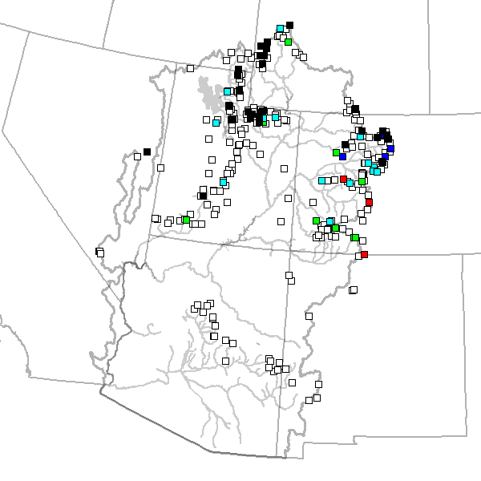
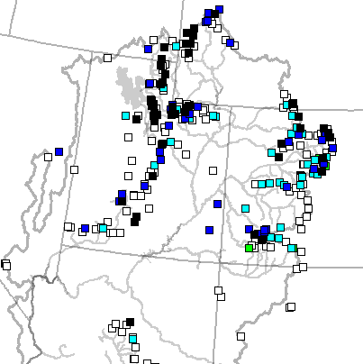
June 2 June 9 June 22

Slide 9
120 sites showing highest value for today!!

Slide 10
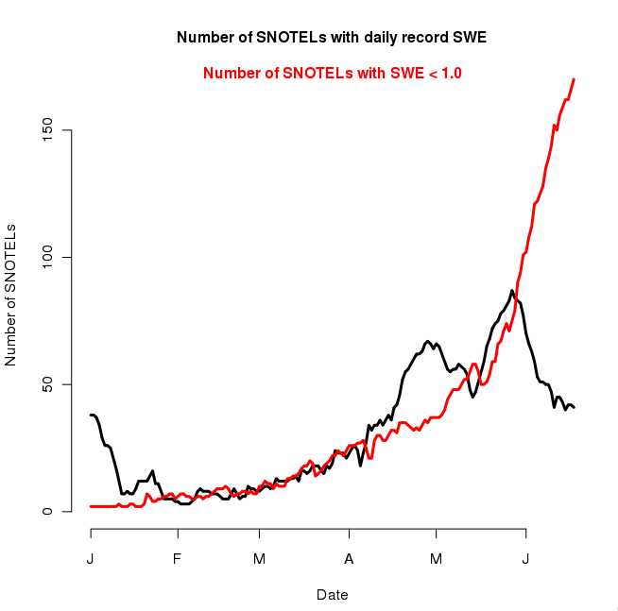
229 sites with 10+ years of record
87/229 or 38% of sites with daily record as of 5/31
170/229 sites with less than 1” SWE as of 6/22

Slide 11
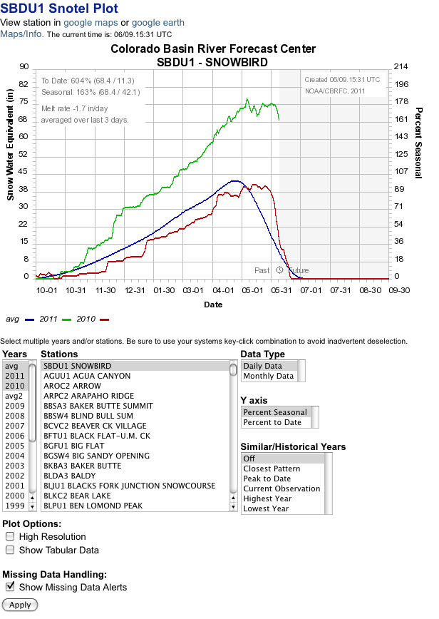
% average daily
% average seasonal peak
Melt or accumulation rate
Historical years
Analogue years

Slide 12
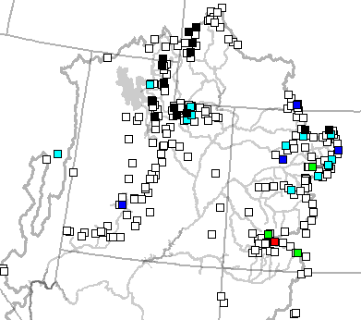
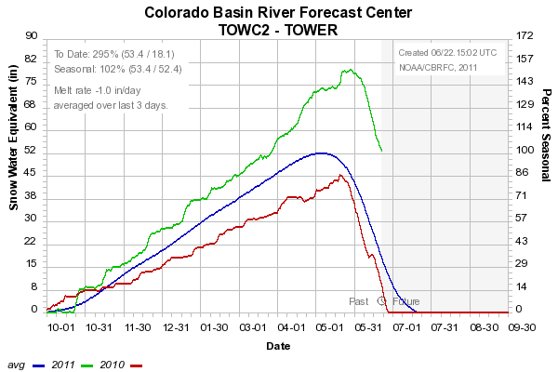
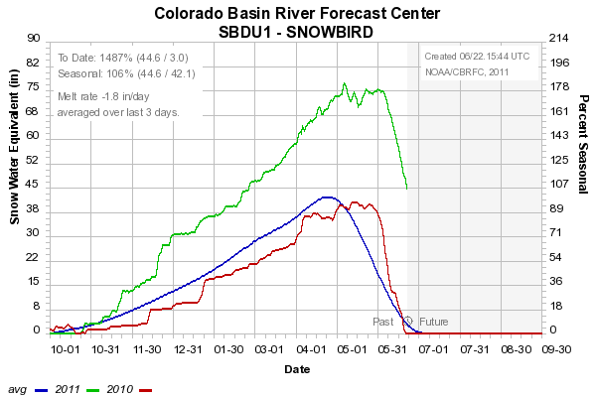
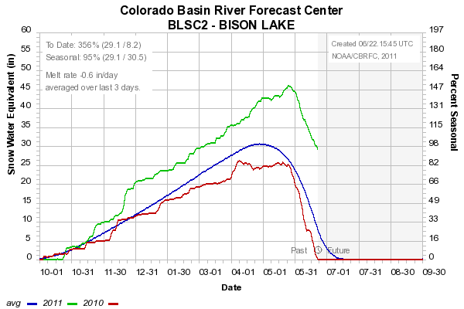

Slide 13
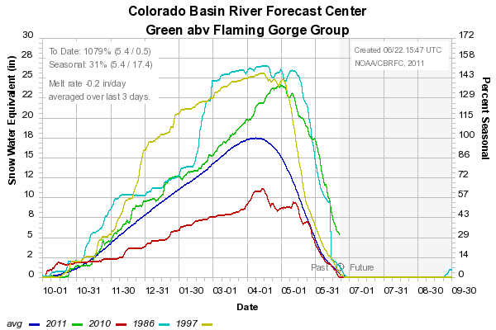
Snow: Upper Green Basin (above Flaming Gorge)
Web Reference: http://www.cbrfc.noaa.gov/station/sweplot/sweplot.cgi???open

Slide 14
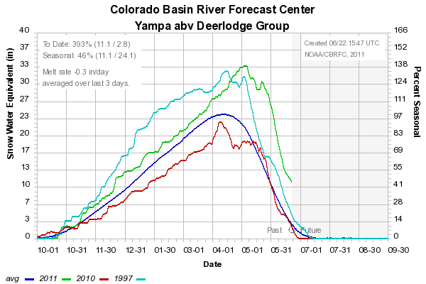
Snow: Yampa
Web Reference: http://www.cbrfc.noaa.gov/station/sweplot/sweplot.cgi???open

Slide 15
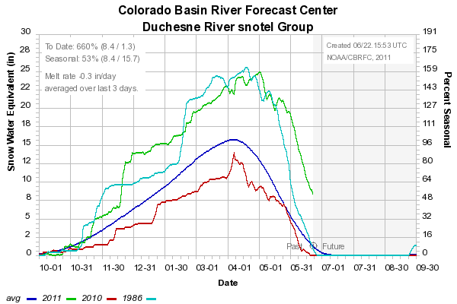
Snow: Duchesne River Basin
Web Reference: http://www.cbrfc.noaa.gov/station/sweplot/sweplot.cgi???open

Slide 16
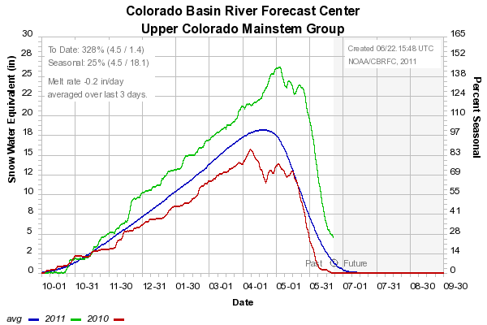
Snow: Colorado Mainstem (above Cameo)
Web Reference: http://www.cbrfc.noaa.gov/station/sweplot/sweplot.cgi???open

Slide 17
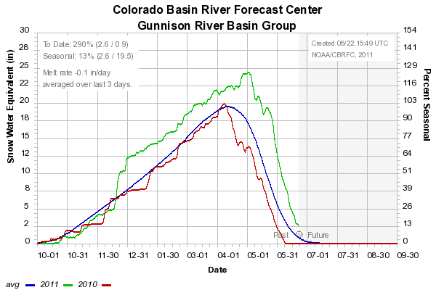
Snow: Gunnison Basin
Web Reference: http://www.cbrfc.noaa.gov/station/sweplot/sweplot.cgi???open

Slide 18
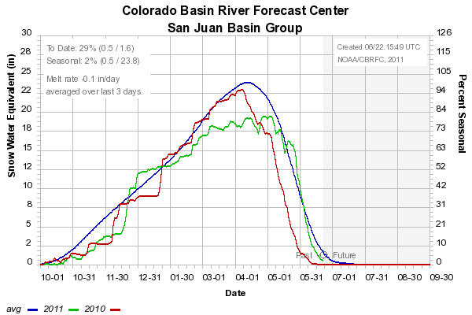
Snow: San Juan Basin
Web Reference: http://www.cbrfc.noaa.gov/station/sweplot/sweplot.cgi???open

Slide 19
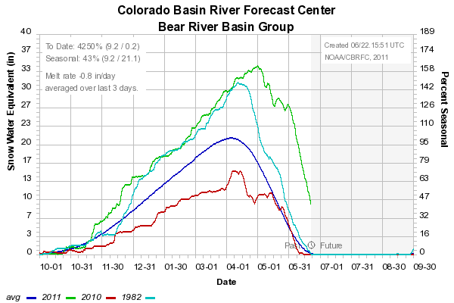
Snow: Bear River Basin
Web Reference: http://www.cbrfc.noaa.gov/station/sweplot/sweplot.cgi???open

Slide 20
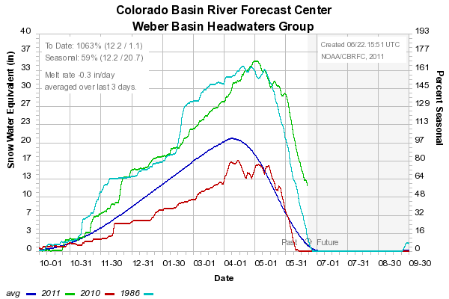
Snow: Weber River Basin
Web Reference: http://www.cbrfc.noaa.gov/station/sweplot/sweplot.cgi???open

Slide 21
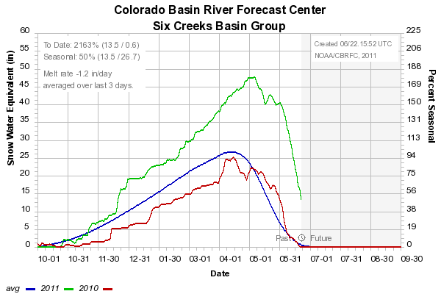
Snow: Six Creeks in Salt Lake County
Web Reference: http://www.cbrfc.noaa.gov/station/sweplot/sweplot.cgi???open

Slide 22
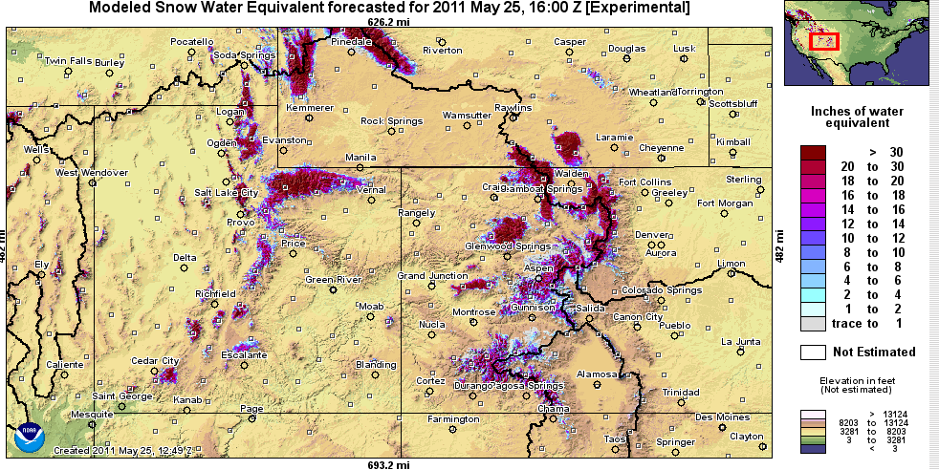
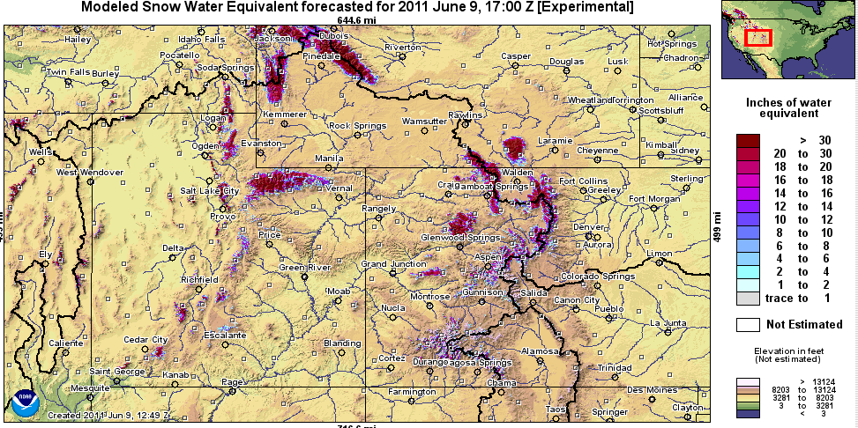
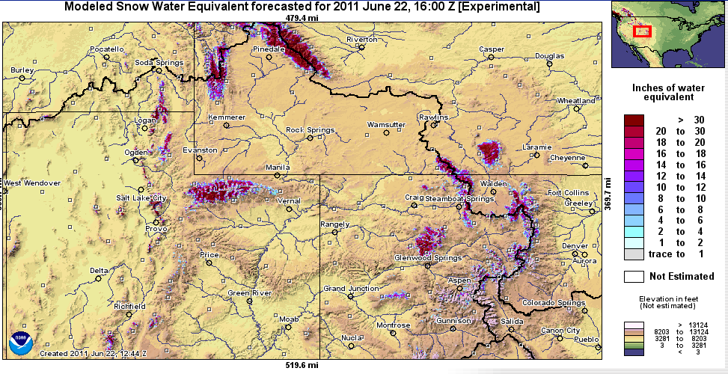
Snow Maps
Web Reference: http://www.nohrsc.nws.gov

Slide 23
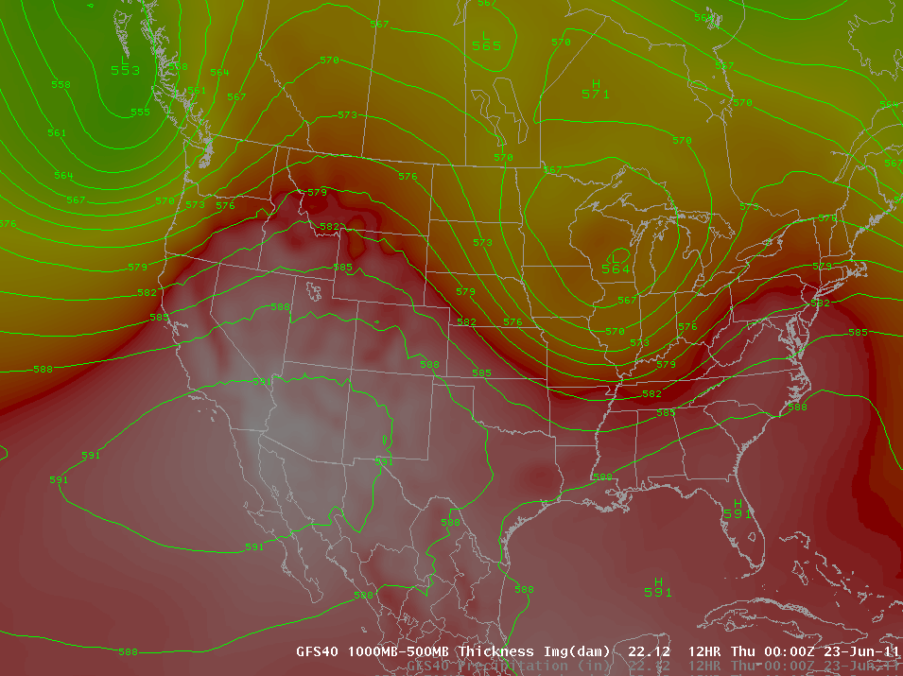
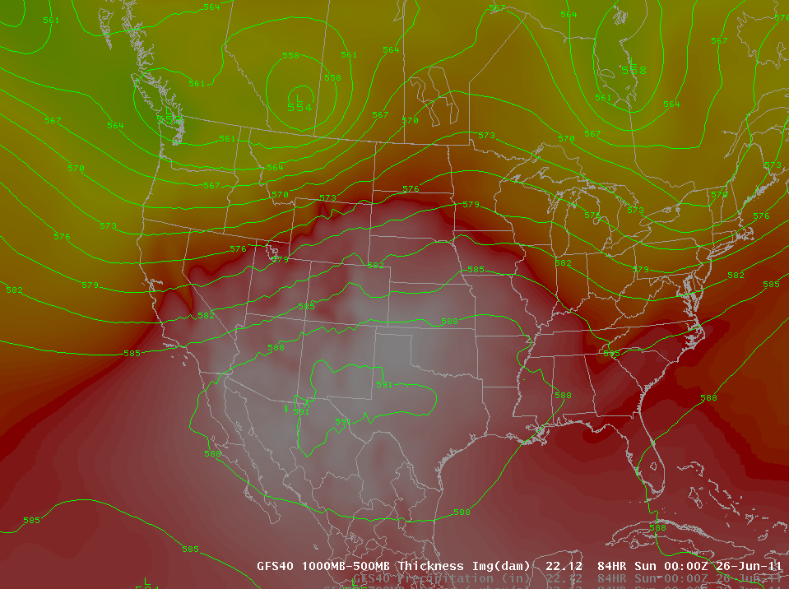
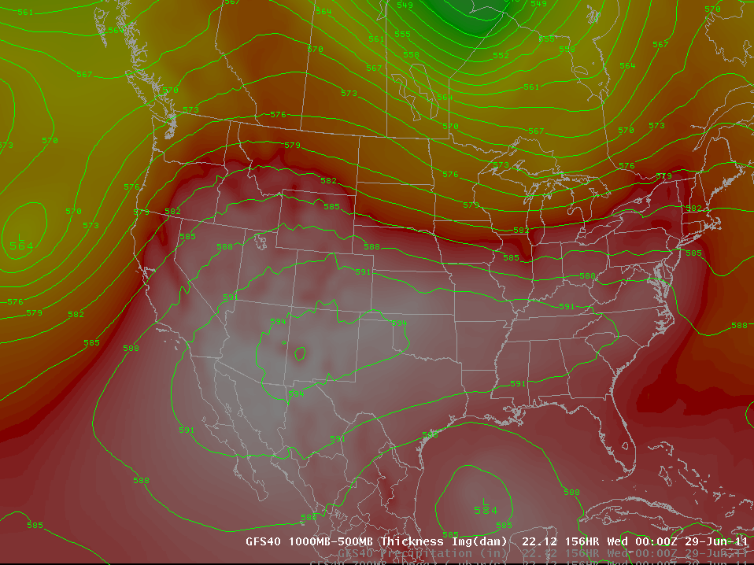
Weather Forecast
<- Today (Thursday)
Saturday PM
Tuesday PM
Heat is coming!!
Above normal temperatures today, tomorrow, Friday
Slight cooling for Utah over the weekend
Colorado stays warm

Slide 24
Wednesday afternoon

Slide 25
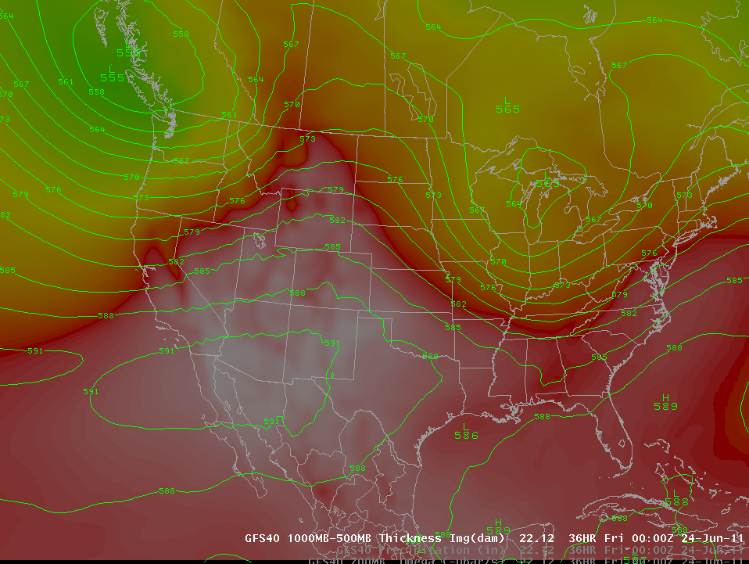
Thursday afternoon

Slide 26
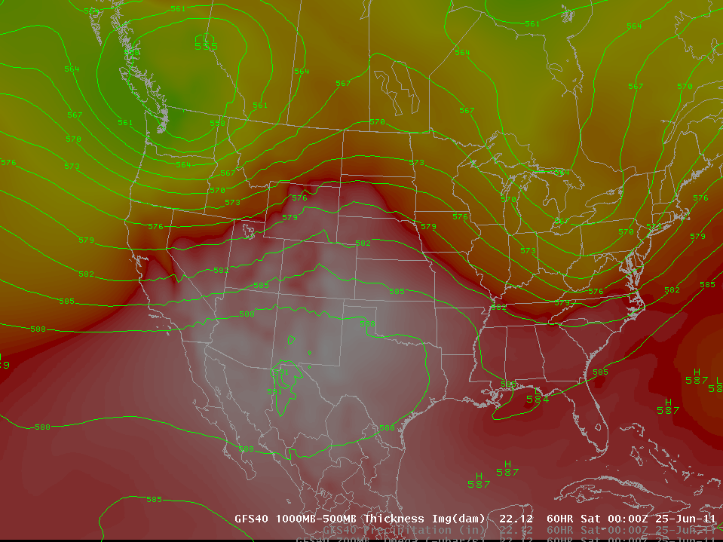
Friday afternoon

Slide 27
Saturday afternoon

Slide 28
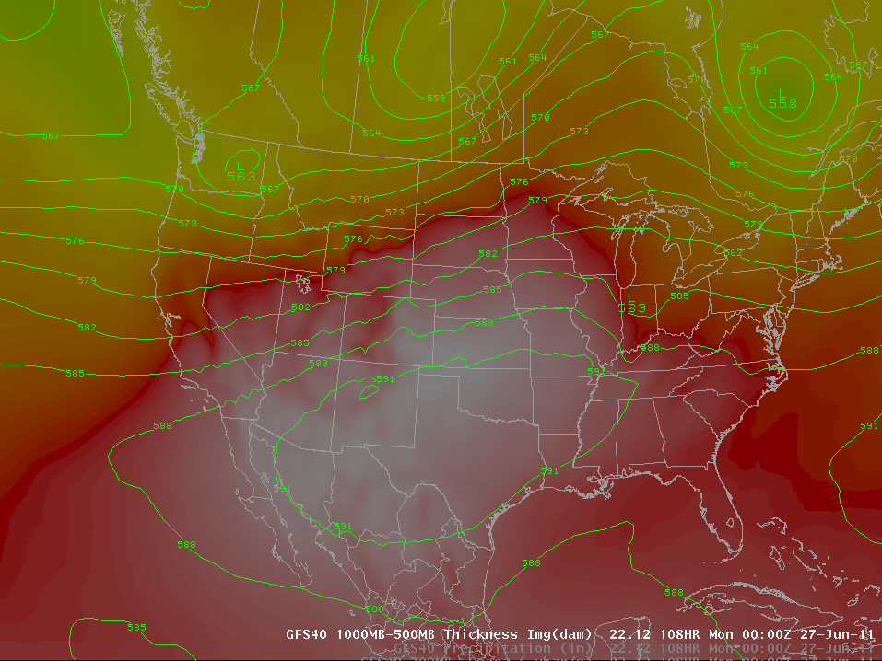
Sunday afternoon

Slide 29
Tuesday afternoon

Slide 30
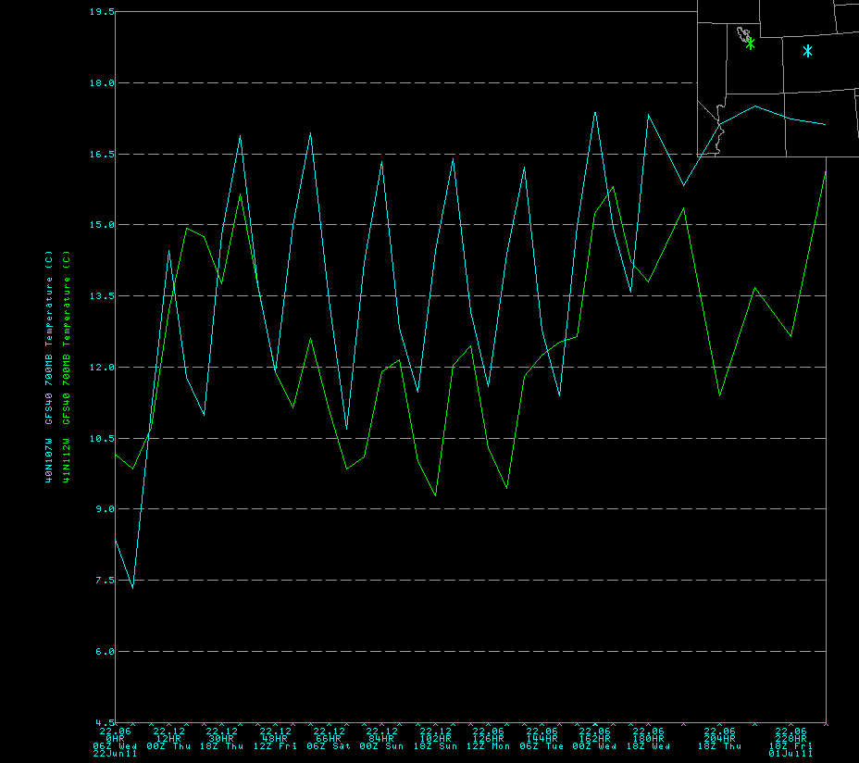

Slide 31
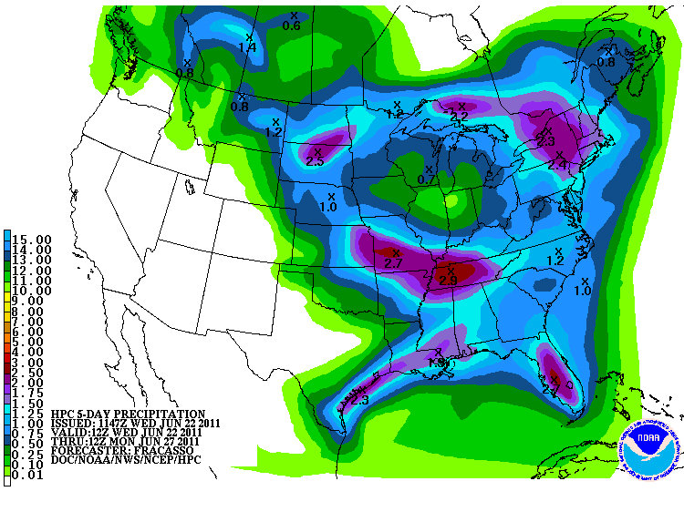
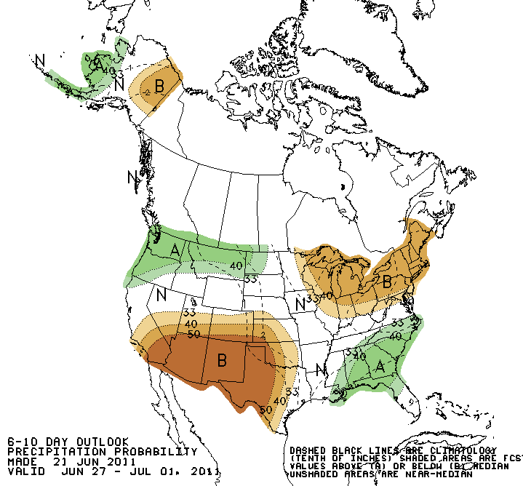
Forecast Precipitation
Showery weather pattern associated with low pressures
Drier next week
Web Reference: www.hpc.noaa.gov

Slide 32
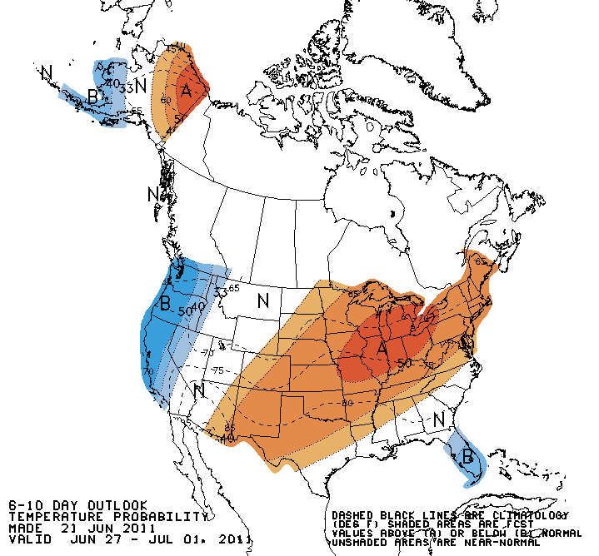
Forecast Temperature

Slide 33
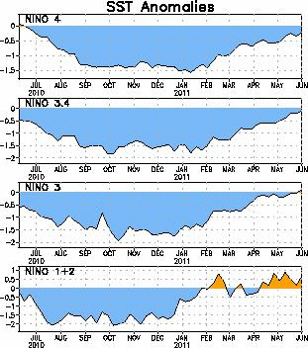
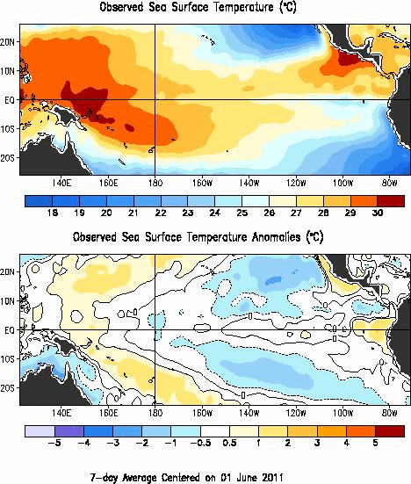

La Nina
Web Reference: http://www.cpc.noaa.gov and iri.columbia.edu/climate/ENSO

Slide 34
Peak Flow Forecasts
Long Lead Peak Flow Forecasts
Snowmelt Mean Daily Maximum Flow (April-July)
Probabilistic Forecasts
Exceedence Probabilities -10%,25%,50%, 75%, 90%
Issued (at least) monthly from March-June (this year weekly starting April 19)
~60 forecast points – some unregulated, some regulated
Daily Forecasts
Full Hydrograph out 14 days
Includes temperature (10 days) and precipitation (5 days) forecast
Includes any knowledge of future regulation (e.g. reservoir release)
Single value forecast
Issued daily by 10am MDT and updated throughout day
~450 forecast points

Slide 35
Spring Weather Really Matters (and has mitigated high flows this year)
Runoff characteristics are largely determined by the day-to-day spring weather.
While large snow pack years increase chances for flooding, it is not an inevitability
Small snow pack years (like last year) can flood with the right sequence of spring temperatures

Slide 36



Slide 37


CBRFC Website Mini Tutorial
Current website
Extensive in scope
Slower, cumbersome
www.cbrfc.noaa.gov

Slide 38


CBRFC Website Mini Tutorial
“Beta” website
Faster
Easier access to key information
Actively being developed
www.cbrfc.noaa.gov/gmap/cmap2.php

Slide 39
Forecast Hydrographs
Flood Stage
Forecast Creation Time
Observed streamflow
Daily forecast
Link to old plot
Bankfull
web reference: www.cbrfc.noaa.gov/gmap/cmap.php

Slide 40


Slide 41


Slide 42



Current Forecasts
May 24 Forecasts
June 16 daily Forecasts

Slide 43




Slide 44



Slide 45



Slide 46



Slide 47



Slide 48




Slide 49



Slide 50



Slide 51



Slide 52



Slide 53




Slide 54



Slide 55



Slide 56




Slide 57


Slide 58



Slide 61



Slide 62


Experimental: Peak Flow Forecast Evolution
Daily long lead peak forecasts from ESP reflect changing weather forecasts and hydrology.
Started in late May and comparing to official forecasts
Little Cottonwood Creek (top)
Yampa near Deerlodge (bottom)
Comments welcome
Web reference: http://www.cbrfc.noaa.gov/devel/dly_peak/

Slide 63

Experimental Daily Ensembles
Ensemble forecasts that incorporate weather forecasts are run daily for Upper Colorado Basin forecast points
Prototype web tool available
Does NOT work correctly downstream of reservoirs yet
NOT available for the Great Basin yet
URL: www.cbrfc.noaa.gov/devel/hefs

Slide 64


NWS Flood Warnings, Watches
NWS Weather Offices are responsible for setting flood stage and issuing flood warnings and watches based on CBRFC forecasts. Key personnel for snow melt floods:
Salt Lake City – Brian McInerney
Grand Junction – Aldis Strautins
Riverton – Jim Fahey
Boulder – Treste Huse

Slide 65
Peak Flow Decision Support
Many rivers peaking this weekend
Daily forecasts posted by ~10am MDT each (and updated later during the day). When temperatures are forecast to warm, please check here for the latest peak flow forecasts.
“beta” website developments:
SNOTEL percentiles
Simplified peak flow chart
Publication referencing forecasts above historic peaks
New peak flow forecast points added
Webinars: One more?? Thursday June 30 at 1pm??
Discussion:
Anything else you need??

Slide 66

CBRFC Blog
Blog.citizen.apps.gov/cbrfc

Slide 67

CBRFC Contacts
Basin Focal Points (Available to discuss forecasts: 801.524.5130)
Upper Colorado: Brenda Alcorn
Green: Ashley Nielson
San Juan / Gunnison: Tracy Cox
Great Basin: Brent Bernard
Lower Colorado (below Lake Powell): Greg Smith

Slide 68


Feedback, Questions, Concerns always welcome….
Kevin Werner
CBRFC Service Coordination Hydrologist
Phone: 801.524.5130
Email: kevin.werner@noaa.gov

