Slide 1
Framework Data Content Standard – Transportation: Transit
Related Topics
NSDI Training Tracks:
An initiative to define areas, topics, and materials for training within the NSDI.
ISO 19100 Series:
Suite of standards developed for geographic data and datasets. The most notable is ISO 19135 which pertains to metadata.
ANSI Standards:
Similar work to ISO, but standards directly apply to
data created within the United States.
Course Information
The National Spatial Data Infrastructure (NSDI) Framework is a collaborative initiative to develop a set of commonly used geographic datasets that are compatible based upon spatial location and content. The Framework approach allows data collected for variety of reasons and agencies to work together seamlessly; which can ultimately reduce project costs and increase interagency cooperation. The Framework Data Content Base Standards Suite dictates the requirements for Framework data.
This course covers the fundamentals of the Framework Data Theme: Transportation: Transit as developed by the Framework Data Content Standard. It is designed for users who are both interested in an overview of the Framework Data Content Standard Transportation: Transit theme as well as designers and developers implementing Framework data, and associated tools specific to Transportation: Transit data.
Prerequisites
General Understanding of GIS, Geospatial Data and Metadata
Familiarity with the Federal Geographic Data Committee (FGDC)
Familiarity with the National Spatial Data Infrastructure (NSDI)
Basic knowledge of Geographic Data Standards (specifically ISO 19100 series)
Completion of Framework Data Content Base Standard Course

Slide 2
Learning Objectives
Understand Transportation: Transit Data
Comprehend Basics of Transportation: Transit Framework Standard
Understand How to Implement the Standard
Course modules
Understanding Transportation: Transit Data
Transportation: Transit (Part 7d) of the Framework Data Content Standard
Implementing the Transportation: Transit Standard
Course Review
Estimated Time
Estimated time for the entire course is 100 minutes.

Slide 3

Module 1: Understanding Transportation: Transit Data
Topics
Time Requirement
What is Transportation: Transit Data?
Types of Transportation: Transit Data
Transportation: Transit in Action Module Exercise
Summary
Estimated time for this module is 30 minutes
First Topic
What is Transportation: Transit Data?

Slide 4
What Are Transportation: Transit Data?
Transportation: Transit data are defined as spatial data, as well as related attributes and metadata, which can be used to depict the most broadly used elements of the public transportation system. As a transportation mode, transit differs substantially from other modes such as rail and road in that core operational features of the transit system consist of spatial and temporal elements that rest upon the transportation infrastructure.
Additionally, Transportation: Transit data can include each of the following types of data:
Transportation Mode
Stops
Interconnections
Facilities
Routes
And Many Others
More About Public Transportation:
Public transport (also public transportation, public transit, or mass transit) is a shared passenger transportation service which are available for use by the general public, as distinct from modes such as Taxicab, car pooling which are not shared by strangers without private arrangement.
Public transport modes include buses, trolleybuses, trams and trains, 'rapid transit' (metro/subways/undergrounds etc.) and, ferries. Intercity public transport is dominated by airlines, coaches, and intercity rail. High-speed rail networks are being developed in a many parts of the world.
Most public transport runs to a scheduled timetable with the most frequent services running to a headway.
Next Topic
Types of Transportation: Transit Data

Slide 5
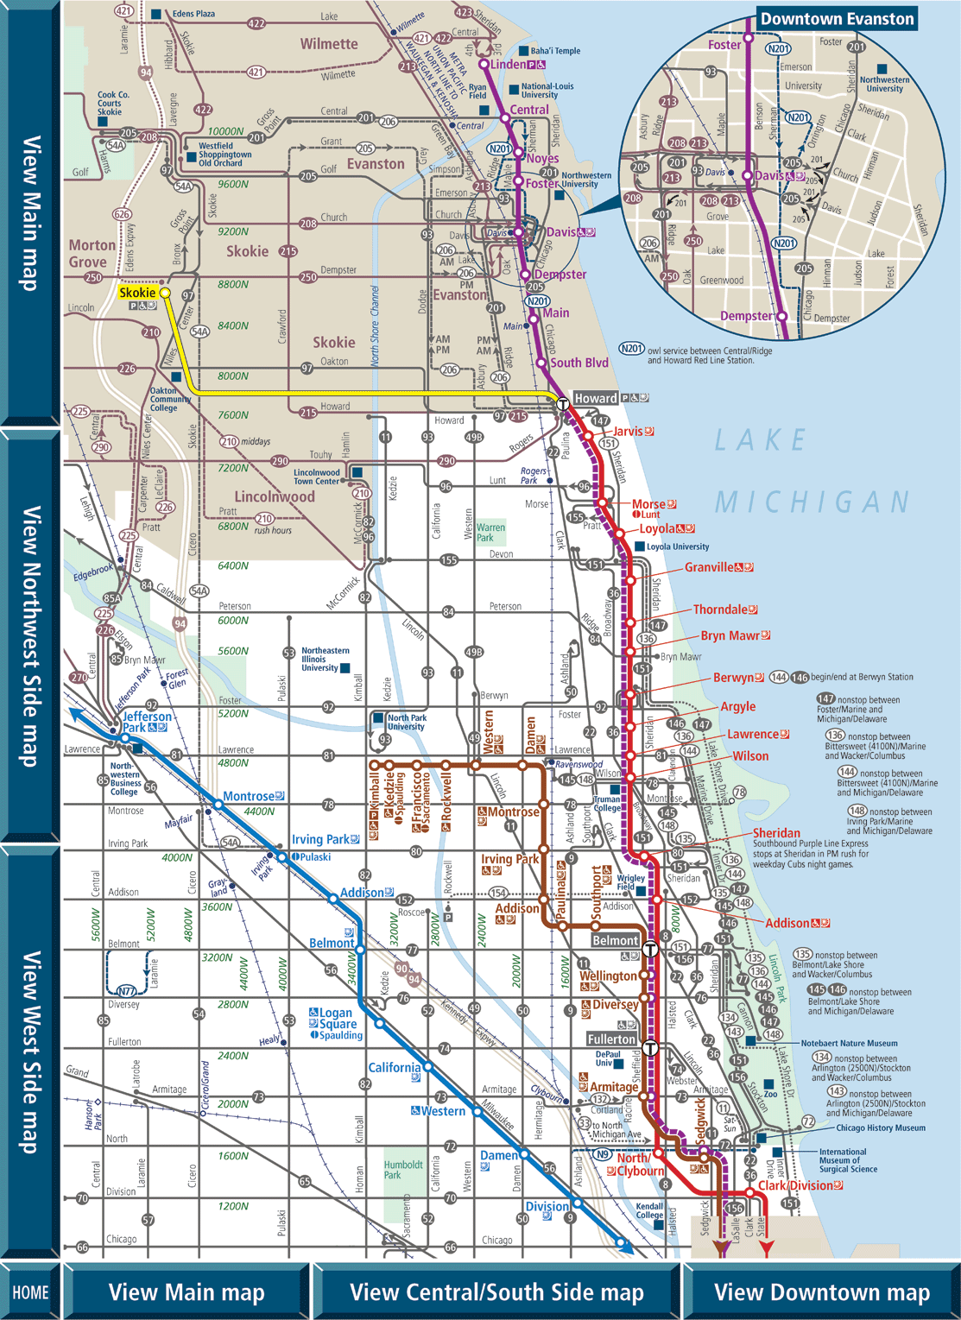
Types of Transportation: Transit Data
Transportation: Transit Data can be include many different types of data as previously mentioned. It can be simply a point location of an Train Depot, or more complex as the diagram to the right indicates.
The diagram to the right shows a portion of the Chicago Transit Authority Map.
Next Topic
Types of Transportation: Transit Data
http://www.transitchicago.com/assets/1/clickable_system_map/200806N.gif

Slide 6
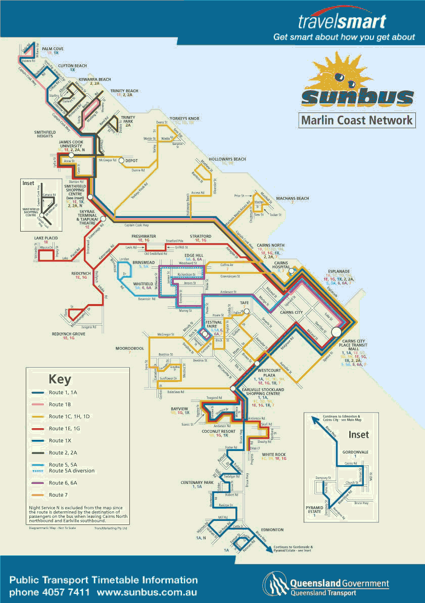
Types of Transportation: Transit Data
This picture shows another Transit map, this one from Cairns, AU, but highlights different features and symbolizes them in a different manner; however the key Transit features are all present and show another way in which Transportation: Transit data can be represented.
Next Topic
Types of Transportation: Transit Data
http://www.aussieinteract.com.au/images/cairns_bus_map.gif

Slide 7
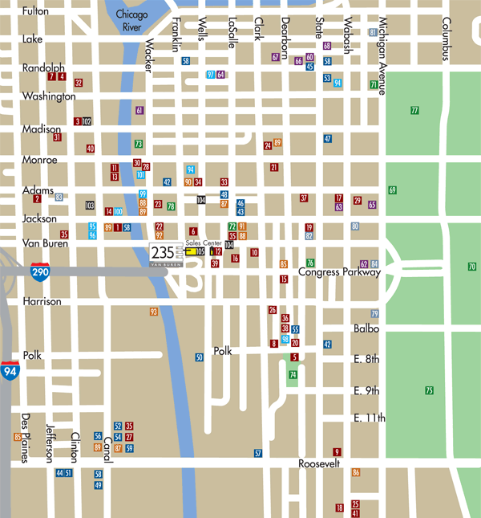
Types of Transportation: Transit Data
So far we have mainly looked at line and polygon features, but as this map indicates, Transportation: Transit data can also be represented by simple point features. The map to the right indicates different types and locations of train depots within downtown section of Chicago.
Next Topic
http://www.235vanburen.com/site/template/assets/home_template_235VanBuren_658/images/map/map.gif
Types of Transportation: Transit Data

Slide 8
Transportation: Transit Module 1 Exercise
Transportation: Transit data is being applied and used in real world projects by many different agencies. These agencies use Transportation: Transit data for a variety of reasons. Now that you have some basic Transportation: Transit knowledge let’s see some Transportation: Transit data sets in action.
Step 1) Open an Internet Browser and proceed to: http://www.mta.info/nyct/maps/submap.htm
Step 2) Click on several different stations
Step 3) What information can you glean from the map and station locations?
Step 4) Is there other information that would be useful to have?
Step 5) If you have an apple iphone/itouch/ipad click on the following link and compare it to the map you have been viewing online
http://itunes.apple.com/us/app/nyc-subway-maps-for-iphone/id282796383?mt=8
Step 6) Close all Internet windows and proceed with the course
Next Topic
Module Summary

Slide 9
Transportation: Transit Module 1 Summary
In this module we have explored Transportation: Transit Data, the different types and why it is important.
Transit data are defined as spatial data, as well as related attributes and metadata, which can be used to depict the most broadly used elements of the public transportation system.
Transportation mode, transit differs substantially from other modes such as rail and road in that core operational features of the transit system consist of spatial and temporal elements that rest upon the transportation infrastructure.
Next Topic
Module 2: Transportation: Transit (Part 1) of the Framework Data Content Standard

Slide 10
Module 2: The Framework Data Content Standard: Transportation: Transit
Time Requirement
Topics
Estimated time for this module is 30 minutes
What is the Transportation: Transit Standard?
Purpose for Standard
Goals of the Standard
Capacities of the Standard
Standard Related Contact Information
Module Exercise and Summary
Key Terms
Transportation: Transit Framework Standard
Framework
Transit model
Next Topic
What is the Transportation: Transit Standard?

Slide 11
What is the Transportation: Transit Standard
Quick Facts
Each Framework standard part was developed and edited by thematic experts
Transportation: Transit is one of the seven themes of Framework data. Each has a separate standard, some including subparts.
All standards use the Framework Data Content Base Standard as the baseline for this data.
The Transportation: Transit Framework Data Content Standard is:
One of the seven themes defined by the FGDC as Framework data
Establishes a baseline for Transportation: Transit data collection and distribution
Builds on the Framework Data Content Base Standard and Framework Transportation: Transit Standard.
Only when a dataset meets the requirements set forth in its thematic standard part and the Framework Base Standard can it be considered Framework data.
Next Topic
Purpose for the Standard

Slide 12
Purpose for the Transportation: Transit Standard
More about the Standard:
This part of the standard is a companion to the Transportation Base (Part 7). It is also one of five thematic parts devoted to one of five primary modes of transportation: Air (Part 7a), Rail (Part 7b), Roads (Part 7c), Transit (Part 7d), and Inland Waterways (Part 7e). There are a number of issues common to the transportation domain that, because of their broader applications are covered in the Transportation Base (Part 7). Other issues, specific to transit, are discussed in the informative annexes.
The primary purpose of the Geographic Information Framework Data Content Standard, Part 7d: Transit is to support the exchange of transportation data related to transit systems. This part of the standard also seeks to establish a common baseline for the content of transit databases for public agencies and private enterprises. It seeks to decrease the costs of acquiring and exchanging transit data for Federal, State, Tribal, local, and other governmental and local users and creators of transit data. Benefits of adopting the part also include the long-term improvement of the geospatial transportation base data, improved integration of safety, emergency response, and enforcement data, and streamlined maintenance procedures
Next Topic
Goals of the Standard

Slide 13
Goals for the Transportation: Transit Standard
The goal of the Transportation: Transit standard is defines components of a model for describing public transportation (transit) systems, which is one of five modes that compose the Transportation theme of the digital geospatial data framework. The primary purpose of the Transit part of the standard is to support the exchange of spatial and temporal data related to public transportation. The emphasis in developing this part has been on supporting data exchange on a regional level to support itinerary planning, infrastructure inventories, and re-routing applications. It is the intent of this part to develop a consensus around a set of common definitions for real world transportation features to advance the goals of the NSDI. It is the intent of the part to set a common baseline that will foster the widest possible set of applications of public transportation data for both user and producer. It is also intended to foster improvements in the common spatial data infrastructure through enhanced data sharing
and the reduction of redundant data production.
Further, the classes, features, and characteristics included in Transit (Part 7d) were developed as part of a comprehensive review of several use cases that have been documented here. Although these use cases addressed the operational requirements of a broad selection of transit business scenarios, they did not provide sufficient input to design an all-inclusive transit model. Additional use cases will be required to identify the universe of classes, features, and characteristics necessary to fully describe transit geographic base data.
Next Topic
Capacities of the Standard

Slide 14
Capacities for the Transportation: Transit Standard
More Information
The FGDC is the responsible organization for coordinating work on all parts of the Geographic Information Framework Data Content Standard including the Transportation: Transit Theme.
The development of this part of the Framework Data Content Standard, used in conjunction with the Transportation: Transit Data Content Standard will greatly assist in mitigating the following issues:
Duplication of data and application development
Complications exchanging Transportation: Transit data and information
Difficulties in integrating data
Define characteristics to fully describe transit geographic base data
Difficulties managing multiple representations of features including data with and without geographic feature representations
Next Topic
Contact Information

Slide 15
Who to Contact for Questions about the Transportation: Transit Standard Part
Standard Coordination
The FGDC is the responsible organization for coordinating work on all parts of the Geographic Information Framework Data Content Standard. The development and maintenance authority for Part 1: Transportation: Transit is held jointly by the U.S. Geological Survey and U.S. Environmental Protection Agency.
The FGDC shall be the sole organization responsible for direct coordination with the InterNational Committee for Information Technology Standards (INCITS) concerning any maintenance or any other requirements mandated by INCITS or ANSI.
Federal Geographic Data Committee Secretariat
c/o U.S. Geological Survey
590 National Center
Reston, Virginia 20192 USA
Telephone: (703) 648-5514
Facsimile: (703) 648-5755
Internet (electronic mail): gdc@fgdc.gov
WWW Home Page: http://www.fgdc.gov
Next Topic
Module 2 Exercise

Slide 16
Transportation: Transit Module Exercise
Open an Internet browser
Open the following application: http://www.swisstrains.ch/
How is GIS being used for this specific Transportation: Transit need?
Besides static locations of stations, etc. what additional information is provided by this application?
Close web browser and continue on with the next part of the module
Next Topic
Module Summary

Slide 17
Module summary
The goal of the Transportation: Transit part of the Framework Data Content Standard is to provide common definitions and model to enable collaborative development, use, and exchange of Transportation: Transit data.
Transportation: Transit establishes common data requirements for the exchange of National Spatial Data Infrastructure (NSDI) framework data for the Transportation: Transit theme
The Transportation: Transit part is just one piece of the seven themes of Framework Data that collectively in unison with the Base Standard comprise the Framework Data Content Standards
Next Topic
Module 3: Transportation: Transit Standard Requirements

Slide 18
Module 3: Transportation: Transit Requirements
Time Requirement
Topics
Estimated time for this module is 60 minutes
Framework Data Content Transportation: Transit Standard Requirements
Encoding and Implementing the Standard
Module Summary
Key Terms
UML
Coding Elements
Feature Relationships
First Topic
Transportation: Transit Standard Requirements

Slide 19
Framework Data Standard Transportation: Transit Requirements
In this module you will learn about the three main requirements for Framework Transportation: Transit data, as specified in the standard. Each requirement is addressed as a separate topic, however more attention may be given to certain requirements as they are the most crucial requirements for creating Framework quality Transportation: Transit data. The three main requirements are:
Application Schema
Data Dictionary
Code List
These materials assume a basic understanding of UML diagrams and flow charts, if you need more information about these topics please visit http://www.uml.org
Next Topic
Transportation: Transit Requirements Continued

Slide 20
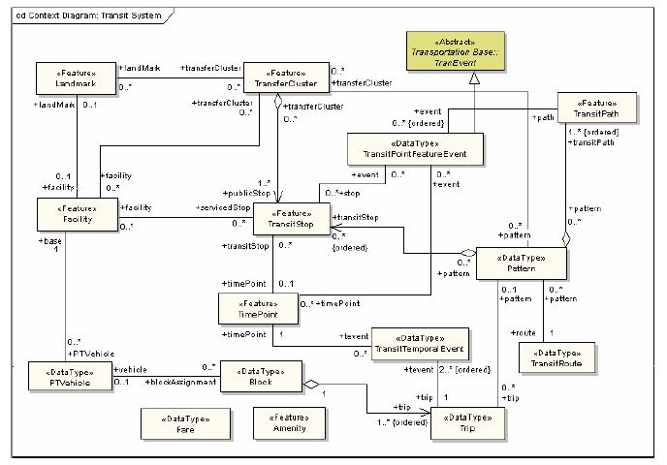
Framework Data Standard Transportation: Transit Requirements
The diagram to the right is the UML flow chart for the Framework Transportation: Transit Standard. This diagram shows the components and relationships that comprise the Framework Transportation: Transit Standard. UML is designed to show these relationships in a generic manner without specifying a coding language or specific software needed to complete the task. For more information about UML visit: http://www.uml.org
Next Topic
Transportation: Transit Requirements Continued

Slide 21
Framework Data Standard Transportation: Transit Requirements: Application Schema
The following is a list of the main components to the Transportation: Transit Standard Application Schema:
TransitFeature - TransitFeatures are objects that represent real world public transport phenomena.TransitFeature is shown in Figure 2 and is a subtype of TranFeature. TimePoint, Facility, Amenity, and TransitStop are all subtypes of TransitFeature.
TransitStop - TransitStop is a Facility and may optionally be represented by its geometry.
ConnectionSeg - A ConnectionSeg is a linear path allowing transit riders to move from one TransitStop to another
TransitPath - TransitPath is a linear section of the transit network, which is designed for the movement of PTVehicles
TimePoint - TimePoint is a location where trips are assigned arrival, dwell, or departure time periods
Pattern - as an ordered sequence of TransitStops or TransitPaths that is followed by a transit vehicle in scheduled service
TransitRoute - TransitRoute is a collection of patterns in revenue service with a common identifier
Block - Block is a sequence of trips over which a PTVehicle is assigned from pull out time to pull in time
PTVVehicle - PTVehicle is the data type that contains the public transportation vehicle, and PTVehicle refers to any public transit conveyance
TransferCluster - TransferCluster is closely related to TransitStop since it is a collection of TransitStops where transit passengers can change routes
Landmark - Landmark is a point of interest
Facility - Facility is a physical place that is used by a transit agency
Amenity - Amenity refers to the elements of a physical feature, a fixed location, or a transit facility
Fare - Fare is a data type that describes the cost for riding a transit vehicle.
Trip - Trip is a one-way scheduled movement of a transit vehicle between starting and ending TimePoints
More Information
This version of the Transit part is closely related to the Transportation Base (see Figure 2 in the Transportation Base). To ensure maximum utility in a variety of contexts, this transit model does not prescribe any specific business rules for the segmentation of the transportation network. The focus of this part is to define a way to encode transit features and their attributes.
Next Topic
Transportation: Transit Requirements Continued

Slide 22
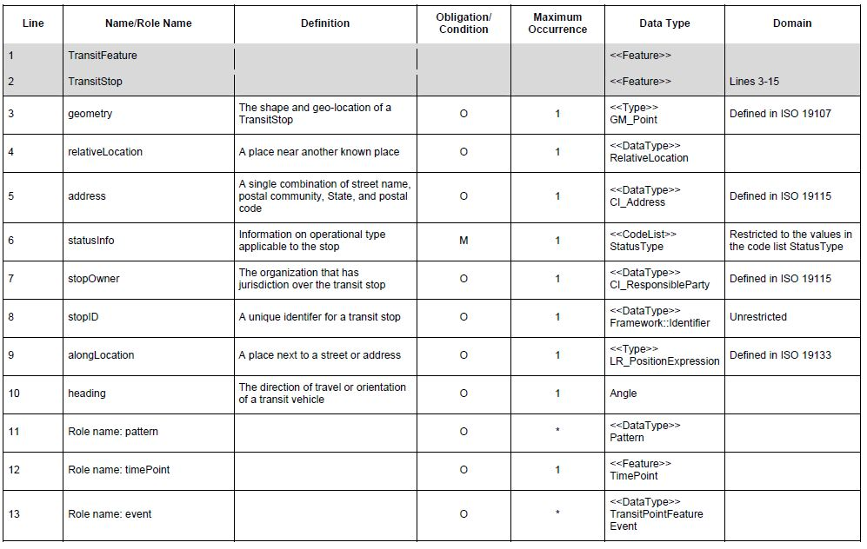
Framework Data Standard Transportation: Transit Requirements: Data Dictionary
A data dictionary is a collection of definitions, rules and advisories of data, designed to be used as a guide or reference with the data warehouse. The directory includes definitions, examples, relations, functions and equivalents in other environments. Each Framework Data Content Standard Part has its own data dictionary that describes the necessary elements needed to define that theme as Framework. Below is a portion of the Transportation: Transit Data Dictionary, for the full table please consult the standard itself.
Next Topic
Transportation: Transit Requirements Continued

Slide 23
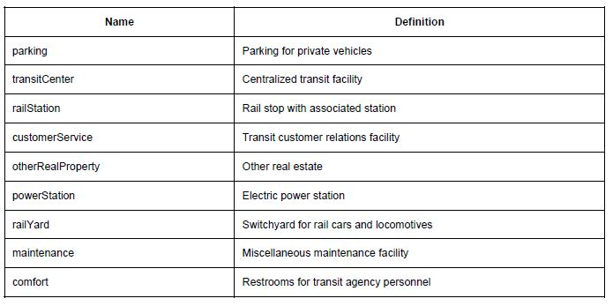
Framework Data Standard Transportation: Transit Requirements: Code List
A Code List is a list of the most common used elements for a certain class. It normally has the name of the feature as well as a definition to help a user determine the appropriate choice. It is not necessarily an exhaustive list, rather a list of the most common and expected values for a given element. Below is on of the 9 code lists associated with the Transportation: Transit Standard for a complete collection of the code lists please refer to the standard itself. This code list applies to the element: FacilityType, and as you can see it lists possible values for the possible types of facilities that are possible for transit data.
Next Topic
Encoding and Implementation

Slide 24
Encoding and Implementation
The Bigger Picture
The Framework Standards do not have a specific application schema that can be implemented. Implementation of the Framework Standards in relation to data and tool creation occurs at the thematic level. Each thematic part complies with the Framework Base Standard. As such a layer (for example) created in accordance with the Framework Transportation: Transit part meets all Framework requirements.
The process of encoding is simply formatting or structuring data in a regulated manner. The Framework standards are encoded by applying the application schemas through the use of several different modeling and markup languages:
Unified Modeling Language (UML)
Extensible Markup Language (XML)
Geographic Markup Language (GML)
Specific knowledge of each language is important for data and tool designers; for more information see the Framework Base Standard Training Materials.
Next Topic
Module Review

Slide 25
Module 3: Transportation: Transit Requirements Summary
Transportation: Transit Data is available in many different formats however the standard dictates the specific requirements to ensure it is Framework
There are 14 context diagrams associated with the model flow, including associated data dictionaries, and 9 lists associated with this standard.
This module covers the specifications for Transportation: Transit framework data implementation
Application Schema
Data Dictionary
Code List
Provides rigid requirements to ensure proper structure and documentation for Transportation: Transit data
UML diagrams and data dictionaries provide specifics for programmers and data creators to develop Transportation: Transit data that meets Framework specifications
Next Topic
Module 4: Standard Implementation

Slide 26
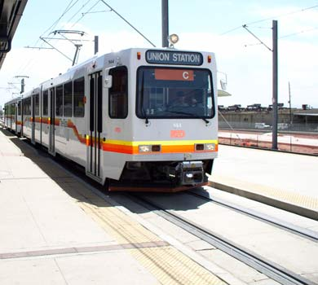
Module 4: Examples, Exercise, and Certificate
Topics
Transportation: Transit Implementation Example
Transportation: Transit Review Exercise
Additional Information
Certificate of Completion
First Topic
Implementation Example

Slide 27
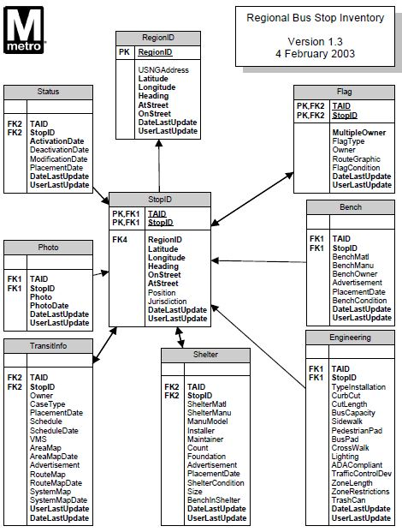
Implementation Example
This example illustrates how Transportation: Transit data can be implemented in a real world example. This diagram shows the data requirements for the Washington Metro Area Transit Authority. The bold items are the minimum requirements for this specific application.
Next Topic
Transportation: Transit Final Exercise

Slide 28
Transportation: Transit Final Exercise
Click on the following hyperlink: http://www.vre.org/service/systmmp.htm
Review the website and explore the different service information provided by the Virginia Railway Express
After reviewing all the site, click on the following link: http://www.vre.org/vremap/app?action=ovmap
Explore the application and click on one or more of the different trains that are currently displayed.
Notice how this site shows data at multiple different levels but incorporates all of the key aspects of Framework Transit Data.
Next Topic
Additional Information

Slide 29
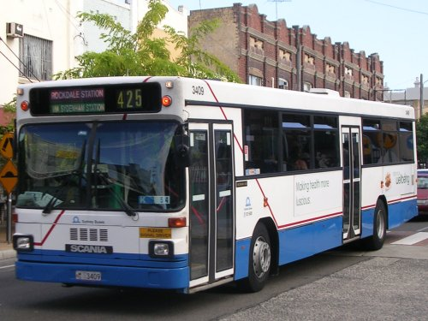
Transportation: Additional Information
In developing the Transit part of the Framework Data Content Standard, specific transit use cases were utilized to assist in defining the transit model. While these use cases are not comprehensive in defining all the potential uses of transit data, they were critical in providing focus for the development team. In future versions of the Transit part, additional use cases will be developed to facilitate expansion of the transit model.
The use cases are provided in the Annexes of the standard and include:
Trip Itinerary
Public Transportation Stop Inventory
Unplanned Rerouting
Additionally address information is not implicit to the Transportation: Transit standard, however a general approach to using addresses is included as Appendix D.
Next Topic
Course completion

Slide 30
Course Certificate
Congratulations, you have successfully completed the Framework Transportation: Transit Standard Training! In order to print the certificate below you will need a copy of Adobe Acrobat Reader, http://www.adobe.com/products/acrobat/readstep2.html.
After you open the certificate file, type your name and today’s date on the name/date line and print.
Click here to receive course certificate

