Slide 1
Things I Learned in Pennsylvania
Dave Cowen
June 2011 NGAC Meeting

Slide 2
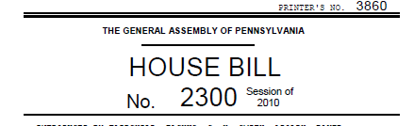
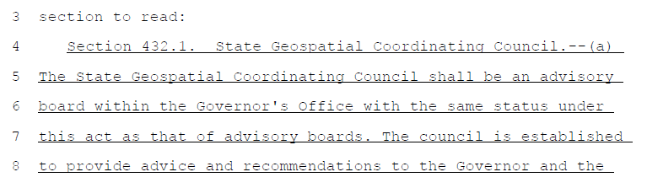
No Council
TABLED

Slide 3
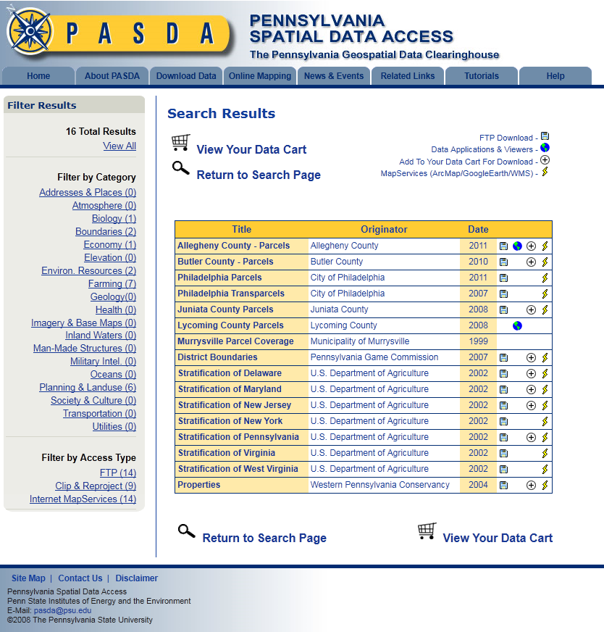
PASDA Parcel Data Four Counties / Two Cities

Slide 4
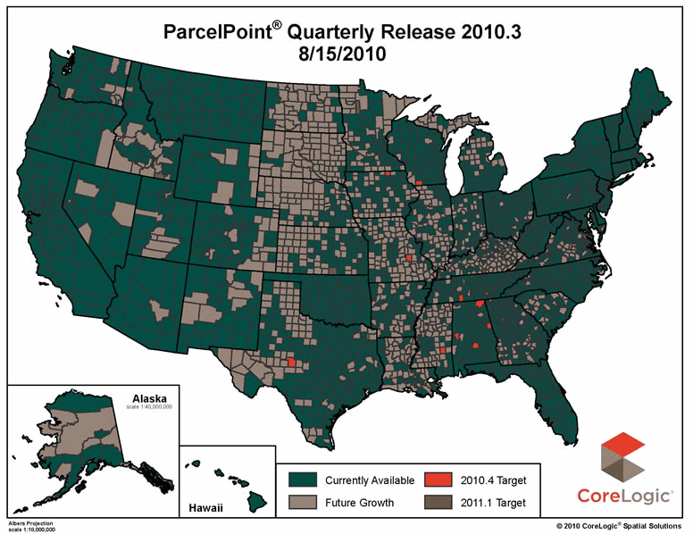
But – Core Logic has all but Mifflin County
66/67 Counties
5,858,465 Parcels

Slide 5
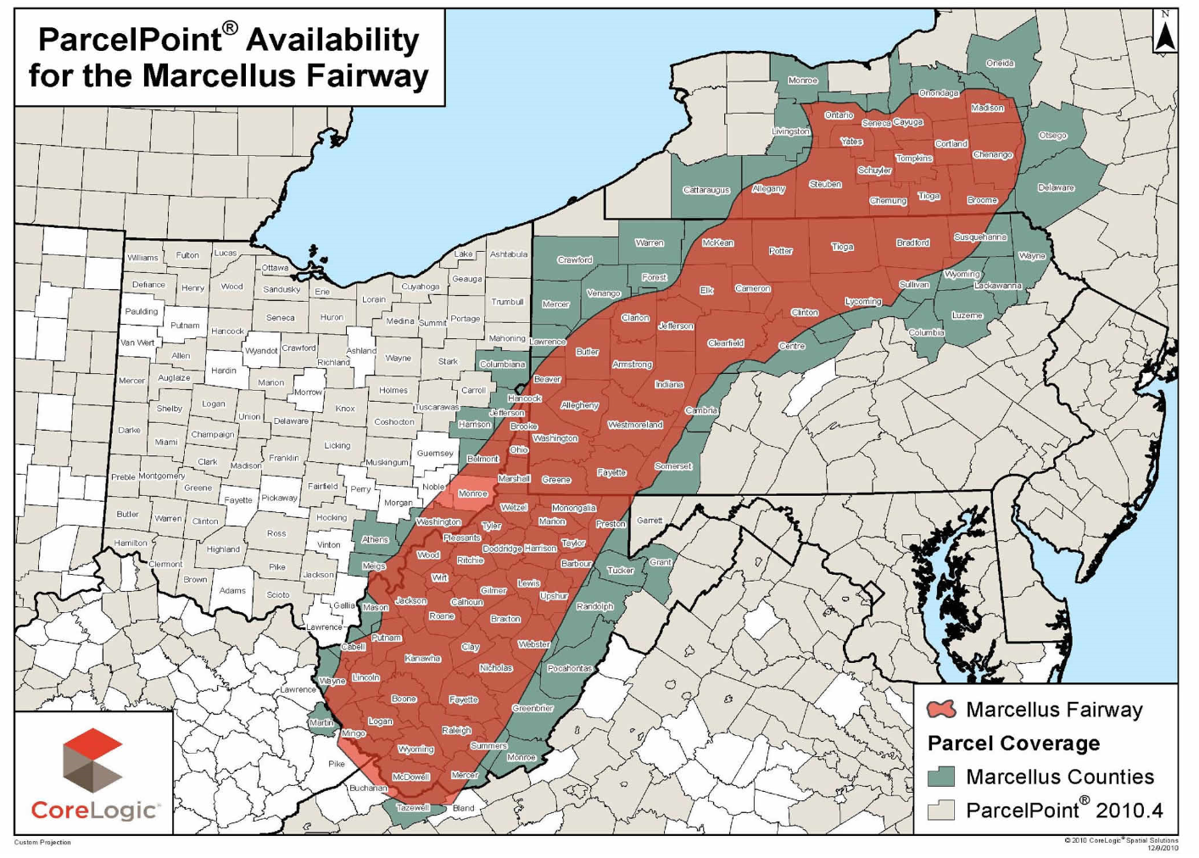

Slide 6

Tackling Land Records Implementation UPI an enabling force
Presented by:
David T. Skoronski, GISP
Director
Luzerne County GIS/Mapping Department
Phone: 570-825-1521

Slide 7
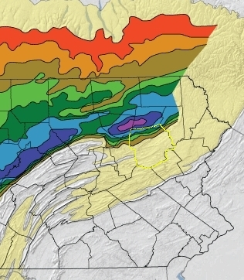
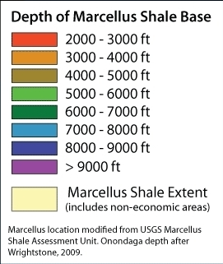
Marcellus Shale Leasing Database Project
Luzerne County is on the edge of the “economical” area
Source: PSU MCOR

Slide 8
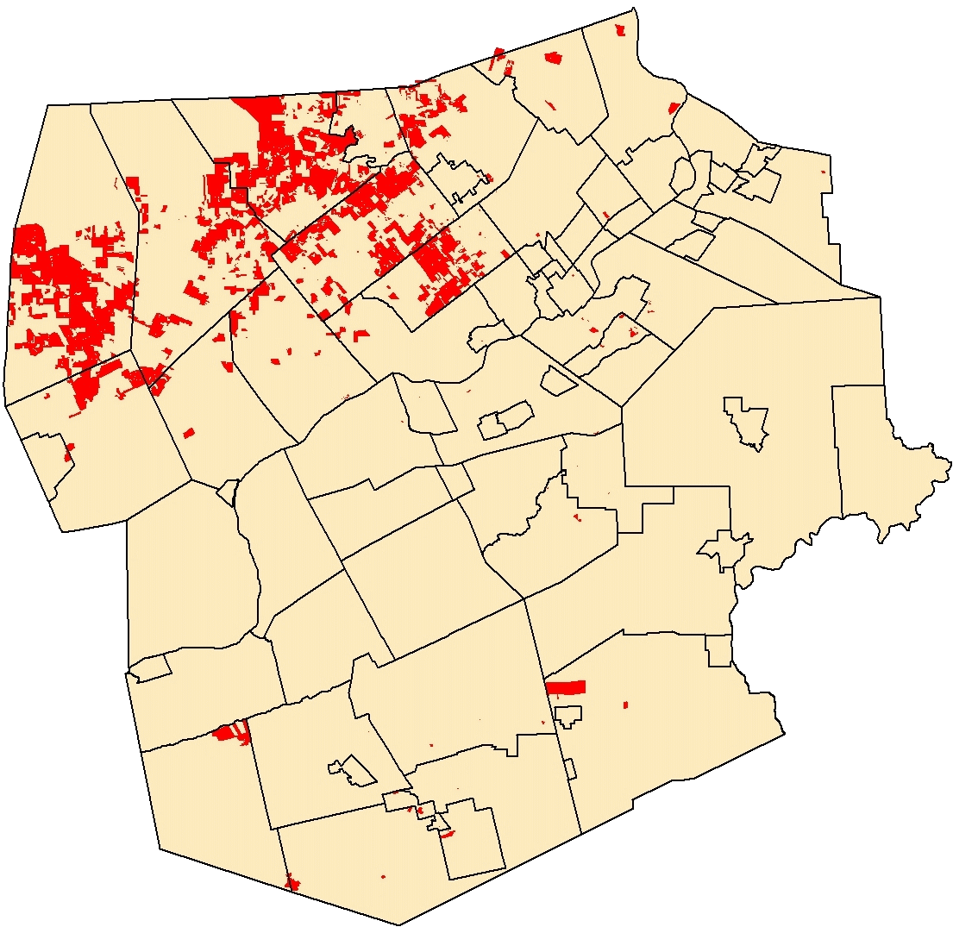
The public (the press) crave the numbers
(and the politicians)
Currently 36,000 Acres
41 out of 76 Municipalities affected
Numerous ad hoc analysis requests!

