Slide 1
Training and Education
Jaci Mize
NOAA/NESDIS/NODC/NCDDC
Notes:
There may be other training and education resources available but we will focus on the resources that we (NOAA/NCDDC and FGDC) have worked with.

Slide 2
Training and Education
What Training Resources are Available?
Resources and Guidance Docs
Workshops
Presentations and Materials
Online Lessons

Slide 3
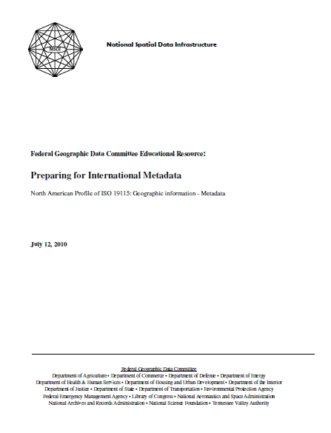
Guidance Documents
Guidance document for preparing for International metadata
Tips for preparing your FGDC metadata to more easily migrate to ISO
http://www.fgdc.gov/metadata/documents/csdgm-to-nap-transition-guidance.pdf

Slide 4
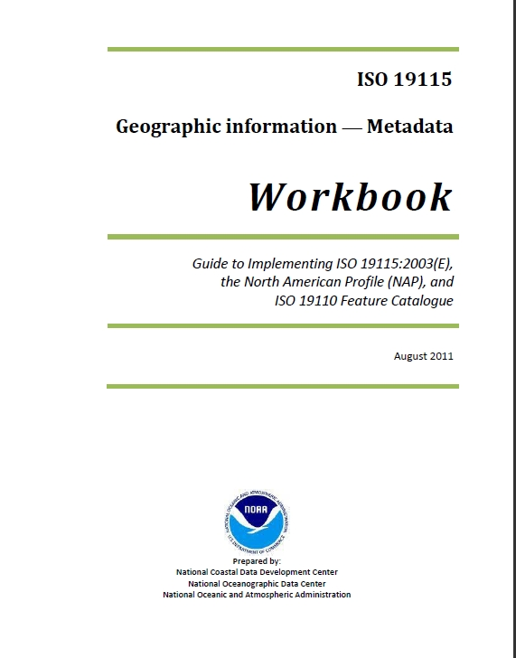
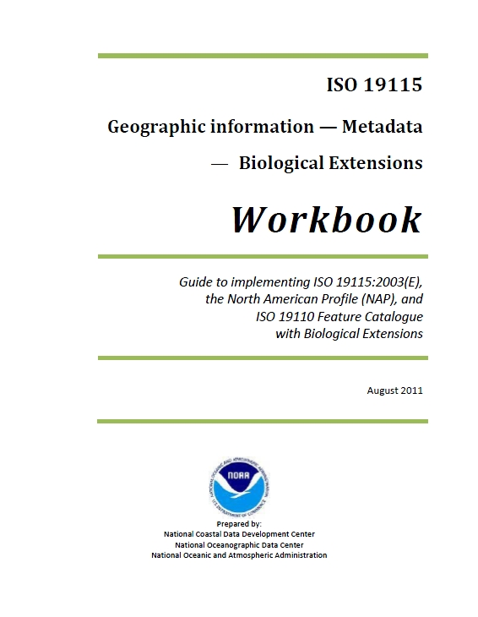
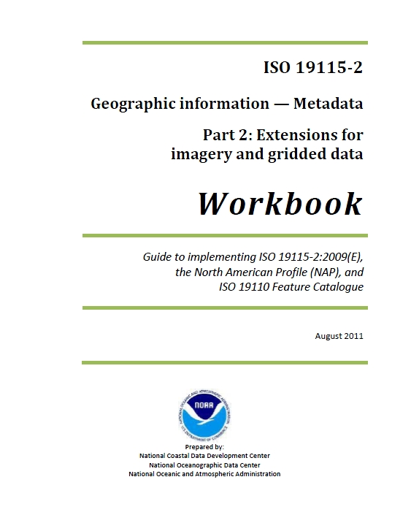
ISO Workbooks
Parallels the standards
Provides FAQs
Implementation Guides
Includes best practices for NAP implementation
Provides names and definitions
Describes domain values
Uses UML and another Graphical Representation of the production rules
http://www.ncddc.noaa.gov/metadata-standards/
Notes:
Workbooks for ISO 19115, 19115-2, biological extensions, and 19110
FGDC is working

Slide 5
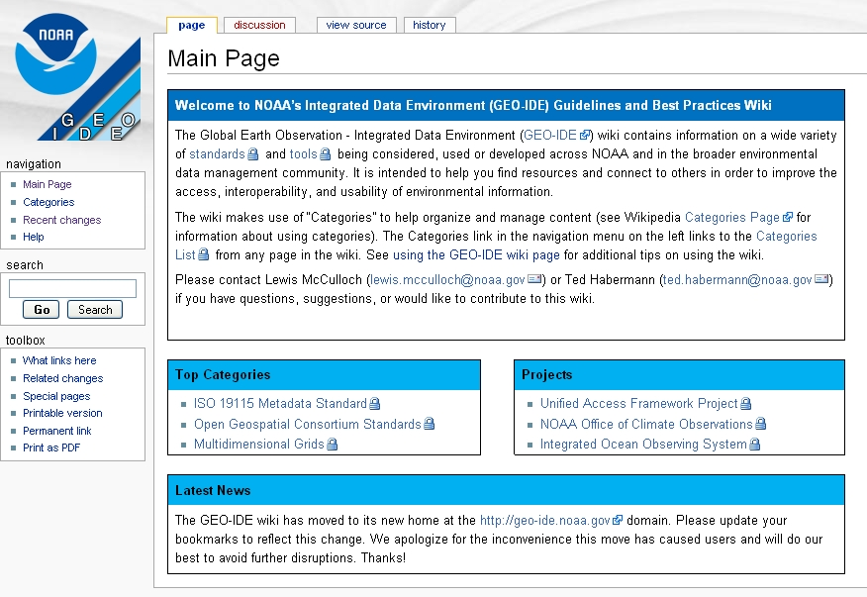
Wiki
https://geo-ide.noaa.gov/wiki/index.php?title=Main_Page
Notes:
The Global Earth Observation - Integrated Data Environment

Slide 6

Workshops
FGDC Event Calendar
http://www.fgdc.gov/calendar/month
NCDDC Training Page
http://www.ncddc.noaa.gov/metadata-standards/metadata-training/
NGDC Training
Email: Ted.Habermann@noaa.gov

Slide 7
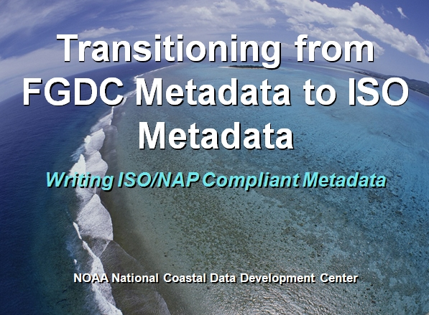
Presentations
Modules
Transitioning 101
ISO Organization and Content Overview
XML Basics
UML Basics
ISO Workbook – Detailed Content
Tools
Creation Methods
Validation
Advanced Topics
Special Problems
Hierarchical Metadata
Publishing Process
Email: ncddcmetadata@noaa.gov

Slide 8
Other Training Materials
Curriculum
Lesson plans
Exercises
Handouts
Sample Metadata
Evaluations
Email: ncddcmetadata@noaa.gov

Slide 9
Online Lessons
North American Profile Development for ISO 19115 Geospatial Metadata
An overview of US and Canadian efforts to adapt and implement the International Standardization Organization (ISO) geospatial metadata standard for use by the North American geospatial community
http://www.fgdc.gov/training/nsdi-training-program/materials/ISONAPDevelopment_20100604.pdf
Notes:
No other online modules that I am aware of, these are a bit outdated.

