Slide 1

Geospatial Platform Update
NGAC Meeting
December 7, 2010
Karen Siderelis
Geospatial Information Officer
Department of the Interior

Slide 2
Overview
Background
Accomplishments Over Last 9 Months
Next Steps

Slide 3

Geospatial Platform: Call to Action
"In 2010 and 2011, Federal data managers for geospatial data will move to a portfolio management approach, creating a Geospatial Platform to support Geospatial One-Stop, place-based initiatives, and other potential future programs. This transformation will be facilitated by improving the governance framework to address the requirements of State, local and tribal agencies, Administration policy, and agency mission objectives. Investments will be prioritized based on business needs. The Geospatial Platform will explore opportunities for increased collaboration with Data.gov, with an emphasis on reuse of architectural standards and technology, ultimately increasing access to geospatial data.“
President’s Budget, Fiscal Year 2011

Slide 4
Geospatial Platform
Definition
The Geospatial Platform will be a managed portfolio of common geospatial data, services, and applications contributed and administered by authoritative sources and hosted on a shared infrastructure, for use by government agencies and partners to meet their mission needs and the broader needs of the Nation
Key Components
Common Data, Services, and Applications
The Platform will deliver trusted geospatial data, services, and applications that are valuable to multiple agencies or customers to meet their business requirements. These common services will be registered and accessible through the Platform.
Shared Infrastructure
The Platform will promote and foster utilization of IT solutions (e.g., cloud computing) and shared investments across multiple partner organizations for joint development, operations, and maintenance of common geospatial services.
Geospatial Segment Architecture
The Platform components will be designed and deployed through a process-driven approach that can be readily deployed in solution architectures by partners collaborating on geospatial data and services.
Collaborative Governance
The Platform will be managed in a collaborative manner allowing partners and stakeholders the opportunity to help shape its structure, functions, and capabilities.
Portfolio Management
The Platform will support the prioritization, selection, and allocation of resources to maximize value in geospatial data, services, and applications to obtain positive outcomes from investments.

Slide 5
Accomplishments
Modernization Roadmap with Business Model and Time Boxes
Stakeholder Review and Engagement
Intergovernmental Subcommittee
Technical Implementation Activities
Collaborative Interactions
Interim Management Framework
Managing Partner Discussions

Slide 6

Modernization Roadmap
Defines Geospatial Platform
Establishes vision and purpose
Describes future state technology architecture
Identifies processes and organization elements to ensure success
Describe strategic path forward to implement vision
Identify actionable projects and activities for short and mid-term implementation including operations

Slide 7
Business Model
The Offering
Business Institution
Managing Partner
Partner Network
Governing Body
Business Processes
Customers
Target Customers
Customer Relations
Financial Approach
Capital Investments
Operating Expenses
Funding Sources

Slide 8
Time Boxes
Time Box 1 (Jul – Sep 2010)
Gulf Oil Spill Mapping
DoD Geospatial Visualization Enterprise Solution(GV-ES)
Homeland Security Infrastructure Protection (HSIP) data
Base map and base map service options
Commercial and government Cloud Computing environment
"Platform as a Service" suites with Federal-wide certification and accreditation
Geospatial Segment Architecture Guidance document
FGDC approval and endorsement for existing open geospatial standards
Approach for registering shared data, services and applications
Interim Geospatial Platform Managing Partner
Interim intergovernmental body
Draft Geospatial Platform Business Model
Final approval of the A-16 Supplemental Guidance
Inventory of data
Strategy to conduct outreach and input with key stakeholders
Enhanced existing GeoPlatform.gov website
Time Box 2 (Oct – Dec 2010)
Common geocoding service(s) requirements
National database pilot projects
National Urban Change Indicator (NUCI) dataset
Additional FSAM compliant data
Sensitive But Unclassified (SBU) Architecture
Guidance language to Federal agencies for geospatial grants and contracts
Select geospatial data for inclusion in the Geospatial Platform portfolio
Inventory of available tools to gather and analyze high-level requirements
Selection criteria for shared services and applications
Time Box 3 (Jan – Sep 2011)
Common geocoding service
Permanent Managing Partner
Final structure for intergovernmental body
National study by trusted institution
Time Box 4 (Oct 2011 – Sep 2012)
Full operations mode

Slide 9
Stakeholder Review & Engagement
Formal Federal Interagency Review
11 Agencies Responded
70 Comments
Largely Favorable Feedback
National Geospatial Advisory Committee
March – Review of Initial Concepts
June – Review of Roadmap V2
September – Advice on Three Key Issues
Intergovernmental Approach
Managing Partner
Stakeholder Engagement
December – Continuing Feedback
Broad Stakeholder Engagement
Initiated October 2010

Slide 10
National Geospatial Advisory Committee
NGAC provided comments on the draft Roadmap approved the following resolution at the June 2010 NGAC meeting:
“The NGAC endorses the Geospatial Platform concept as described in the Platform Roadmap and encourages the Administration, along with federal agency leadership, to adopt, support, and implement this initiative in partnership with State, local, regional and Tribal governments.”

Slide 11
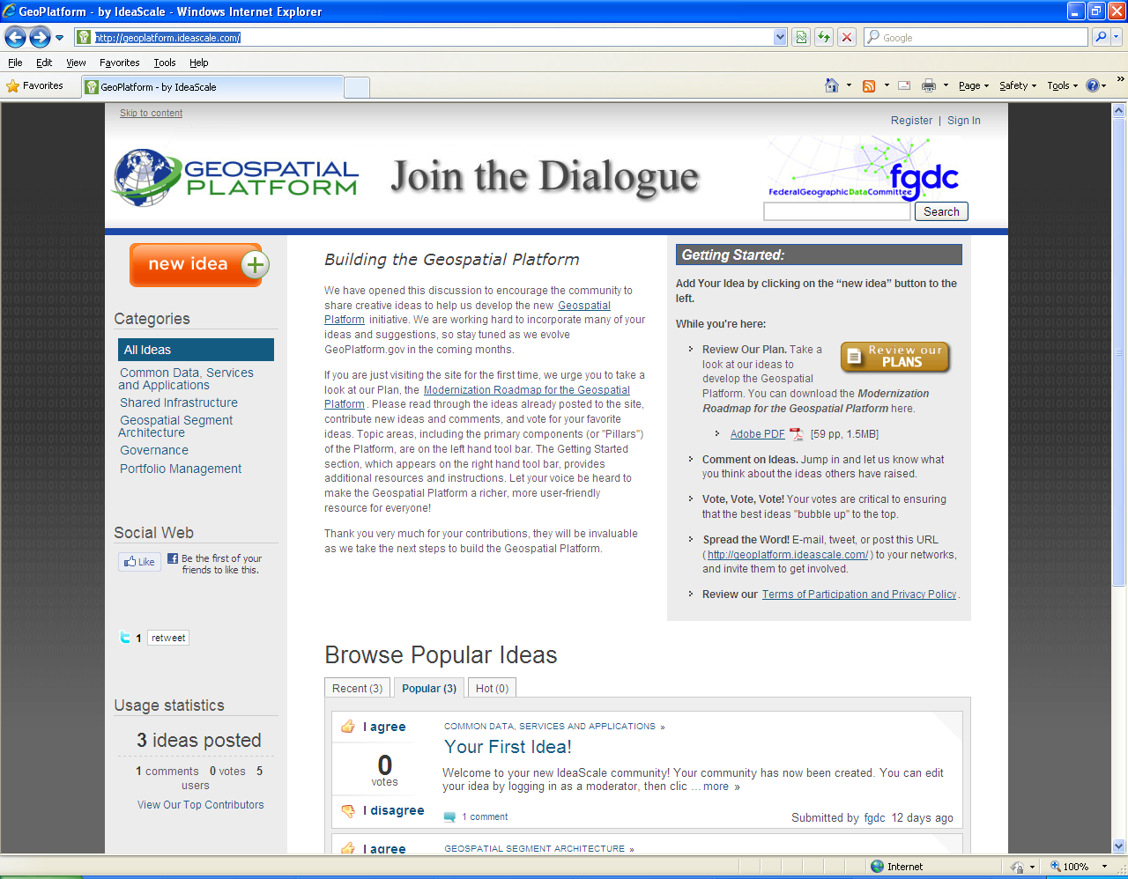
Stakeholder Engagement
60 Day Stakeholder Engagement Process (Nov-Dec 2010)
IdeaScale website (http://geoplatform.ideascale.com) promotes dialogue and user ideas, comments, voting
Collaboration with National Geospatial Advisory Committee
Targeted e-mails – stakeholders/partners
Webinar(s), conference presentations
GeoPlatform.gov website
For more information visit: www.geoplatform.gov

Slide 12
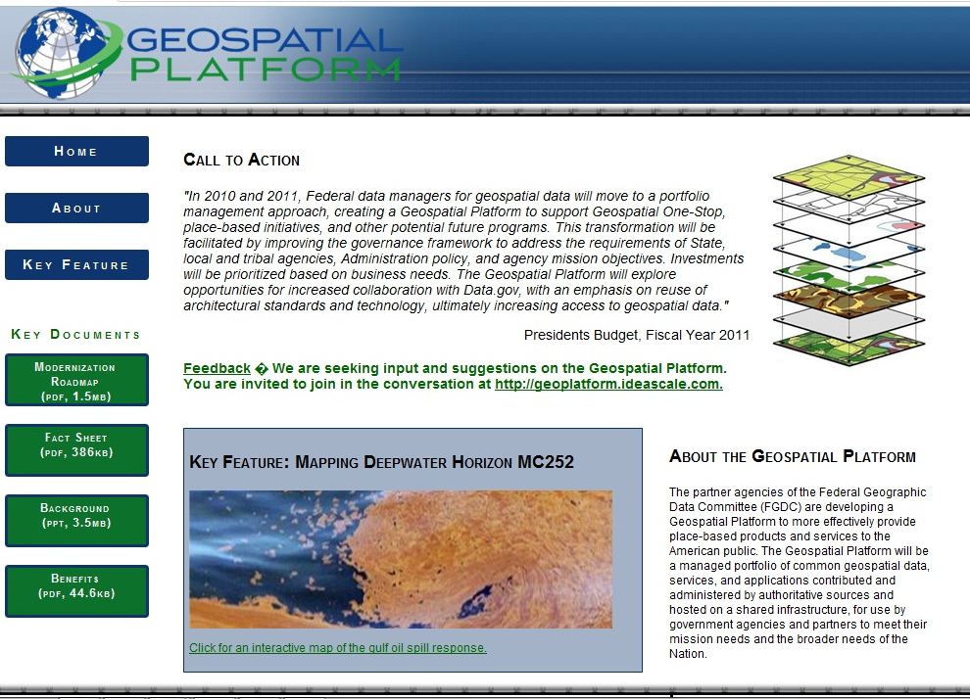
www.geoplatform.gov

Slide 13
Intergovernmental Subcommittee
Purpose: Interim body to provide advice and recommendations in the development of the Geospatial Platform
Subcommittee Membership:
Jerry Johnston (EPA) - Chair
Sean Ahearn (Hunter College)
Sophia Beym (State of New Mexico)
Dick Clark (State of Montana)
Randy Johnson (Hennepin County, MN)
Barney Krucoff (District of Columbia)
Anne Miglarese (Booz Allen Hamilton)
Gene Schiller (SW Florida Water Management District)

Slide 14
Technical Implementation Activities
GeoPlatform.gov
GeoPlatform.gov/GULFRESPONSE
CNN News
Government Computer News – Top Ten for 2010
Technical Deployment Task Team
Evaluate and stand-up data, applications and services in Roadmap V3 time boxes
Evaluate underlying infrastructure requirements
Initiate and stand-up other approved data, applications and services
Develop "quick-start guide"
Calls for Content
Federal agencies
State, local, tribal and regional organizations
Possible RFI and Industry Day

Slide 15
Collaborative Interactions
Data.gov
Sharing infrastructure, tools, and content; clarifying “swim lanes”
GSA Federal Cloud
Understanding infrastructure requirements and options
Broadband Mapping
Seeking efficiencies and sharing lessons learned
A-16 Supplemental Guidance
Building the framework for portfolio management

Slide 16
Interim Management Framework
Focus on the Geospatial Platform
Make the existing governance structure work
Use project management discipline
Form around tasks
Keep it simple

Slide 17
Interim Management Framework
FGDC Governance Structure
Steering Committee
Executive Committee
Coordination Group
ExCom/CG Liaisons
Secretariat
National Geospatial Advisory Committee
Geospatial Platform Project Management
Political Leadership
Project Sponsor
Project Manager
Core Team
Task Teams
NGAC Intergovernmental Subcommittee

Slide 18
Interim Project Management
Sponsor – DOI (Siderelis)
Project Managers (Johnston and Siderelis)
Core Team
Sponsor
PMs
CG co-chairs (DeLoatch and Fusaro)
Secretariat (Shaffer and Mahoney)
GT (Garie, Archetto, Nolan)
Task Teams (TBD and adaptive)
Technical Deployment Task Team
NGAC Subcommittee (TBD and adaptive)

Slide 19
Platform Management Roles
High Level Strategic Directions
Political Leadership
Steering Committee
Project Sponsor
Strategic Technical and Programmatic Directions
ExCom
PM(s)
Technical and Programmatic Advice and Recommendations to ExCom
Coordination Group
NGAC
Tactical Activities That Support Strategic Decisions
PM(s)
Core Team
Secretariat
GT
Communication and Coordination
ExCom/CG Liaisons

Slide 20
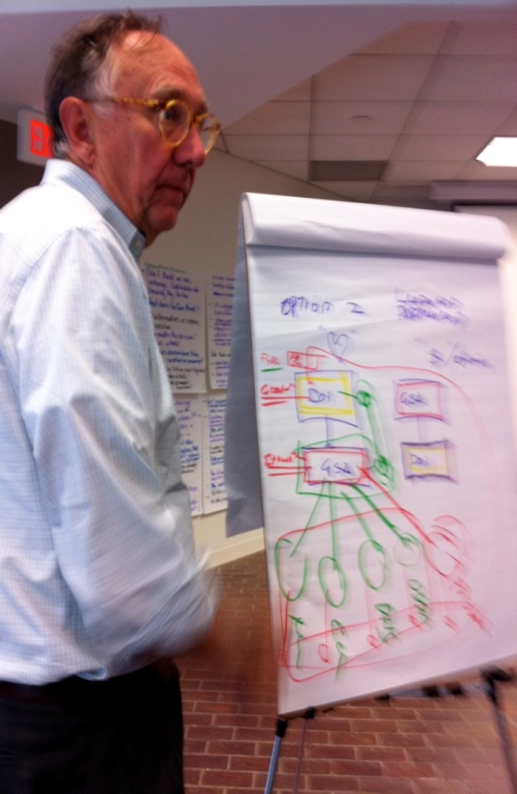
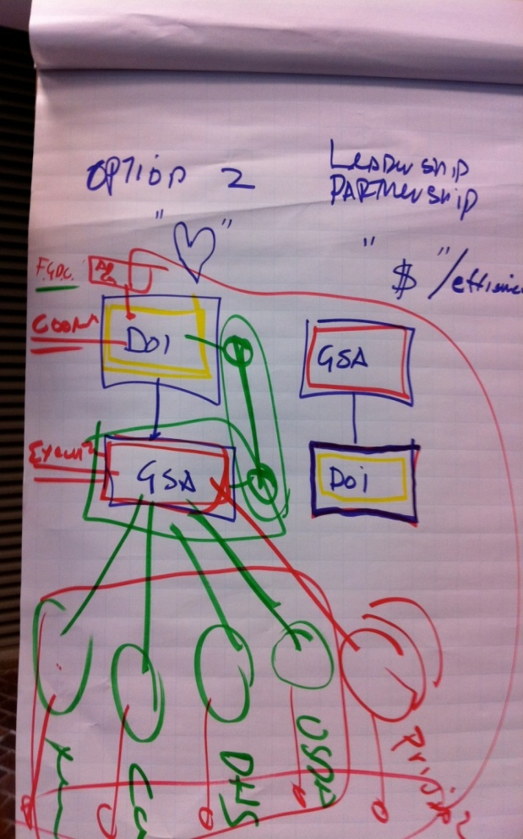
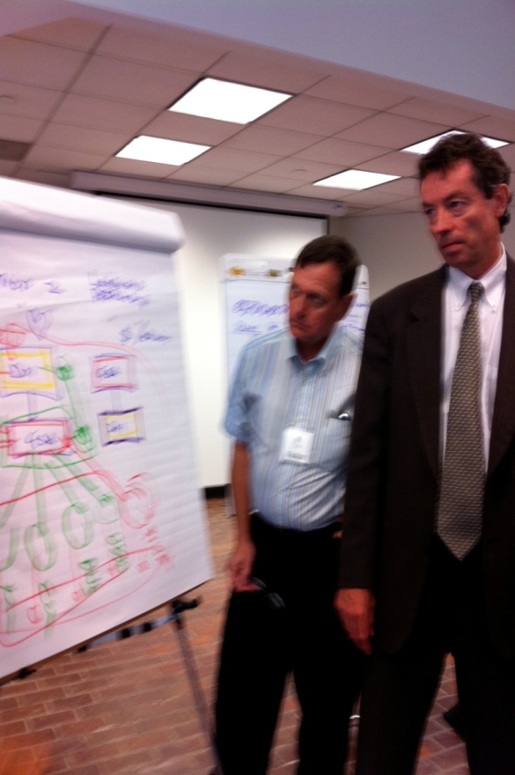
Managing Partner Discussions

Slide 21
Next Steps
Continue Outreach and Communications
Publish Roadmap Version 4
Identify Managing Partner and Refine Business Model
Enhance Intergovernmental Approach
Accelerate Technical Implementation
Inventory Potential Content
Federal agencies
State, local, tribal and regional organizations
Possible RFI and Industry Day

Slide 22
Thank you!
Questions?

