Slide 1
NWS March 2011 CUWCD Briefing
2pm, March 9, 2011
These slides: www.cbrfc.noaa.gov/present/present.php

Slide 2
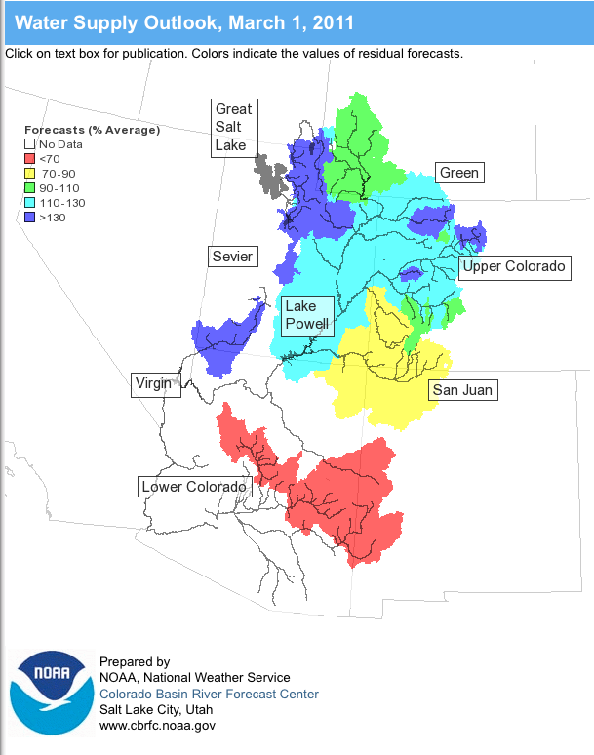
Outline
February Weather Review
Snow States
Water Supply Forecasts
Web Reference: www.cbrfc.noaa.gov/wsup/pub2/map/html/cbrfc.1.2011.html

Slide 3
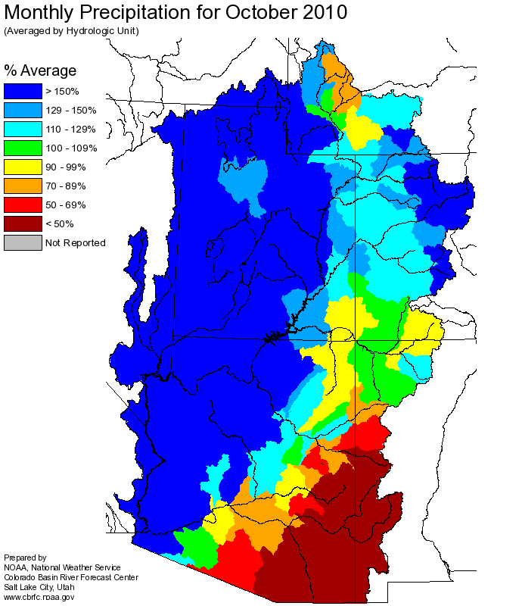
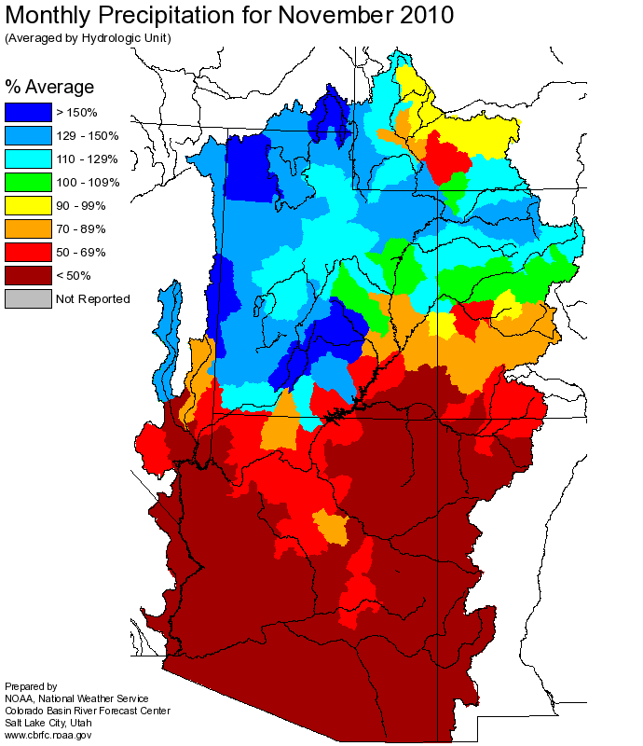
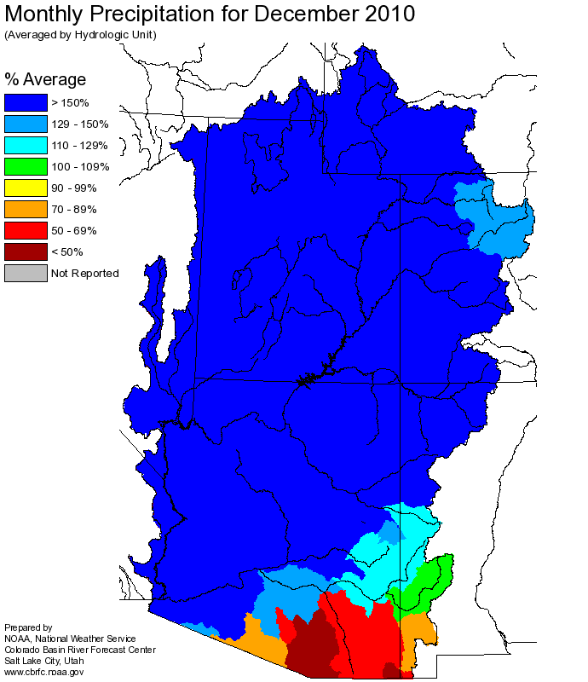
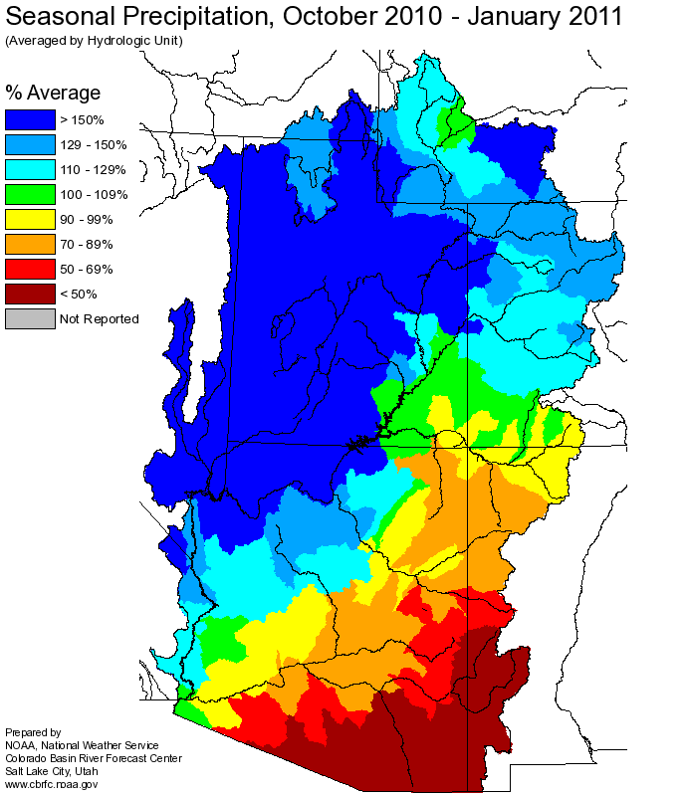
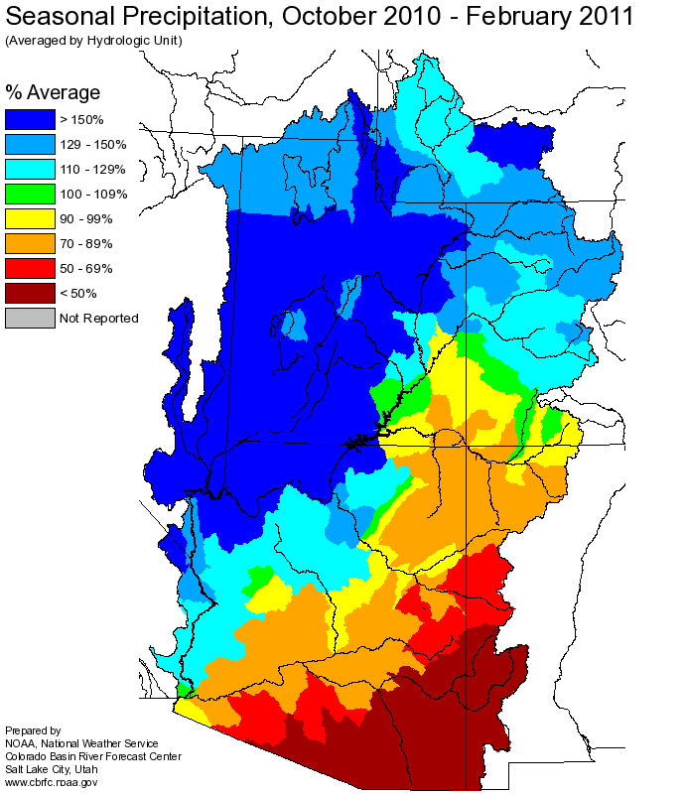
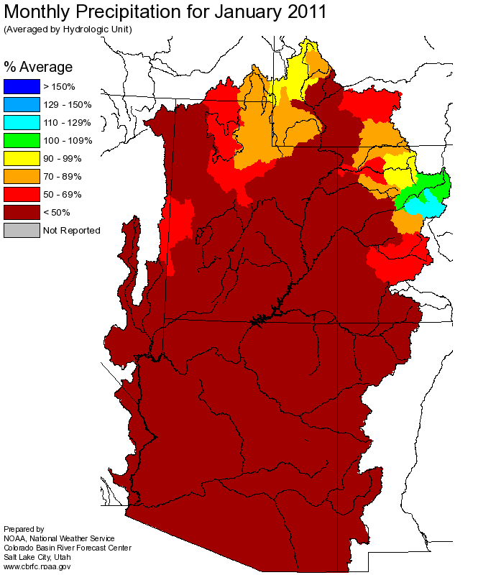
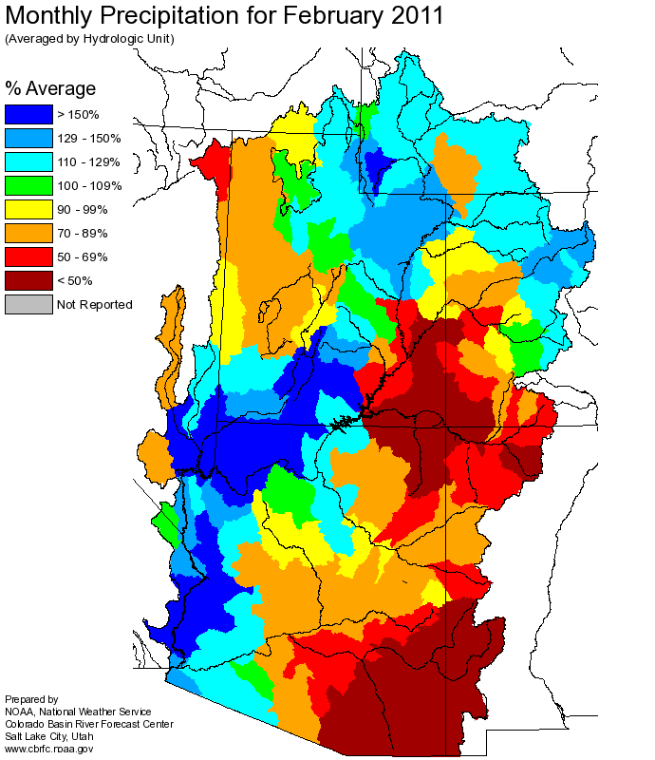
Web Reference: http://www.cbrfc.noaa.gov

Slide 4
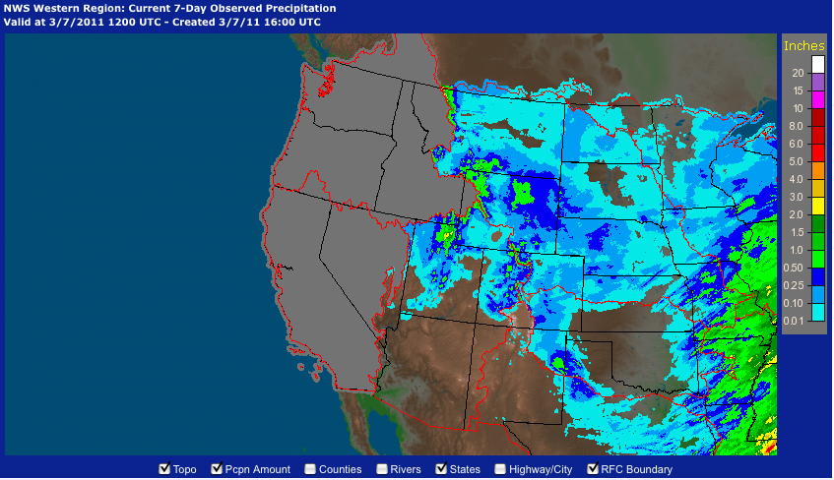

Slide 5
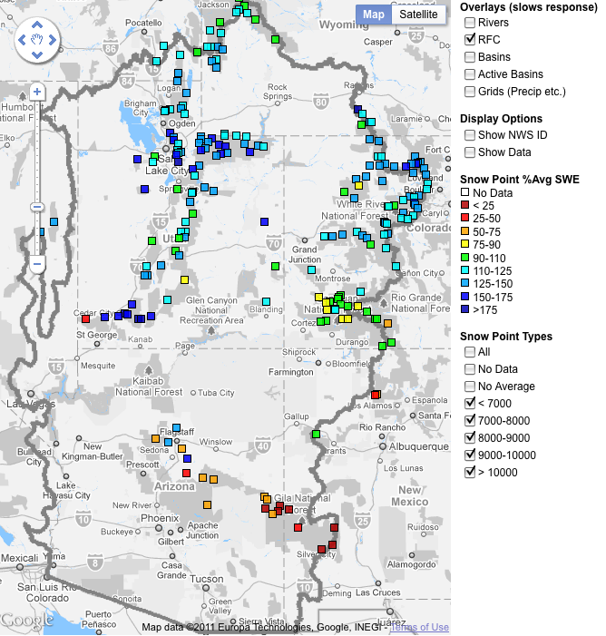
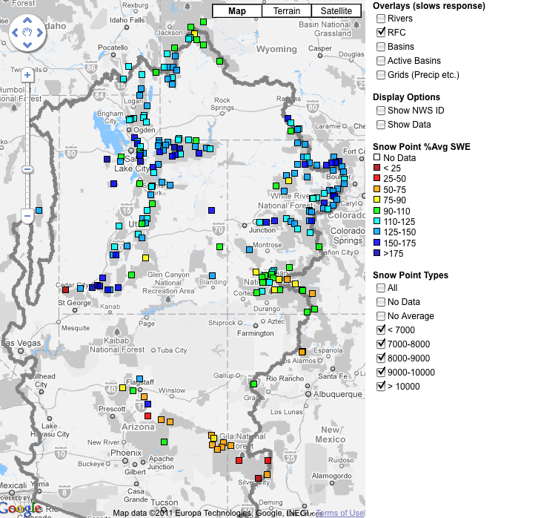
Snow
February 7 (above)
March 7 (right)
Web Reference: http://www.cbrfc.noaa.gov/gmap/gmapm.php?scon=checked

Slide 6
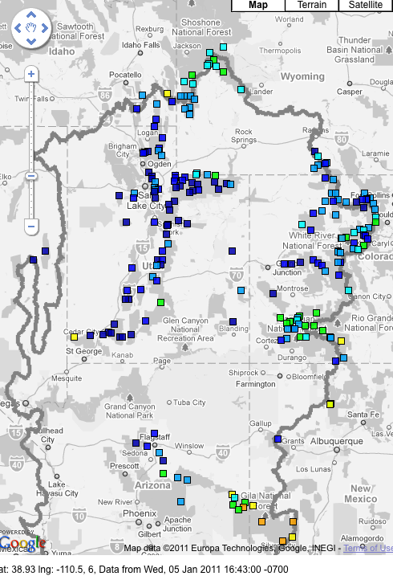
Snow
January 6 (above)
February 7 (right)
Web Reference: http://www.cbrfc.noaa.gov/gmap/gmapm.php?scon=checked

Slide 7
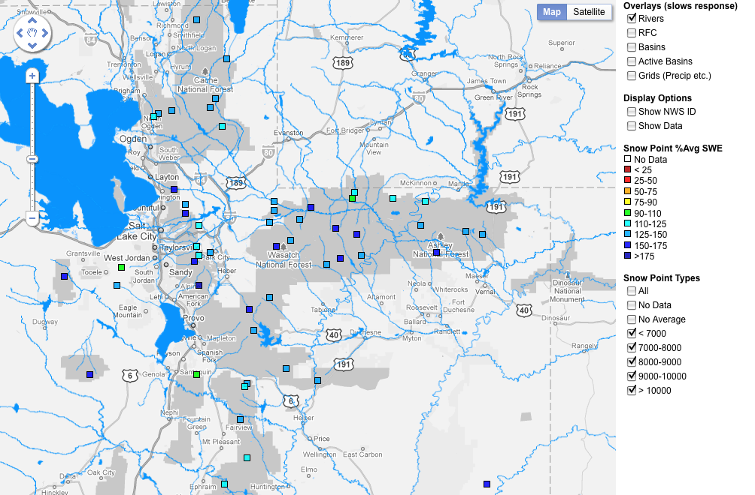
Web Reference: http://www.cbrfc.noaa.gov/gmap/gmapm.php?scon=checked

Slide 8
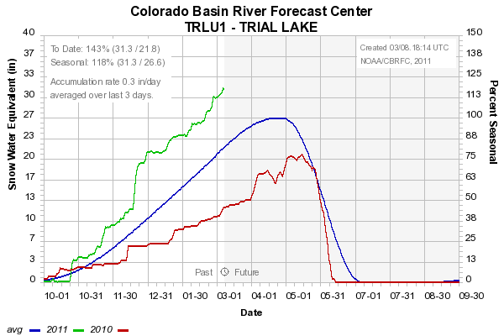
Snow: Trial Lake
Web Reference: http://www.cbrfc.noaa.gov/station/sweplot/sweplot.cgi???open

Slide 9
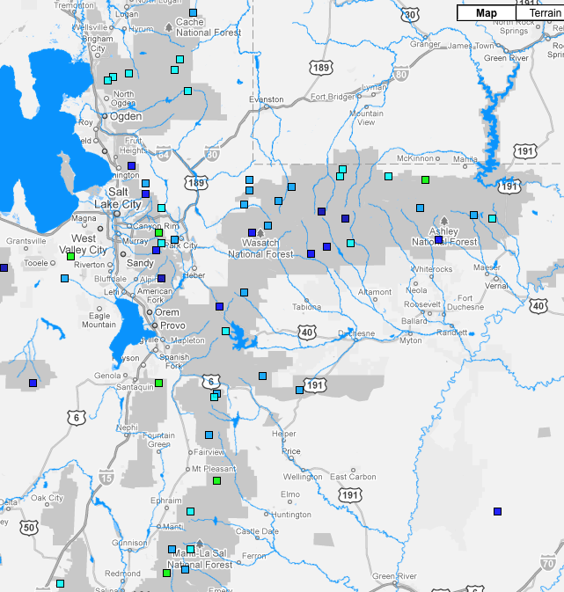
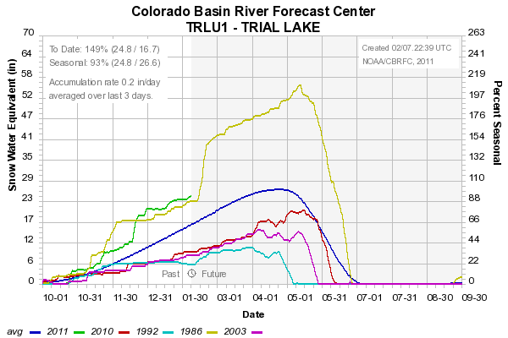
Snow: Trial Lake
Web Reference: http://www.cbrfc.noaa.gov/station/sweplot/sweplot.cgi???open

Slide 10
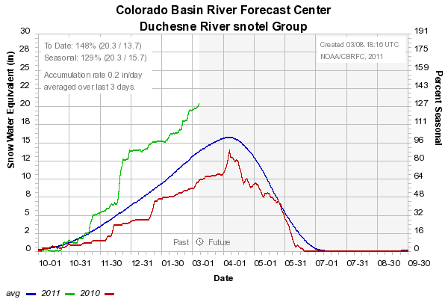
Snow: Duchesne River Group
Web Reference: http://www.cbrfc.noaa.gov/station/sweplot/sweplot.cgi???open

Slide 11
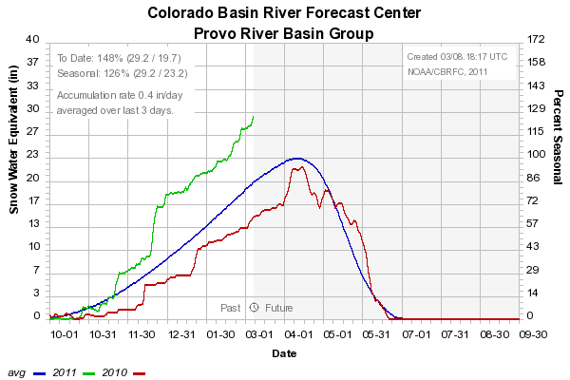
Snow: Provo River Group
Web Reference: http://www.cbrfc.noaa.gov/station/sweplot/sweplot.cgi???open

Slide 12
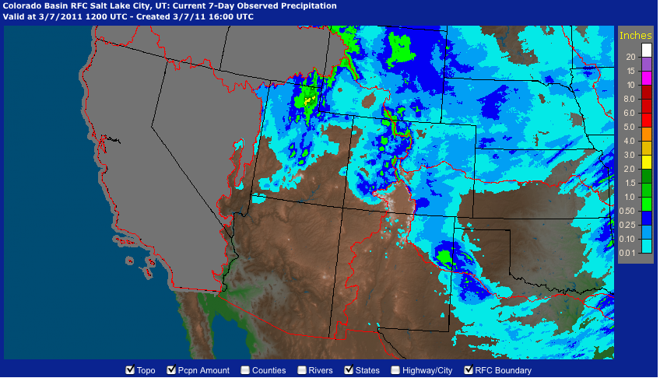
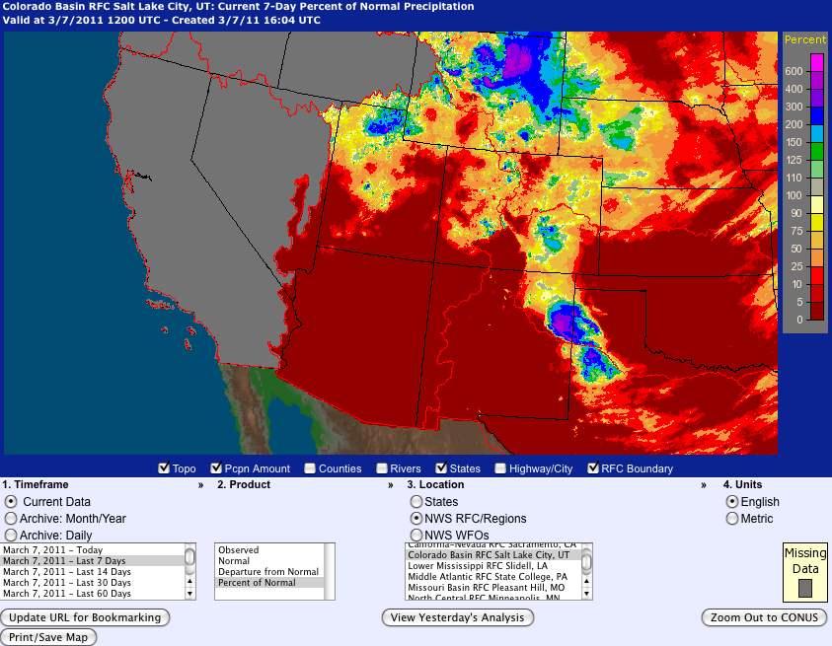
Last 7 days…
Web Reference: http://water.weather.gov

Slide 13
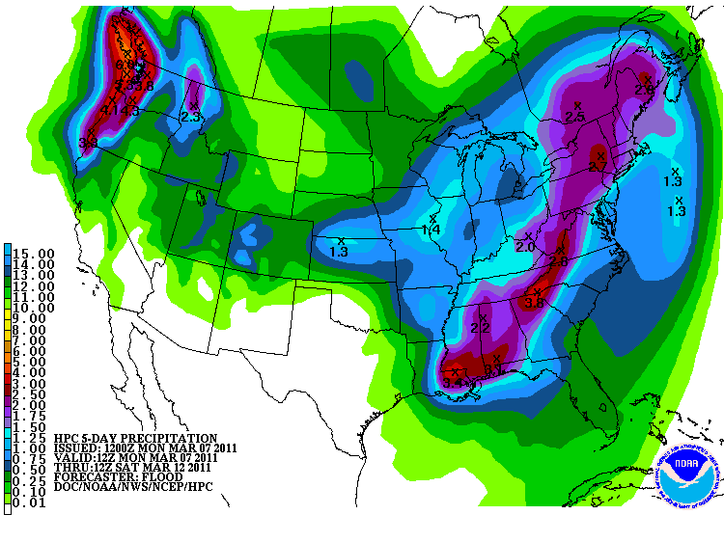
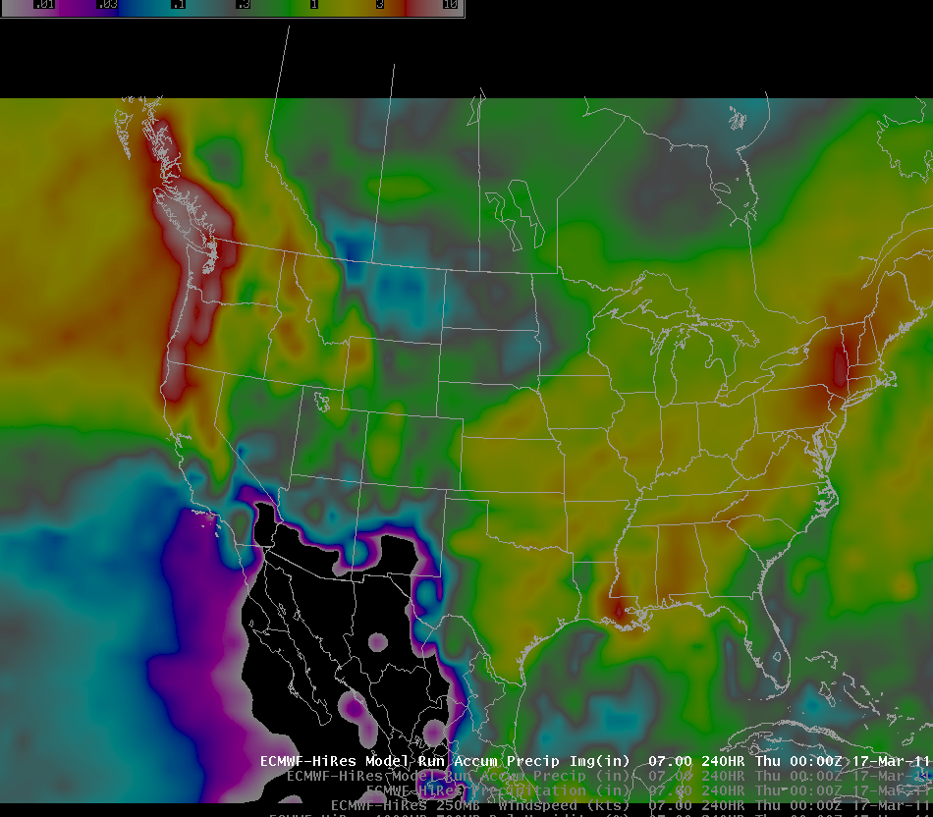
Forecast Precipitation
Active weather period continues!!
Storm #1 passing through today/tomorrow
Storm #2 Friday/Saturday (mostly north)
Storm #3 Sunday/Monday
Total accumulations around 2” of water in northern basins
Web Reference: www.hpc.noaa.gov

Slide 14
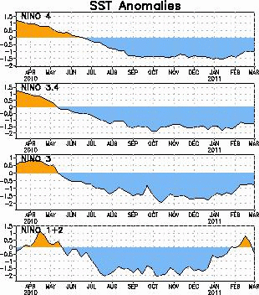
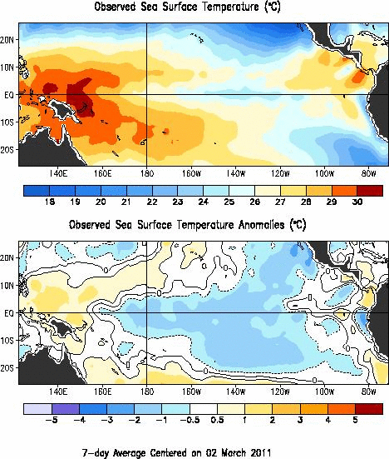
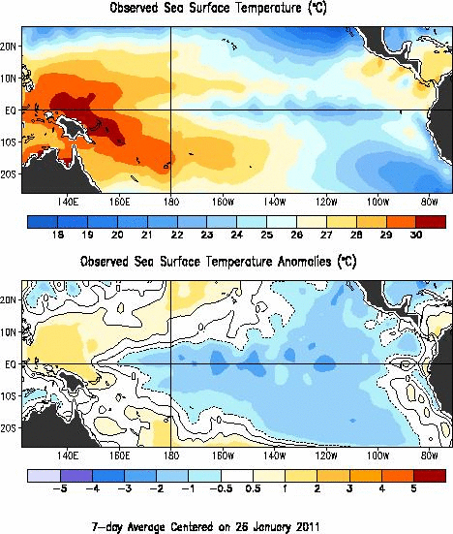
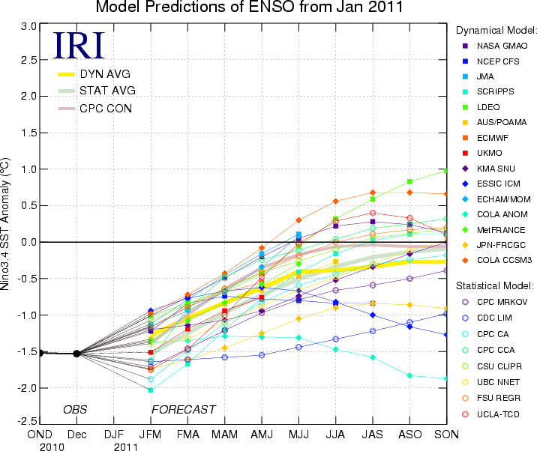
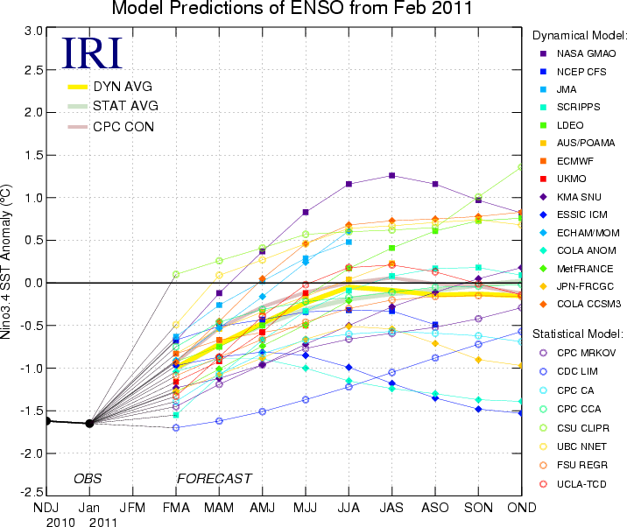
La Nina Update
Web Reference: http://www.cpc.noaa.gov and iri.columbia.edu/climate/ENSO

Slide 15
NOAA Operational Definitions for El Niño and La Niña
El Niño: characterized by a positive ONI greater than or equal to +0.5°C.
Weak: +0.5 to +0.99, Moderate: +1 to +1.49, Strong: > +1.5
La Niña: characterized by a negative ONI less than or equal to -0.5°C.
Weak: -0.5 to -0.99, Moderate: -1 to -1.49, Strong: < -1.5
To be classified as a full-fledged El Niño or La Niña episode, these thresholds must be exceeded for a period of at least 5 consecutive overlapping 3-month seasons.
CPC considers El Niño or La Niña conditions to occur when the monthly Niño3.4 OISST departures meet or exceed +/- 0.5°C along with consistent atmospheric features. These anomalies must also be forecasted to persist for 3 consecutive months.

Slide 16
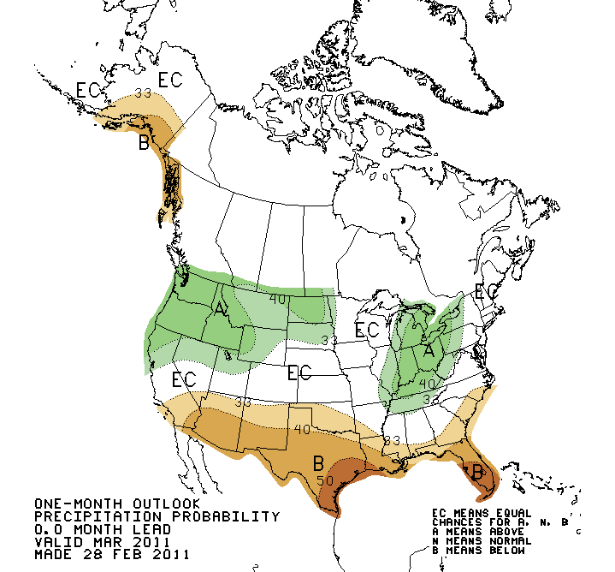
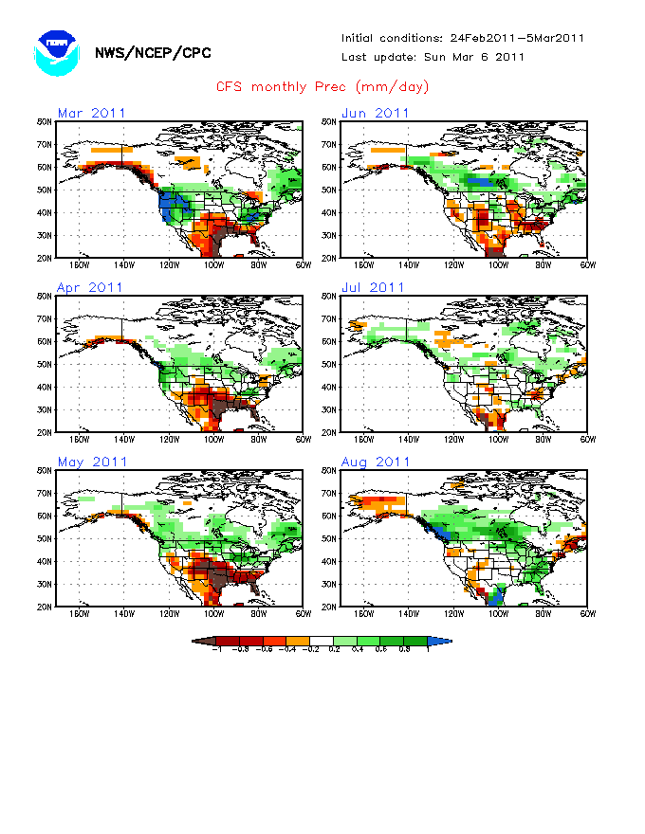
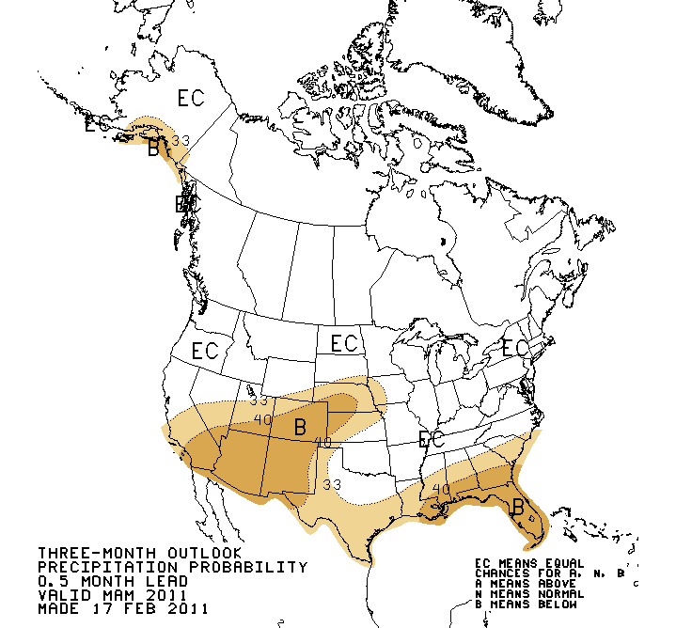
Web Reference: http://www.cbrfc.noaa.gov/climate/climoForecasts.cgi

Slide 17
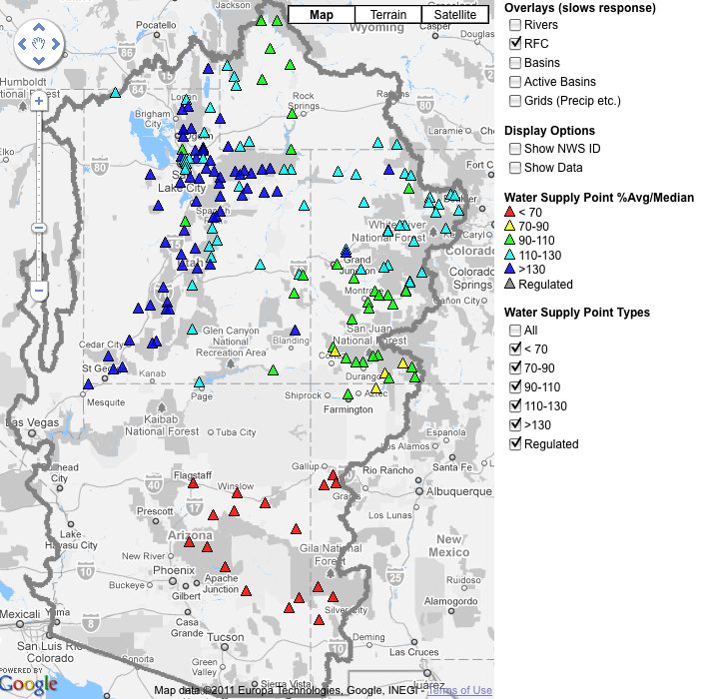
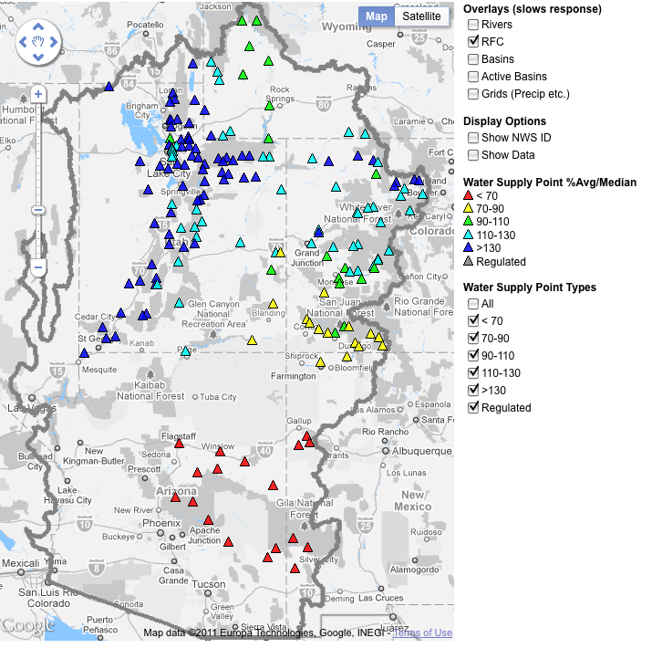
March 1, 2011
Water Supply Forecasts
Highlights:
Wet winter continues for much of the basin with many forecasts higher than any year since 1997
Some northern basins predicting flows near the top 10%
Forecasts slightly higher across northern basins since Feb 1
San Juan and lower basin somewhat lower since Feb 1
Web Reference: www.cbrfc.noaa.gov/gmap/gmapm.php?wcon=checked

Slide 18
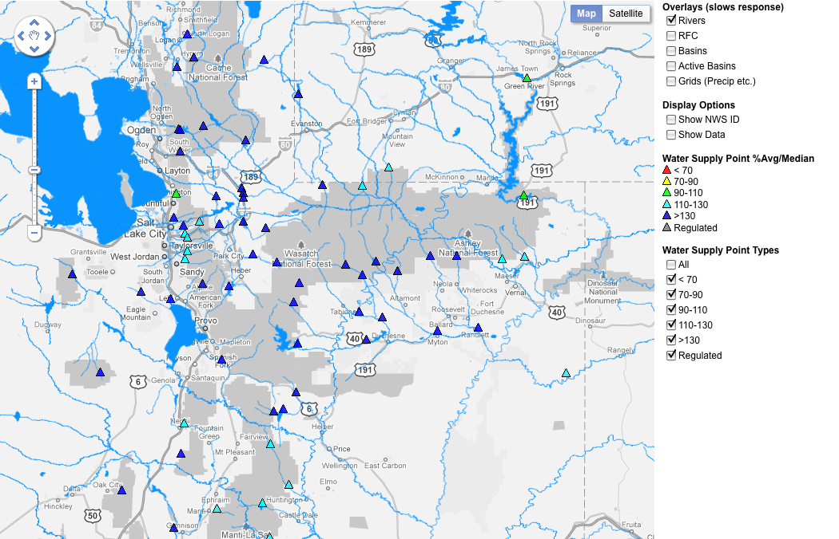

Slide 19
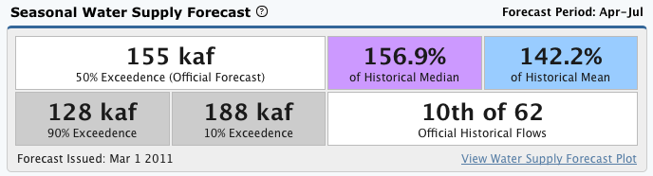
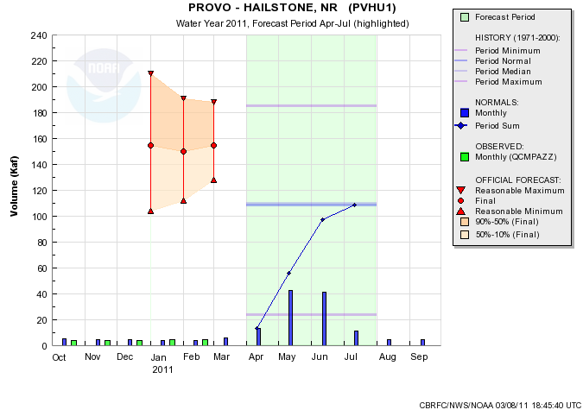
Web Reference: www.cbrfc.noaa.gov/gmap/gmapm.php?wcon=checked

Slide 20
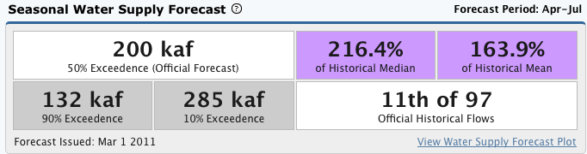
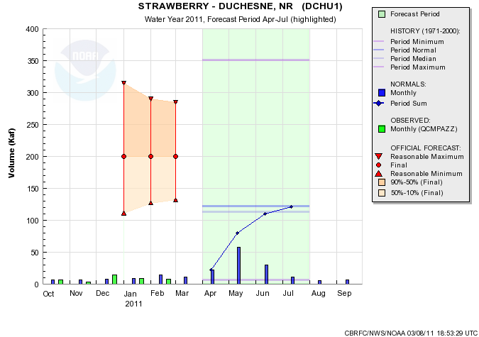
Web Reference: www.cbrfc.noaa.gov/gmap/gmapm.php?wcon=checked

Slide 21
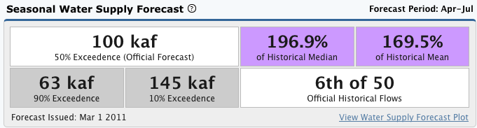
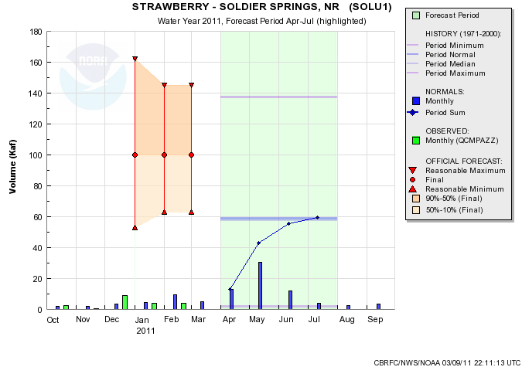
Web Reference: www.cbrfc.noaa.gov/gmap/gmapm.php?wcon=checked

Slide 22
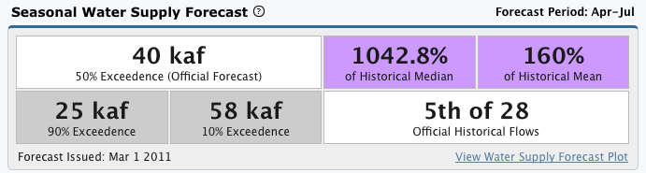
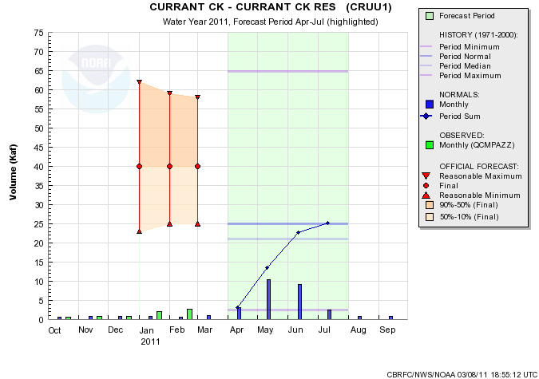
Web Reference: www.cbrfc.noaa.gov/gmap/gmapm.php?wcon=checked

Slide 23
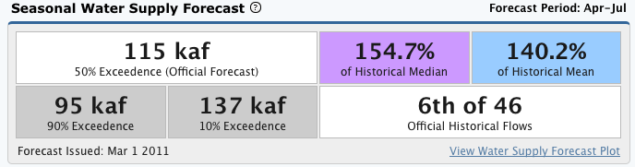
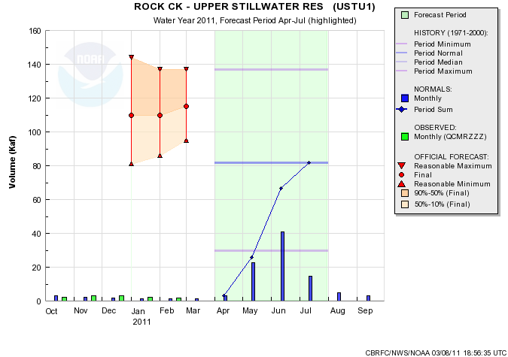
Web Reference: www.cbrfc.noaa.gov/gmap/gmapm.php?wcon=checked

Slide 24
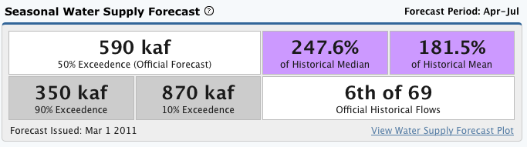
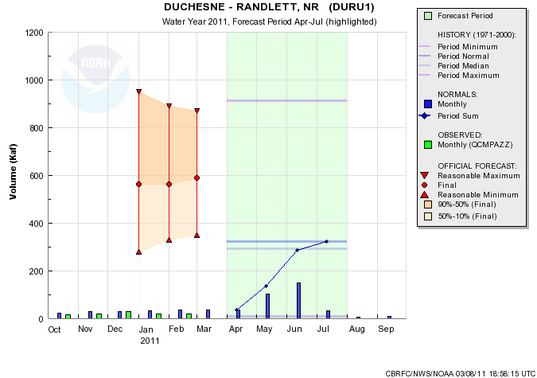
Web Reference: www.cbrfc.noaa.gov/gmap/gmapm.php?wcon=checked

Slide 25
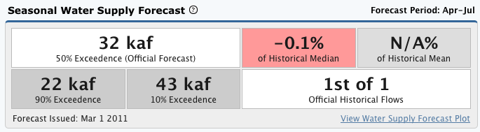
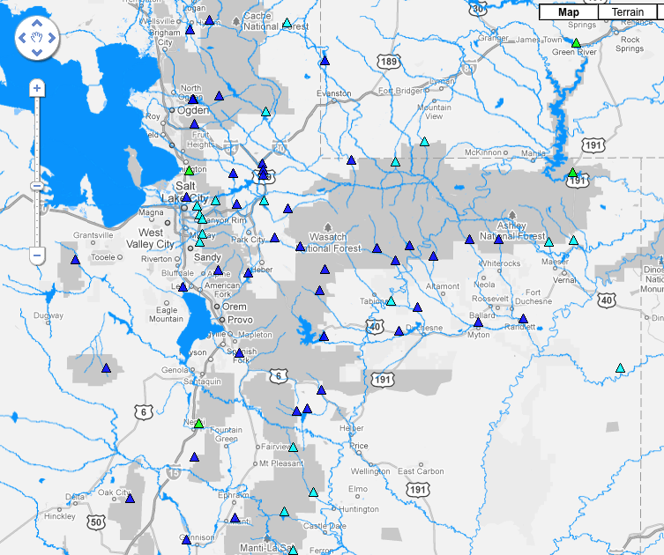
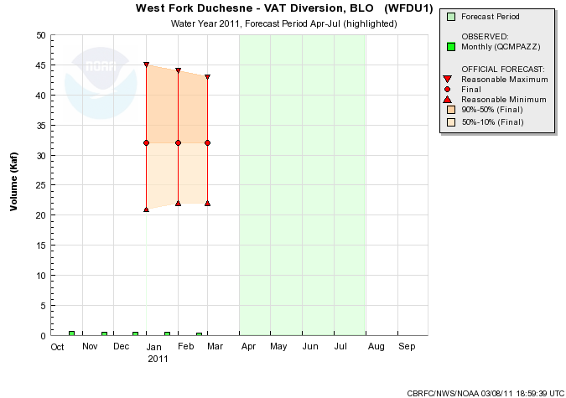
Web Reference: www.cbrfc.noaa.gov/gmap/gmapm.php?wcon=checked

Slide 26
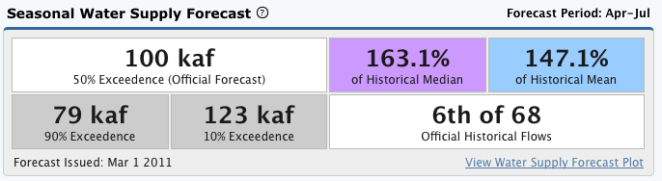
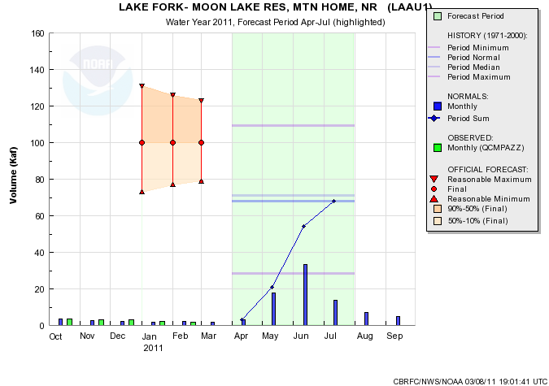
Web Reference: www.cbrfc.noaa.gov/gmap/gmapm.php?wcon=checked

Slide 27


Web Reference: www.cbrfc.noaa.gov/gmap/gmapm.php?wcon=checked

Slide 28


Web Reference: www.cbrfc.noaa.gov/gmap/gmapm.php?wcon=checked

Slide 29


Web Reference: www.cbrfc.noaa.gov/gmap/gmapm.php?wcon=checked

Slide 30
Other points:
Sevier – Piute Dam – 130 kaf, 197% of average
Manti Creek – Near Dugway Creek – 23 kaf, 126% of average
Web Reference: www.cbrfc.noaa.gov/gmap/gmapm.php?wcon=checked

Slide 31

Peak Flow Forecast
March 1 Peak flow forecasts highlights:

Slide 32



Slide 33



Slide 34



Slide 35


Slide 36


Slide 37

Peak Flow Publication

Slide 38

CBRFC News
Basin Focal Points (Available to discuss forecasts: 801.524.5130)
Upper Colorado: Brenda Alcorn
Green: Ashley Nielson
San Juan / Gunnison: Tracy Cox
Great Basin: Brent Bernard
Lower Colorado (below Lake Powell): Greg Smith
Here now:
Sign up for all webinars through May 2011
Weekly ESP model guidance
Email product updates via govdelivery (can add more products / webpages upon request)
Changes to CBRFC webpage
Blog (blog.citizen.apps.gov/cbrfc)
Coming soon:
New water supply publication – example

Slide 39
More Resources
www.cbrfc.noaa.gov
Wateroutlook.nwrfc.noaa.gov

Slide 40


Feedback, Questions, Concerns always welcome….
Kevin Werner
CBRFC Service Coordination Hydrologist
Phone: 801.524.5130
Email: kevin.werner@noaa.gov

