Slide 1


Forecasting changes in water quality and aquatic biodiversity in response to future bioenergy landscapes in the Arkansas-White-Red River basin
Peter E. Schweizer, Henriette I. Jager, and Latha M. Baskaran
April 8, 2010
2010 US-IALE 25th Anniversary Symposium
Athens, Georgia USA

Slide 2

OUTLINE
Context and assumptions
Hypotheses
Data sources
Study area
Modeling approach
Results
Limitations
Implications and future direction

Slide 3


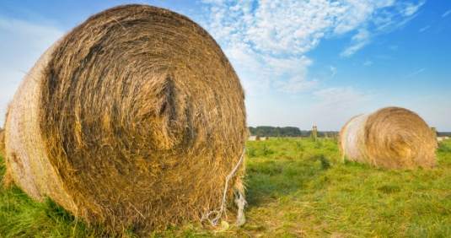
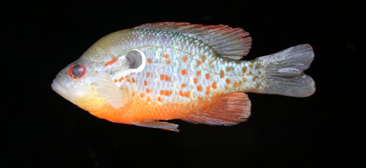
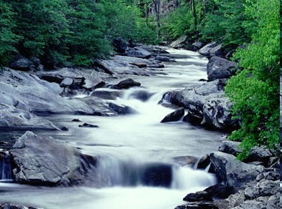
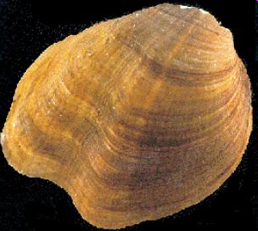
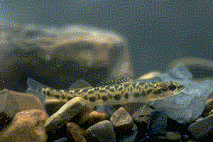
Sustainability
Humans change landscapes
Bioenergy industry and public concerns
Aspects of sustainability
Long-term profitability of bioenergy production (switchgrass yield)
Long-term water quality
Aquatic biodiversity
Products
Bioenergy
Clean rivers
Notes:
3

Slide 4
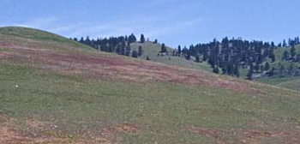
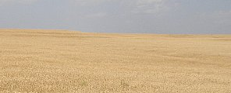
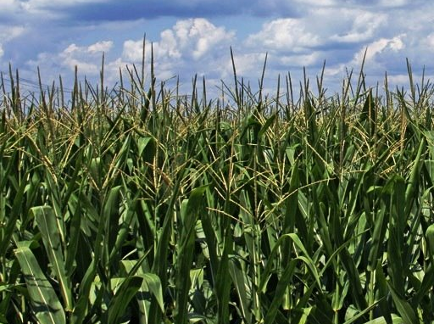
The Arkansas-White-Red River (AWR) basin
KS
Arkansas River
CO
CO
KS
MO
642,000 km²
173 HUC-8
Tributary to Mississippi River
Gulf of Mexico
MO
Cimarron River
Upper White River
& Black River
NM
North Canadian River
OK
Canadian River
OK
NM
Lower Arkansas
AR
Red River Drainages
AR
TX
TX
LA
LA
Notes:
4

Slide 5
EISA 2007
Grasslands, pasture and hay 45 %
Forest 21 %
Agriculture 15 %
Future energy landscape(s)
LULC where ?
water quality
fish biodiversity

Slide 6
Assumptions
switchgrass as bioenergy crop
limited to existing agriculture and pasture land
total area of cultivated land static 2010 - 2030
Hypotheses
Where switchgrass replaces agriculture
nutrients in streams decrease
perennial crops decrease sediment loads
increase in fish diversity

Slide 7
METHODS: conceptual approach
Existing landscape
Watershed characteristics
Land cover (CDL & NLCD)
Slope and elevation
Soils
Stream layers
Projected landscape
(POLYSYS)
Projected
water quality
(SWAT)
Changes
in water quality
SWAT
Discharge
Water quality
Projected
species richness
Changes
in fish richness
Species richness model
(Native fish species)

Slide 8
Tools
SWAT
Basin-scale hydrologic model
Integrates land change
Project water quality
Stream discharge
Sediment loads
Nutrient levels
POLYSYS
Agro-economic model
Land change projections
% area agriculture replaced by switchgrass

Slide 9
Data sources
CDL and NLCD land cover
STATSGO soils
USGS elevation and slope
NHDplus streams and
watershed boundaries
NatureServe fish and mussel data

Slide 10
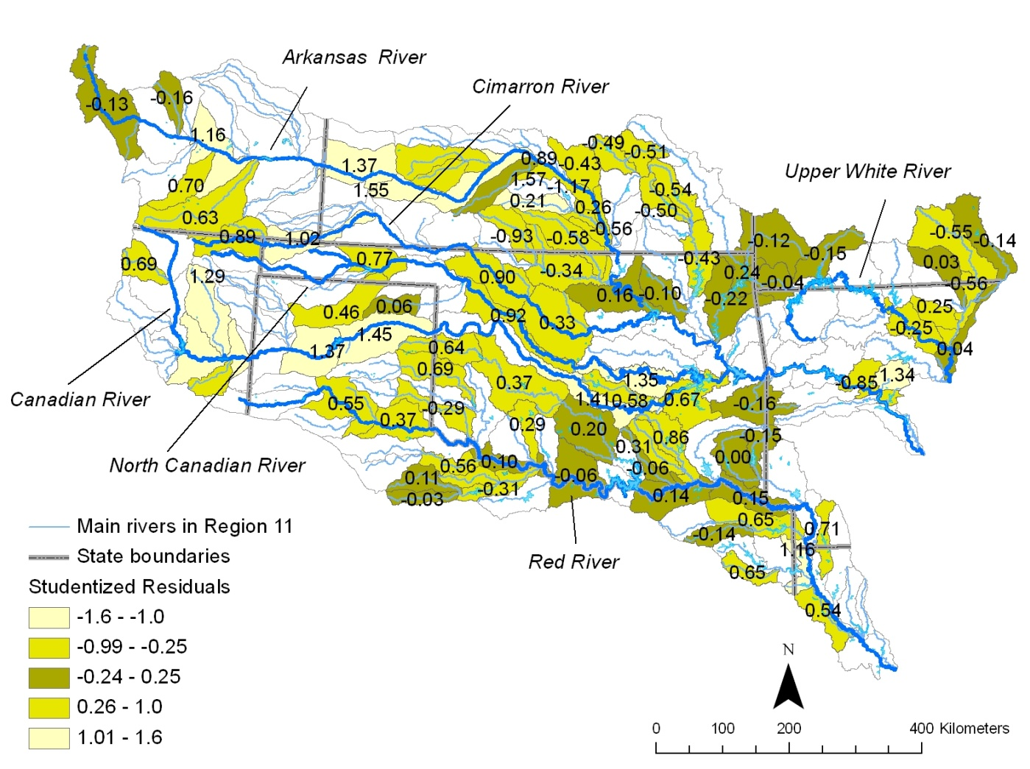
SWAT modeling
Validation: discharge, nutrients and sediment load
1981-2003 model run
Alamo switchgrass
Tiles
Calibration
Agricultural watershed
Forest watershed
Nash-Sutcliffe > 0.75

Slide 11
Fish species richness in the AWR
Precipitation
Elevation
Regional biodiversity
Number of native fish species per HUC-8
76 – 100
> 100

Slide 12
Modeling current fish species richness
Stratified data 70/30, by subregion
Poisson regression with log-link function
Number Species
discharge
number of dams
elevation
sediment concentration
number upstream HUC
percent water
nitrate nitrogen
total phosphorus
R² adj. = 0.86
N Species = exp(4.32 + 0.0003 flow – 0.0163 dams – 0.002 elevation – 0.04 sediments)
p < 0.001

Slide 13
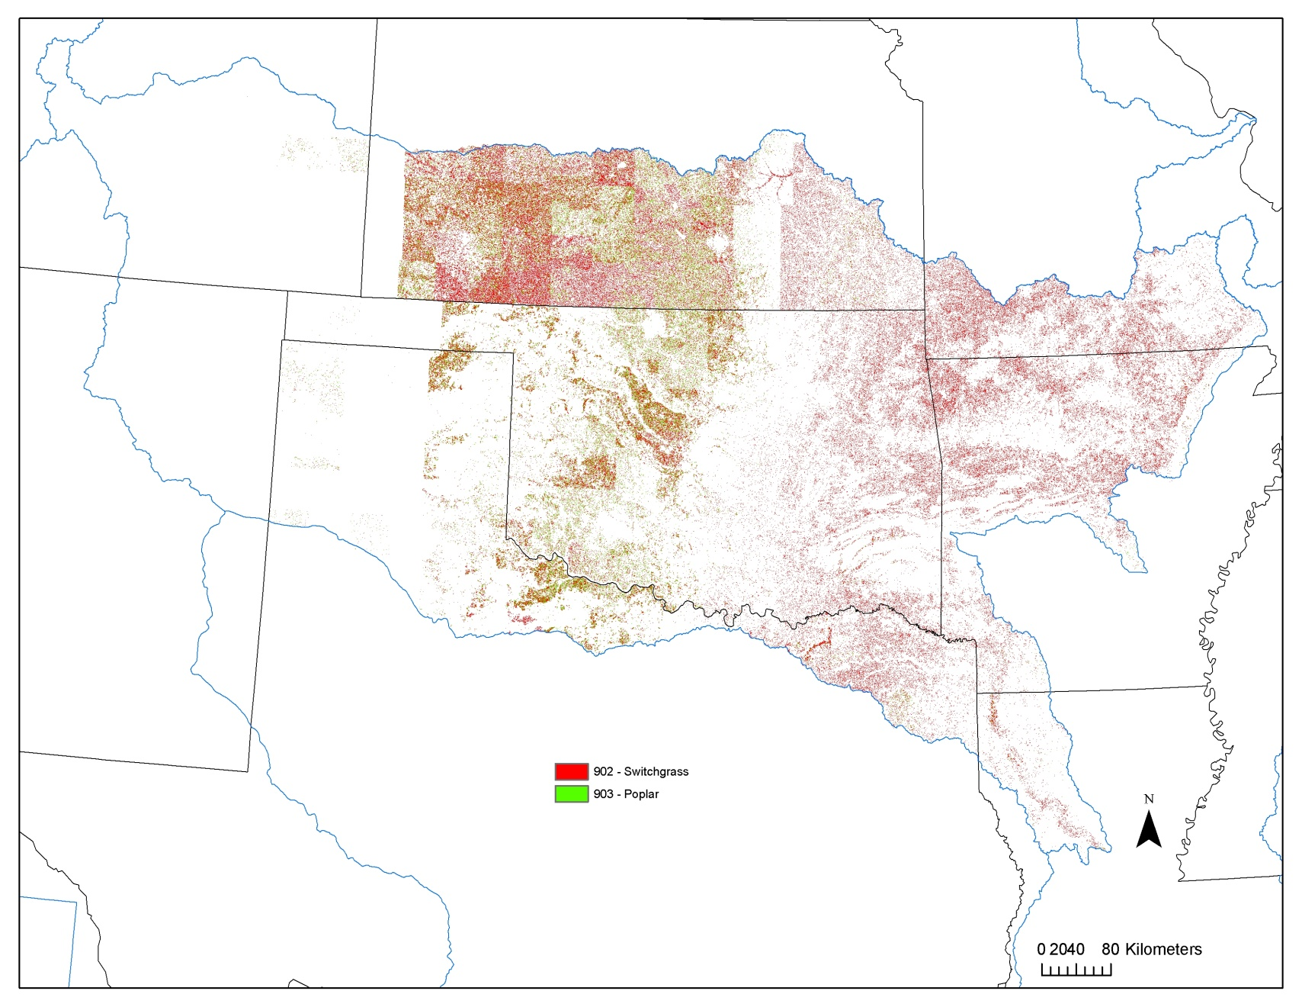
POLYSYS
Landscape 2030
Conversion to switchgrass (9.7%)
60 % from pasture
28 % from wheat
4 % from soybean
4 % from sorghum
3 % from corn
Economic regions
- Upper Midwest
- Lower Midwest

Slide 14
RESULTS: changes in stream discharge

Slide 15
Sediment loads
KS
CO
MO
OK
NM
AR
TX
LA

Slide 16
Total phosphorus

Slide 17
NO3-nitrogen concentrations
KS
CO
MO
OK
NM
AR
TX
LA

Slide 18
Changes in fish species richness in the AWR

Slide 19
SWAT projections for bioenergy scenarios
Discharge overall decrease
- increase where replacing intensive agriculture
- decrease where pasture/hay is replaced
Sediment load overall decrease
- increase from former pasture/hay?
Nitrate nitrogen increase where pasture/hay is replaced
- less input than from corn
Total phosphorus overall decrease
(correlated with sediment loads)
Fish diversity benefits in former agro-intensive areas - suggested decreases where replacing pasture/hay

Slide 20
LIMITATIONS
Replications with alternate transition scenarios needed
Multiple scenarios for % replacement needed
Spatial resolution at county scale
Spatial context important, current scenarios are not spatially explicit
Biotic data 0/1
FUTURE DIRECTION
Include spatial context (buffer zones, conservation practice, BMP’s)
Include upland varieties
Species traits and empirical data for biotic component

Slide 21
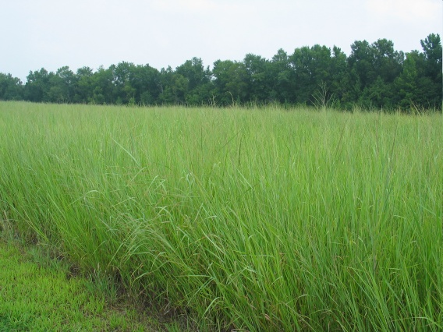
FUNDING
U.S. Department of Energy
ORNL Laboratory directed Research and Development
Acknowledgements
Bob Perlack and Craig Brandt (POLYSYS)
Oak Ridge Associate Universities (ORAU) ORISE Program
Contacts
SchweizerPE@ornl.gov JagerHI@ornl.gov

