Slide 1
Assessing watershed benefits of bioenergy crops: recreational and subsistence value of fishes
Laurence Eaton, Peter Schweizer, Yetta Jager, and Rebecca Efroymson
International Association for Landscape Ecology
April 8, 2010
Athens, Georgia

Slide 2
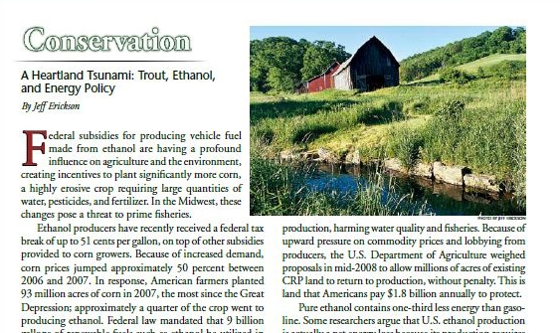
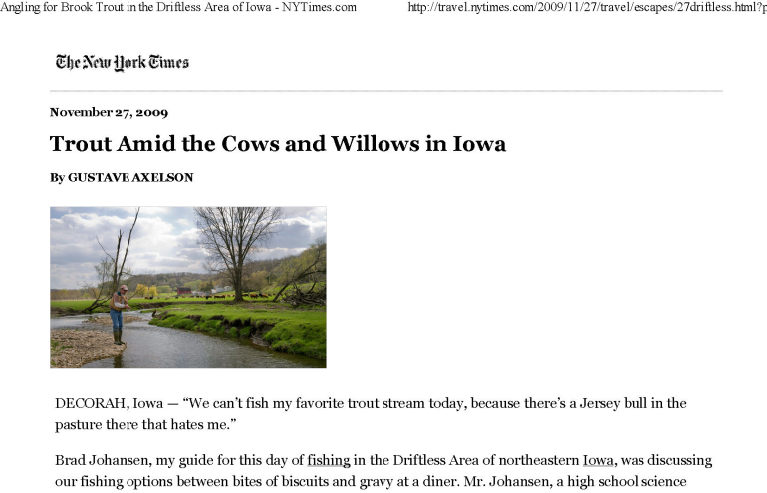
Motivation
Could there be conflicting social and ecological objectives in increasing biomass production?
Why anglers?
Consume ecological and biophysical final goods
Promote economic development
Responsive to quality (richness) and quantity of fishing opportunities?
Notes:
“With the 1980s and the rise of the Conservation Reserve Program, the Driftless Area's prairie character began to re-emerge. Today 33 trout streams in the area support natural spawning…. But now anglers worry that high corn prices caused by demand for ethanol could erase those gains, as more lands are put back to agricultural use.” (NYTimes)
Can we be sacrificing fish richness and angler participation for energy independence?

Slide 3
Presentation Outline
Overview
Approach and Data
Model
Results
Conclusion
Notes:
“With the 1980s and the rise of the Conservation Reserve Program, the Driftless Area's prairie character began to re-emerge. Today 33 trout streams in the area support natural spawning…. But now anglers worry that high corn prices caused by demand for ethanol could erase those gains, as more lands are put back to agricultural use.” (NYTimes)

Slide 4
Overview: Conceptual Framework
Δ in Landscapes
Δ in Water Quality and Quantity
Δ in Species Richness
Δ in Economic Impact
Δ in Economic Activity
Δ in Biofuels Policy
EISA mandates 21 billion gallons of second generation by 2022.
New landscapes include
Switchgrass and miscanthus
hybrid poplar, pine, eucalyptus, and willow (SRC)
Different landuse scenarios vary in association with water quality and aquatic biodiversity
Q: What is the relationship between fish richness and fishing privilege and activity?

Slide 5
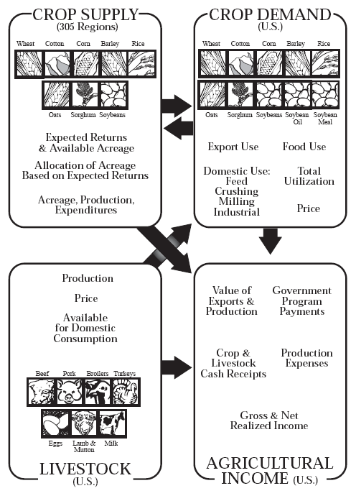
Overview: POLYSYS modeling framework
Simulates US Agricultural Sector
Billion Ton Study Update ongoing
USDA baseline forecasts
County-level supply curves
Includes perennial crops, fixed land supply
Representative 2030 scenario:
$60/dt market price, perennial crop annual yield growth 4%

Slide 6
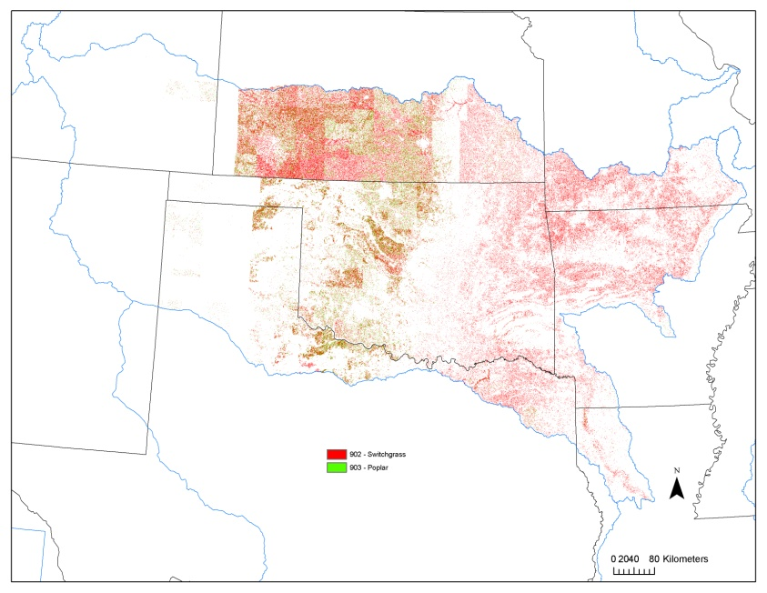
Overview: Resource Assessment and Agricultural Forecasting
Preliminary POLYSYS scenarios of biofuels market for perennial biomass crops production
Highest conversion to switchgrass is from wheat and pastureland
Notes:
2006 Survey results – 87.5 million participants engaged in wildlife-related recreation; 30 million fished, 517 million activity days; $42.0 billion in expenditures.
Other info: Trip-related expenditures, including food, lodging, and transportation, were $24.6 billion— 32 percent of all fi shing and hunting expenditures. Total equipment expenditures amounted to $41.0 billion, 53 percent of the total. Other expenditures— magazines, membership dues, contributions, land leasing and ownership, and licenses, stamps, tags, and permits—accounted for $11.1 billion, or 15 percent of all sportspersons’ expenditures.

Slide 7

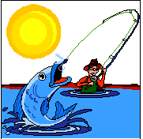
Overview: Approaches to ecological valuation
Total Value (market, non-market, surrogate)
Macro- top down
Environmental/Economic indicies
Micro- bottom up
“Travel Cost Method” (TCM)
“Contingent Valuation Method” (CVM)
Revealed Behavior approach
Loomis, 2005
Notes:
Discuss difference in consumer surplus

Slide 8
Approach: Economic Model
Total use = f (F, C, B)
Where
Total use= resident and non-resident activity days (based upon privilege status and total trip days)
F= ecological final goods (e. g. lakes, streams, rivers)
C= capital infrastructure (e. g. access to sites)
B= biophysical final goods (native fish richness and native game fish richness)

Slide 9
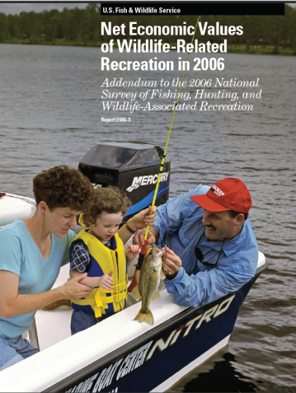
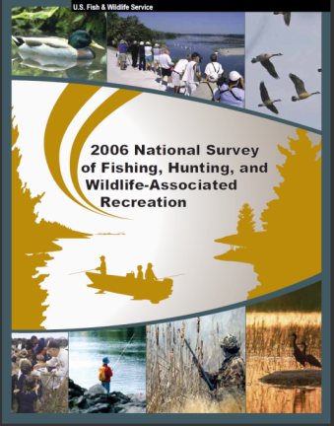

Data: Sources and method
County-level license sales (2008-9)
National Survey of Fishing, Hunting, and Wildlife-Associated Recreation (2006)
Net Economic Values of Wildlife-Related Recreation in 2006 (2009)
Total Privilege
Population with fishing rights
Temporary (6 classes,1 day - 2 weeks)
Annual (2 classes, annual fishing and combo)
Activity days
Income unobserved
Allows combining temporary and annual privileges, (Total and Nonresident activity days correlation .95, and Total and Resident activity correlation .99)
Resident and Nonresident Activity
Average Activity Days | Average Annual Expenditure | Average Daily Expenditure | Total variable expenditures
Revealed Behavior
Fishing Privilege
Notes:
2006 Survey results – 87.5 million participants engaged in wildlife-related recreation; 30 million fished, 517 million activity days; $42.0 billion in expenditures.
Other info: Trip-related expenditures, including food, lodging, and transportation, were $24.6 billion— 32 percent of all fi shing and hunting expenditures. Total equipment expenditures amounted to $41.0 billion, 53 percent of the total. Other expenditures— magazines, membership dues, contributions, land leasing and ownership, and licenses, stamps, tags, and permits—accounted for $11.1 billion, or 15 percent of all sportspersons’ expenditures.

Slide 10
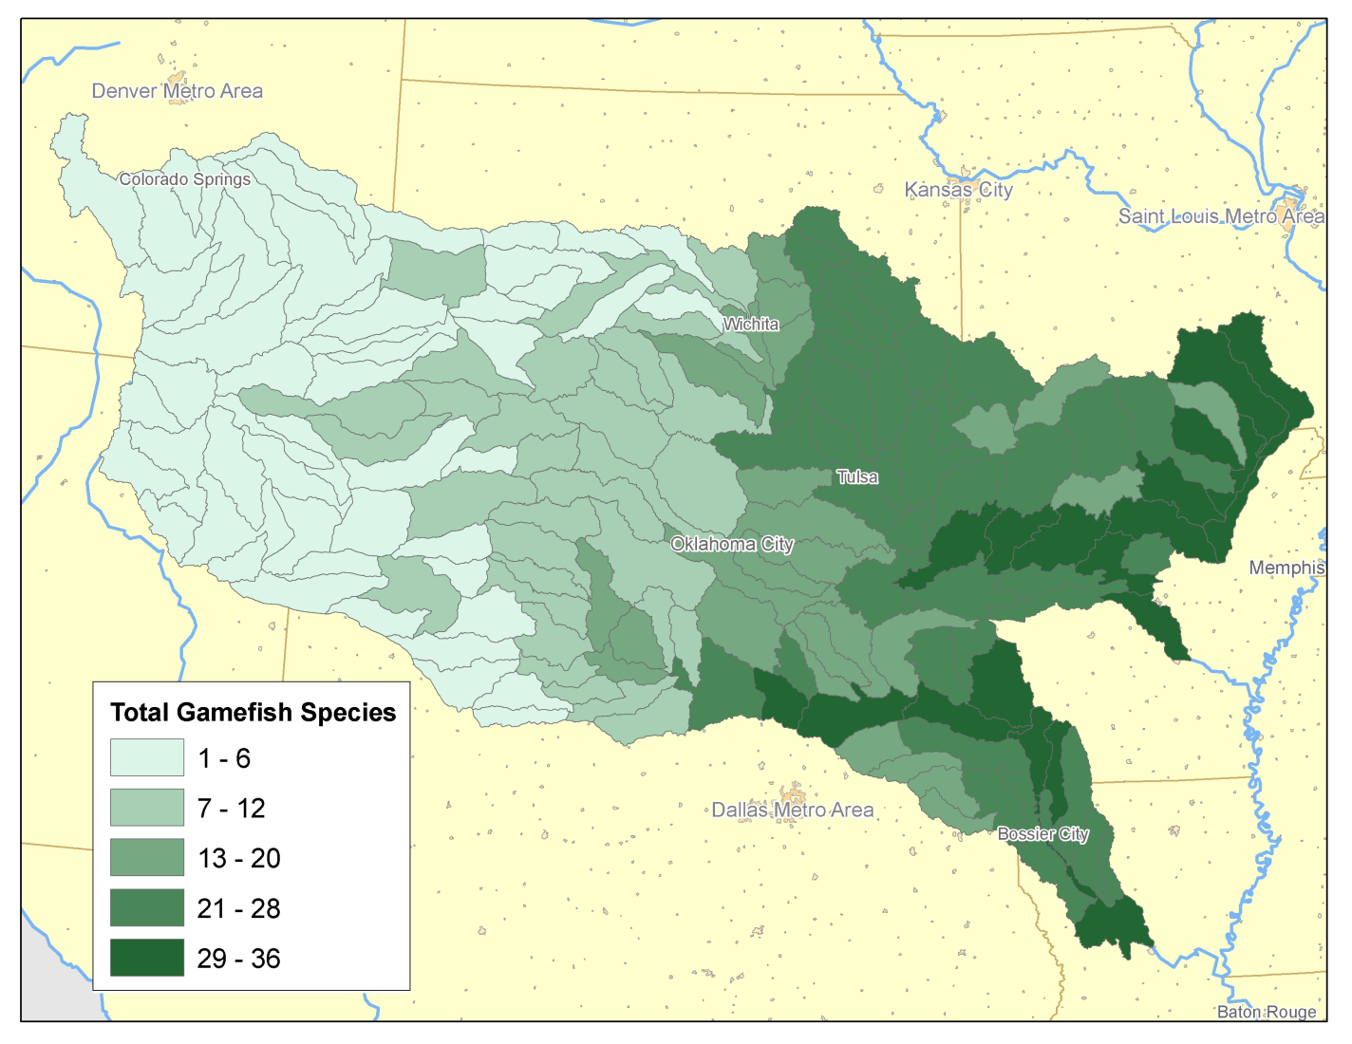
Approach: Study area and data
Native Gamefish Richness
Arkansas White Red River Basin HUC-8 regions (n=173)
8 states, 322 counties, 1353 census tracts, 7783 block groups (lowest level of census population reporting)

Slide 11
Approach: Data Arrangment
County Level License Sales Information
County-Level CENSUS Population Characteristics
Block Group Level License Sales
Block Group Level CENSUS Population Characteristics
Dependent Variable
+
Fishing Activity
State Level Activity Information (USFWS)
State Level Activity Days and Expenditures
Native fish Species by HUC 8 Boundary
Biophysical Final Goods by HUC
Nature Serve Native Fish Richness
Native Game Species by HUC 8
Explanatory Variables
Road Density
Ecological Goods
Stream lengths/Surface water
Environmental Quality Attributes
Sediment

Slide 12
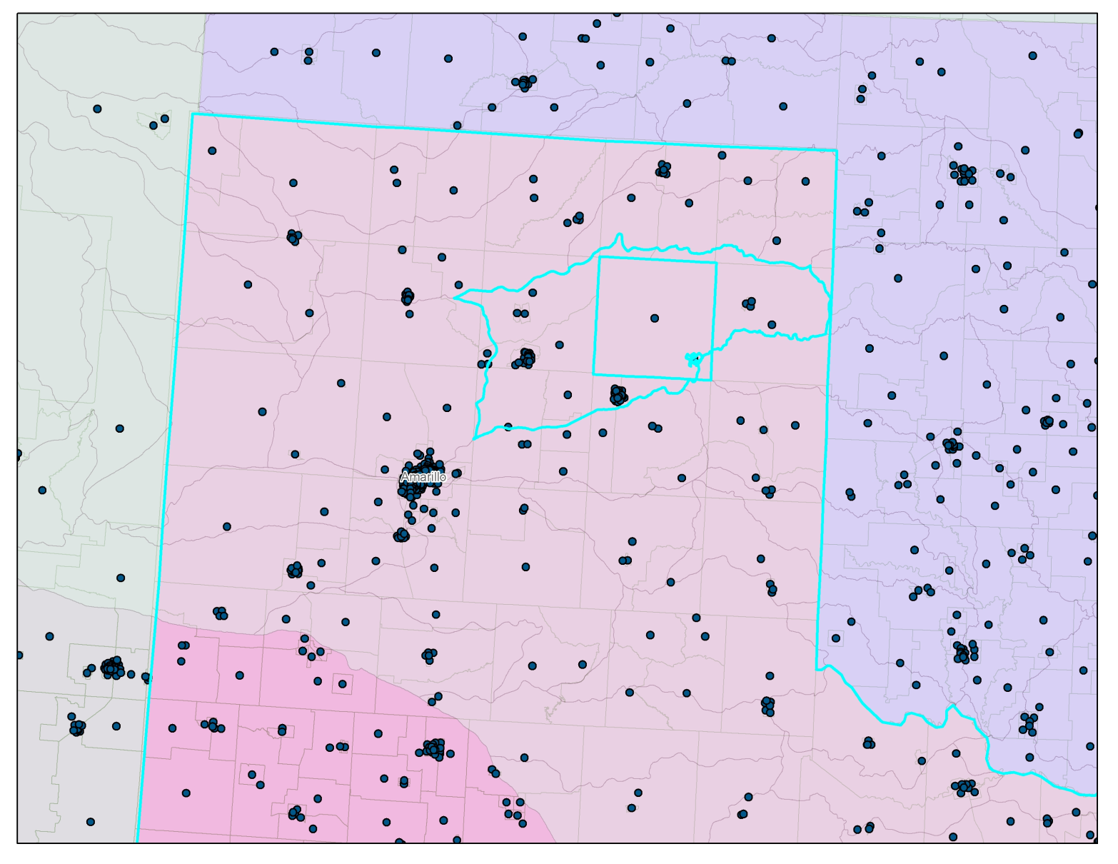
Approach: Block Groups and Watershed Boundaries

Slide 13
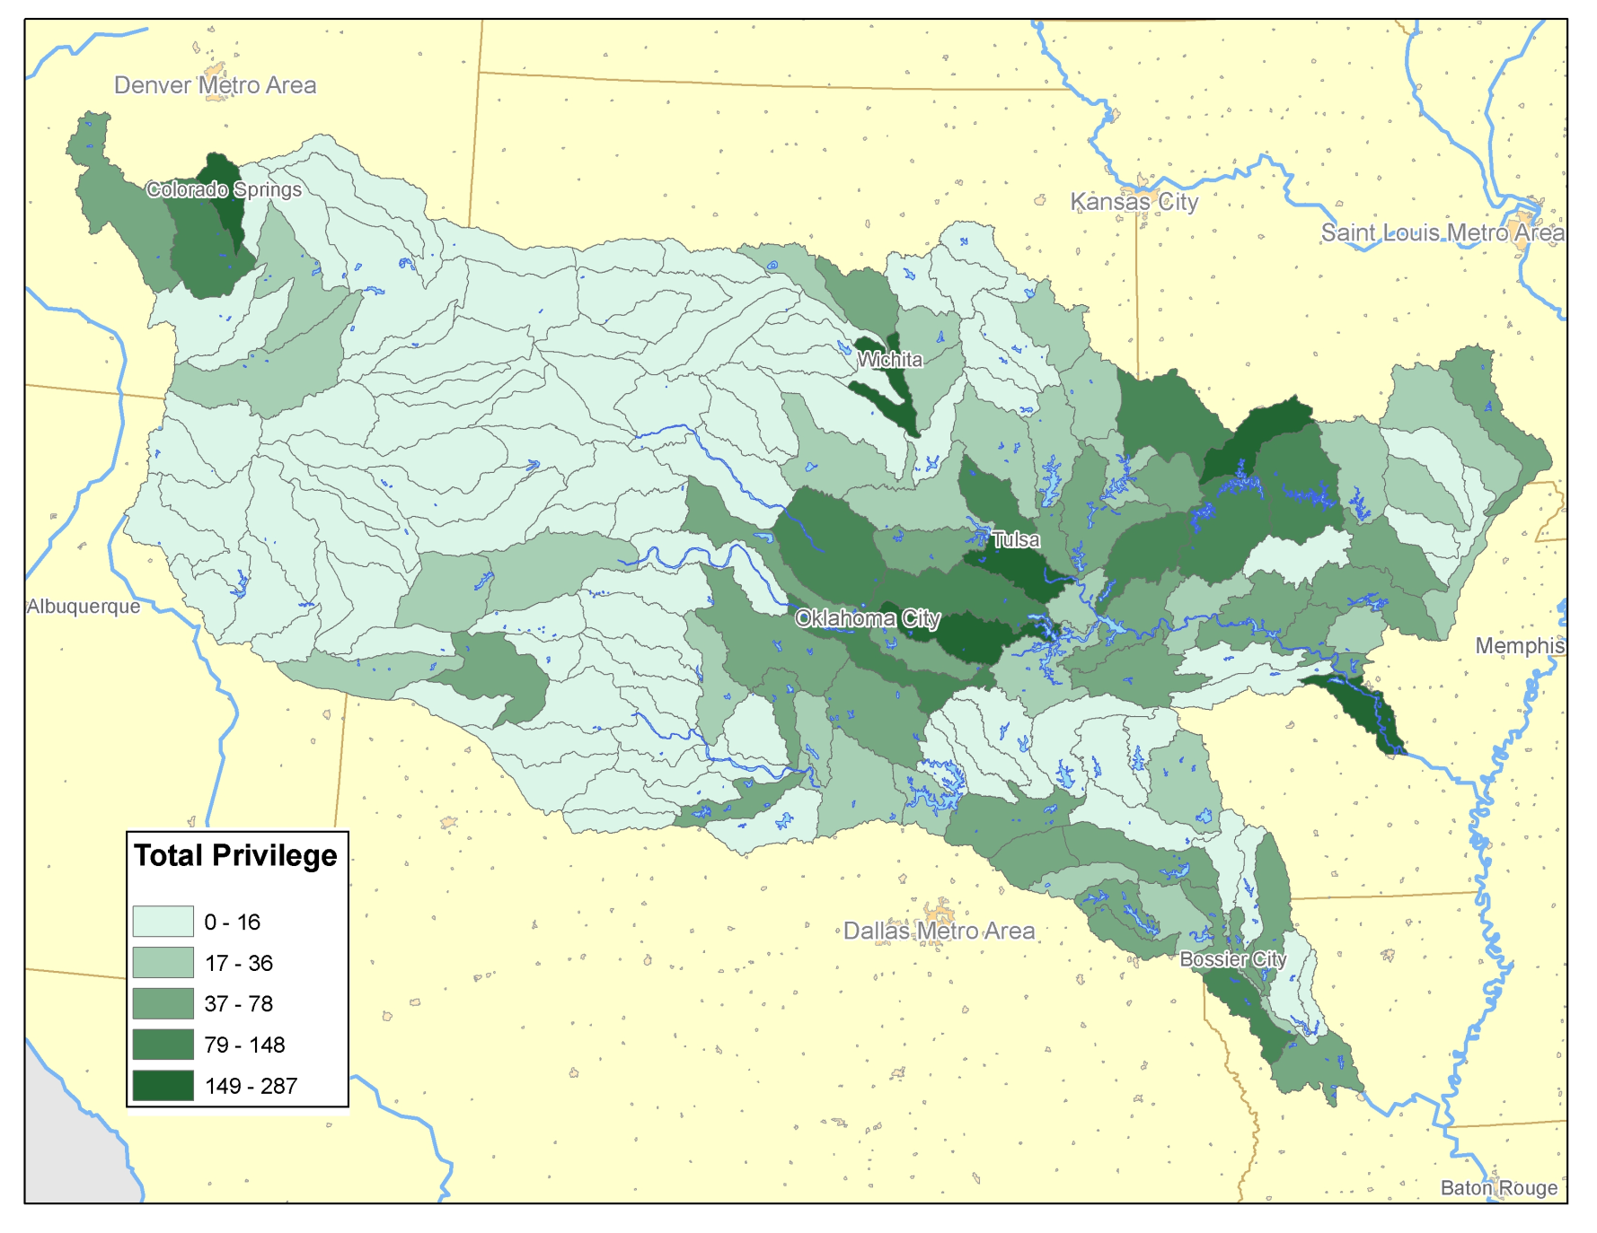
Data: Total fishing privilege

Slide 14
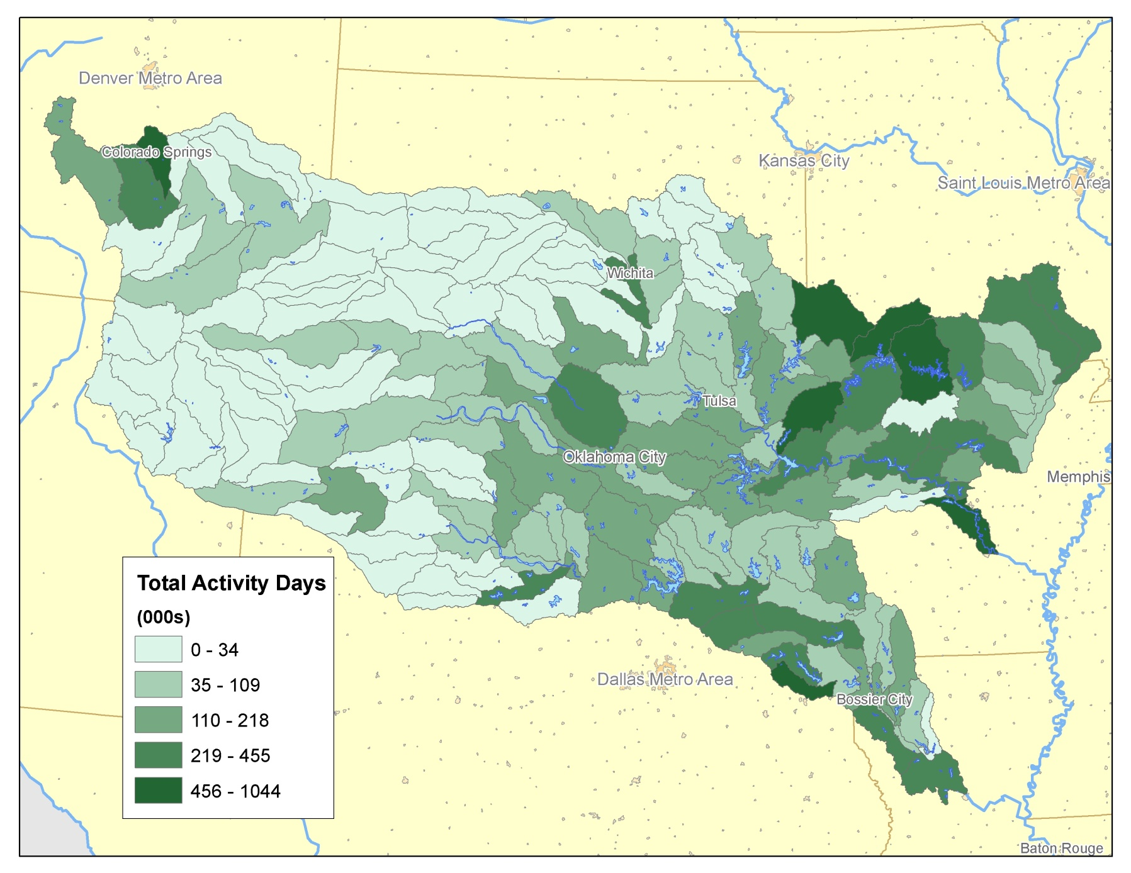
Results: Total observed activity days

Slide 15
Model: Full Linear Regression
Total Use = f (Pop, N, G, S, A, Pw, Elev_Drain, TMDL, Stream2max, Stream3plus)
Where
Total Use= resident and nonresident privilege and activity days
Pop= total population by HUC
N = total native fish species
G = total native game fish species
S = sediment concentration (mg/kg)
A = road density
Pw = percent of surface water by HUC
Elev_Drain = elevation drainage
TMDL= Total Maximum Daily Limit
Stream2max = first and second order stream lengths
Stream3plus = length of streams at third and higher order
Estimated using a log-link Poisson distribution regression

Slide 16
Results: Reduced Model Results
Parameter | Estimate | Standard Error | 95% Confidence Limits |  | Z | Pr > |Z|
Intercept | 9.5127 | 0.2497 | 9.0233 | 10.0020 | 38.10 | <.0001
POP_T | 0.0017 | 0.0010 | -0.0003 | 0.0036 | 1.67 | 0.0943
N_GameFish | 0.0417 | 0.0074 | 0.0271 | 0.0563 | 5.59 | <.0001
SEDmgkg | -0.0003 | 0.0001 | -0.0005 | -0.0001 | -3.00 | 0.0027
Roads_km | 0.0002 | 0.0000 | 0.0001 | 0.0002 | 5.06 | <.0001
p8_Water | 0.0794 | 0.0188 | 0.0426 | 0.1163 | 4.23 | <.0001

Slide 17
Current Model Limitations
Specification of stocked warm and cold water fishes (Loomis, 1998)
Spatial resolution of fishery information
Spatial context of population
Quantitative fish density data
Angling success and satisfaction

Slide 18

Results: Total observed activity days

Slide 19
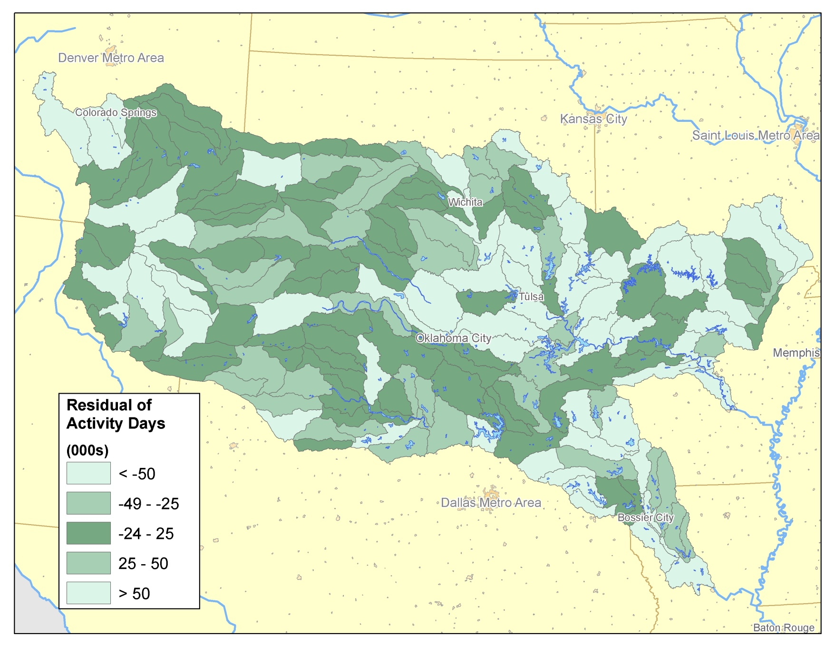
Results: Residual of observed and predicted activity days
Spearman R= 0.816 (p<.0001); Pearson R= 0.753 (p<.0001)

Slide 20
Conclusion
We combine socioeconomic and ecological parameters to predict direct use, with correct anticipated sign of coefficients
Omitted variable bias could be due to error in estimating total population, recreational amenities, and stocking frequency and distribution
Total valuation of fishes in this area is a much larger and complex process

Slide 21
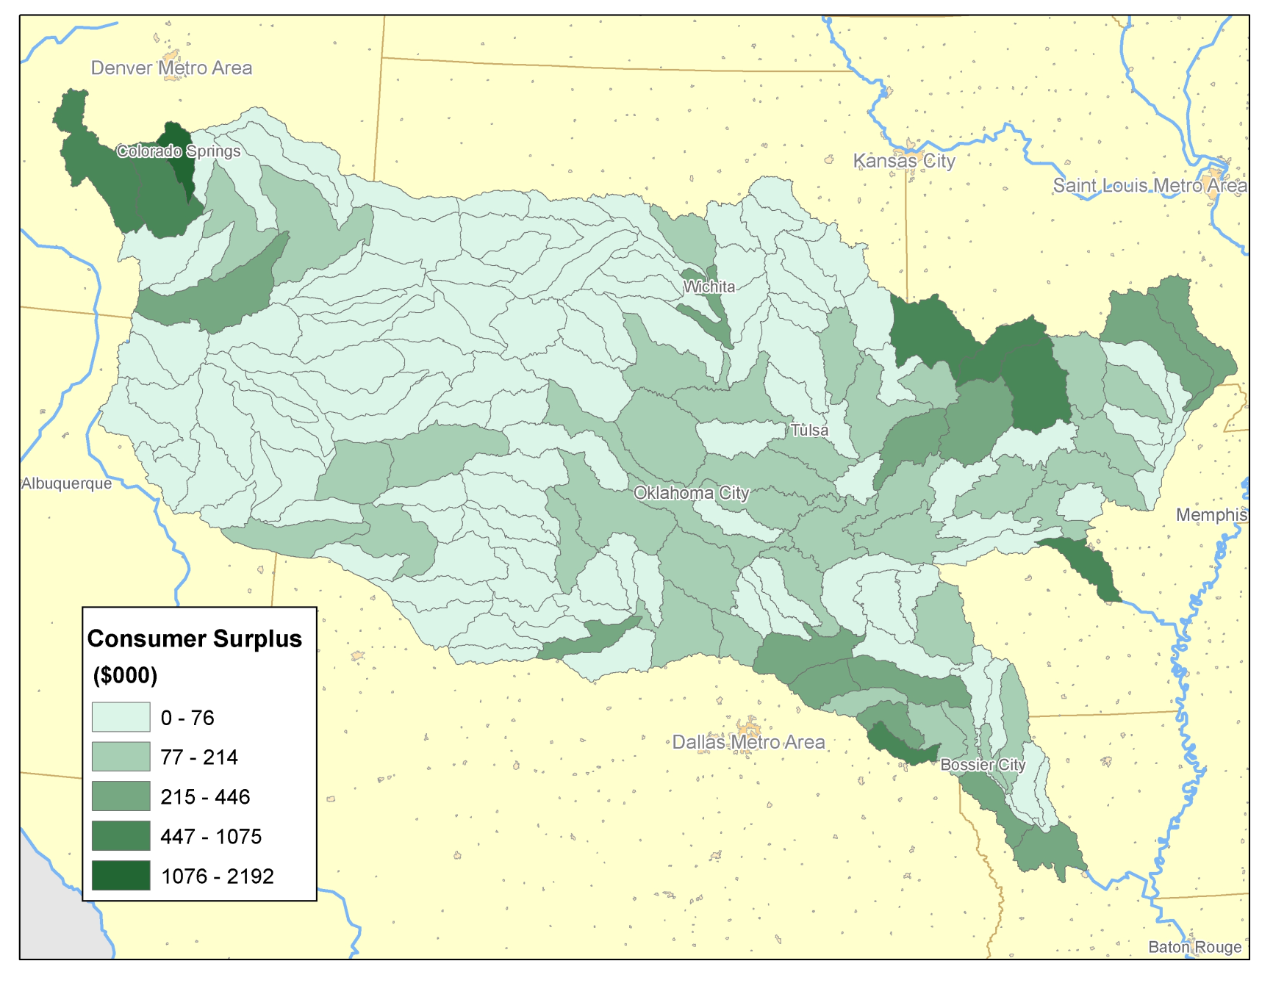
Conclusion: Consumer Surplus

Slide 22
Future research
Improving population estimates (raster approach)
Extending travel cost method to include driving distance to water
Multi-metric approach to ecosystem valuation related to fishes (including rare species; net economic value; non-use values; intrinsic values)
Forecast use changes from future landscape and water quality scenarios

Slide 23
Acknowledgements
Latha Baskaran, Bob Perlack, Anthony Turhollow, Mark Downing (ORNL)
Virginia Dale (CBES-ORNL)
Chad Hellwinckel (UT-APAC)
Oak Ridge Associate Universities (ORAU) ORISE Program

Slide 24
Public Perceptions
“With the 1980s and the rise of the Conservation Reserve Program, the Driftless Area's prairie character began to re-emerge. Today 33 trout streams in the area support natural spawning…. But now anglers worry that high corn prices caused by demand for ethanol could erase those gains, as more lands are put back to agricultural use.”
Notes:
“With the 1980s and the rise of the Conservation Reserve Program, the Driftless Area's prairie character began to re-emerge. Today 33 trout streams in the area support natural spawning…. But now anglers worry that high corn prices caused by demand for ethanol could erase those gains, as more lands are put back to agricultural use.” (NYTimes)
Can we be sacrificing fish richness and angler participation for energy independence?

