Slide 1
An Overview of the State’s Demographics and Economy
Legislative Analyst’s Office
Presented to:
California Senate
January 28, 2013
www.lao.ca.gov

Slide 2
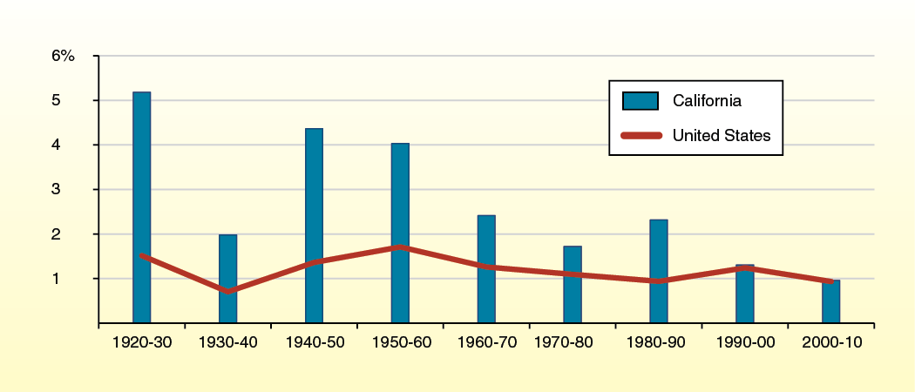
California's Population Has Grown Faster Than the U.S. … Until Recently
Average Annual Growth Rate by Decade

Slide 3
California Somewhat Younger Than the Nation
2010
Age Group | California |  |  | United States
0 – 19 | 28.1% |  |  | 27.0%
20 – 39 | 28.6 |  |  | 26.8
40 – 64 | 31.9 |  |  | 33.2
64 – 74 | 6.1 |  |  | 7.0
75 and over | 5.3 |  |  | 6.1

Slide 4
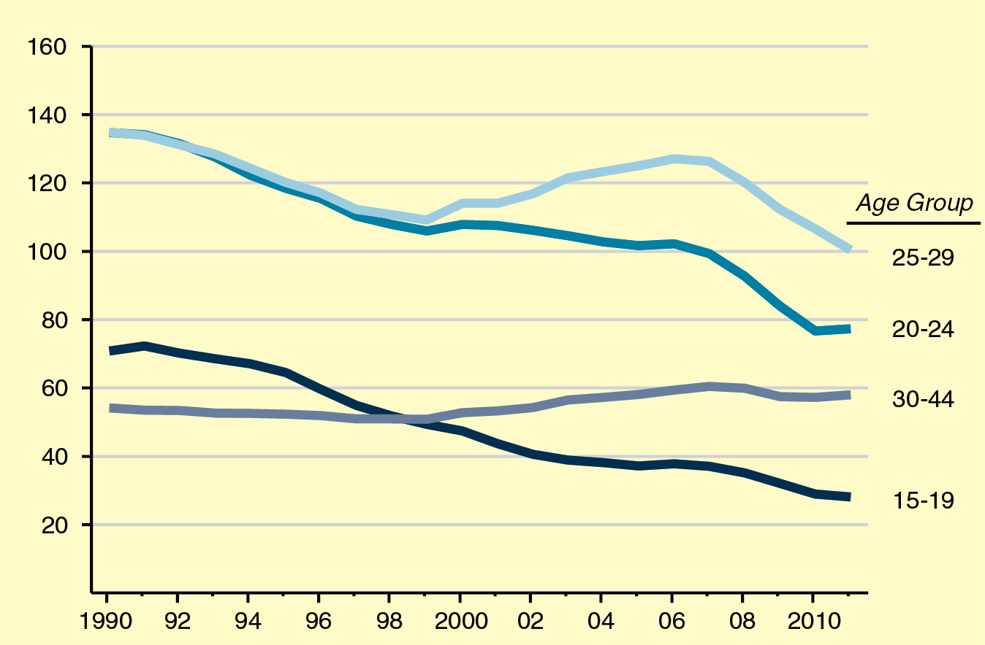
Birth Rates Falling Significantly
Births per 1,000 Women per Year

Slide 5
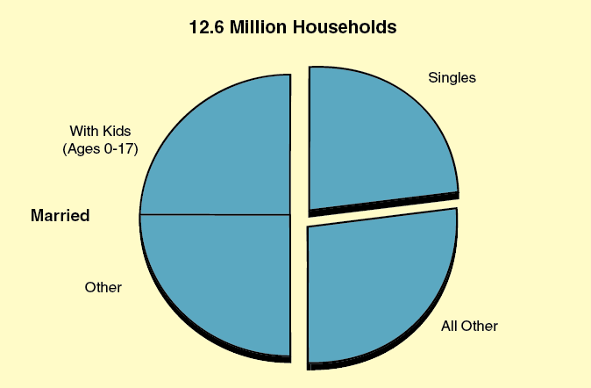
Characteristics of California Households
2010

Slide 6
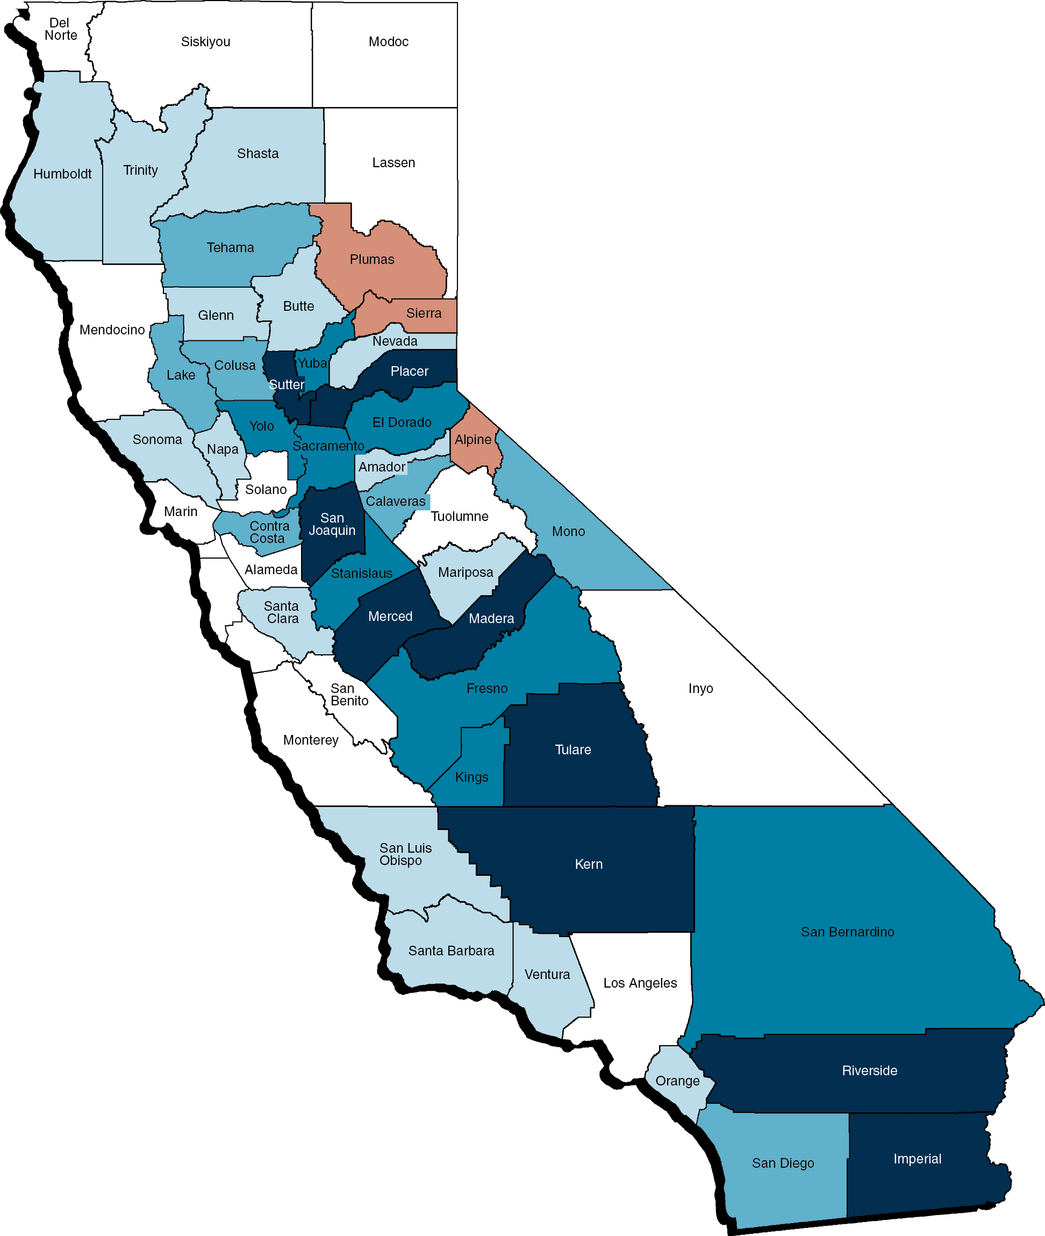
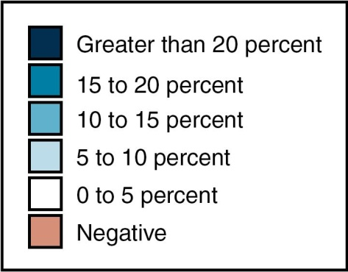
Population Growth By County
(2000 Through 2010)

Slide 7
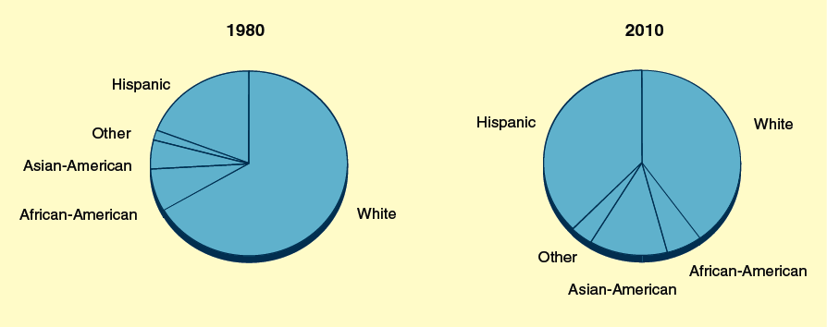
California’s Racial and Ethnic Makeup Has Changed Since 1980
Share of Population in Each Group

Slide 8
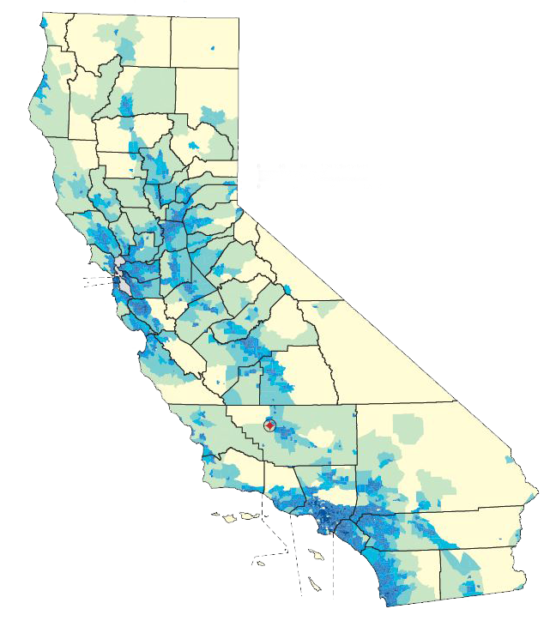
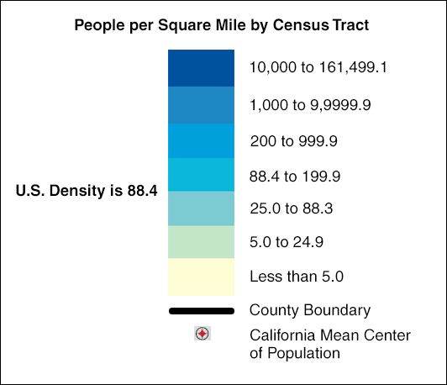
Population Density By Census Tract

Slide 9
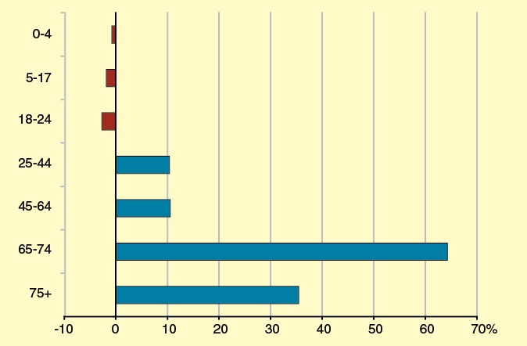
California’s Elderly Population Will Grow Rapidly in the Next Decade
LAO Projected Growth by Age Group, 2010 Through 2020

Slide 10
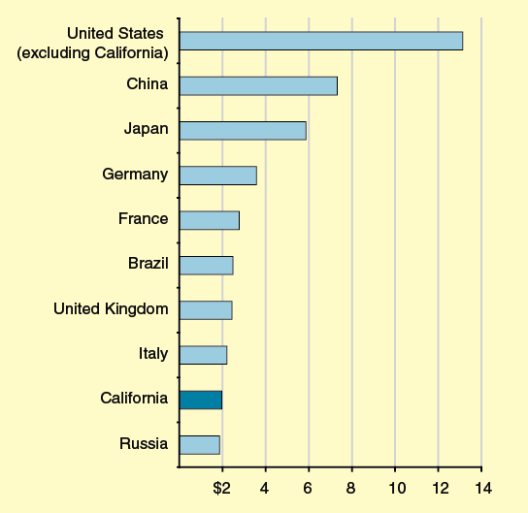
California’s Economy Is Ninth-Largest in the World
Gross Domestic Product in 2011 (In Trillions)

Slide 11
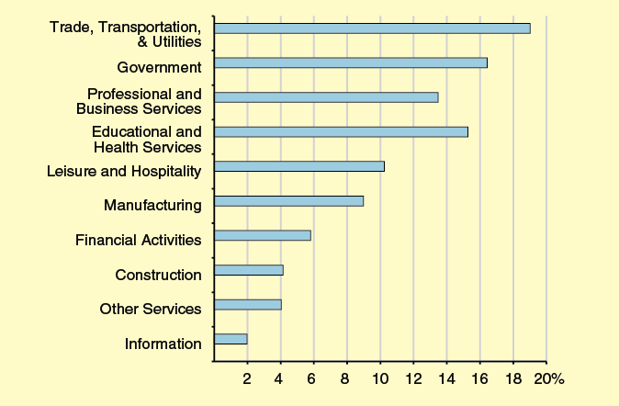
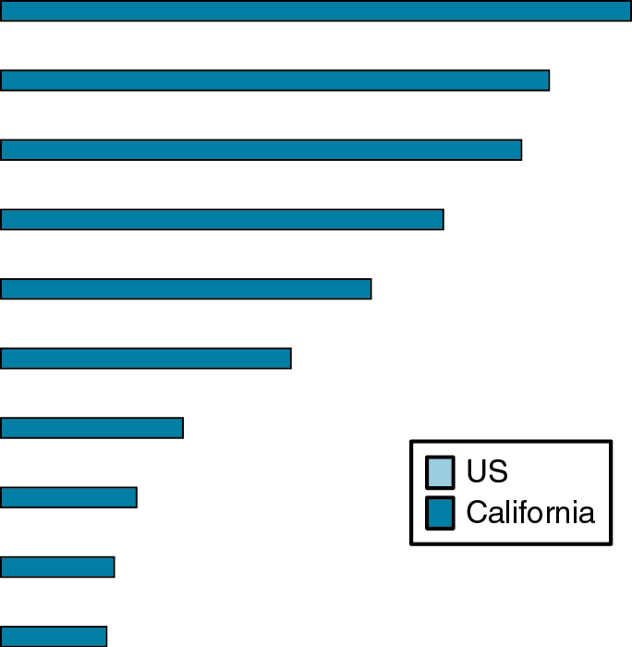
California’s Mix of Jobs by Industry Is Similar to the U.S.
Percentage of Nonfarm Employment, August 2012

Slide 12
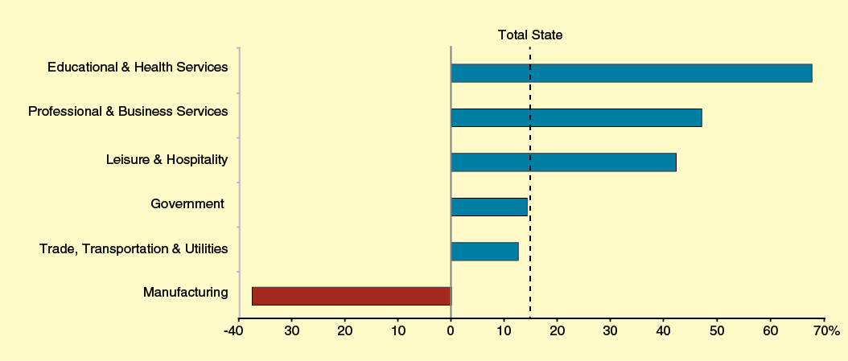
Changes in California’s Job Mix Since 1990
Percent Change in Jobs, 1990 to 2012

Slide 13
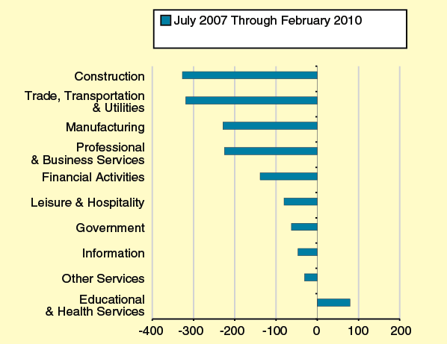
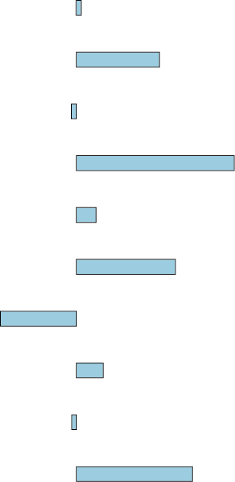
Jobs Since the Recession: Some Sectors Are Struggling
Change in California Employment (In Thousands)

Slide 14
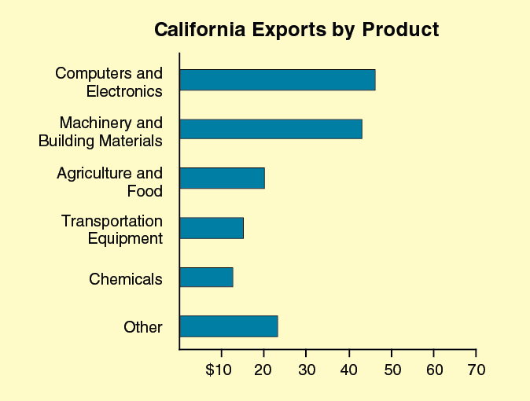
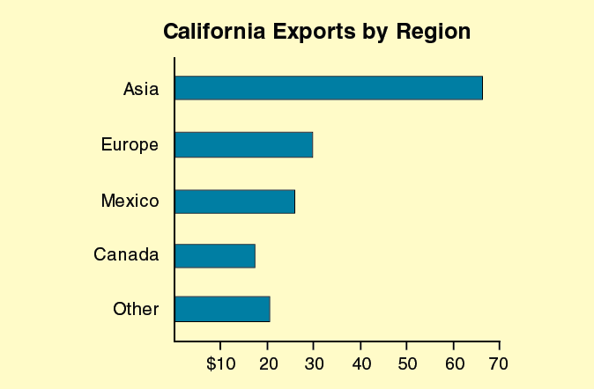
Trade Is an Important Source of California Economic Activity
2011 International Exports (In Billions)

Slide 15
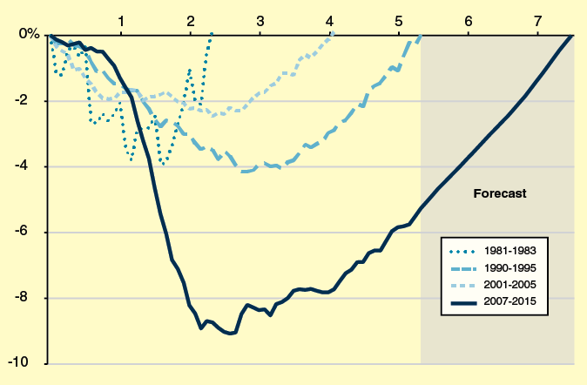
Jobs in California Recovering Much More Slowly Than in Prior Recoveries
Job Loss and Years to Return to Pre-Recession Employment Peak

